Slide 1


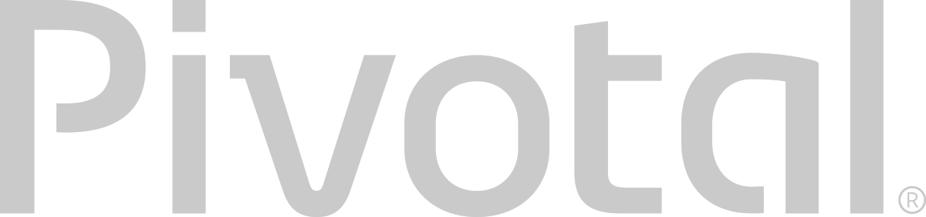
.NET on PCF
The Cloud Native Journey

Slide 2
The Promise of Cloud Native
Deploy new features *daily* to production
Faster Feedback (experiment. Fail Fast.)
Outcome not activity focus (optimize)
Loose Coupling (upgrades and fixes)
Self-service, automated middleware
Free/Cheap horizontal scaling
No Downtime Upgrades
Availability and resiliency

Slide 3

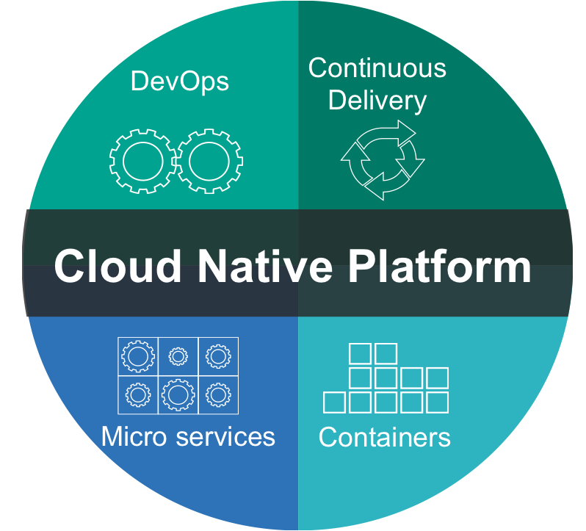

What is Cloud Native?
A term that recognizes that getting software to work in the cloud requires a broad set of components that work together.
It requires an architecture that departs from traditional enterprise application design, such as ‘Microservices’
It requires a Cloud Native platform
Notes:
http://www.informationweek.com/cloud/platform-as-a-service/cloud-native-what-it-means-why-it-matters/d/d-id/1321539

Slide 4
Characteristics of Cloud Native Architectures
Twelve Factor Apps (http://12factor.net/)
Continuously Delivered
Microservices
DevOps
Self-Service agile infrastructure
API-based collaboration
Anti-fragility

Slide 5
12-Factor Applications
Codebase
Dependencies
Configuration
Backing Services
Build, release, run
Processes
Port binding
Concurrency
Disposability
Dev/prod parity
Logs
Admin processes
APPS
contract
Cloud Platform
Architectural and development practices – http://12factor.net
Notes:
References:
http://12factor.net/
Architectural and development practices, that ensure an optimal experience on a cloud platform.

Slide 6
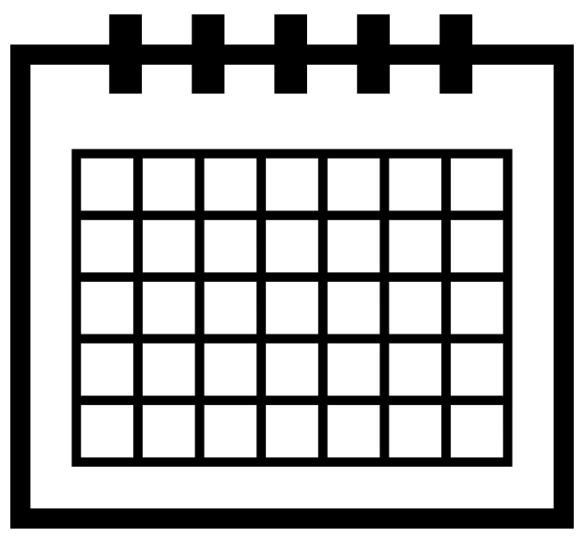
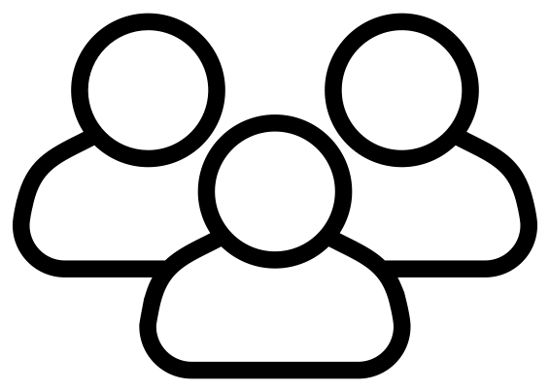
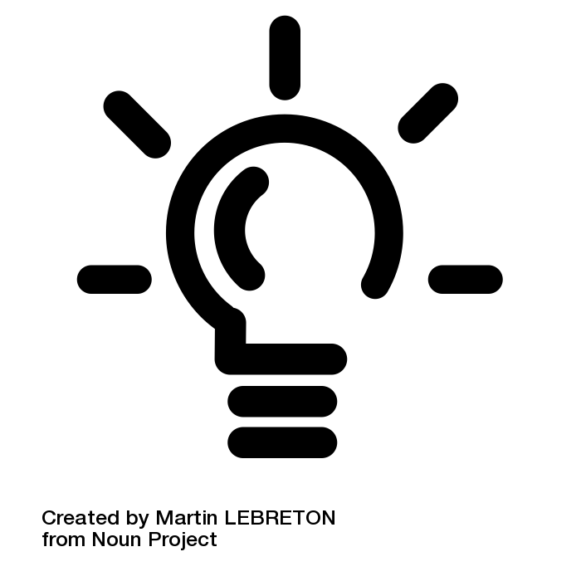
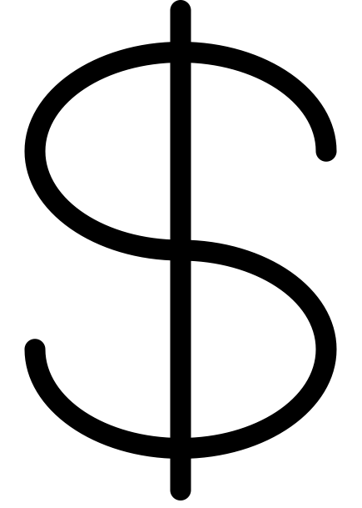
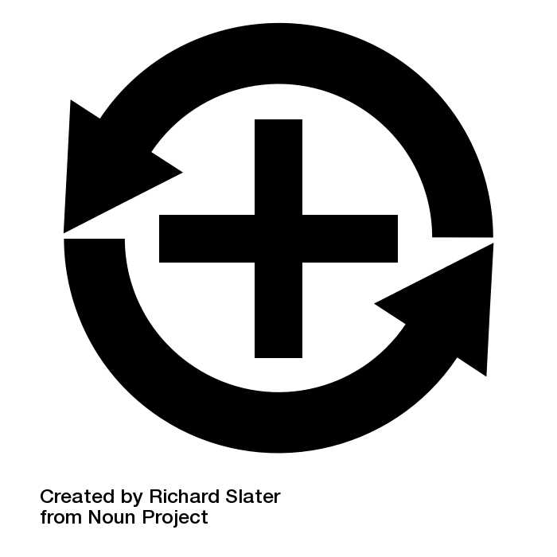
Apps
3+ Months
Plan
Dev
Test
Deploy
Operate
Notes:
Light Bulb by Martin LEBRETON from the Noun Project
multiple users by To Uyen from the Noun Project
dollar sign by icon 54 from the Noun Project
Positive Feedback Loop by Richard Slater from the Noun Project
Calendar by Star and Anchor Design from the Noun Project

Slide 7
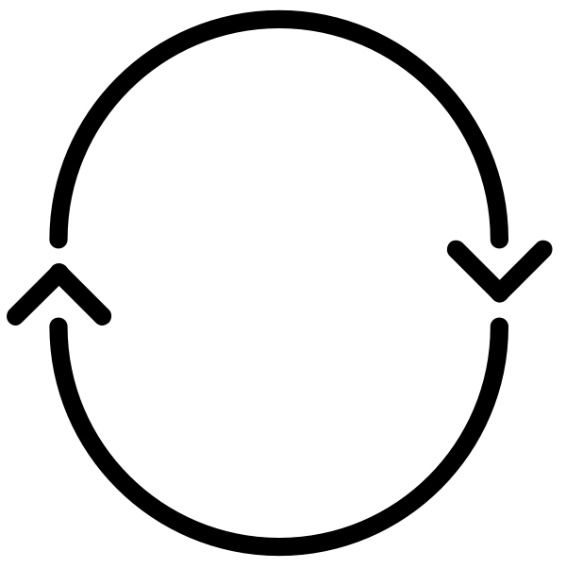
Apps
Agile!
CI
Plan
Dev
Test
Deploy
Operate
CI
-Code
-CI
-Build
-Unit Tests
-Artifact
Notes:
Light Bulb by Martin LEBRETON from the Noun Project
multiple users by To Uyen from the Noun Project
dollar sign by icon 54 from the Noun Project
Positive Feedback Loop by Richard Slater from the Noun Project
Calendar by Star and Anchor Design from the Noun Project
cycle by Chris Jones from the Noun Project

Slide 8
Apps
Water -
Scrum
Agile!
- Fall
3+ Months
CI
Plan
Dev
Test
Deploy
Operate
CI
-Code
-CI
-Build
-Unit Tests
-Artifact
SIT
FT
UAT
Perf
Prod
-H/W & VM
-OS
-Runtime
-Middleware
-Network
-Services
-Config
-Code
-Tests
-H/W & VM
-OS
-Runtime
-Middleware
-Network
-Services
-Config
-Code
-Tests
-H/W & VM
-OS
-Runtime
-Middleware
-Network
-Services
-Config
-Code
-Tests
-H/W & VM
-OS
-Runtime
-Middleware
-Network
-Services
-Config
-Code
-Tests
-H/W & VM
-OS
-Runtime
-Middleware
-Network
-Services
-Config
-Code
-Tests
Inconsistent, Corrupt & Dirty
Notes:
Light Bulb by Martin LEBRETON from the Noun Project
multiple users by To Uyen from the Noun Project
dollar sign by icon 54 from the Noun Project
Positive Feedback Loop by Richard Slater from the Noun Project
Calendar by Star and Anchor Design from the Noun Project
cycle by Chris Jones from the Noun Project

Slide 9
Apps
Agile
DevOps
CI
CD - Automate
Plan
Dev
Test
Deploy
Operate
CI
-Code
-CI
-Build
-Unit Tests
-Artifact
SIT
FT
UAT
Perf
Prod
-H/W & VM
-OS
-Runtime
-Middleware
-Network
-Services
-Config
-Code
-Tests
-H/W & VM
-OS
-Runtime
-Middleware
-Network
-Services
-Config
-Code
-Tests
-H/W & VM
-OS
-Runtime
-Middleware
-Network
-Services
-Config
-Code
-Tests
-H/W & VM
-OS
-Runtime
-Middleware
-Network
-Services
-Config
-Code
-Tests
-H/W & VM
-OS
-Runtime
-Middleware
-Network
-Services
-Config
-Code
-Tests
Automated Platform
Notes:
Light Bulb by Martin LEBRETON from the Noun Project
multiple users by To Uyen from the Noun Project
dollar sign by icon 54 from the Noun Project
Positive Feedback Loop by Richard Slater from the Noun Project
Calendar by Star and Anchor Design from the Noun Project
cycle by Chris Jones from the Noun Project

Slide 10
Microservices Architecture

Slide 11
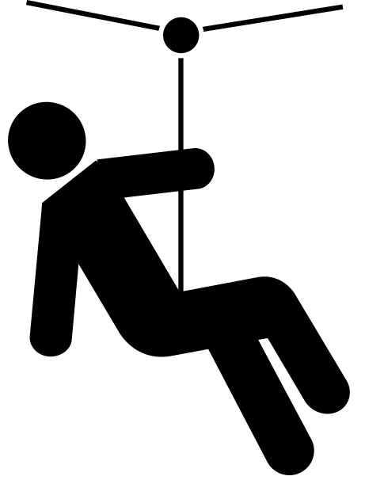
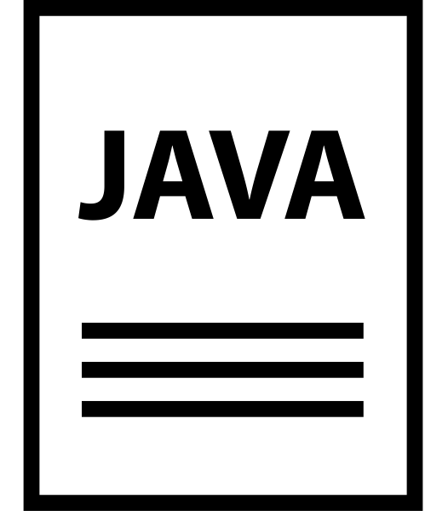
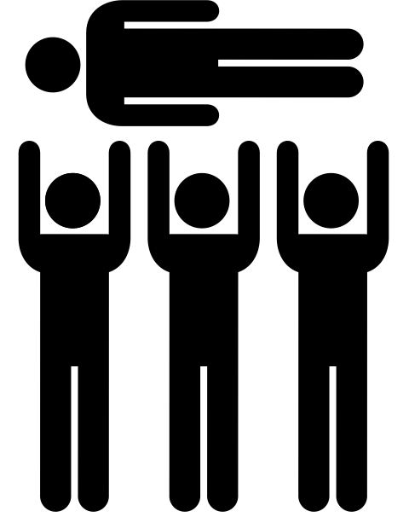
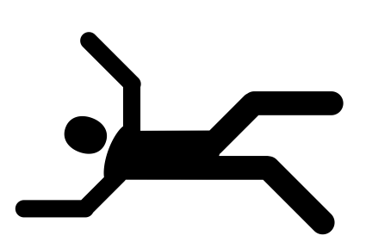
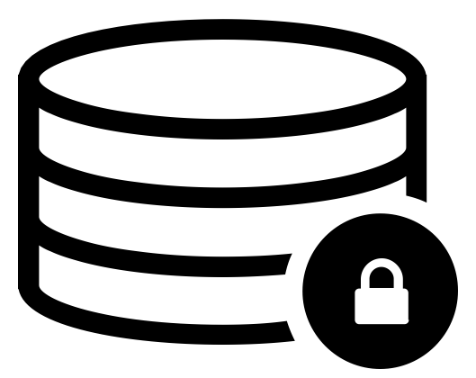
The Monolithic Application
HTML
Java
Script
MVC
X
Service
Service
6+ Months
Data Access
Notes:
Big commitment
falling by Eric Benoit from the Noun Project
Zipline by Miranda Dempster from the Noun Project
Crowd Surfing by Gilbert Bages from the Noun Project
JAVA File by Alfredo Hernandez from the Noun Project
Secure Database by Leonardo Schneider from the Noun Project

Slide 12
What are Microservices?
If every service has to be updated in concert, it’s not loosely coupled!
Loosely coupled service oriented architecture with bounded contexts
If you have to know about surrounding services you don’t have a bounded context.
Notes:
I presume you’re all familiar with microservices and cloud-native, but quickly, here’s an introduction. They’re loosely coupled, service oriented architecture with bounded contexts.
Because each service can be updated independently, your teams can work in parallel. Because each service is isolated, it’s much easier to automate your testing.

Slide 13
Trend towards new lightweight architectures
Microservices addressing speed to market and cloud scale
MONOLITHIC/LAYERED
MICROSERVICES
Notes:
Enterprise companies in finance and telco industries are embracing microservice and cloud-native models.
There are new architectures emerging atop these lightweight app servers to address the scale, speed and safety: new ways of tackling cloud scale and speed to market. Microservices has emerged from the internet giants as such an alternative: a change in culture, organization structure and technology that allows teams to work more independently, and increase velocity. It’s a key part of cloud-native applications, which we’ll talk about shortly.
Microservices are both a cultural and organizational change as a change in how we design and implement systems.

Slide 14
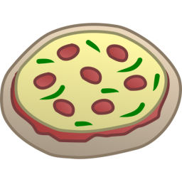
One-Size-Fits-All Methodologies have become an Anti-pattern to the Business
HTML
Java
Script
MVC
Service
Service
Data Access
Monolithic Application
> 2 Pizzas Per Project = Too Many Pizzas

Slide 15






Deploying a .NET Application to Windows
+
=
cf push MCDotNet
-s windows2012R2
Cloud Controller
Cloud Controller
Bridge
Auctioneer
BBS
Specify the windows
stack
Router
Linux Cell
Linux Cell
Win2012 r2 Cell
Linux Cell
Rep
Rep
Rep
Executor
Executor
Executor

Slide 16



Agile, Disruptive Companies Use Non-traditional, Modular Approaches to Software Systems
Microservice based architecture
Relational
DB
Key/Value
Store
AQMP
…..........
Shared
DB
DB Service
Caching Service
Messaging Service
Two Pizzas Per Microservice = Manageable!
Notes:
To build a Microservices architecture at scale requires a platform

Slide 17
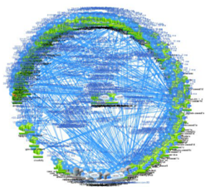
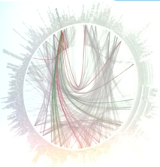
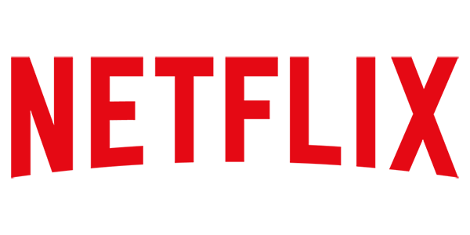
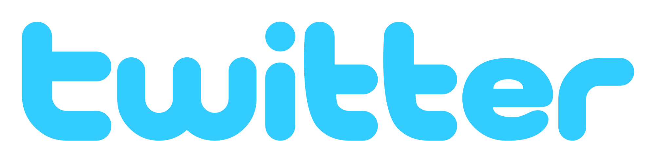
But… microservices are hard
Discovery
User Management
Failover and HA
Configuration
Security
API Management
Monitoring & Logging

Slide 18
It Takes a Platform
An end-to-end platform that makes implementing distributed application best practices, a turn-key and first practice
Notes:
Inverse Conway Maneuver coined by Thoughtworks - http://jonnyleroy.com/2011/02/03/dealing-with-creaky-legacy-platforms/
Goal is to create self contained, business aligned teams with the smallest feedback loop.
Business capability teams interact with platform operations team via APIs and not meetings. This creates a friction free experience for the business capability team who now have the tools to

Slide 19

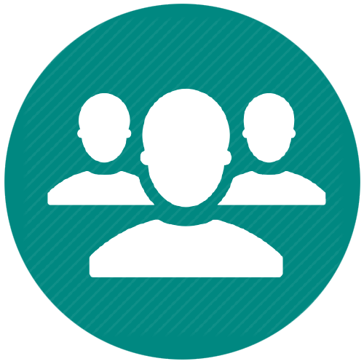


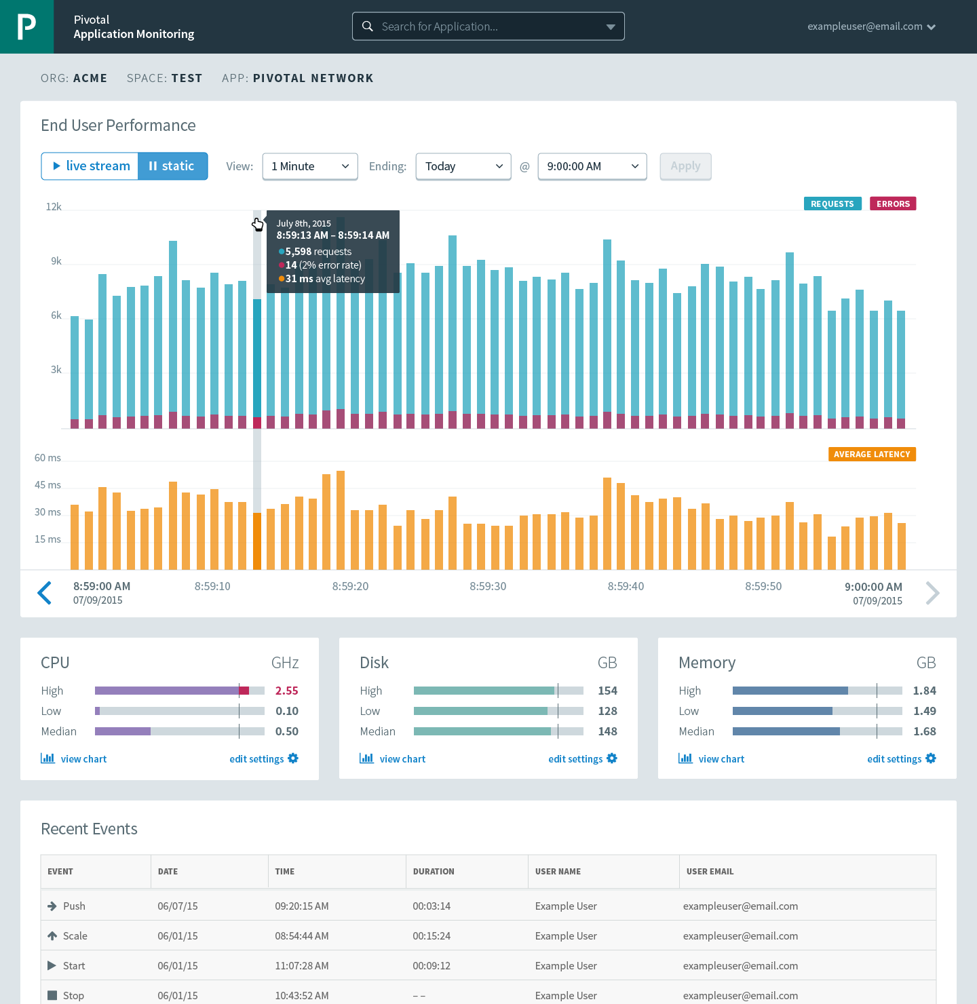
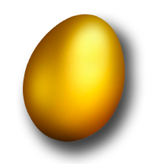

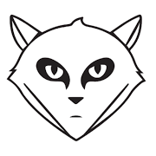
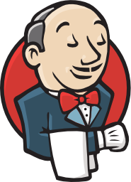

Cloud Foundry: An Application-centric Platform
Mobile Services
Centralized Log Management
Networking
& Load Balancing
Auto-Scaling
APM & Tracing
APPLICATION
Health management
Full Stack CI/CD platform
Notes:
Your Application is the Center of the universe!
Cloud Foundry takes care of the rest. Everything you need to deliver software is builit into this platform such as…. It changes the way applications and services are deployed and run by reducing the develop to deployment cycle time. And Devops culture enables the overall ownership there for allows teams to do what’s best for the applications, and therefore what’s best for the business, so not only your application is more robust, it can constantly adapts to changing environmental.
So Spring Boot/Cloud meant create apps fast – But Dev & Ops is asking Day2 questions -
How do you do logging, routing, apm, scaling, and lifecycle management of all these apps.
Enter CF Runtime
best in class container management
integrated agentless logging
with APM
auto scaling
Effortless runtime with minimum human operational overhead. We run 1000s of apps and 10,000s containers on PWS with 6 guys.
But we realized that stopping there wasn't enough

Slide 20
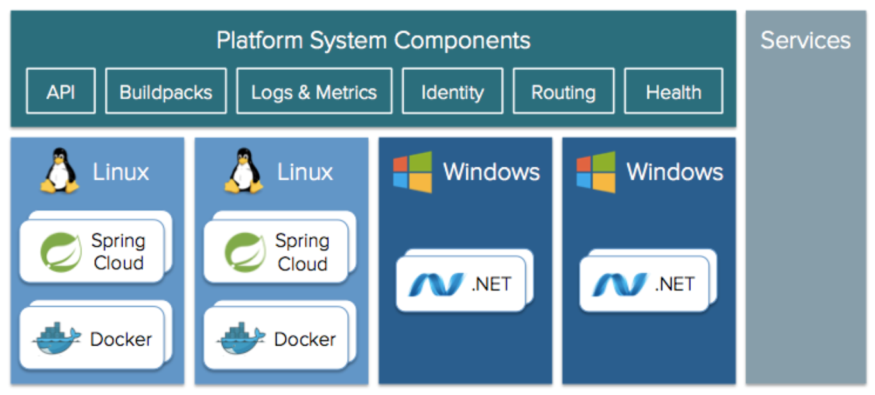



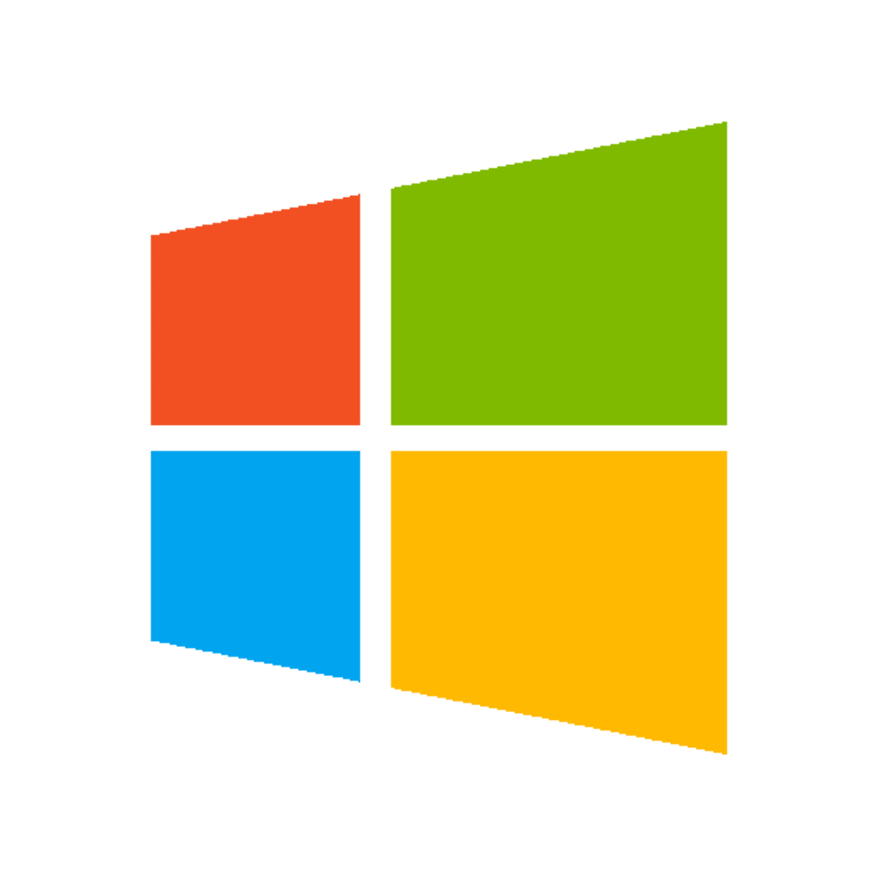

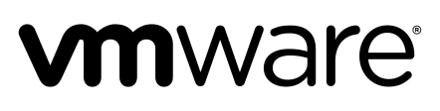
PCF Architecture
Node.js, Ruby, GO, etc.
BOSH - Automation Layer
Azure
Notes:
.NET and windows are first class citizen in PCF. PERIOD.
Not mono (check name) where .NET is emulated on Linux.
Windows VMs, running containers, running .NET.
You get all the benefits of the platform.

Slide 21

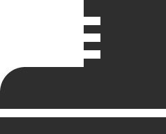
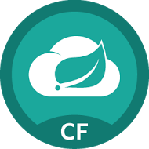
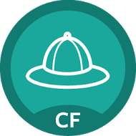
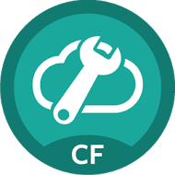
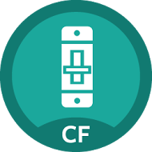
Application Framework Steeltoe
Steeltoe is a framework providing best practices for microservices in the .NET ecosystem
cross microservice configuration using Spring Cloud Config Server
service discovery provided by Eureka
circuit breaker behavior
Cloud
Services
Service
Registry
Config
Server
Circuit
Breaker
http://steeltoe.io

Slide 22
Application Framework Steeltoe
Steeltoe works...
with different versions of .NET framework and with .NET core
on Windows and on Linux
standalone and running on Cloud Foundry
Cloud
Services
Service
Registry
Config
Server
Circuit
Breaker
http://steeltoe.io

Slide 23
Cloud Foundry Haiku
Here is my source code
Run it on the cloud for me
I do not care how
Notes:
Best way to summarize cloud foundary experience for developers. Here is the famous CFH.
a Japanese poem of seventeen syllables, in three lines of five, seven, and five

Slide 24
.NET Core
Open source
Cross-Platform
CLI
Compatible
ASP .NET Core is based on Nuget packages
A cloud-ready environment-based configuration system
Improved performance
Decreased costs when running in cloud
Supported by Microsoft

Slide 25
Deploying a .NET Core Application to Linux
+
=
cf push MCDotNetCore
Cloud Controller
Cloud Controller
Bridge
Auctioneer
BBS
Router
Linux Cell
Linux Cell
Win2012 r2 Cell
Linux Cell
Rep
Rep
Rep
Executor
Executor
Executor

Slide 26
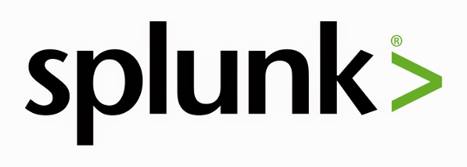
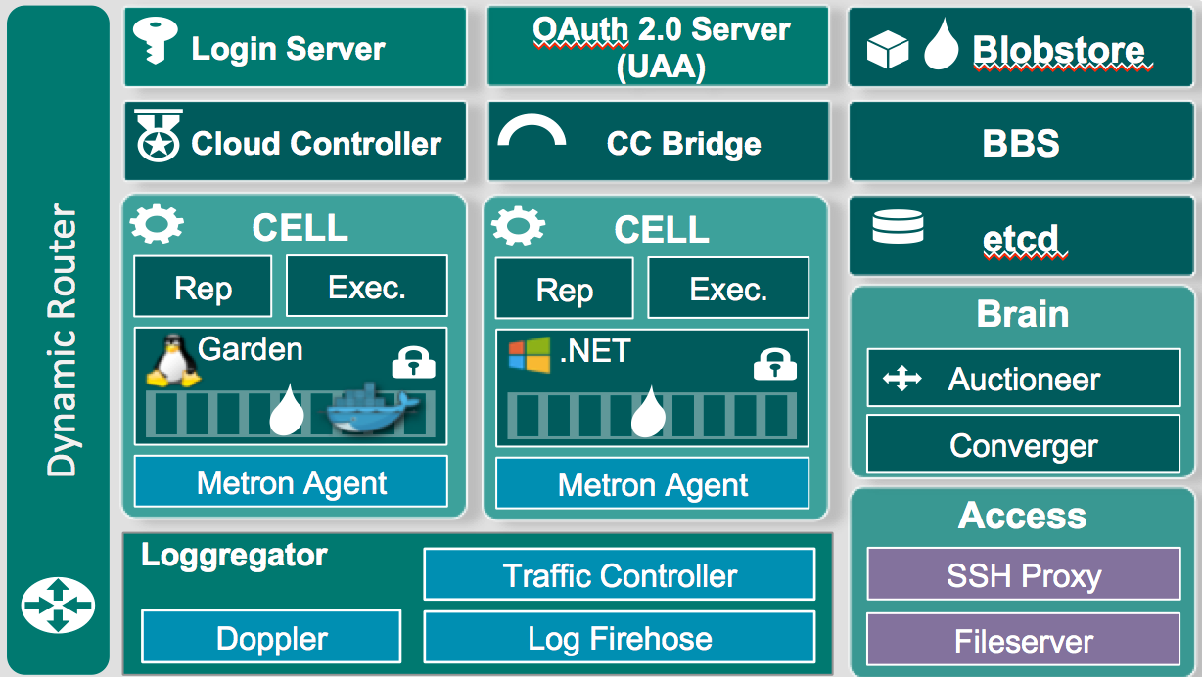
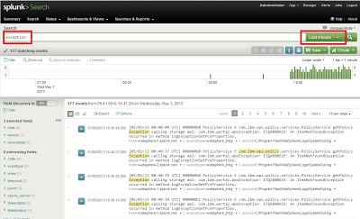
Platform Logging
Elastic Container Runtime
Dynamic Router
Logging / Metrics
Application
Access
Notes:
Need to install a plugin so Splunk can read CF logs properly
Note this isnt showing a full Splunk Arch

Slide 27
Replatforming Existing Applications
Non Cloud-Native stuff you’ll want to change:
Reading/Writing to the Registry
Reading/Writing to the local disk
Integrated Windows Auth
In-Process State
Environment-specific config

Slide 28
Cloud Native Maturity Model
Cloud Native
Microservices architecture
API-first design
Fault-tolerant and resilient design
Cloud-agnostic runtime implementation
Bundled metrics and monitoring
Proactive failure testing
Cloud Resilient
Cloud Friendly
12 Factor App methodology
Horizontally scalable
Leverages platform for high availability
Cloud Ready
No permanent disk access
Self-contained application
Platform-managed ports and networking
Consumes platform-managed backing services
Notes:
Cloud Ready: No mounting file systems!
Cloud Friendly: Scalable, platform provides HA
Cloud Resilient: Cloud Agnostic, Fault Tolerant
Cloud Native: microservices + API first

Slide 29
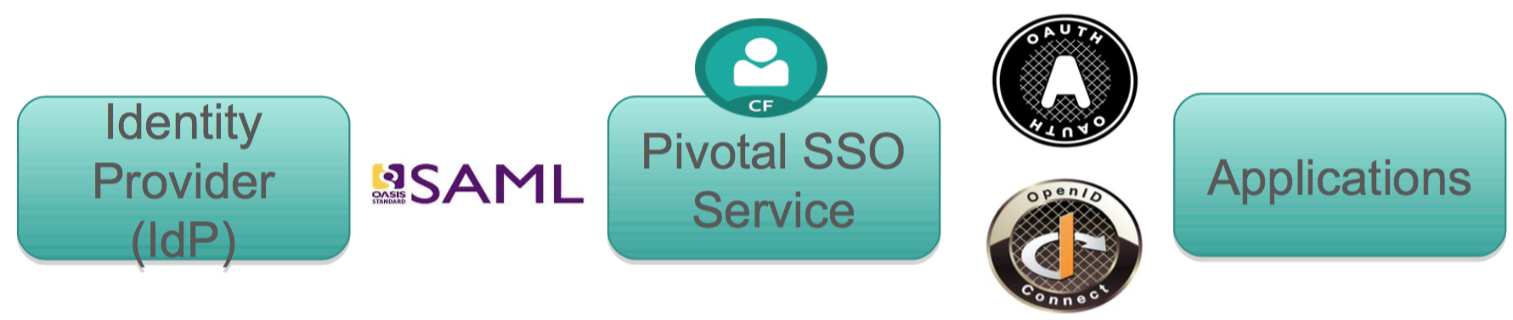
Authentication, Authorization and SSO
ADFS
Use OAuth instead of integrated Windows Auth. Your application must be Oauth aware.
Pivotal SSO Service provides SSO security and convenience to applications hosted on or external to the Cloud Foundry platform
Uses an internal user store or an external SAML compliant federated identity provider such as ADFS
Implemented as a managed service (available in the marketplace)
Notes:
Certified with Ping Identity, CA SSO, Azure ADFS, ForgeRock Open AM, VMware Identity Management, Okta

Slide 30
Summary
Windows, Linux parity
Minimal effort to make your .NET applications (any version) to be cloud ready
Platform provides application frameworks to help .NET applications to leverage cloud native patterns
Platform provides .NET applications security and SSO capabilities

Slide 31
Suggested Next Steps
.NET PCF workshop
Deploy PCF Runtime for Windows
- Vmware OVF creation tool
- Datastore for stemcell
- MC Windows2012R2 ISO
.NET Applications Migration

Slide 33
Run in Cloud Foundry Stack Comparison - .NET vs .NET Core
Stack Name
windows2012R2
cflinuxfs2
CF Runtime
CF Runtime
Diego
Diego
Buildpack
.Net core buildpack
Buildpack
binary_buildpack
HWC buildpack
CLR Version
.NET 3.5-4.5+
CoreCLR
Container
Garden-Windows
Garden-Linux
Developer OS
Windows
Win, Mac OSX, Linux
Notes:
Binary buildpack. App is precompiled, no detect.

Slide 34
When to choose Which
Greenfield Applications – Core First
Replatforming Existing Apps – stay with ASP.NET
Dependencies and framework requirements will dictate your choice

Slide 35
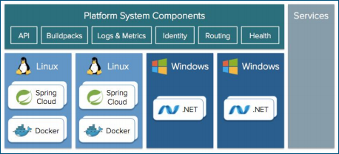

Enter Cloud Foundry
● True runtime elasticity
● Lifecycle Management (no more pets)
● Better containerization
● Improved security posture
Goals could be accomplished for .Net
● Bend cost curve of infrastructure, licensing
● Reduce complexity of deployments
● Leverage available capacity (app density)
● Adhere to our own standards
● Improve security posture
● Improve availability and reliability SLAs
● Improve agile, self service, devops maturity
● Prepare for public cloud
● Do “More, Better, Faster, Cheaper

Slide 36
Deploying .NET Apps Shouldn’t Be Painful
Traditional
Provision a VM
Configure IP, DNS
Configure Firewall
Windows updates, reboot…
Install IIS
Deploy Application
Configure app pool
Configure SSL
Configure Load Balancer
Pivotal Cloud Foundry
cf push
Notes:
Discuss the traditional challenges associated with deployments and how PCF automates many of the steps. The team is not spending time writing and maintaining Infrastructure as code systems (i.e. puppet, chef, etc). This basic functionality is baked into the platform.

Slide 37
PCF 1.10 updates
Windows Linux parity on the platform
BOSH for Windows (from manual Diego Windows MSI installer to fully automated)
Steeltoe for Microservices goes GA, fully supported
.NET Buildpacks
Windows 2016 (future)
Notes:
Automated
No more manual infrastructure management; automate Windows at scale
Consistent
Devs and operators can build, deploy, and run .NET apps on PCF just like any other framework
Accessible
Breakthrough cloud-native capabilities for Windows shops, beyond what’s in-market today

Slide 38
our current state and goals
Current state:
● # of.NET apps
● IIS on Windows Server 2008
● Standard server configuration
● networking and firewall rules?
● IIS configuration
● Thousands of virtual servers, licenses
● ops team expansion
● no elasticity
● no life cycle management, pets not cattle
● no containerization
● security features are limited
Goals:
● Bend cost curve of infrastructure, licensing
● Reduce complexity of deployments
● Leverage available capacity (app density)
● Adhere to our own standards
● Improve security posture
● Improve availability and reliability SLAs
● Improve agile, self service, devops maturity
● Prepare for public cloud
● Do “More, Better, Faster, Cheaper”

Slide 39
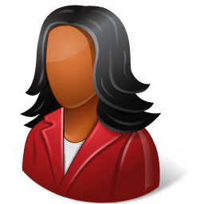
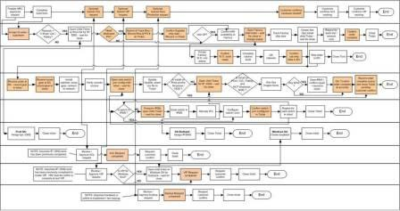
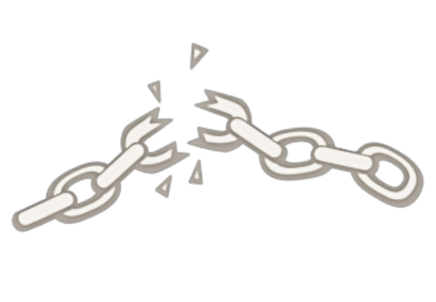
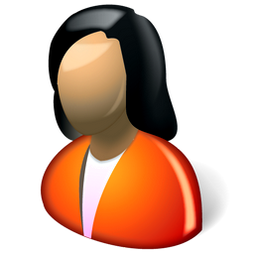
Monolithic Applications Drive Complex, Manual Deploys & Waterfall Release Cycles
Developer
Can you deliver full CI/CD for every major app in your portfolio today, or are you doing 75+ step manual deployments?
Operator
Notes:
We’re working with customers like Comcast and Lockheed Martin who have been struggling to ship software faster. Both in terms of new projects and implementing these modern, DevOps-friendly environments that can handle real continuous delivery.
If you’re doing big project with ‘agile waterfall’ where you use agile development with weekly sprints but have a huge manual process to actually ship every 3-9months.
Disconnect between dev and ops. Throw the code over the wall
… and do it all over again from Dev → Test → Prod on any infrastructure

