Slide 1



.NET on PCF
Steeltoe

Slide 2


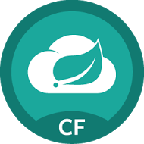
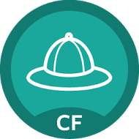
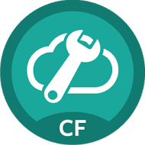

Application Framework Steeltoe
Steeltoe is a framework providing best practices for microservices in the .NET ecosystem
cross microservice configuration using Spring Cloud Config Server
service discovery provided by Eureka
circuit breaker behavior
Cloud
Services
Service
Registry
Config
Server
Circuit
Breaker
http://steeltoe.io

Slide 3
Application Framework Steeltoe
Steeltoe works...
with different versions of .NET framework and with .NET core
on Windows and on Linux
standalone and running on Cloud Foundry
Cloud
Services
Service
Registry
Config
Server
Circuit
Breaker
http://steeltoe.io

Slide 4

Run in Cloud Foundry Stack Comparison - .NET vs .NET Core
Stack Name
windows2012R2
cflinuxfs2
CF Runtime
CF Runtime
Diego
Diego
Buildpack
.Net core buildpack
Buildpack
binary_buildpack
HWC buildpack
CLR Version
.NET 3.5-4.5+
CoreCLR
Container
Garden-Windows
Garden-Linux
Developer OS
Windows
Win, Mac OSX, Linux
Notes:
Binary buildpack. App is precompiled, no detect.

Slide 5
When to choose Which
Greenfield Applications – Core First
Replatforming Existing Apps – stay with ASP.NET
Dependencies and framework requirements will dictate your choice

Slide 6
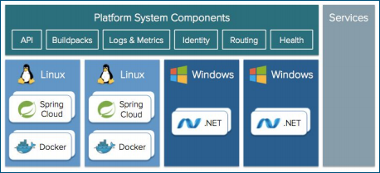

Enter Cloud Foundry
● True runtime elasticity
● Lifecycle Management (no more pets)
● Better containerization
● Improved security posture
Goals could be accomplished for .Net
● Bend cost curve of infrastructure, licensing
● Reduce complexity of deployments
● Leverage available capacity (app density)
● Adhere to our own standards
● Improve security posture
● Improve availability and reliability SLAs
● Improve agile, self service, devops maturity
● Prepare for public cloud
● Do “More, Better, Faster, Cheaper

Slide 7
Deploying .NET Apps Shouldn’t Be Painful
Traditional
Provision a VM
Configure IP, DNS
Configure Firewall
Windows updates, reboot…
Install IIS
Deploy Application
Configure app pool
Configure SSL
Configure Load Balancer
Pivotal Cloud Foundry
cf push
Notes:
Discuss the traditional challenges associated with deployments and how PCF automates many of the steps. The team is not spending time writing and maintaining Infrastructure as code systems (i.e. puppet, chef, etc). This basic functionality is baked into the platform.

Slide 8
PCF 1.10 updates
Windows Linux parity on the platform
BOSH for Windows (from manual Diego Windows MSI installer to fully automated)
Steeltoe for Microservices goes GA, fully supported
.NET Buildpacks
Windows 2016 (future)
Notes:
Automated
No more manual infrastructure management; automate Windows at scale
Consistent
Devs and operators can build, deploy, and run .NET apps on PCF just like any other framework
Accessible
Breakthrough cloud-native capabilities for Windows shops, beyond what’s in-market today

Slide 9
our current state and goals
Current state:
● # of.NET apps
● IIS on Windows Server 2008
● Standard server configuration
● networking and firewall rules?
● IIS configuration
● Thousands of virtual servers, licenses
● ops team expansion
● no elasticity
● no life cycle management, pets not cattle
● no containerization
● security features are limited
Goals:
● Bend cost curve of infrastructure, licensing
● Reduce complexity of deployments
● Leverage available capacity (app density)
● Adhere to our own standards
● Improve security posture
● Improve availability and reliability SLAs
● Improve agile, self service, devops maturity
● Prepare for public cloud
● Do “More, Better, Faster, Cheaper”

Slide 10

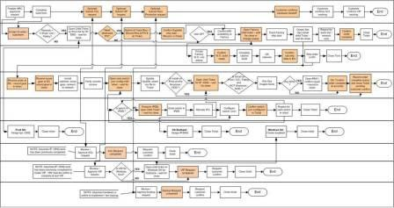
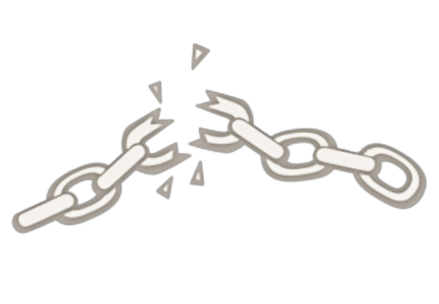

Monolithic Applications Drive Complex, Manual Deploys & Waterfall Release Cycles
Developer
Can you deliver full CI/CD for every major app in your portfolio today, or are you doing 75+ step manual deployments?
Operator
Notes:
We’re working with customers like Comcast and Lockheed Martin who have been struggling to ship software faster. Both in terms of new projects and implementing these modern, DevOps-friendly environments that can handle real continuous delivery.
If you’re doing big project with ‘agile waterfall’ where you use agile development with weekly sprints but have a huge manual process to actually ship every 3-9months.
Disconnect between dev and ops. Throw the code over the wall
… and do it all over again from Dev → Test → Prod on any infrastructure

