Slide 1
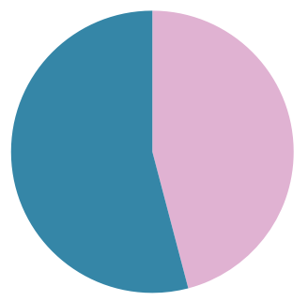
Differences in Cyclistic Usage by Annual Members and Casual Riders
October 2020 – September 2021
By: Jenny Smith
Purpose:
Identify differences in ride behavior between annual members and casual riders
Use insights to guide marketing strategy to convert casual riders to annual members
Annual Members
Casual Riders
54%
46%
Dataset: ~5.1 million rides
Location, Date, Time, Type of Bike
No data on individual users

Slide 2
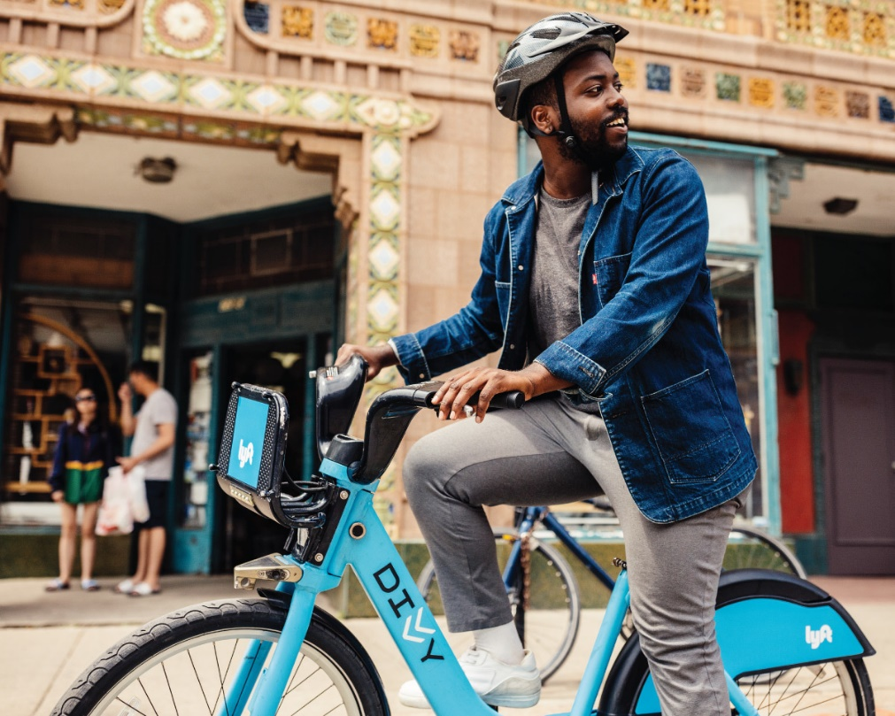
Analysis Questions
Broad Themes:
When do they ride?
Month, Day of Week, Time of Day
How do they ride?
Bike Type, Distance Traveled, Ride Duration
Where do they ride?
Frequently Used Stations, Proximity to Tourist Attractions
From divvybikes.com

Slide 3
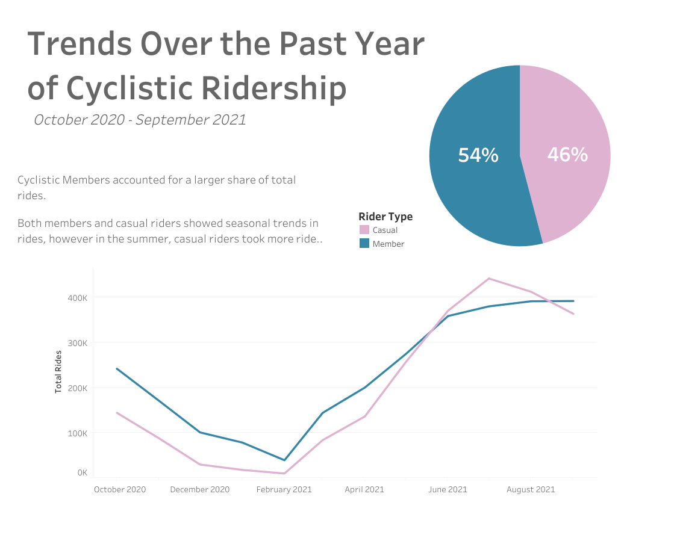
Number of Rides Per Month Taken By Cyclistic Members and Casual Riders Over the Past Year
Ridership shows similar seasonal ups and downs for both groups
Casual rides peaks June-August, which is the only time of year where it exceeds member rides.

Slide 4
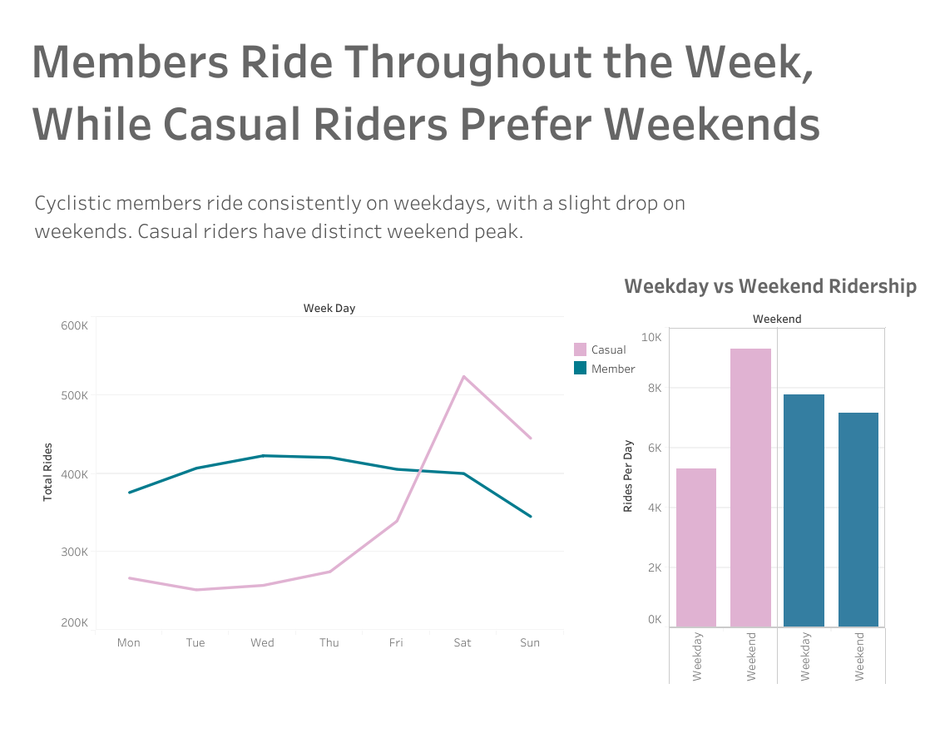
Weekly Ridership Differs Greatly Across Groups
Casual rides peak on weekends, where members ride the least
Casual riders take 75% more rides on a Sat/Sun than on a weekday

Slide 5
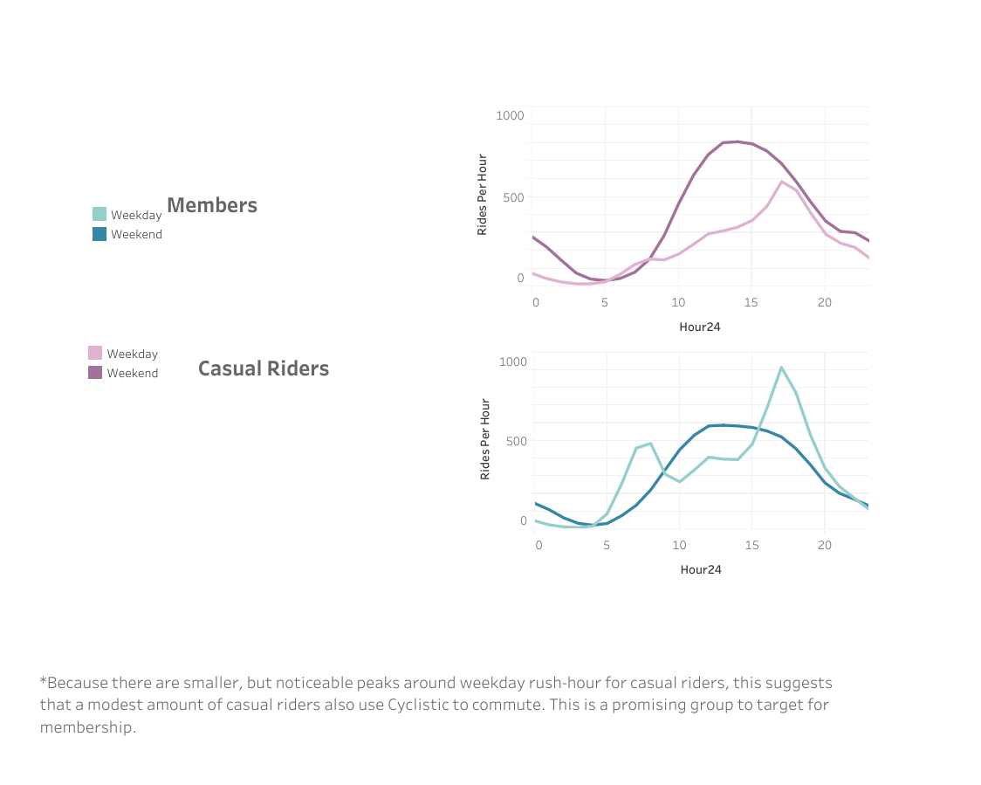
Daily Cyclistic Usage Differs for Members and Casual Riders
For both groups, weekend ridership peaks in early afternoon, with a smaller peak near midnight.
For members, pronounced weekday rush-hour peaks suggest that a large portion of them use Cyclistic on their daily commute
Casual riders have smaller rush-hour peaks, which means there are likely some “casual commuters” too
This could be a group to target for membership
Rides Per Hour
Casual
12am
5am
10am
3pm
8pm
Rides Per Hour
Members
12am
5am
10am
3pm
8pm

Slide 6
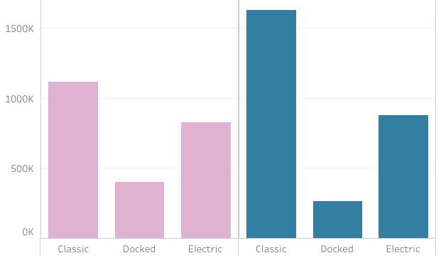
Casual Riders and Members both use Classic Bikes the Most
Popular Bike Types
Number of Rides
Casual
Members

Slide 7
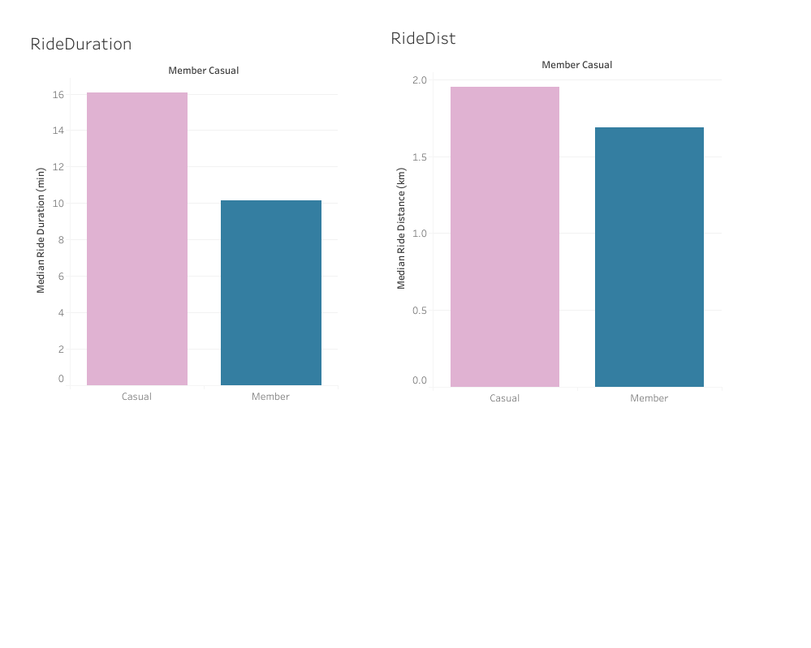
Casual Users Ride Longer and Farther than Members
***
***
2.0
16
14
12
1.5
10
Median Ride Duration (min)
Median Ride Distance (km)
8
1.0
6
4
0.5
2
0
0
Casual
Member
Casual
Member
***p<.001, Wilcoxon Rank Sum Test

Slide 8
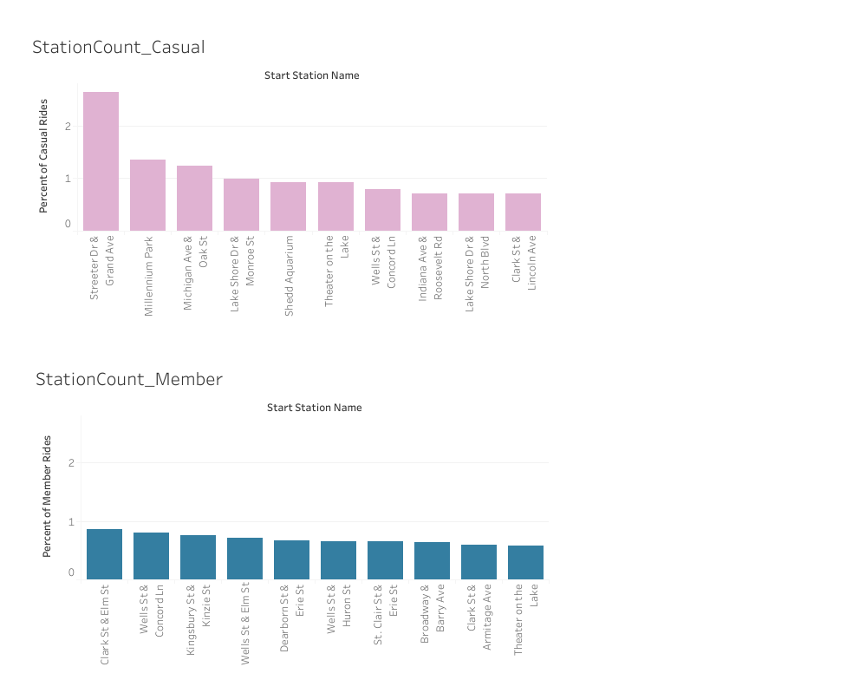
Most Popular Start Stations Mostly Differ Between Casual Riders and Members
Casual
Members
3
Navy Pier
3
2
2
Percent of Rides
1
1
0
0
10 locations accounted for 12.3% of rides that started at docking stations
10 locations accounted for 7.6% of rides that started at docking stations

Slide 9
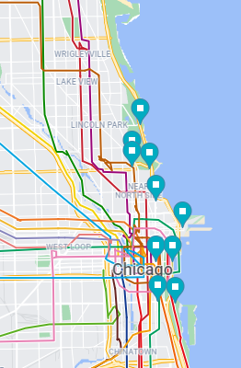
Most Popular Casual Rider Start Stations are Near Tourist Attractions
Casual Rider Top 10 Start Stations
Streeter and Grand (Navy Pier)
Millenium Park
Michigan and Oak (Magnificent Mile)
Lakeshore and Monroe (Maggie Daley Park)
Shedd Aquarium
Theater on the Lake
Wells and Concord (Lincoln Park)
Indiana and Roosevelt (Grant Park)
Lakeshore and North (Lakefront)
Clark and Lincoln (Lincoln Park/Zoo)
- Shared Top 10 across groups
From Google Maps

Slide 10
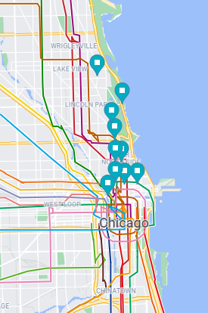
Most Popular Member Start Stations are North of The Loop
Member Top 10 Start Stations
Clark and Elm
Wells and Concord
Kingsbury and Kinzie
Wells and Elm
Dearborn and Erie
Wells and Huron
St. Clair and Erie
Broadway and Barry
Clark and Armitage
Theater on the Lake
- Shared Top 10 across groups
From Google Maps

Slide 11
Recommendations
Summer and Weekends are when casual ridership peaks and may be great times to offer annual membership promotions.
The “Casual Commuters” are a sub-group of casual riders that may be uniquely open to membership, given that they already use Cyclistic in a similar way to existing members.
Incorporating tourism into marketing strategy may appeal to the large portion of casual riders that frequent tourist attractions.

