Slide 1
Overview of Modern Web Frameworks & Technologies

Slide 2
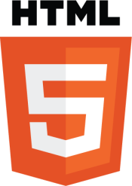
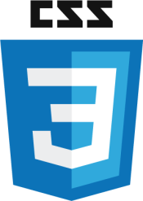

Modern Web Development Frameworks
HTML5, CSS3, and JavaScript
HTML5 Stands for HyperText Markup Language. Provides a way for developers to semantically "markup" web pages. Written using a series of tags. Those tags are parsed by web browsers and the result is displayed visually to the user. HTML can include other technologies like JavaScript for scripting, CSS for format and structure, and more.
CSS3 Stands for Cascading Style Sheets. Used to describe the structure and presentation of a web page. Properties include the ability to format type, backgrounds, lists, paragraphs, borders, the layout of a page, and a lot more. CSS can also allow the same markup to be presented in different styles for different rendering methods (Responsive Web Design).
JavaScript Implemented as part of a web page to provide enhanced user interfaces, interactions, conditional logic, calculations, validation, and more. Use of JavaScript diminished for almost a decade during the “Flash” era. The advent of web-based APIs, asynchronous coding, and numerous other JavaScript-related libraries have helped return JavaScript to the spotlight. Today, JavaScript powers the Modern Web Architecture Model and ties in with the "JavaScript-everywhere" paradigm.

Slide 3
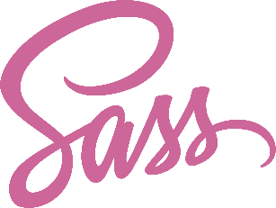
Modern Web Development Frameworks
SASS
Short for Syntactically Awesome Style Sheets.
Preprocessor scripting language that is interpreted or compiled into CSS.
SassScript is the scripting language.
CSS3 consists of a series of selectors and pseudo-selectors that group rules that apply to them. SASS on the other hand, extends CSS by providing several mechanisms available in more traditional programming languages like variables, nesting, mixins, inheritance, math, etc.
When SassScript is interpreted, it creates blocks of CSS rules for various selectors as defined by the SASS file. The SASS interpreter then translates SassScript into CSS.

Slide 4

Modern Web Development Frameworks
jQuery
jQuery is a modern JavaScript framework designed to simplify HTML DOM tree traversal and manipulation, as well as event handling, CSS animation, and Ajax.
As of May 2019, jQuery is used by 73% of the 10 million most popular websites.
Web analysis indicates that it is the most widely deployed JavaScript-based framework by a large margin, having 3 to 4 times more usage than any other JavaScript-based framework.
jQuery also provides capabilities for developers to create plug-ins on top of the JavaScript library. This enables developers to create abstractions for low-level interaction and animation, advanced effects and high-level, and themeable widgets.
The modular approach to the jQuery framework allows the creation of powerful dynamic web pages and Web applications.

Slide 5

Modern Web Development Frameworks
Bootstrap
Bootstrap is a free and open-source front-end CSS framework developed by Twitter.
Bootstrap is directed at responsive, mobile-first front-end web development.
It contains CSS- and (optionally) JavaScript-based design templates for typography, forms, buttons, navigation and other interface components.
In a nutshell, Bootstrap makes creating user interfaces and interactions for the web, very easy.
Bootstrap 4, the current version of the framework, is built on top of SASS and relies on jQuery for much of the user interface component's interactivity.

Slide 6

Modern Web Development Frameworks
React
React is a JavaScript framework for building user interfaces.
It is maintained by Facebook and a community of individual developers and companies.
It is currently used by Facebook, Instagram, Netflix, Yahoo! Mail, WhatsApp, Codeacademy, Dropbox, and more.
React can be used as a base in the development of single-page or mobile applications, as it is optimal for fetching rapidly changing data that needs to be recorded.
Complex React applications usually require the use of additional libraries for state management, routing, and interaction with an API.
The main features of React include JSX (HTML-like syntax used by React), a Virtual DOM (a copy of the site's DOM that React will make changes to before applying them to the actual DOM), and more.

Slide 7
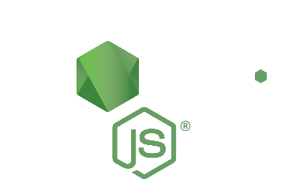
Modern Web Development Frameworks
Node.js
Node.js is an open-source, cross-platform JavaScript run-time environment that executes JavaScript code outside of a browser.
Node.js lets developers use JavaScript to write command line tools and for server-side scripting.
Node.js represents a "JavaScript everywhere" paradigm, unifying web application development around a single programming language, rather than different languages for server- and client-side scripts.
Corporate users of Node.js include GoDaddy, Groupon, IBM, LinkedIn, Microsoft, Netflix, PayPal, SAP, Walmart, Yahoo! and more.

