Slide 1
Classic Web Architecture

Slide 2
Classic Web Architecture
What is web architecture?
Webster’s has many definitions for architecture, the most generic being “Orderly arrangement of parts”. The most complex being “The overall design or structure of a computer system, including the hardware and the software required to run it”.
The Web is similar in concept to a computer system. In years past we’d have a mainframe as the foundation for company data. Terminals were used to retrieve and modify information within the mainframe computer. The mainframe was the supplier of data and the terminal was just a "dumb" access point.
Fortunately, the Web changed the way many of us interact with computers. Application service providers (ASP’s) are now common.
Since this is the case, the architecture of computing had to change. We now work in a tiered architecture model.

Slide 3

Classic Web Architecture
The Application Service Provider (ASP)
An Application Service Provider or ASP, is a third-party entity that manages and distributes software-based services and solutions to customers across a network from a central data center.
Let’s use eBay as an example.

Slide 4


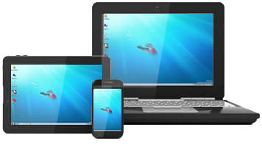
Classic Web Architecture
The Tiered Architecture Model
Tiered architecture provides a model for developers to create applications regardless of technology or platform.
1st Tier - The application is located somewhere. That application, regardless of technologies used, is a tier of the architecture.
2nd Tier - eBay auction information is stored in some sort of data source.
3rd Tier – The millions of buyers and sellers that use eBay daily make up the 3rd tier.

Slide 5

Classic Web Architecture
The Tiered Architecture Model
Visitor (Client)

Slide 6
Classic Web Architecture
The Tiered Architecture Model
Visitor (Client) HTML, CSS, JavaScript

Slide 7


Classic Web Architecture
The Tiered Architecture Model
Visitor (Client) HTML, CSS, JavaScript
Web Server

Slide 8

Classic Web Architecture
The Tiered Architecture Model
Visitor (Client) HTML, CSS, JavaScript
Web Server
3. Server responds by sending back the page requested
Internet
1. Visitor types the URL into their browser in hopes of seeing a page
2. Request is sent to
server for processing

Slide 9
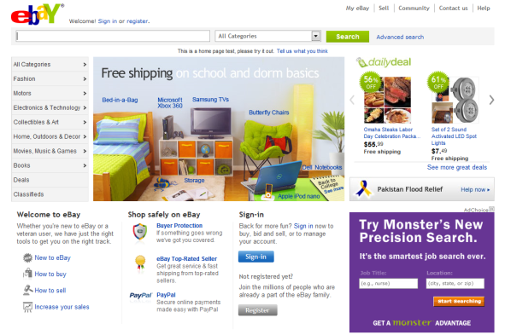
Classic Web Architecture
The Tiered Architecture Model
Visitor (Client) HTML, CSS, JavaScript
Web Server
3. Server responds by sending back the page requested
Internet
1. Visitor types the URL into their browser in hopes of seeing a page
2. Request is sent to
server for processing
4. Browser parses HTML, CSS, and JavaScript
and visitor sees the page.

Slide 10
Classic Web Architecture
The Tiered Architecture Model
Visitor (Client) HTML, CSS, JavaScript
Web Server PHP, ASP.NET, JSP, Ruby
3. Server responds by sending back the page requested
Internet
1. Visitor types the URL into their browser in hopes of seeing a page
2. Request is sent to
server for processing

Slide 11

Classic Web Architecture
The Tiered Architecture Model
Visitor (Client) HTML, CSS, JavaScript
Web Server PHP, ASP.NET, JSP, Ruby
3. Server responds by sending back the page requested
Internet
1. Visitor types the URL into their browser in hopes of seeing a page
2. Request is sent to
server for processing
Relational Database SQL Server, Oracle, MySQL, DB2

Slide 12
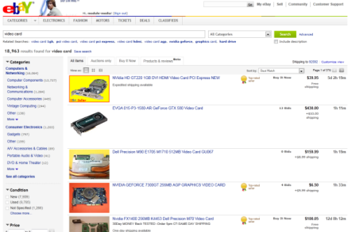
Classic Web Architecture
The Tiered Architecture Model
Visitor (Client) HTML, CSS, JavaScript
Web Server PHP, ASP.NET, JSP, Ruby
5. Server-side application processes data returned in a format the browser can understand. Typically HTML.
Internet
1. Visitor types the URL into their browser in hopes of seeing a page
2. Request is sent to
server for processing
3. Server-side application accesses information contained within data store. Also known as a query.
4. Data is returned in the form of a recordset.
6. Browser parses HTML, CSS, and JavaScript
and visitor sees the page.
Relational Database SQL Server, Oracle, MySQL, DB2

