Slide 1
Basic Structure of a Web Page

Slide 2
Basic Structure of a Page
The basic structure of a web page
A typical web page will contain two major areas:
The Doctype Declaration
The Document Tree

Slide 3
Basic Structure of a Page
The Doctype Declaration
The first item to appear in the source code of a web page is the doctype declaration. It will look like this:
<!DOCTYPE html>

Slide 4
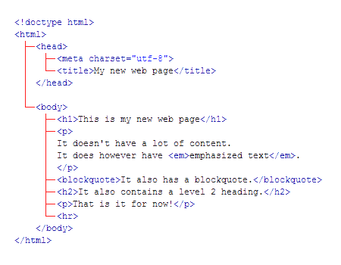
Basic Structure of a Page
The Document Tree
A web page is typically considered a document tree because it will contain a combination of HTML markup organized like the branches of a tree.
Pay close attention to the symmetry of the way that tags are opened and closed.

Slide 5
Basic Structure of a Page
The <html> Tag
Immediately after the doctype comes the html tag - this is the root tag of the document tree and everything that follows is a descendant of that tag.
The html tag breaks the document into two main sections: the head and the body.

Slide 6
Basic Structure of a Page
The <head> Tag
The head tag contains meta data - information that describes the document itself, or associates it with related resources, such as scripts and style sheets. The example below contains the title element, which represents the document’s title or name and a simple JavaScript code block that displays a popup message. <!doctype html> <html> <head> <title>Welcome to Vecta Corporation</title> <script> alert('Hello World'); </script> </head> <body> <h1>This is a simple example</h1> </body> </html>

Slide 7
Basic Structure of a Page
The <body> Tag
This is where the bulk of the page is contained. Everything that you can see in the browser window is contained inside this element, including paragraphs, lists, links, images, tables, and more. How the page looks will depend entirely upon the content that you decide to fill it with.

