Slide 1
HTML Syntax

Slide 2
HTML Syntax
Six things to consider…
Writing valid HTML5 is not a terribly difficult task once you know the syntax and what the rules are for writing the code. The list below provides a quick reference to the "general rules" that will ensure your markup is well-formed and valid.
Be mindful of the document tree
Implement a correctly formed tag structure
Make everything lowercase (with few exceptions)
Be sure to close all of your tags (with few exceptions)
Write your code so that it's readable
Comment your markup!

Slide 3
HTML Syntax
Be mindful of the document tree
A web page is, at its heart, little more than a collection of HTML elements.
The element is created by writing an opening tag, and completed by writing a closing tag (in most cases).
An element may contain other nested elements.
Where this occurs, the opening and closing tags must be symmetrical. If an opening paragraph tag is followed by the opening em tag, the closing tags must appear in the reverse order: <p><em>Hello World</em></p>

Slide 4
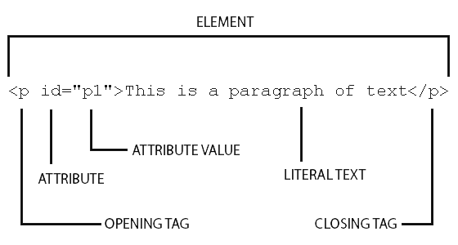
HTML Syntax
Implement a correctly formed tag structure
In general, all HTML elements will resemble the following structure:

Slide 5
HTML Syntax
Make everything lowercase (with few exceptions)
In HTML, tag names are not case sensitive. Since this is the case, you can write the markup in lowercase, mixed case, or uppercase letters. So the following would all be valid: <p>this is a paragraph</p> <P>this example</P> <P>this markup would be valid</p>
As a general rule of thumb however, you should always write your code in lowercase.

Slide 6
HTML Syntax
Be sure to close all of your tags (with few exceptions)
In HTML, it’s possible to omit some closing tags. For instance, this is valid markup: <p>This is a paragraph without a closing tag <p>This is a second paragraph without a closing tag
As a general rule of thumb however, you should always include a closing tag as follows: <p>This is a third paragraph with a closing tag</p>

Slide 7
HTML Syntax
Write your code so that it's readable
Spaces A browser doesn’t care whether you use a single space to separate attributes, ten spaces, or even complete line breaks; it doesn’t matter, as long as at least one space is present. Take into consideration however, that the more spaces you include, the larger your web page’s file size will be since each occurrence of whitespace takes up additional bytes.
Attribute Quotes
In HTML all attribute values should be quoted, so you’ll need to write id=“button1" rather than id=button1. It’s valid to omit the quotes from your HTML, though it may make reading the markup more difficult for developers revisiting old markup. Additionally, if you’re using a visual editor that colors your code, omitting the quotes from your attribute values will result in incorrect code colors.

Slide 8
HTML Syntax
Comment your markup
You may add comments in your HTML, perhaps to make it clear where sections start or end, or to provide a note to remind yourself why you approached the creation of a page in a certain way. The HTML comment looks like this: <!-- This is a comment -->
These hyphens tell the browser when to start ignoring text content, and when to start paying attention again. The fact that the -- characters signify the beginning and end of the comment means that you should not use them anywhere inside a comment.

