Slide 1
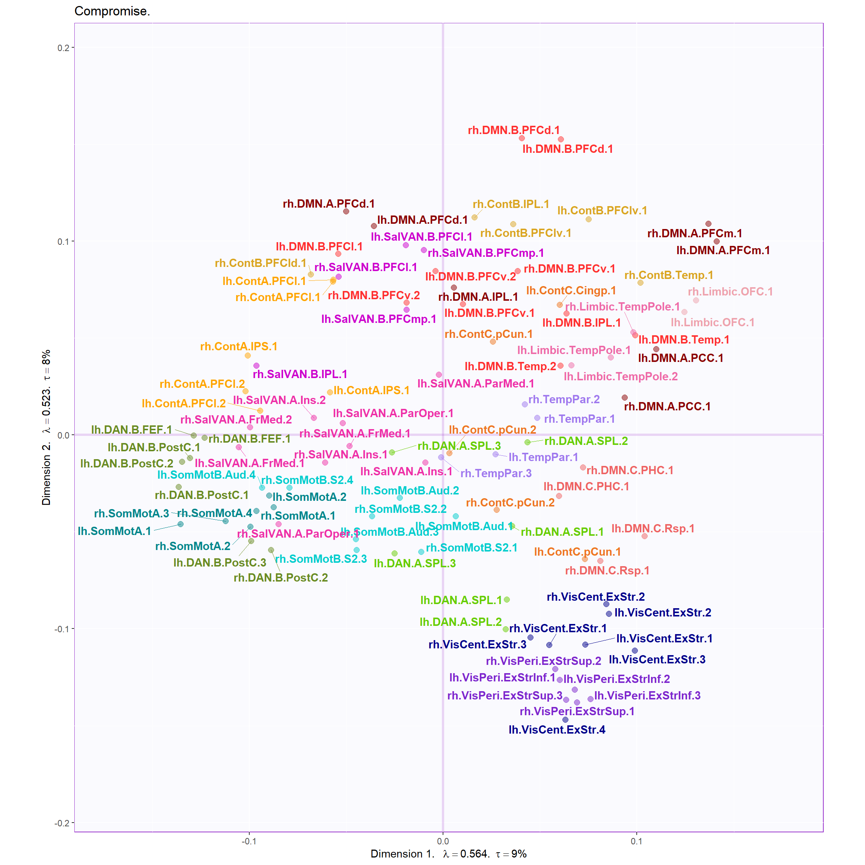
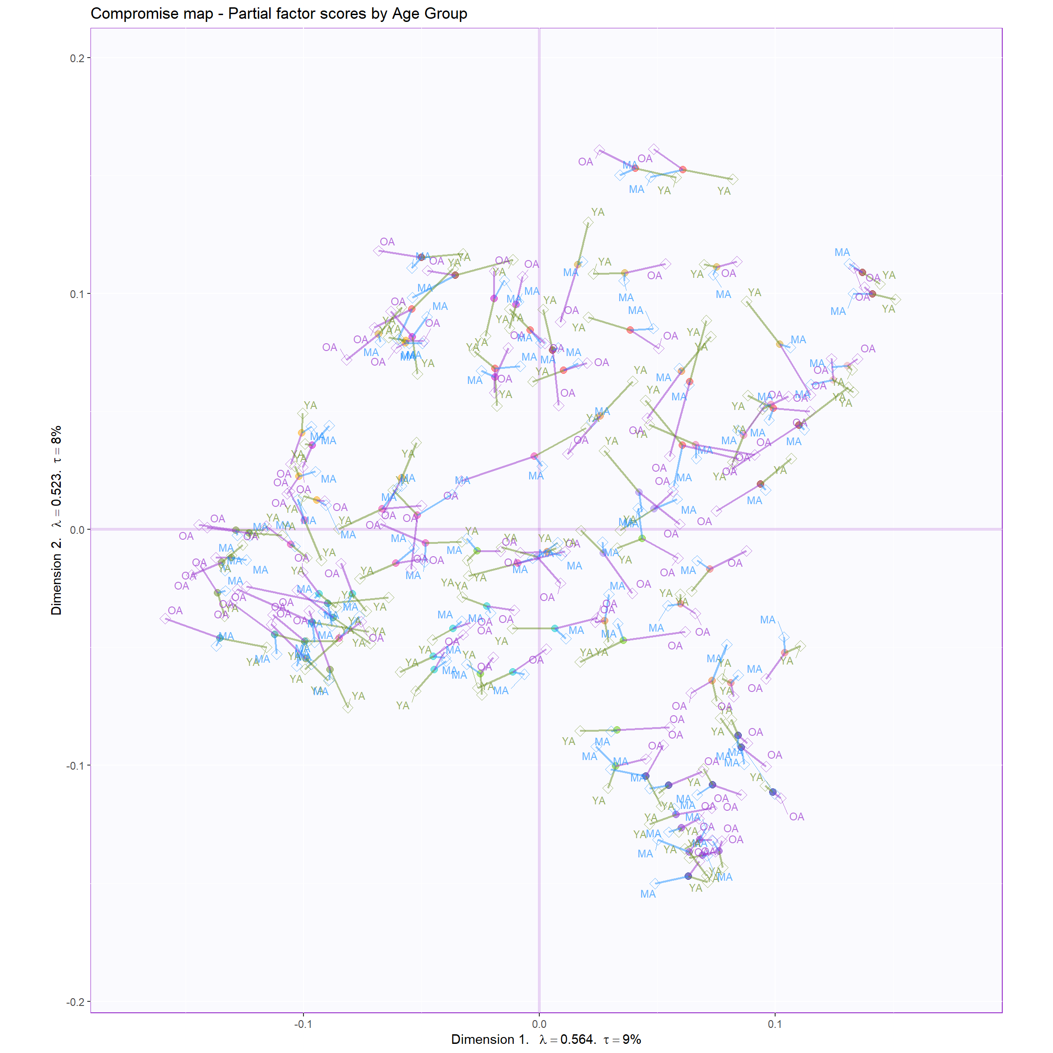
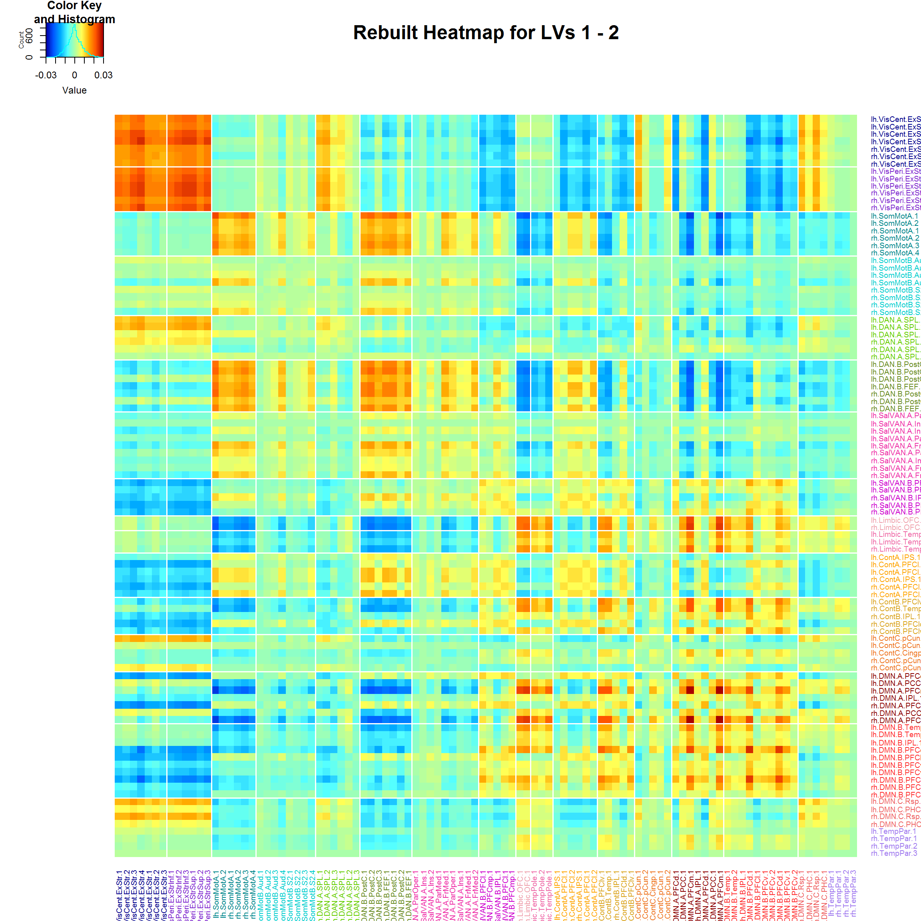
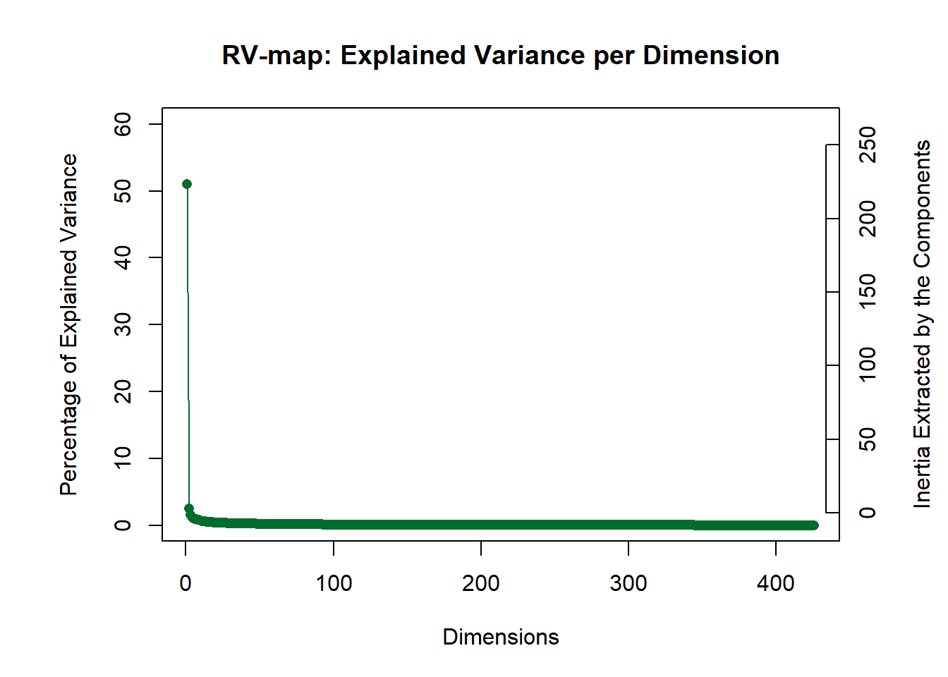
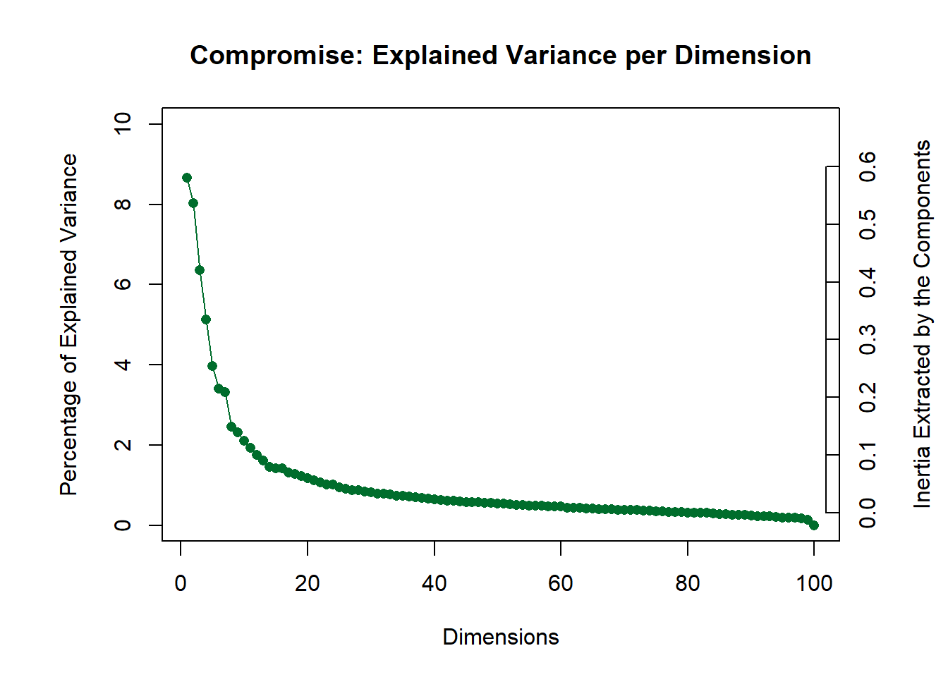
C-MARINeR Shiny App
INPUT
Select a connectivity cube
Select a row/col design
Select a participant design
Select a target matrix
(k+1covSTATIS) (optional)
RUN
DISTATIS RESULTS
Explorable Compromise Map Compromise HeatMap
Plotting Options
x-axis: Component 1
y-axis: Component 2
Compromise Potting:
ROI Labels: ON
Partial Factor Scores: ON
Click an ROI and highlight all partial projections for that ROI
Click an individual and highlight that individual across all ROIs
Rv SCREE PLOT
Compromise SCREE PLOT

