Slide 1
CS351 Project#2 Boggle
Jaehee Shin
jennyshin42@gmail.com

Slide 2
Controller
Timer
<<includes>>
TimerV
Answers
<<extends>>
Nodes
Board
Dictionary
WordList
StartSceneV
<<includes>>
<<includes>>
EndingSceneV
BoardV
WordListV
Score
<<includes>>
ScoreV

Slide 3
Controller
Timer
<<includes>>
TimerV
Answers
<<extends>>
Nodes
Board
Dictionary
WordList
StartSceneV
<<includes>>
<<includes>>
EndingSceneV
BoardV
WordListV
Score
<<includes>>
ScoreV

Slide 4
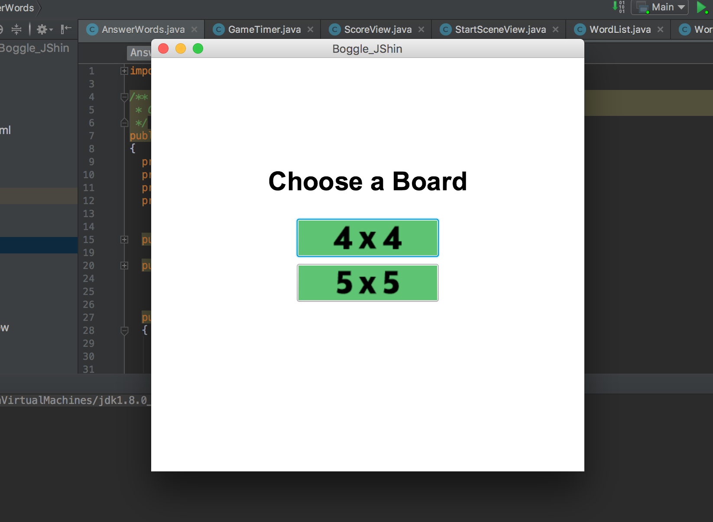

Slide 5
Click

Slide 6
Controller
Timer
<<includes>>
TimerV
Answers
<<extends>>
Nodes
Input num
Board
Dictionary
WordList
StartSceneV
<<includes>>
<<includes>>
EndingSceneV
BoardV
WordListV
Score
<<includes>>
ScoreV

Slide 7
Controller
Timer
<<includes>>
TimerV
Answers
<<extends>>
Nodes
Find out answer words
Board
Dictionary
WordList
StartSceneV
<<includes>>
<<includes>>
EndingSceneV
BoardV
WordListV
Make a board
Score
<<includes>>
ScoreV

Slide 8
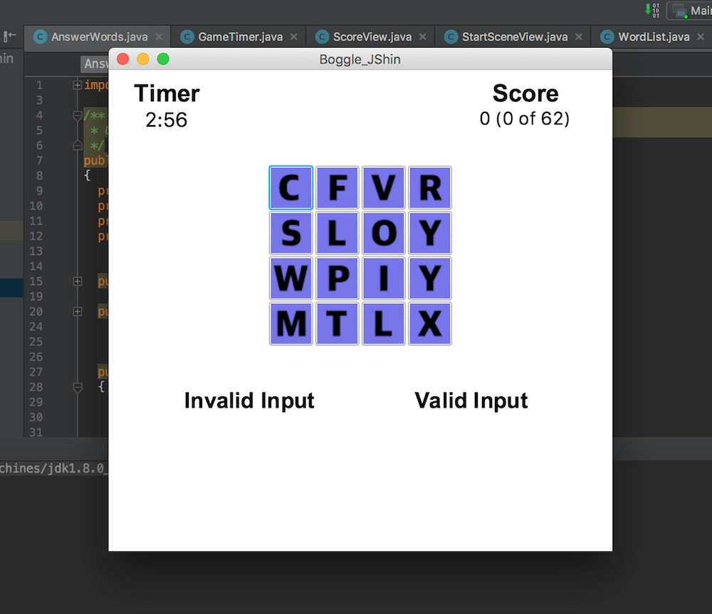

Slide 10
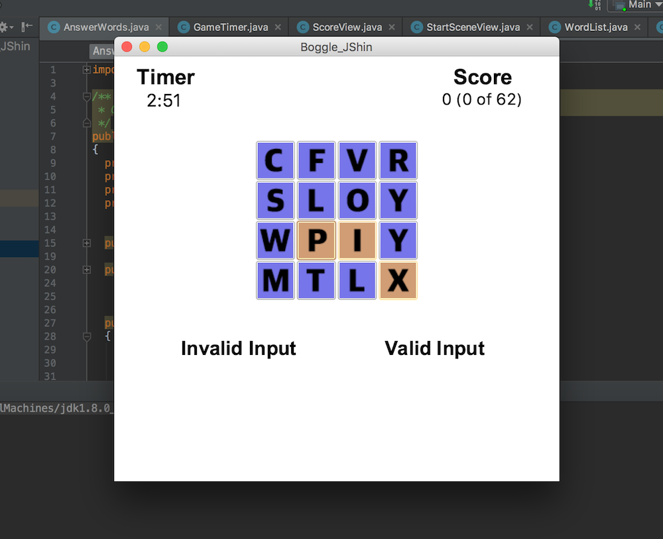

Slide 11
Controller
Timer
<<includes>>
TimerV
Answers
<<extends>>
Nodes
Check if the input word is in the dictionary
Board
Dictionary
WordList
StartSceneV
<<includes>>
<<includes>>
EndingSceneV
BoardV
WordListV
Score
<<includes>>
ScoreV

Slide 12
Controller
Timer
<<includes>>
TimerV
Answers
<<extends>>
Nodes
findWord(input) -> return True or False
Board
Dictionary
WordList
StartSceneV
<<includes>>
<<includes>>
EndingSceneV
BoardV
WordListV
Score
<<includes>>
ScoreV

Slide 13
Controller
Timer
<<includes>>
TimerV
Answers
<<extends>>
Nodes
Board
Dictionary
WordList
StartSceneV
<<includes>>
<<includes>>
EndingSceneV
BoardV
WordListV
If(findWord(input))
Grade input’s score
Score
<<includes>>
ScoreV

Slide 14
Controller
Timer
<<includes>>
TimerV
Answers
<<extends>>
Nodes
If score > 0, validWordList.add(input)
else, invalidWordList.add(input)
Board
Dictionary
WordList
StartSceneV
<<includes>>
<<includes>>
EndingSceneV
BoardV
WordListV
Score
<<includes>>
ScoreV

Slide 16
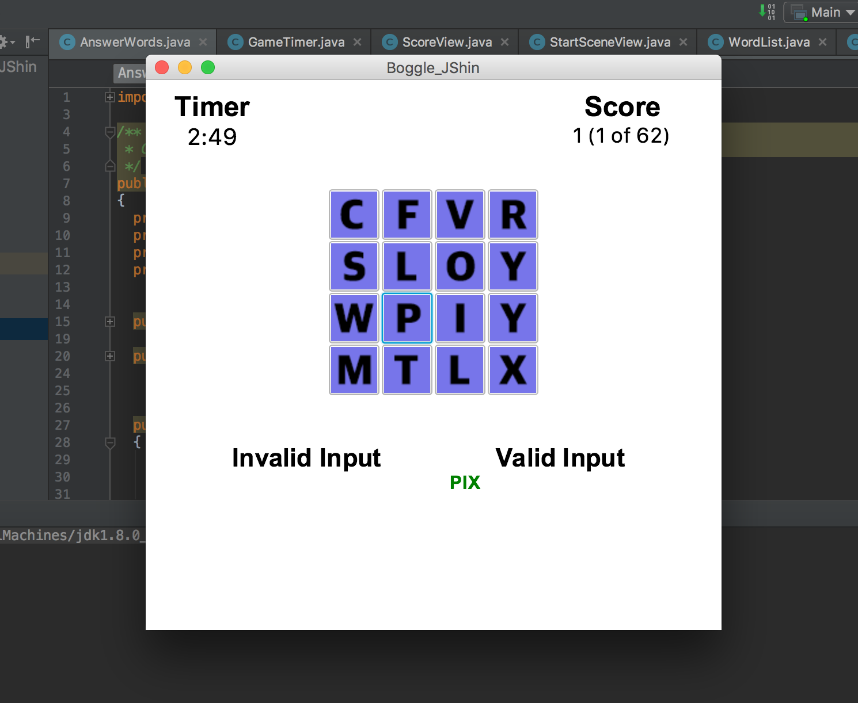

Slide 17
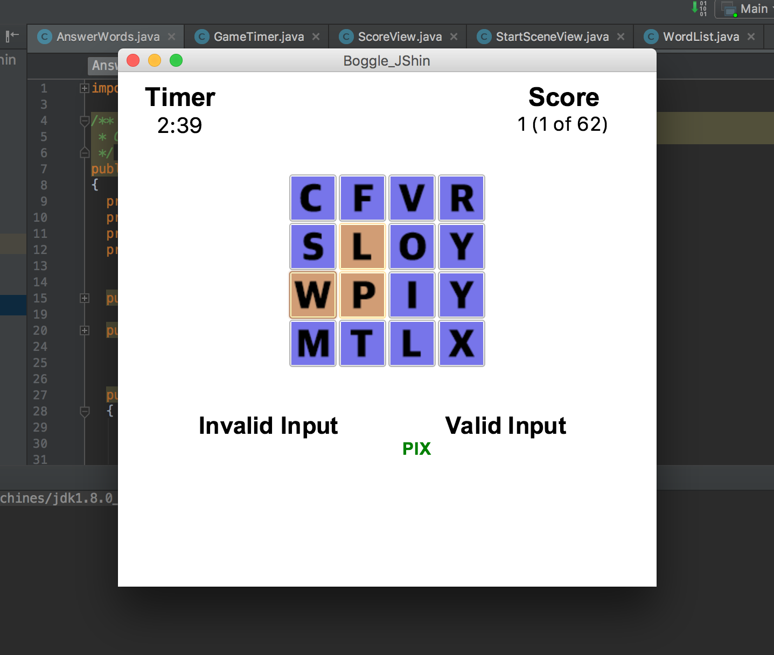

Slide 18
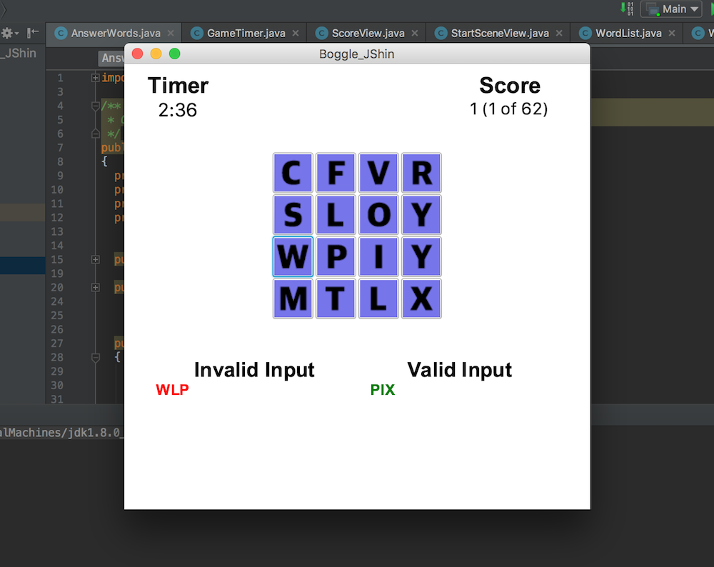

Slide 19
Let’s play 5x5 board

Slide 20
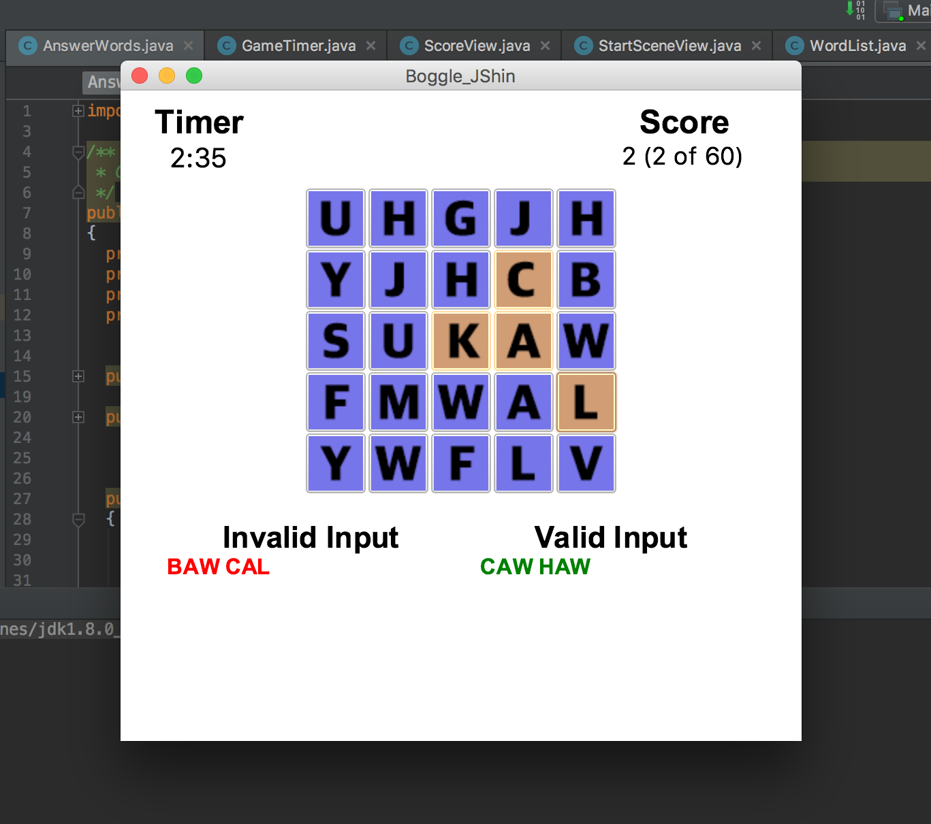

Slide 21
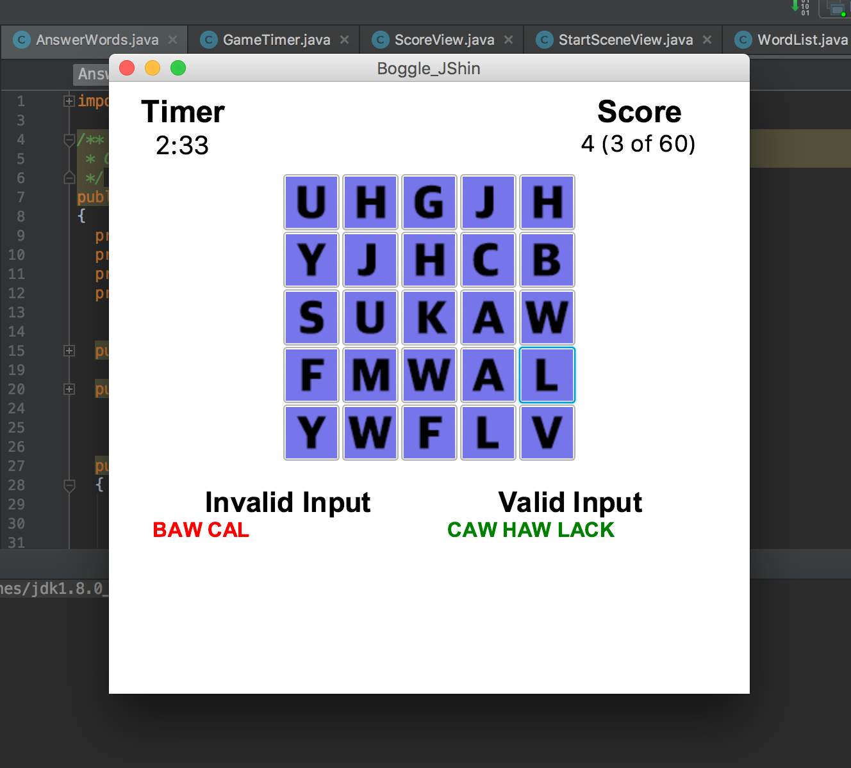

Slide 22
When time’s up,

Slide 23
Controller
Timer
<<includes>>
TimerV
Answers
<<extends>>
Nodes
Board
Dictionary
WordList
StartSceneV
<<includes>>
<<includes>>
EndingSceneV
BoardV
WordListV
Score
<<includes>>
ScoreV

Slide 24
Controller
Timer
<<includes>>
TimerV
Answers
<<extends>>
Nodes
Board
Dictionary
WordList
StartSceneV
<<includes>>
<<includes>>
EndingSceneV
BoardV
WordListV
Score
<<includes>>
ScoreV
BoardView
ScoreView
WordListView
.getChildren().clear()

Slide 25
Controller
Timer
<<includes>>
TimerV
Answers
<<extends>>
Nodes
Board
Dictionary
WordList
StartSceneV
<<includes>>
<<includes>>
EndingSceneV
BoardV
WordListV
Score
<<includes>>
ScoreV

Slide 26
