Slide 1
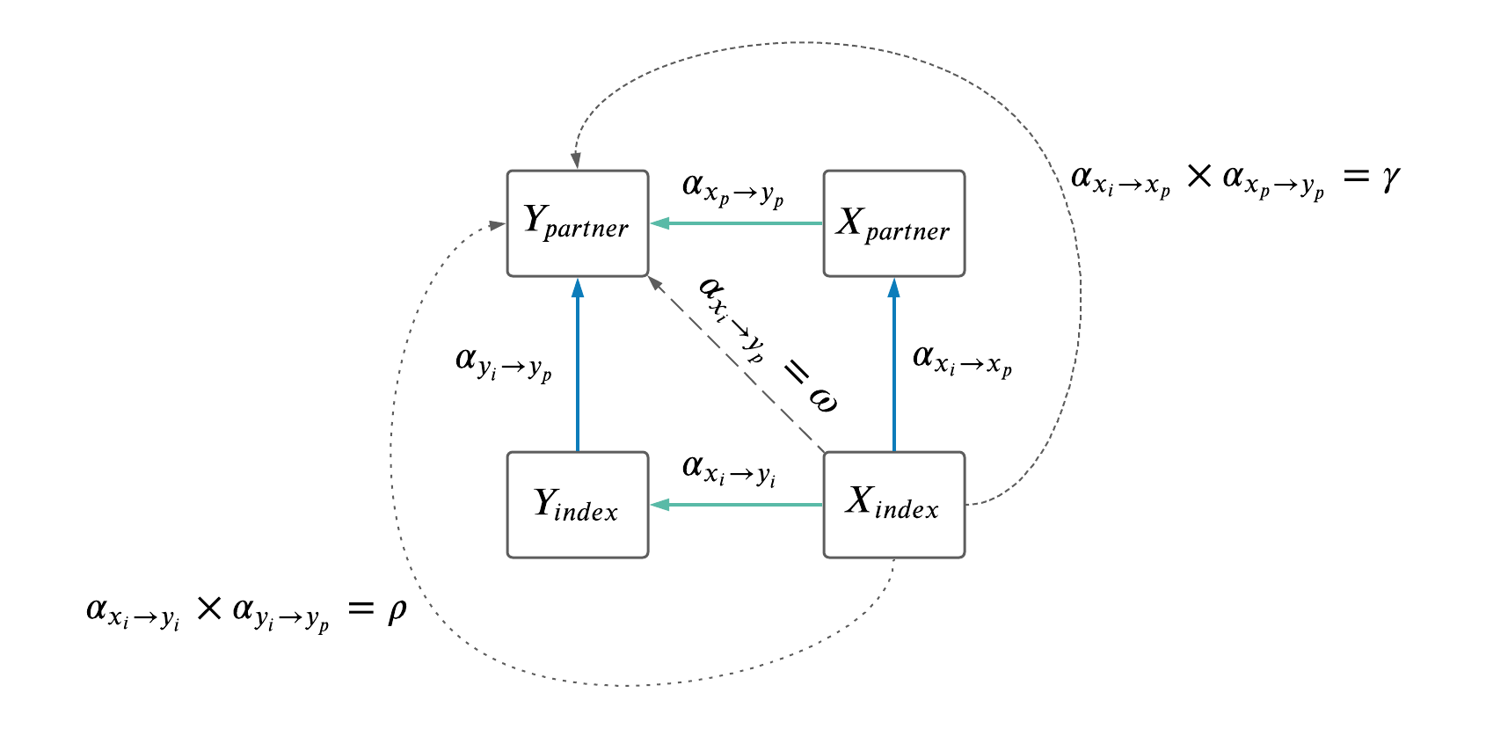
Notes:
https://lucid.app/lucidchart/fc22ff65-6a6a-48d3-a807-28fd066b3e8e/edit?page=0_0#
See above link to edit

