Slide 1
tSNE measures how close different datapoints
is to each other in higher dimensionality
Only for visualisation
Perplexity is a measure to balance attention between local and global acpects of data
Made for keeping local structure

Slide 2
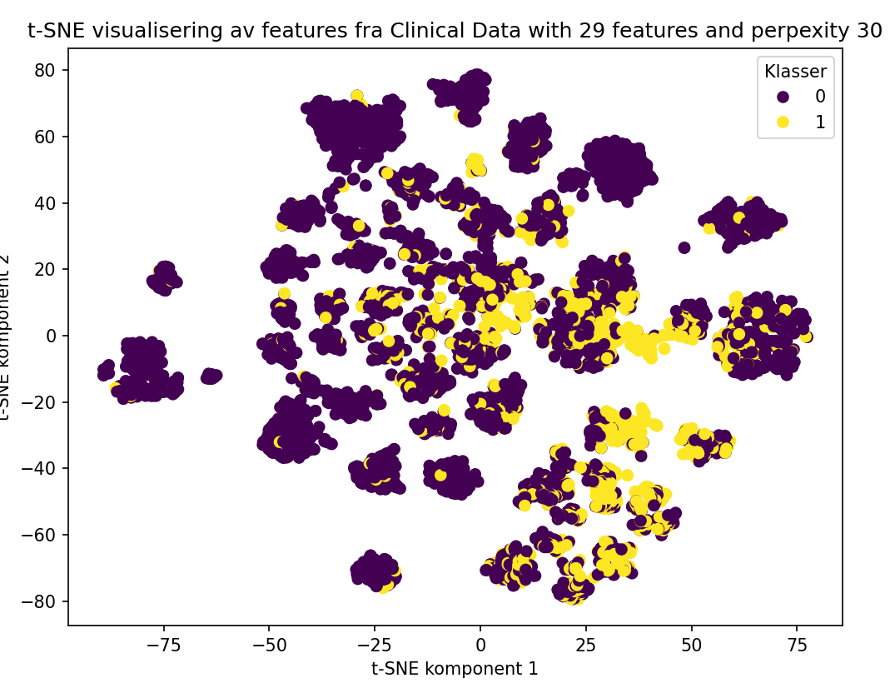
tSNE measures how close different datapoints is to eachother in higher dimensjonality

Slide 3
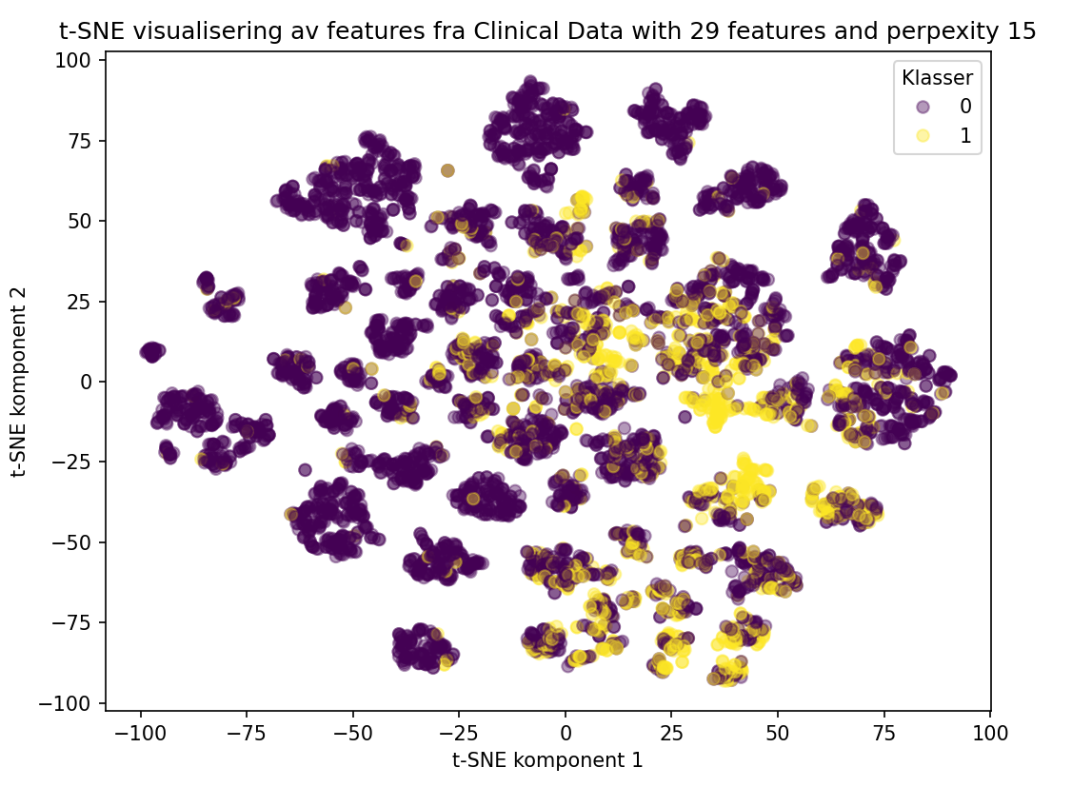

Slide 4
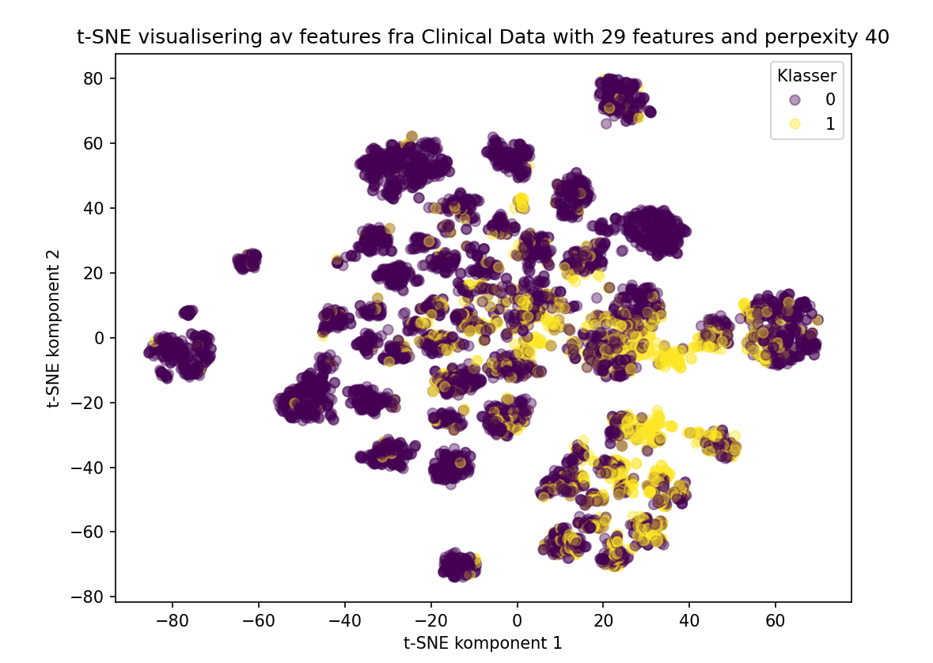

Slide 5
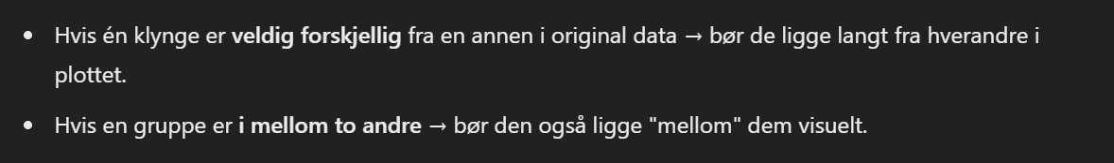
UMAP
Visualistaion method just as tSNE, used for visualizing large amounts of data in higher dimensionalities
Possible to use the features afterward
Made for keeping local and global structure

Slide 6
