Slide 1


Building a Personal Website Using R
Sydney
If you haven’t already please:
Jenny Sloane @jfsloane
Tehilla Ostrovosky @TehillaOst
Make sure R, Rstudio, and Git are installed
Create a Github account
Check out Jenny’s blog – this will be our guide for building our website today
jennysloane.netlify.app/project/blogdown/

Slide 2
Goals for Today:
Brief overview of all the platforms
1
Build a website using the Wowchemy academic theme
2
Set up basic configurations
3
Edit some content
4
Publish our website
5

Slide 3


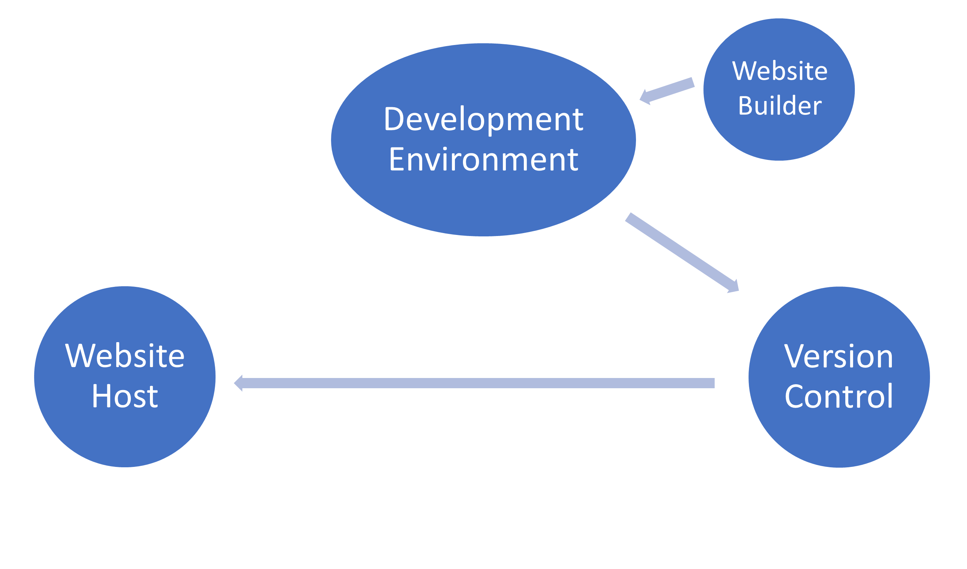


Notes:
In this series of tutorials we will be using the blogdown package in R to build a persomal-acadmic website. We will with talking about the different platforms that are involved in building your website. The next tutorial will build on how to build the websoite and will dedicate a few tutorials to editing the content changes in your website

Slide 4


Additional Resources
Hugo - gohugo.io
Wowchemy - wowchemy.com
Netlify - netlify.com
How to build a blogdown website YouTube tutorials
https://www.youtube.com/playlist?list=PLpZT7JPM8_GbPiX4ibrP7ogl7GyEofZMj
Alison Hill’s Blog
alison.rbind.io/blog/2020-12-new-year-new-blogdown/
Dr. Maria Tackett RLadies on building a website with distill
www.youtube.com/watch?v=RYf5HqU1pI4

