Slide 1
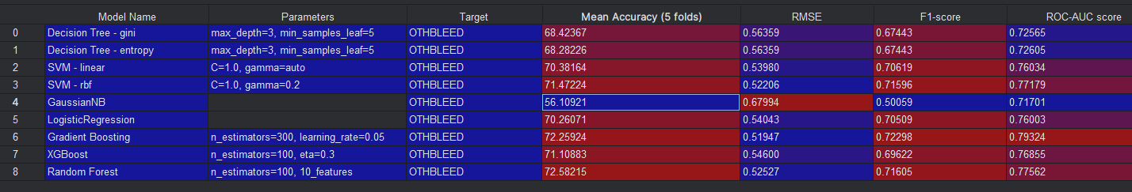
Model Performance
Best model
2nd Best model

Slide 2
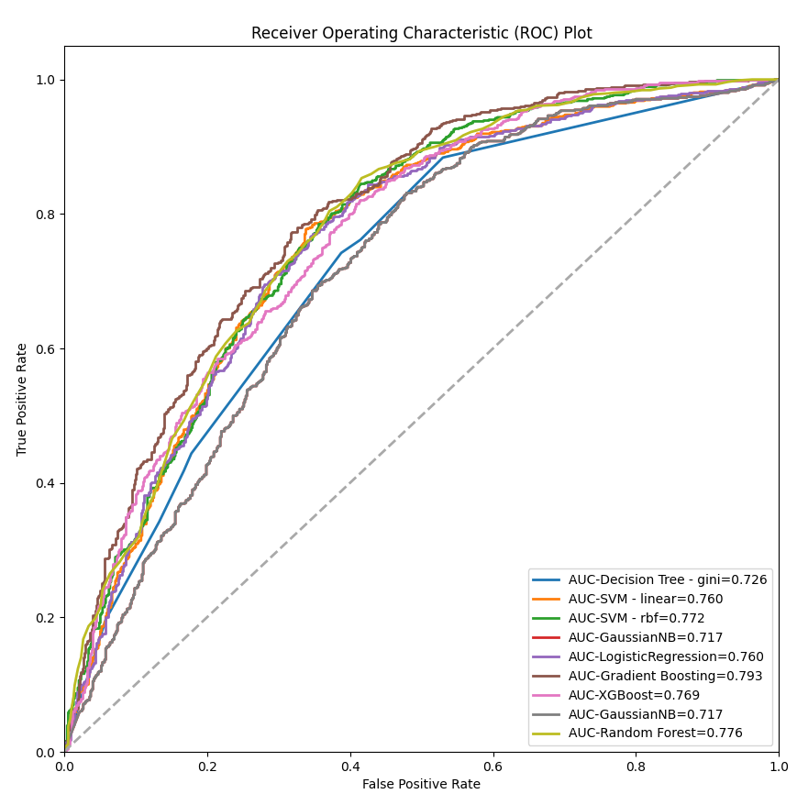

Slide 3
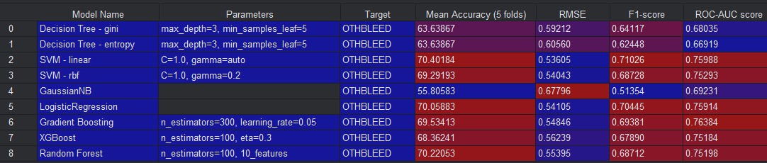
Model Performance – Before Feature Selection
Model Performance – After Feature Selection
Best model
2nd Best model

Slide 4
Class
class_baseline_decision_tree
DecisionTree
class_baseline_svm
SVM
class_baseline_logistic
LogReg
class_baseline_xgboost
XGB
Utilities
utils_models

Slide 5
