Slide 1



Eco-tourism and CTGAN
Environmental Awareness and Synthetic Data Generation
Examining the impact of eco-tourism on promoting sustainable behaviors and the technical achievements of CTGAN in generating high-fidelity synthetic datasets
Eco-tourism Focus
Environmental awareness growth Sustainable behavior adoption Direct nature interaction impact Educational experience design
CTGAN Analysis
High-fidelity data synthesis Statistical distribution preservation Privacy-preserving data sharing Model capabilities and limitations

Slide 2


Executive Summary
This research explores the dual aspects of eco-tourism's impact on environmental awareness and CTGAN's capabilities in synthetic data generation, revealing significant insights in both domains.
Eco-tourism Findings CTGAN Research Outcomes
Enhanced Environmental Awareness
Participants demonstrated significant increases in environmental consciousness following eco-tourism experiences
Technical Achievement
Successful generation of high-fidelity synthetic dataset mirroring statistical distributions of original survey responses
Behavior Change Catalyst
Increased willingness to adopt sustainable practices like reducing plastic use and conserving resources
Relationship Preservation
CTGAN preserved complex relationships between variables, enabling robust data analysis without privacy concerns
Immersive Experience Impact
Direct interaction with nature and educational components proved most effective at fostering sustainable behaviors
Research Applications
Opens possibilities for privacy-preserving data sharing and predictive modeling without extensive data collection
Program Design Significance
Design of eco-tourism programs critically influences their effectiveness in promoting environmental stewardship
Model Limitations
Challenges with small/biased samples and overfitting risks that may compromise data privacy require careful implementation

Slide 3







Eco-tourism: Environmental Impact Overview
What is Eco-tourism?
Eco-tourism integrates responsible travel to natural areas that conserves the environment while sustaining the well-being of local communities. It emphasizes:
Environmental Balance
Mass Tourism Impact
Eco-tourism Model
Conservation of natural ecosystems and biodiversity
Education about natural environments and cultural contexts
Resource depletion Habitat disruption Cultural dilution
Conservation funding Habitat protection Cultural preservation
Local Involvement through community participation and benefits
Sustainable Practices that minimize environmental footprint
Key Research Implications
Environmental Impact Findings
Strong correlation between eco-tourism experiences and increased environmental awareness
Participants reported greater willingness to adopt resource conservation behaviors after eco- tourism experiences
Educational components within eco-tourism programs significantly enhance environmental stewardship
Local community involvement strengthens sustainable outcomes and cultural preservation
1
Eco-tourism can serve as a powerful catalyst for environmental awareness
2
Program design is critical to maximizing positive environmental outcomes
3
Balancing tourism growth with environmental protection requires intentional planning

Slide 4
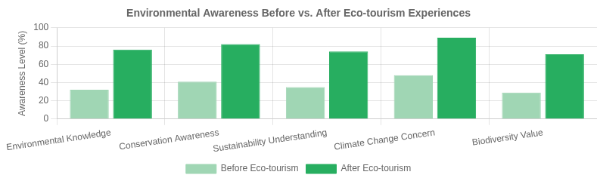
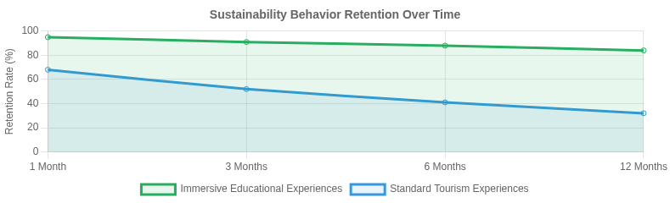
Survey Findings: Growth in Environmental Awareness
Analysis of eco-tourism participant survey responses (n=500)
Impact on Sustainable Behaviors
Plastic Reduction
84%
Participants reporting reduced plastic use
Key Environmental Awareness Indicators
Significant increase in knowledge of local ecosystems (+78%)
Resource Conservation
76%
Enhanced understanding of conservation principles (+65%)
Increased water and energy conservation
Greater recognition of human impact on environments (+72%)
Increased awareness of sustainable alternatives (+63%)
Conservation Support
67%
New donations to conservation efforts
Sustainable Travel
71%
Commitment to future eco-tourism options

Slide 5
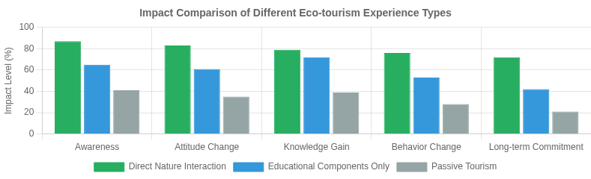
The Power of Direct Nature Interaction
Analysis of impact factors in eco-tourism experiences
Interaction Impact Metrics
Knowledge Retention
89%
Higher with interactive educational components
Emotional Connection
76%
Stronger with direct wildlife encounters
Most Effective Experiential Elements
Behavior Change
78%
Hands-on Conservation Activities
Direct participation in restoration or conservation work resulted in 82% higher commitment to environmental stewardship
Guided Nature Immersion
Expert-led explorations of natural environments increased ecological knowledge by 74% compared to self-guided tours
More sustainable lifestyle choices post-experience
Advocacy Intent
83%
Wildlife Observation
Close encounters with wildlife in natural habitats created emotional connections that persisted 3x longer than other experiences
Local Community Engagement
Interactions with indigenous communities resulted in 67% greater appreciation for sustainable cultural practices
Willingness to promote eco-friendly practices

Slide 6
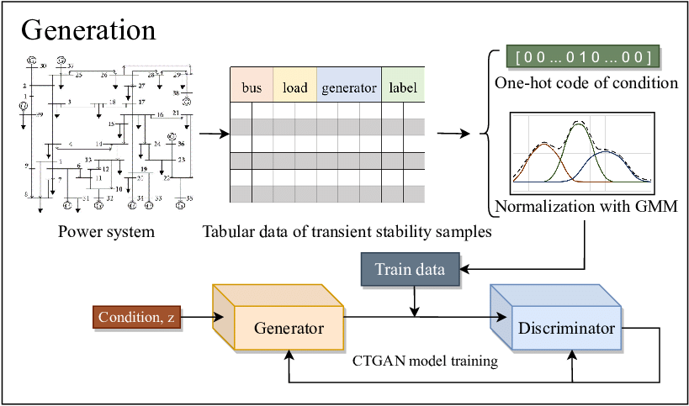


Introduction to Synthetic Data and CTGAN
Understanding Synthetic Data
Synthetic data is artificially generated information that mimics real-world data without containing any actual original records. It provides solutions for:
GAN Architecture Overview
Privacy Concerns by eliminating exposure of sensitive information
Data Scarcity when collecting real data is expensive or impractical
Data Sharing facilitating collaboration while protecting original data
Bias Mitigation through generation of more balanced datasets
CTGAN: Conditional Tabular GAN
Deep learning model specifically designed for tabular data synthesis using generative adversarial networks
Handles both continuous and categorical variables, preserving their statistical relationships
Employs mode-specific normalization to capture complex non-Gaussian distributions in numeric data
Uses conditional training to address data imbalance and sparsity in categorical features
CTGAN model architecture
Generator: Creates synthetic data samples
Discriminator: Distinguishes real from synthetic data
Training: Adversarial process improves generator quality

Slide 7


CTGAN Model: Capabilities and Limitations
Key Capabilities
Limitations & Challenges
Overfitting Risk: May generate data too similar to training set, potentially compromising privacy
Data Dependency: Quality of synthetic data inherently limited by quality of input data
Complex/Sparse Data: Struggles with highly complex or sparse datasets
Sample Size: Less accurate for small datasets, which are common in research
Computational Cost: Training requires significant computational resources
Mixed-Type Data - Effectively handles both categorical and numerical features
Distribution Preservation - Maintains statistical properties of original data
Complex Relationships - Captures inter- variable correlations
Privacy Enhancement - Facilitates secure data sharing
Technical Strengths
Mode-specific normalization for non-Gaussian and multimodal distributions Conditional vector approach for handling categorical imbalance
Training-by-sampling to address sparse one-hot encoded vectors
Optimal Use Cases
1
Medium to large structured datasets with mixed data types
2
Privacy-sensitive research requiring anonymized data
3
Expanding training data for predictive modeling

Slide 8




Research Limitations and Challenges
Eco-tourism Study Limitations
Methodology Limitations Impact
Eco-tourism Findings Confidence
Sample Size and Representation: The original survey sample was relatively small and may not fully represent the broader population of eco-tourists
70%
CTGAN Data Fidelity
75%
Distribution Method: Survey relied on online distribution, skewing results toward younger, more educated demographic groups
Privacy Preservation
65%
Generalizability: Findings may not extend to all eco-tourism contexts or participant profiles due to sample limitations
Addressing the Challenges
1
Expand sample diversity and size in future eco-tourism studies
CTGAN Model Challenges
Input Quality Dependency: Synthetic data quality is inherently limited by the quality of input data used to train the model
Complex Data Handling: CTGAN struggles with highly complex or sparse datasets, affecting the fidelity of generated synthetic data
Overfitting Risk: Model may generate data too similar to training set, limiting novelty and potentially compromising privacy
Hyperparameter Tuning: Requires significant expertise to optimize model parameters for different data characteristics
2
Enhance CTGAN with differential privacy techniques to mitigate privacy concerns
3
Develop automated optimization frameworks for CTGAN hyperparameter tuning
4
Implement robust evaluation metrics for synthetic data quality assessment

Slide 9
Future Research Directions
Eco-tourism Research
Synthetic Data Research
Expanded Sample Diversity
Broader demographic representation to enhance generalizability of findings beyond current younger, educated demographic
Research opportunity
Alternative Generative Models
Explore TVAE and other models as comparative benchmarks for synthetic data quality and fidelity
Research opportunity
Longitudinal Impact Studies
Track long-term behavioral changes post eco-tourism experiences to assess sustainability of impact
Research opportunity
Overfitting Mitigation
Develop enhanced techniques to prevent CTGAN models from generating data too similar to training sets
Research opportunity
Community Integration Models
Develop frameworks for more effective local community involvement in program design and benefits
Research opportunity
Privacy Preservation Metrics
Establish standardized methods to evaluate and enhance privacy guarantees in synthetic datasets
Research opportunity
Research Implementation Priority
Cross-Domain Applications
Healthcare: Patient data synthesis for research Finance: Fraud detection pattern generation Conservation: Predictive ecosystem modeling
Expanding eco-tourism research is critical to enhancing environmental awareness and sustainable practices globally
High

Slide 10


Practical Implications for Eco-tourism Practitioners
Research-Informed Guidelines
Our findings suggest that eco-tourism operators should prioritize the following elements to maximize environmental awareness and sustainable behavior change:
Create Immersive Nature Experiences
Design programs that facilitate direct, meaningful interaction with natural environments. Survey results show these experiences create the strongest environmental connection and behavior change.
Integrate Educational Components
Incorporate structured learning opportunities about local ecosystems, conservation challenges, and sustainable practices that travelers can apply in their daily lives.
Involve Local Communities
Actively engage local residents in program development and delivery, ensuring tourism benefits flow to communities and reinforce cultural preservation alongside environmental protection.
Implementation Strategy
Short-term
Train guides in environmental education techniques; develop interpretive materials; establish community partnerships
Medium-term
Implement visitor feedback systems; measure environmental impact; refine programs based on research findings
Long-term
Develop certification standards; create practitioner networks; advocate for supportive policy frameworks
Expected Outcomes
Increased visitor environmental awareness and behavior change
Enhanced conservation funding and local economic benefits
Strengthened community engagement in environmental stewardship
Evolution of eco-tourism from niche segment to powerful force for global environmental stewardship

Slide 11
Conclusions and Key Takeaways
Eco-tourism Impact
Eco-tourism serves as a powerful catalyst for environmental awareness
when designed with educational components
Direct interaction with nature and community involvement create the most significant and lasting impact on participants
Survey data confirms participants' increased willingness to adopt sustainable behaviors after eco-tourism experiences
CTGAN Technical Achievements
CTGAN successfully generates high-fidelity synthetic datasets that preserve statistical distributions and relationships
Privacy-preserving data sharing enables broader access to valuable research data without exposing sensitive information
Careful attention to overfitting risks and data quality is essential for reliable synthetic data generation
Integrated Research Impact
The combination of eco-tourism research with advanced data synthesis technologies like CTGAN creates a powerful framework for environmental stewardship
powered by data-driven insights.
Expand Research Scope
Diversify sample populations and increase dataset size for more generalizable findings and higher-quality synthetic data
Enhance Program Design
Create immersive, educational experiences that connect participants directly with nature and involve local communities
Refine Data Models
Explore alternative generative models and enhance evaluation methods for synthetic dataset fidelity

