Slide 1

Sensible Defaults for Client Side Security
Jen Zajac @jenofdoom

Slide 2

FIG. 1

Slide 3
The original
“someone else’s computer”

Slide 4
HTML, CSS, images fonts, and JavaScript

Slide 5
If we insist that our users need JavaScript, we must make it secure.

Slide 6
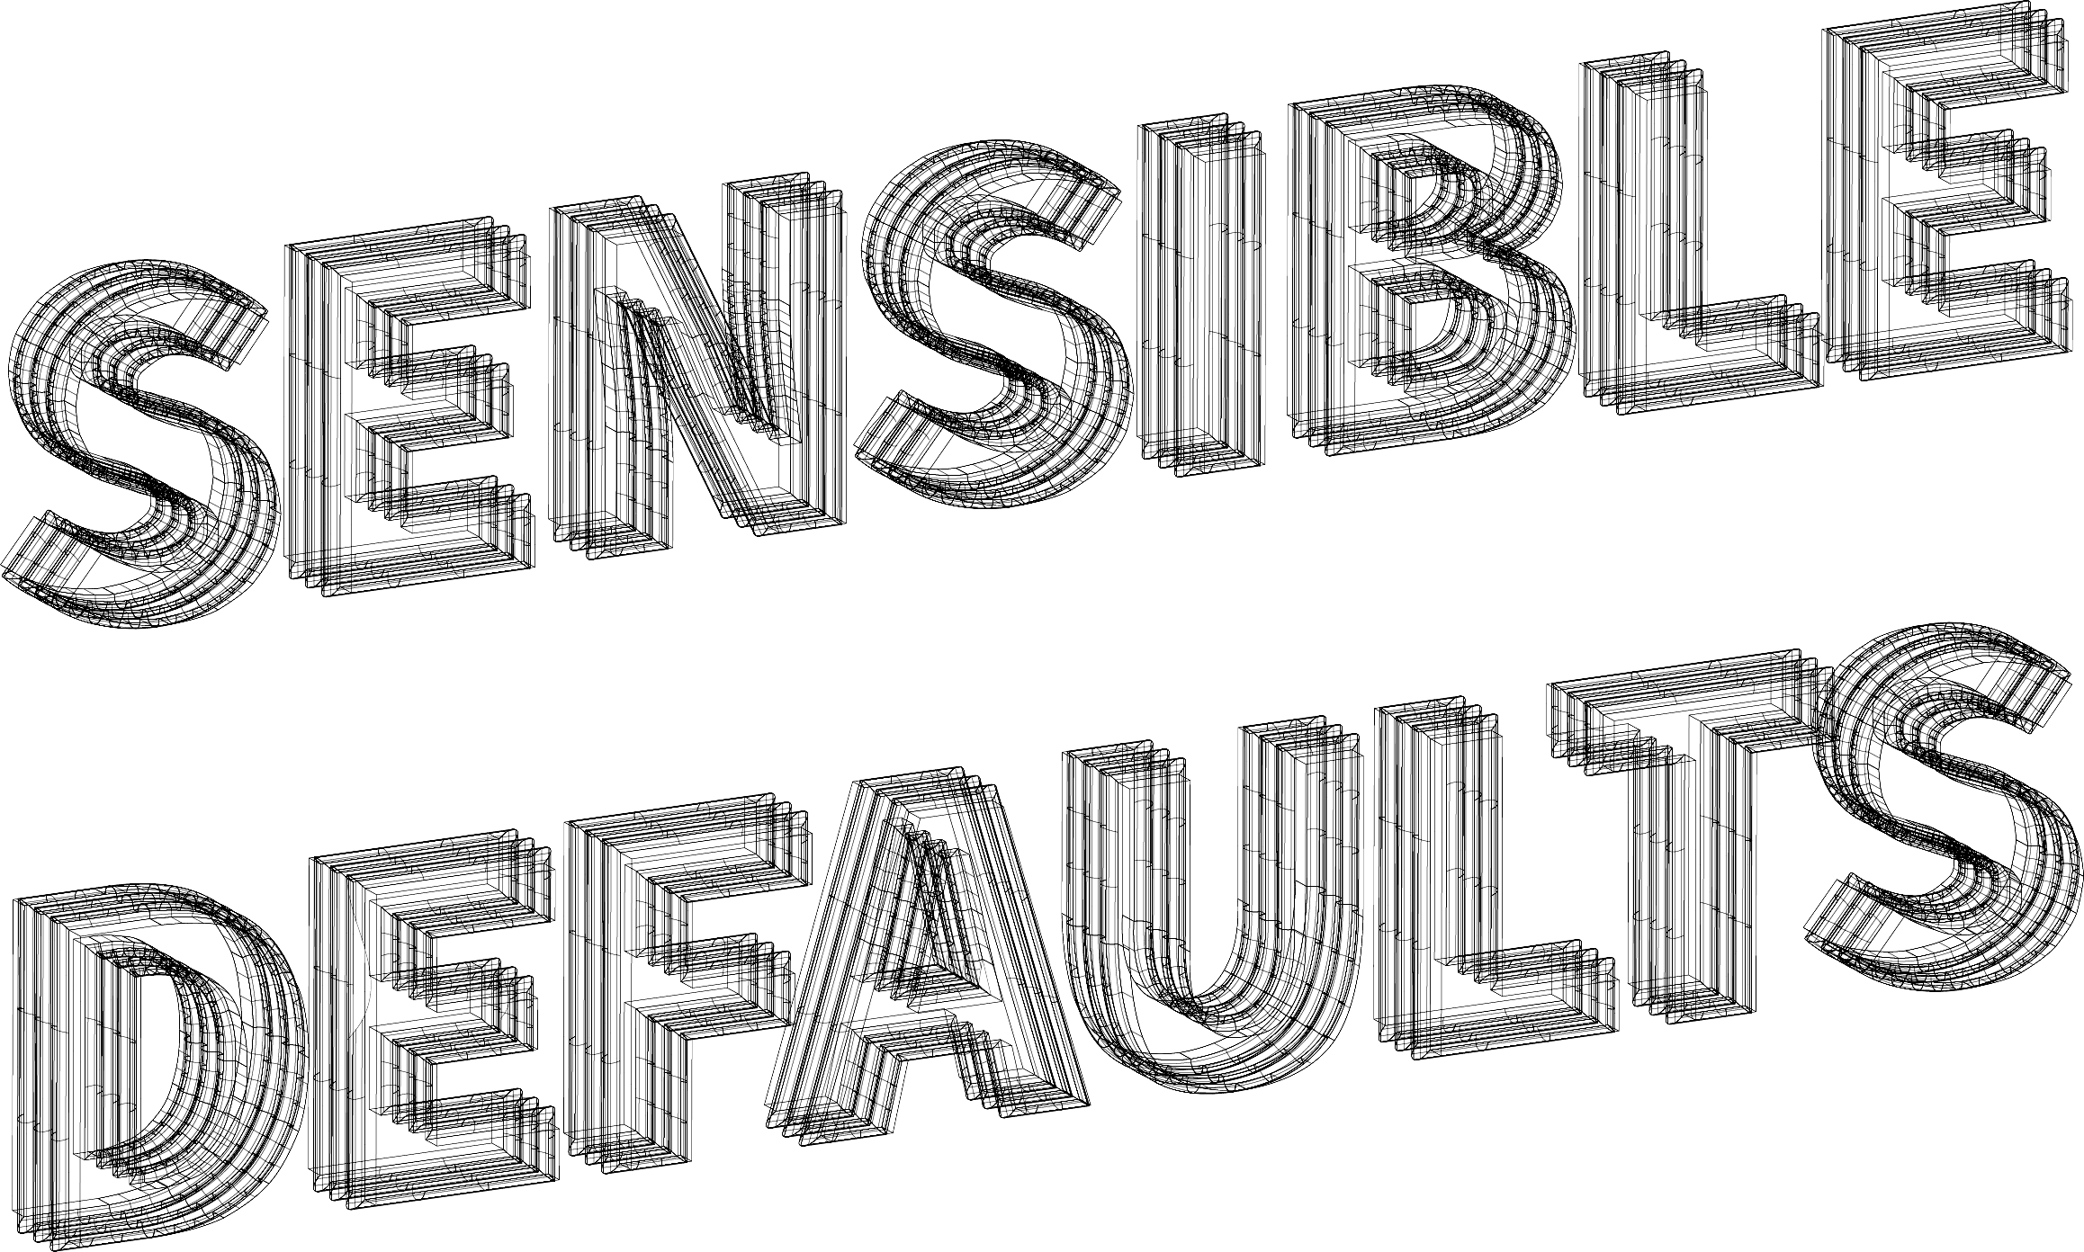
FIG. 2

Slide 7
What is a default?
Default values are standard values that... make [our project] as accessible as possible... without necessitating a lengthy configuration process
– Somebody on Wikipedia
https://en.wikipedia.org/wiki/Default_(computer_science)

Slide 8
Why “sensible” defaults?
Frivioulous defaults wouldn’t make much sense ;)
Reduce the congnitive overload of descision making
Set our projects up to be secure by convention

Slide 9
... even if those choices are both clear and useful, the act of deciding is a cognitive drain. And not just while [we]’re deciding... even after we choose, an unconscious cognitive background thread is slowly consuming/leaking resources, “Was that the right choice?”
– Kathy Sierra http://seriouspony.com/blog/2013/7/24/your-app-makes-me-fat

Slide 10
Beyond configuration
“Zero configuration” trend in the JavaScript world
We’re not there yet for security...
Is there such a thing as a style guide for security?

Slide 11
Make your own checklist
  Dependency management
  Content Security Policy
  Storing data locally
  Escaping

Slide 12

FIG. 3

Slide 13
If we’re standing on the shoulders of giants, we’d better measure them

Slide 14
How do we measure?
Use a package manager like npm so we have a manifest of dependencies and versions
Use metrics like how popular the library is and how often it receives updates https://npmcompare.com/

Slide 15
Finding the right balance
We don’t want our app to break from constant updates
We do want to get critical security updates
Right now this requires decision making squishy humans

Slide 16
Assisting the squishy humans with tooling
Automated regression tests so you can update with more confidence
Tools to check for outdated packages and known security vulns

Slide 17
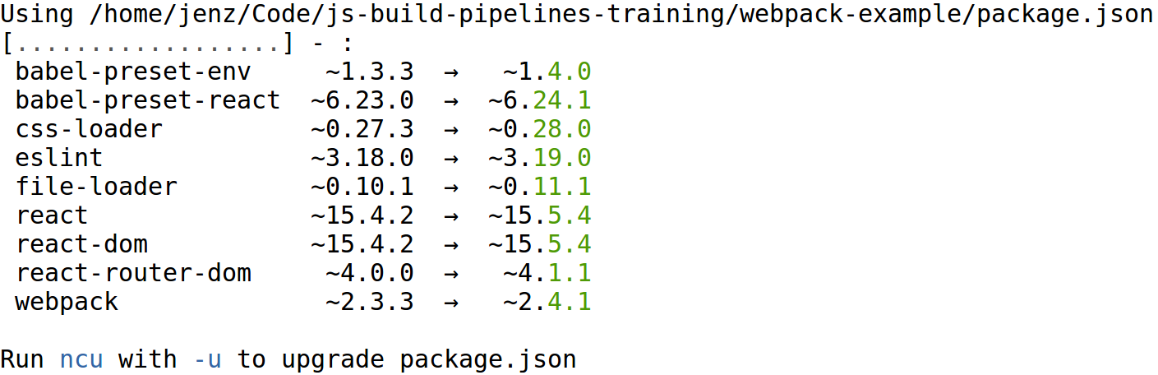
npm-update-checker

Slide 18
Retire.js
https://www.npmjs.com/package/retire
https://nodesecurity.io/advisories/
Alternative tools:
  nsp (free CLI tool)
  snyk (commercial only)

Slide 19
Enjoy the firehose of everything being awful
Once you’ve investigated a problem that a dependency has:
  Update to newer fixed version
  Or, avoid that dep altogether
  Or, document an exception in
  .retireignore.json if not relevant

Slide 20
Set up for easy use
  npm install --save-dev retire npm-check-updates
  "scripts": {
  "deps:check": "./node_modules/.bin/npm-check-updates && ./node_modules/.bin/retire",
  "deps:update": "./node_modules/.bin/npm-check-updates -u && npm install && ./node_modules/.bin/retire",

Slide 21
Verify CDN resources
With subresource integrity:
  <script src="https://code.jquery.com/jquery-3.2.1.min.js" integrity="sha256-hwg4gsxgFZhOsEEamdOYGBf13FyQuiTwlAQgxVSNgt4=" crossorigin="anonymous"></script>
Make your own: https://www.srihash.org/

Slide 22

FIG. 4

Slide 23
uh, isn’t that server-side?

Slide 24
yes, but

Slide 25
it strongly affects the client side

Slide 26
so f/e devs should both know and care about it

Slide 27
(it’s also your last line of protection against XSS)

Slide 28
Set up your CSP policy
Test during dev too – you don’t want a rude awakening later when stuff doesn’t work
Lock it down really hard to start with, and open it up later if it becomes absolutely necessary

Slide 29
In your server config
Apache
  Header set Content-Security-Policy "<stuff in here>"
nginx
  add_header Content-Security-Policy "<stuff in here>";

Slide 30
Suggested starter rules
default-src 'none';
script-src 'https://yourdomain';
connect-src 'https://yourdomain';
img-src 'https://yourdomain' data:;
style-src 'https://yourdomain';
font-src 'https://yourdomain';
object-src 'https://yourdomain';

Slide 31
CSP continued
IE doesn’t support it (properly) but Edge does
You can send reports of fails to a log
You can do legacy inline JS via nonces
Version 3 of the standard gives us some new fancy features

Slide 32
CSP resources
Reference guide:
https://content-security-policy.com
Chrome plugin for testing new policies against existing sites:
https://goo.gl/Nkghf5
Tool to evaluate your policy:
https://csp-evaluator.withgoogle.com

Slide 33

FIG. 5

Slide 34
User Sessions
Session cookies or JWT?

Slide 35
Session cookies
This form of auth has been around for ages.
It’s not bulletproof but its drawbacks are well understood.
Most frameworks implement this well.

Slide 36
Hands off the cookies
Assuming you have a backend handling auth, the client side has no need to access your sesssion cookies.
Make them HttpOnly

Slide 37
Secure all your cookies
Assuming your site is https (it is, right?) then you should always set the Secure flag to true
Consider setting hostOnly and domain as appropriate too, although these can be spoofed...

Slide 38
Better CSRF protection
There is a new flag that can more reliably (where supported) ensure cookies don’t get sent along with malicious requests:
  SameSite
  https://scotthelme.co.uk/csrf-is-dead/

Slide 39
JSON Web Tokens (JWT)
Recent-ish standard for representing a claim between two or more systems.
https://jwt.io/introduction

Slide 40
Although many of the early critical failures in JWT are fixed, it’s still new and not as well understood

Slide 41
JWTs are good as single use tokens https://goo.gl/qcJfDa

Slide 42
It’s a standard not a storage mechanism
Still need to choose a storage method:
localStorage
sessionStorage
as a cookie

Slide 43
JWT in localStorage
Token would persist until deleted (although hopefully you’d give it an expiry!)
You must make sure you use HTTPS
Only avaiable via same domain, but readable via JS === vulnerable to XSS

Slide 44
JWT in sessionStorage
This is the same as localStorage, except it would be cleared on the user closing the window
Still vulnerable to XSS

Slide 45
JWT in a cookie
If you make the cookie HttpOnly, much less vulnerable to XSS
You are vulnerable to cross domain attacks but these can be mitigated via CSRF token use
Much smaller storage area though

Slide 46
Stick with user sessions unless you have a specific need for JWT

Slide 47
Other User Data?

Slide 48
Things to consider:
Store locally, or on the server? Set it to expire or persist?
If locally, store in:
localStorage?
sessionStorage?
in a cookie?

Slide 49

FIG. 6

Slide 50
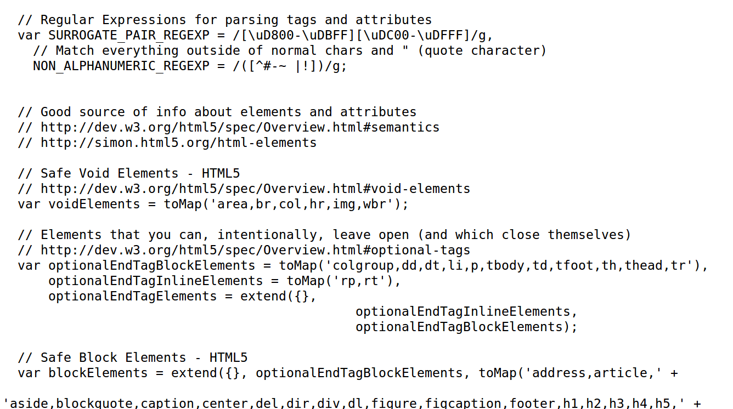
Don’t roll your own

Slide 51
Use your framework
For example, React escapes anything safely in a normal template {variable}.
But if you’re using dangerouslySetInnerHTML={}
then the clue is in the name that you need to pay more attention!

Slide 52
Make sure you’re escaped for the right context
Escaped for HTML != escaped for a HTML tag attribute
https://goo.gl/Zd1HQV

Slide 53

FIG. 7

Slide 54
_blank tabnapping
Do you link off to an external site, opening it in a new tab by setting target="_blank" ?
https://goo.gl/nu3oRK

Slide 55
Some (not all) mitigations
  <a
  href="http://site.com"
  target="_blank"
  rel="noopener noreferrer"
  >
  External link
  </a>

Slide 56
Code obfuscation
Don’t bother – serious attackers can overcome this easily

Slide 57
Avoid troublesome stuff
iframes
flash
java applets

Slide 58
Stay informed!
Keep reading, keep learning
Work with backend devs, ops people and testers to create applications that are secure across the whole attack surface

Slide 59
Thanks
@jenofdoom

