Slide 1
Beginners teaching beginners: learning R using meaningful data
Belinda Fabian
@beacurious
RLadies Sydney 1st Birthday
31 July 2019

Slide 2
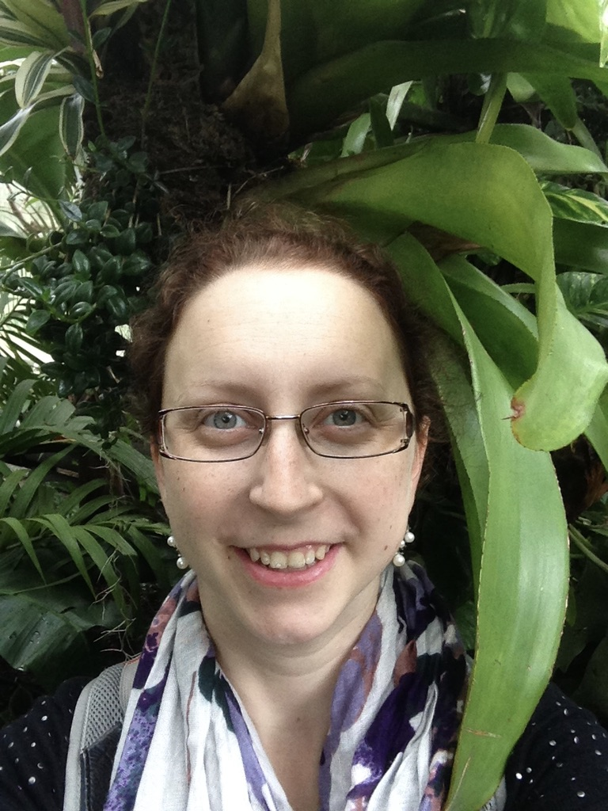
Context
Doing PhD in Microbiology & Genomics
Use R for visualisations & manipulating data
Still an R beginner
Love problem solving and a challenge
‘We can’t be the only ones wanting to do this’
‘Might not be the most elegant way, but it works’

Slide 3
NEW! Big Data Analysis and Synthetic Biology
~70 postgrads, 99% never coded before
Complement soil microbiome wet lab work
Make a figure for a poster assessment
Challenges:
10 hours of teaching
Have to teach all 70 students at once
Great freedom

Slide 4
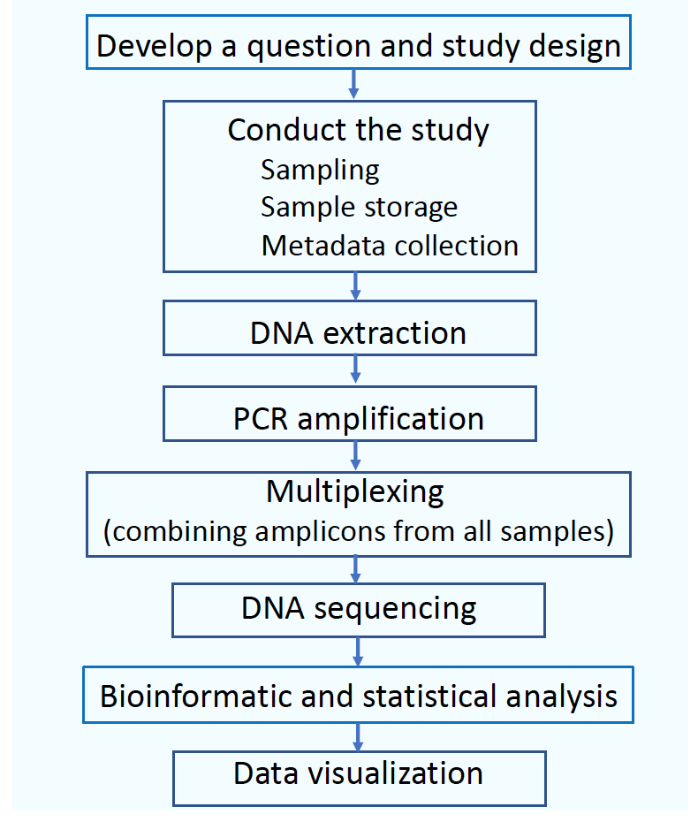
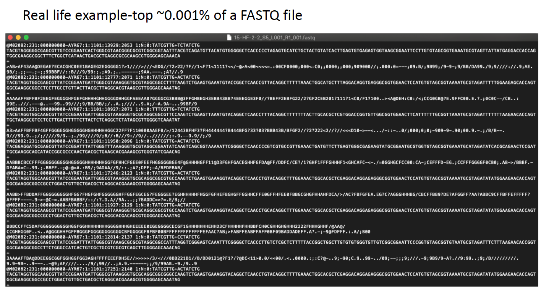
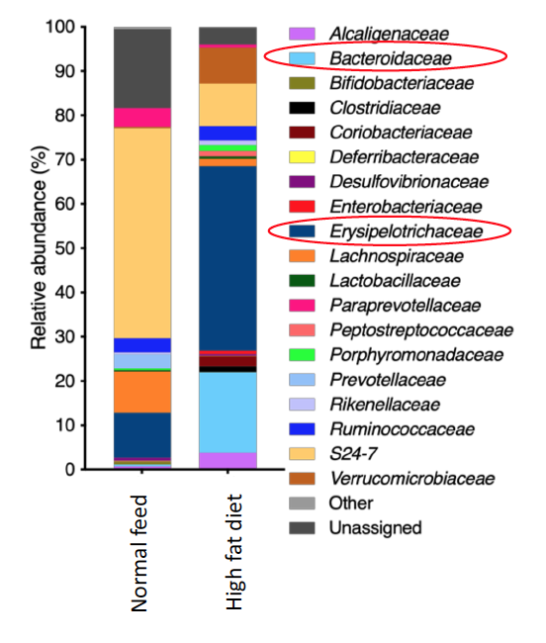
Microbiome experiment workflow
Wet lab work

Slide 5
Our approach
R ≠ abstract concept
Simplified existing microbiome data & created a metadata file
Use own laptops
Scripts + comments for students to follow
Walk through code in the workshop
Used post-it note method and floating helpers during workshop
8 hours of content, 2 hours of free-time with helpers

Slide 6
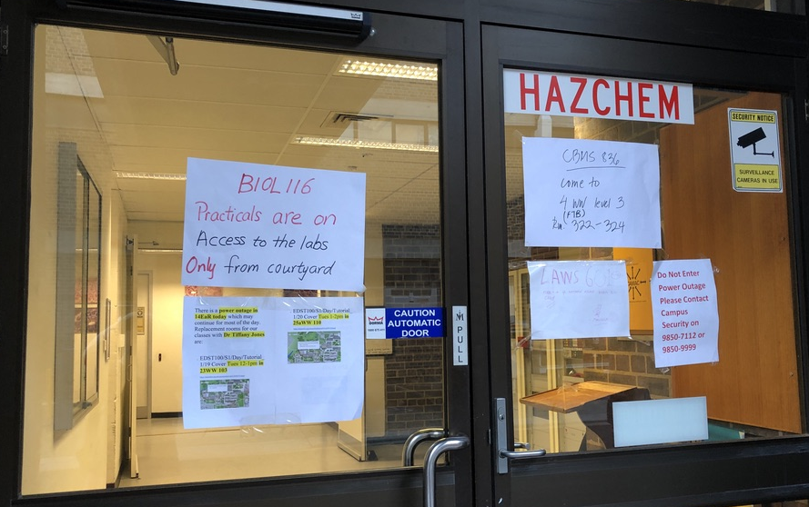
Speedbumps
1. Wet lab work
2. Sequencing
Teacher for sequencing data analysis away, so process out of order
Data analysis workflow was an abstract concept & hard to follow
Major blackout during the first R session
New cramped room not designed for teaching, started late, everyone flustered
3 helpers for 70 learners: not enough!
Wanted learners to use own computers, but a lot of support needed & some code varied between operating systems
3. Process sequence data
4. Create visualisation

Slide 7
Outcomes
Had to reign in our aspirations for what would be useful
All students had a figure on their poster & submitted their R script
A lot of the students didn’t grasp the overall picture of this as answering a research question
I had fun designing & running it!

