Slide 1
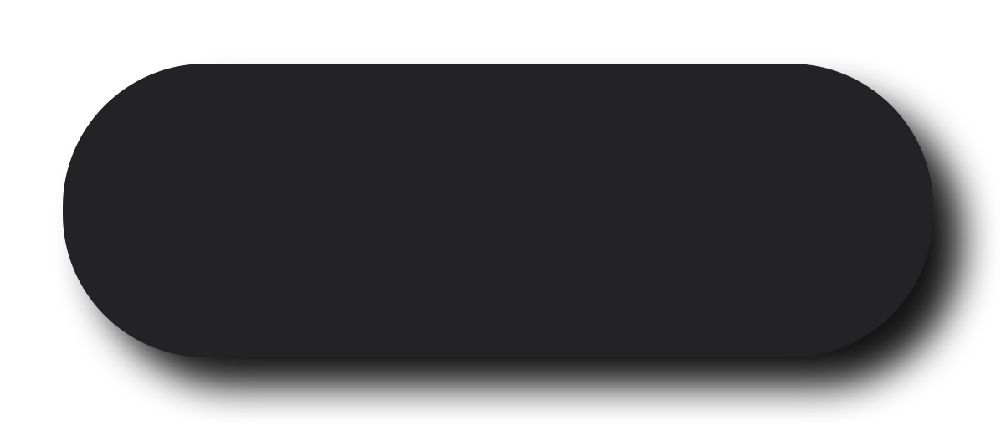
Device Overview
Design DIY Pedal Board
Jens goes mad

Slide 2
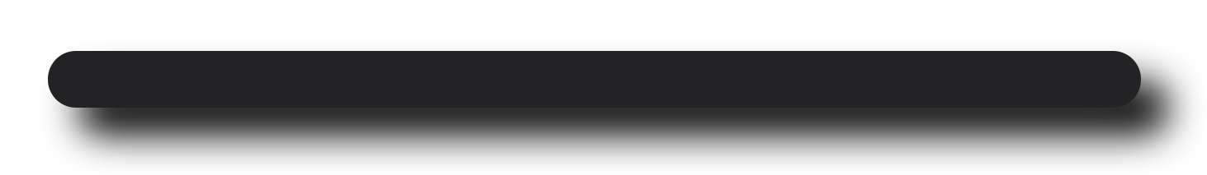
01
Standard
Simple Pedal board
02
7’’ Display
03
Piano Layout

Slide 3
01
Standard
02
7’’ Display
Adding 7’’ Touchscreen
03
Piano Layout
04
Future?

Slide 4
USB 2.0 / 3.0
NETWORK CAT5 / WLAN
MIDI IN - OUT - THRU
01
Standard
02
7’’ Display
03
Piano Layout
Button Piano Layout
04
Future?

Slide 5
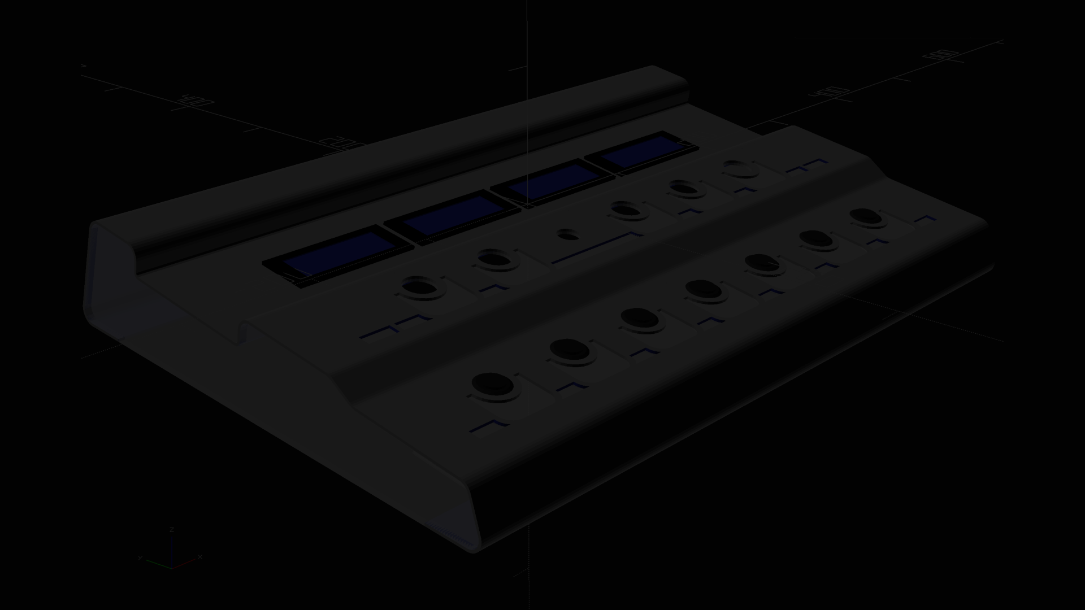
02
7’’ Display
03
Piano Layout
04
Future?
?

Slide 6
USB 2.0 / 3.0
NETWORK CAT5 / WLAN
MIDI IN - OUT - THRU
03
Piano Layout
04
Future?
05
Front view
Front
06
Rear view
07
MIDI

Slide 7
04
Future?
05
Front view
MIDI IN - OUT - THRU
NETWORK CAT5 / WLAN
USB 2.0 / 3.0
06
Rear view
Rear connections
07
MIDI
08
Network

Slide 8
05
Front view
06
Rear view
NETWORK CAT5 / WLAN
USB 2.0 / 3.0
MIDI IN - OUT - THRU
07
MIDI
Rear connections
08
Network
09
USB

Slide 9
06
Rear view
07
MIDI
MIDI IN - OUT - THRU
USB 2.0 / 3.0
NETWORK CAT5 / WLAN
08
Network
Rear connections
09
USB
10
!

Slide 10
07
MIDI
08
Network
MIDI IN - OUT - THRU
NETWORK CAT5 / WLAN
USB 2.0 / 3.0
09
USB
Rear connections
10
!
May the
pedal board
be with you!

Slide 11
USB 2.0 / 3.0
NETWORK CAT5 / WLAN
MIDI IN - OUT - THRU
08
Network
May the
pedal board
be with you!
09
USB
10
!
Jens-goes-mad

Slide 12
MIDI IN - OUT - THRU
NETWORK CAT5 / WLAN
USB 2.0 / 3.0
06
Birds view
Birds view

