Slide 1
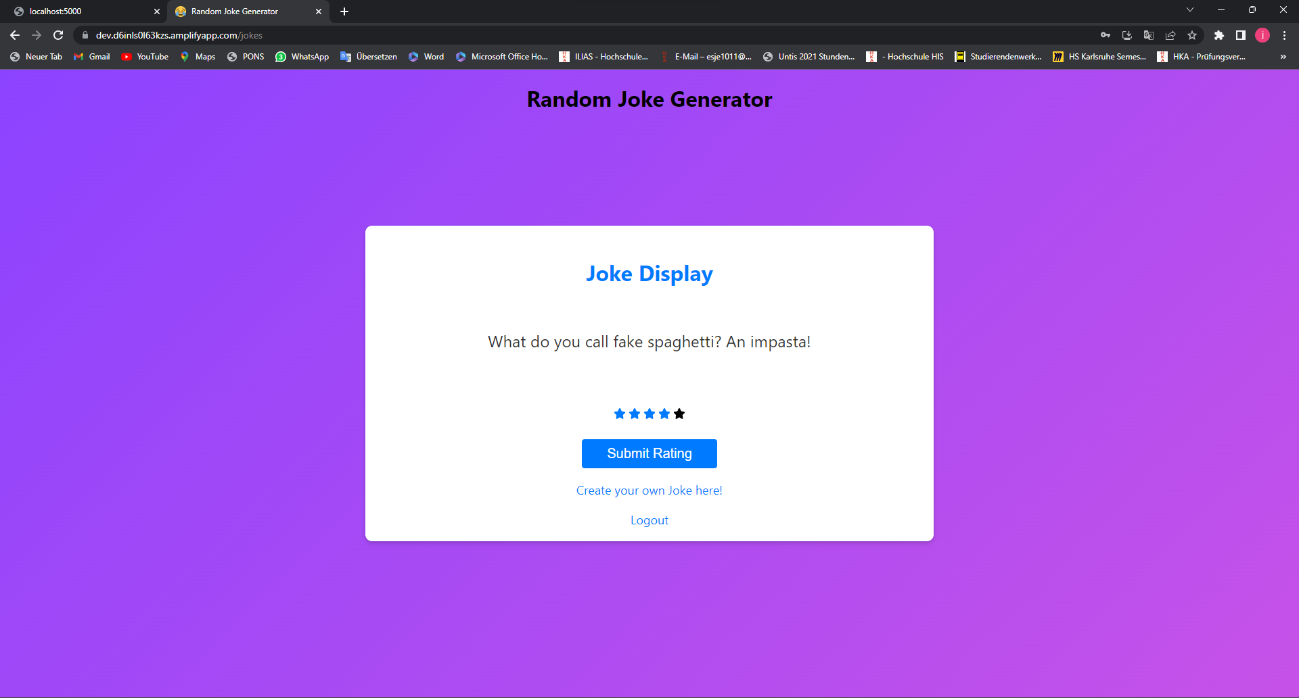

Slide 2
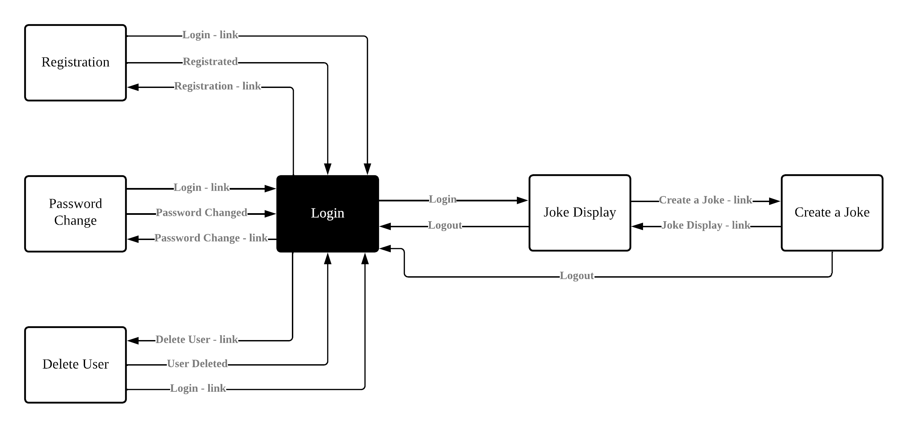
Website Structure

Slide 3
Communication Structure
Calls function
Passes required data
Passes SQL the statement
Passes required data
Website
Webserver
Database
hosted on aws
hosted on localhost
hosted on aws
Displays the Webpages and handles the Website functions
Handles the communication between Website and Database
Stores all the data and handles the access to it
Returns response from the database (json)
Responds to the given SQL statement

Slide 4
CRUD functions
Create
Read
Register a new user
Create a new joke
Rate a joke
Login
Validate user data for password change
Fetch a joke
Update
Delete
Change password
Delete a user

Slide 5
Live Demonstration
https://dev.d6inls0l63kzs.amplifyapp.com/

