Slide 1

Angular

Slide 2
What is Angular?
Front-end development framework to build single page applications (SPA’s)
Typescript
Component based
Large set of integrated libraries (routing, form management, http communication, etc…)

Slide 3
Main building blocks
Components
Services
Modules

Slide 4
Component
Angular application = tree of components
@Component decorator
Typescript class
Html template
Css/scss styling

Slide 5
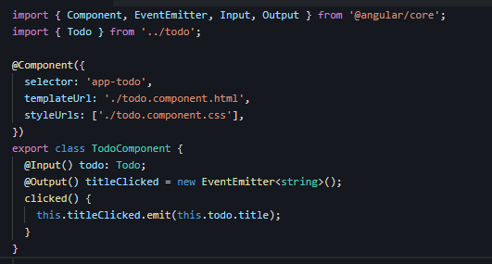

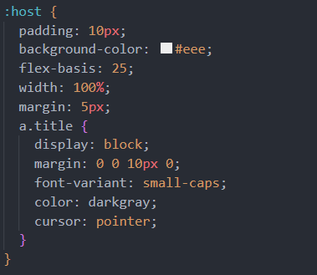

Component

Slide 6
Components
Root component
child component
child component
child component
grandchild component
grandchild component
grandchild component
…

Slide 7
Service
Dependency injection
@Injectable decorator
Share code
Testability
Decouple view logic (component) and other logic (service)

Slide 8
Services
Root component
Service 1
child component
child component
child component
Service 2
grandchild component
grandchild component
grandchild component
…
Service 3

Slide 9
Modules
NgModules != Javascript modules
Logic group of components, services, directives, etc
Group per feature, page, domain, etc
Lazy-loading

Slide 10
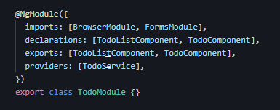
Modules
Declarations: The components, directives, and pipes that belong to this module.
Exports: Declarations that should be usable in the component in other modules.
Imports: Other modules from which the declarations are used in this model
Providers: Services (also available outside this module)
Bootstrap: Contains component that will get bootstrapped (root component).

Slide 11
Modules
Module 1
Module 2
Root component
Service 1
child component
child component
child component
Service 2
grandchild component
grandchild component
grandchild component
…
Service 3

Slide 12
Example
Basic example on Stackblitz

Slide 13
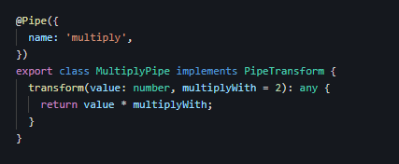
Pipes
@Pipe decorator
Function to transform data
Built in pipes: datePipe, uppercasePipe, currencyPipe,...
Custom pipes
Async pipe
Stackblitz examples

Slide 14
Directive
Attribute directive
Structural directive

Slide 15
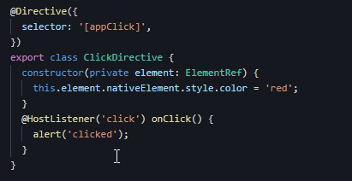
Attribute directive
@Directive() decorator
Add additional behaviour/styling to an existing element
No template file
Built in attribute directives: NgClass, NgStyle, ngModel, etc

Slide 16



Attribute directive
Built in attribute directives: ngClass, ngStyle, ngModel, etc

Slide 17

Structural directive
Directives that change the DOM
Built in structural directives: ngIf, ngFor, …
Shorthand is prefixed with *

Slide 18

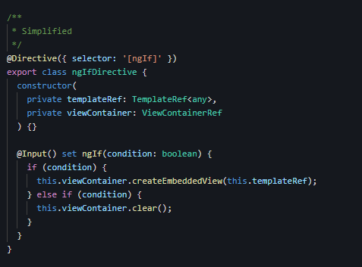
Structural directive
Behind the scenes

Slide 19
Forms
Template driven forms
Most suited for simple forms
Straightforward
No direct access to underlying form object model
Rely on directives in the template
Reactive forms
Direct access to underlying form object model
Scalable, reusable, and testable
Stackblitz example

Slide 20
Routing
Navigate between (parts of) pages in a SPA.
basic example
Example with guards
Example with nested routes
Example with lazy loading

Slide 21
HttpClient
Communicate with server over http
Sends http requests
Converts response in observable
Stackblitz example

Slide 22
Example
Github link

