Slide 1
Odometry
move_base
Localisation
Transformations
Velocity commands
Sensor data
Map

Slide 2
move_base
Map
global_costmap
global_planner
Localisation
Sensor data
recovery_ behaviour
Transformations
Velocity commands
local_costmap
local_planner
Odometry

Slide 3
Map server
Transformations
Adaptive Monte Carlo Localisation
move_base
Commands translator
ESC + Steering servo
LiDAR-sensor
Hectormapping

Slide 4
move_base
global_planner
global_costmap
recovery_
behaviour
Sensor
data
local_planner
local_costmap

Slide 5
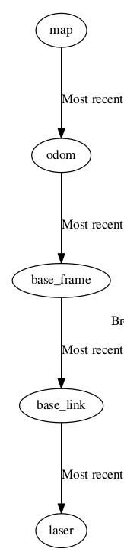
laser
tf
base_link
map
tf
amcl
base_frame
odom
hector_odom

Slide 6
laser
tf
laser
base_link
base_frame
base_link
map
a
b
c
map
odom
tf
amcl
d
base_frame
odom
hector_odom

Slide 7
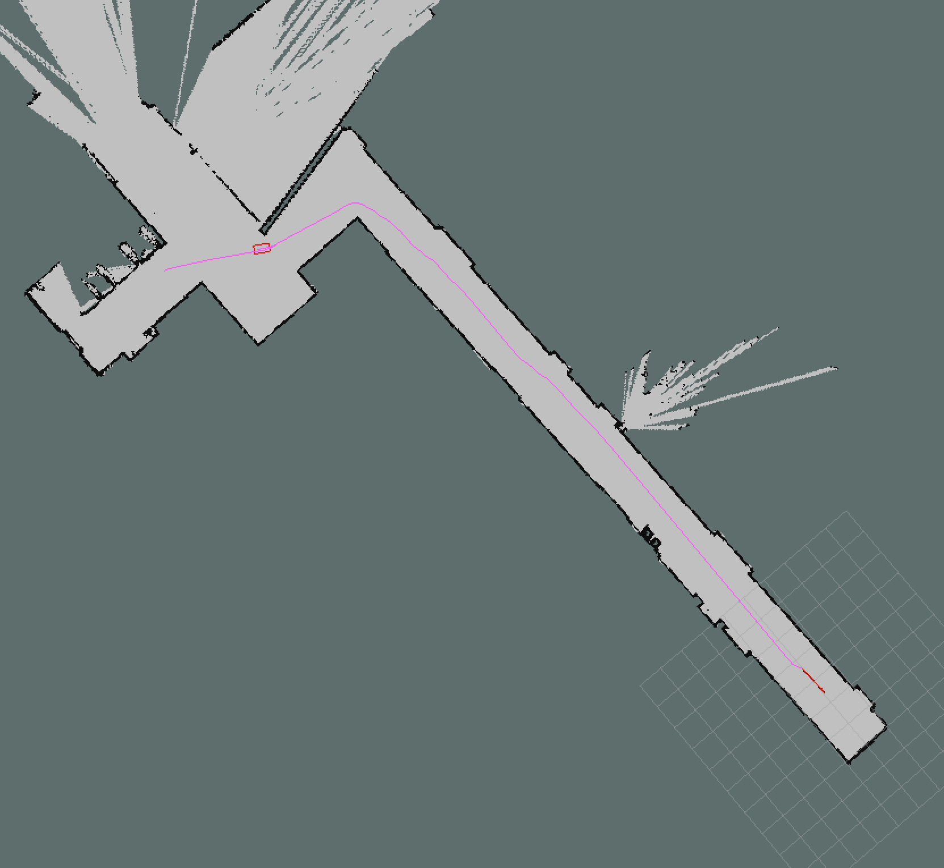

Slide 8
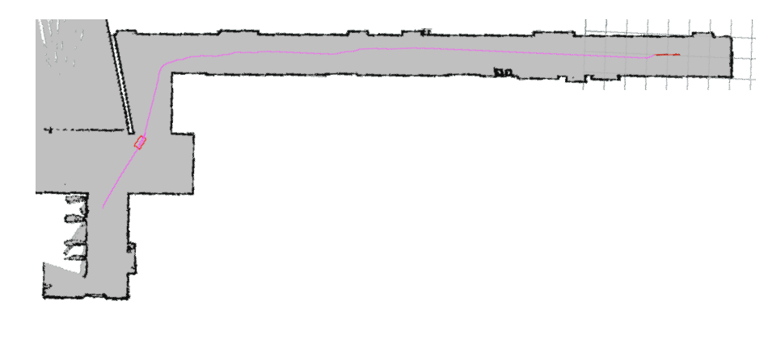

Slide 9
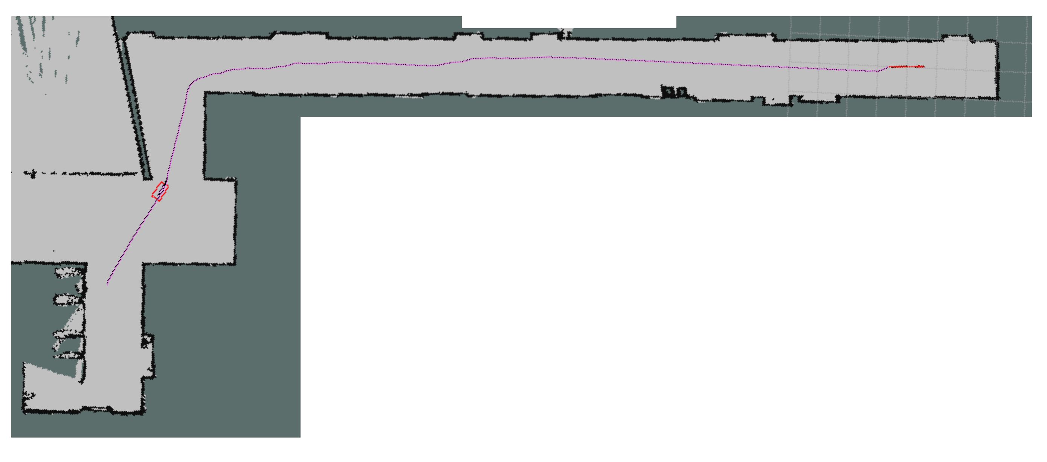
a
b

Slide 10
