Slide 1
Odometry
move_base
Localisation
Transformations
Velocity commands
Sensor data
Map

Slide 2
move_base
Map
global_costmap
global_planner
Localisation
Sensor data
recovery_ behaviour
Transformations
Velocity commands
local_costmap
local_planner
Odometry

Slide 3
move_base
global_planner
global_costmap
recovery_
behaviour
Sensor
data
local_planner
local_costmap

Slide 4
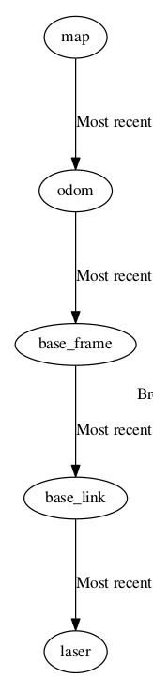
laser
tf
base_link
map
tf
amcl
base_frame
odom
hector_odom

Slide 5
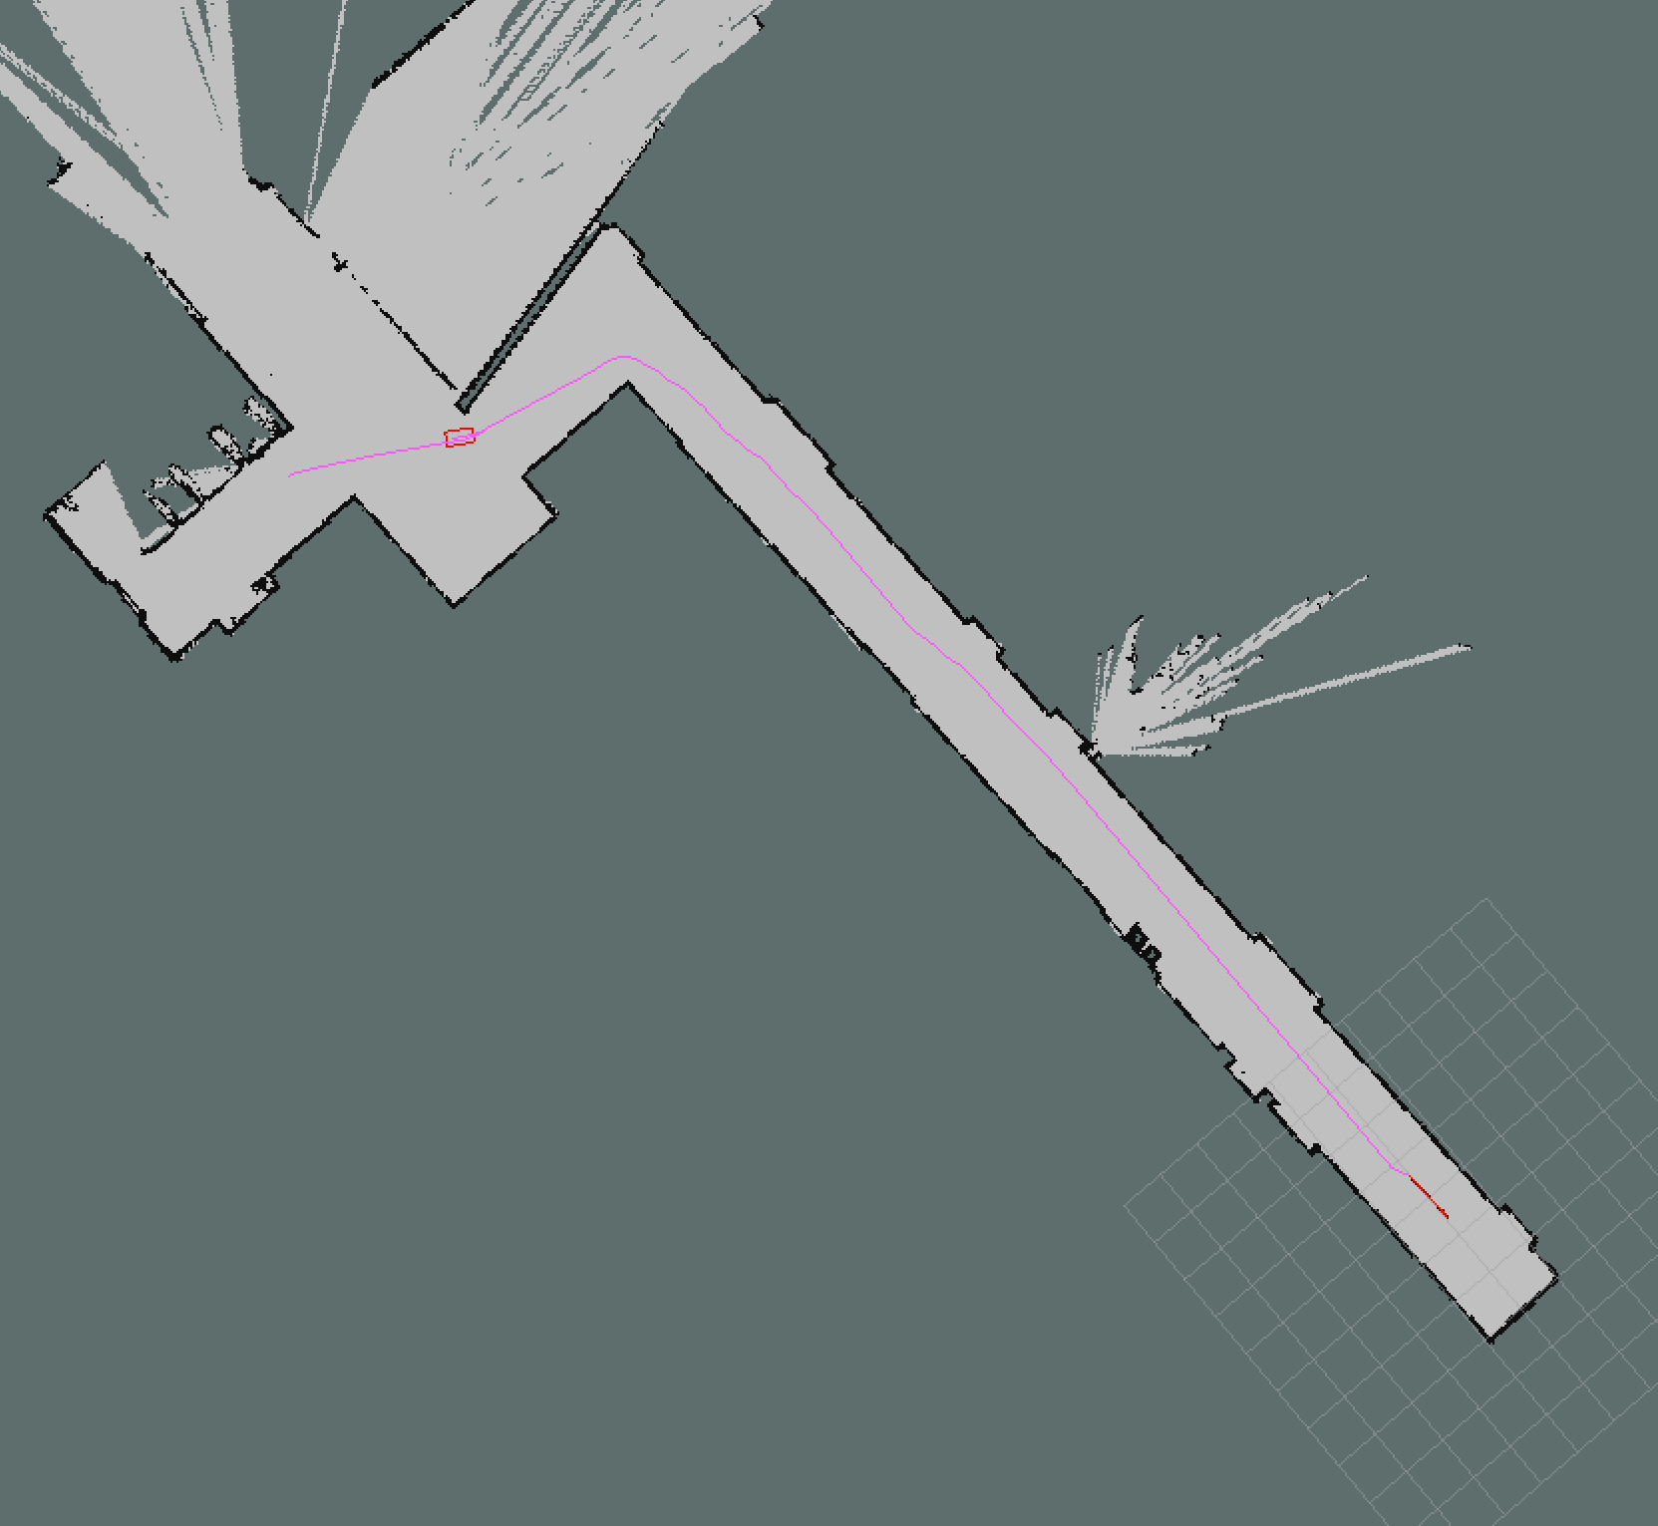

Slide 6
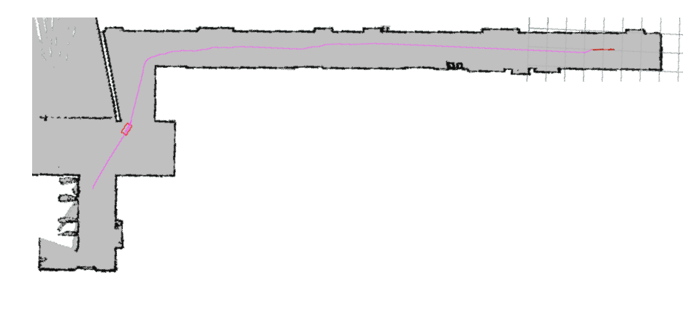

Slide 7
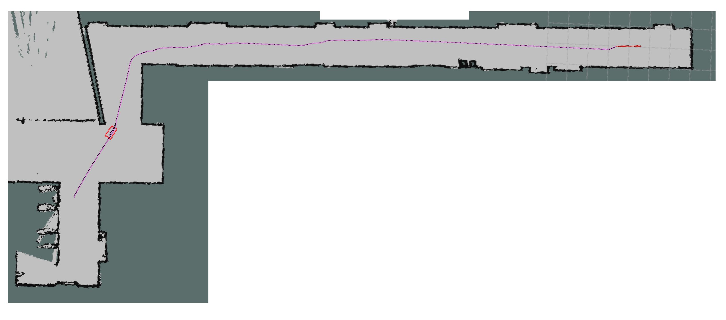

Slide 8
