Slide 1
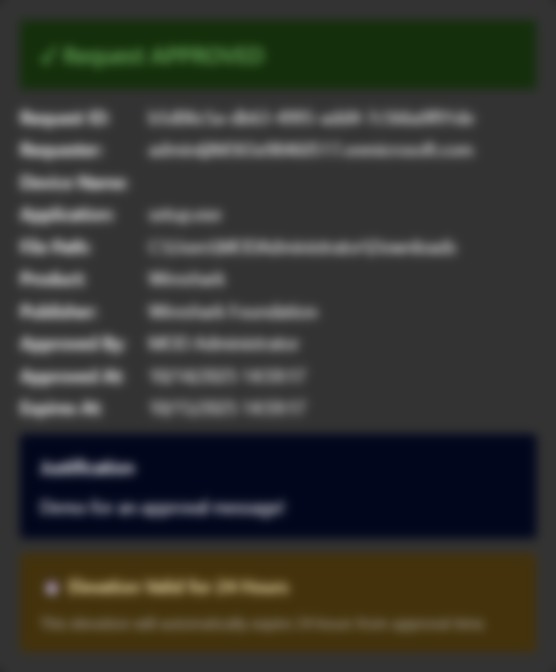
EPM Approval Workflow
Logic App with Teams Integration
Notes:
Login to Intune, Teams, Windows365 and Azure beforehand for demos!
How to create a Logic App with Adaptive Cards to get EPM Support-Approved Elevations in Teams
How to automate a deployment through Bicep with Azure CLI
The architecture and different components needed and their purpose

Slide 2
Agenda
Concept
Components
Why this approval flow?
Features
Deployment
Demo
Q&A

Slide 3
Concept
Logic App (Recurrence Trigger - every 5 minutes)
|
|-──> GET Microsoft Graph API
| /deviceManagement/elevationRequests
|
|──> Filter requests with status = "supportApproved"
|
|──> For each approved request:
| |──> Post Adaptive Card to Teams channel
| |──> Approve button
| |──> Deny button
|
|──> When button clicked:
|──> PATCH elevation request via Graph API

Slide 4
Architecture
Logic App (Recurrence Trigger - every 5 minutes)
|
|-──> GET Microsoft Graph API
| /deviceManagement/elevationRequests (EPM)
|
|──> Filter requests with status = "supportApproved"
|
|──> For each approved request:
| |──> Post Adaptive Card to Teams channel
| |──> Approve button
| |──> Deny button
|
|──> When button clicked:
|──> PATCH elevation request via Graph API

Slide 5
Components
Logic App
Microsoft Graph API
Endpoint Privilege Management
Adaptive Card
Microsoft Teams

Slide 6
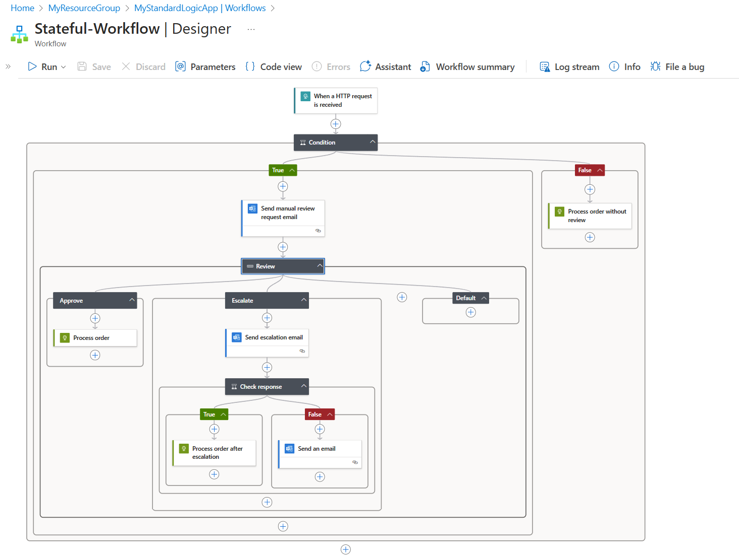
Components
Logic App
Microsoft Graph API
Endpoint Privilege Management
Adaptive Card
Microsoft Teams

Slide 7
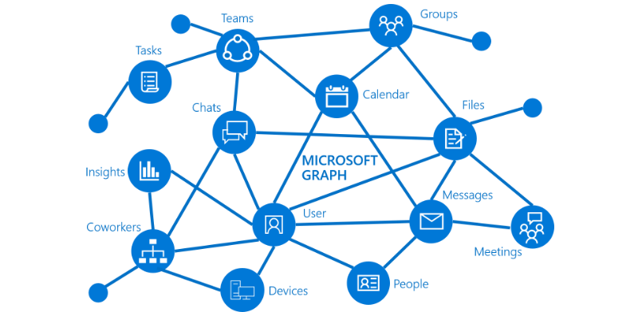
Components
Logic App
Microsoft Graph API
Endpoint Privilege Management
Adaptive Card
Microsoft Teams

Slide 8
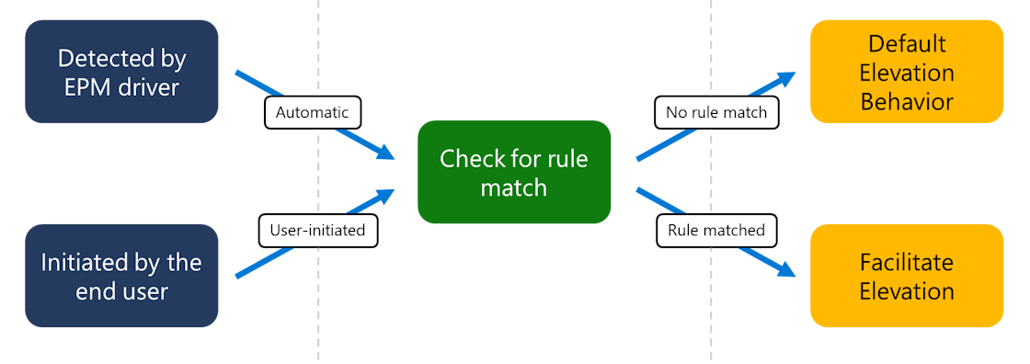
Components
Logic App
Microsoft Graph API
Endpoint Privilege Management
Adaptive Card
Microsoft Teams

Slide 9
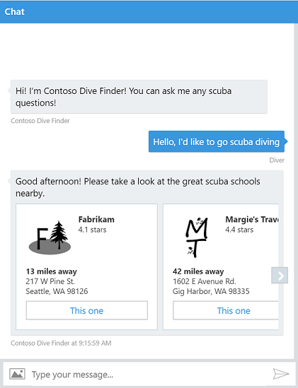
Components
Logic App
Microsoft Graph API
Endpoint Privilege Management
Adaptive Card
Microsoft Teams

Slide 10
Hidden components
Managed Identity
Teams API Connection
Log Analytics (Optional)

Slide 11
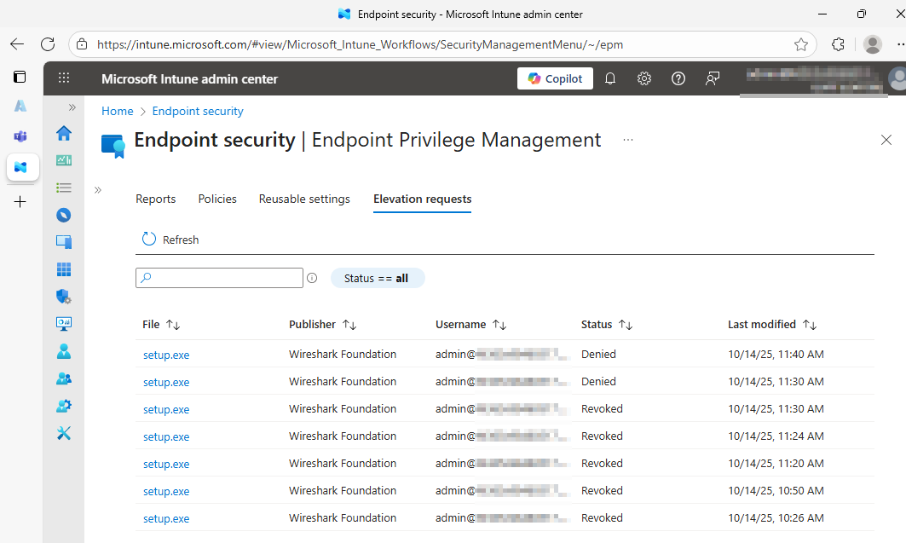
Why this approval workflow?

Slide 12
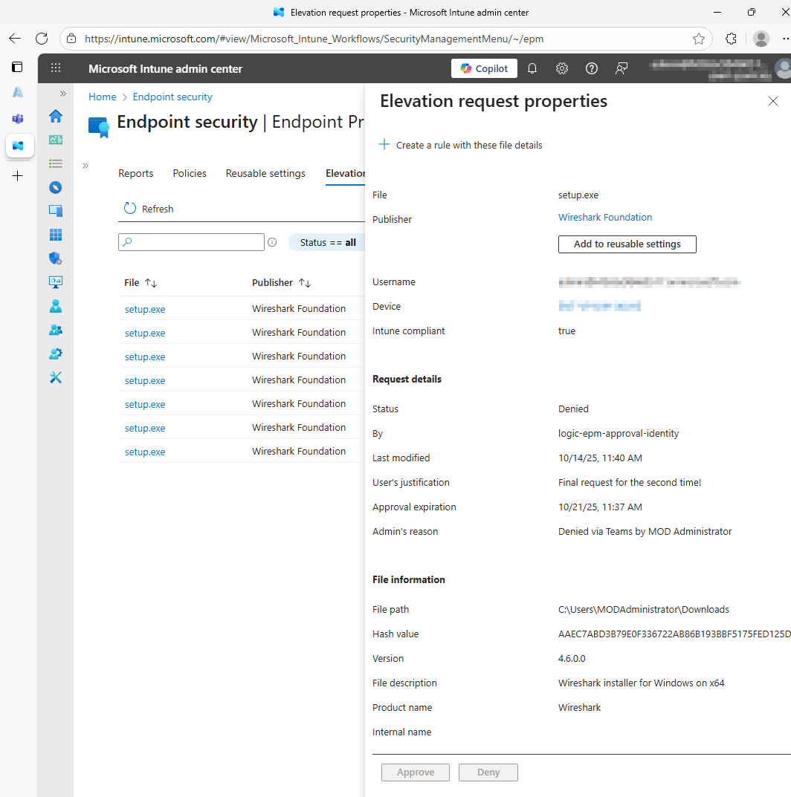
Why this approval workflow?

Slide 13
Features
(Automated) Polling: Checks for new EPM elevation requests every 5 minutes
Teams Integration: Posts Adaptive Cards with rich request details
One-Click Approval: Approve or deny requests directly from Teams
Managed Identity: Secure authentication to Microsoft Graph API
Least Privilege: Uses minimal required Graph API permissions
Monitoring: Integrated diagnostics with Log Analytics (Optional)
Secure by Design: No secrets stored, outputs secured

Slide 14
Deployment
Create a User-Assigned Managed Identity
Assign Microsoft Graph API Permissions to the Managed Identity
Create the Logic App
Assign the Managed Identity
Create a Teams API Connection
[Optional] Configure Diagnostics

Slide 15
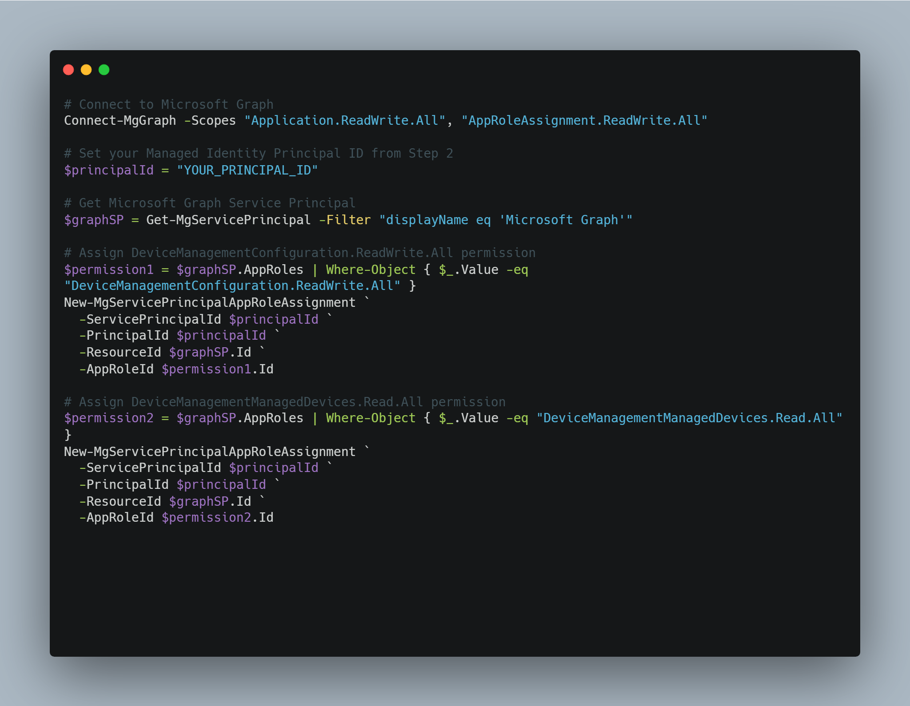
Assign Microsoft Graph API Permissions to the Managed Identity

Slide 16
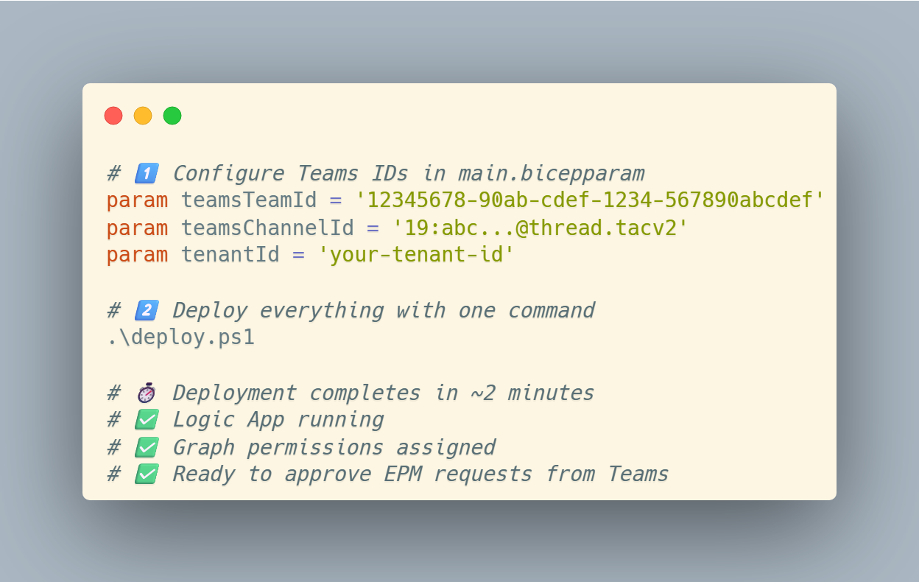
Automating the deployment – Bicep!
Task | Manual | Bicep
Steps Required | 10+ manual steps | 1 command
Time to Deploy | 20-30 minutes | 2 minutes
Error Prone | High (copy/paste IDs) | Low (validated)
Repeatable | No | Yes

Slide 17
Demo
Create an EPM elevation request in Intune that requires approval
Wait up to 5 minutes for the Logic App to run
Check your Teams channel for the Adaptive Card
Click Approve or Deny to test the workflow
Verify the request status updates in Intune

Slide 18
Cost Estimate
Resource | Pricing Tier | Usage Pattern | Monthly Cost
Logic App | Consumption (Pay-per-execution) | Runs every 5 minutes = ~8,640 executions/month | ~$0.50
Managed Identity | User-Assigned | Always included | $0 (Free)
Teams API Connection | Standard | Included with M365 | $0 (Free)
Log Analytics (Optional) | Pay-per-GB ingestion | ~500 MB/month logs | ~$2-5
Without Diagnostics: ~$0.50/month
With Diagnostics: ~$2.50-$5.50/month

Slide 19
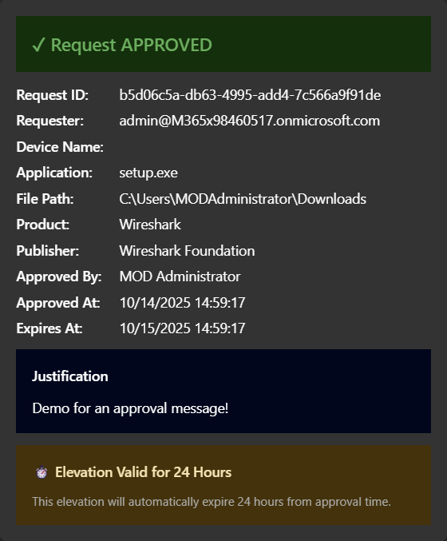
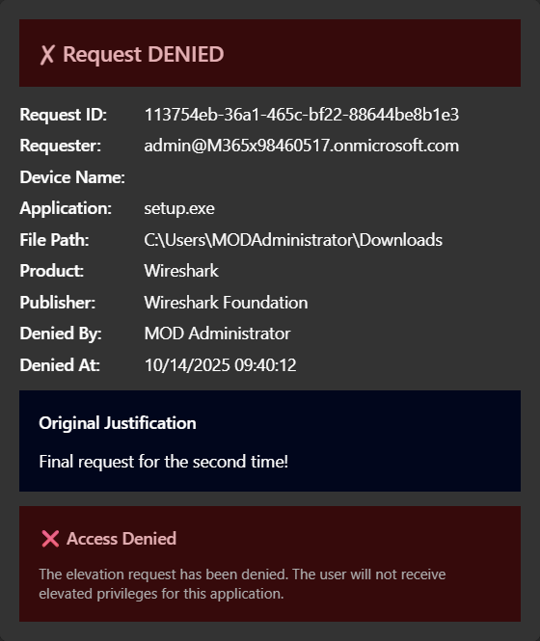
What’s next?
Send the notifications to a pre-defined group
Kinda like Alerts no?
Convince PG to have me implement this awesome feature!
Always open for Feature Requests!

Slide 20
Q&A

Slide 21
We would love to hear your feedback!

Slide 22
Thank You!

