Slide 1

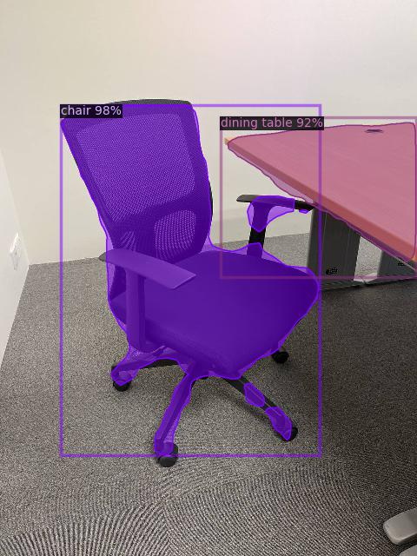

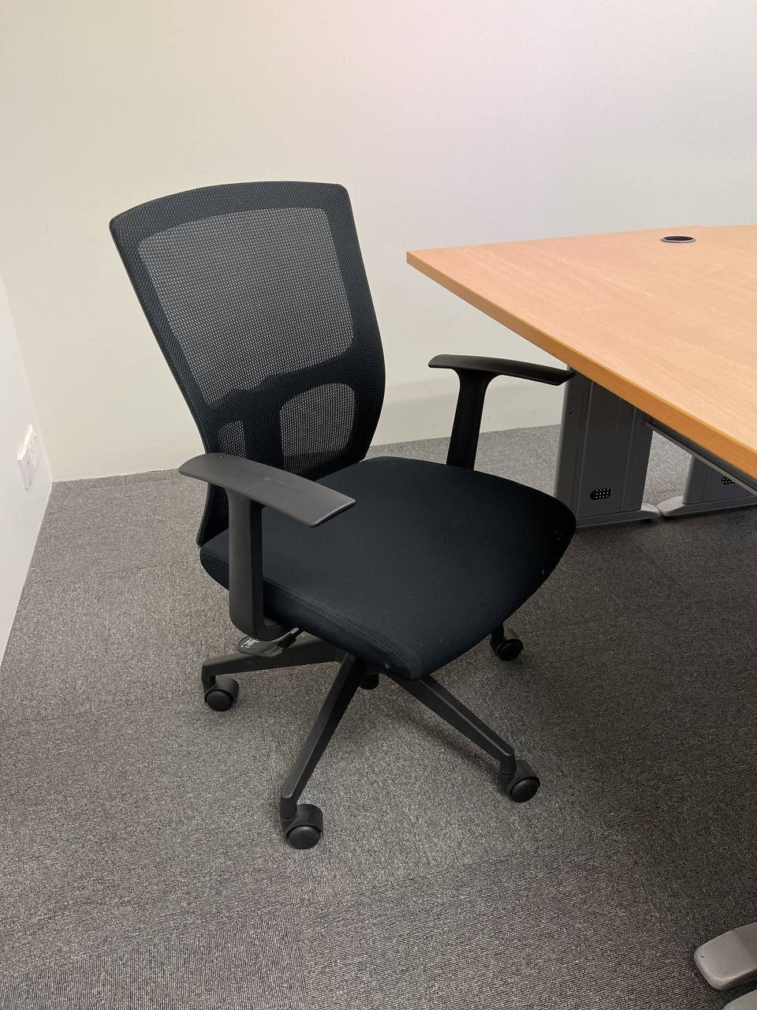






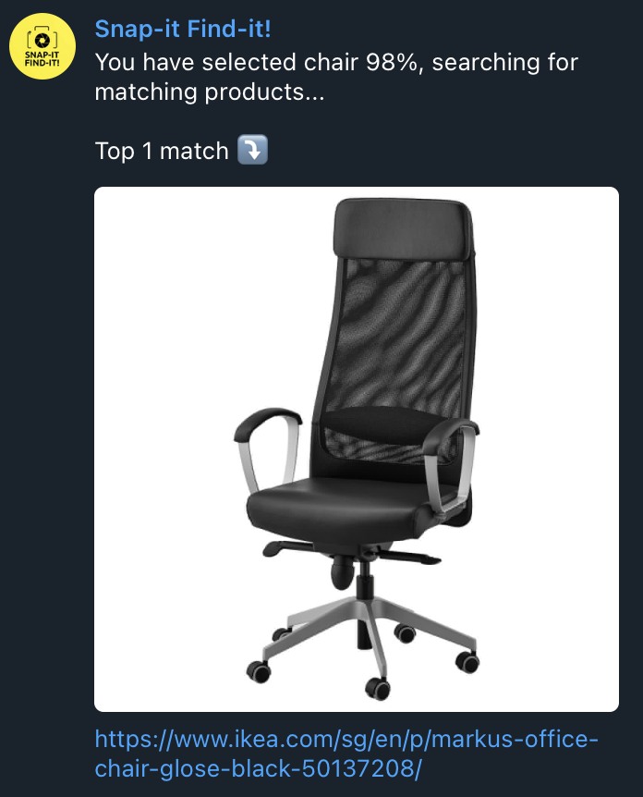

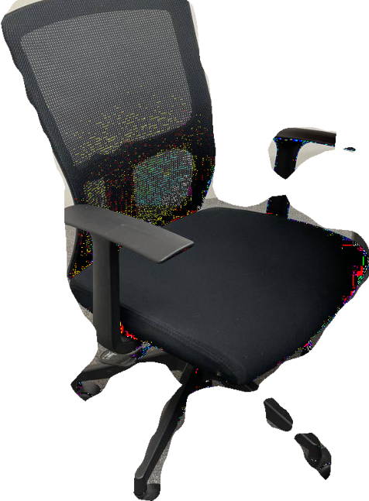

I’m looking to buy a chair like this!
Take a
photo
Upload
photo
Identify
object
User select object
IKEA
HIPVAN
Background
removal
Return top
matching
product
Extract feature &
search in database

