Slide 1
OM 420 Presentation
By: Jensen Khemchandani & Kevin Quach

Slide 2

The Dataset
Daily and Total statistics for COVID19 for each Province in Canada by date.
Date range (Jan. 2020 - Apr. 2022)
Notable Columns:
Daily/total cases
Daily/total tests
Daily/total recovered
Daily/total active cases
Daily/total deaths
Daily/total hospitalizations
Daily/total vaccinations
Link to the dataset: Provincial Daily Totals | Provincial Daily Totals | COVID-19 Canada (arcgis.com)

Slide 3
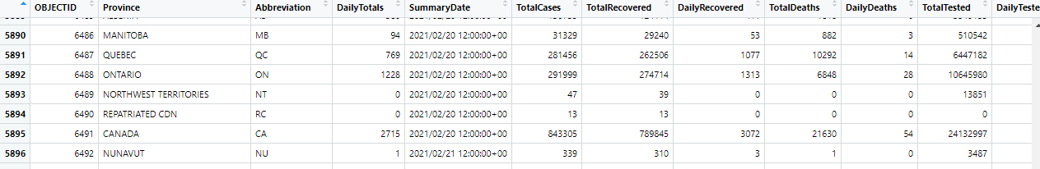
The Dataset

Slide 4

Our Approach
Cleaning the data
Remove/filter out uninformative rows
Date ranges
Rows where data was unavailable or inaccurate
Remove/separate outliers
Territories vs Provinces
Converted column types for data processing
Investigated the data
Discover inconsistencies
Discover overall trends in the data
Find interesting things about the data
Create prediction models for the data

Slide 5

Interesting Finding #1
Investigated overall trends in the data during the holiday months (Dec - Feb)
Noticed that:
Daily totals seemed to be much higher during these months than during the rest of the year for both 2021 and 2022
Compared our findings during these months with the average daily totals for the entire 2021 year.

Slide 6
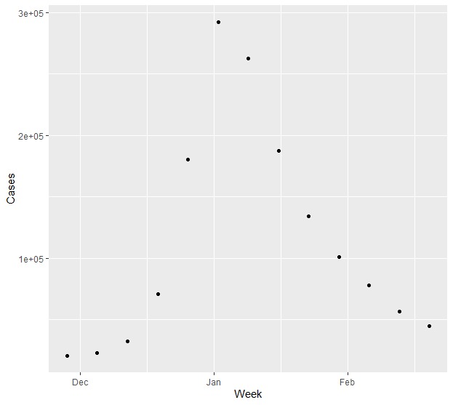
Interesting Finding #1
Total new cases in the country grouped by week for the 2021 holiday months (Dec-Feb)

Slide 7
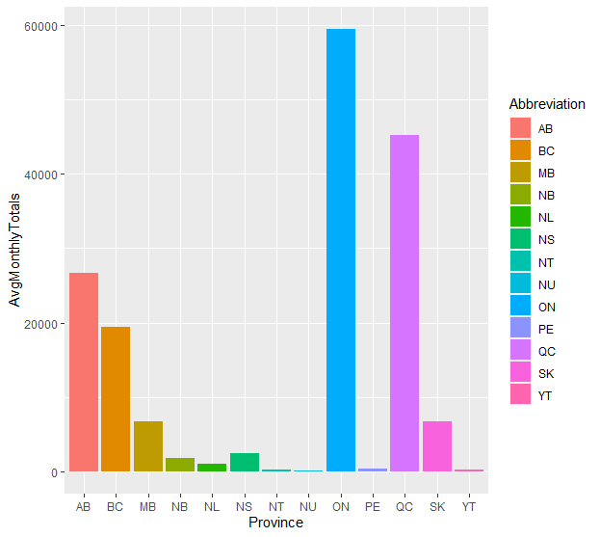
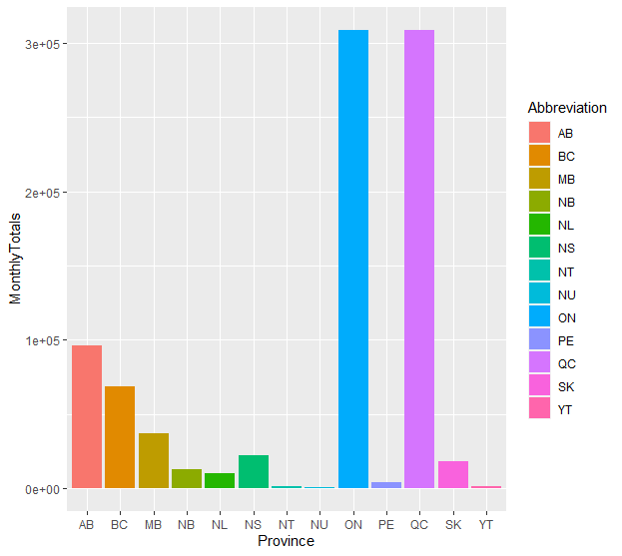
Interesting Finding #1
2021-2022 Monthly Average
January 2022
A comparison of monthly COVID cases for each province between January 2022 and the full 2021-2022 year

Slide 8
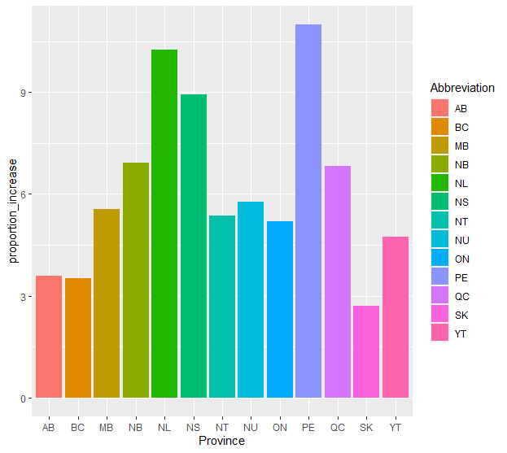
Interesting Finding #1
A visualization of the proportion of the increase in cases for each province recorded during January 2022, vs the average of the 2021-2022 calendar year.

Slide 9

Interesting Finding #2
Investigated overall differences between provinces with regards to recorded vaccination related data during the periods that vaccinations were available.
Noticed that:
Certain provinces seemed to record higher vaccination rates than others
Territories data was much more inconsistent than provinces
Different provinces vaccinated at different rates throughout the pandemic
Compared our findings using ‘per-capita’ metrics, since each province/territory has wildly different populations.

Slide 10
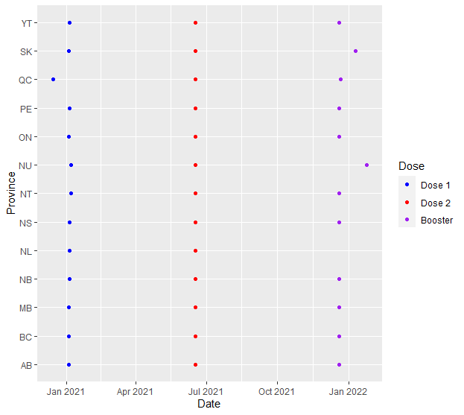
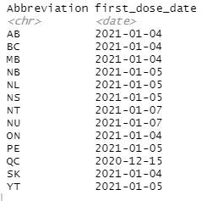
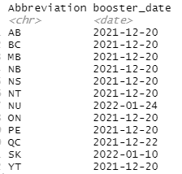
Interesting Finding #2
Firstly, we investigated the first reported vaccination for each province, additionally grouped by the type of ‘dose’.

Slide 11
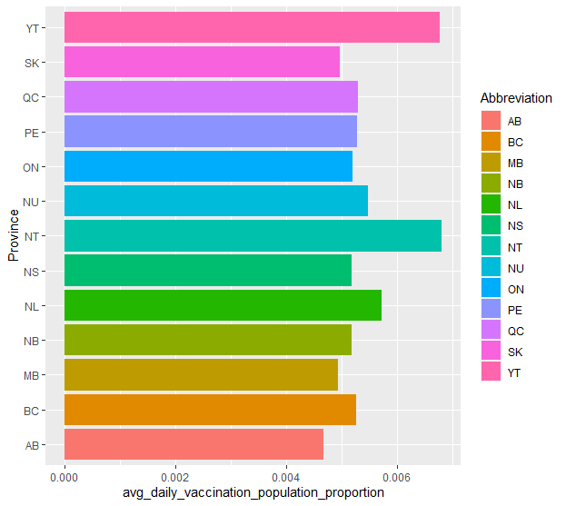
Interesting Finding #2
Proportion of the population of each province that, on average, was getting vaccinated each day during the pandemic.
Population data was retrieved from this source.

Slide 12
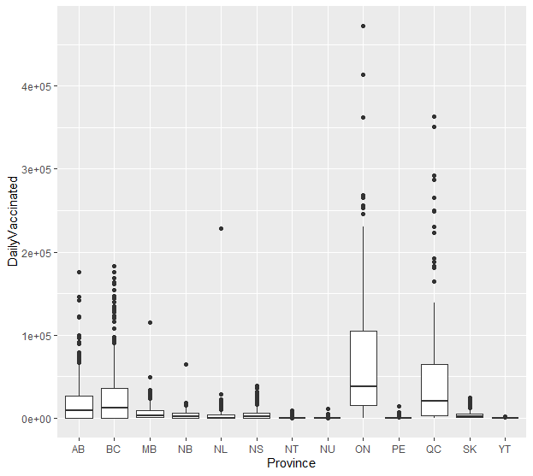
Interesting Finding #2
Boxplot showing the daily vaccination counts for each Province

Slide 13
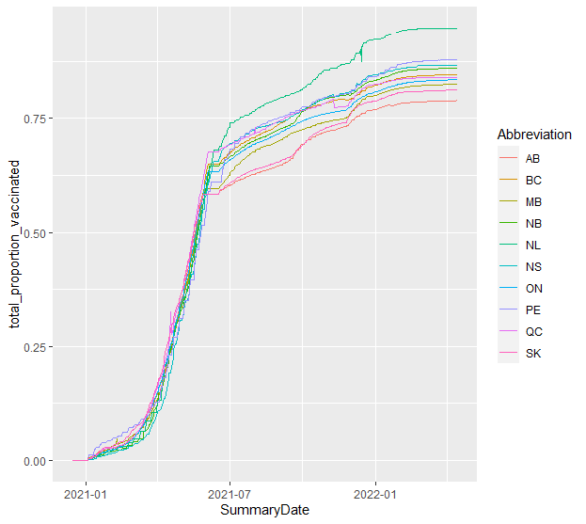
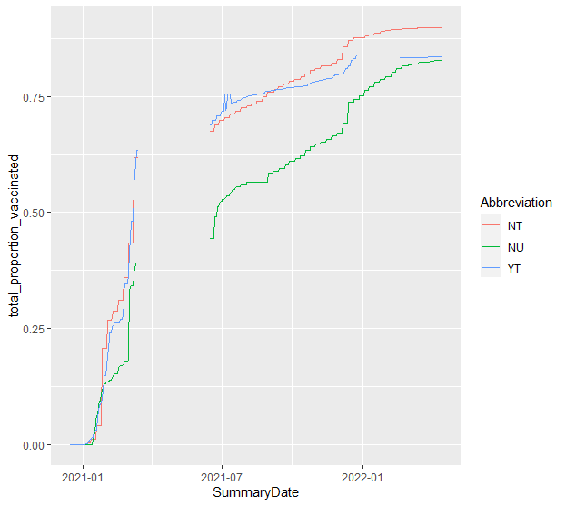
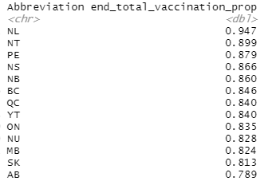
Interesting Finding #2
Provinces isolated
Territories isolated
Line graphs for the proportion of the population of each province/territories that had at least one vaccination over the course of the pandemic.

Slide 14
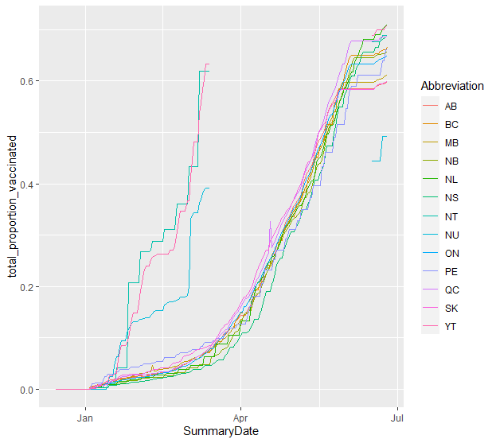
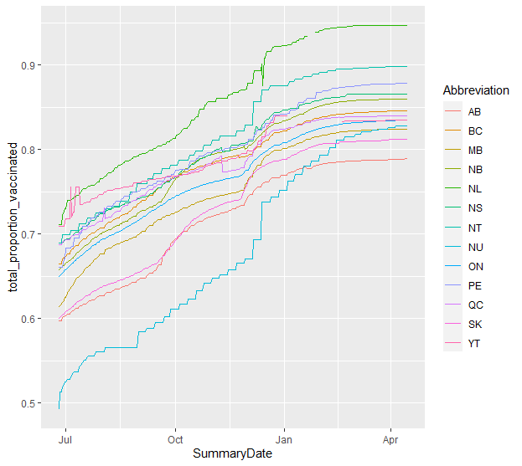
Interesting Finding #2
Jan 2021 - July 2021
July 2021 - Apr. 2022
Same plot as before (both provinces and territories this time), but split by time frame

Slide 15

Objective
To predict the Province with a given set of daily and total columns from the data set via classification methods.
The following columns (and subsets of) were used during model building
DailyTotals
DailyTested
DailyRecovered
DailyActive
DailyDeaths
DailyHospitalized
TotalDeaths
TotalCases
TotalRecovered
TotalTested
TotalHospitalized
Territories were not included in the models due to lack of data points and overall inconsistencies in the data.

Slide 16
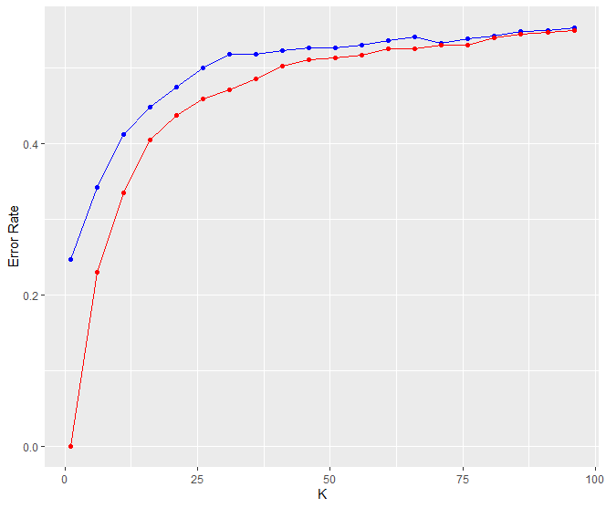
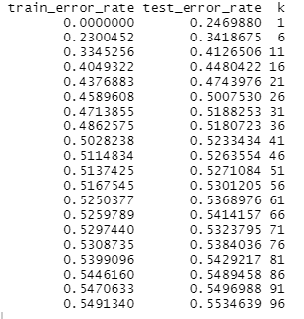

KNN
*All columns from the Objective slide were used to create the following plot(s)
Trained a sample of the dataset using the KNN model (80% of data used during training) and tested for values of ‘k’ from 1-100
Optimal value of K would be 1
Error rate sat at around 24.6% at K=1
Accurate, but very complicated model
Test/training error rate for each k value
Blue line = Test Error
Minimum error rate
Red line = Training Error

Slide 17
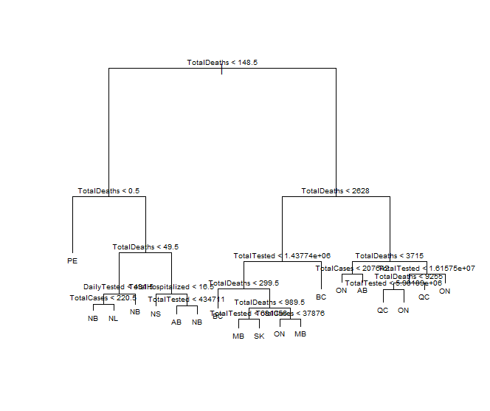
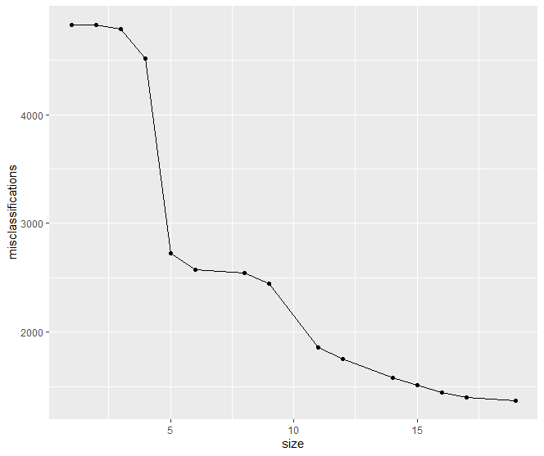
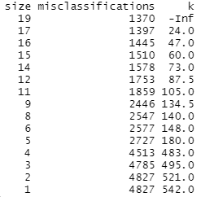
Decision Trees
*All columns from the Objective slide were used to create the following plot(s)
Best tree found via k-folds CV (k=19)
Trained a sample of the dataset using the Binary classification tree model (80% of data used during training) using a ‘k’ value of 10 for k-folds cross validation
Size of tree vs misclassifications
Test Misclassification (Error) Rate for the above tree

Slide 18
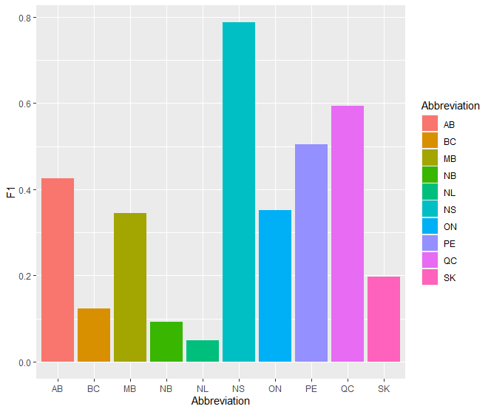
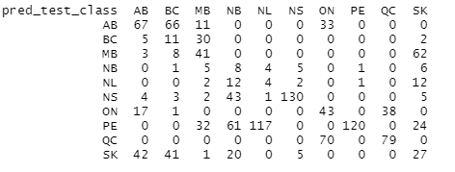
Logistic Regression
F1 Score for each Class
Trained a sample of the dataset using Multinomial Logistic Regression (80% of data used during training).
We noticed that many of the predictors were influencing each other (collinearity), so after removing such variables from the model, our predictor list became the following:
DailyTotals
DailyTested
DailyActive
DailyDeaths
DailyHospitalized
TotalDeaths
Confusion Matrix
Error rates

Slide 19

Opinion Time: Best Model
Comparing the error rates from the 3 models we used above:
KNN with k=1 - 0.246988 (Non-parametric)
Classification Tree with k=19 - 0.2597892 (Non-parametric)
Multinomial Logistic Regression - 0.6009 (Parametric)
From the above results, we can see that the KNN and Classification tree models performed the best when applied to the ‘test’ (held-out) data. However, both of these models were very high in complexity, (high variance).

Slide 20


Retrospective
Additional information that would have helped us:
Less inconsistencies in data
More accurate information for the territories
Difficulties:
Figuring out how to clean up the data
Determine what data is and not relevant for our model(s)

Slide 21
Thank you

