Slide 1
Prompt Fight: AI Bros vs. Insurance Pros
PLUS 2026 SINGAPORE SYMPOSIUM · 1 OCT 2026 · 11:05 AM
One D&O underwriting worksheet, drafted by an AI agent running on hardware I own. A human still signs it.
Today's case: Sheng Siong Group · SGX-listed · S$10m D&O · no claims · new policy · public filings only
Jensen Loke · CEO, Success IT
Notes:
Wait for the host's handover. One line on the frame: the agent drafts, the engine prices, the underwriter decides. The case-study card repeats the organiser's assumptions: no claims, new policy, everything else from public sources on the insured's website.

Slide 2
Your speaker — Jensen Loke
I design products, workflows and teams that make complex services work better.
Across consumer and corporate digital products, the goal has stayed the same: use technology to solve real business problems and improve outcomes.
Consumer products — DBS digital banking
Corporate platforms — Temasek · Ant Financial · Amazon
Now — CEO, Success IT
Community — convene 1,000+ Agentic Builders
linkedin.com/in/jensenloke
Notes:
Thirty seconds at most; the slot is short. I'm on the AI side of the fight, not an underwriter. My career has been building digital products across banking and corporate platforms. Today I run Success IT and help convene the Agentic Builders Collective.

Slide 3
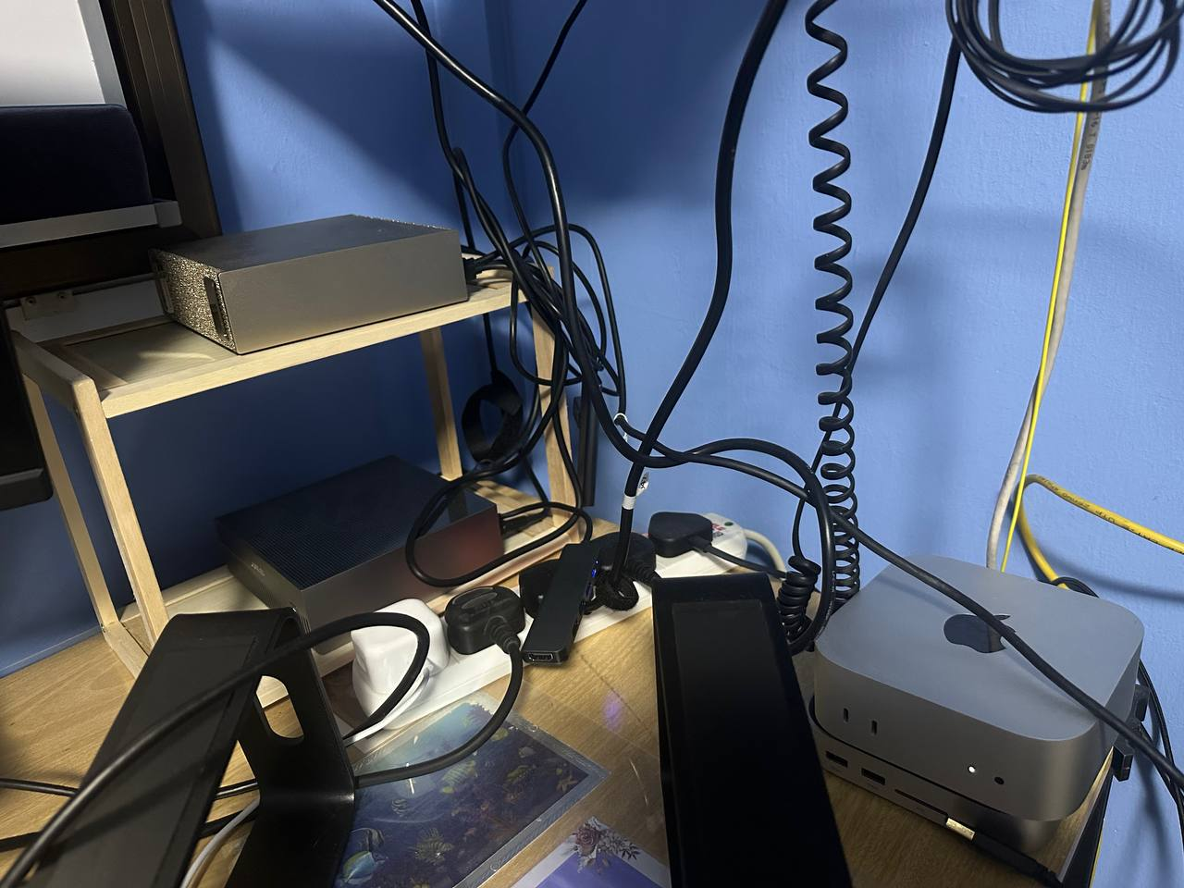
The agent runs on my own hardware
THE SIMPLE ARCHITECTURE
Mac — agent app and harness
Tailscale — private encrypted access
LiteLLM — one stable API (dgx-current)
DGX Spark — Qwen 3.8 27B, local inference
WHY IT MATTERS
Private by default — the model backend stays on loopback; remote access stays inside the tailnet.
No per-token bill — research runs cost electricity and time, not API spend.
Swap the model — any OpenAI-compatible model, local or cloud, plugs into the same agent.
Notes:
This answers "how does it work, and what does it cost". The model runs on one DGX Spark in my home lab, reached privately over Tailscale through a LiteLLM router. For an underwriter that means the research stays on hardware I control, and a run has no per-token bill. The same agent can point at a cloud model instead; that's one setting.

Slide 4
How ANDREW works — research in parallel, price in code
1 · Gather
2 · Research teams
3 · Synthesise
4 · Review
5 · Price & refer
CODE — Pick the listed company. Market data and annual-report PDFs are fetched once and shared.
MODEL · PARALLEL — Five teams read the filings at once: market & securities, financials, governance & audit, shareholding, adverse news.
MODEL — A lead underwriter merges the findings into one proposal. Every answer carries a value, a rationale and a source.
HUMAN — The underwriter re-sets modifiers and toggles exclusions before anything is priced.
CODE — The worksheet's rating tables and ~38 referral triggers. Premium, CLEAR or REFER, and the formula shown.
Notes:
This is "how I approached it". Not one big prompt: specialist research teams read the public filings in parallel, a lead model writes the cited proposal, the underwriter reviews it, and the pricing and referral checks are ordinary code built from the worksheet's own formulas. The leveling assumptions (no claims, new policy) are enforced in code, not left to the model.

Slide 5
Three rules keep it honest
Numbers in code
Words in the model
Judgement with the human
The model never does pricing math. The engine reproduces the worksheet's worked example to the cent.
Research and narrative come with citations. “None identified” is a finding; a blank is not.
The agent refers when it's unsure instead of bluffing a number. An underwriter signs off.
Notes:
If the room remembers one slide, make it this one. The split of duties is the whole argument: arithmetic belongs in code, language belongs in the model, and the decision belongs to a licensed human.

Slide 6
Live demo — let's underwrite Sheng Siong
THE BRIEF
Insured — Sheng Siong Group Ltd · SGX-listed
Cover — Directors & Officers liability
Limit — S$10m
Claims — none · new policy, no current cover
Inputs — annual reports, SGX filings, public news
WHAT TO WATCH
1 · The research lanes — each team reading filings, with sources as it goes.
2 · The cited proposal — risk narrative, modifiers and exclusions, each with its reason.
3 · The human review — where I push back on the agent's calls.
4 · The price and verdict — premium, CLEAR or REFER, and the formula behind it.
Notes:
Switch to the terminal. Start a live Sheng Siong run to show the research lanes working, then switch to the pre-run completed before the session for the output: a full run takes longer than the slot. Walk the output: premium, referral status, two judgement calls. Then cover challenges, surprises, and what I'd build with more time.

Slide 7



Take the agent home
X · TWITTER
@jensenloke
x.com/jensenloke
LINKEDIN
Jensen Loke
linkedin.com/in/jensenloke
OPEN SOURCE · GITHUB
ANDREW
github.com/jensenloke/andrew-do-worksheet
ANDREW is open source — run it on your own laptop against any OpenAI-compatible model, local or cloud.
Notes:
Leave this up through Q&A. ANDREW is open source: underwriters can run it on their own laptop against any OpenAI-compatible model, local or cloud.

