Slide 1
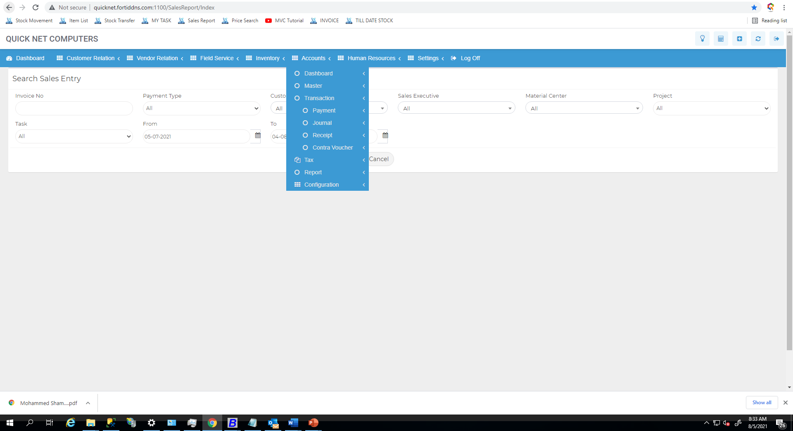
ASSET Management

Slide 2
ASSET Management
Create
List

Slide 3
ASSET From Inventory
Create
List

Slide 4
ID
DATE
Item Name
Barcode
Items Unit
Items Qty
Unit Price
Total Price
Depreciation %
ASSET ACCOUNTS
Depreciation Account
Items Name
Barcode
Items Unit
Items Qty
Unit Price
Total Price
Depreciation %
ASSET ACCOUNTS
Depreciation Account
Items Name
Barcode
Items Unit
Items Qty
Unit Price
Total Price
Depreciation %
ASSET ACCOUNTS
Depreciation Account
SAVE
CLOSE

Slide 5
ASSET to Inventory
Create
List

Slide 6
ID
DATE
ASSET ACCOUNTS
Item Name
Barcode
Items Unit
Items Qty
Unit Price
Total Price
Items Name
Barcode
Items Unit
Items Qty
Unit Price
Total Price
Items Name
Barcode
Items Unit
Items Qty
Unit Price
Total Price
SAVE
CLOSE

Slide 7
ASSET Purchase
Create
List

Slide 8
ID
DATE
Vendor Name
Purchase Invoice No:
Item Name
Barcode
Items Unit
Items Qty
Unit Price
Total Price
Depreciation %
ASSET ACCOUNTS
Depreciation Account
Items Name
Barcode
Items Unit
Items Qty
Unit Price
Total Price
Depreciation %
ASSET ACCOUNTS
Depreciation Account
Items Name
Barcode
Items Unit
Items Qty
Unit Price
Total Price
Depreciation %
ASSET ACCOUNTS
Depreciation Account
Vat
Total Asset Value
Attachment
SAVE
CLOSE

Slide 9
ASSET Adjustment
Create
List

Slide 10
Adjust ID
DATE
ASSET ACCOUNTS
Item Name
Barcode
Items Unit
Items Qty
Unit Price
Total Price
Depreciation %
Depreciation Account
Items Name
Barcode
Items Unit
Items Qty
Unit Price
Total Price
Depreciation %
Depreciation Account
Items Name
Barcode
Items Unit
Items Qty
Unit Price
Total Price
Depreciation %
Depreciation Account
Adjust Reason
SAVE
CLOSE

Slide 11
ASSET Barcode Print

Slide 12
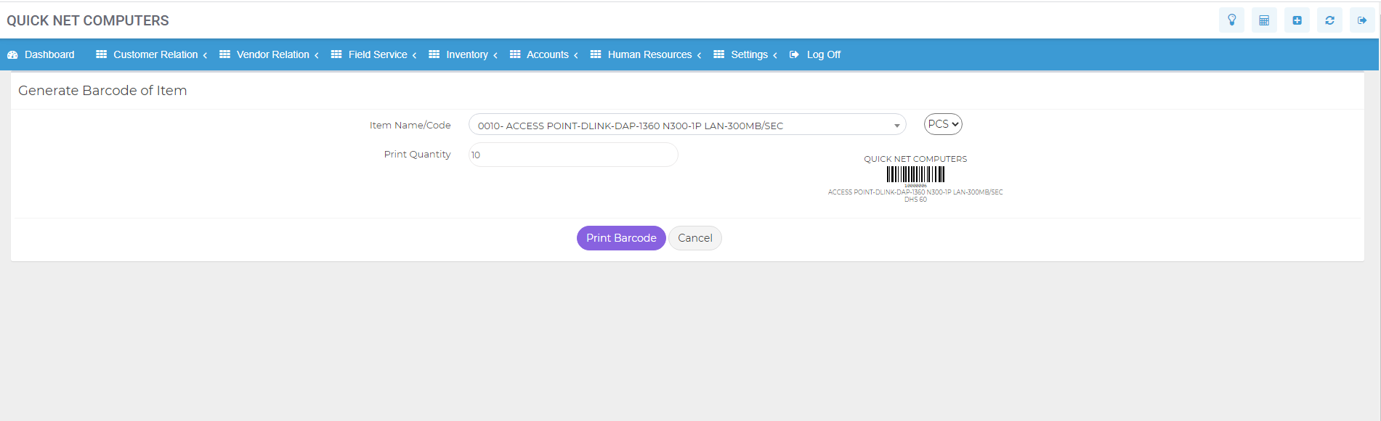
ASSET Barcode Print
ASSET Account

Slide 13
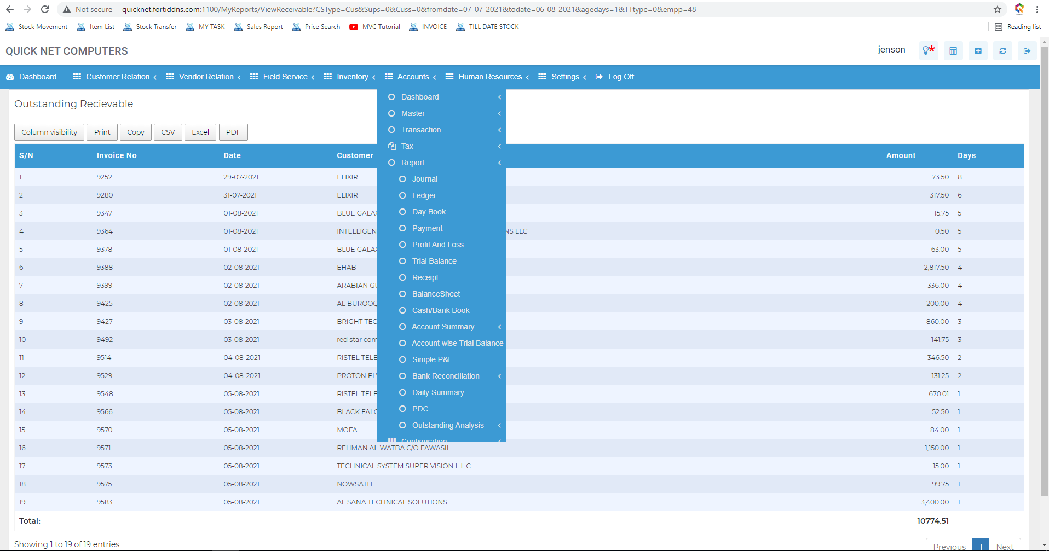
ASSET Report
Asset Account Wise

Slide 14
Asset Account
ASSET ID | ASSET NAME | QTY | ITEM VALUE | TOTAL VALUE | Days as an Asset

