Slide 1


PRINCE DR. K. VASUDEVAN COLLEGE
OF ENGINEERING AND TECHNOLOGY
Department of Computer Science and Engineering
PDKVCET
TITLE
OrphaConnect - An Integrated System for Charitable Initiatives to Engage Communities
Domain: Social Computing
Guided & Co-ordinated By :
Mrs. Shalini S, M.E,
Head of Dept.
Presented By :
Jenson Y
Reg. No : 411620104006
Raja Selvam M
Reg. No : 411620104015

Slide 2
AIM AND OBJECTIVE
We aim to revolutionize charitable initiatives by seamlessly connecting surplus event food to orphanages, combating global food waste. Simultaneously, establish a secure and efficient system for fund charity to verified orphanages.
Objectives:
Implement a reward-based system.
Utilize machine learning for fraud prevention.
Enable secure fund charity for verified orphanages.
Ensure transparency and verifiable data.
Enhance overall efficiency in charity processes.
Foster a seamless connection between users and orphanages.
PDKVCET

Slide 3
ABSTRACT
OrphaConnect, a pioneering web-based charity operations management system, combats global food waste by seamlessly connecting surplus event food to orphanages. Employing a reward-based system and machine learning, it ensures legitimacy and prevents fraud.
This project simplifies food and fund charity, offering transparency, security, and efficiency. OrphaConnect strives to create a virtuous cycle of sustained charitable engagement, addressing both food waste and supporting verified orphanages.
PDKVCET

Slide 4
EXISTING SYSTEM
PDKVCET
The current food charity system relies on manual processes, leading to inefficiencies in data management and communication. Challenges include technological lag, limited accessibility, and coordination issues. The focus is on highlighting the need for improvement and innovation in addressing global food waste.

Slide 5
DISADVANTAGE
Manual Inefficiencies: Reliance on manual processes leads to inefficiencies in data handling and distribution management.
Technological Lag: Lack of integration with modern technology hinders the system's overall efficiency and adaptability.
Limited Accessibility: Challenges in providing accessible services for both donors and beneficiaries, hindering the reach of the charity.
Coordination Issues: Difficulty in managing surplus food distribution requests and coordinating efforts among charity workers.
Communication Gaps: Inadequate channels for effective communication and collaboration, impacting the overall effectiveness of the food charity system.
PDKVCET

Slide 6
PROPOSED SYSTEM
PDKVCET
Introducing OrphaConnect, a web-based charity operations management system designed to combat global food waste. With automated efficiency, technological innovation, dual charity initiatives, security measures, and user-centric design, OrphaConnect aims to create a seamless and impactful platform for sustained charitable engagement.

Slide 7
ADVANTAGES
Automated Efficiency: Streamlining operations seamlessly for a user-friendly experience.
Reward-Based Incentives: Encouraging contributions through a motivating reward system.
Dual Charity Initiatives: Supporting both food and fund charity for a holistic impact.
Enhanced Security Measures: Implementing robust safeguards for user trust and data protection.
Technological Innovation: Utilizing machine learning for adaptability and fraud prevention.
PDKVCET

Slide 8
ALGORITHM USED
Recommendation Algorithms for User Incentives: Implement recommendation algorithms to suggest personalized incentives for users based on their engagement history, encouraging continued contributions.
Geospatial Algorithms for Efficient Food Distribution: Incorporate geospatial algorithms to optimize the routing and distribution of surplus food, ensuring timely and efficient deliveries to beneficiaries.
Data Clustering for Beneficiary Registration: Use clustering algorithms to group and manage beneficiary data efficiently, allowing for streamlined registration processes.
Machine Learning Algorithms for Fraud Detection: Utilize machine learning algorithms, such as anomaly detection or pattern recognition, to identify and prevent fraudulent activities within the system.
PDKVCET

Slide 9















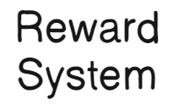

SYSTEM ARCHITECTURE
System Administrators
Technological
Infrastructure
PDKVCET
Beneficiaries
Beneficiary Registration
Beneficiary Support
Charity Organization Administrators
Security Measures
Donation Processing
Donors
Donation Management
Payment Gateways
Feedback Mechanisms
Reward System
Authentication Services

Slide 10
SOFTWARE REQUIREMENTS
OPERATING SYSTEM : windows 11
IDE : Microsoft visual studio
FRONT END : HTML, CSS
CODING LANGUAGE : JavaScript
BACK END : MongoDB
PDKVCET
HARDWARE REQUIREMENTS
PROCESSOR : Intel i5
HARD DISK : 140GB
RAM : 4GB (Mimimum)

Slide 11
PROJECT IMPLEMENTATION MODULES
Donor Modules:
Registration and Authentication
Profile Management
Donation Posting
Real-Time Notifications
Verification of Beneficiaries
Level-Based Rewards
Beneficary Modules:
Registration and Verification
Profile Management
Receiving and Confirming Donations
Notification Center
PDKVCET

Slide 12
Module Description
USER MODULE:
1. Registration and Authentication
Purpose: To enable users to create secure accounts and participate in charitable activities.
Functionality: Users register with essential details and undergo a secure authentication process.
Implementation: Utilize a user-friendly registration form with email verification for account activation.
2. Profile Management:
Purpose: Empower donors to personalize and manage their user profiles efficiently.
Functionality: Users can update personal details, preferences, and track their charitable history.
Implementation: Design an intuitive profile dashboard with easy-to-navigate editing options.
PDKVCET

Slide 13
3. Donation Posting:
Purpose: Facilitate the contribution of surplus food by allowing users to post donation details.
Functionality: Users provide information on available food, including type, location, and duration.
Implementation: Create a straightforward posting interface with necessary fields for donation specifics.
4. Real-Time Notifications:
Purpose: Ensure timely communication by notifying nearby beneficiaries of available food.
Functionality: Implement a notification system for immediate alerts to beneficiaries.
Implementation: Use geolocation services and push notifications for real-time updates.
PDKVCET

Slide 14
5. Monetary Contributions:
Purpose: Enable users to make direct financial contributions to verified orphanages and care homes.
Functionality: Donors can choose to contribute a monetary amount securely through integrated payment gateways.
Implementation: Integrate widely-used and secure payment gateways, ensuring transparent and seamless transactions.
6. Verification of Beneficiaries:
Purpose: Guarantee the legitimacy of beneficiary organizations receiving donations.
Functionality: Orphanages and care homes undergo a verification process for authenticity.
Implementation: Develop a verification system involving document submission and validation.
PDKVCET

Slide 15
7. Level-Based Rewards:
Purpose: Encourage sustained engagement and recognize donors for their contributions.
Functionality: Users progress through levels based on donation history, unlocking rewards.
Implementation: Implement a point-based system or tiered structure for tracking and rewarding user levels.
BENEFICIARY MODULES:
1. Registration and Verification:
Purpose: Enable orphanages and care homes to register securely and gain access to donations.
Functionality: Beneficiaries provide essential information and undergo a verification process.
Implementation: Design a streamlined registration form with a verification protocol.
PDKVCET

Slide 16
2. Profile Management:
Purpose: Allow beneficiaries to maintain updated profiles for effective communication.
Functionality: Beneficiaries can manage their details, update preferences, and showcase their mission.
Implementation: Create an intuitive dashboard for profile management.
3. Receiving and Confirming Donations:
Purpose: Streamline the process for beneficiaries to view, confirm, and receive food donations.
Functionality: Provide a dashboard displaying available donations and options for confirmation.
Implementation: Incorporate a user-friendly interface with clear donation details.
PDKVCET

Slide 17
4. Notification Center:
Purpose: Centralize communication for beneficiaries to manage donation-related notifications.
Functionality: Beneficiaries receive and track notifications in a dedicated notification center.
Implementation: Develop a unified space for managing communication on received donations.
PDKVCET

Slide 18
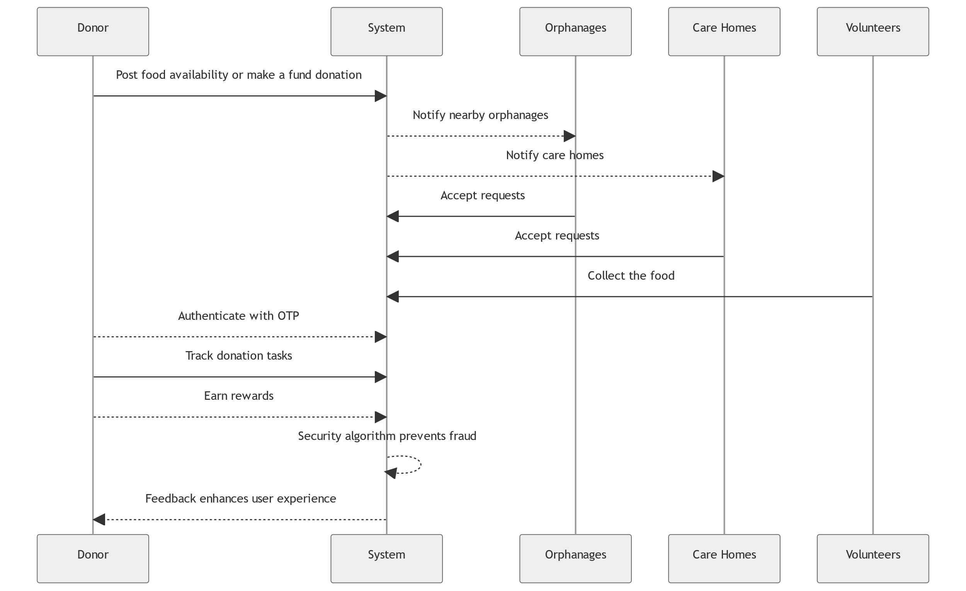
Sequence Diagram
PDKVCET

Slide 19
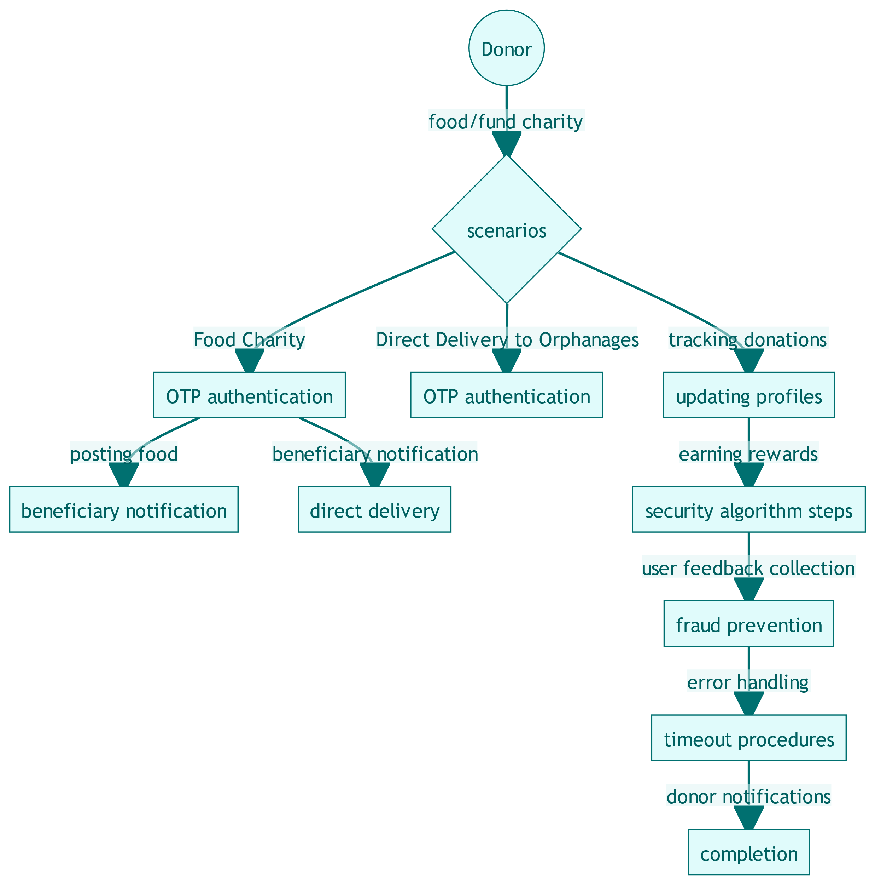
State Diagram
PDKVCET

Slide 20
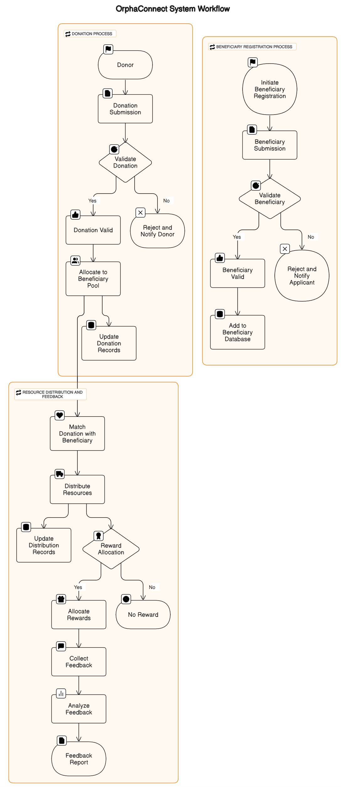
Flow Diagram
PDKVCET

Slide 21
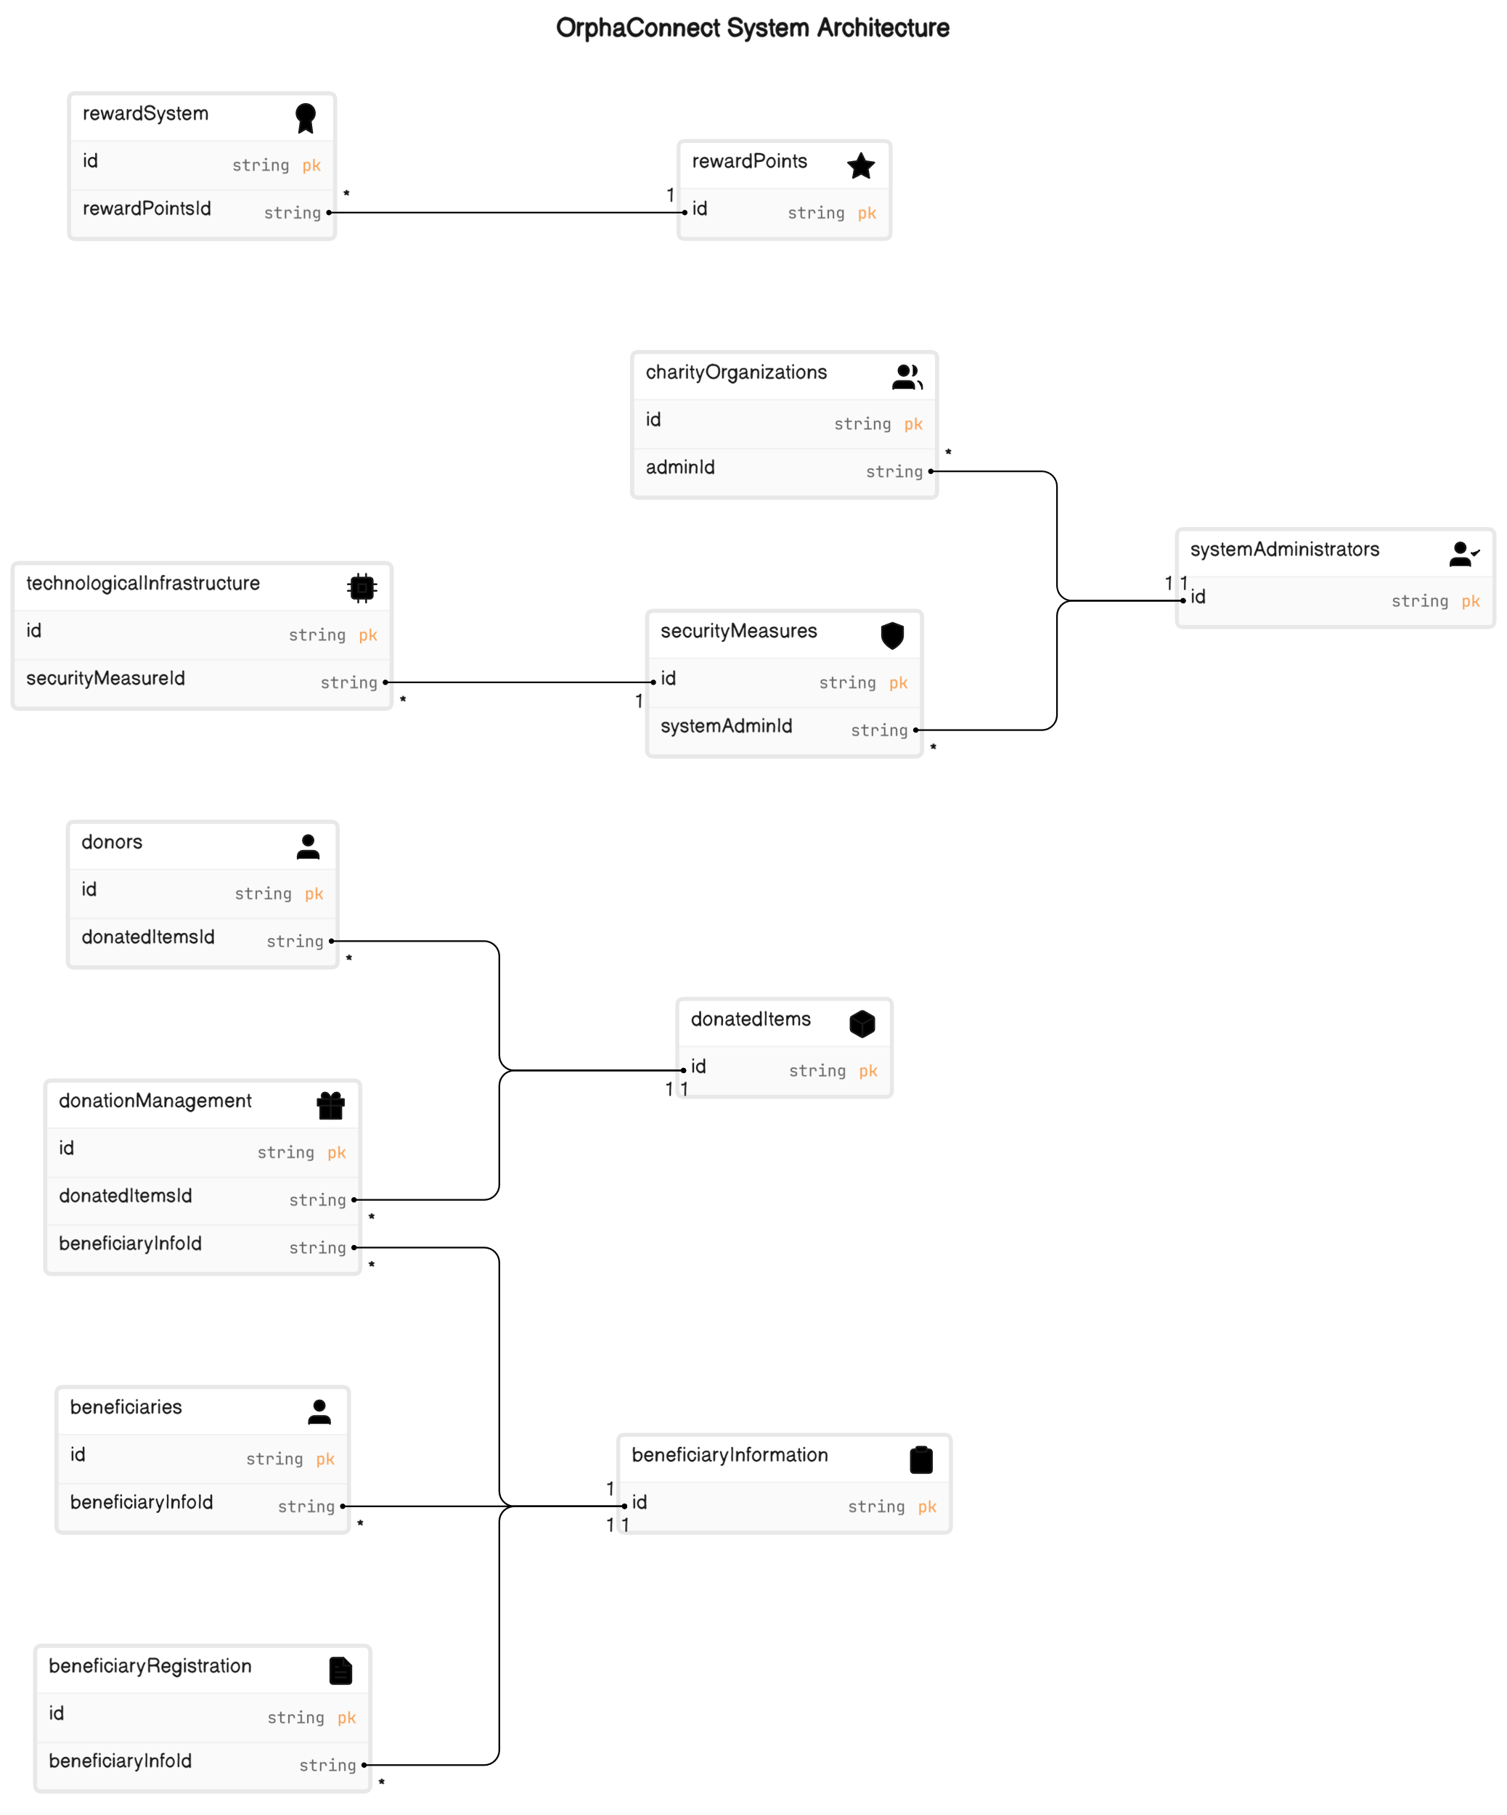
Class Diagram
PDKVCET

Slide 22








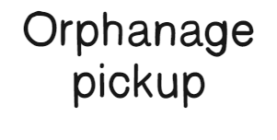











Activity Diagram
PDKVCET

Slide 24
PDKVCET
LITERATURE SURVEY

Slide 25
PAPER 1
Title: Donation Management System
Author: D.I.De Silva, W.A.C Pabasara, S.A.N Wimalasooriya, H.M.C.D Samaraweera, W.S.D Thenabandu, B.A.D.K.M Balachandra, M.G.R Pasan
Year: 2023
Abstract: Any individual living in society need to satisfy their individual needs, supplying of quality food is one of the primal requirements of one of those needs. However, there are many privileged people in any society who are capable of satisfying their needs and some who don’t. In such environments there are people who are willing to aid (donors) and the people who are longing to accept the help (donees). These both parties required a trustworthy platform to facilitate their needs. On this research the main focus is to analyze the government schools in Sri Lanka provincially. Surveys are conducted to analyze data and to aid to arrive conclusions. In addition to that it was necessary to fulfill the requirement of having a stabilized centralized trustworthy platform where both parties can interact securely.
PDKVCET

Slide 26
CONCEPT RELATED TO OUR PROJECT
Our project mirrors the research paper's use of the MERN stack for web development and incorporates advanced algorithms, like content analysis and machine learning, to enhance data evaluation and ensure secure transactions. The dual initiative approach, inspired by the paper, optimizes surplus food distribution and encourages user engagement through a reward-based system.
PDKVCET
ALGORITHM USED
Content Analysis and Thematic Analysis: Qualitative data analysis methods involving identifying, coding, and interpreting patterns and themes in textual data. Applied to analyze data collected through interviews and focus group discussions.
Statistical Analysis: A quantitative data analysis method involving applying mathematical and statistical techniques to numerical data. Used to analyze data collected through online surveys to measure user satisfaction and engagement.

Slide 27
ADVANTAGES
Innovative Algorithms: The research paper introduces novel algorithms, contributing to the advancement of knowledge in the respective domain.
Data-Driven Insights: Through statistical analysis and data-driven methodologies, the research paper provides insights into patterns, trends, and correlations within the studied dataset.
PDKVCET
DISADVANTAGES
Unaddressed Unnecessary Behavior Security: Limited discussion on explicit measures for securing against unnecessary behavior introduces potential vulnerabilities.
Absence of Reward-Based User Experience Enhancement: Lack of exploration into a reward-based approach hinders potential enhancements to user experience dynamics.

Slide 28
PAPER 2
Title: SeVa: A Food Donation App for Smart Living1
Author: Christina Varghese, Drashti Pathak and Aparna S. Varde2
Year: 2021
Abstract: This research addresses the crucial objective of minimizing food waste during crises, like the COVID-19 pandemic, by repurposing surplus food through a mobile app named SeVa. The app enables users to identify and access available food resources in their local area, simultaneously addressing hunger and food waste. Aligned with UN SDGs and AI for Smart Living in Smart Cities, SeVa integrates IoT and ubiquitous computing, contributing positively to healthcare and the environment. The development follows AI and HCI principles, evaluated through user surveys, and identifies potential future enhancements.
PDKVCET

Slide 29
CONCEPT RELATED TO OUR PROJECT
The research paper introduces SeVa, a mobile app addressing food waste and hunger. Our project, OrphaConnect, echoes this by leveraging technology to connect surplus event food to orphanages. Both prioritize user-centric design principles from AI and HCI, using technology to facilitate impactful connections in the community.
PDKVCET
ALGORITHM USED
Constraint Satisfaction Problems (CSP): CSP is a mathematical problem-solving technique employed in the SeVa app. It involves a set of objects with states that must adhere to various constraints or restrictions. In SeVa, CSP is utilized to match food donors with recipients, considering factors like location, time, and food type, ensuring a streamlined and efficient food donation process.

Slide 30
ADVANTAGES
Effective CSP Implementation: Successful application of Constraint Satisfaction Problems (CSP) in SeVa facilitates structured food donation matching with consideration for multiple constraints.
AI and HCI Integration: Integration of AI and HCI principles ensures a user-friendly and intuitive design, enhancing the overall user experience in the SeVa app.
PDKVCET
DISADVANTAGES
Scope for Future Enhancements: The paper provides minimal insights into potential technological advancements for future improvements in the SeVa app.
Potential Scalability Oversight: Absence of explicit scalability considerations may pose challenges as the user base of the SeVa app expands.

Slide 31
PAPER 3
Title: Intelligent Transaction System for Fraud Detection using Deep Learning Networks
Author: J Fenila Naomi, Roshan Jeniel R, Sakthi Eswaran K, Sanjeev Kumaar N M
Year: 2021
Abstract: This paper proposes a deep representation learning model for online transaction fraud detection, which aims to improve the separability and discrimination of features by combining distance and angle loss functions. The model uses a BiLSTM MaxPooling-BiGRU architecture to extract deep features from transaction data and classify them as genuine or fraudulent. The paper evaluates the model on the IEEE-CIS Fraud Detection dataset and compares it with existing methods. The results show that the proposed model achieves better performance and stability than the state-of-the-art methods.
PDKVCET

Slide 32
CONCEPT RELATED TO OUR PROJECT
Our project, akin to the referenced research paper, focuses on secure aid transfers to orphanages. Both emphasize innovative approaches for reliable and safe transactions, reflecting a shared commitment to leveraging advanced technologies in the realm of secure transactions.
PDKVCET
ALGORITHM USED
Bidirectional Long Short-Term Memory (BiLSTM): A type of recurrent neural network (RNN) that captures temporal and sequential features in transaction data.
Bidirectional Gated Recurrent Unit (BiGRU): Another type of recurrent neural network similar to LSTM but with a simpler structure, used alongside BiLSTM for capturing sequential features

Slide 33
ADVANTAGES
Deep Learning Techniques: The research utilizes deep learning techniques, such as BiLSTM and BiGRU, for capturing temporal and sequential features in transaction data.
Feature Separability Focus: The fully central loss layer, combining ACL and DCL, emphasizes improving feature separability for enhanced fraud detection.
PDKVCET
DISADVANTAGES
Dependency on a Specific Dataset: The reliance on Kaggle's IEEE-CIS Fraud Detection dataset might limit the generalizability of the proposed model to other datasets or real-world scenarios.
Insufficient Discussion on Hyperparameter Tuning: The paper lacks a thorough discussion or insights into the hyperparameter tuning process, leaving readers without guidance on crucial aspects such as learning rates, batch sizes, or regularization techniques.

Slide 34
PAPER 4
Title: FoodX, a System to Reduce Food Waste
Author: Shinta Oktaviana R, Diana Ambarwati Febriani, Intan Yoshana, Lalu Payanta
Year: 2020
Abstract: The research addresses the pressing issue of food waste in Indonesia, the second-largest producer globally. Existing manual processes hinder effective distribution of excess food from donors to communities in need. The study introduces the FoodX system, utilizing prototype methodology for faster user feedback. Testing involving volunteers and communities confirms the system's efficacy in catering to the needs of diverse food communities.
PDKVCET

Slide 35
CONCEPT RELATED TO OUR PROJECT
Our project directly aligns with concepts discussed in the research paper, focusing on key areas like reducing food waste, efficient charity operations, user engagement, technological innovation, dual charity initiatives, security, feedback integration, and global impact. By implementing these concepts, the project aims to provide practical solutions and contribute to real-world advancements in charitable operations.
PDKVCET
ALGORITHM USED
Geotag is an algorithm that integrates GPS and GIS to locate food donors, communities, and recipients.
Google Maps Engine API and Google Maps Direction API are algorithms that provide information on the distance and direction between different locations on the map.
Prototyping is a method that involves iterative design and development of a system based on user feedback.

Slide 36
ADVANTAGES
Prototype Methodology: The use of prototype methodology allows for faster development cycles, enabling quicker user feedback and iterative improvements.
Feedback Mechanism: The system is designed to facilitate faster feedback from users, ensuring continuous improvement and addressing any issues promptly.
PDKVCET
DISADVANTAGES
User Engagement: Maintaining user engagement over time can be challenging. The system may need to incorporate features such as gamification to keep users engaged.
Absence of Reward-Based Approach: potentially missing an opportunity to enhance user engagement and motivation for sustained contributions, a feature present in the proposed system.

Slide 37
PAPER 5
Title: A New Secure One-Time Password Algorithm for Mobile Applications
Author: Mohamed.H.S.AbouSteit, Dr. Ashraf Farouk Tammam, and Dr. AbdelMoneim Wahdan
Year: 2020
Abstract: This page presents a paper that proposes a new one-time password (OTP) framework that achieves the confidentiality of exchanging the OTP by using a combination of AES 256 bit, RSA, SHA 512. The paper also discusses the motivation, the proposed system, the performance analysis, the future works, and the conclusions of the research. The paper claims that the proposed model is resilient to different types of attacks and provides end-to-end encryption for the OTP delivery. The paper also compares the proposed model with other existing models and shows its advantages. The paper was published in the 2020 Fourth World Conference on Smart Trends in Systems, Security and Sustainability (WorldS4)
PDKVCET

Slide 38
CONCEPT RELATED TO OUR PROJECT
Both project revolve around a common theme: leveraging OTP approach. While OrphaConnect uses OTP for authentication in food distribution process, our project employs OTP approach also for authenticating users. The shared focus lies in maximizing the potential of OTP approach to achieve project goals.
PDKVCET
ALGORITHM USED
AES-256: A symmetric-key encryption algorithm.
RSA: An asymmetric-key encryption algorithm.
SHA-512: A cryptographic hash function.
Feistel cipher: A structure for designing block ciphers.
Elliptic curve cryptography (ECC): A public-key cryptography algorithm.
BitWise Masking Alternate Sequence (BWMAS): A technique for encrypting images using bitwise operations.

Slide 39
ADVANTAGES
High Security: Utilizes AES-256, RSA, and SHA-512 for robust protection against various attacks.
Efficient Delivery: Network traffic-based OTP delivery ensures faster and reliable transmission.
PDKVCET
DISADVANTAGES
Internet Dependency: Users without internet access may face challenges in receiving OTPs.
Complex Implementation: Multiple cryptographic algorithms increase implementation complexity and resource requirements.

Slide 40
PAPER 6
Title: Task Recommendation in Reward-Based Crowdsourcing Systems
Author: Ayswarya R Kurup, G P Sajeev
Year: 2017
Abstract: This research explores task recommendation in reward-based crowdsourcing, where small tasks are outsourced to a crowd for solutions in exchange for monetary rewards. Implicit and explicit features of worker-reward and worker-task attributes are leveraged to recommend tasks to workers. Two models, based on worker-reward features and worker-task features, are introduced. The study aims to exploit interactions between tasks and workers, utilizing real-world datasets for evaluation. The proposed approach is compared with existing techniques, evaluating its effectiveness in improving task recommendations within reward-based crowdsourcing platforms.
PDKVCET

Slide 41
CONCEPT RELATED TO OUR PROJECT
We repurpose task recommendation models from our system to enhance the allocation of surplus food to orphanages. Integrating these principles into OrphaConnect is expected to create a more efficient and engaging surplus food distribution system, effectively tackling food waste and supporting orphanages.
PDKVCET
ALGORITHM USED
Probabilistic Matrix Factorization (PMF): This technique is utilized to decompose a sparse matrix into latent factors. In the context of the paper, it is applied to predict worker-task and worker-reward probabilities, contributing to the recommendation model.
Bayesian Personalized Ranking (BPR): BPR is employed to optimize the ranking of tasks for each worker based on implicit feedback. It enhances the recommendation system by considering the preferences and historical interactions of workers.

Slide 42
ADVANTAGES
Effective Utilization of Implicit Feedback: Algorithms like Bayesian Personalized Ranking (BPR) leverage implicit feedback, optimizing task rankings based on workers' historical interactions, leading to more personalized recommendations.
Flexible Matrix Factorization: Probabilistic Matrix Factorization (PMF) offers flexibility by decomposing sparse matrices, allowing for efficient prediction of worker-task and worker-reward probabilities.
PDKVCET
DISADVANTAGES
Cost Implications: Implementing a reward-based system incurs costs, potentially limiting scalability, especially in projects with budget constraints.
Risk of Fraudulent Behavior: The allure of rewards may lead to dishonest behavior, such as false reporting or gaming the system to obtain rewards without genuine contributions, necessitating effective fraud management.

Slide 43
PAPER 7
Title: Learning and Modelling User Interests using User Feedback: a Novel Approach
Author: Tarek Alloui, Imane Boussebough, and Allaoua Chaoui
Year: 2015
Abstract: This paper presents a novel approach for building user interests for personalized information retrieval. The approach relies on explicit user feedback on the retrieved results to learn the user information needs and construct two sets of keywords that represent the user interests. The paper also shows the experimental results of the approach and discusses its effectiveness.
PDKVCET

Slide 44
CONCEPT RELATED TO OUR PROJECT
The research investigates the implementation and impact of a reward-based system, security measures, and user feedback integration within OrphaConnect. It aims to optimize charity operations and address global food waste, with a particular focus on the role of user feedback in enhancing system functionality and user experience.
PDKVCET
ALGORITHM USED
Genetic Algorithm: A search heuristic mimicking natural selection, cited for potential application in web search personalization.
Keyword Extraction Algorithm: Utilizes natural language processing to identify key terms in documents, aiding in the construction of user interests from relevant and irrelevant content.

Slide 45
ADVANTAGES
Personalized User Interests: Leverages explicit user feedback for dynamic construction, enhancing relevance.
Efficient Iterative Learning: Adapts to evolving user needs through iterative refinement.
PDKVCET
DISADVANTAGES
Dependency on User Feedback: Relies on user input, limiting effectiveness without consistent engagement.
Sensitivity to Noisy Feedback: Susceptible to inaccuracies, impacting precision in user interest construction.

Slide 46
PAPER 8
Title: Development of Web Annotation Technique for Search Result Records Using Web Database
Author: Sonali T. Kadam and Sanchika Bajpai
Year: 2015
Abstract: The paper proposes a method for annotating web pages that contain search results from web databases. The method uses ontology-assisted data extraction, multi-data alignment, and query-based annotation to assign meaningful labels to the data units in the search result records. The paper also describes an automatic wrapper generation technique that can be used to annotate new result pages from the same web database. The paper claims that the proposed method is efficient and effective for web annotation.
PDKVCET

Slide 47
CONCEPT RELATED TO OUR PROJECT
Our project, inspired by the research paper on web annotation techniques, features a search bar engine. While the paper enhances annotation processes, our project uses this mechanism to locate nearby orphanages efficiently. Both projects share a common goal of optimizing search functionalities, with the research paper guiding our approach to creating an effective search engine for specific needs.
PDKVCET
ALGORITHM USED
Multi-Data Alignment Algorithm: Groups data units with the same semantics in search result records (SRRs) using features like data content, presentation style, data type, tag path, and adjacency.
Annotation Wrapper Generation: Utilizes annotated data units to automatically create rules for extracting and annotating new data from the same web database, enhancing the annotation process.

Slide 48
ADVANTAGES
Innovative Approach: Introduces a novel web annotation technique combining web database extraction and automatic wrapper generation for effective annotation.
Thorough Literature Review: Provides a comprehensive literature survey, highlighting existing web annotation systems and their limitations, setting a solid foundation for the proposed technique.
PDKVCET
DISADVANTAGES
Resource-Intensive Annotation: Requires significant manual effort and expertise, potentially limiting scalability and making the annotation process resource-intensive.
Complex Database Challenges: May struggle with complex or dynamically structured web databases, limiting adaptability to diverse layouts, formats, or structures in search result records.

Slide 49
PAPER 9
Title: Incentive Mechanism and Protocol Design for Crowdsourcing Systems
Author: Hong Xie, John C.S. Lui, Joe Wenjie Jiang, Wei Chen
Year: 2014
Abstract: This research delves into the intricate fabric of crowdsourcing systems, unveiling an innovative incentive mechanism and a robust reputation protocol. The study introduces a sophisticated rating system, nuanced reward distribution, and vigilant reputation tracking, enhancing the quality of task solutions. Through rigorous game-theoretic analysis, the protocols ensure strategic equilibrium, promising high-quality outcomes. Noteworthy is the seamless integration with existing systems, emphasizing adaptability and scalability. This research contributes significantly to advancing crowdsourcing efficiency, emphasizing the pivotal role of incentives and protocol design in optimizing results
PDKVCET

Slide 50
CONCEPT RELATED TO OUR PROJECT
Our proposed system is closely related to the research paper on crowdsourcing systems. We adapt the incentive mechanism and reward concepts from the paper to encourage active participation in donating surplus event food. The research principles guide our approach to fostering a seamless connection between donors and orphanages, ensuring transparency and efficiency in charitable contributions.
PDKVCET
ALGORITHM USED
Repeated Game-Theoretic Framework: Mathematical model analyzing long-term worker behavior. Uses the one-shot deviation principle for a stable equilibrium, ensuring high-quality solutions.
Probabilistic Model for Task Assignment: Statistical model describing how tasks are assigned. Tasks go to novice workers with probability (β) and to expert workers with probability (1-β).
Binary Rating System and Reward Dividing Scheme: System where a positive rating (1) is given to expert worker solutions, and a negative rating (-1) to others. Rewards are evenly divided among positively rated workers or among all if none receive a positive rating.

Slide 51
ADVANTAGES
Effective Incentive Mechanism: The research paper introduces a comprehensive incentive mechanism with a rating system, reward dividing scheme, and reputation system. This motivates workers to provide high-quality solutions in crowdsourcing systems.
Game-Theoretic Analysis: Game-theoretic analysis is applied to understand the strategic behavior of workers. This analytical approach ensures the design of mechanisms that guarantee high-quality solutions and eliminate free-riding risks.
PDKVCET
DISADVANTAGES
Algorithmic Complexity: The research paper may introduce complex algorithms as part of the incentive mechanisms. Complex algorithms can pose challenges during implementation, making the system harder to understand and maintain.
Scalability Issues: The proposed incentive mechanisms may face scalability issues as the user base grows. Scalability challenges could result in degraded performance or increased resource requirements.

Slide 52
PAPER 10
Title: Design and Implementation of Tourism Information System Based on Google Maps API
Authors: Yimeng Wu, Zhixue Liang, Liming Liu
Year: 2014
Abstract: This paper proposes a tourism information system using Google Maps with Web GIS to provide accurate information for self-navigation tourists. The system is based on J2EE platform and uses Struts2 framework, Google Maps API, Ajax, JSON, and other technologies to implement an open travel information platform. The system allows tourists to access classified tourism information, mark and discuss places they have traveled, and provide feedback. The paper analyzes the system's architecture, database design, and key technologies, concluding that the system effectively resolves the defects of information search in traditional tourism websites.
PDKVCET

Slide 53
CONCEPT RELATED TO OUR PROJECT
Both project revolve around a common theme: leveraging mapping technology. While OrphaConnect uses maps for efficient food distribution, our project employs maps to track specific venues. The shared focus lies in maximizing the potential of mapping technology to achieve project goals.
PDKVCET
ALGORITHM USED
Geocoding Algorithm: Converts addresses or location names into geographic coordinates for accurate map placement and location-based information.
Search Algorithm: Enables users to search for specific tourism information based on keywords, categories, or locations, facilitating efficient data retrieval from the system's database.
Event Handling Algorithms: Manage user interactions with the map, including click and drag events, to ensure a responsive and interactive user experience within the system.

Slide 54
ADVANTAGES
Enhanced User Experience: The system offers an interactive and visually engaging platform, facilitating easy access to tourism information for effective travel planning.
Efficient Search Functionality: Search algorithms enable quick and effective retrieval of tourism information based on keywords, categories, or locations, enhancing usability and efficiency in information retrieval.
PDKVCET
DISADVANTAGES
Incomplete Information Scope: The system does not provide comprehensive details on certain essential services, limiting its coverage in areas such as availability, potentially leaving users without crucial information for their travel needs.
Limited Offline Functionality: The system may face constraints in scenarios with unreliable or no internet connectivity, hindering users' access to critical information when offline.

Slide 55
ADVANTAGES
Enhanced User Experience: The system offers an interactive and visually engaging platform, facilitating easy access to tourism information for effective travel planning.
Efficient Search Functionality: Search algorithms enable quick and effective retrieval of tourism information based on keywords, categories, or locations, enhancing usability and efficiency in information retrieval.
PDKVCET
DISADVANTAGES
Incomplete Information Scope: The system does not provide comprehensive details on certain essential services, limiting its coverage in areas such as availability, potentially leaving users without crucial information for their travel needs.
Limited Offline Functionality: The system may face constraints in scenarios with unreliable or no internet connectivity, hindering users' access to critical information when offline.

Slide 56
References
[1] N. Alblihed, M. Almutairi, R. Almahmoud, S. Aladhadh and A. Alabdulatif, "Developing Food Charity Operations Management System," 2022 2nd International Conference on Computing and Information Technology (ICCIT), Tabuk, Saudi Arabia, 2022, pp. 93-96, doi: 10.1109/ICCIT52419.2022.9711609.
[2] C. Varghese, D. Pathak and A. S. Varde, "SeVa: A Food Donation App for Smart Living," 2021 IEEE 11th Annual Computing and Communication Workshop and Conference (CCWC), NV, USA, 2021, pp. 0408-0413, doi: 10.1109/CCWC51732.2021.9375945.
[3] Naomi, J., Jeniel, R., Eswaran, K., & Kumaar, N. (2021). Intelligent Transaction System for Fraud Detection using Deep Learning Networks. Journal of Physics: Conference Series, 1916, 012031. https://doi.org/10.1088/1742-6596/1916/1/012031
[4] R. Shinta Oktaviana, D. A. Febriani, I. Yoshana and L. R. Payanta, "FoodX, a System to Reduce Food Waste," 2020 3rd International Conference on Computer and Informatics Engineering (IC2IE), Yogyakarta, Indonesia, 2020, pp. 361-365, doi: 10.1109/IC2IE50715.2020.9274576.
[5] H. S. Elganzoury, A. A. Abdelhafez and A. A. Hegazy, "A new secure one-time password algorithm for mobile applications," 2018 35th National Radio Science Conference (NRSC), Cairo, 2018, pp. 249-257, doi: 10.1109/NRSC.2018.8354370.
PDKVCET

Slide 57
References
[6] A. R. Kurup and G. P. Sajeev, "Task recommendation in reward-based crowdsourcing systems," 2017 International Conference on Advances in Computing, Communications and Informatics (ICACCI), Udupi, India, 2017, pp. 1511-1518, doi: 10.1109/ICACCI.2017.8126055.
[7] T. Alloui, I. Boussebough and A. Chaoui, "Learning and modelling user interests using user feedback : A novel approach," 2015 Fifth International Conference on Digital Information Processing and Communications (ICDIPC), Sierre, Switzerland, 2015, pp. 136-140, doi: 10.1109/ICDIPC.2015.7323019.
[8] S. T. Kadam and S. Bajpai, "Development of Web Annotation Technique for Search Result Records Using Web Database," 2015 International Conference on Computing Communication Control and Automation, Pune, India, 2015, pp. 348-352, doi: 10.1109/ICCUBEA.2015.73.
[9] H. Xie, J. C. S. Lui, J. W. Jiang and W. Chen, "Incentive mechanism and protocol design for crowdsourcing systems," 2014 52nd Annual Allerton Conference on Communication, Control, and Computing (Allerton), Monticello, IL, USA, 2014, pp. 140-147, doi: 10.1109/ALLERTON.2014.7028448.
[10] Y. Wu, Z. Liang and L. Liu, "Design and implementation of tourism information system based on Google Maps API," 2013 21st International Conference on Geoinformatics, Kaifeng, China, 2013, pp. 1-4, doi: 10.1109/Geoinformatics.2013.6626139.
PDKVCET

Slide 58
PDKVCET
THANKING YOU

