Slide 1
DATA SCIENCE / EDA PROJECT
EV Purchase Analysis
Understanding the Factors Influencing Electric Vehicle Adoption
A real customer-level survey of 10,000 buyers, analyzed end-to-end from cleaning through a predictive model.
Interview Presentation • Data Analyst / Data Scientist Role

Slide 2
The Business Problem
“Which customers are most likely to buy an EV, and which factors actually drive that decision versus which ones just seem like they should?”
PROJECT AT A GLANCE
Dataset
10,000 real customers
Target
An EV company wants to understand which customer characteristics and concerns influence purchase decisions, so it can target marketing more effectively.
Will_Buy_EV (17.5% positive)
Strongest factor
Subsidy availability (11x swing)
Model
Logistic Regression
Result
0.91 ROC-AUC, 86% recall
EV Purchase Analysis — Real Customer Data
Slide 2

Slide 3
Understanding the Dataset
Field | Detail
Rows | 10,000 customers, 15 columns
Missing values | Income (178), Commute (181), Env. Concern (184) — filled with median
Duplicates / Key | 0 duplicates; Buyer_ID unique across all rows
Target | Will_Buy_EV — Yes/No, 17.5% positive (imbalanced)
DATA QUALITY FLAG
Several fields are stored as Yes/No or Low/Medium/High text, not numbers (target included). Encoded explicitly before any correlation or modeling step.
EV Purchase Analysis — Real Customer Data
Slide 3

Slide 4
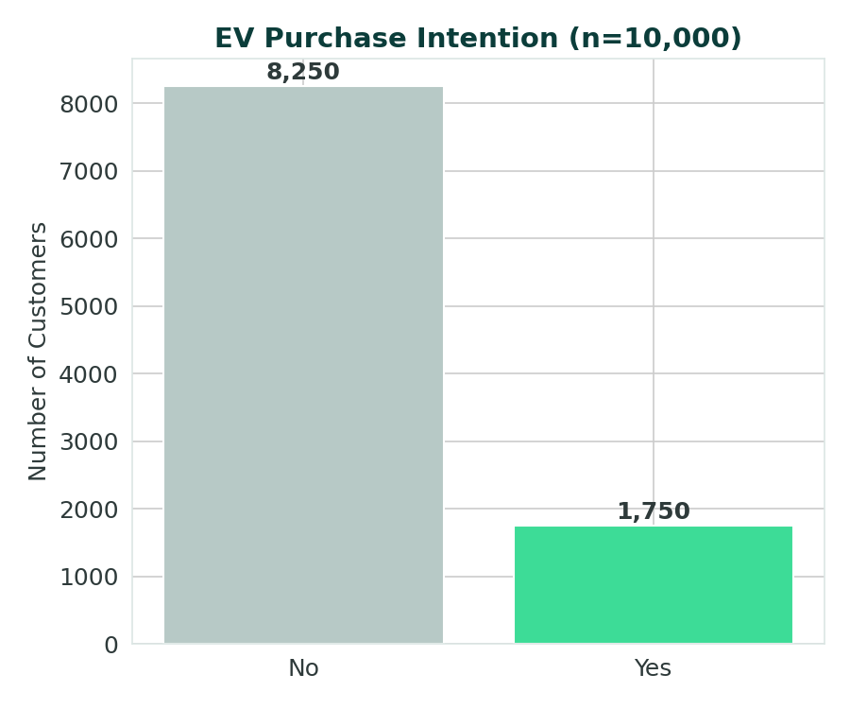
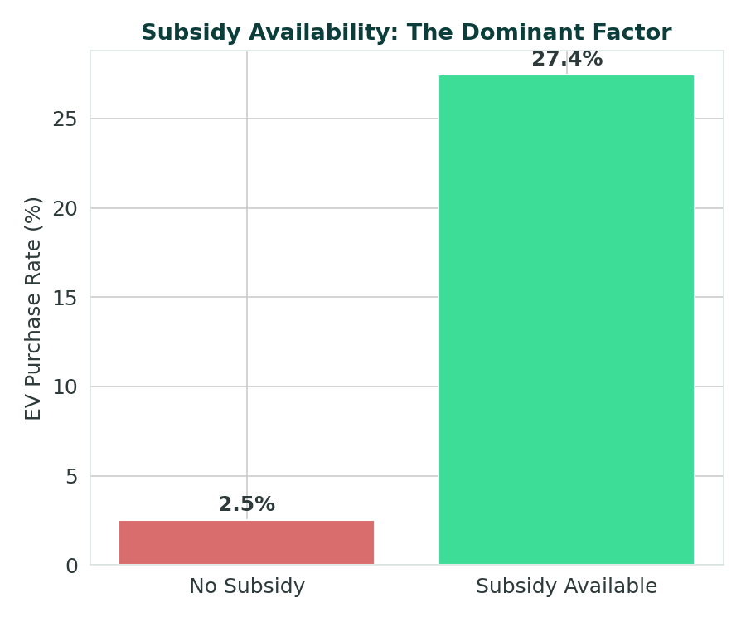
The Headline Finding: Subsidy Dominates
Only 17.5% of customers intend to buy
Subsidy access = 11x difference in buy rate
EV Purchase Analysis — Real Customer Data
Slide 4

Slide 5
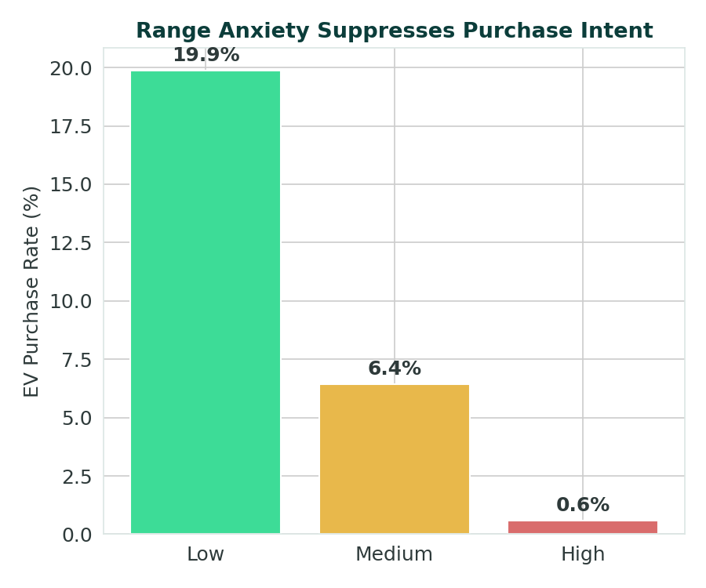
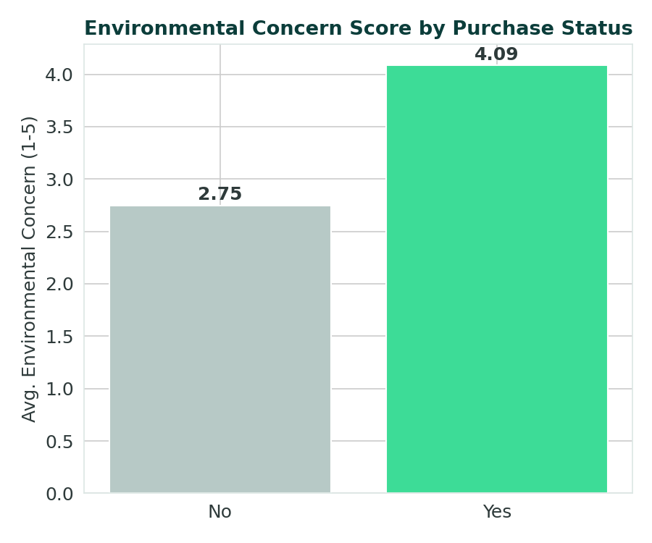
Range Anxiety & Environmental Concern
High anxiety nearly eliminates purchase intent (0.6%)
Buyers score 4.09/5 vs 2.75/5 on eco-concern
EV Purchase Analysis — Real Customer Data
Slide 5

Slide 6
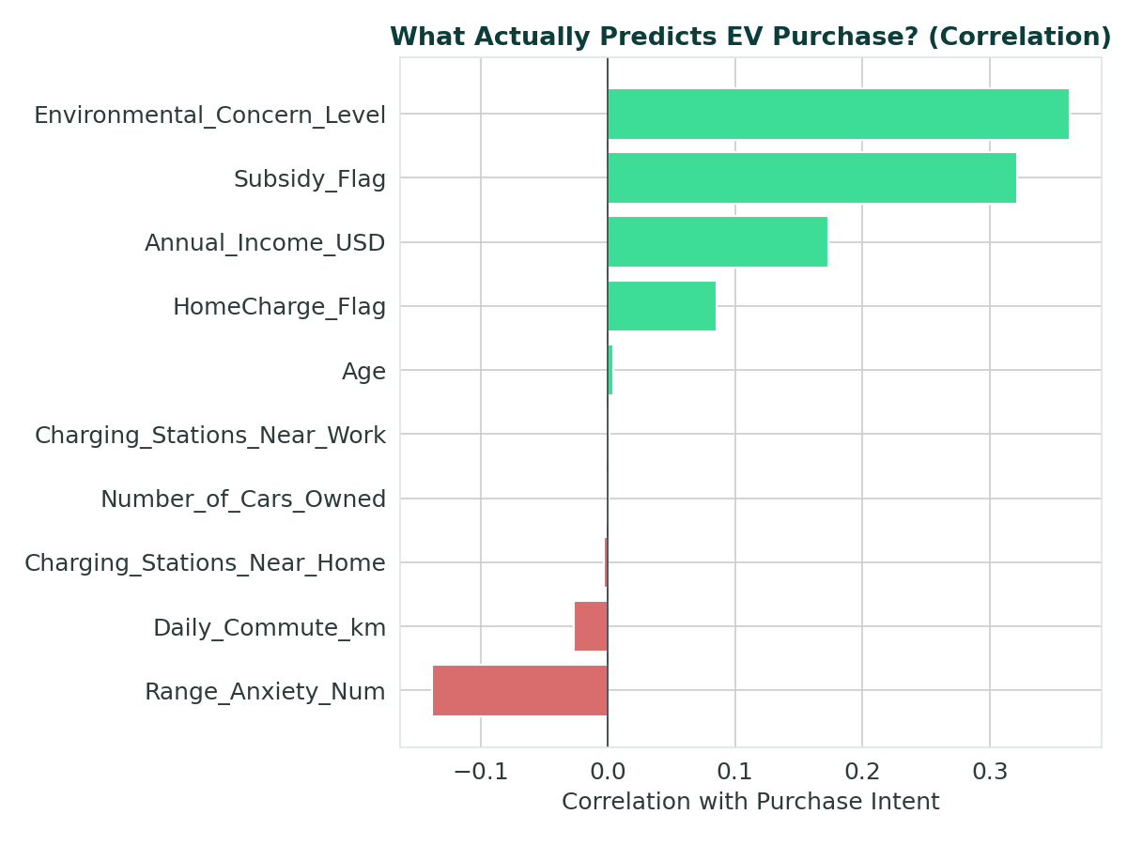
What Actually Predicts a Purchase?
EV Purchase Analysis — Real Customer Data
Slide 6

Slide 7
An Assumption the Data Corrected
“Surely nearby charging stations drive EV purchases...”
Charging stations near home: correlation −0.003. Near work: +0.001. Both statistically meaningless.
Age, gender, city type, current car type, number of cars owned, and daily commute distance were all similarly negligible.
Lesson: check assumptions against the data before building a strategy on them.
EV Purchase Analysis — Real Customer Data
Slide 7

Slide 8
Predicting Purchase Intent
Clean &
Encode
Train/Test
Split (stratified)
Logistic Regression
(class_weight=balanced)
Predict &
Evaluate
82.5%
81.4%
0.48
0.86
0.91
Baseline
Accuracy
Precision
Recall
ROC-AUC
Accuracy (81.4%) sits below the 82.5% baseline on purpose — class weighting trades a little accuracy for 86% recall on real buyers, versus 0% for a model that just predicts ‘No’ every time.
EV Purchase Analysis — Real Customer Data
Slide 8

Slide 9
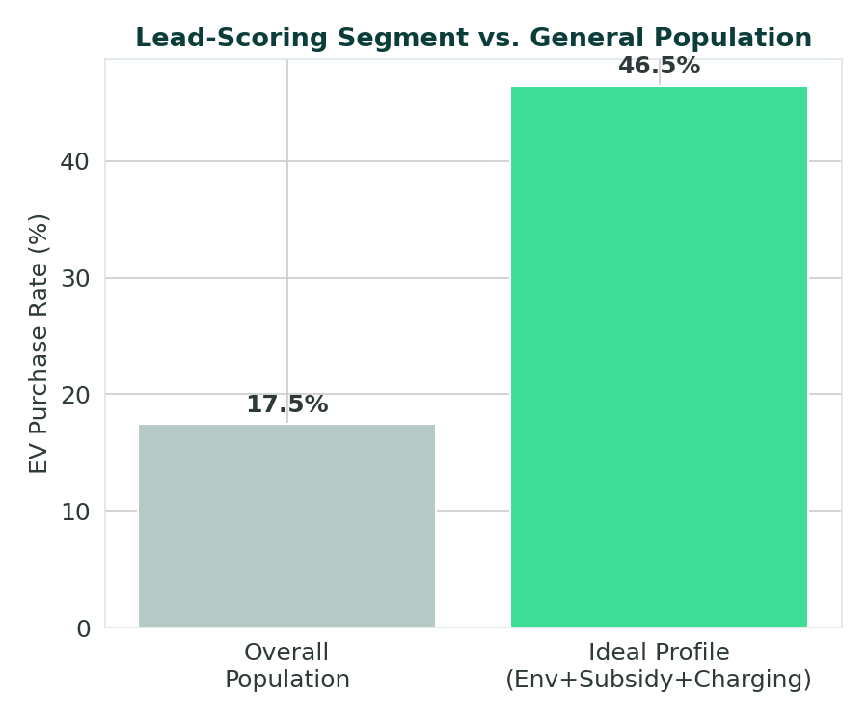
Turning Findings Into a Lead-Scoring Rule
THE RULE
Above-median environmental concern
+ Subsidy available
+ Home charging possible
= 46.5% buy rate
vs. 17.5% overall — a 2.7x lift, covering 2,292 of 10,000 customers (23%).
Simple enough to hand directly to a sales team — no model required to act on it.
EV Purchase Analysis — Real Customer Data
Slide 9

Slide 10
Business Recommendations
1
2
3
Lead with subsidy eligibility
Invest in range-anxiety messaging
Drop charging-station-count targeting
An 11x swing in buy rate — the highest-leverage lever available, ahead of any demographic targeting.
Warranty, roadside assistance, and range calculators before broad demographic campaigns.
The data shows no effect — charging feasibility matters, station count doesn't.
EV Purchase Analysis — Real Customer Data
Slide 10

Slide 11
Your 60-Second Interview Answer
“I analyzed a 10,000-customer EV purchase survey to find which factors actually predict intent. After fixing a common issue where Yes/No fields were stored as text, I ranked every feature by correlation — only four mattered: environmental concern, subsidy, income, and range anxiety. Everything else, including charging-station proximity, was noise, correcting an assumption I started with. Subsidy access alone produced an 11x swing in buy rate. I trained a class-weighted Logistic Regression and got 0.91 ROC-AUC and 86% recall, explicitly explaining why accuracy came in below baseline rather than hiding it. I combined the top three factors into a lead-scoring rule that lifts buy rate from 17.5% to 46.5% for 23% of customers — a concrete, actionable output for a sales team.”
EV Purchase Analysis — Real Customer Data
Slide 11

Slide 12
Frequently Asked Questions
Q: Why is accuracy below the baseline?
Q: Why exclude nothing but use class_weight instead?
A: Class weighting trades accuracy for recall — 86% of real buyers caught vs. 0% for the naive baseline.
A: Keeps all signal available; weighting addresses the 17.5% imbalance directly without discarding data.
Q: Doesn't charging-station count matter intuitively?
Q: What's the most useful output for the business?
A: It seems like it should — the data says it doesn't (correlation ≈ 0). Feasibility matters, count doesn't.
A: A 3-factor lead-scoring rule lifting buy rate from 17.5% to 46.5% for 23% of customers.
EV Purchase Analysis — Real Customer Data
Slide 12

Slide 13
Check assumptions against
the data — then act on
what's actually there.
Four real factors, one actionable lead-scoring rule, and an honest account of a model's trade-offs.
Thank you

