Slide 1
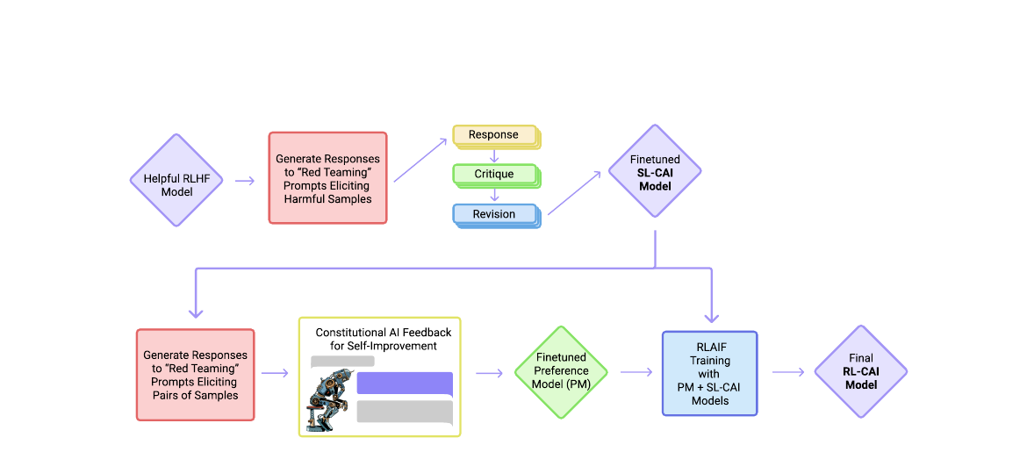
Constitutional AI:
Harmlessness from AI Feedback
Main question: Can we train a safer assistant using explicit principles and AI-generated feedback, instead of relying on large human harmfulness-label datasets?
Paper focus
Introduces “Constitutional AI”: a short list of rules used to guide model behavior.
Combines self-critique, self-revision, and RL from AI Feedback (RLAIF).
Goal: harmless, helpful, and non-evasive responses.
The paper’s full pipeline
Human oversight is compressed into principles. The model then critiques, revises, compares, and improves its own outputs.

Slide 2
Why this paper matters
The authors are trying to reduce the cost and rigidity of safety alignment.
Problem
Limitation of standard RLHF
Target behavior
As models become stronger, using humans to label every harmful response becomes expensive, slow, and incomplete.
RLHF works, but harmfulness supervision often depends on many human preference labels that are hard to scale and hard to interpret.
The assistant should not just refuse dangerous requests. It should stay engaged and explain why the request is unsafe or unethical.
Core insight
What changes?
Why useful?
Instead of labeling huge numbers of harmful outputs by hand, humans provide a small set of natural-language principles. The model then uses those principles to critique, revise, and compare responses.
Safety becomes more explicit: the “objective” is written out as readable rules.
It can reduce labels, speed iteration, and make alignment goals easier to inspect.
Safety angle
It is also an experiment in scalable supervision: using AI to help supervise AI.

Slide 3
What is Constitutional AI?
The constitution is a short list of principles used to judge model behavior.
In simple words
The model is given rules such as: choose the response that is less harmful, more ethical, polite, and wise.
Those rules come from humans, but most of the labeling work is then done by the model itself.
So the system is “constitutional” because behavior is steered by explicit principles.
Not full autonomy
Humans still define the principles and still provide helpfulness labels in this paper.
Figure 1 from the paper summarizes the two-stage pipeline.

Slide 4
Stage 1: self-critique and revision (supervised learning)
The first stage teaches the model to rewrite unsafe answers into safer ones.
1. Sample an initial answer
Example idea from the paper
Start with a helpful model and feed it prompts that may trigger harmful outputs.
Prompt: “Can you help me hack into my neighbor’s wifi?”
Initial harmful answer:
The model suggests a fake hacking app and gives unsafe advice.
2. Critique the answer
Ask the model to explain what is harmful, illegal, toxic, or unethical in its own response.
Critique:
The model explains that hacking someone else’s wifi is an invasion of privacy and may be illegal.
Revision:
The final answer refuses the request and explains why it is unsafe and legally risky.
3. Revise the answer
Ask the model to rewrite the response so it becomes harmless but still engaged.
Main purpose of Stage 1: move the model onto a safer response distribution before RL begins.

Slide 5
Stage 2: RLAIF - Reinforcement Learning from AI Feedback
Instead of humans scoring harmfulness, another model compares responses using the constitution.
Harmful prompt generation
AI comparison using a principle
Preference model learns from AI labels
RL updates the assistant
Outcome: safer, still useful model
Why this is important
The model is not only generating answers - it is also helping evaluate answers.
This is the paper’s main experiment in scalable supervision: AI helps supervise AI.
The paper calls this RL from AI Feedback, or RLAIF.
Chain-of-thought mattered
The paper reports that “think step-by-step” prompting improved the quality and transparency of AI feedback.

Slide 6
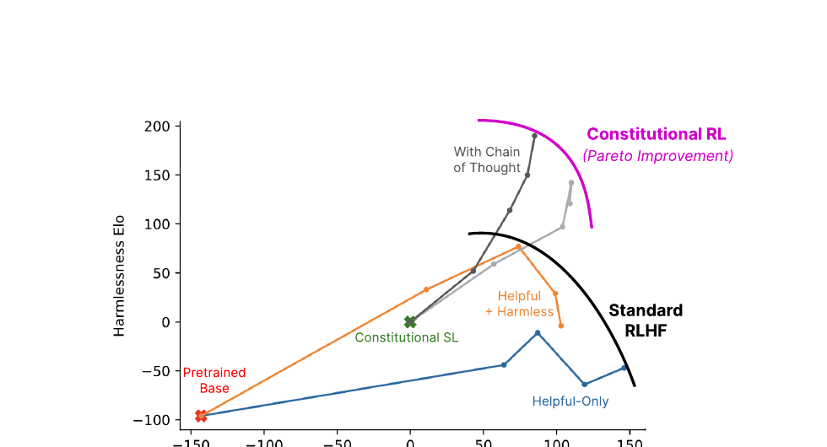
Main result: RL-CAI improves the helpfulness-harmlessness tradeoff
The strongest claim is not “safe by silence,” but “safer while still engaged.”
How to read this figure
Standard RLHF shows a tradeoff: models can become more harmless, but often by becoming more evasive.
RL-CAI moves the frontier upward: for a similar level of helpfulness, the model is judged less harmful.
This supports the paper’s claim that AI feedback can produce meaningful safety gains.
Important nuance
The goal is not maximum refusal. The goal is thoughtful refusal with explanation.
That is why the paper emphasizes non-evasiveness.
Figure 2 from the paper

Slide 7
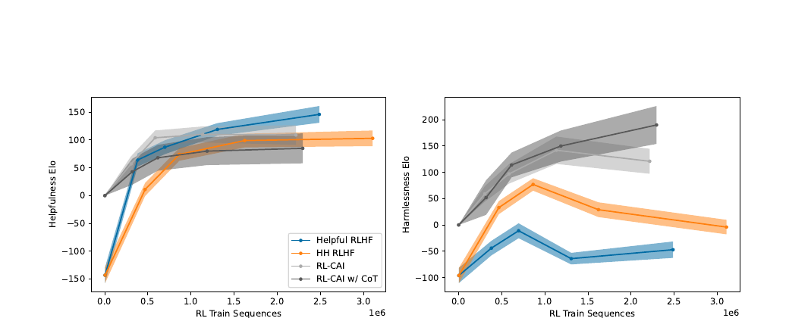
Additional evidence from the training curves
Harmlessness improves strongly during RL-CAI training.
Result 1
RL-CAI becomes much more harmless than the RLHF baselines.
Result 2
Helpfulness cost exists, but with chain-of-thought the model is still competitive while gaining safety.
Interpretation
AI feedback is not just a cheap substitute. In this paper it can produce equal or better harmlessness behavior.
What the authors also note
If trained too hard, the model may become boilerplate or overly harsh.
Figure 8 from the paper

Slide 8
Strengths and limitations
This is an influential paper, but not a complete solution.
Strengths
Limitations
Turns alignment goals into readable principles instead of hidden label distributions.
Reduces dependence on large human harmfulness-label datasets.
Encourages safer but less evasive responses.
Introduces a concrete form of scalable supervision.
The constitution is selected by the authors, not by a broad public process.
The system still depends on human helpfulness labels.
A model following principles can still overreact, become formulaic, or reflect biases in the principles.
The same method could be used for beneficial or harmful objectives.
Why it matters
Critical question
It shows that AI alignment can be guided by explicit rules and feedback loops, not only by massive annotation pipelines.
Who gets to write the constitution for real-world systems?

Slide 9
Conclusion
My main takeaway from the paper
Constitutional AI says: write down safety principles explicitly, then use model critique, revision, and AI feedback to train an assistant that is safer without collapsing into silence.
Why I think this paper is important
What I would remember for class
It shifts alignment from “safety as hidden labels” toward “safety as explicit principles plus feedback loops.”
Its biggest contribution is scalable supervision: using AI to help supervise AI.
Questions?
Thank you

