Slide 1
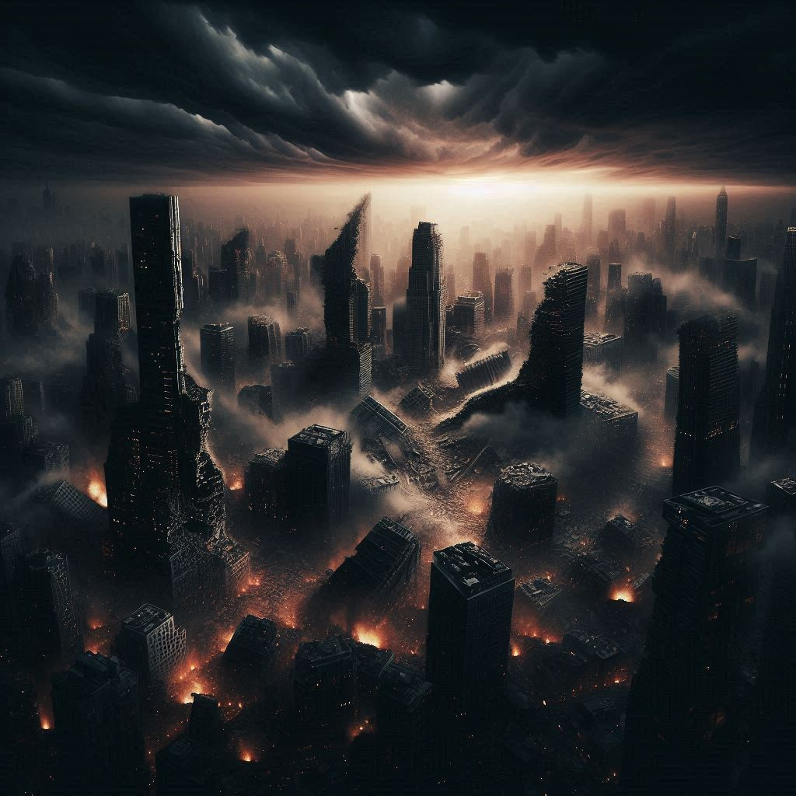
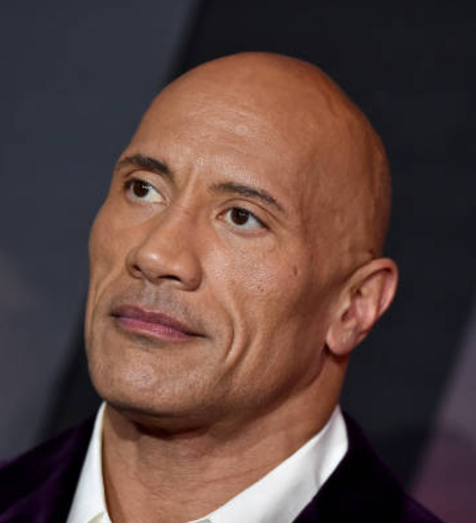

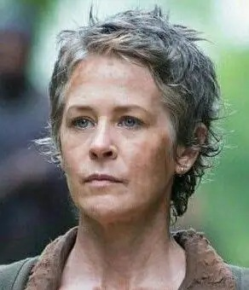
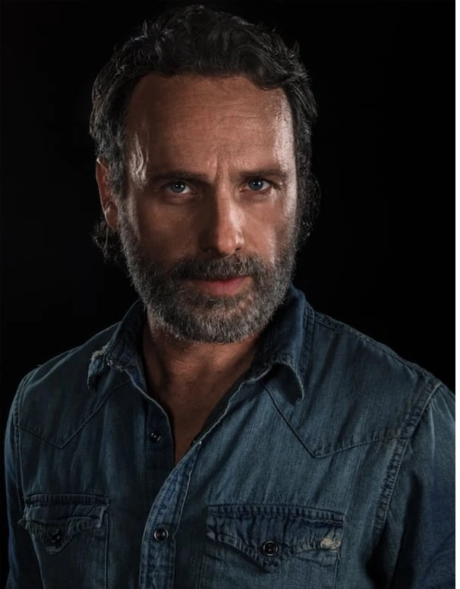
AFTERSHOCKS
Directed by James DeMonaco
The Earth cracked open. So did the Gates of the Dead.
Dwayne Johnson
Jennifer Lawrence
Carol Peletier
Rick Grimes
After a massive quake hits Goodsprings, something ancient awakens beneath the rubble. A team led by Dwayne Johnson must survive the undead to stop a world-ending curse.
🔥 Coming Soon • Only In Theaters

