Slide 1

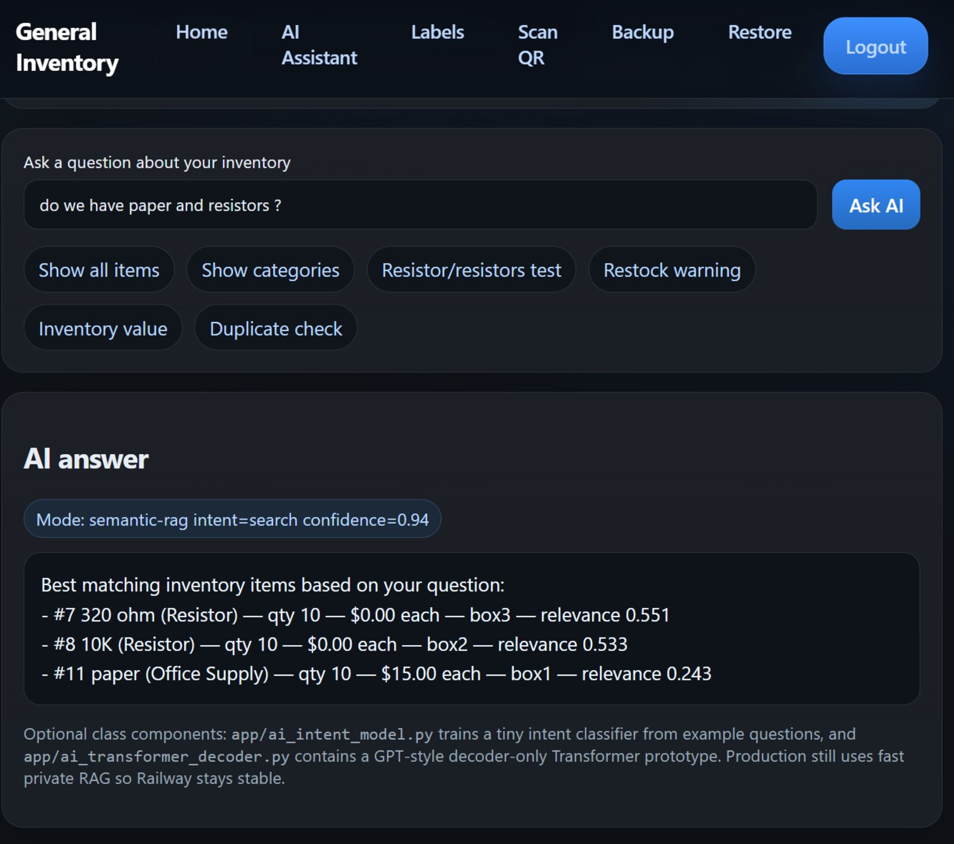
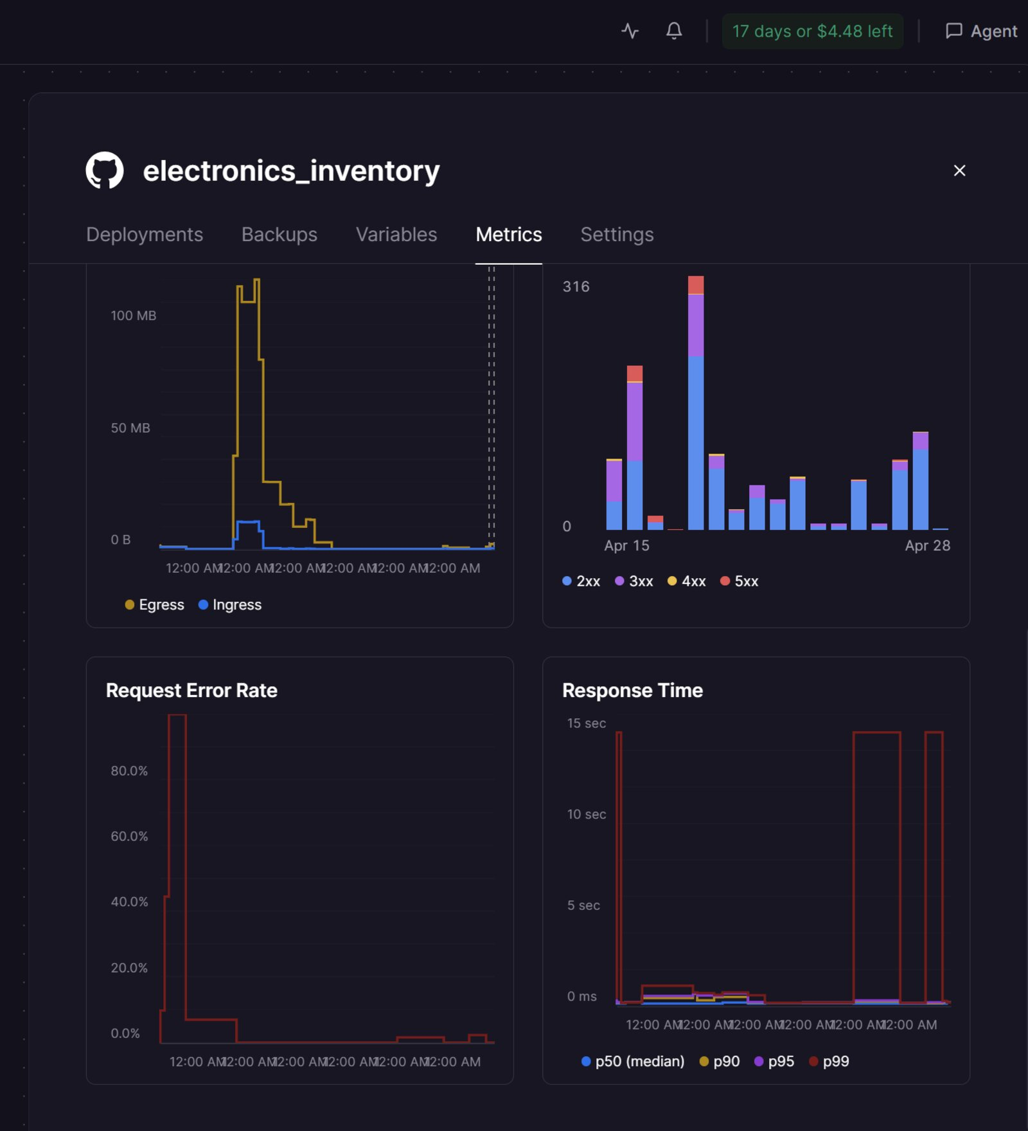
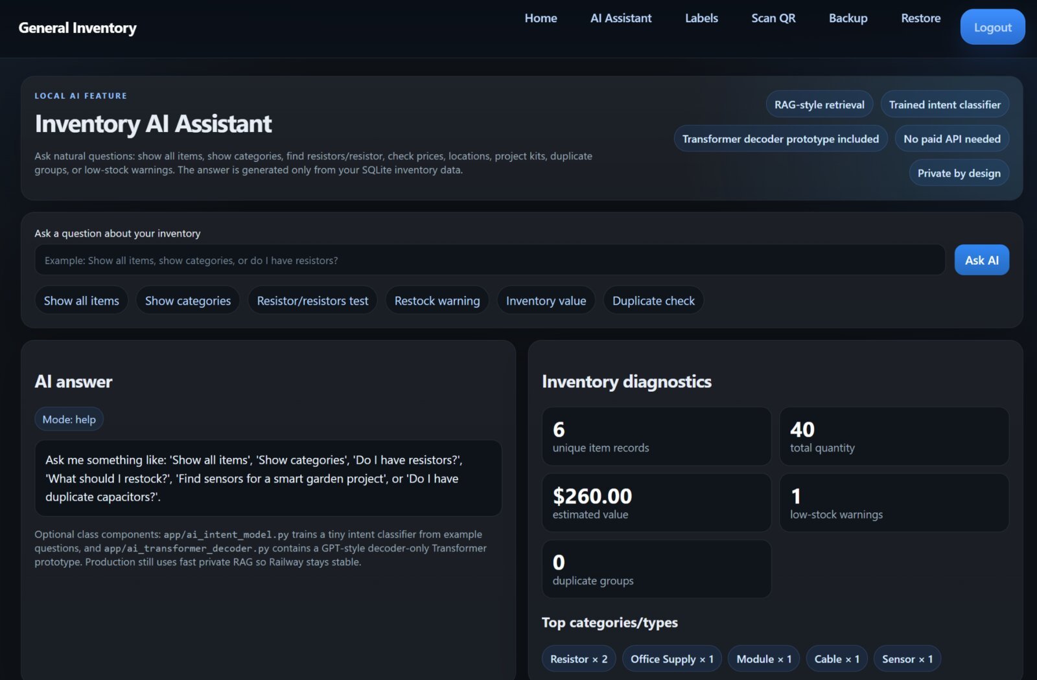


General Inventory AI Assistant
SCAN THE PROJECT REPOSITORY
Source code, documentation, UI screenshots, and deployment notes.
github.com/jentimanatol/electronics_inventory
A private, retrieval-grounded inventory web app that lets users ask natural-language questions about real stored items
Anatolie Jentimir | Bunker Hill Community College | Computer Science / AI Project | GitHub: jentimanatol/electronics_inventory
Private SQLite data
No paid external API
Railway deployment
Optional decoder prototype
ABSTRACT
METHOD OVERVIEW
GROUNDED QUERY EXAMPLE
General Inventory AI Assistant addresses a common real-world problem: many items are spread across drawers, shelves, boxes, and project kits, but standard inventory search only works if the user remembers exact names. This project adds a lightweight AI assistant to a deployed inventory site so the user can ask direct questions and receive answers grounded in private SQLite records.
Production behavior combines four parts: inventory row textification, text normalization, retrieval ranking, and intent routing. Each SQLite row is converted into searchable text; terms are normalized; likely matches are scored; and a small Naive Bayes-style classifier decides whether the user wants search, categories, low-stock analysis, duplicate detection, total value, or a full listing.
MOTIVATION & PROBLEM
• Manual search becomes slow when collections grow.
• Users naturally ask for items in plain language, not database syntax.
• Inventory data may contain private prices, notes, locations, and photos.
• A useful AI system must be accurate, explainable, and cheap enough to deploy under realistic hosting limits.
SYSTEM PIPELINE
User
question
Intent
classifier
Query
routing
SQLite
retrieval
Grounded
answer
Example shown: the query “do we have paper and resistors?” retrieves matching resistor and office-supply rows with confidence displayed in the interface. This demonstrates multi-item search grounded in actual records rather than open-ended generation.
DEPLOYMENT EVIDENCE
Evidence rows and diagnostics are shown back to the user, which keeps the system explainable and reduces hallucination risk. Optional decoder-lab files demonstrate concepts such as greedy decoding, top-k, top-p, beam search, repetition penalty, and KV-cache ideas for class discussion.
INVENTORY FUNCTIONS
The app is more than a chatbot. It supports everyday inventory work: add/edit/delete items, upload item photos, generate QR labels, scan QR codes, search by fields, organize mixed categories, back up or restore the database, estimate total value using quantity × unit price, warn about low stock, and detect duplicates.
AI INTERFACE OVERVIEW
KEY CONTRIBUTIONS
IMPACT & FUTURE WORK
1. A grounded assistant that answers from retrieved rows instead of inventing records.
2. A compact local intent classifier for commands such as show all, categories, restock, duplicates, and value.
3. Singular/plural normalization so natural phrases like resistor/resistors still work.
4. A practical deployment strategy that stays stable on CPU-only Railway hosting.
5. Optional course evidence through an offline GPT-style decoder prototype without making production heavy.
This project shows that small, grounded AI can be genuinely useful in a practical workflow. Future improvements could include stronger synonym handling, semantic embeddings, OCR for labels, richer duplicate grouping, and multi-user collaboration with role-based permissions.
WHY PRIVATE / LIGHTWEIGHT AI
The deployment intentionally avoids loading a full PyTorch stack in production. That cuts memory use, cold-start time, and failure risk on a small hosted service. The result is a systems-oriented AI design: use the simplest architecture that solves the real task reliably, then keep heavier model experiments offline where they are safer and easier to control.
REFERENCES
Lewis et al., Retrieval-Augmented Generation (2020)
Manning, Raghavan, and Schütze, Introduction to Information Retrieval (2008)
McCallum and Nigam, Naive Bayes Text Classification (1998)
FastAPI documentation
SQLite documentation
Railway deployment documentation
Project repository is available through the QR code in the header.

