Slide 1
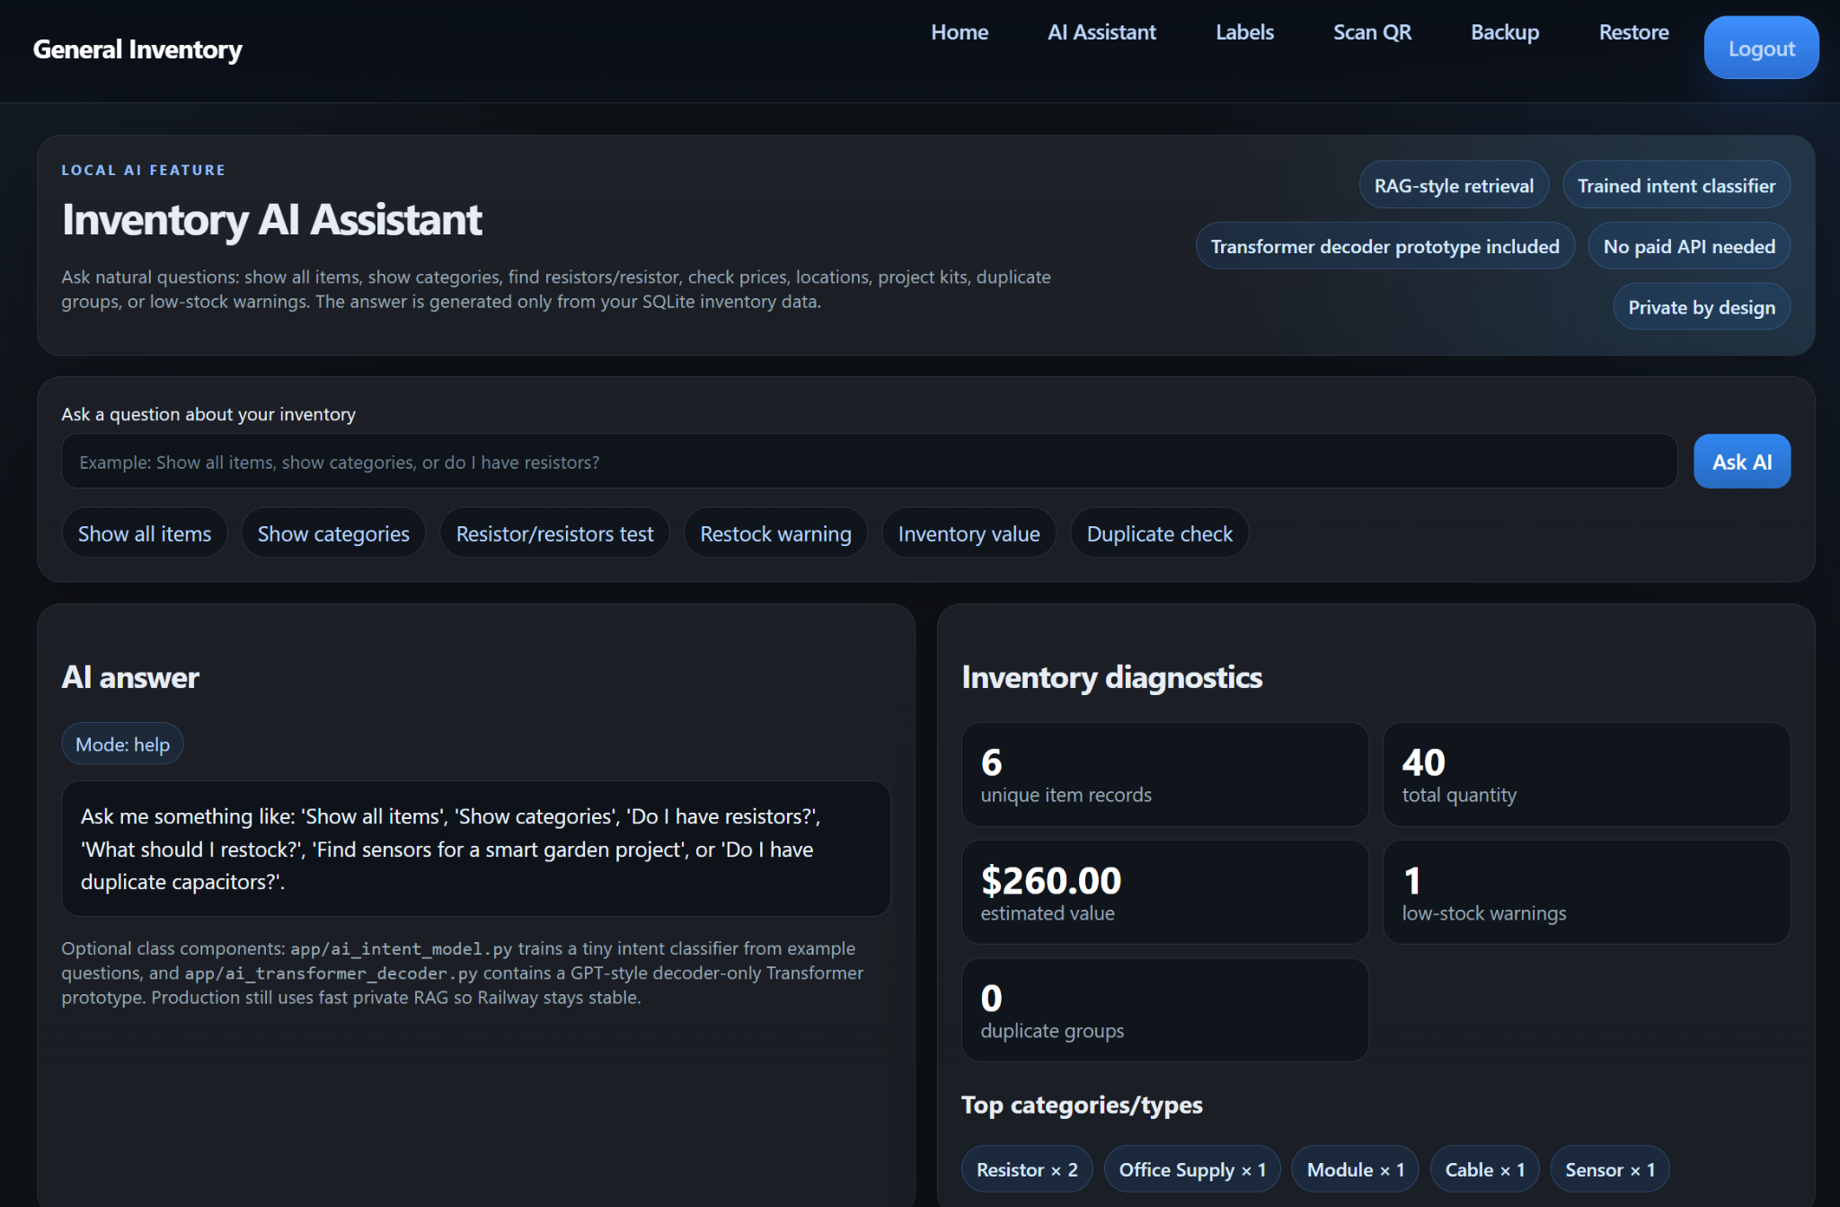
General Inventory
AI Assistant
Private RAG + trained intent classification for a deployed inventory web app
Track D: Systems / deployment
LLM-style workflow
• Natural-language inventory questions
• Grounded answers from SQLite records
• No paid API or GPU needed in production
Team member: Anatolie Jentimir
Live /ai page with answer panel, diagnostics, and category chips

Slide 2
Problem and success criteria
Why natural-language inventory support matters
Problem
Example questions
Success means
• Manual search is slow when items are spread across boxes, drawers, and locations.
• Exact keyword search fails when users ask naturally.
• Users need summaries, prices, duplicates, and restock warnings.
“Show all items”
“Show categories”
“Do I have textbooks?”
“What should I restock?”
“What is my inventory worth?”
• Answer from current database rows only.
• Handle common wording variations.
• Show evidence for transparency.
• Stay stable on Railway without heavy inference.

Slide 3
Data and system architecture
Private SQLite data plus a lightweight AI workflow
Deployed AI workflow
Data statement
Production answers stay lightweight, grounded, and private.
Intent model
• Primary corpus: private SQLite items table.
• Fields: category, type, value/model, quantity, price, location, tags, notes.
• Final demo: 6 unique rows, 40 total quantity, $260 estimated value.
• No public benchmark data is required for deployment.
show all / search
category / restock
value / duplicate
SQLite
items
qty + price
location + tags
Answer
Web UI
grounded reply
weak-match refusal
summaries
/ai page
evidence
diagnostics
RAG retrieval
text rows
normalization
ranked evidence
Design reason: it solves a real application problem while keeping private data local and compute realistic.

Slide 4
Improved method
A general inventory AI pipeline, not a single-category search tool
Final pipeline
Baseline
Intent + grounded answer
Literal search
1
Textify rows
• Intent model routes commands: list all, categories, search, restock, value, duplicates.
• Answer generator uses only retrieved database evidence.
• Weak matches return a safe “not found” message instead of hallucinating.
• Optional offline Transformer prototype is kept separate from production startup.
Turn each item record into a searchable document.
• Works for exact item names.
• Weak for categories, prices, restock, and natural phrasing.
• No special handling for “show everything” style commands.
2
Normalize language
Handle common wording, item names, categories, and plural forms.
3
Rank evidence
Score likely database rows using lightweight retrieval.
Good starting point, but limited.
Result: general inventory questions become structured, explainable answers.

Slide 5
Training, compute, and deployment decisions
Small models in production; larger experiments stay offline
Production path
Class experiment
Compute realism
• FastAPI + SQLite on Railway.
• CPU-only retrieval and answer generation.
• Intent model trains instantly from local example phrases.
• Safe migration added price to old databases.
• Tiny decoder-only Transformer file included for offline learning.
• Decoder lab demonstrates greedy search, sampling, beam search, and deployment tradeoffs.
• Not loaded by Railway startup.
• No GPU required for the deployed system.
• No paid API key required.
• Lower memory use and faster cold starts.
• Reproducible on a normal laptop.

Slide 6
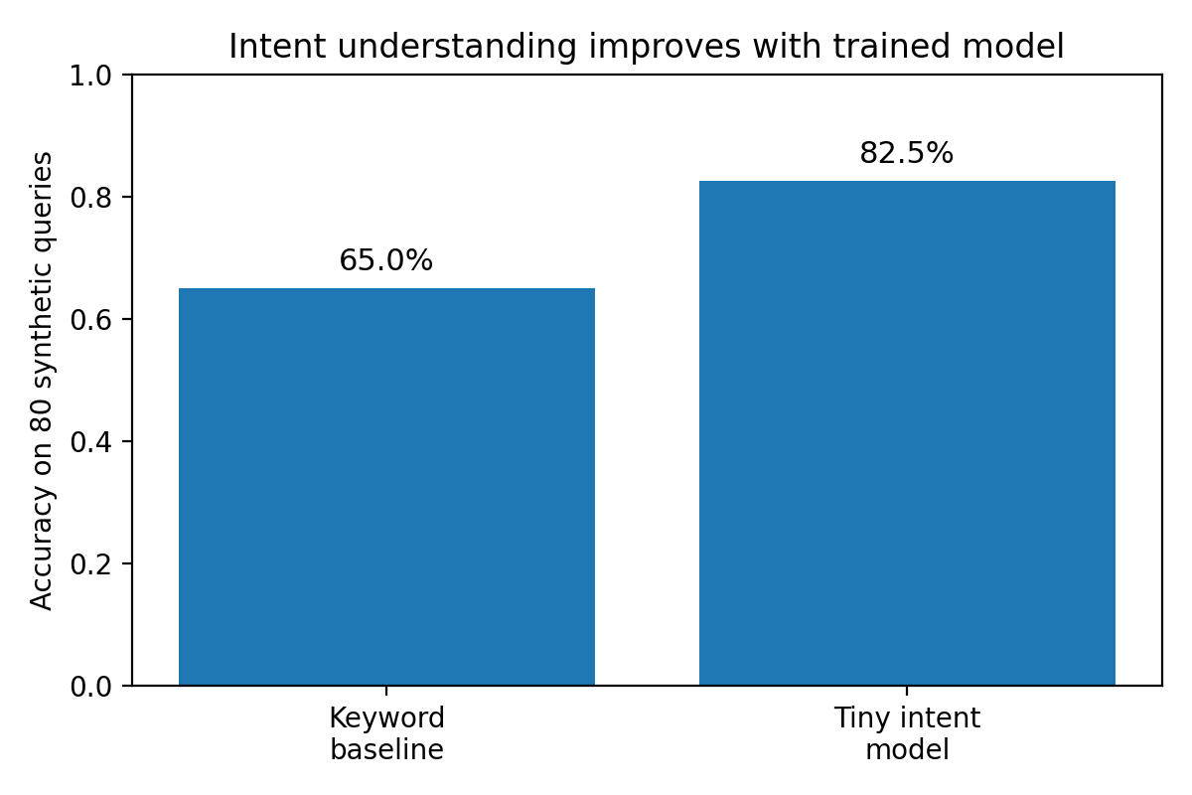
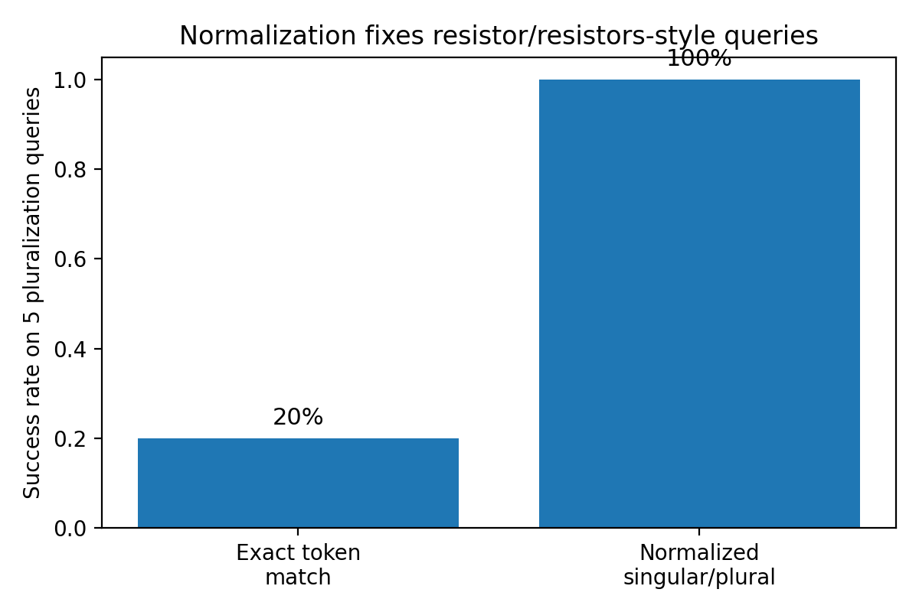
Evaluation and results
Component-level checks plus live functional testing
Key findings
• Intent routing improved structured command handling on synthetic test questions.
• Word normalization improved retrieval for common item wording variations.
• Live tests passed for show-all, category summary, item lookup, restock warning, duplicate check, and inventory value.
Diagnostics are shown directly in the app: record count, total quantity, value estimate, low-stock warnings, duplicate groups, and top categories.

Slide 7
Responsible AI and limitations
Grounded answers are safer than free-form generation for private inventory
Responsible AI choices
Limitations
• Inventory data can include private locations, photos, and prices.
• The production assistant does not need external LLM API calls.
• Evidence rows are visible for transparency.
• Weak matches should be refused, not invented.
• Small private dataset, not a benchmark-scale study.
• Intent examples are compact and can miss unusual phrasing.
• Normalization handles common cases, not unlimited vocabulary.
• Offline Transformer prototype is educational, not production-grade.

Slide 8
Conclusion and future work
A practical deployed system with a clear path for improvement
Conclusion
Future work
• The system upgrades a working inventory app with a useful AI layer.
• It answers general inventory questions using grounded database evidence.
• The design balances AI capability, privacy, reproducibility, and deployment stability.
• Add spelling correction and better synonym support.
• Add charts for value by category and stock over time.
• Add barcode support and CSV import/export.
• Create a larger fixed evaluation set.
• Improve project-kit recommendations.
Main lesson: for a real deployed app, a small grounded AI workflow can be more useful than a heavy model that is expensive or unstable to serve.
Thank you.

