Slide 1
Energy Efficiency of Residential Buildings
Arjun R., Skyler S., Jenny T., Emily W., Qingzi Z.
August 2019

Slide 2
Executive Summary
Goal: To predict residential buildings’ energy consumption, specifically their heating and cooling loads (HL and CL), to enable more energy efficient designs and creations
Dataset: Simulated data of 768 buildings for a research paper by Dr. Tsanas and Xifara¹
Models tested: Regressions, Bagging, Random Forest, Boosting
Best Model: Boosting
Relevant predictors: Roof, relative compactness, surface area, glazing area
Note(s): The paper name is “Accurate quantitative estimation of energy performance of residential buildings using statistical machine learning tools”
Notes:
Goal: specifically, the heating and cooling loads of buildings
Heat load refers to the amount of heating that a building needs in order to maintain the indoor temperature at established levels
Cooling load refers to the amount of heat that needs to be removed to maintain indoor temperature
The lower the heating or cooling loads, the better; can range from 5 to 50
Big-Picture Problem:
Growing concern for the state of our environment and the impact of our energy consumption on the planet, specifically building energy consumption, as populations increase and demand for energy grows
Heating, ventilation, and air conditioning (HVAC) account for most of the energy consumption in buildings. Computing the heating load and cooling load is required to determine the specifications of the heating and cooling equipment needed to maintain comfortable indoor air conditions. Keeping these values low is key for buildings to be energy efficient.
Research on the energy performance of buildings is often conducted using energy simulation tool, as there are factors that need to be controlled that are not easily done with actual buildings. A civil engineer simulated the data set in our study.
The relevant predictors are based on the best model

Slide 3




Basis of dataset
Our dataset contains 12 building types with four constant features
Volume:
(771.75 m³)
Material:
Modern
Location:
Athens, Greece
Building type:
Residential,
7 persons
Notes:
It is important to ensure identical conditions, therefore these features, when determining the most important impactful predictors of energy efficiency. The controlled volume specifically also impacts our analysis.
Same volume, different SA and dimensions
Location and material affects humidity, air speed, etc.
7 persons with sedentary activity (70W) requires less energy than say, a gym
Additionally:
The internal design conditions were set as follows:
Clothing: 0.6 clo
humidity: 60%
air speed: 0.30 m/s
For the thermal properties, they used:
mixed mode with 95% efficiency
thermostat range 19- 24 ℃, with 15-20 hours of operation on weekdays and 10-20 hours on weekends.

Slide 4

Potential predictors
Our dataset contains eight potential variables to predict HL and CL
 | Potential predictor | Type
 | Relative compactness (~V/SA) | Continuous
 | Surface area (SA) (m²) | Continuous
 | Wall area (m²) | Continuous
 | Roof area (m²) | Continuous
 | Height (m) | Continuous
 | Orientation (4: N, S, E, W) | Categorical
 | Glazing area (% of floor area) | Continuous
 | Glazing distribution (6: by direction) | Categorical
4
1
1
2
5
3
2
4
7
8
3
5
6
7
6
8
Notes:
Relatively compactness is correlated with V/SA
Orientation: the cardinal direction the building is rotated towards in the simulation (N, S, E, W)
4 glazing areas (% of floor area): 0%, 10%, 25%, 40%
6 glazing distributions:
No glazing area
uniform: with 25% glazing on each side,
north: 55% on the north side and 15% on each of the other sides
east: 55% on the east side and 15% on each of the other sides,
south: 55% on the south side and 15% on each of the other sides
west: 55% on the west side and 15% on each of the other sides.

Slide 5
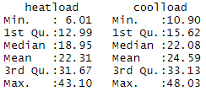
Summary of HL and CL
For reference, our HL and CL range from six to just below 50 kW
Note(s): See appendix for predictor summary
Notes:
Describing what heating loads and cooling loads are and that we’d like to minimize them (during presentation)
Fun fact: 1 kWh = 900 calories = 1 BigMac with fries = on average running your AC for an hour
2) Slide 5: draw attention to the fact that for a building of the same volume, there is 500-700% difference between energy use. 6 watts, vs 43 watts. ie if that was scaled to a whole neighborhood etc.

Slide 6
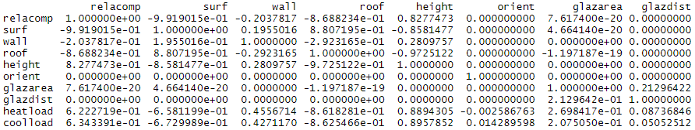
Potential predictor correlations
Before modeling, we noted near perfect collinearities between (1) relative compactness and surface area and (2) roof area and height
We decided to drop relative compactness and roof area for regression models
Note(s): See appendix for pairwise plots
Notes:
We’re almost ready to start modeling
Such collinearities were expected, given fixed volume and geometry. (relative compactness = inner SA/volume!)
This collinearity will impact the performance of regression models. Therefore, surface area or relative compactness should be taken out. We chose to take out relative compactness of regressions.
While height and roof area, roof and relative compactness, and roof and surface areas, are also highly correlated, they’re not as perfect as relative compactness and surface area. And they don’t go into each other’s calculation – so we hypothesize they will tell different information.

Slide 7
Modeling approach
We analyzed the dataset with the approach below
Basis
80/20 training/testing sets
Dummy variables for multivariate regression
CV where applicable
Two models per method, HL and CL
Best based on test RMSE
Models tested
Regressions
Univariate linear
Multivariate linear
Univariate polynomial
Stepwise regressions (all three)
Lasso
Ridge
Bagging
Random Forest
Boosting
Notes:
Likely similar to most people here
Split the energy data set 80/20 for training and test sets
CV within the training set to fine tune parameters where needed (for Lasso, Ridge, and tree methods)
Choose best model based on RMSE calculated on the test set

Slide 8
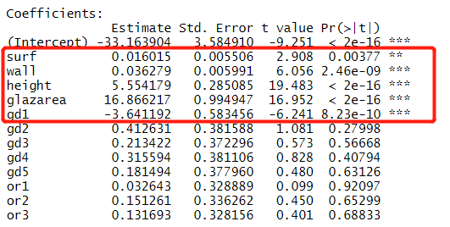
HL predictor relevance – multi. regression
To predict HL, five variables appear to be significant
Predictor | Impact on HL
Surface area (SA) (m²)
Wall area (m²)
Height (m)
Glazing area (% of floor)
No glazing (gd1)
Orientations of windows and of the building are not significant contributors of heating load
Note(s): See appendix for dummy variable explanation
Notes:
Go over significant variables
Roof= can be calculated knowing volume, height and SA
Direction of glaze and orientation weren’t relevant, just the lack of windows reduced the HL.
We also ran the forward, backwards and stepwise regressions, and they all gave the same variables with a little juggling of sa, height, and roof but as I mentioned, they are interchangeable.
Again, we see that increasing the SA, Wall area, height, glazing area, and the presence of windows increasing the heating load, which makes sense.
Other regression’s relevance:
Forward regression (similar): Wall, roof (instead of surface area), height, glazarea, and glazdist are significant
Backward (same): surface, Wall, height, glazarea, and glazdist
Stepwise (same): Wall, roof (instead of surface area), height, glazarea, and glazdist are significant

Slide 9
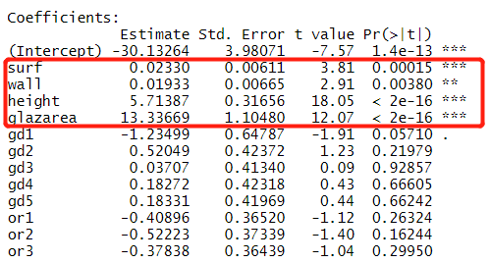

CL predictor relevance – multi. regression
Variables relevant for CL are similar to those for HL
Predictor | Impact on HL
Surface area (SA) (m²)
Wall area (m²)
Height (m)
Glazing area (% of floor)
No glazing (gd1)
Existence of windows might have been captured by glazing area completely already
Note(s): See appendix for dummy variable explanation
Notes:
Here we see that CL is very similar to HL, except for that “gd1 or no windows” may not be significant. It is borderline, and could have been swallowed by the glazarea.
To explore it further, we could always look into the intricacies of heat transfer like Nusselt numbers and Reynolds numbers, but any of your classmates from engineering will vouch that there is a reason we are doing data analytics.
Just like for HL, forward, backwards, and stepwise returned the same variables.
Other regression’s relevance:
Forward regression (same): Surf, wall, height, glazing area (not gd1!)
Backward (same): Surf, wall, height, glazing area
Both (same): Surf, wall, height, glazing area

Slide 10
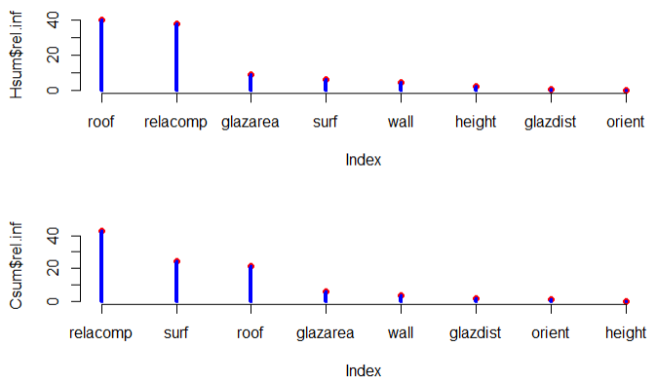
Predictor relevance – Boosting
Boosting was able to leverage roof and relative compactness for predictions
HL relevant predictors
CL relevant predictors
Note(s): See appendix for Random Forest relevance
Notes:
Glazing distribution and orientation of the houses do not matter again
But tree
ee’s flexibility in using highly correlated predictors changed the landscape of predictor relevance a lot
Key take aways. ➔ focus on X,Y,Z

Slide 11
Final verdict
Based on test RMSEs, Boosting is the best model for both HL and CL
Model | HL Test RMSE (kW) | CL Test RMSE (kW)
Boosting | 0.405 | 1.19
Random Forest (including bagging) | 0.498 | 1.79
Multivariate regression | 2.87 | 3.46
Stepwise regression (all three) | 3.07 | 3.53
Lasso regression | 3.18 | 3.68
Ridge regression | 3.35 | 3.88
Numtree = 100
Interaction depth = 10
Lambda = 0.20
HL:
M = 7
Numtree = 300
CL:
M = 8 (bag.)
Numtree = 50
Notes:
How to apply what we learn: Maximize relative compactness and minimize glazing area – or using better insulated windows (nobody wasn’t to live in a jail)
Recommendations: Add window materials to the model to better predict; flex on volume to better determine

Slide 12
Appendix

Slide 13
Getting to n (768)
Buildings with Glazing
12
Building Forms
3
Glazing Areas
5
Glazing Distributions
4
Orientations
=
720
Building Samples
→
Buildings without Glazing
12
Building Forms
4
Orientations
=
48
Building Samples
→
768
Total Building Samples
Notes:
This information could be added to another slide later after things are condensed, there’s just not a place for it right now.

Slide 14
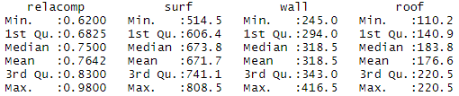
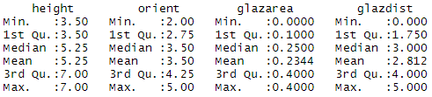
Potential predictor summary
Back

Slide 15
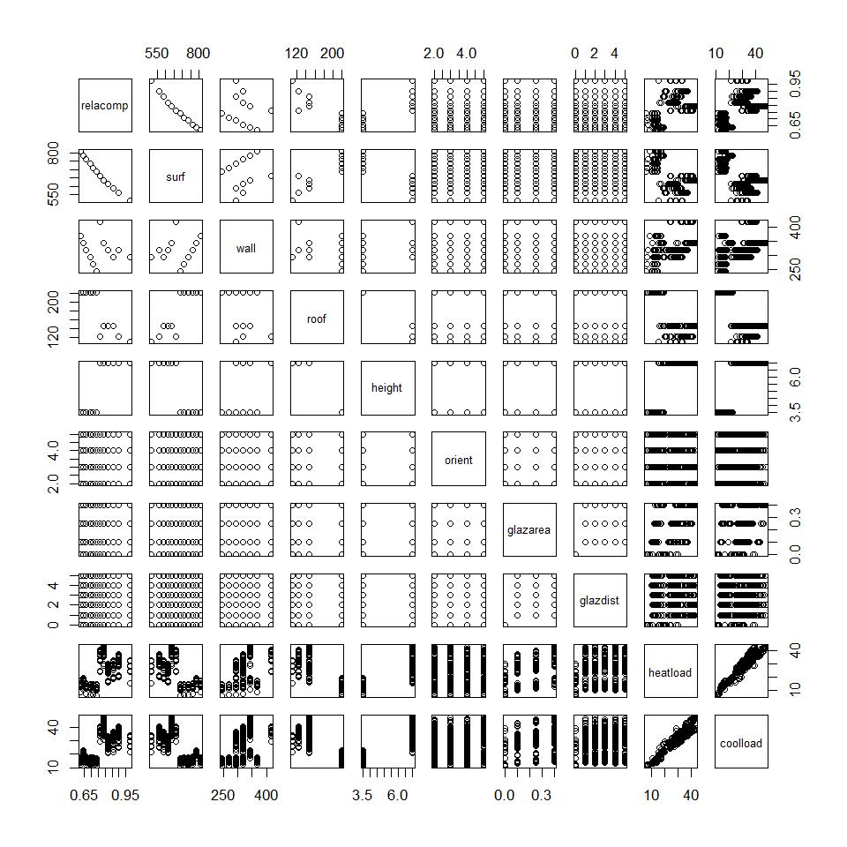
Variable pairwise plots
In support of perfect collinearity
Back
Notes:
Such collinearities were expected, given fixed volume and geometry. (relative compactness = inner SA/volume!)
This collinearity will impact the performance of regression models. Therefore, surface area or relative compactness should be taken out. While height and roof area, roof and relative compactness, and roof and surface areas, are also highly correlated, they’re not as perfect as relative compactness and surface area. And they don’t go into each other’s calculation – so will tell different information.

Slide 16
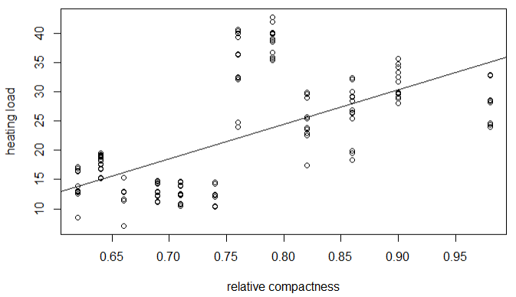
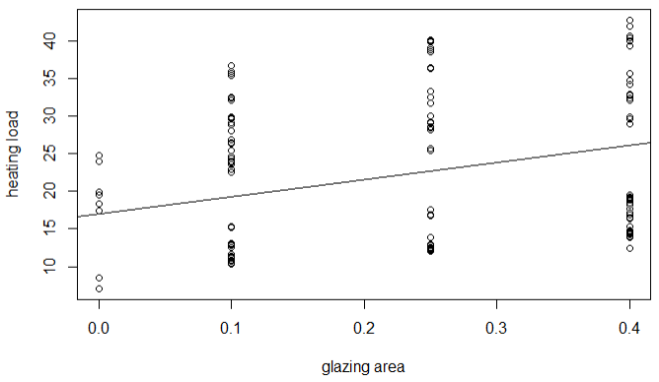
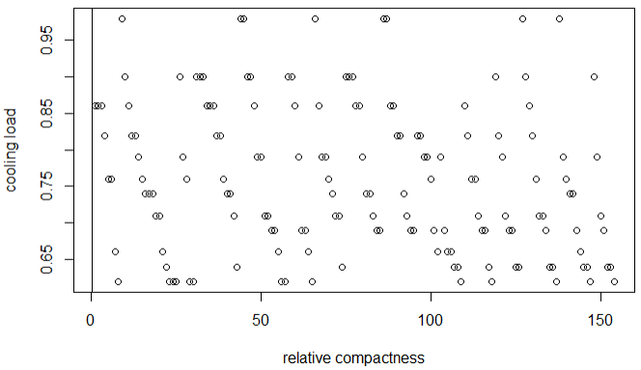
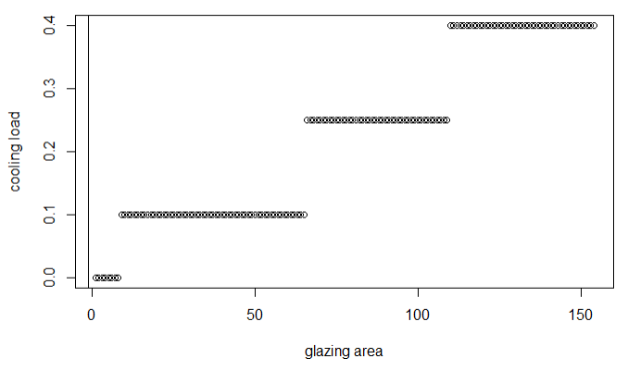
Simple linear regressions
We ran linear regressions for two variables; both had RMSEs > 7 kW
Back
Notes:
Heating vs relacomp = 7.51
Heating vs glazarea = 9.73
Cooling vs relacomp = 7.25
Cooling vs glazing area = 9.56
While we also ran simple polynomial regressions and some values (especially for the area variable) are significant, it is hard to interpret their significance is due to the way volume is calculated. Given that volume is controlled in our data set, it is difficult to conclude whether they all play together.

Slide 17
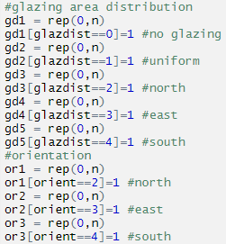
Dummy variable setup
For multivariate regression
Back to modeling & analysis
Back to predictor relevance

Slide 18
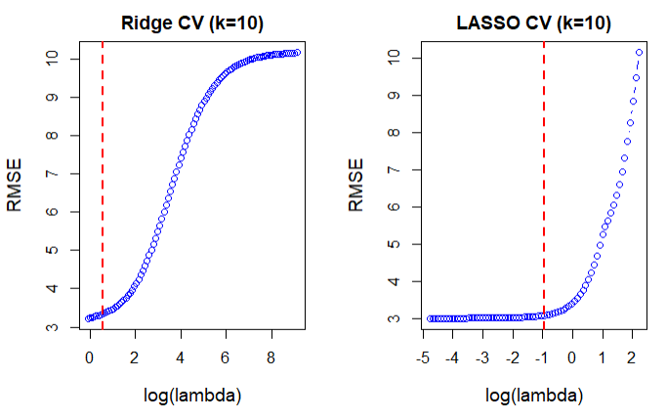
Lasso and Ridge – HL

Slide 19
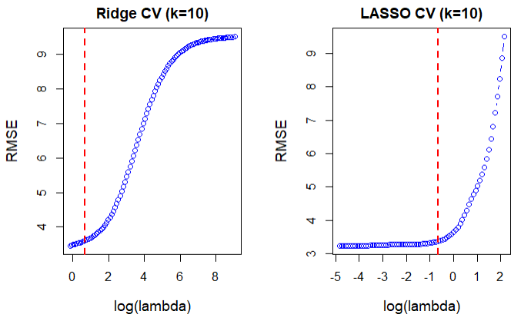
Lasso and Ridge – CL

Slide 20
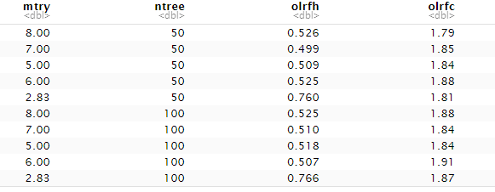
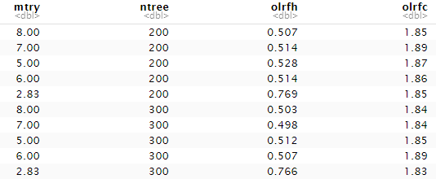
Sample RF/Bagging CV Output
Tested
M = sqrt(8), 5, 6, 7, 8
Numtree = 10, 20, 50, 100, 200, 300, 600

Slide 21
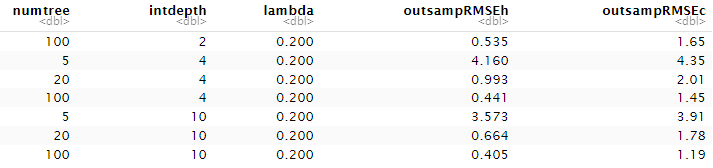
Sample Boosting CV Output
Tested
Numtree = 5, 20, 100
Interaction depth = 2, 4, 10
Shrinkage = 0.001, 0.1, 0.2

Slide 22
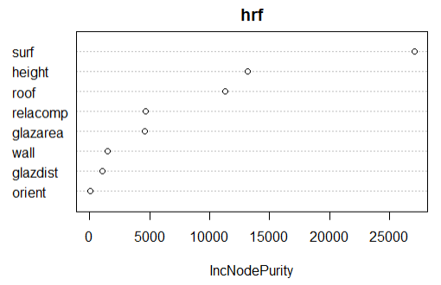
HL predictor relevance – Random Forest
R.F. also appears to put little emphasis on glass distribution and orientation
R.F.’s ability to use correlated variables puts focus on roof area
Back to predictor relevance
Notes:
R.F.’s ability to use correlated variables may enable reliance on fewer x’s – surface area, height, and roof
Boosting: roof, relacomp, and glaz area are most important
Wall does not appear to be significant here, likely because of the inclusion of all the other areas

Slide 23
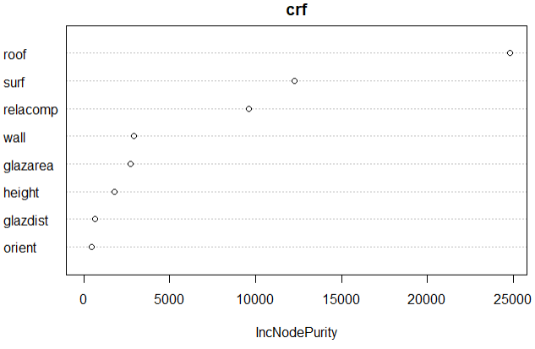
CL predictor relevance – Random Forest
R.F. result is similar to that of multivariate regression
The ability to use roof area is even more pronounced for CL
Back to predictor relevance
Notes:
Again, glazdist and orientations are not important, and R.F. is able to use roof! Good to be able to use highly correlated variables
Boosting: relacomp, surf, roof (pretty much the same, just different order)
Again, including roof and surface area seem to be particularly important. Because we couldn’t do that for regression, R.F. appear to “need” fewer variables

