Slide 1
XAMARIN CHALLENGES PRESENTATION
By
DIPAK DUTTA

Slide 2
AGENDA
What is Xamarin?
How Xamarin Work?
Xamarin.Forms UI challenge?
Example
Conclusion

Slide 3
What is Xamarin?
Xamarin is an open-source platform for building modern and performant applications for iOS, Android, and Windows with .NET. Xamarin is an abstraction layer that manages communication of shared code with underlying platform code. Xamarin runs in a managed environment that provides conveniences such as memory allocation and garbage collection.
Xamarin enables developers to share an average of 90% of their application across platforms. This pattern allows developers to write all of their business logic in a single language (or reuse existing application code) but achieve native performance, look, and feel on each platform.
Xamarin applications can be written on PC or Mac and compile into native application packages, such as an .apk file on Android, or an .ipa file on iOS.

Slide 4
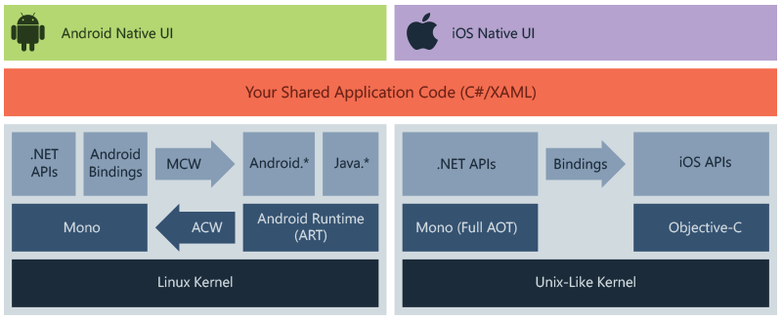
How Xamarin Work

Slide 5
The diagram shows the overall architecture of a cross-platform Xamarin application. Xamarin allows you to create native UI on each platform and write business logic in C# that is shared across platforms. In most cases, 80% of application code is sharable using Xamarin.
Xamarin is built on top of .NET, which automatically handles tasks such as memory allocation, garbage collection and interoperability with underlying platforms.
For more information about platform-specific architecture, see Xamarin.Android and Xamarin.iOS.

Slide 6
Advantages of Xamarin
Open Source platform: Xamarin acquainted by Microsoft is an open-source platform for all that has various components free to use. Developers can replace, change, and separate those components with complete freedom and flexibility as per their requirement.
Single technology for all platforms: Xamarin being an open-source platform uses c# to code and build an app for android, iOS or windows. Xamarin allows developers to use .net tools and library specifically to build apps for Android, iOS, tvOS, watchOS, macOS, and windows that make is the cost-effective and first choice of developers and the clients that posses future in it.
Mobile App Testing made quick and easy: The new version of xamarin has the great benefit of automation testing on the cloud. There is no need of a mobile device with the same OS to test, with this advanced xamarin cloud testing feature, any app can be tested on any version of the mobile device no matter if it’s Android, iOS, Windows or any other. Hence, this has brought a great change that helps in making any changes if required also saves time and money both for you.

Slide 7
Xamarin.Android applications compile from C# into Intermediate Language (IL) which is then Just-in-Time (JIT) compiled to a native assembly when the application launches. Xamarin.Android applications run within the Mono execution environment, side by side with the Android Runtime (ART) virtual machine. Xamarin provides .NET bindings to the Android.* and Java.* namespaces. The Mono execution environment calls into these namespaces via Managed Callable Wrappers (MCW) and provides Android Callable Wrappers (ACW) to the ART, allowing both environments to invoke code in each other.

Slide 8
Added features
Complete binding for the underlying SDKs – Xamarin contains bindings for nearly the entire underlying platform SDKs in both iOS and Android. Additionally, these bindings are strongly-typed, which means that they’re easy to navigate and use, and provide robust compile-time type checking and during development. Strongly-typed bindings lead to fewer runtime errors and higher-quality applications.
Objective-C, Java, C, and C++ Interop – Xamarin provides facilities for directly invoking Objective-C, Java, C, and C++ libraries, giving you the power to use a wide array of third party code. This functionality lets you use existing iOS and Android libraries written in Objective-C, Java, or C/C++. Additionally, Xamarin offers binding projects that allow you to bind native Objective-C and Java libraries using a declarative syntax.
Modern language constructs – Xamarin applications are written in C#, a modern language that includes significant improvements over Objective-C and Java such as dynamic language features, functional constructs such as lambdas, LINQ, parallel programming, generics, and more.

Slide 9
Robust Base Class Library (BCL) – Xamarin applications use the .NET BCL, a large collection of classes that have comprehensive and streamlined features such as powerful XML, Database, Serialization, IO, String, and Networking support, and more. Existing C# code can be compiled for use in an app, which provides access to thousands of libraries that add functionality beyond the BCL.
Modern Integrated Development Environment (IDE) – Xamarin uses Visual Studio, a modern IDE that includes features such as code auto completion, a sophisticated project and solution management system, a comprehensive project template library, integrated source control, and more.
Mobile cross-platform support – Xamarin offers sophisticated cross-platform support for the three major platforms of iOS, Android, and Windows. Applications can be written to share up to 90% of their code, and Xamarin.Essentials offers a unified API to access common resources across all three platforms. Shared code can significantly reduce both development costs and time to market for mobile developers.

Slide 10
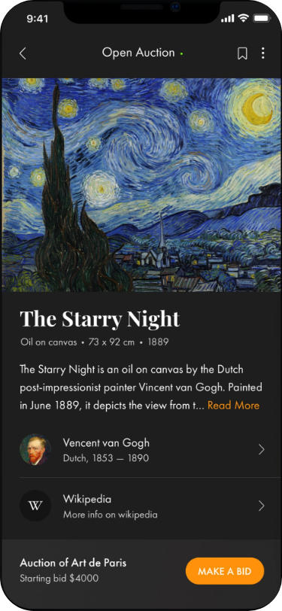
Xamarin.Forms UI challenge:

Slide 11
This screen is actually pretty basic, the key elements are:
Root layout is a Grid with 2 rows. So the footer section can always be at the bottom of the page
The main section is contained within a ScrollView so that if it gets longer than the page it will allow us to scroll to see the additional information.
Then it’s pretty much a StackLayout o lay the elements down the screen.
The top bit of text with the Read Row section which was provided by a very kind community contribution by Pedro Jesus. It’s a custom control with a couple of bindable properties which specify the MaxLenth of the label and a ReadMore property which specifies the color of the readmore text When the text is set it creates a FormattedText with a span for both the text and the Read More section .
The Vincent Van Gogh image got the circular treatment thanks to James Montemagno’s
The Wikipedia icon is a SVG. In Android it’s an xml file that sits under the drawale file and in iOS it is provided by an AssetCatalog which creates a Vector from a PDF.

Slide 12
The nicest part of this screen is the fading and popup that happens when you press the

Slide 13
Conclusion
The architecture of Xamarin is different based on the platforms. Also, the code is compiled in different ways. But all of them use the same classes and libraries of C#.

Slide 14
Thank you!!

