Slide 1

Investment Recommendations for App Trader
Team Blofeld
This Photo by Unknown Author is licensed under CC BY-SA

Slide 2
Key Factors to Consider
Star Rating:
Since monthly revenue is static, the primary variable in net profit is life of the app
Life of App = (Star Rating * 2) + 1
Price:
App Trader’s purchase price = 10,000x the price of any apps over $1
Presence in both app stores:
Each app generates $2,500 in revenue for App Trader per month per app store
Market costs are constant at $1,000 per month for the life of the app
Therefore, apps in both stores generate $4,000 monthly vs. only $1,500 monthly for apps in 1 store

Slide 3
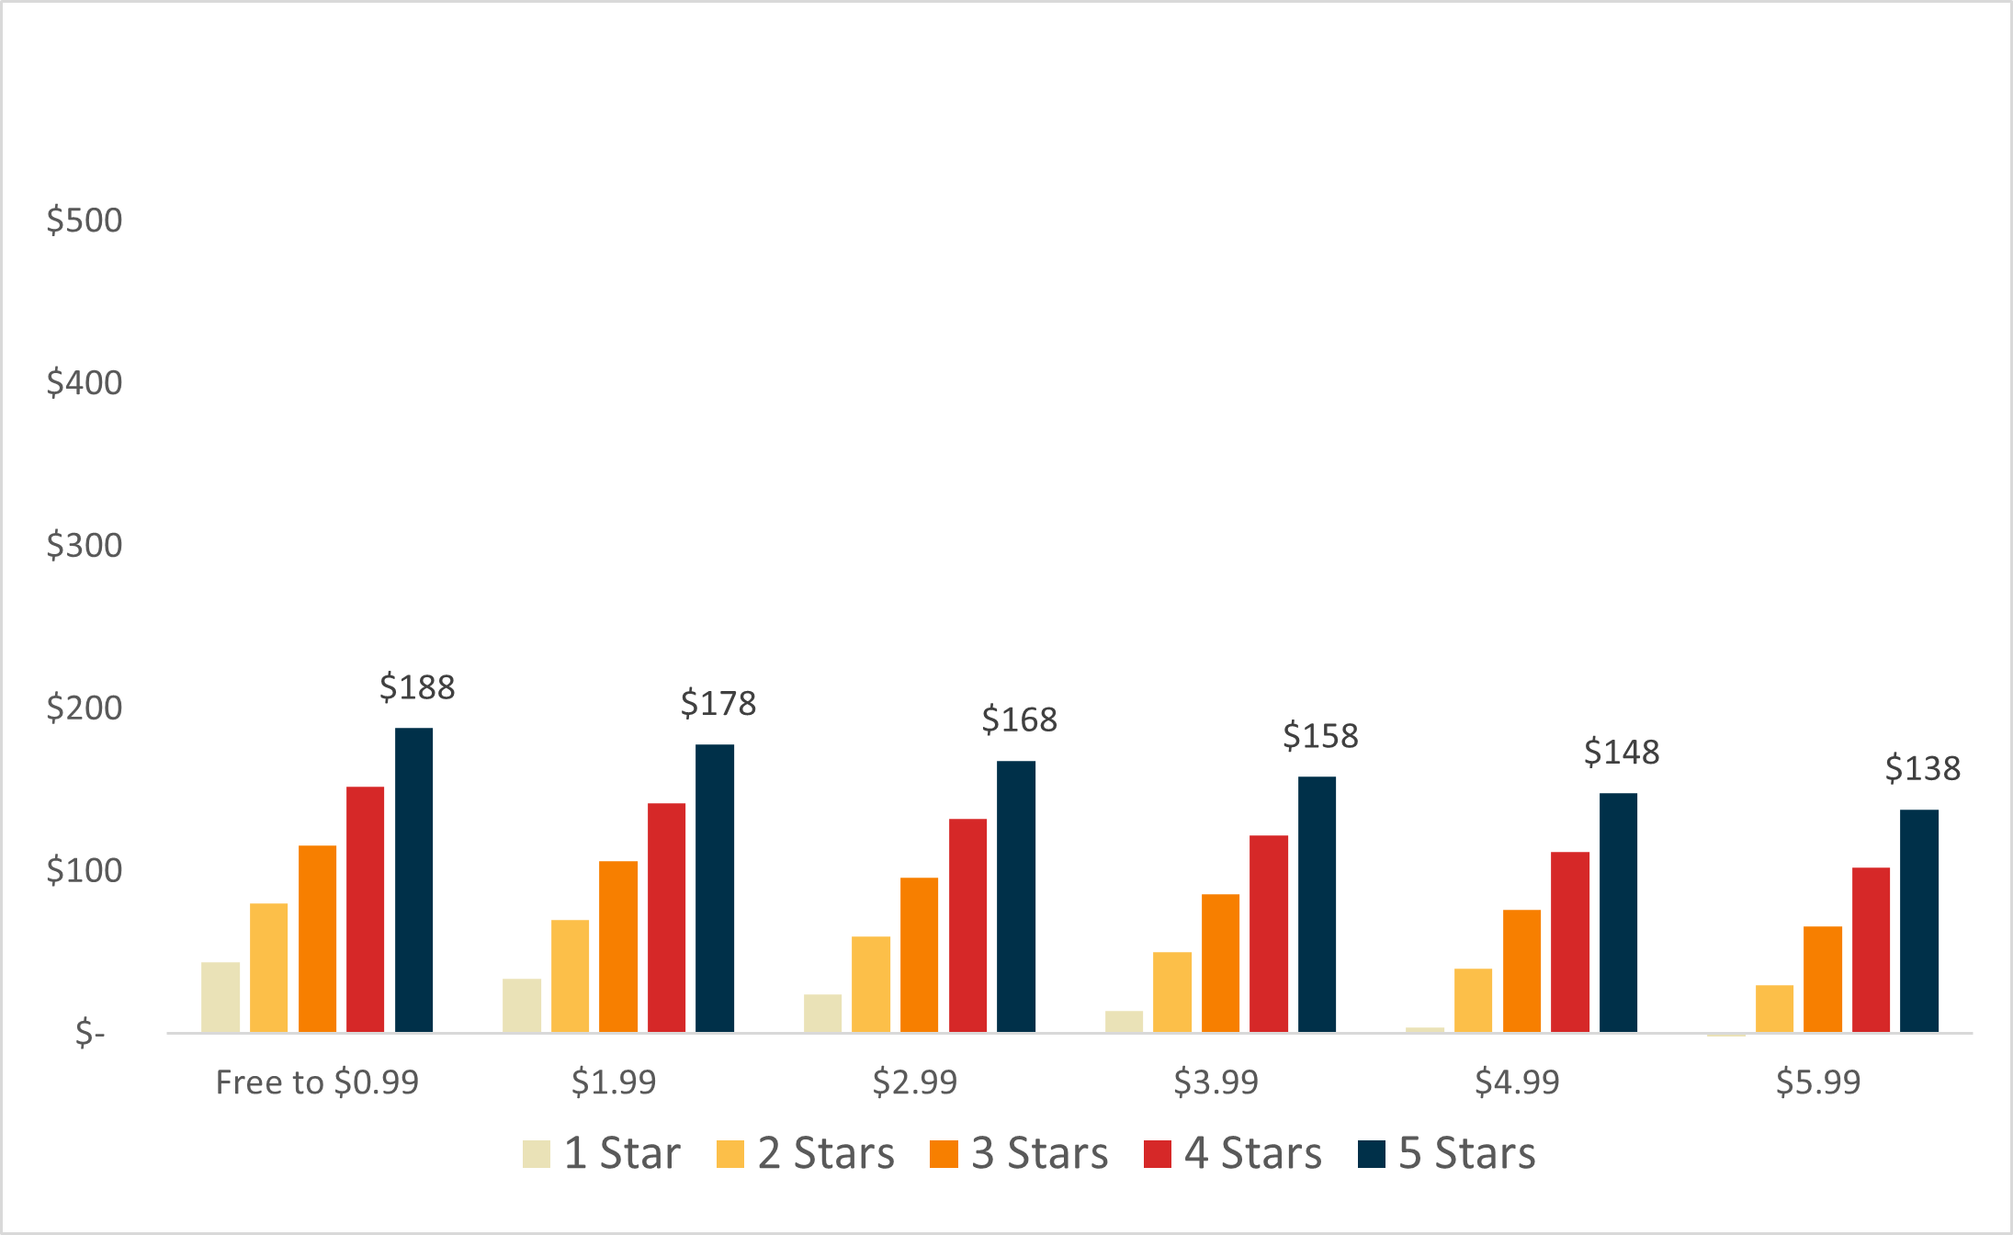
Net Profits (in thousands) for Apps in 1 Store

Slide 4
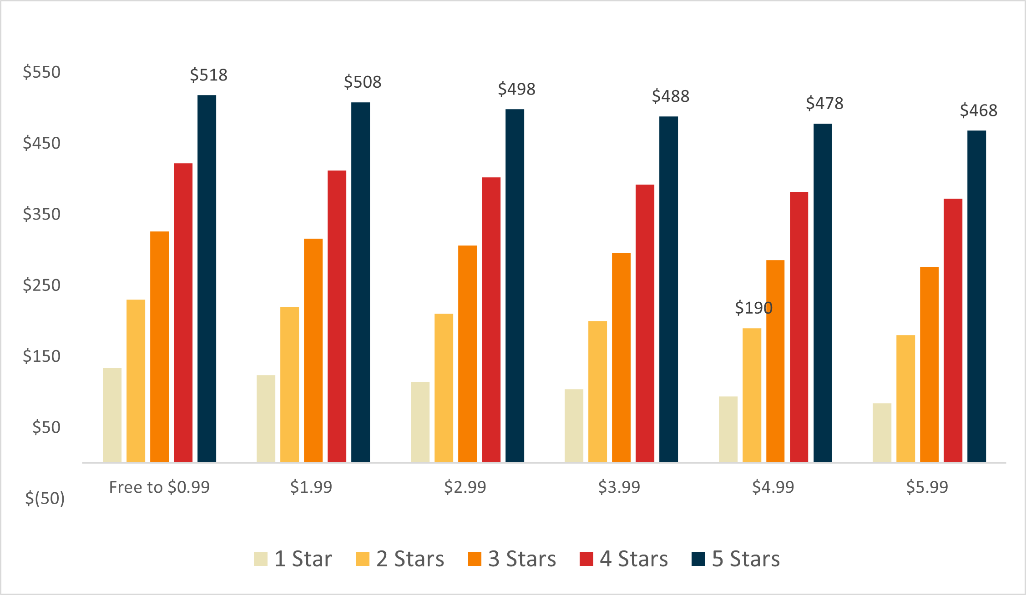
Net Profits (in thousands) for Apps in Both Stores

Slide 5
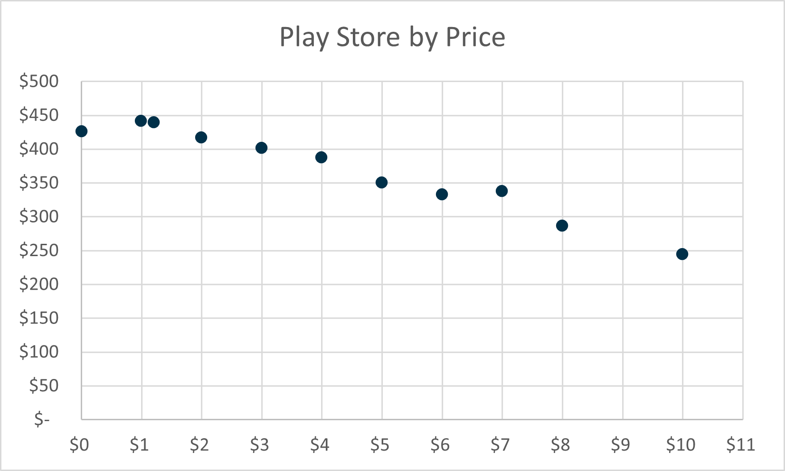
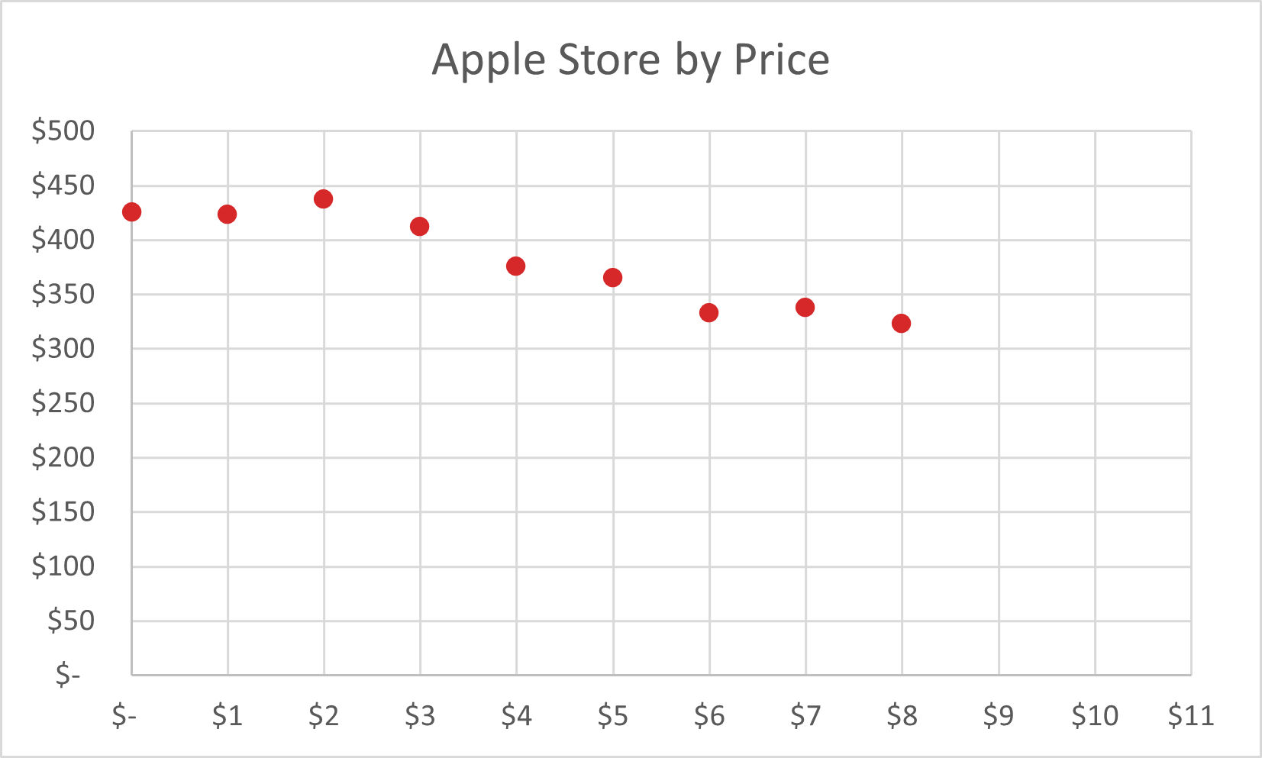
Is price a good indicator of profitability?
*Net Profits listed in thousands

Slide 6
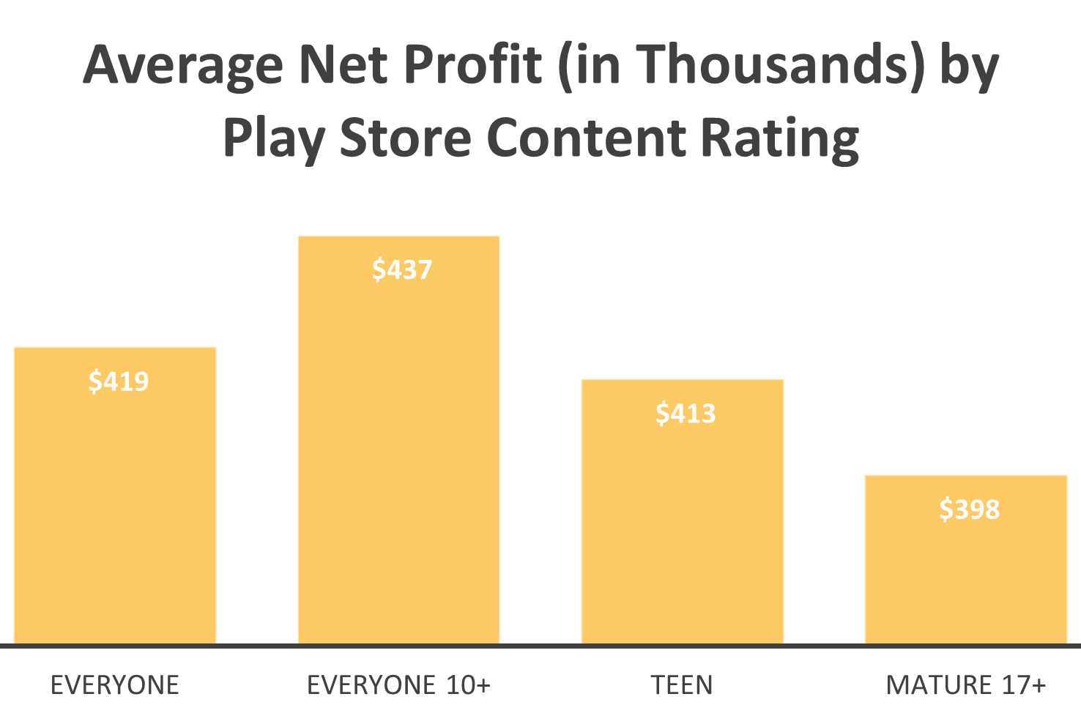
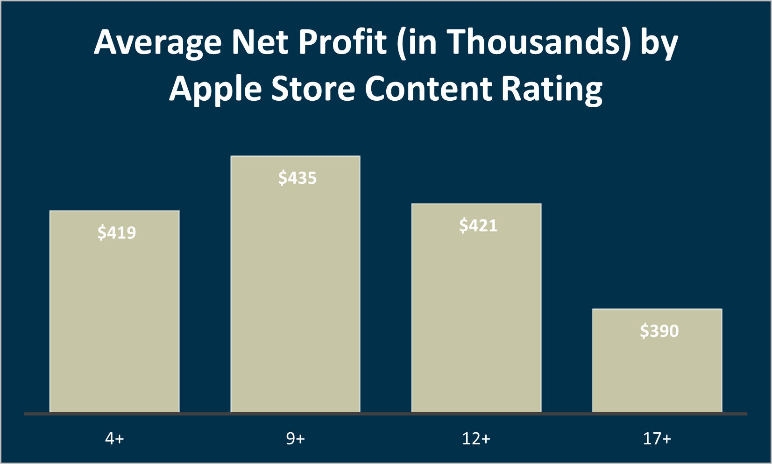
Are content ratings a good indicator of profitability?

Slide 7
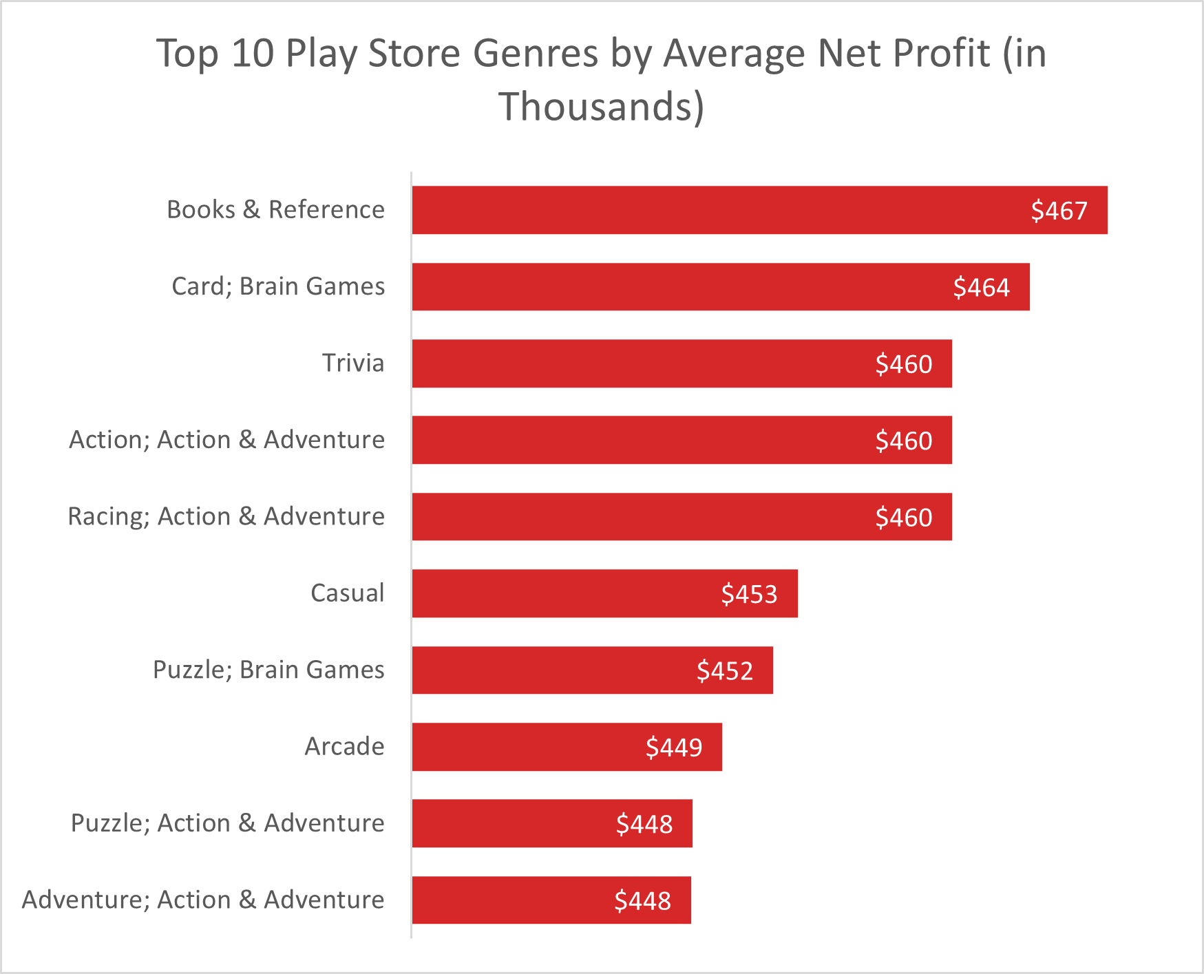
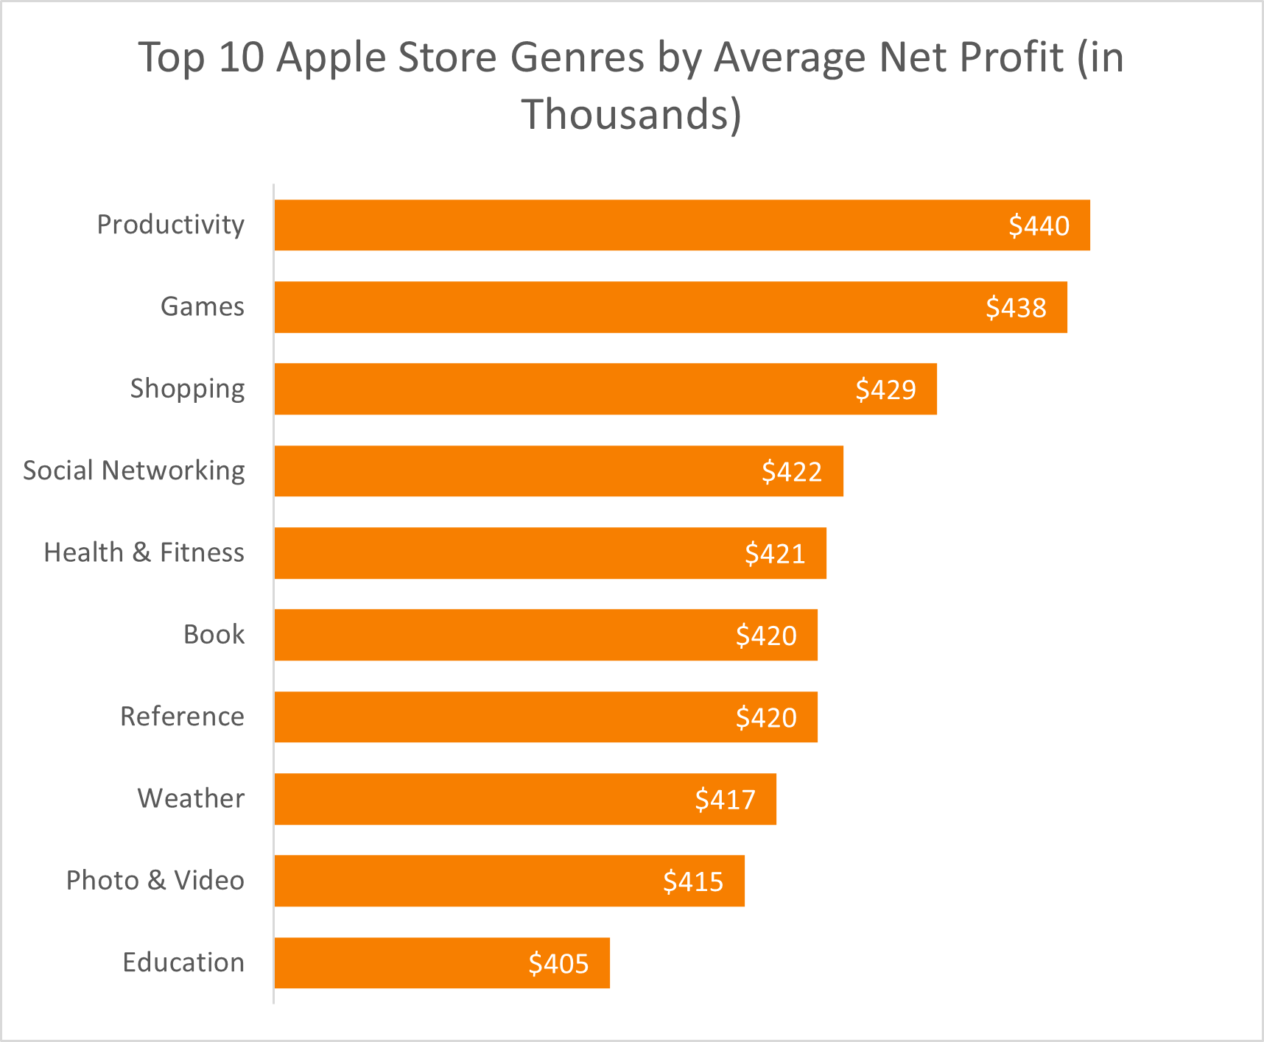
Are genres a good indicator of profitability?

Slide 8
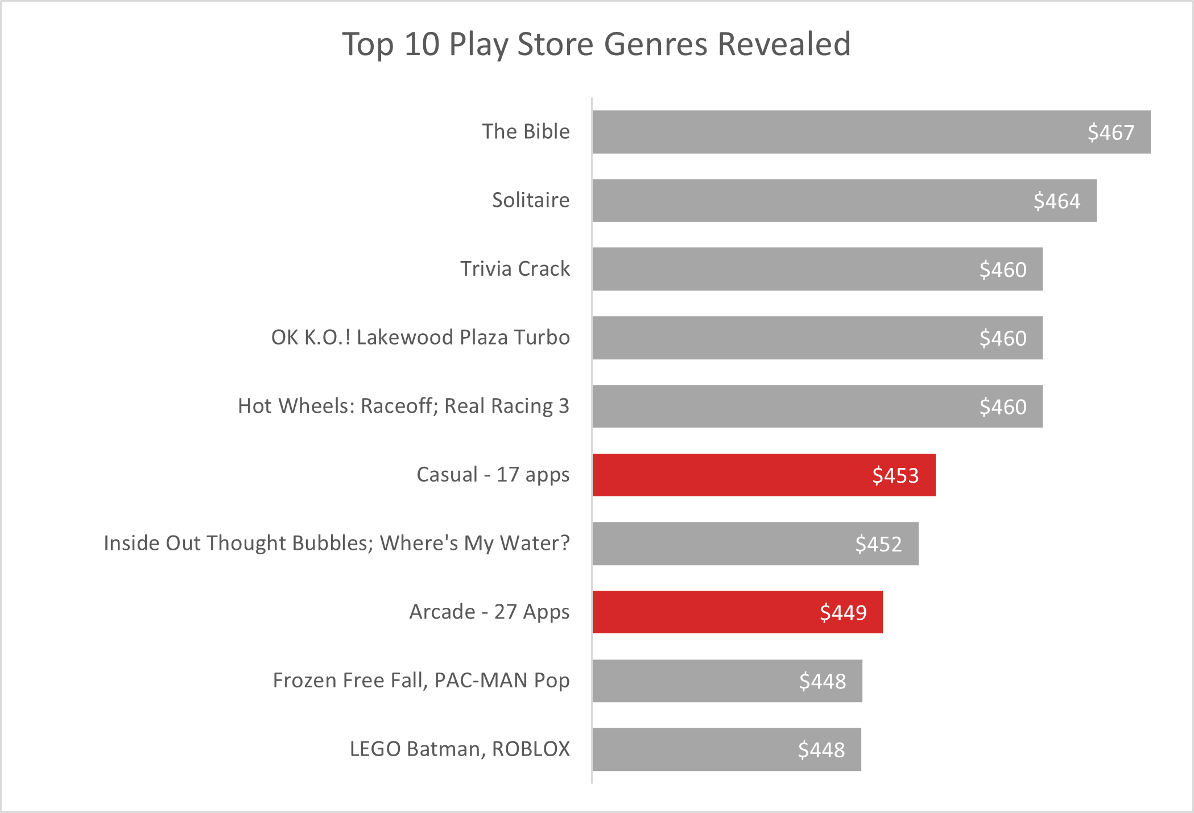
Closer Look

Slide 9
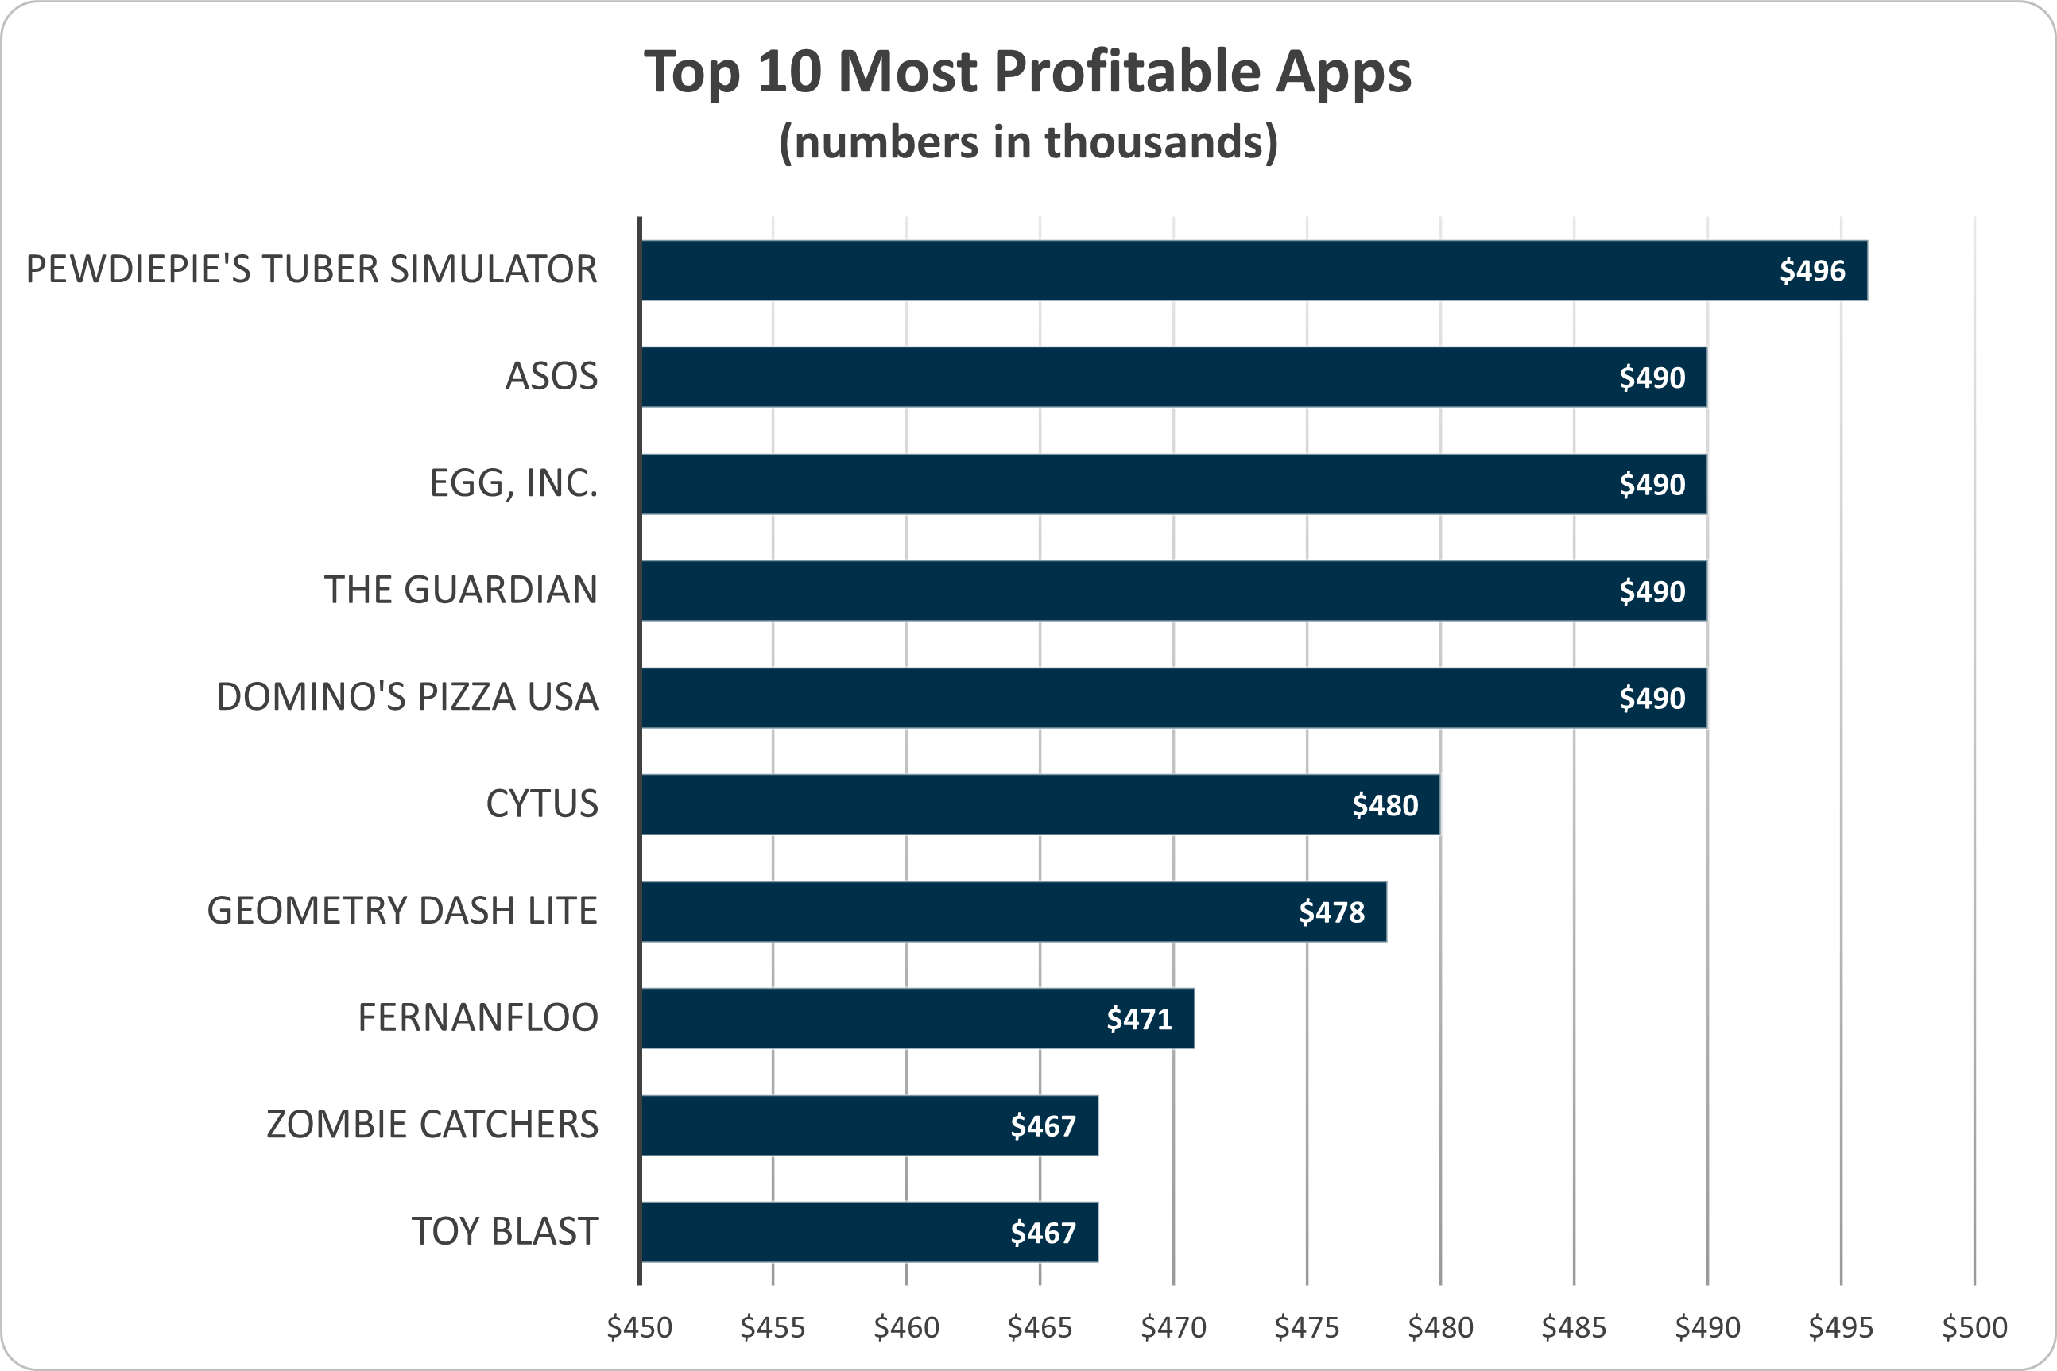









Top 10 Most Profitable Apps

Slide 10


Total Profit:

Slide 11
$4.8 million

