Slide 1
Racial Disparities in Tennessee Federal Sentencing: 2015 to 2019
Jennifer Whitson
April 30, 2021

Slide 2

Guiding Questions
Are there racial disparities between the sentencing population and the general population in Tennessee?
What kinds of crimes are most common among different racial groups?
Are people of color receiving longer sentences on average?
How do sentence lengths for drug crime compare to other types of crime?

Slide 3

Data Collection and Cleaning
5 .sas files and 5 .dat files from ussc.gov (The U.S. Sentencing Commission)
Nationwide dataset with over 300k rows and 1000+ columns
Identified 195 columns for analysis
Extracted Tennessee specific data

Slide 4
Background: Federal v. State Crime
State law:
Murder
Sexual assault
Robbery/burglary
Most violent crime
Violations of state drug laws
Federal law:
Drug possession and sales
Immigration
Tax fraud and counterfeiting of money
Bank robbery
State crimes that
Occur on federal land;
Are committed against federal agents;
Cross state lines;
Occur in Washington D.C. or in international waters;
Are investigated by a federal agency, such as the FBI

Slide 5
Analysis and Insights

Slide 6
Are there racial disparities between the sentencing population and the general population in Tennessee?

Slide 7
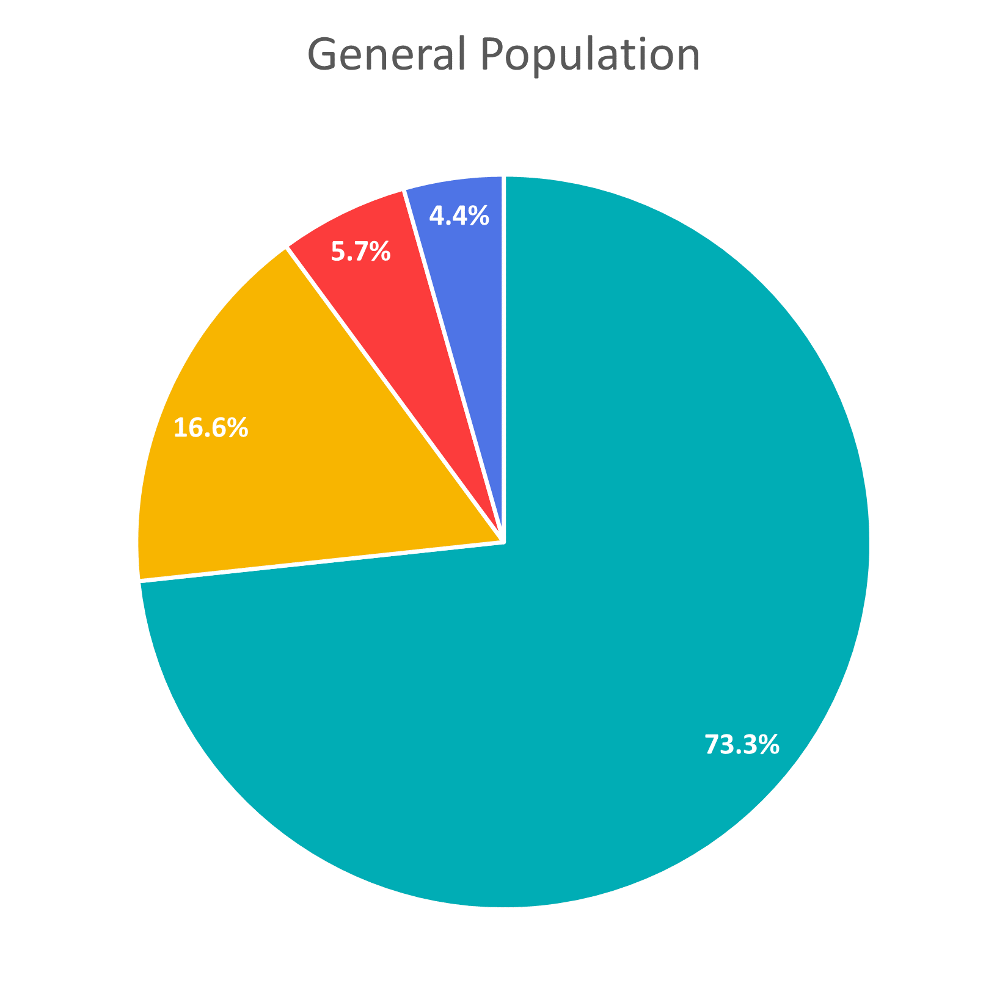
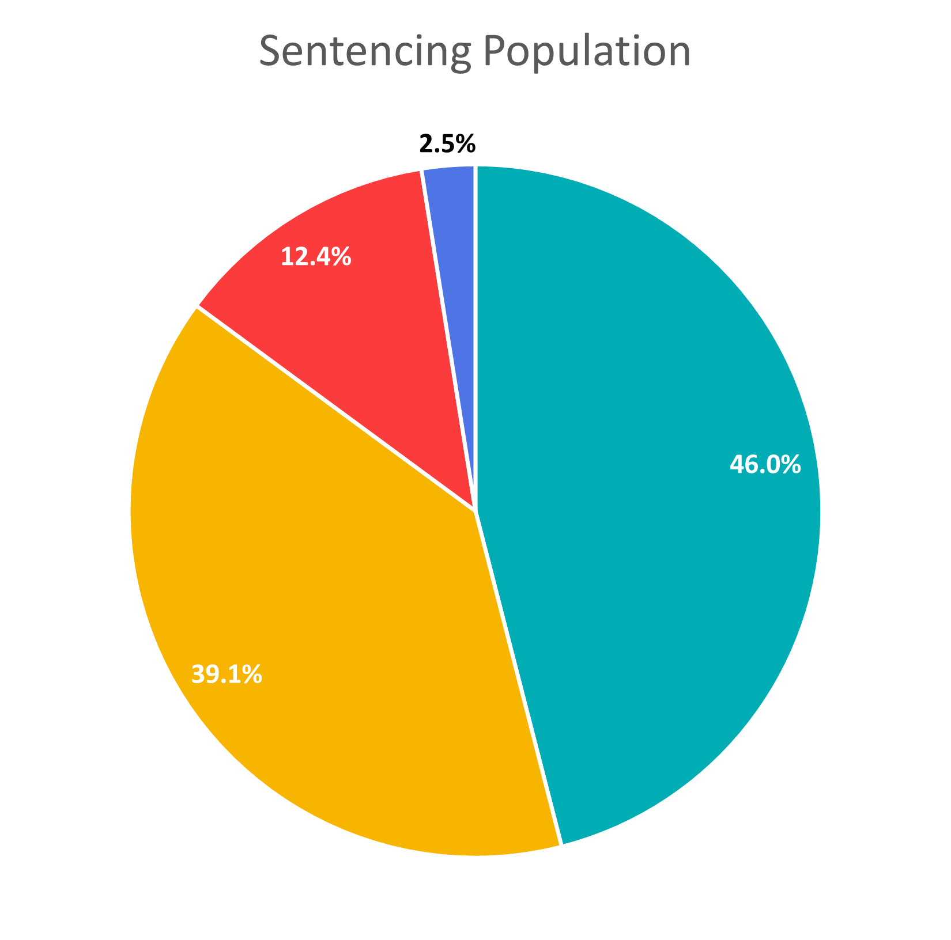

A black person is
3.9x
more likely to be sentenced than a white person
A hispanic person is
3.5x
more likely to be sentenced than a white person

Slide 8
What kinds of crimes are most common among different racial groups?

Slide 9
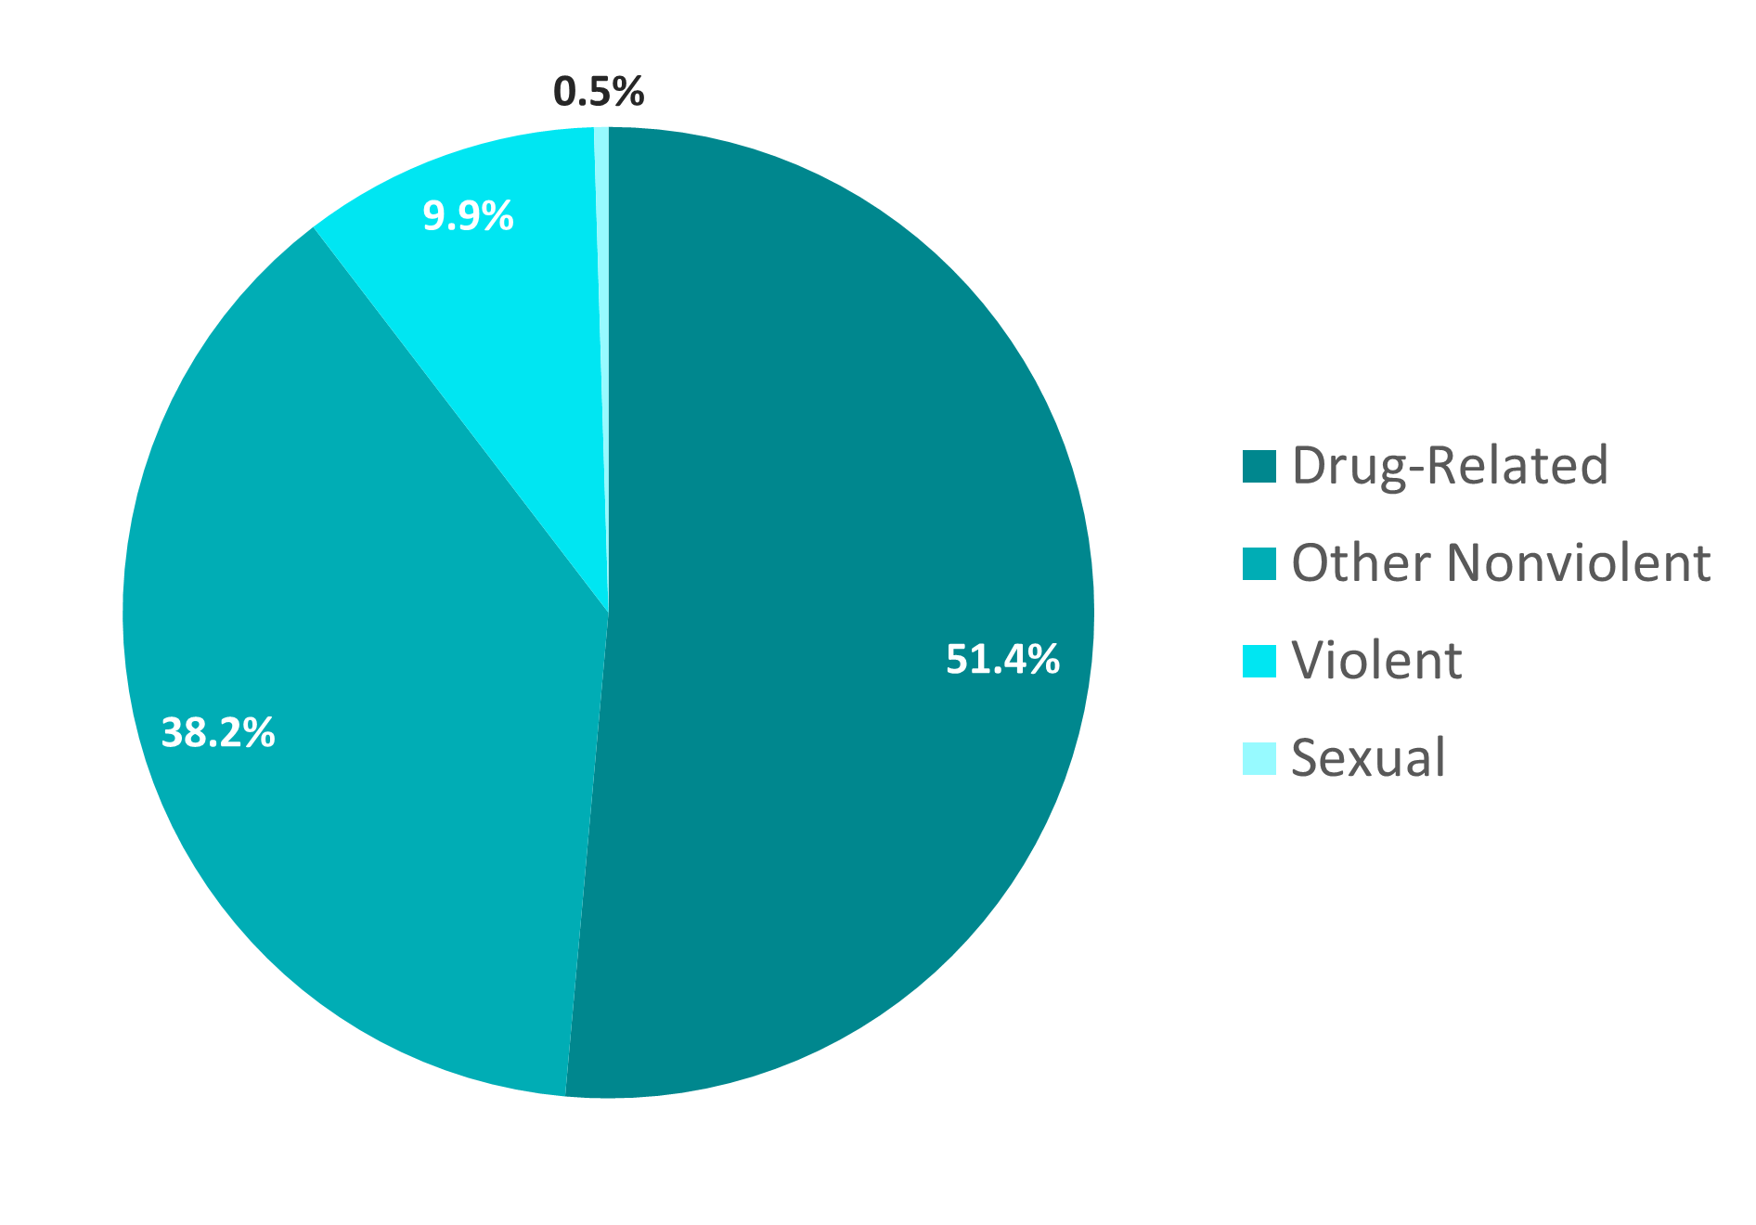
Crime Categories
White Sentencing Population

Slide 10
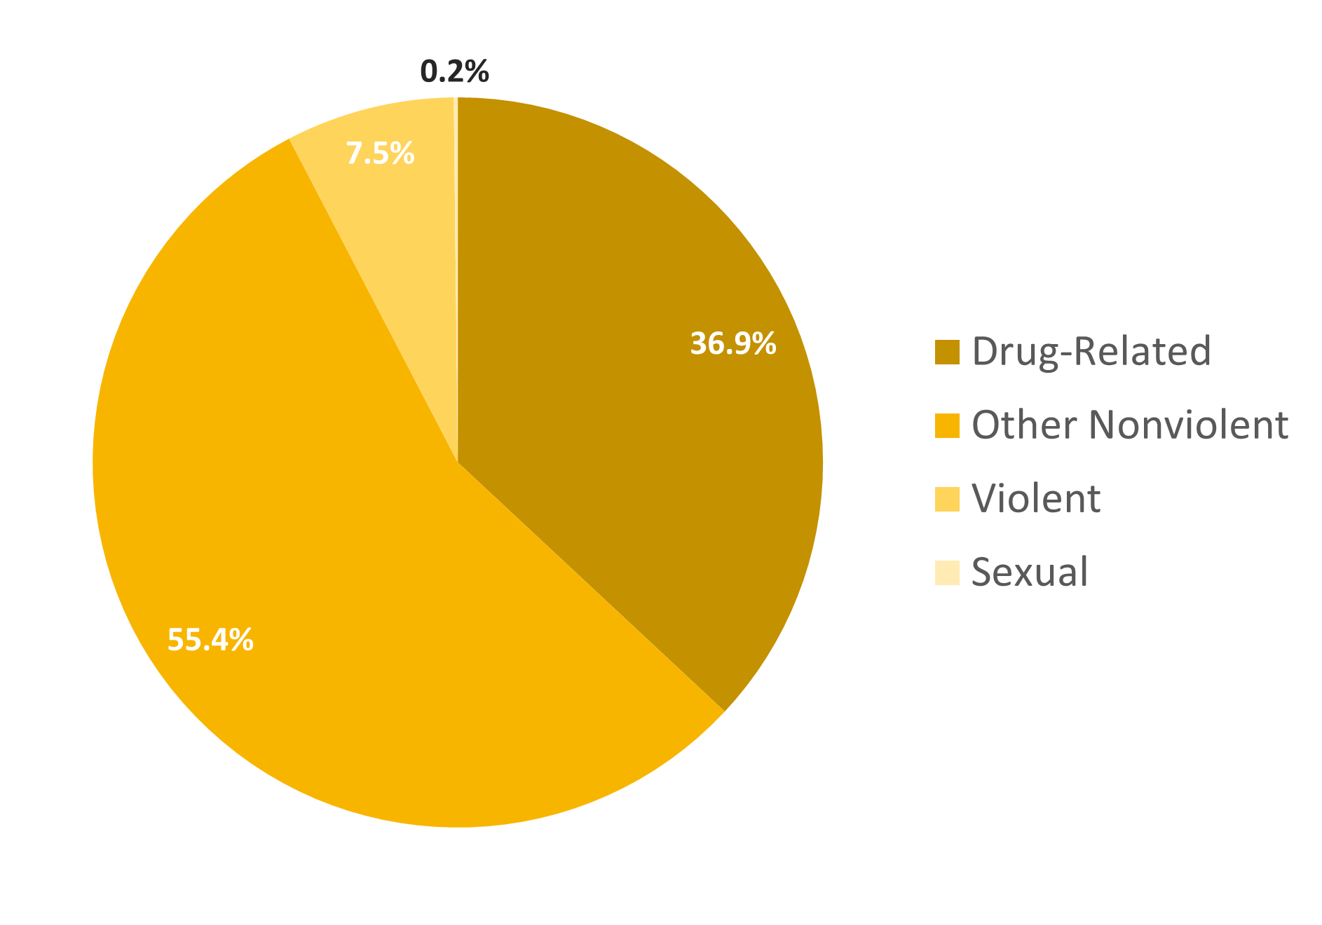
Crime Categories
Black Sentencing Population

Slide 11
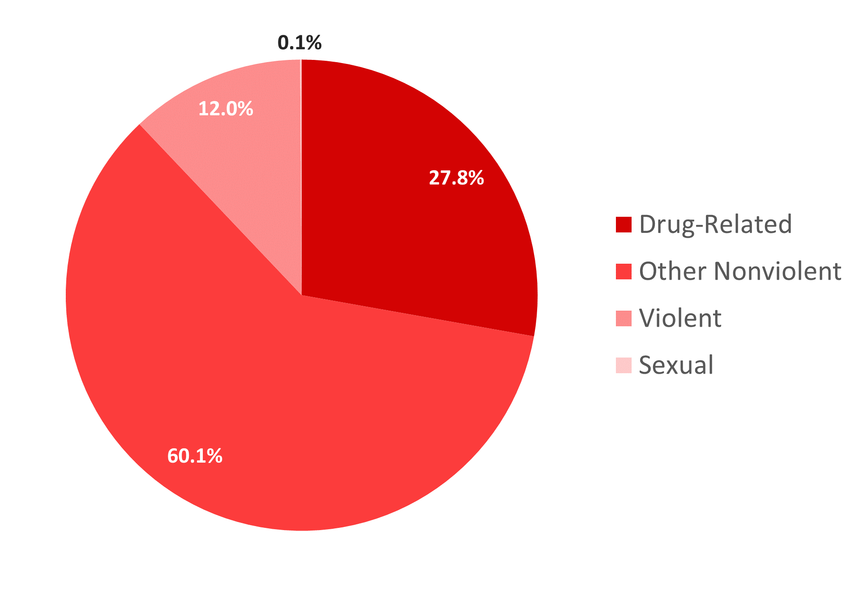
Crime Categories
Hispanic Sentencing Population

Slide 12
Are people of color receiving longer sentences on average?

Slide 13
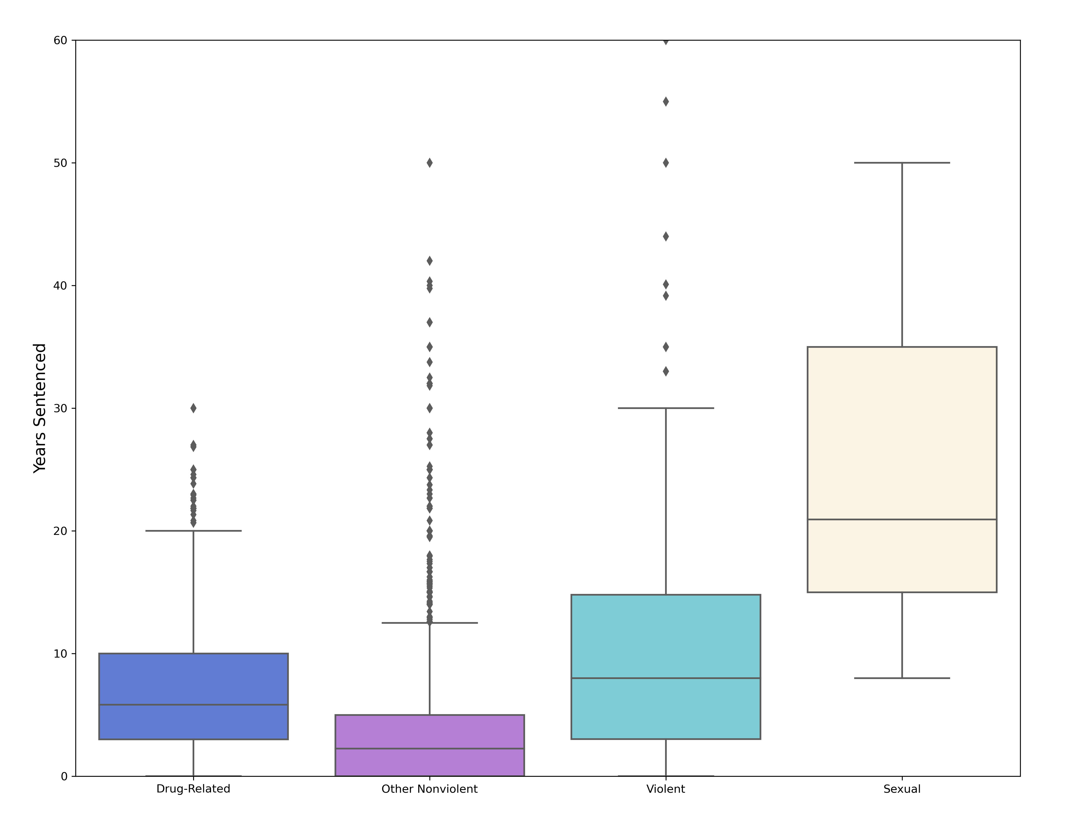
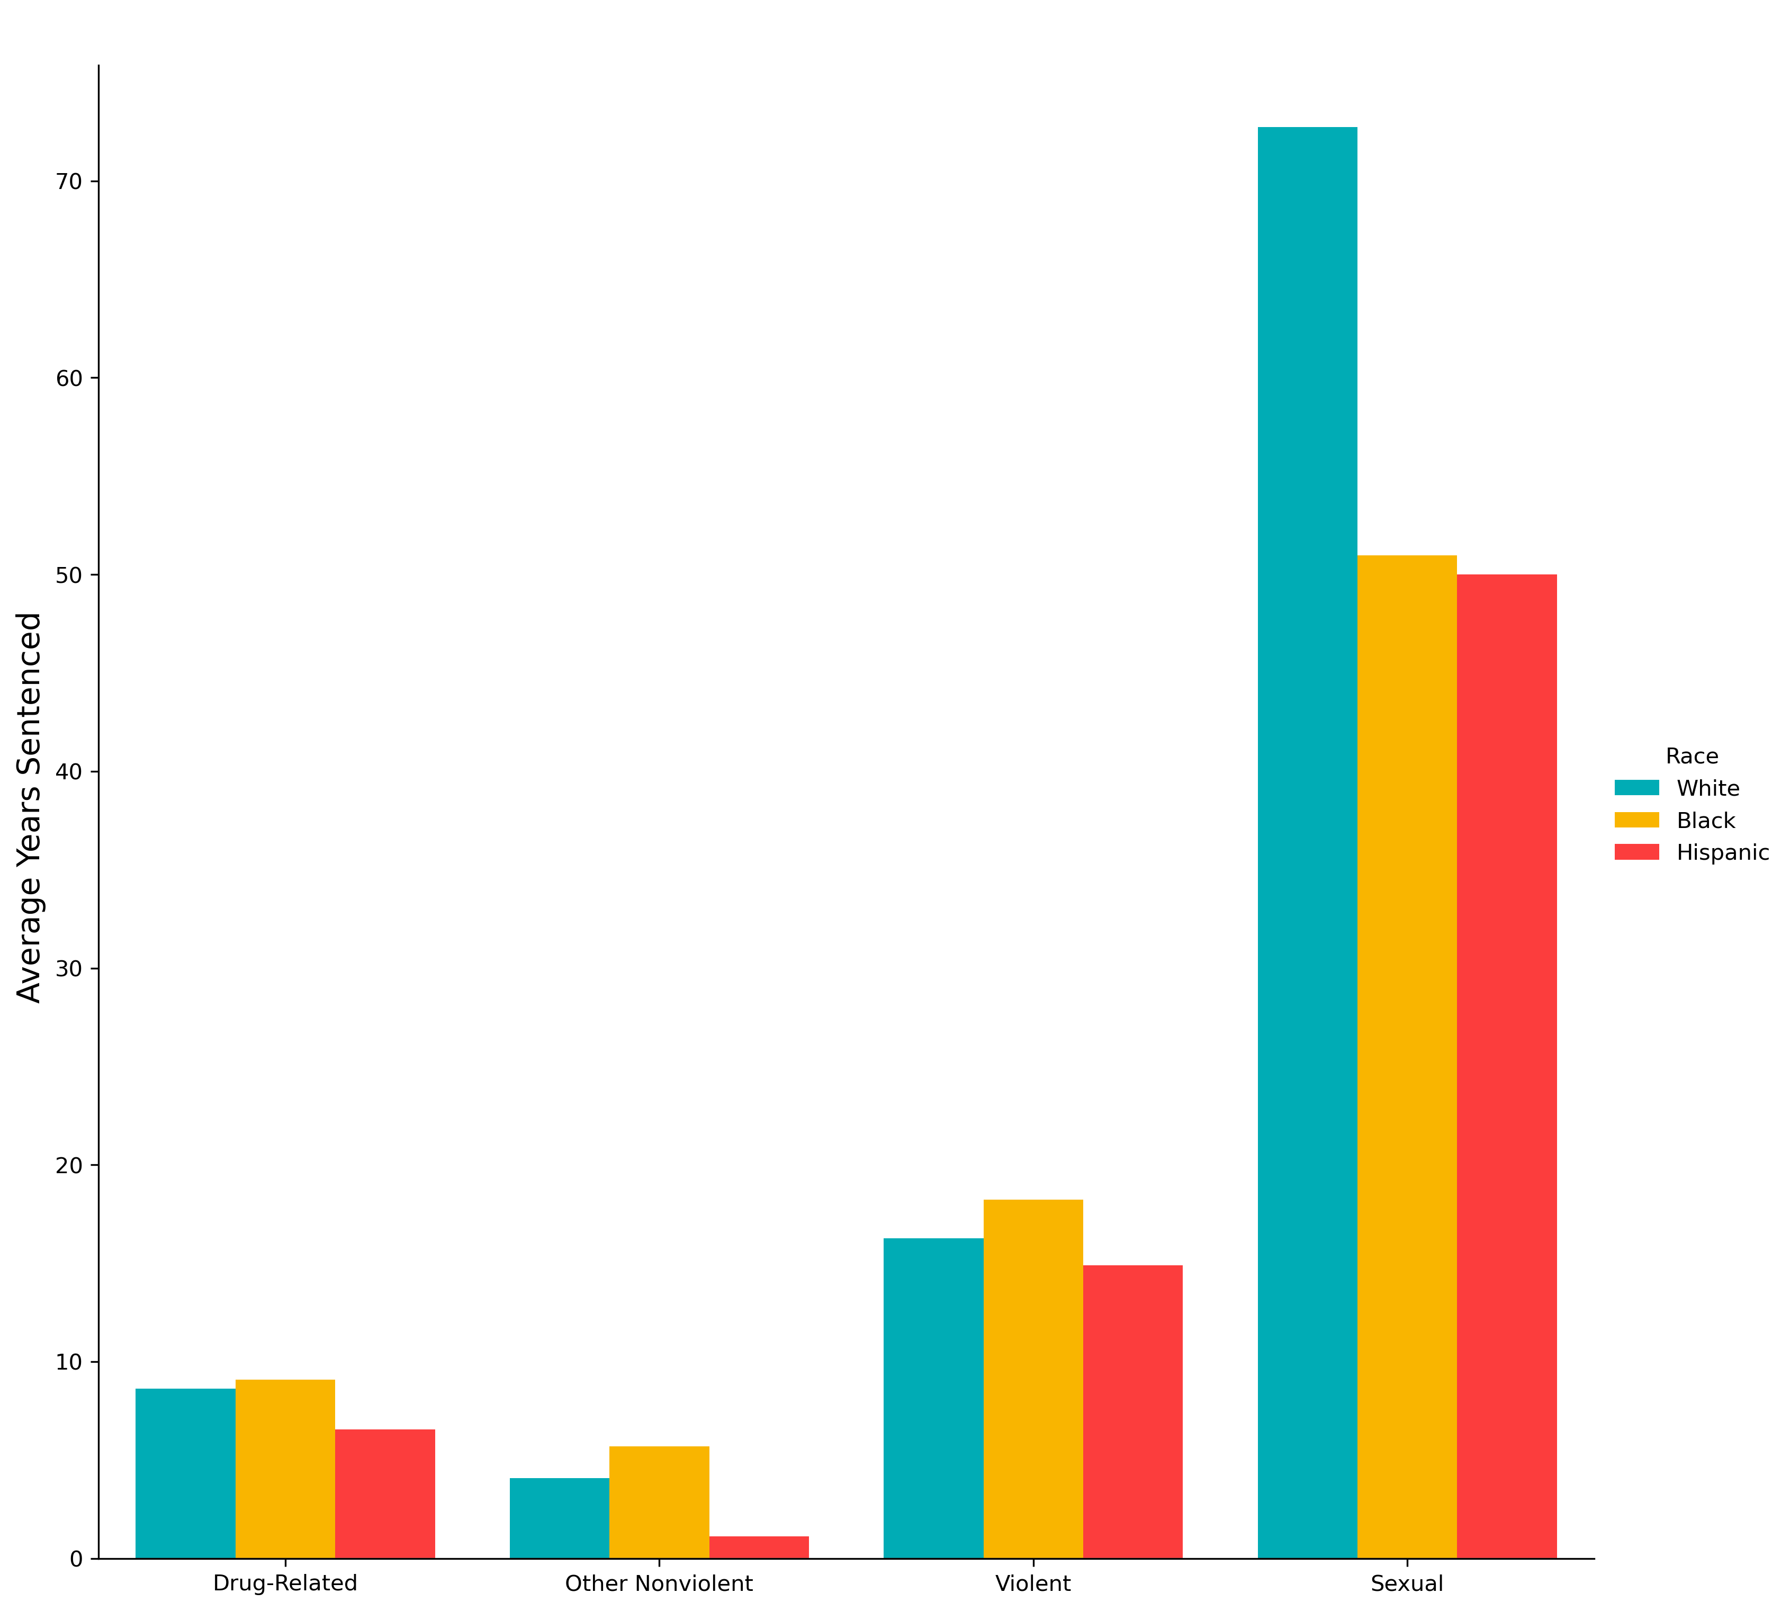
Sentence Length by Crime Category
Sentence Distribution
Racial Breakdown

Slide 14
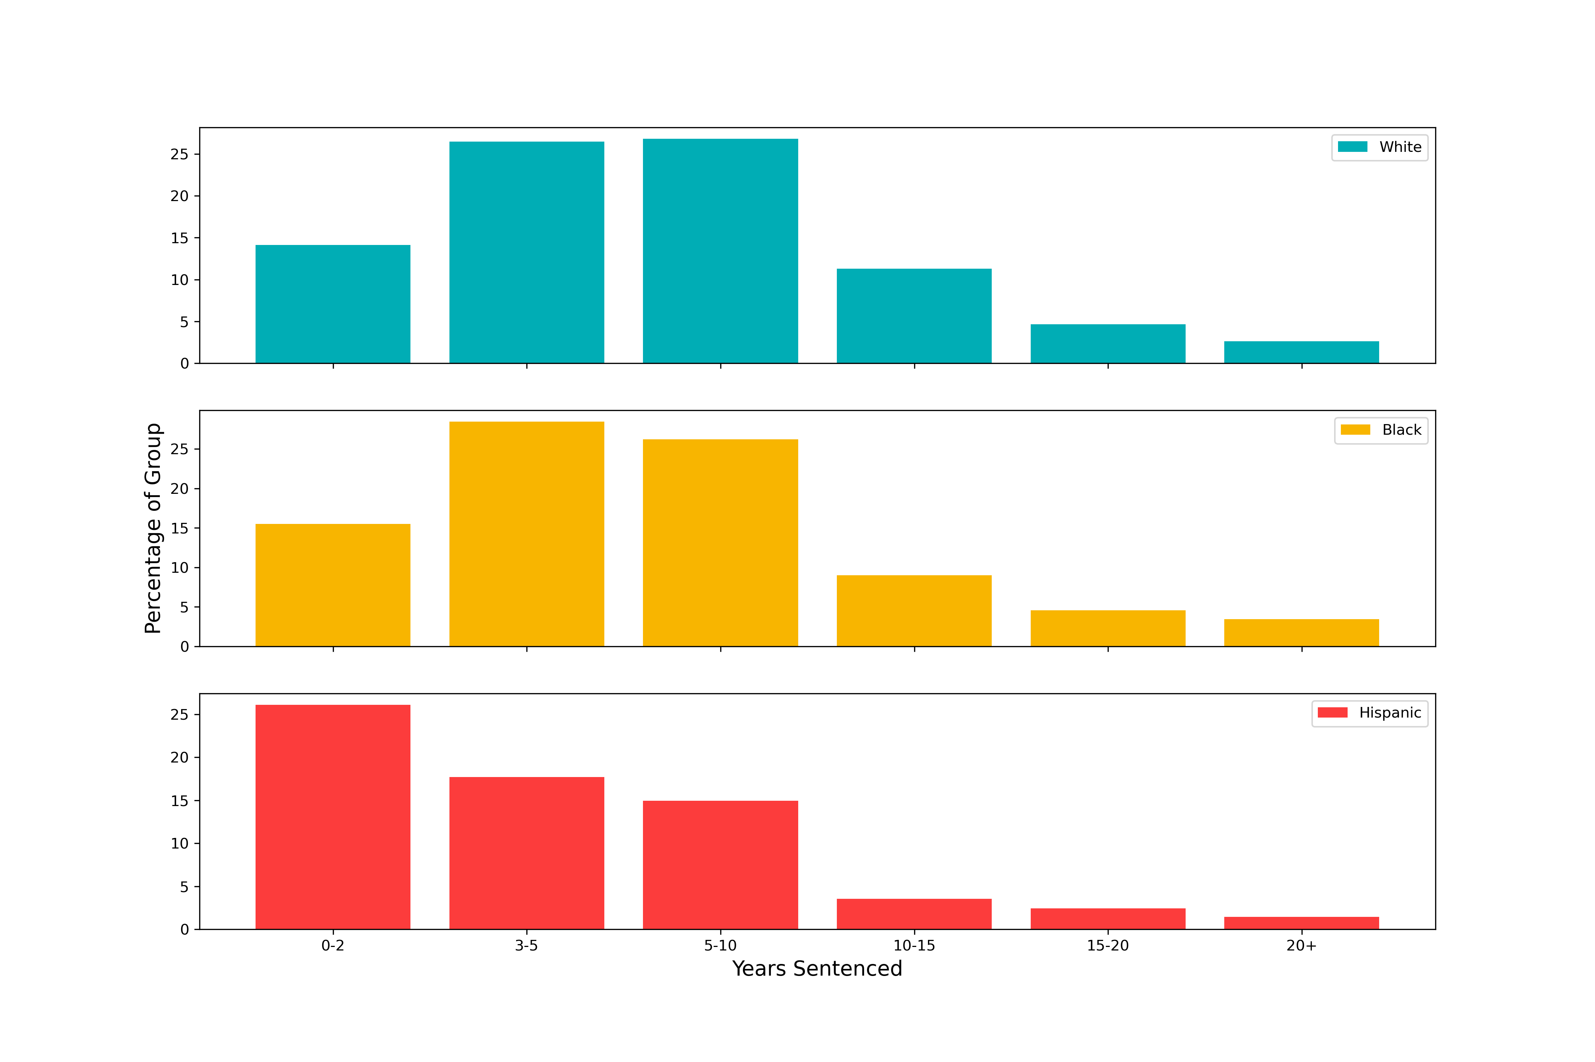
Distribution of Sentence Length by Race

Slide 15
Additional Insights

Slide 16
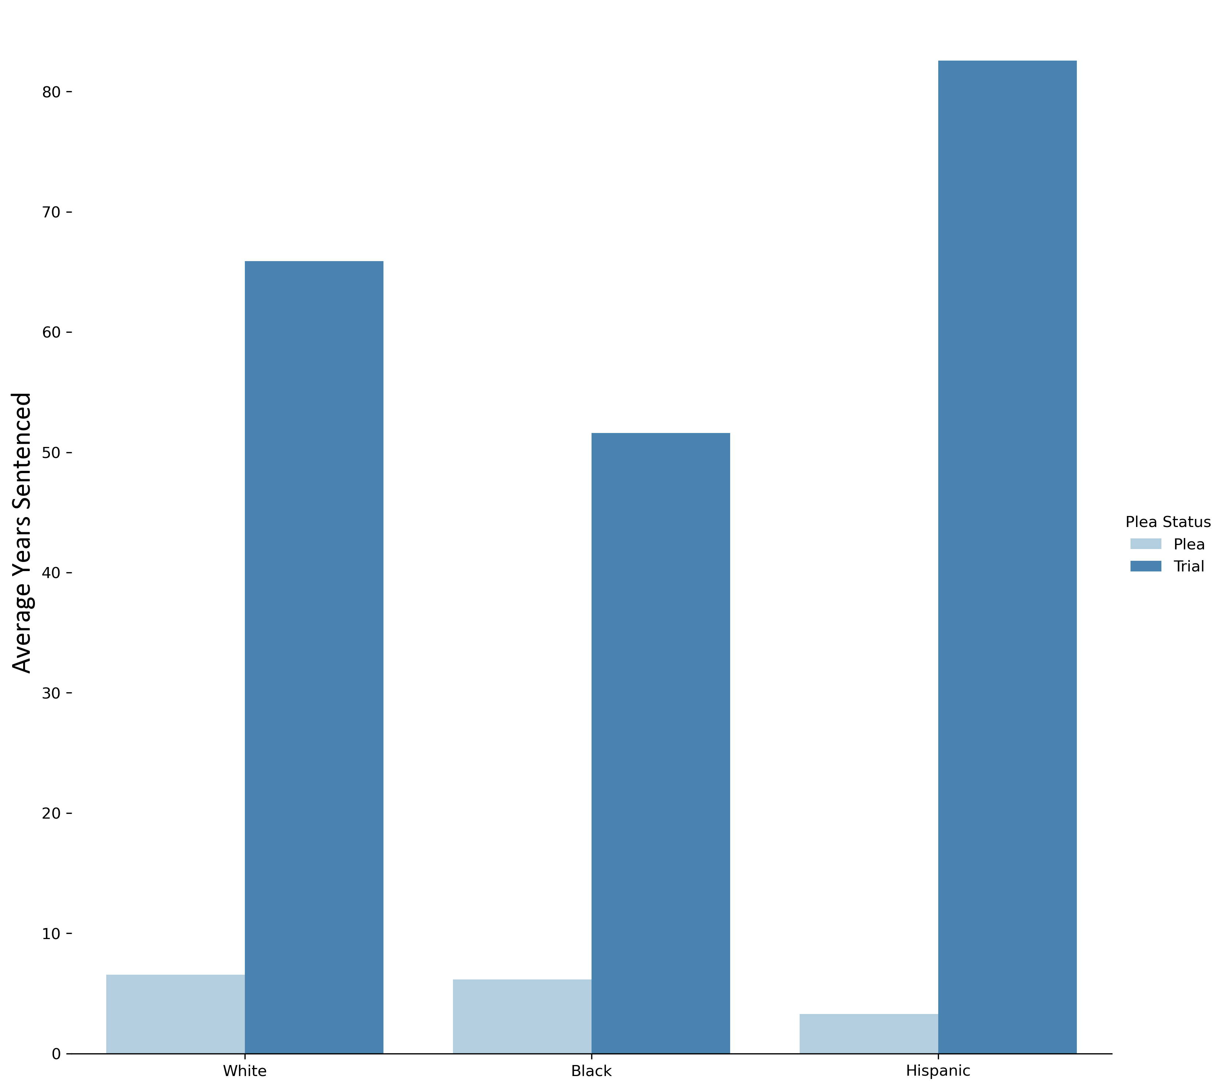
Insights: Pleas v. Trials
Average sentence for a plea:
5.9
years
Average sentence for a trial:
58.3
years
Difference between average sentence length for plea v. trial:
Black: 45.4 years
White: 59.3 years
Hispanic: 81.5 years
Median sentences are dramatically lower, but going to trial still increases the median sentence by 6.6 years

Slide 17
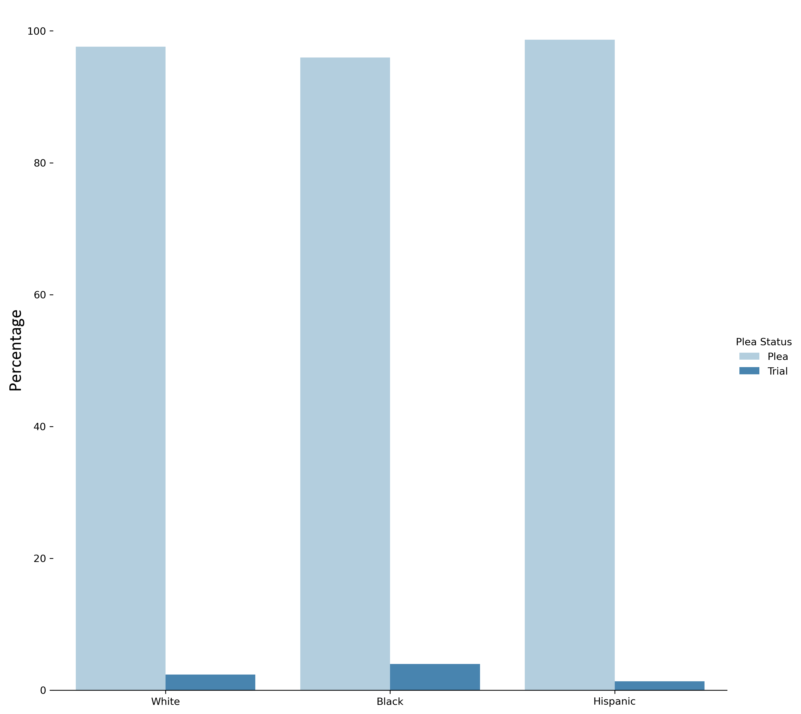
Insights: Pleas v. Trials
97%
of all defendants plead out
3.9% of black defendants pursue trial
2.4% of white defendants pursue trial
1.3% of Hispanic defendants pursue trial

Slide 18
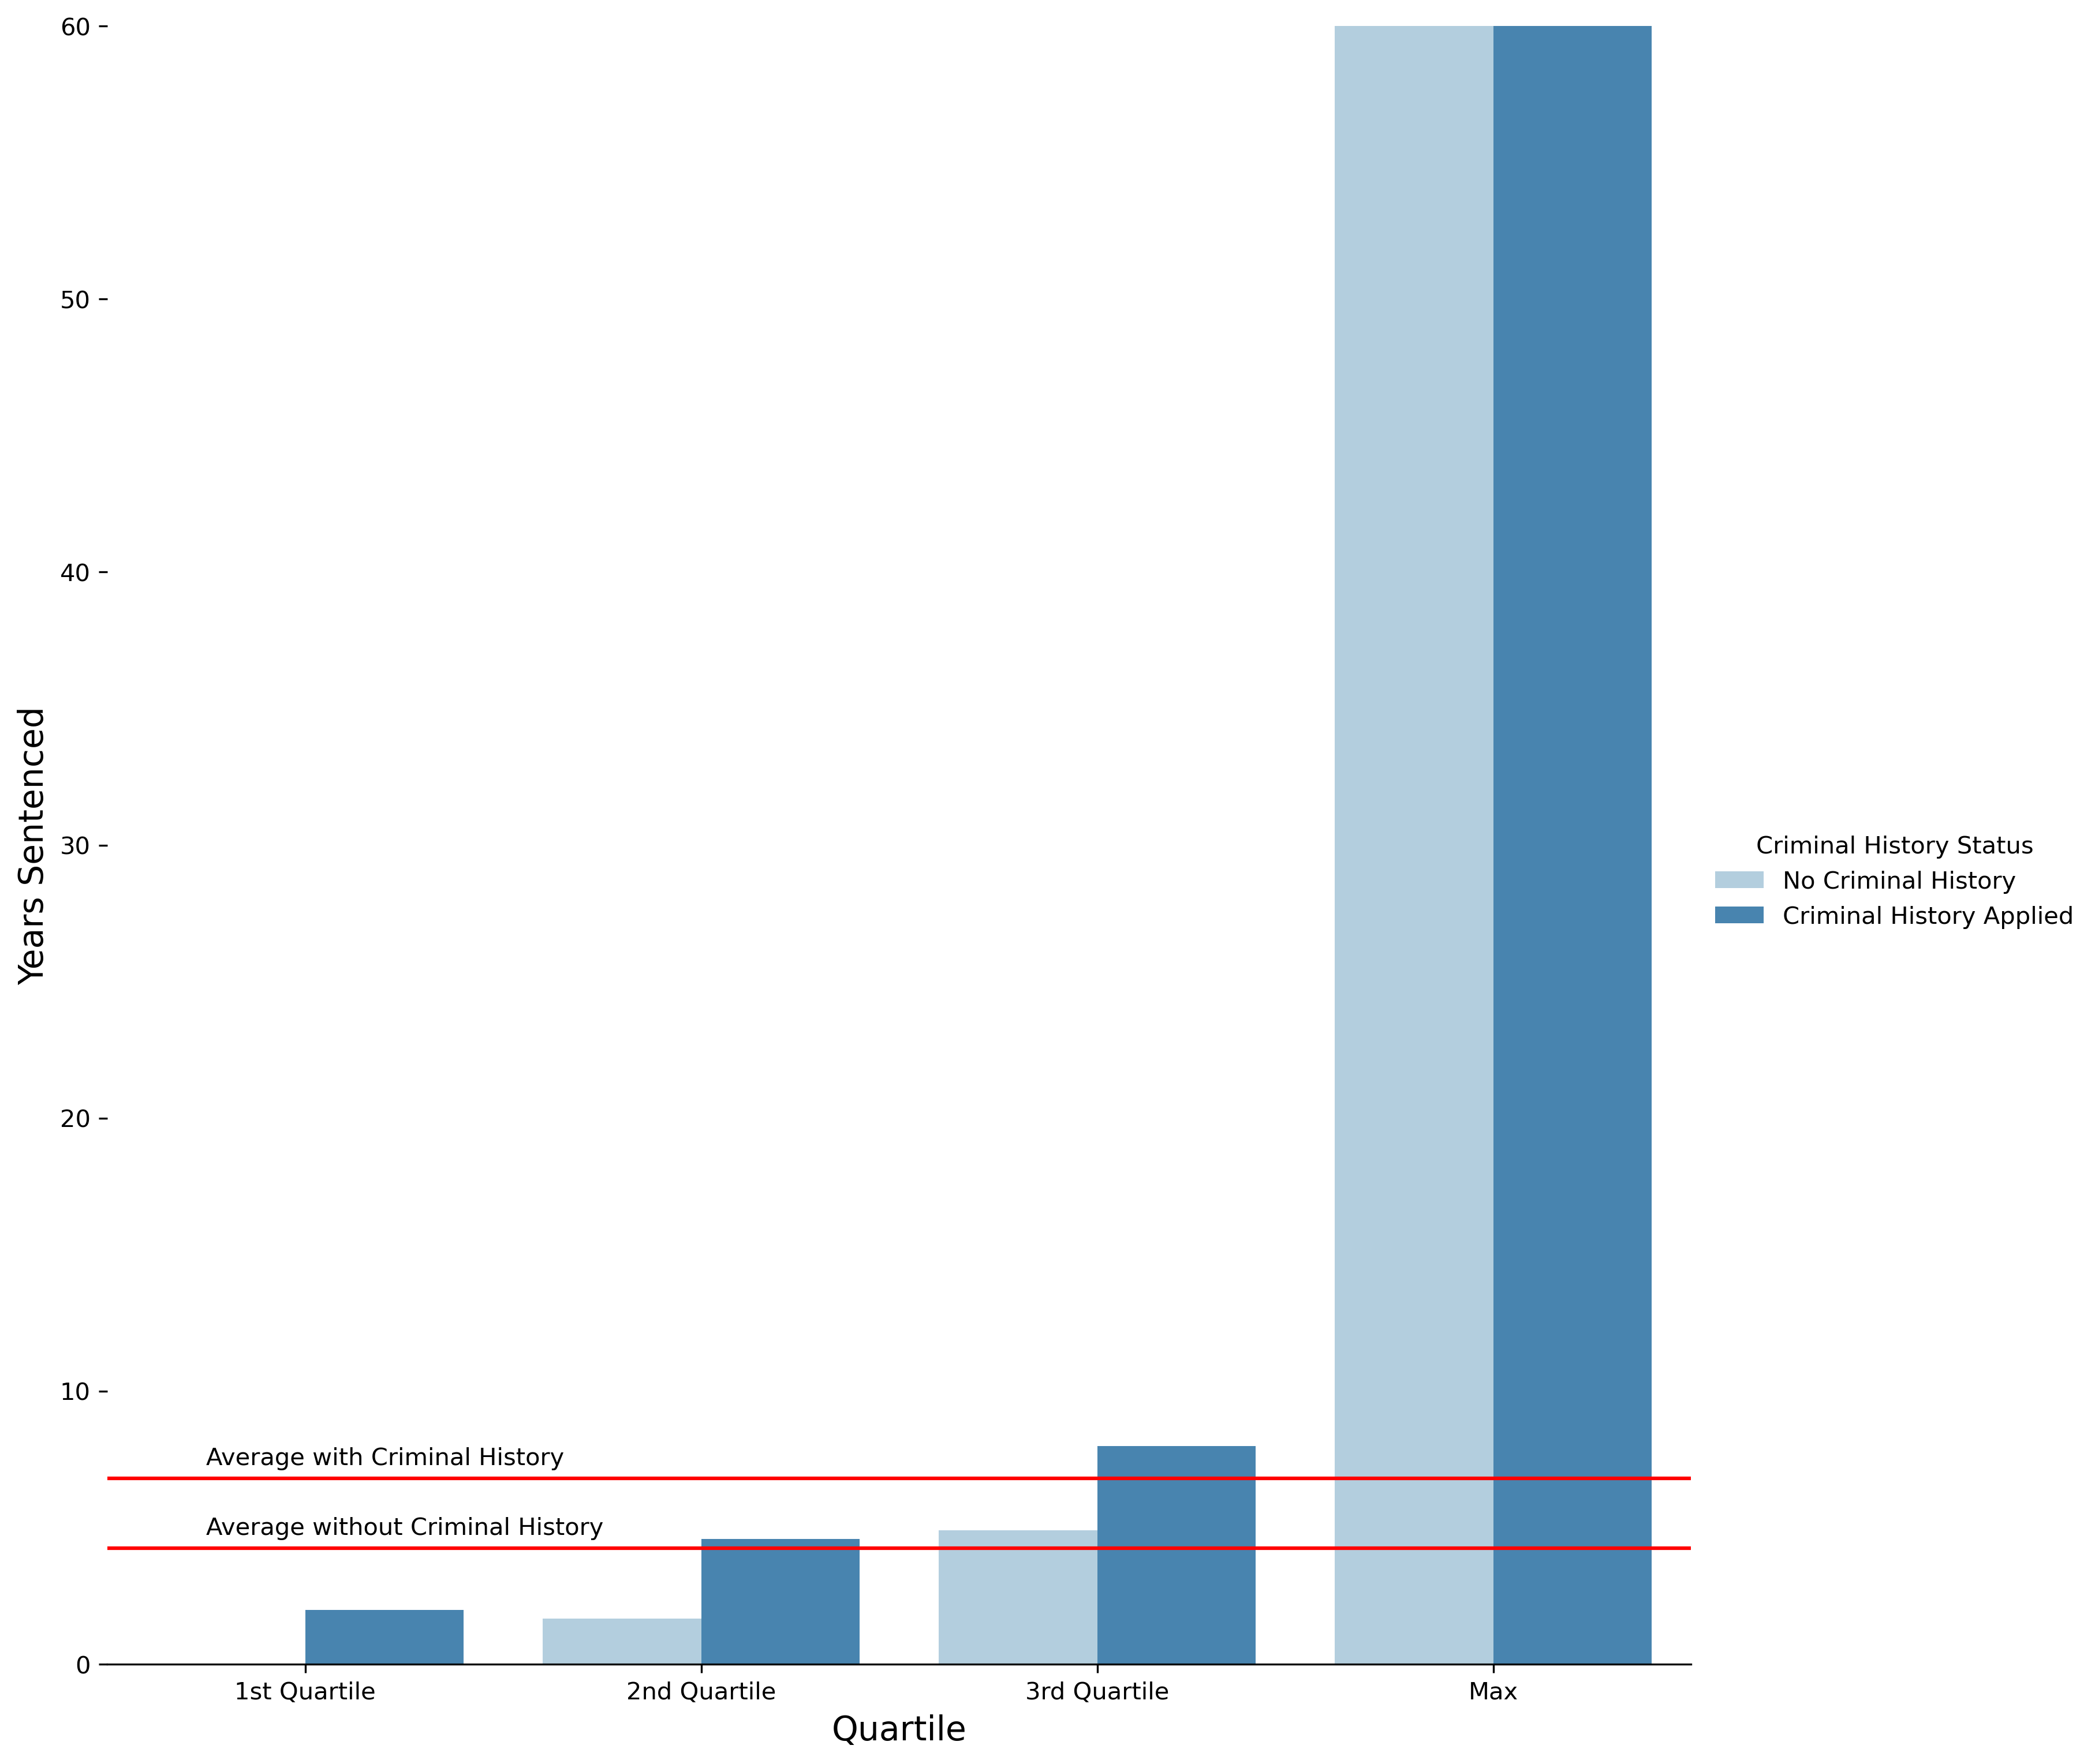
Insights: Sentence Enhancements
Sentence enhancements available:
Criminal history points
“Career Offender” status
“Armed Career Offender” status
Sentence mitigations available:
Safety valve
Application of criminal history points increases the average sentence by 2.6 years

Slide 19
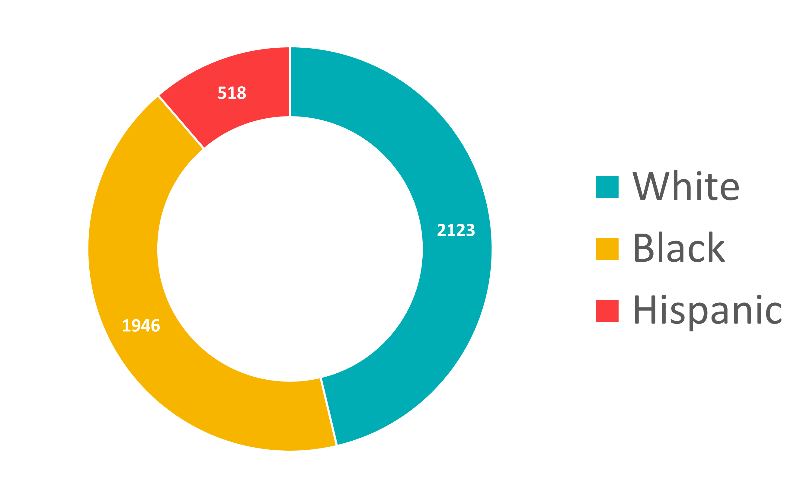
Insights: Sentence Enhancements
Criminal history points are applied in 64% of cases and increases sentences an average of by 2.6 years
Criminal History Points Applied

Slide 20
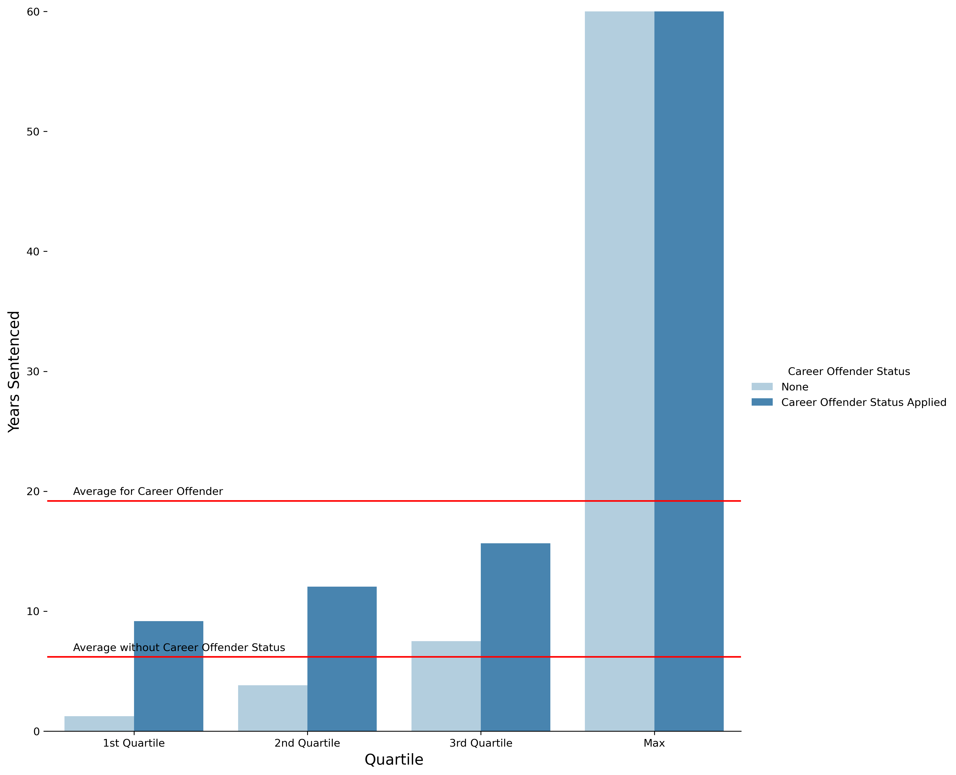
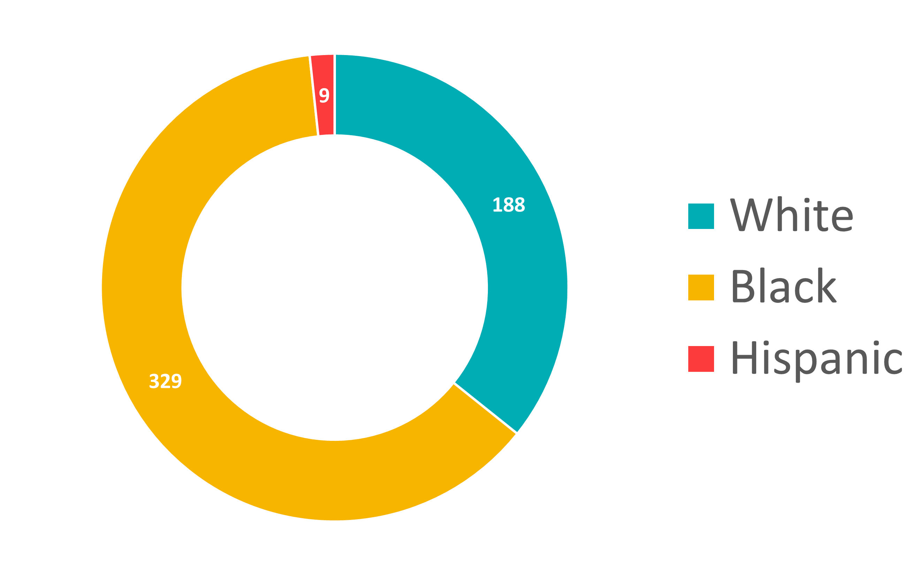
Insights: Sentence Enhancements
Career Offender status is applied in 7% of cases and increases sentences an average of by 12.7 years
Career Offender Status Applied

Slide 21
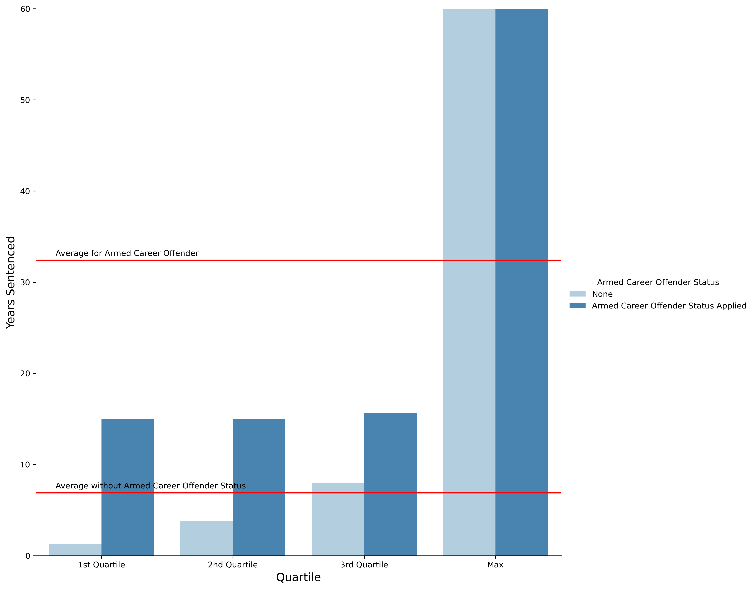
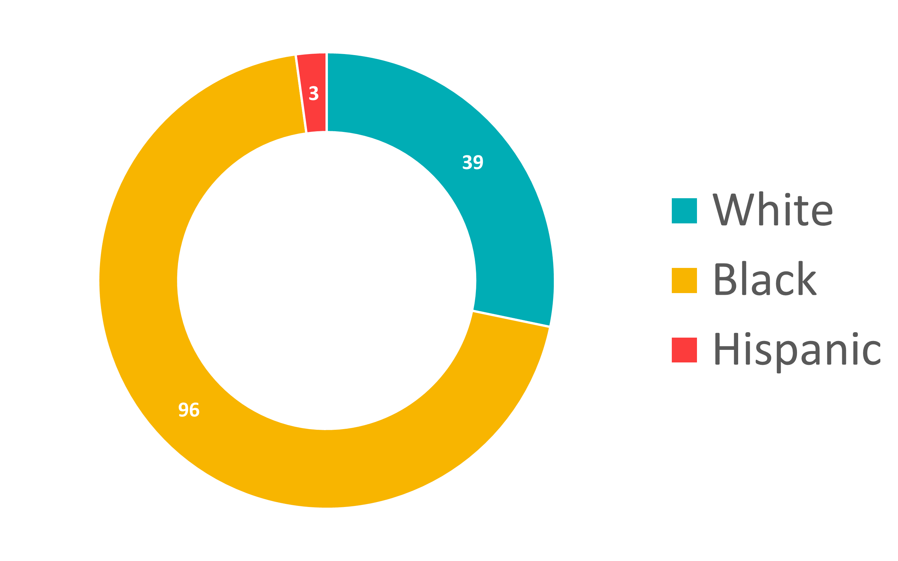
Insights: Sentence Enhancements
Armed Career Offender status is applied in only 2% of cases, but increases sentences an average of by 25.3 years
Armed Career Offender Status Applied

Slide 22
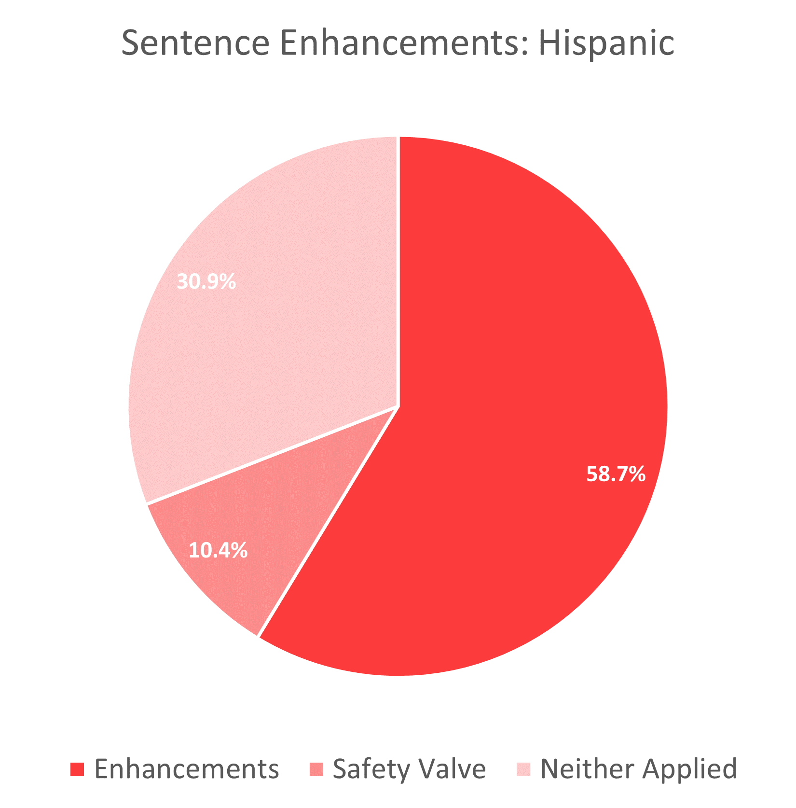
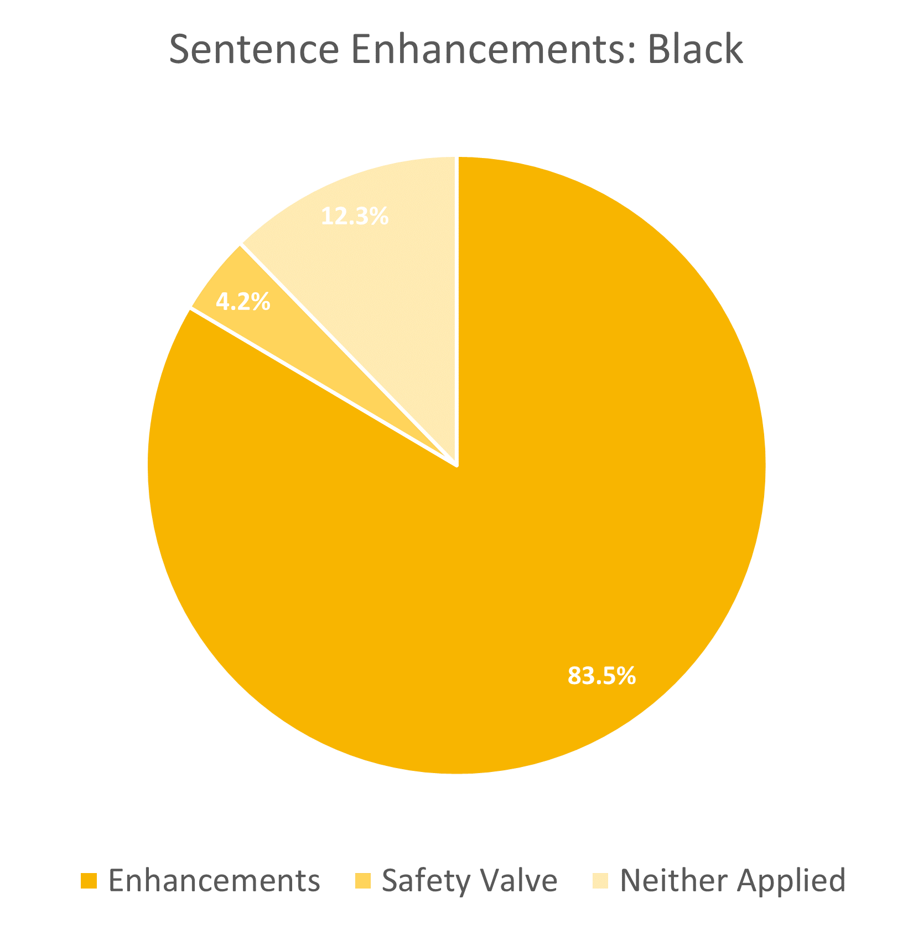
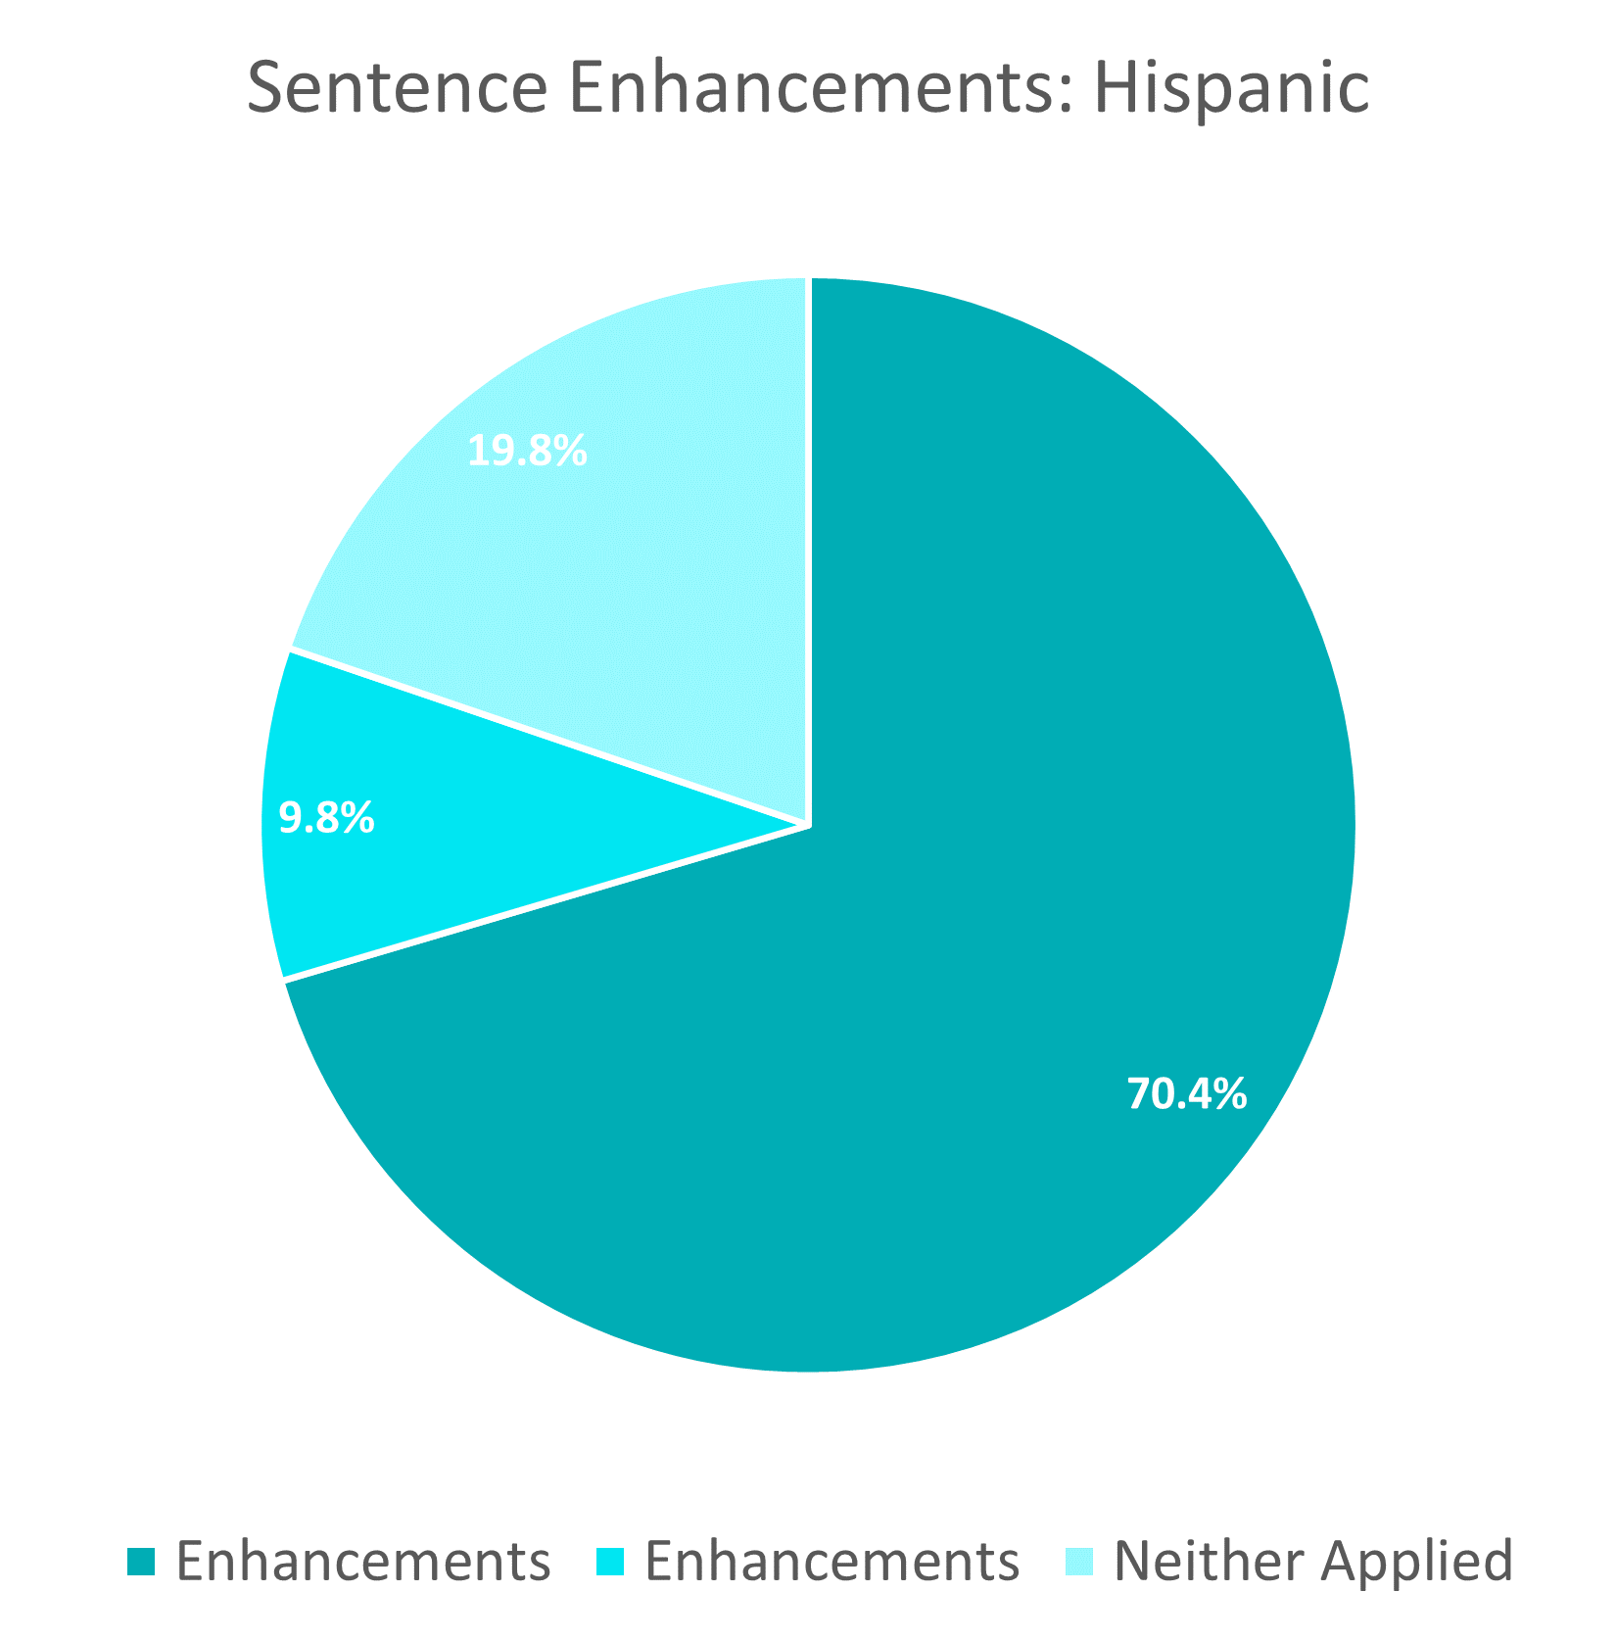
Sentence Enhancements and Mitigation

