Slide 1

Racial Disparities in Tennessee Federal Sentencing: 2015 to 2019
Jennifer Whitson
April 30, 2021

Slide 2

Guiding Questions
Are there racial disparities between the incarcerated population and the general population in Tennessee?
Are people of color receiving longer sentences on average for the same crimes?
Are there disparities in the application of sentence enhancements and sentence mitigation measures?
Is a person’s sentence affected by whether they plead or go to trial? If so, does this difference vary by race?

Slide 3

Background: Federal v. State Crime
State law:
Murder
Sexual assault
Robbery/burglary
Most violent crime
Federal law:
Drug possession and sales
Immigration
“White Collar Crime” (e.g., fraud, money laundering)
Bank robbery
State crimes that:
Occur on federal land;
Are committed against federal agents;
Cross state lines;
Occur in Washington D.C. or in international waters;
Are investigated by a federal agency, such as the FBI

Slide 4

Data Collection and Cleaning
SAS files from ussc.gov (The U.S. Sentencing Commission)
Nationwide dataset with over 300k rows and 1000+ columns
Identified 201 columns for analysis
Extracted Tennessee specific data

Slide 5
Demographics of General Population v. Incarcerated Population

Slide 6
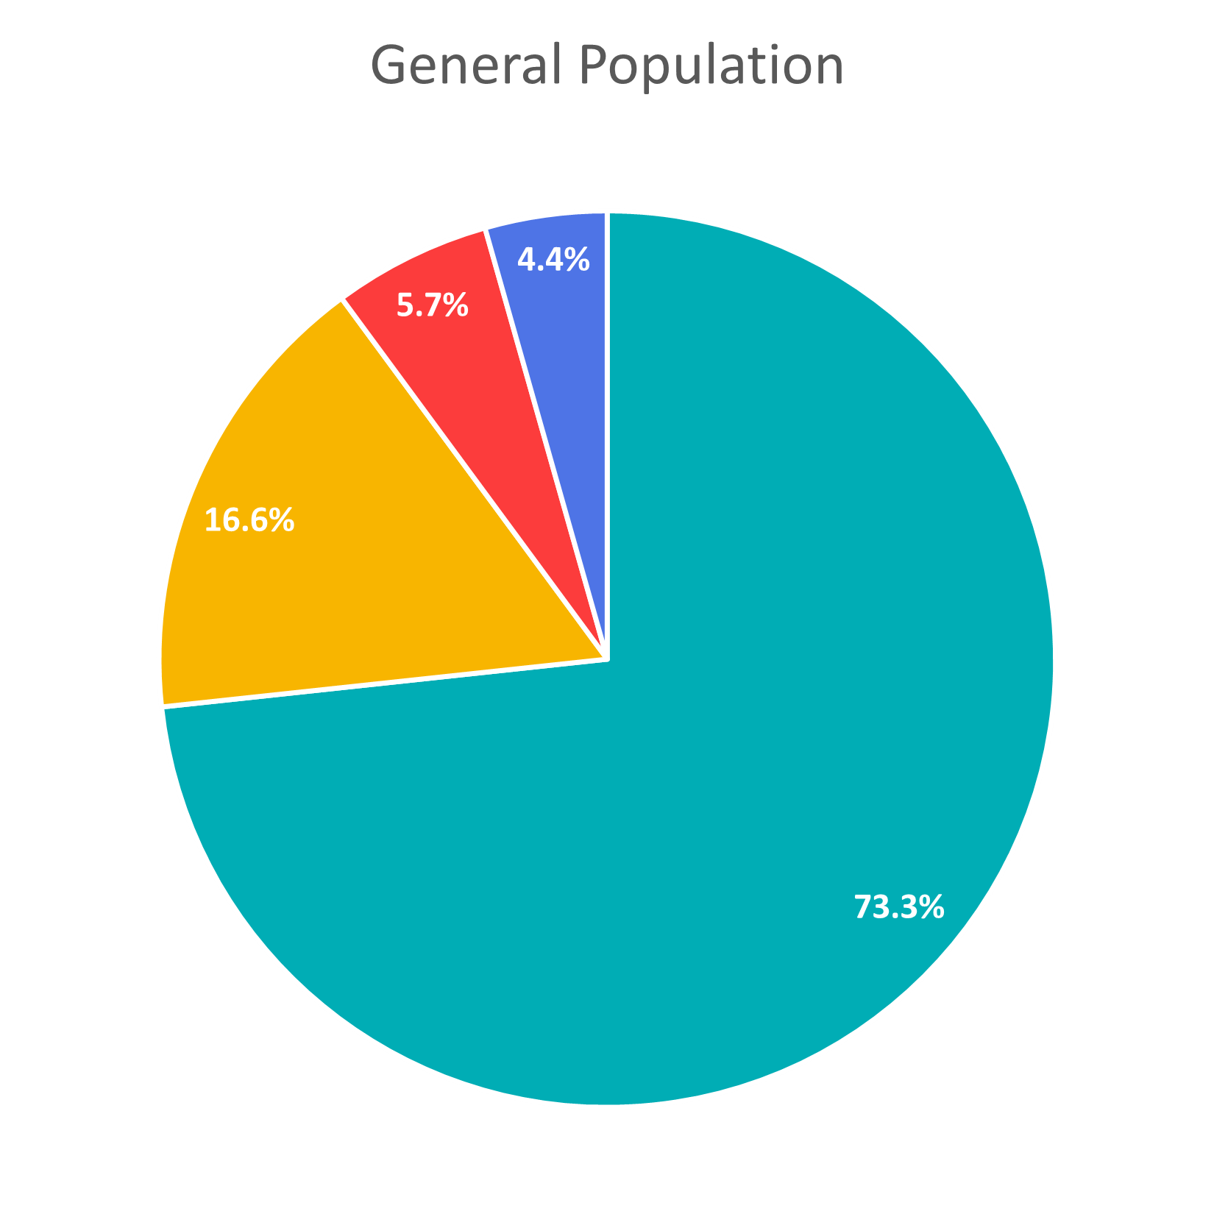
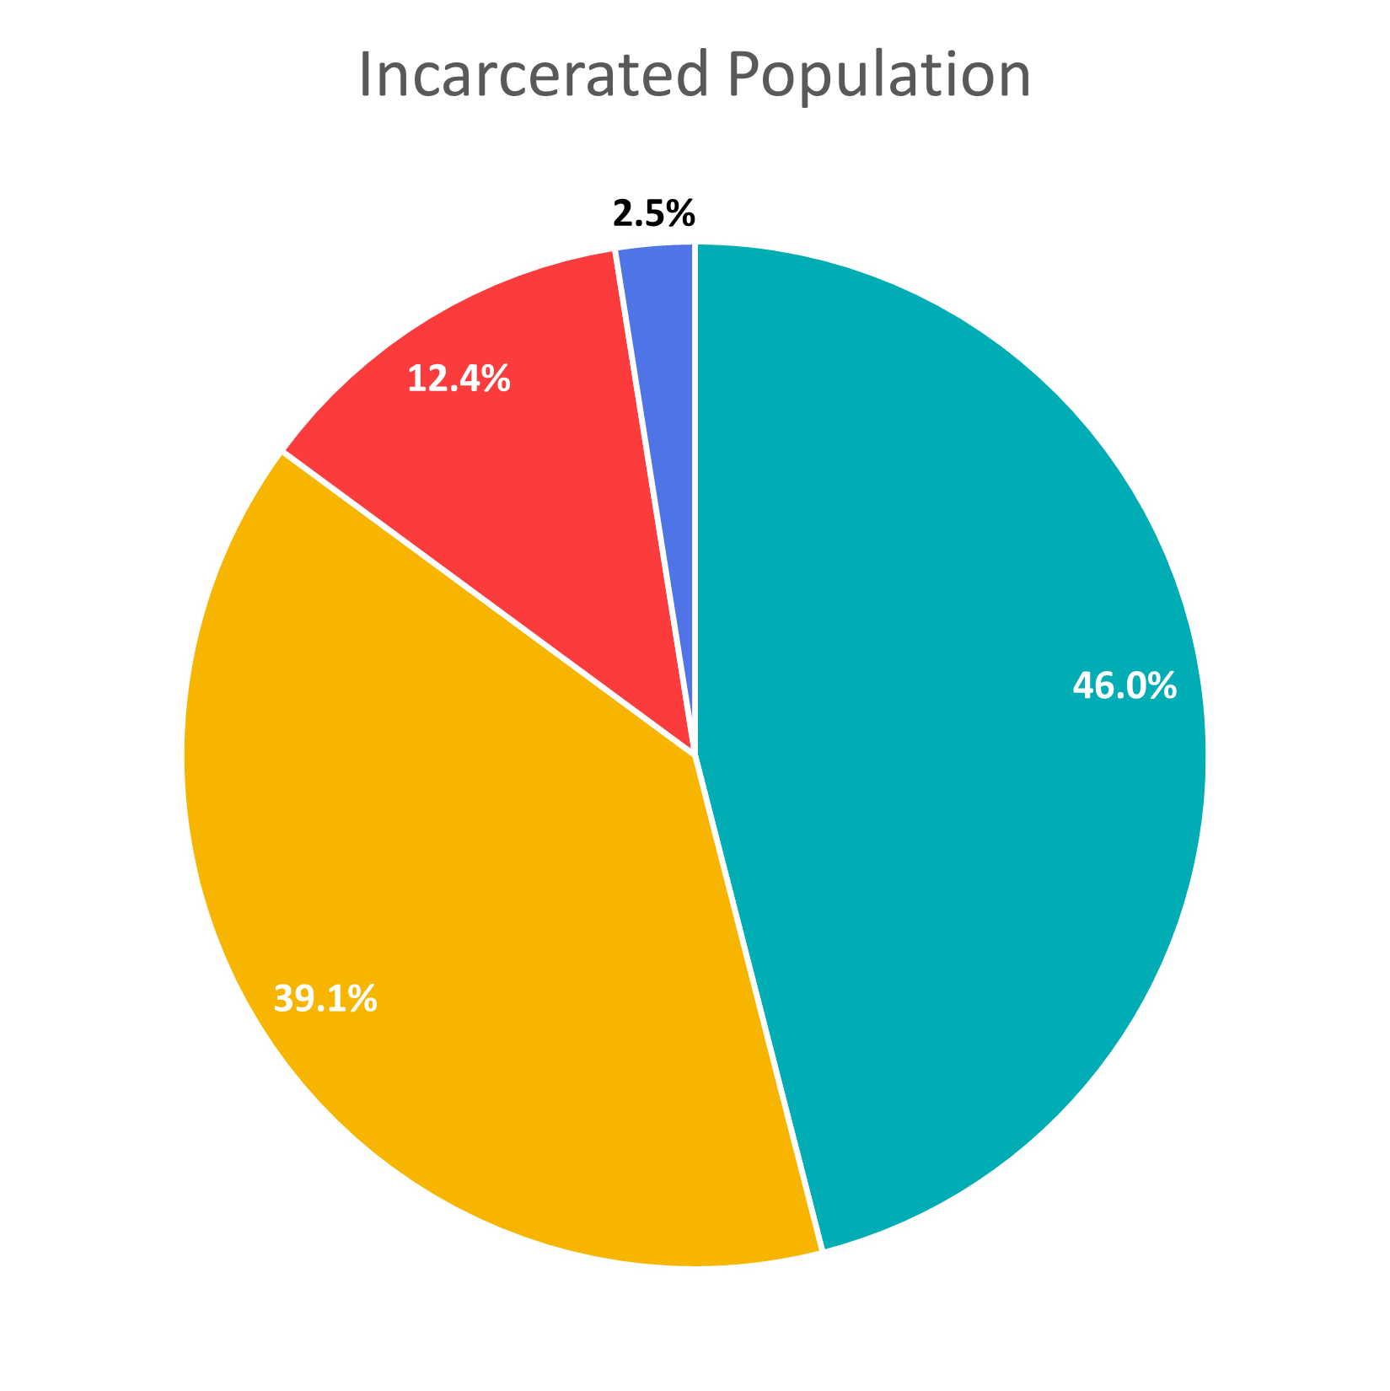

A black person is
3.9x
more likely to be incarcerated than a white person
A Hispanic person is
3.5x
more likely to be incarcerated than a white person

Slide 7
Sentence Length by Crime Category

Slide 8
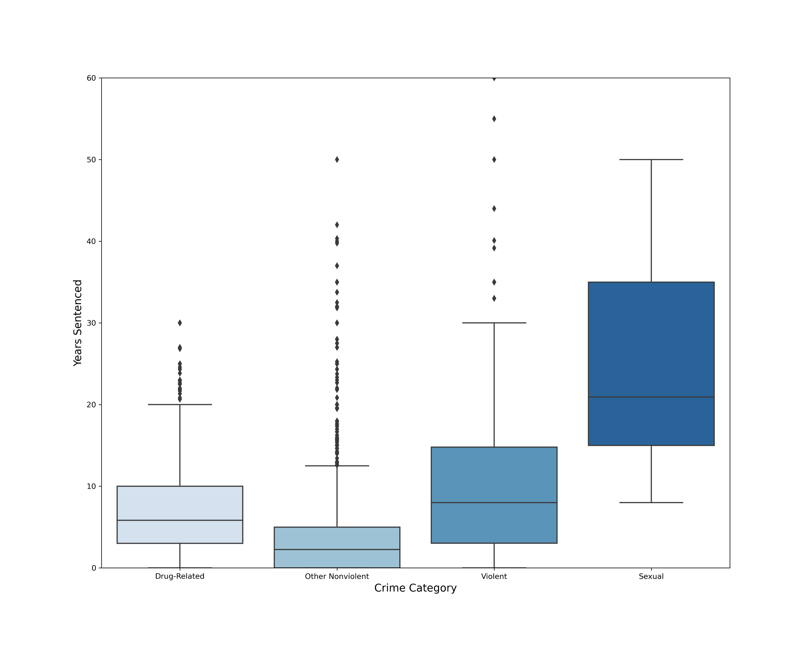
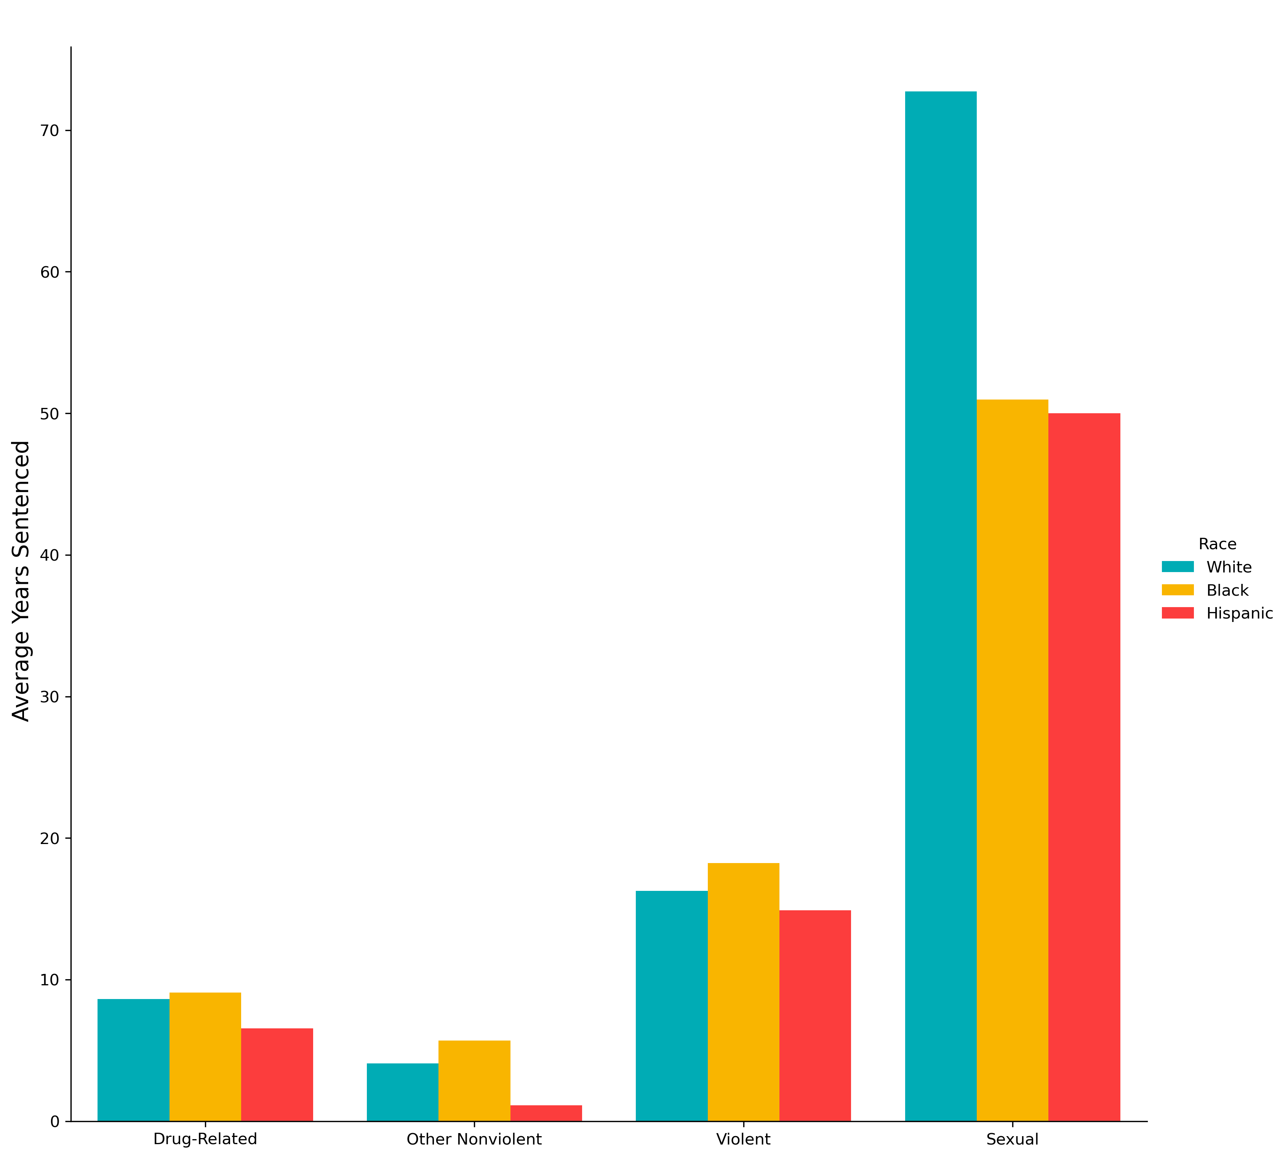
Sentence Length by Crime Category
Sentence Distribution
Racial Breakdown
Notes:
Sexual crimes are less than 1% of dataset
Violent crime is right around 10%
Rest is drug-related or other nonviolent

Slide 9
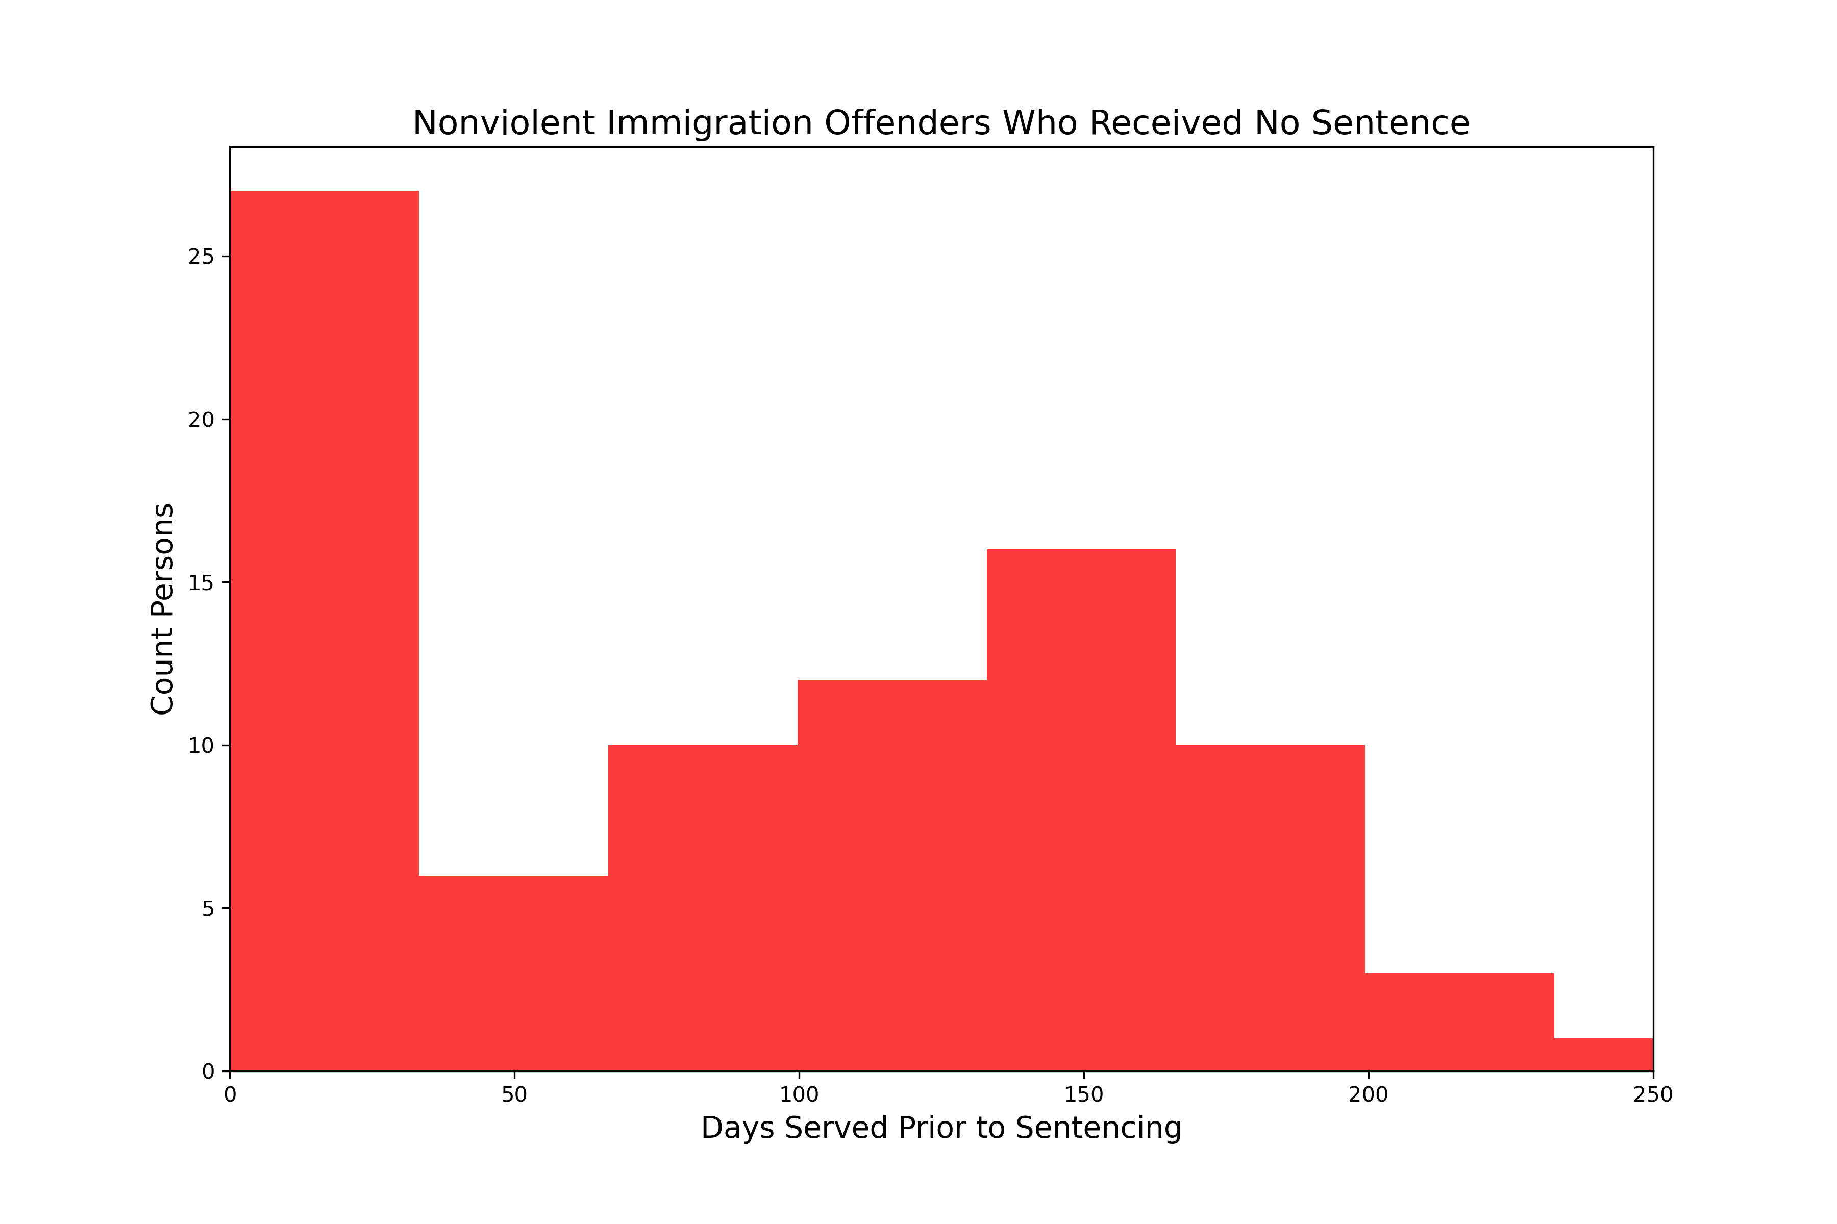
Closer Look: Immigration Offenses
97%
not legal residents
43% of all Hispanic defendants receive sentences for immigration-related offenses, which carry no mandatory minimum sentence.
Of those, exactly half received credit for time served and therefore receive no additional sentence. The average time served prior to sentencing for this group is 70 days.
Additionally, 97% of these defendants are not legal residents of the U.S., meaning they may have been deported rather than sentenced to additional time.
Notes:
60.1% of offenses by Hispanic defendants are “other nonviolent”
71% of those offenses are immigration related
Comes out to 43% of all offenses

Slide 10
Sentence Enhancements & Mitigation Measures

Slide 11

Sentence Enhancements & Mitigation
Sentence enhancements available:
Criminal history points
“Career Offender” status
“Armed Career Offender” status
Sentence mitigations available:
Safety valve

Slide 12
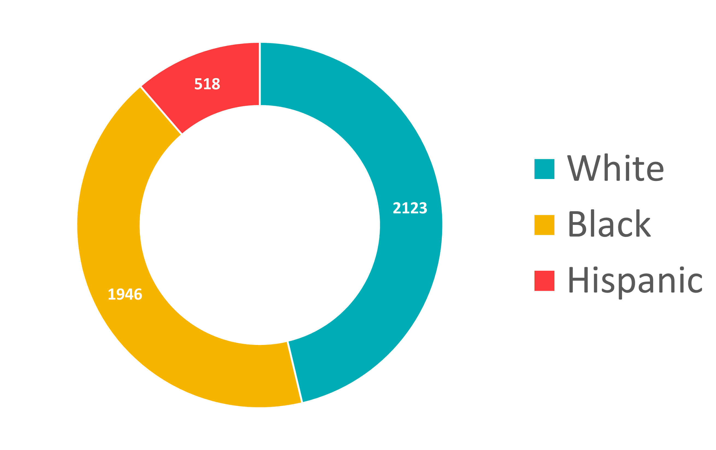
Sentence Enhancements
Criminal History Points Applied
Applied in
64%
of cases
Increases sentence by average of
2.6
years
Distribution roughly matches demographics of general incarcerated population

Slide 13
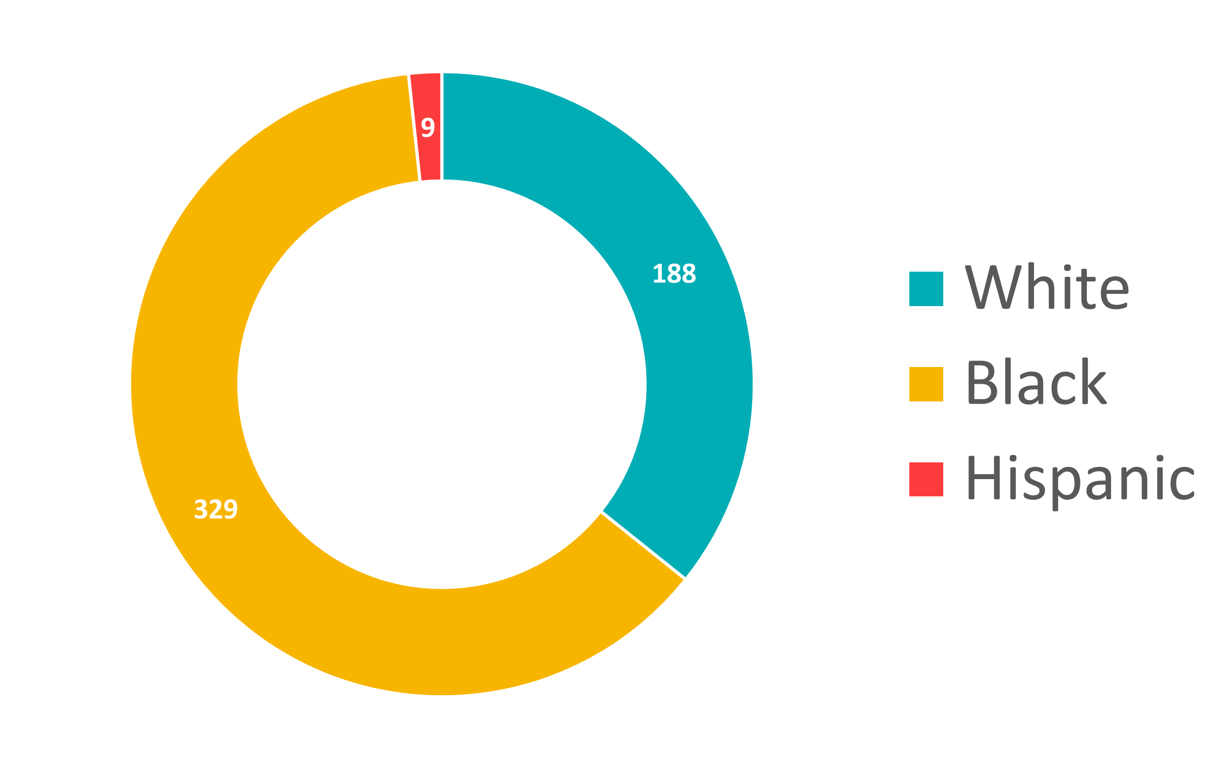
Sentence Enhancements
Career Offender Status Applied
Applied in
7%
of cases
Increases sentence by average of
12.7
years
Black defendants are labeled “Career Offenders” 2x as often as white defendants and 11.6x as often as Hispanic defendants
Notes:
Distribution skews heavily toward black defendants

Slide 14
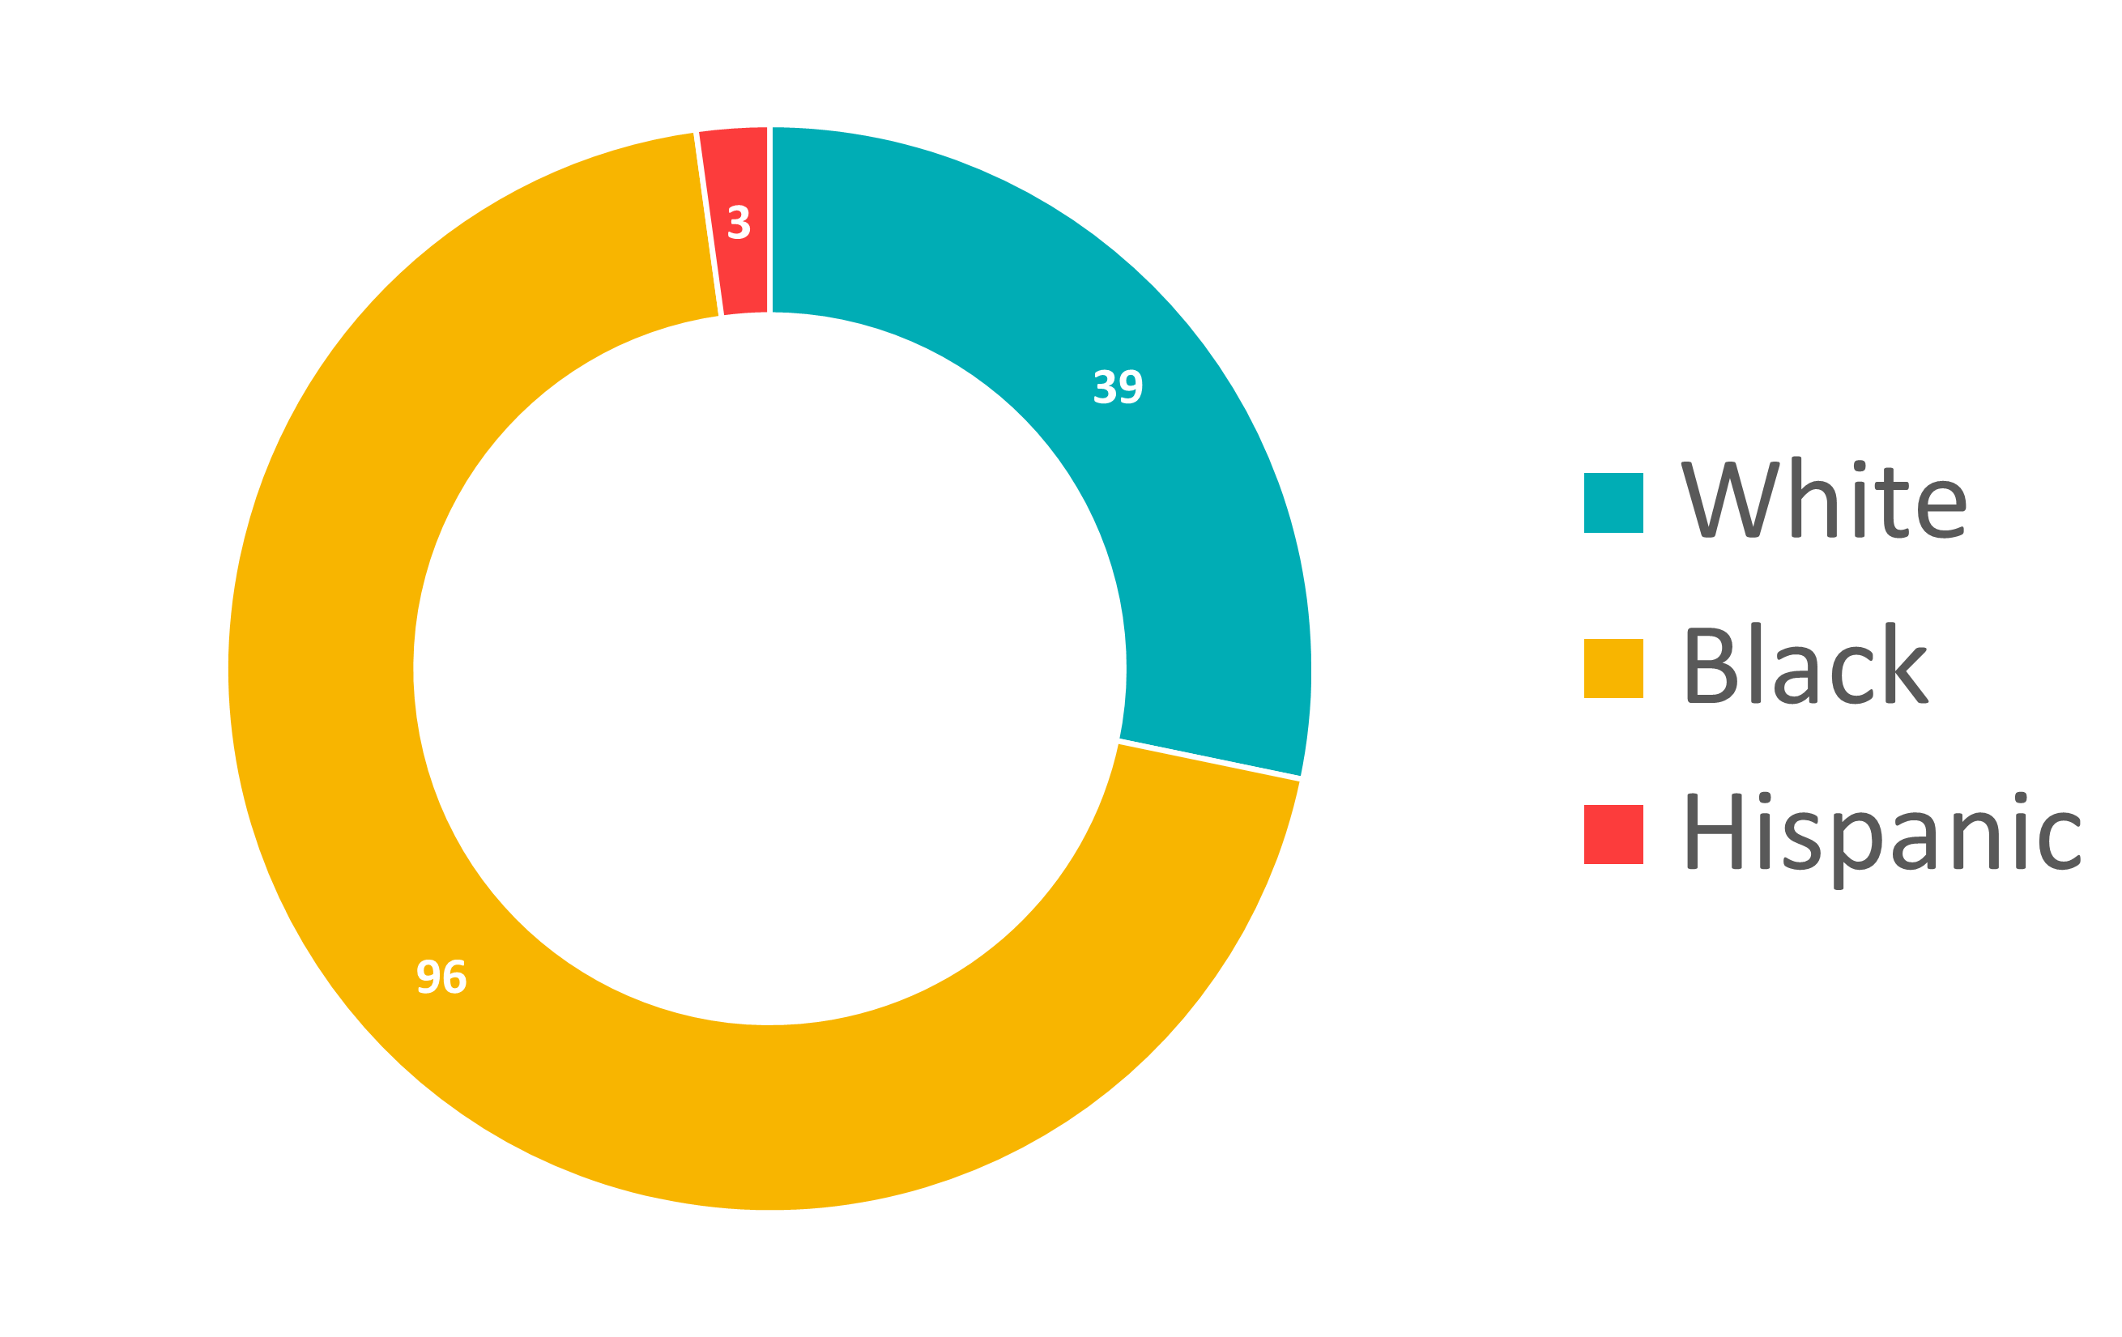
Sentence Enhancements
Armed Career Offender Status Applied
Applied in
2%
of cases
Increases sentence by average of
25.3
years
Black defendants are labeled “Armed Career Offenders” 2.7x as often as white defendants and 8.5x as often as Hispanic defendants

Slide 15
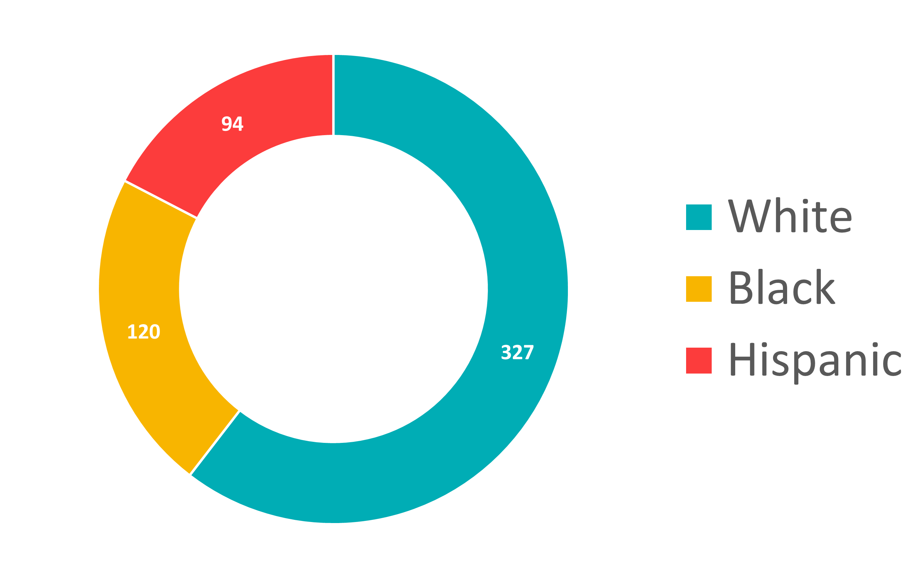
Sentence Mitigation
Safety Valve Applied
Applied in
18%
of drug cases
Reduces sentence by average of
7.2
years
Black defendants receive the safety valve measure 40% less than white defendants and 70% less than Hispanic defendants
Notes:
Drug breakdown: 56% white, 34.2% black, 8.2% Hispanic
Safety valve breakdown: 59.9% white, 22% black, 17.2% Hispanic

Slide 16
Pleas v. Trials
Notes:
Judges and juries have less discretion, due to rigid sentencing guidelines
Only variance is in what you’re charged with, which is determined by prosecutors
They use harsh sentences as bargaining chips to encourage defs to plead
This can be a problem, bc an innocent defendant may feel pressured to plead rather than risk a much longer sentence at trial

Slide 17

Pleas v. Trials: Background*
Rigid sentencing guidelines leave little discretion to judges and juries in determining sentence length
Prosecutors frequently use harsh mandatory minimums as bargaining chips to encourage defendants to plead out under a lesser charge rather than pursue trial
This may cause innocent defendants to plead rather than risk a longer sentence at trial
I wanted to see how these dynamics play out in Tennessee
*Source: Prisoners of Politics: Breaking the Cycle of Mass Incarceration by Rachel Elise Barkow

Slide 18
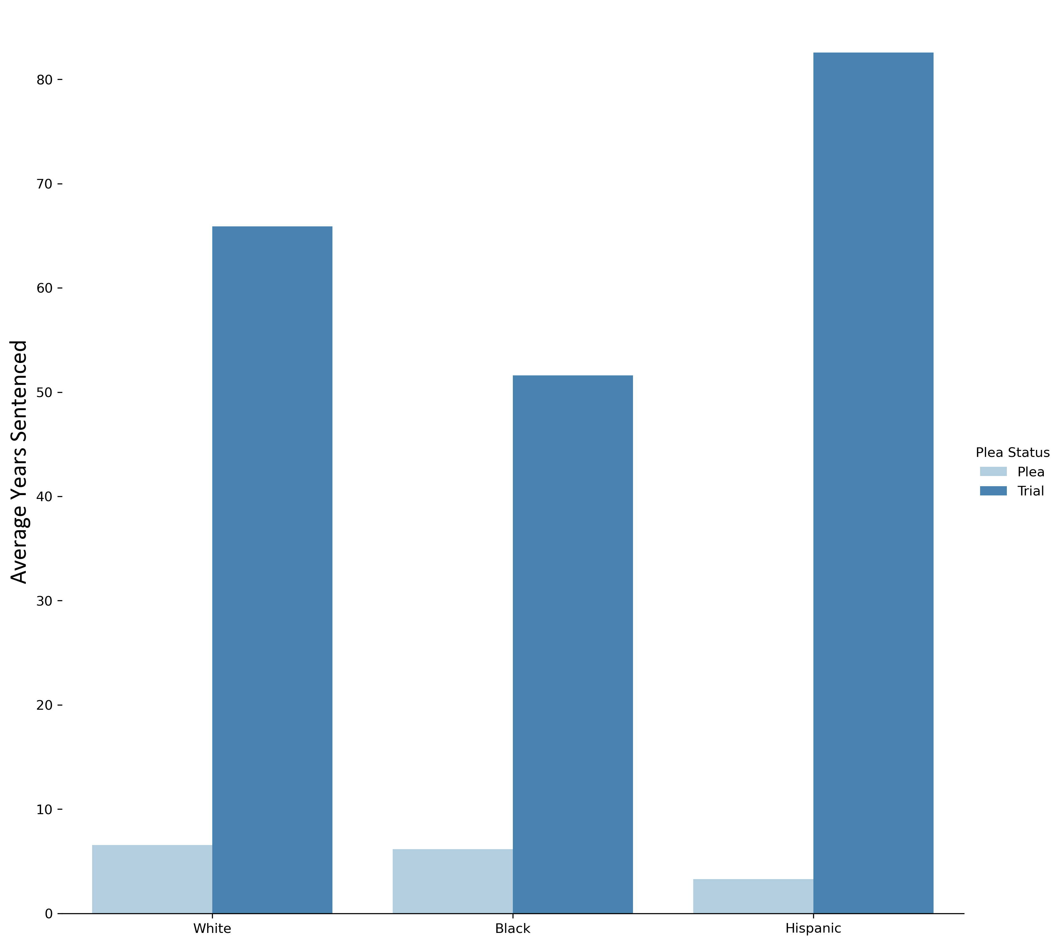
Pleas v. Trials
Average Sentence Length by Race
Average sentence for a plea:
5.9
years
Average sentence for a trial:
58.3
years
Difference between average sentence length for plea v. trial:
Black: 45.4 years
White: 59.3 years
Hispanic 81.5 years
Median sentences are dramatically lower, but going to trial still increases the median sentence by 6.6 years
Notes:
Judges and juries have less discretion, due to rigid sentencing guidelines
Only variance is in what you’re charged with, which is determined by prosecutors
They use harsh sentences as bargaining chips to encourage defs to plead
This can be a problem, bc an innocent defendant may feel pressured to plead rather than risk a much longer sentence at trial

Slide 19
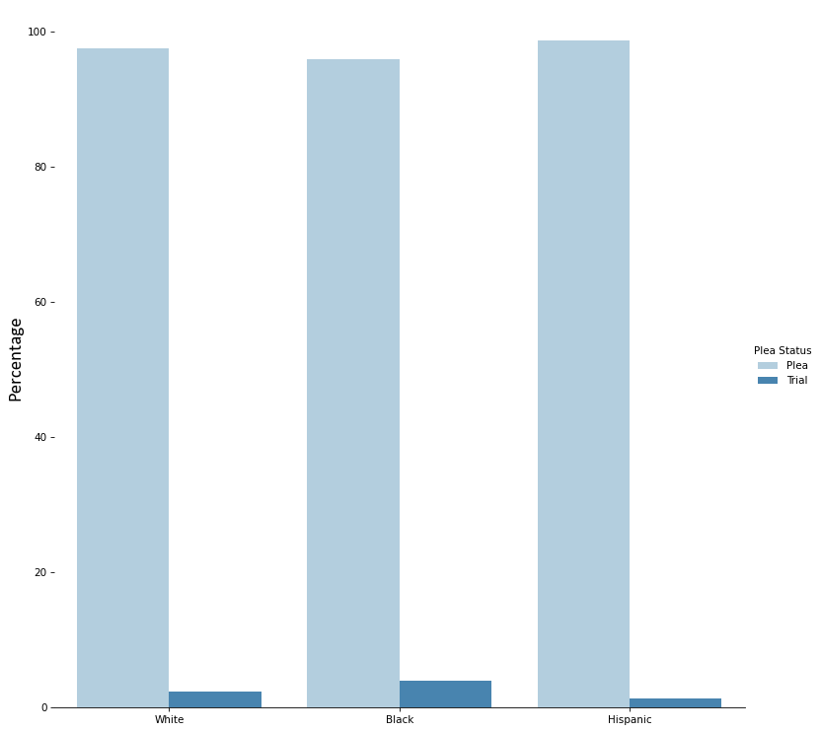
Pleas v. Trials
Percentage of Pleas v. Trials by Race
97%
of all defendants plead out
3.9% of black defendants pursue trial
2.4% of white defendants pursue trial
1.3% of Hispanic defendants pursue trial
Notes:
Judges and juries have less discretion, due to rigid sentencing guidelines
Only variance is in what you’re charged with, which is determined by prosecutors
They use harsh sentences as bargaining chips to encourage defs to plead
This can be a problem, bc an innocent defendant may feel pressured to plead rather than risk a much longer sentence at trial

Slide 20

Key Insights
Black and Hispanic Tennesseans are incarcerated at a rate of 3.5x that of white Tennesseeans.
Black defendants are 40% less likely than white defendants to receive sentence reductions, but twice as likely to receive designations that substantially lengthen their sentences.
Defendants across racial lines receive sentences 10x longer on average than defendants who plead. This creates a strong incentive for defendants (regardless of race) to plead out rather than pursue their constitutional right to a trial by jury.

