Slide 1

Racial Disparities in Tennessee Federal Sentencing: 2015 to 2019
Jennifer Whitson
April 30, 2021

Slide 2

Guiding Questions
Are there racial disparities between the sentencing population and the general population in Tennessee?
Are people of color receiving longer sentences on average for the same crimes?
Are there disparities in the application of sentence enhancements and sentence mitigation measures?

Slide 3

Data Collection and Cleaning
SAS files from ussc.gov (The U.S. Sentencing Commission)
Nationwide dataset with over 300k rows and 1000+ columns
Identified 195 columns for analysis
Extracted Tennessee specific data

Slide 4

Background: Federal v. State Crime
State law:
Murder
Sexual assault
Robbery/burglary
Most violent crime
Federal law:
Drug possession and sales
Immigration
“White Collar Crime” (e.g., fraud, money laundering)
Bank robbery
State crimes that:
Occur on federal land;
Are committed against federal agents;
Cross state lines;
Occur in Washington D.C. or in international waters;
Are investigated by a federal agency, such as the FBI

Slide 5
Are there racial disparities between the sentencing population and the general population in Tennessee?

Slide 6
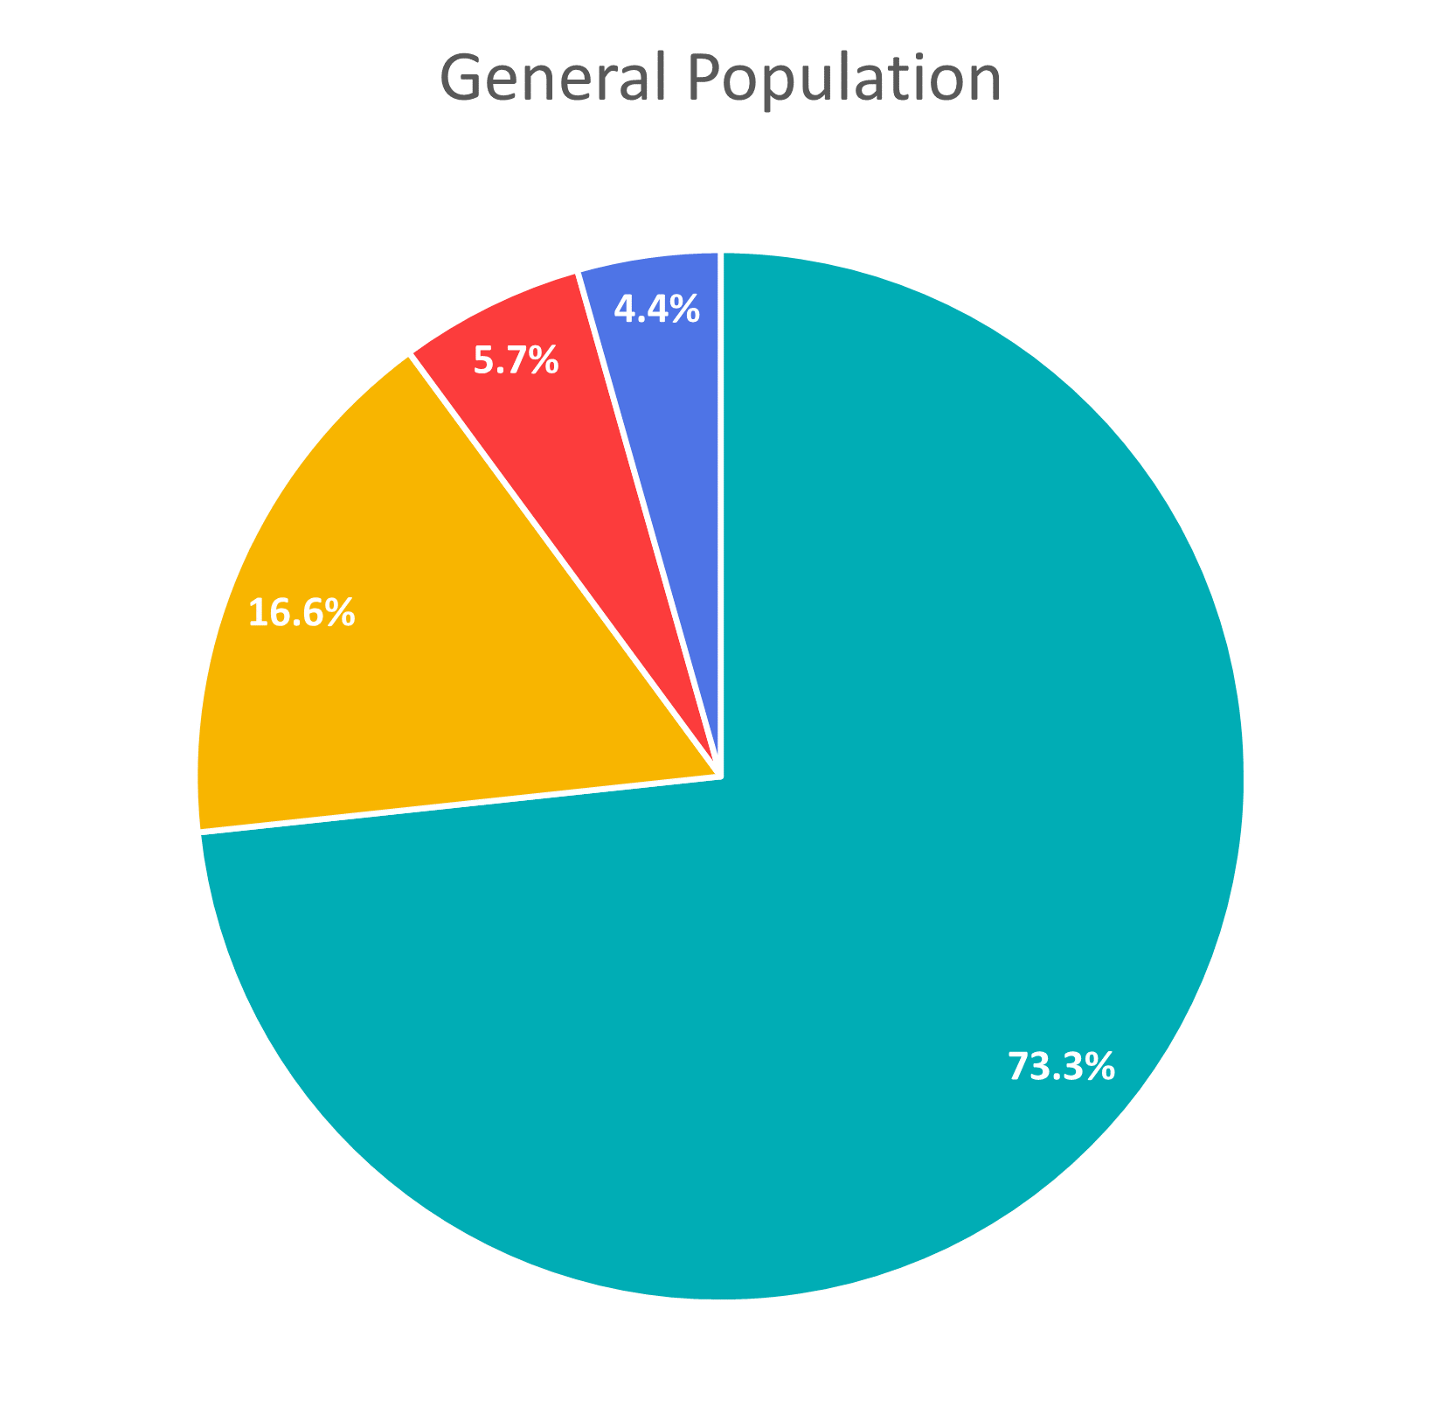
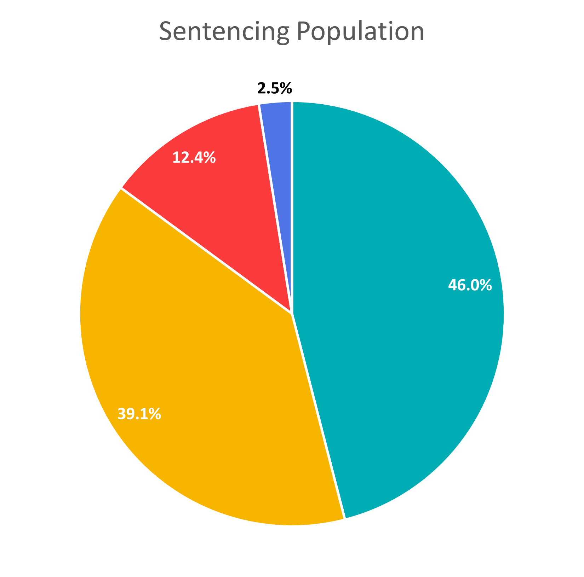

A black person is
3.9x
more likely to be sentenced than a white person
A Hispanic person is
3.5x
more likely to be sentenced than a white person

Slide 7
Are people of color receiving longer sentences on average for the same crimes?

Slide 8
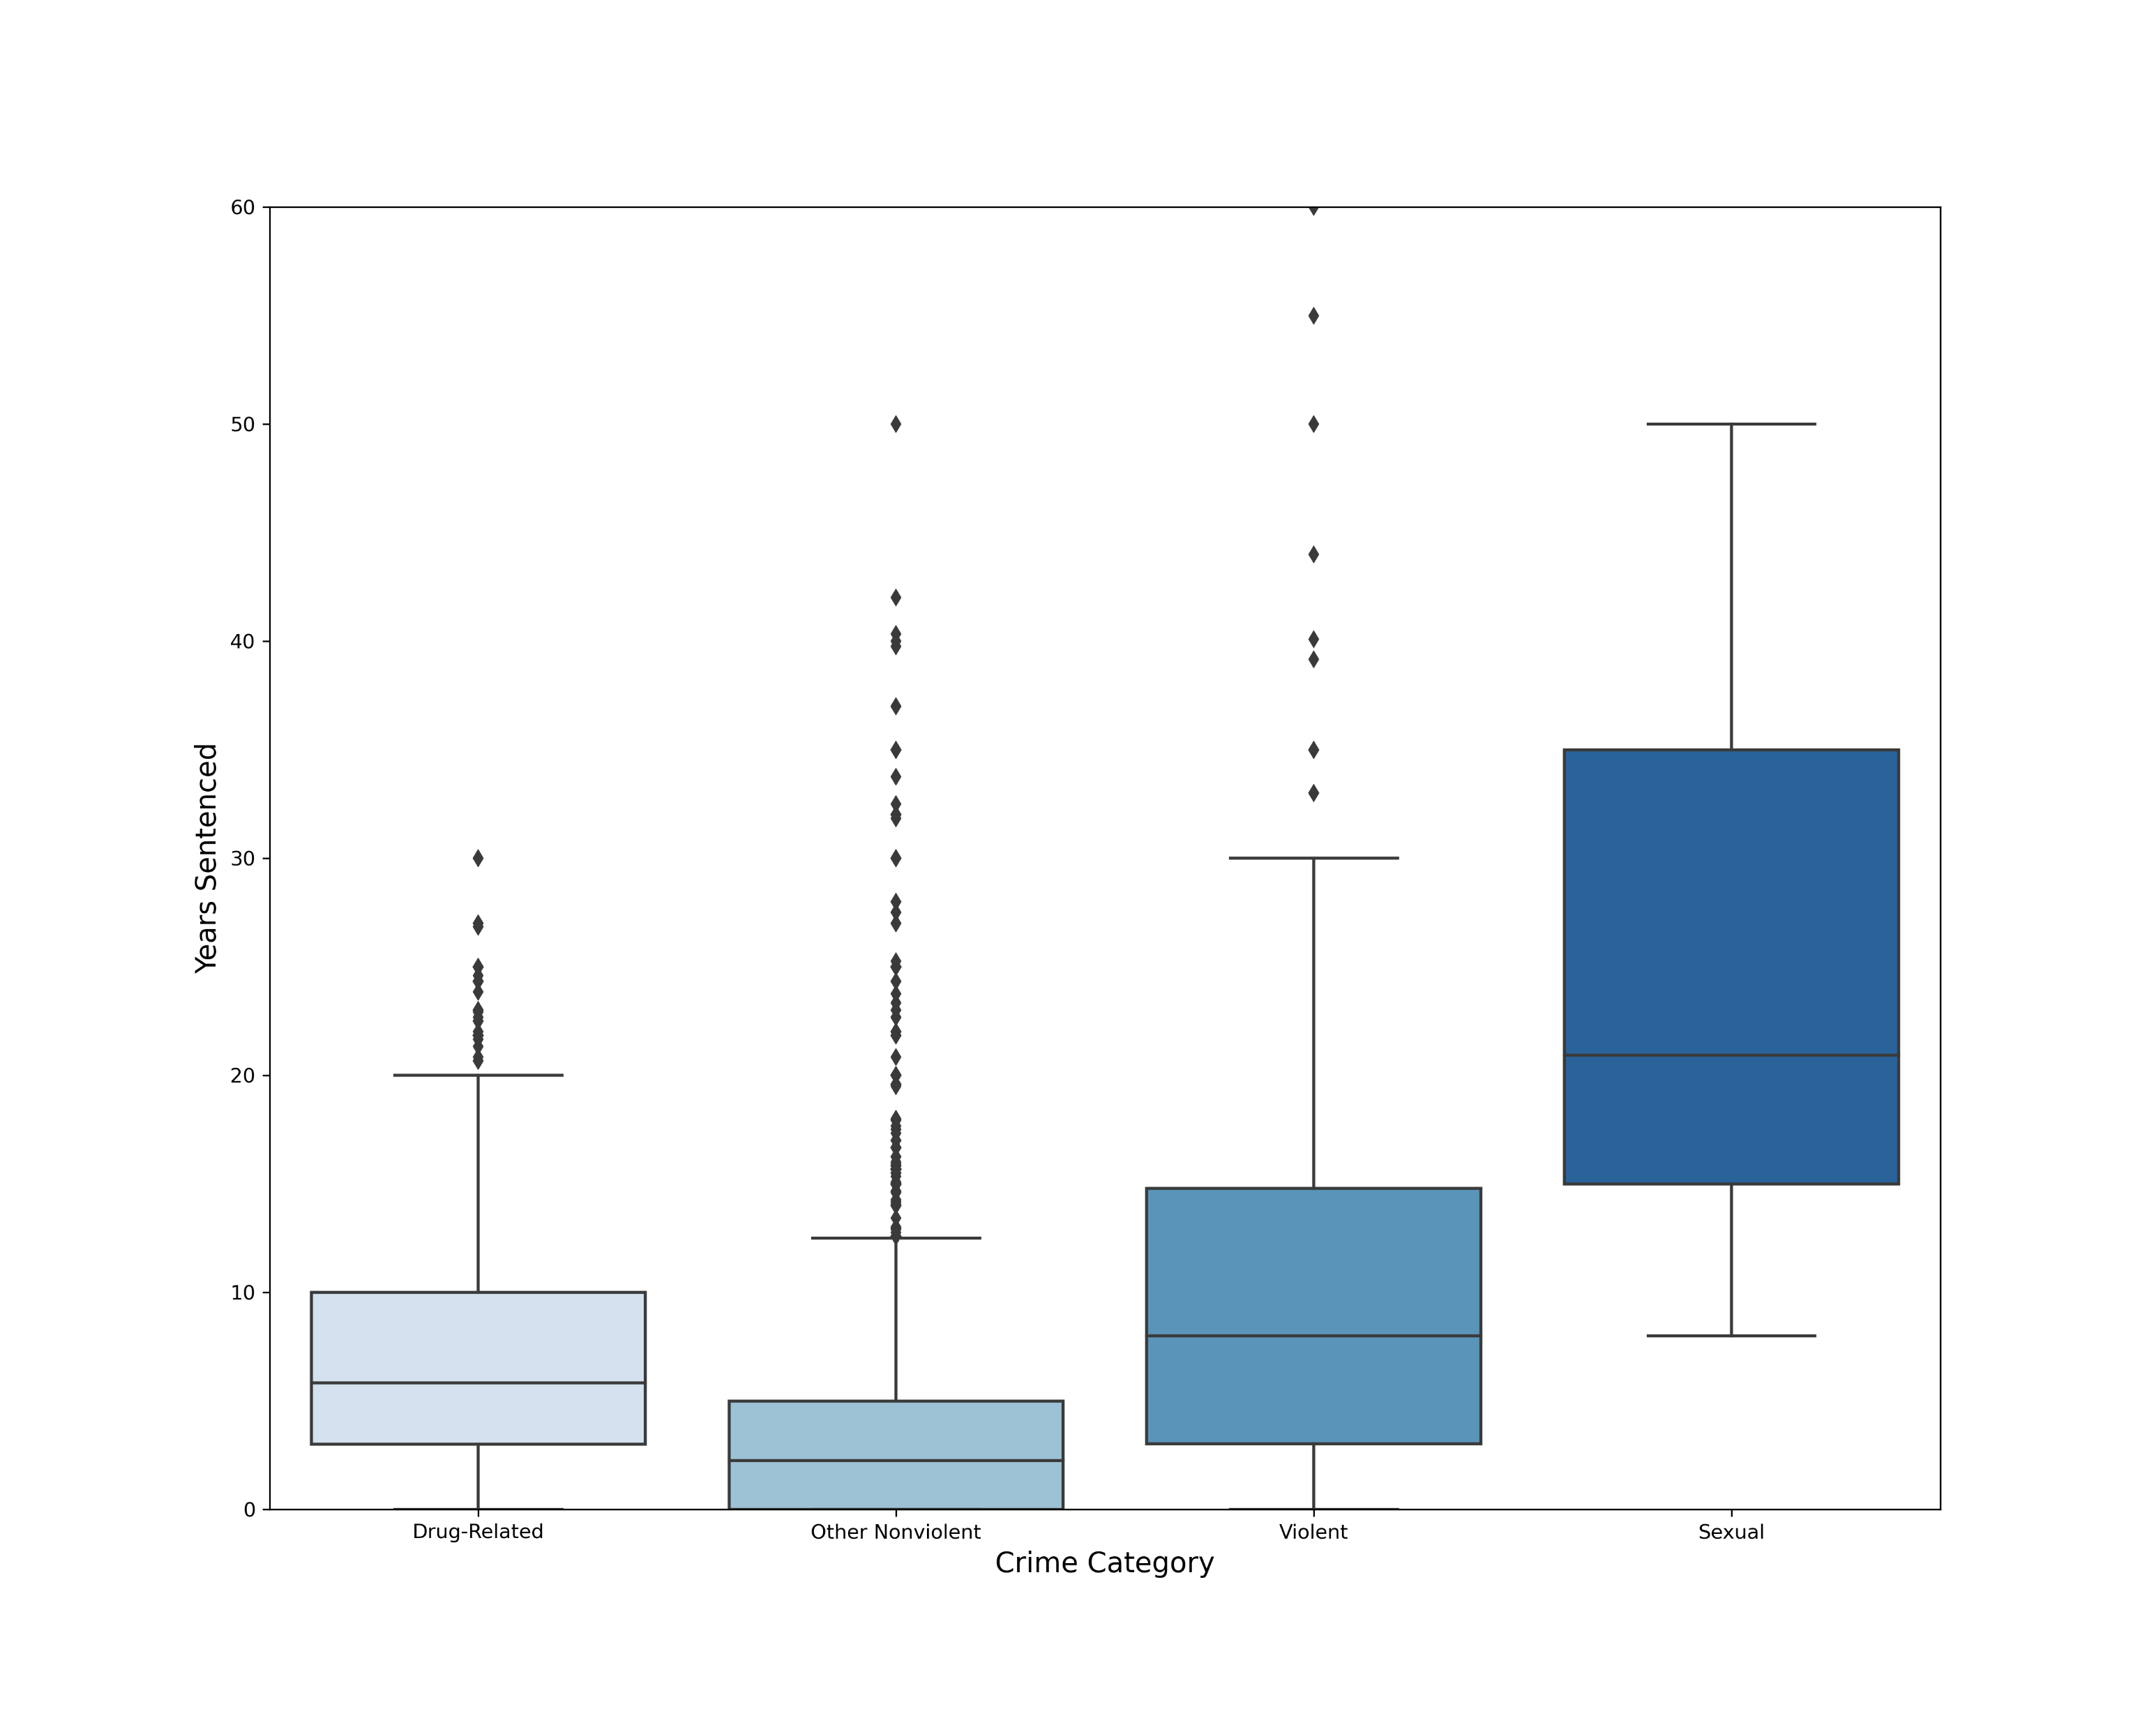
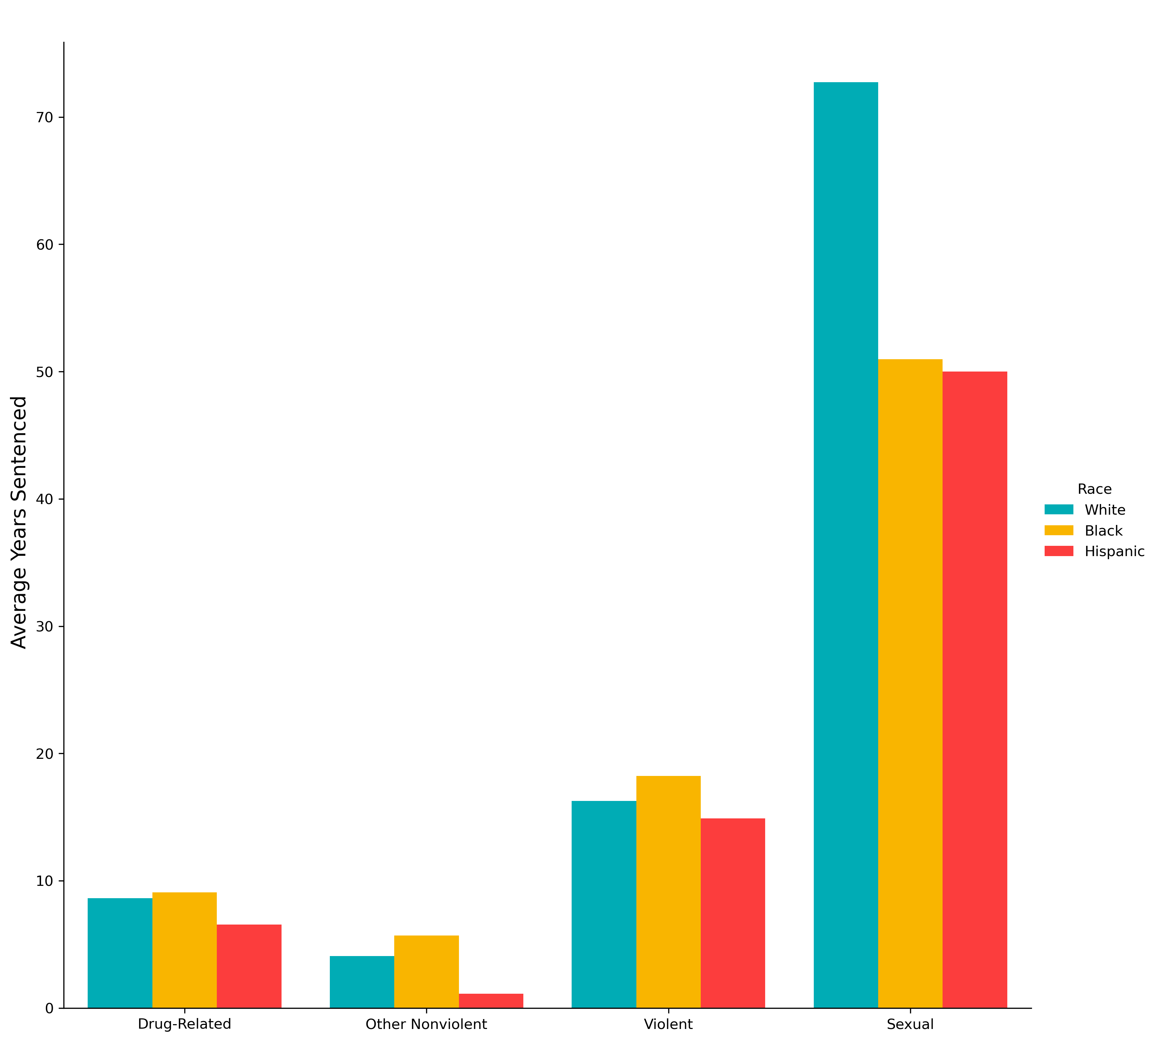
Sentence Length by Crime Category
Sentence Distribution
Racial Breakdown

Slide 9
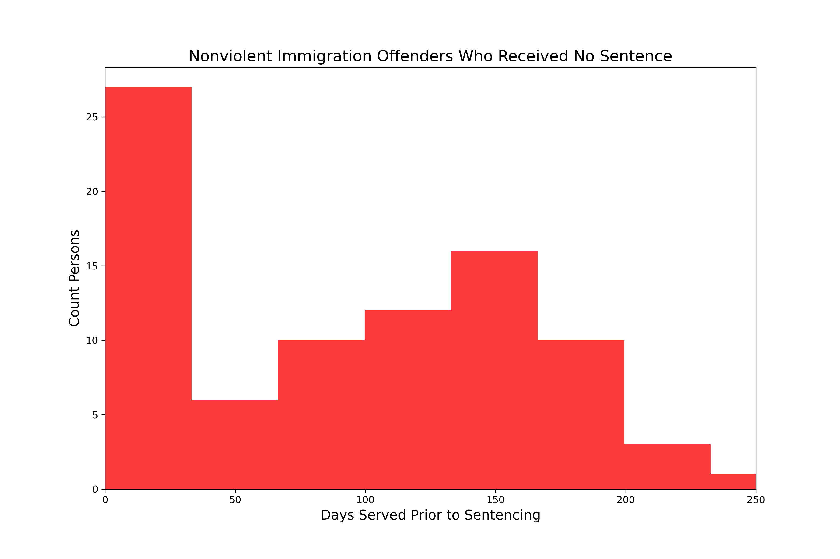
Closer Look: Immigration Offenses
97%
not legal residents
43% of all Hispanic defendants receive sentences for immigration-related offenses, which carry no mandatory minimum sentence.
Of those, exactly half received credit for time served and therefore receive no additional sentence. The average time served prior to sentencing for this group is 70 days.
Additionally, 97% of these defendants are not legal residents of the U.S., meaning they may have been deported rather than sentenced to additional time.
Notes:
60.1% of offenses by Hispanic defendants are “other nonviolent”
71% of those offenses are immigration related
Comes out to 43% of all offenses

Slide 10
Are there disparities in the application of sentence enhancements and sentence mitigation measures?

Slide 11

Sentence Enhancements & Mitigation
Sentence enhancements available:
Criminal history points
“Career Offender” status
“Armed Career Offender” status
Sentence mitigations available:
Safety valve

Slide 12
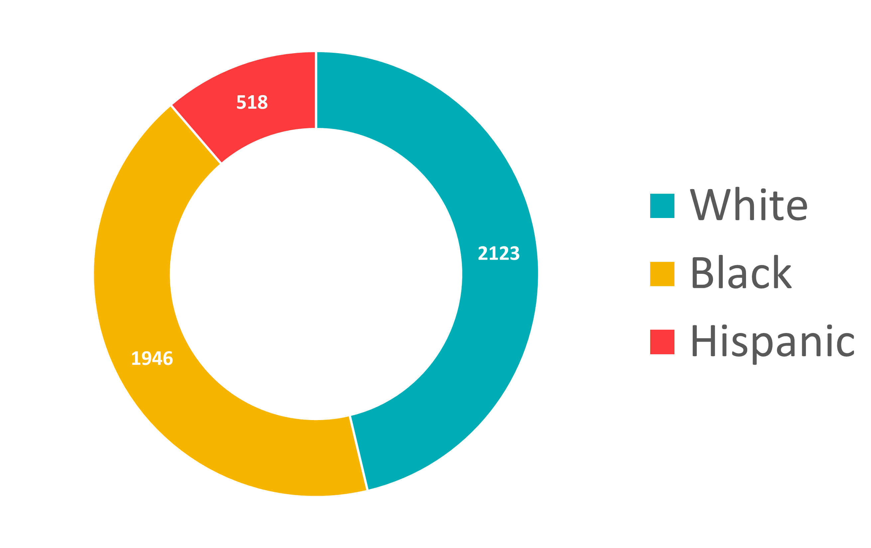
Sentence Enhancements
Criminal History Points Applied
Applied in
64%
of cases
Increases sentence by average of
2.6
years
Distribution roughly matches demographics of general sentencing population

Slide 13
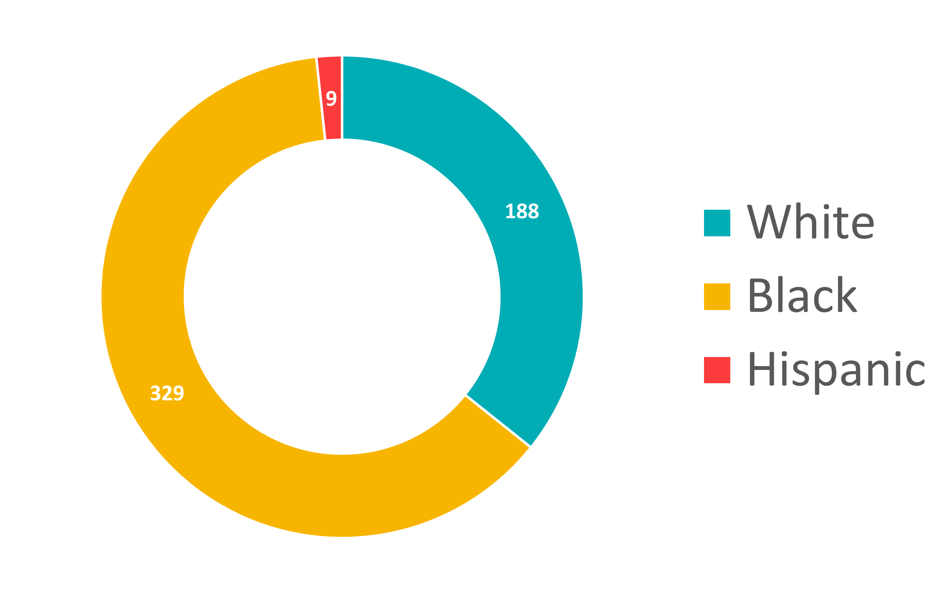
Sentence Enhancements
Career Offender Status Applied
Applied in
7%
of cases
Increases sentence by average of
12.7
years
Black defendants are labeled “Career Offenders” 2x as often as white defendants and 11.6x as often as Hispanic defendants
Notes:
Distribution skews heavily toward black defendants

Slide 14
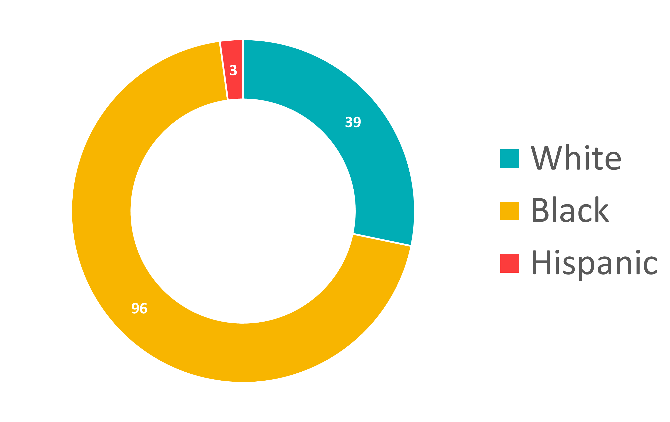
Sentence Enhancements
Armed Career Offender Status Applied
Applied in
2%
of cases
Increases sentence by average of
25.3
years
Black defendants are labeled “Armed Career Offenders” 2.7x as often as white defendants and 8.5x as often as Hispanic defendants

Slide 15
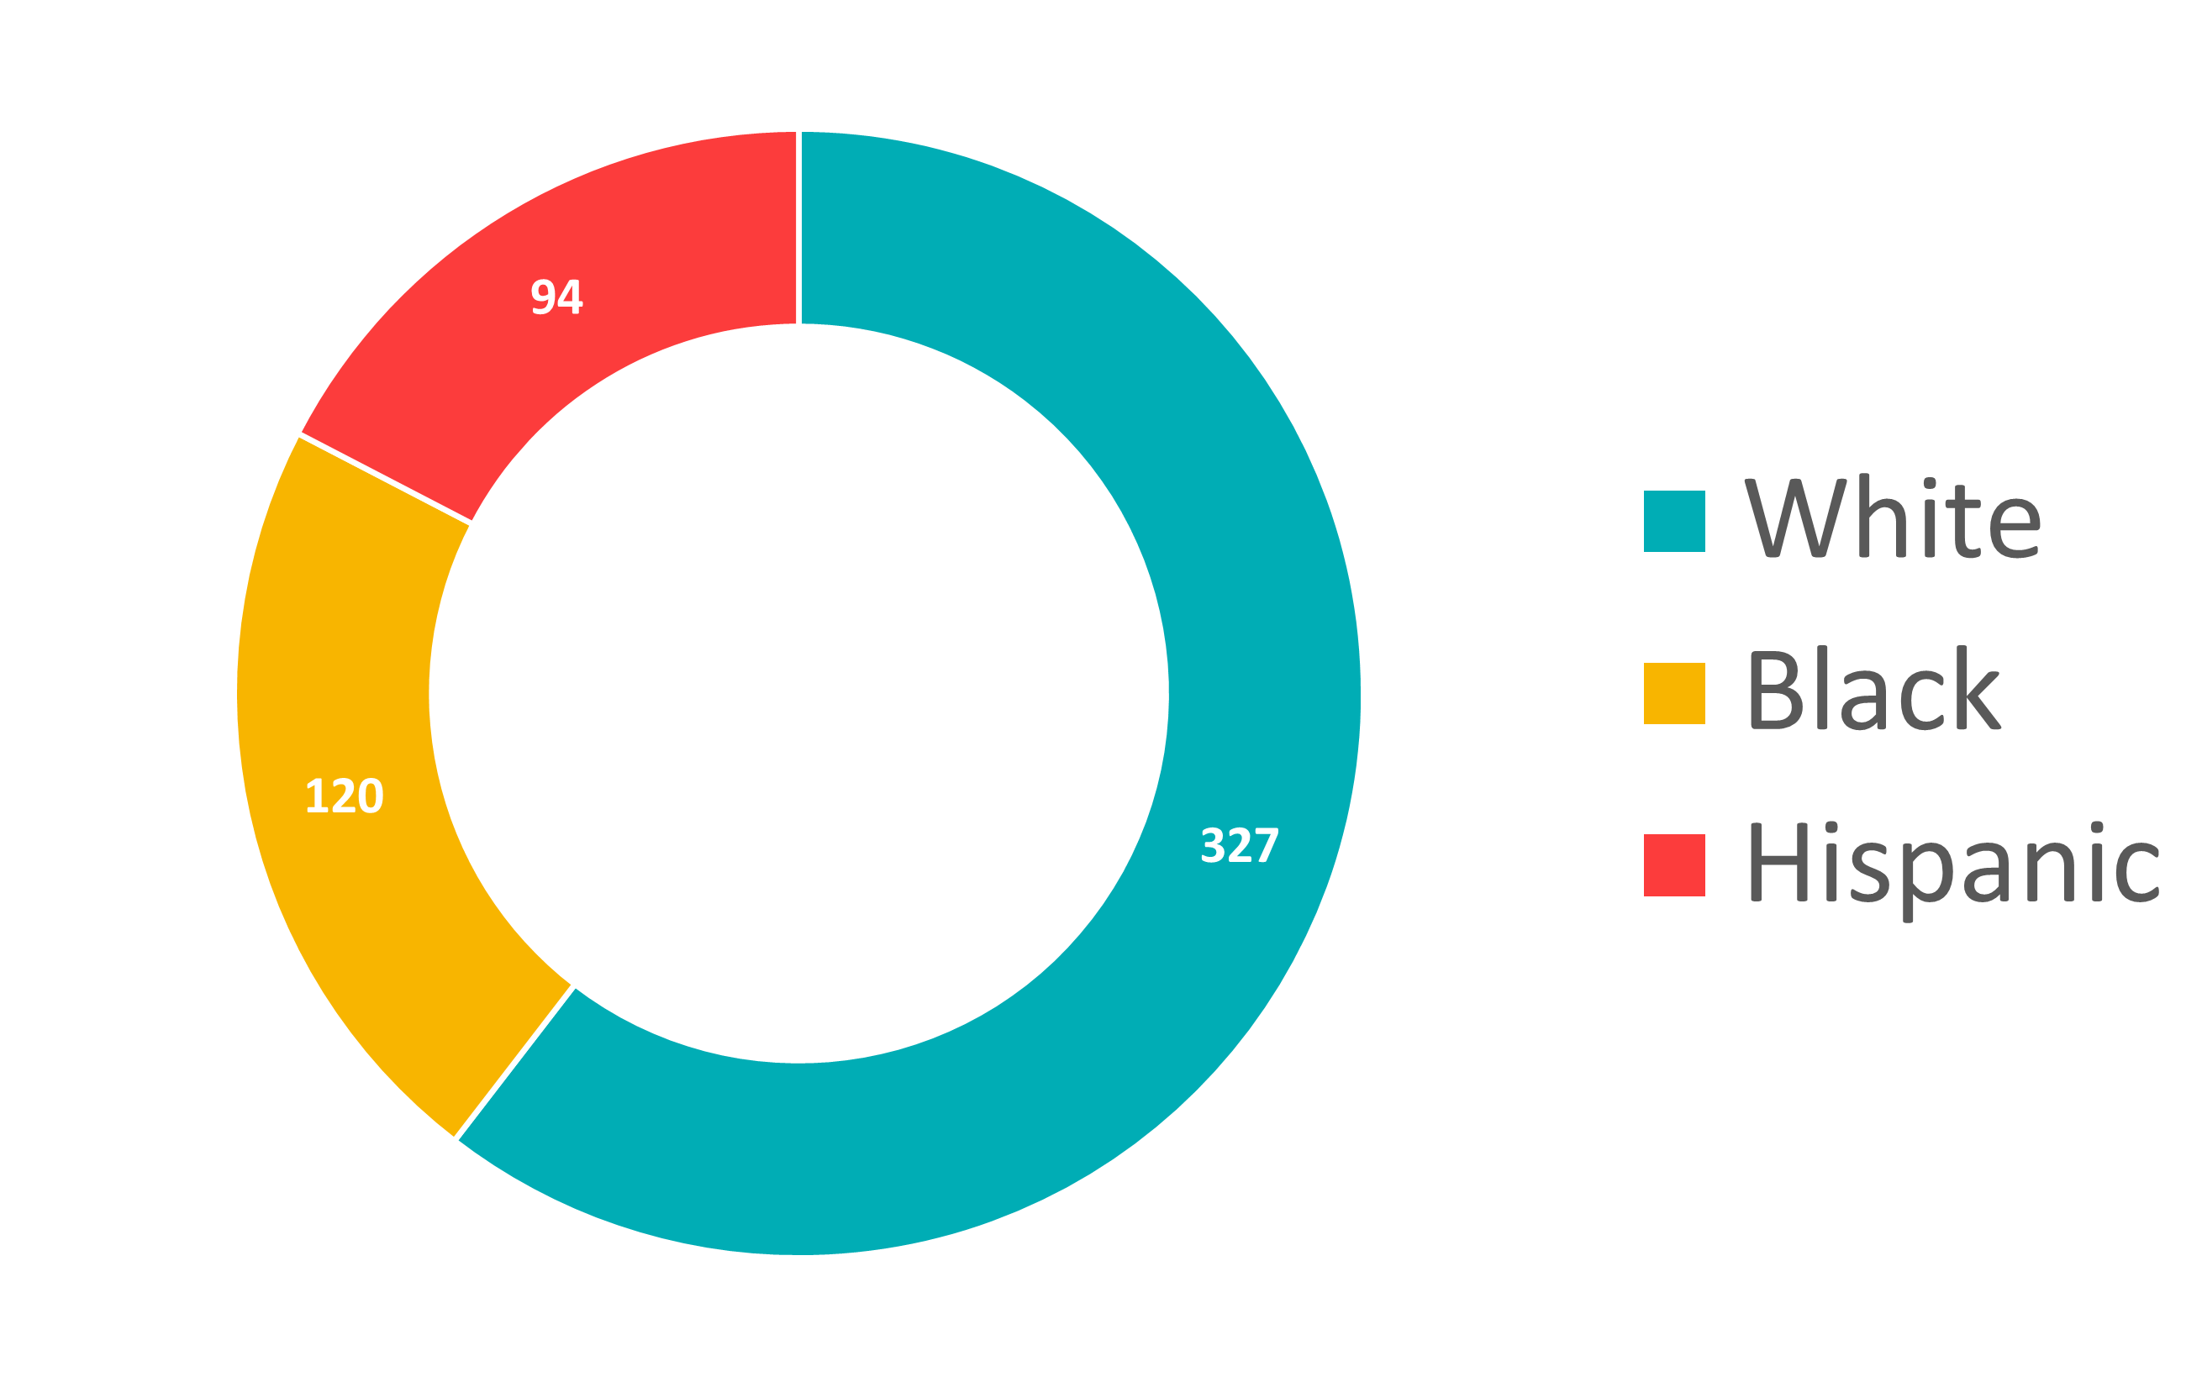
Sentence Mitigation
Safety Valve Applied
Applied in
18%
of drug cases
Reduces sentence by average of
7.2
years
Black defendants receive the safety valve measure 40% less than white defendants and 70% less than Hispanic defendants
Notes:
Drug breakdown: 56% white, 34.2% black, 8.2% Hispanic
Safety valve breakdown: 59.9% white, 22% black, 17.2% Hispanic

Slide 16
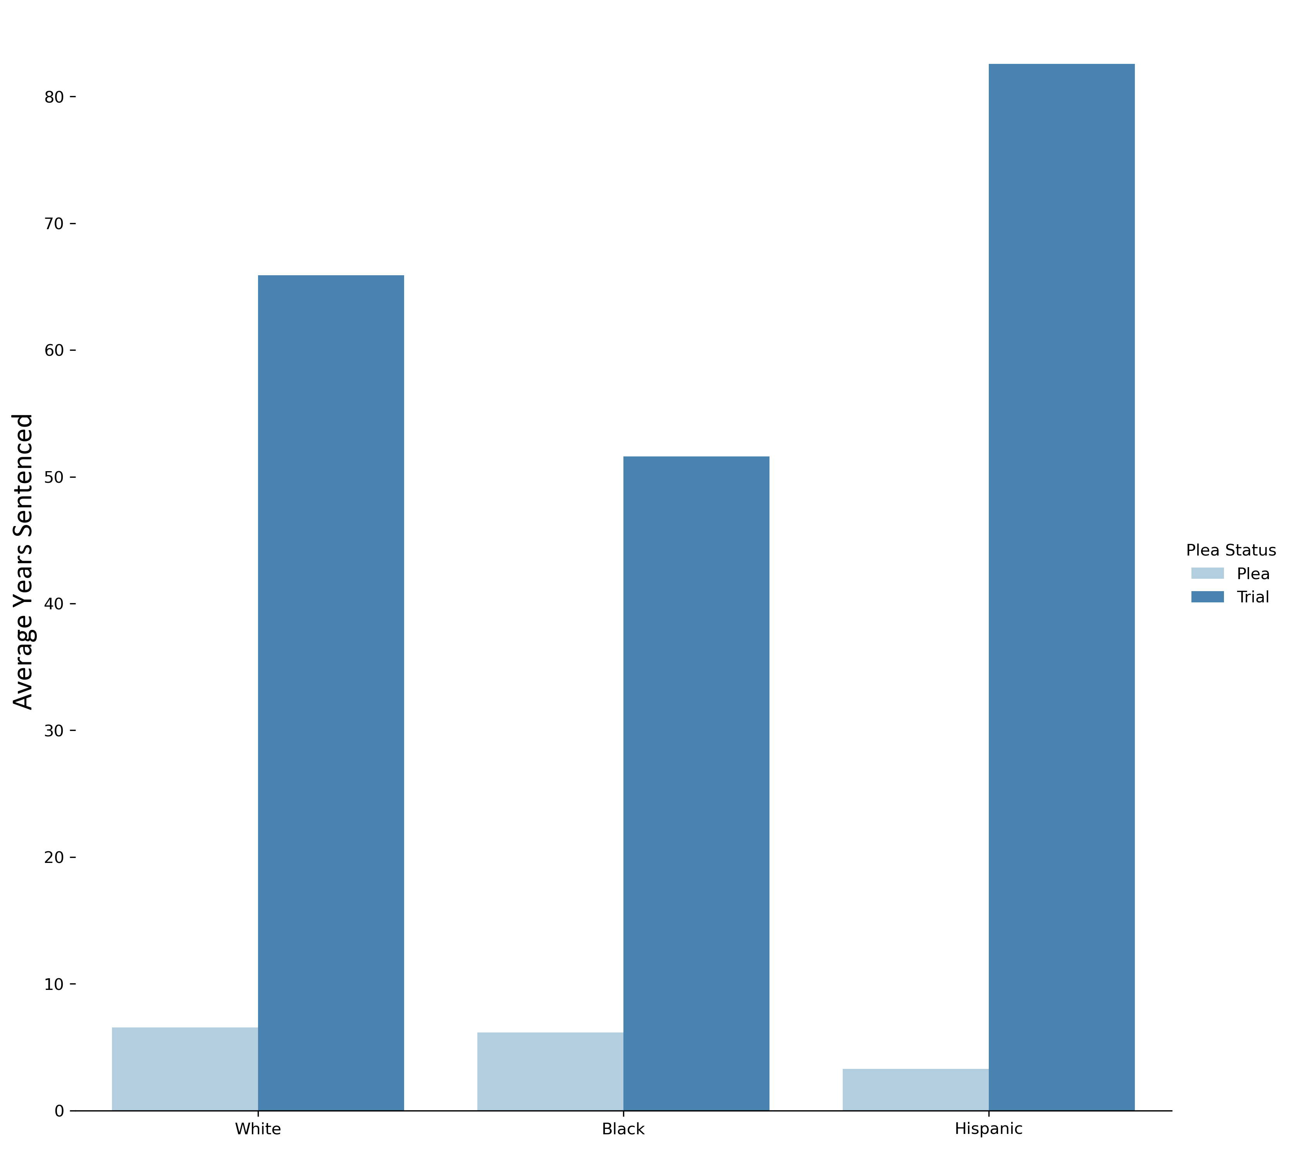
Final Note: Pleas v. Trials
Average sentence for a plea:
5.9
years
Average sentence for a trial:
58.3
years
Difference between average sentence length for plea v. trial:
Black: 45.4 years
White: 59.3 years
Hispanic 81.5 years
Median sentences are dramatically lower, but going to trial still increases the median sentence by 6.6 years

Slide 17
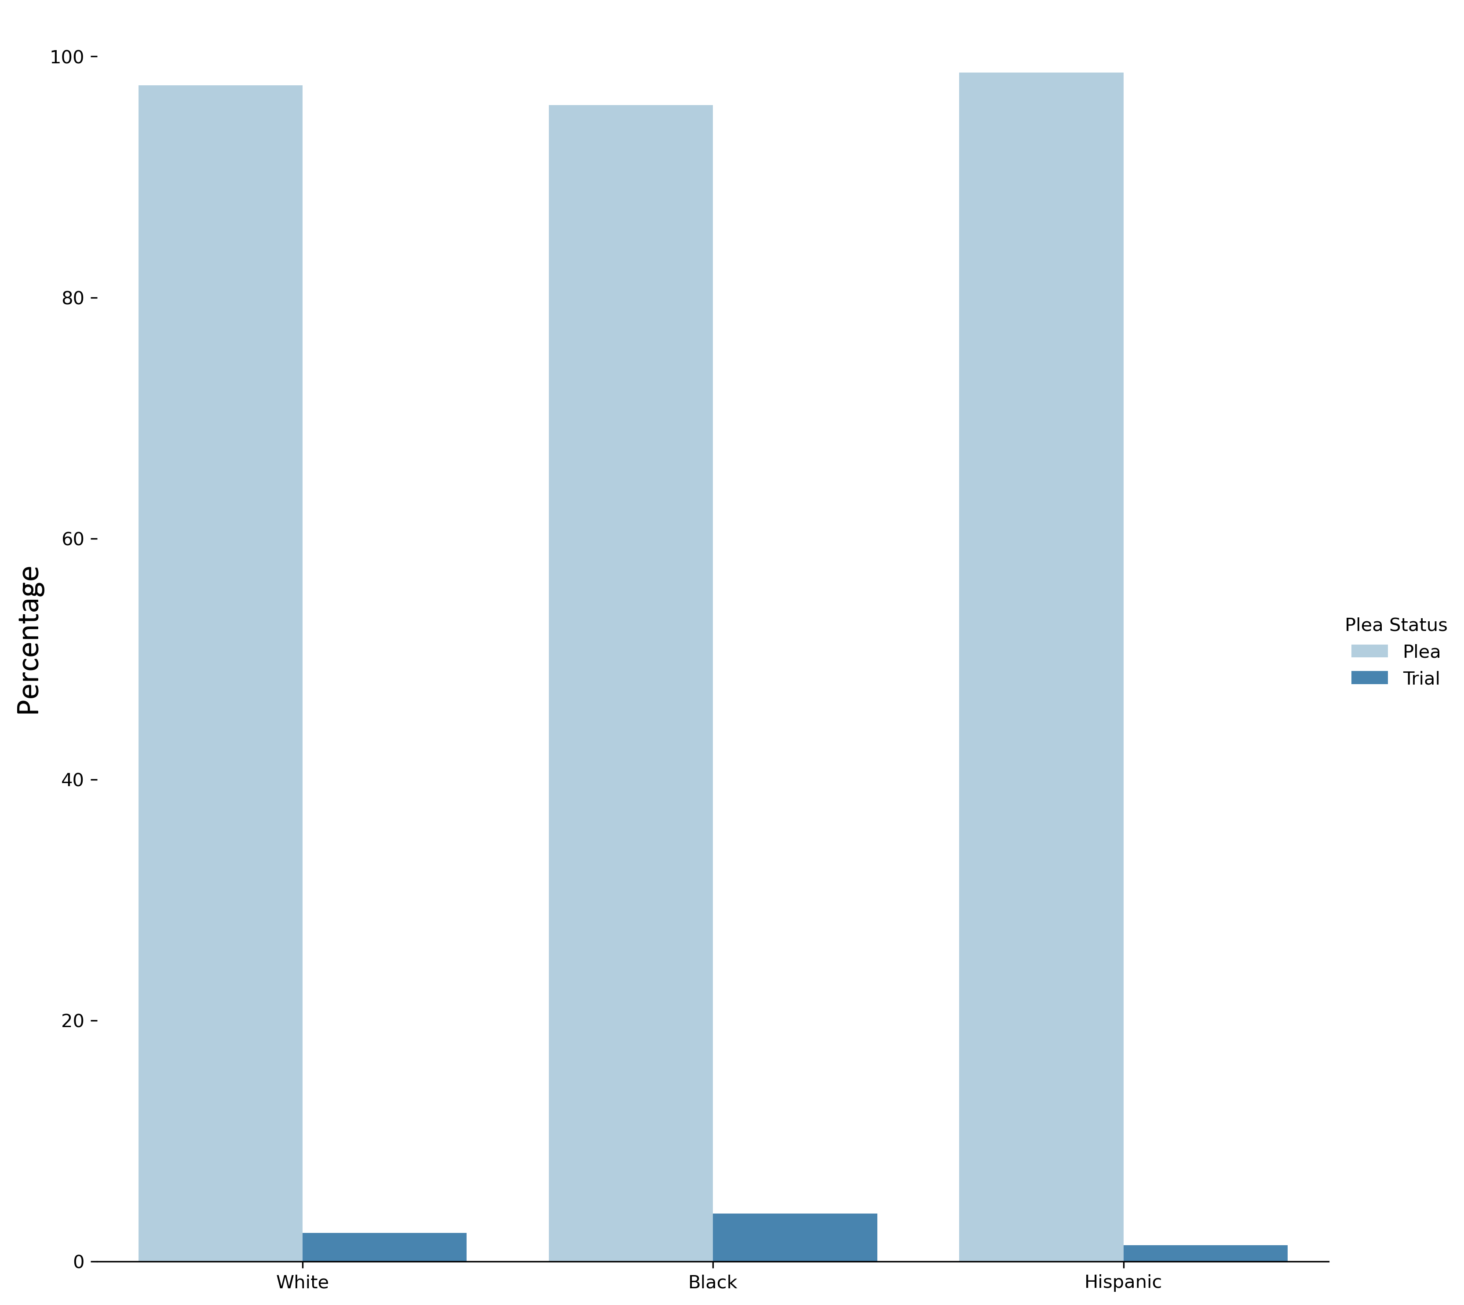
Final Note: Pleas v. Trials
97%
of all defendants plead out
3.9% of black defendants pursue trial
2.4% of white defendants pursue trial
1.3% of Hispanic defendants pursue trial

Slide 18

Key Insights
Black and Hispanic defendants are over 3.5x more likely to be incarcerated than white defendants
The most severe sentence enhancements are applied disproportionately to black defendants, while they receive a much smaller proportion of mitigating measures
There is a strong incentive for defendants (regardless of race) to plead out rather than pursue their constitutional right to a trial by jury

