Slide 1

Racial Disparities in Tennessee Federal Sentencing: 2015 to 2019
Jennifer Whitson
April 30, 2021

Slide 2

Guiding Questions
Are there racial disparities between the sentencing population and the general population in Tennessee?
What kinds of crimes are most common among different racial groups?
Are people of color receiving longer sentences on average?
Are there disparities in the application of sentence enhancements and sentence mitigation measures?

Slide 3

Data Collection and Cleaning
SAS files from ussc.gov (The U.S. Sentencing Commission)
Nationwide dataset with over 300k rows and 1000+ columns
Identified 195 columns for analysis
Extracted Tennessee specific data

Slide 4
Background: Federal v. State Crime
State law:
Murder
Sexual assault
Robbery/burglary
Most violent crime
Violations of state drug laws
Federal law:
Drug possession and sales
Immigration
Tax fraud and counterfeiting of money
Bank robbery
State crimes that
Occur on federal land;
Are committed against federal agents;
Cross state lines;
Occur in Washington D.C. or in international waters;
Are investigated by a federal agency, such as the FBI

Slide 5
Analysis & Insights

Slide 6
Are there racial disparities between the sentencing population and the general population in Tennessee?

Slide 7
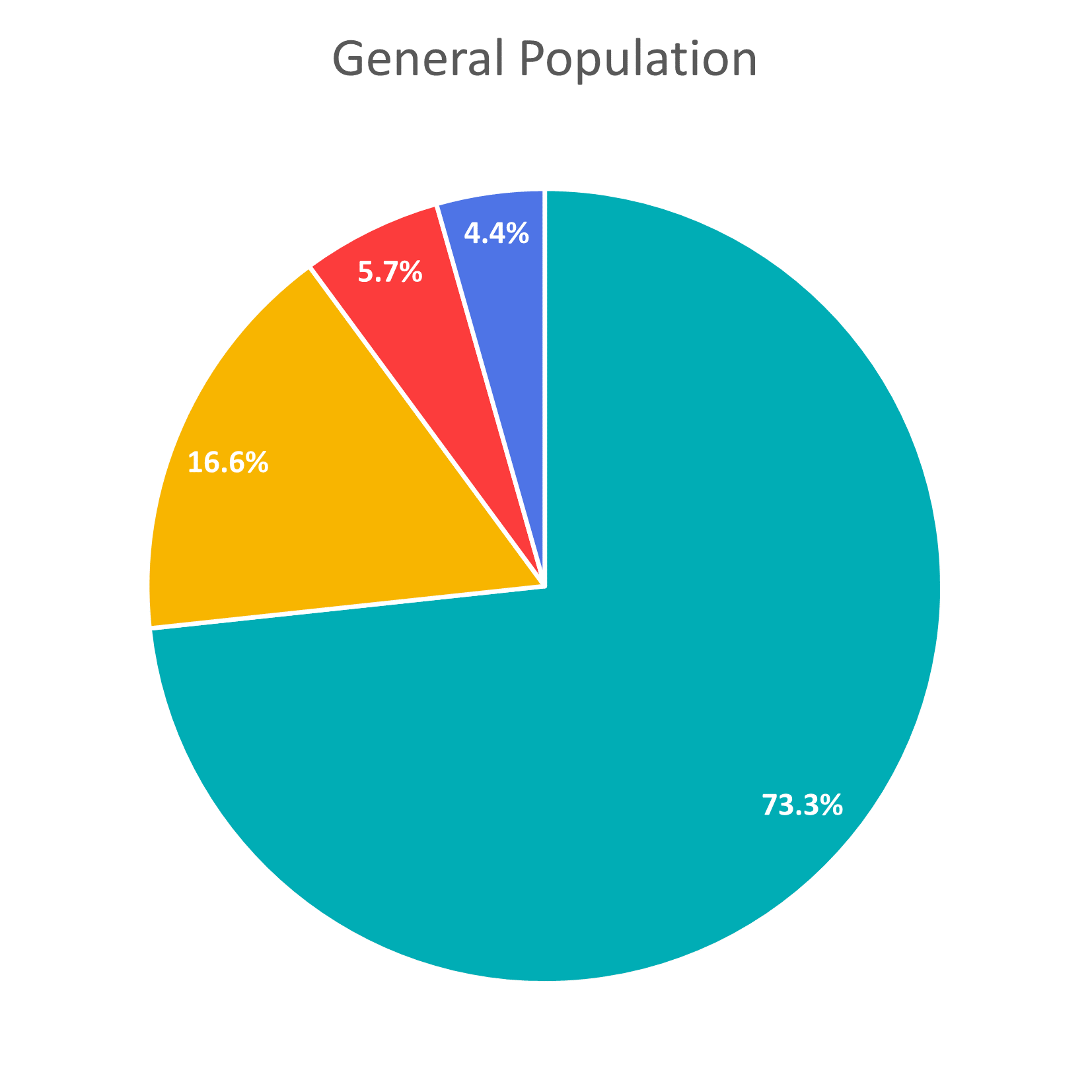
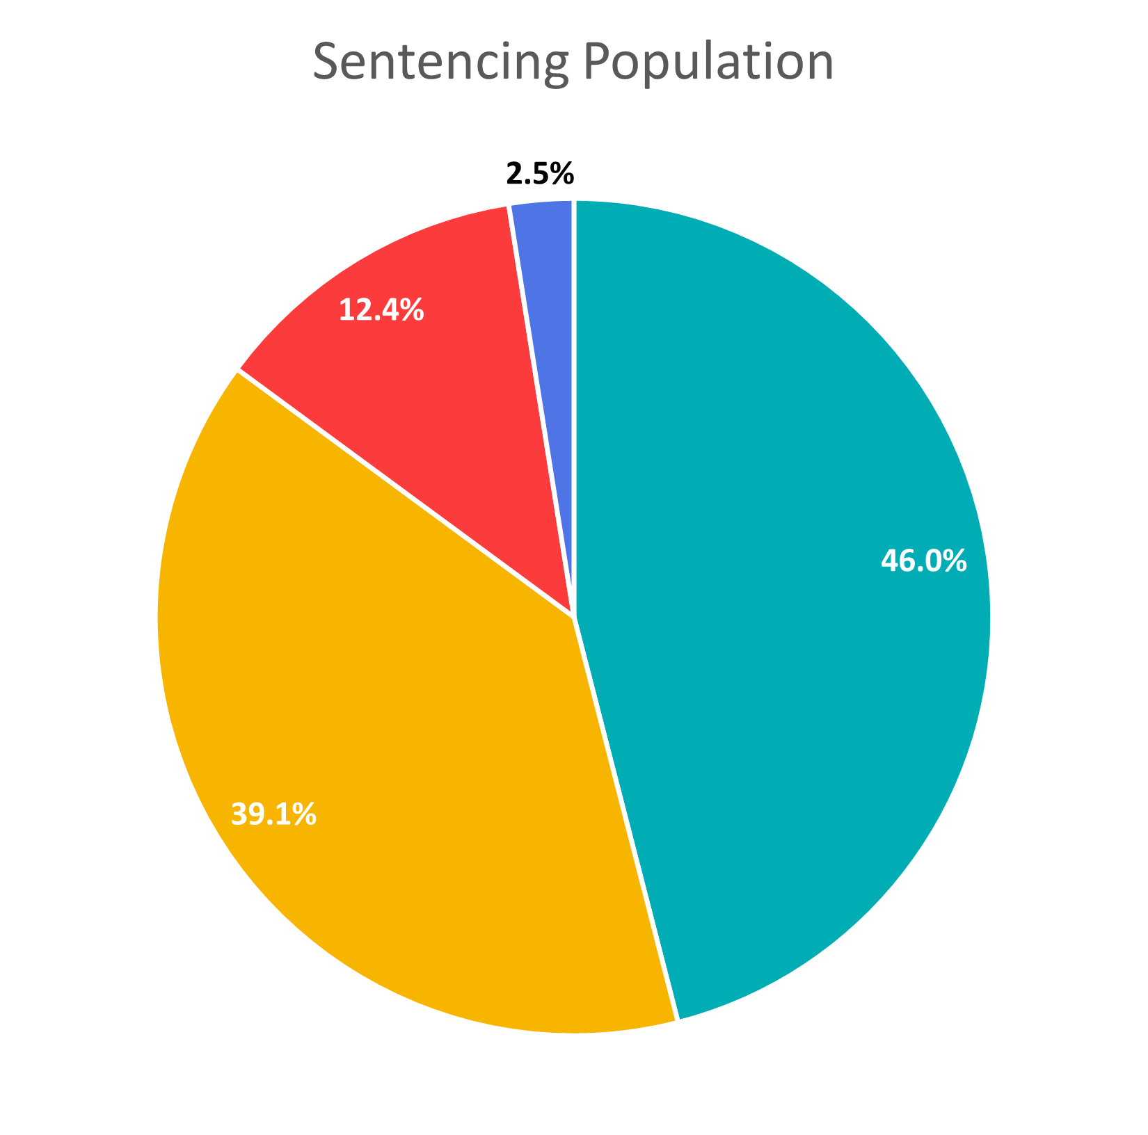

A black person is
3.9x
more likely to be sentenced than a white person
A hispanic person is
3.5x
more likely to be sentenced than a white person

Slide 8
What kinds of crimes are most common among different racial groups?

Slide 9
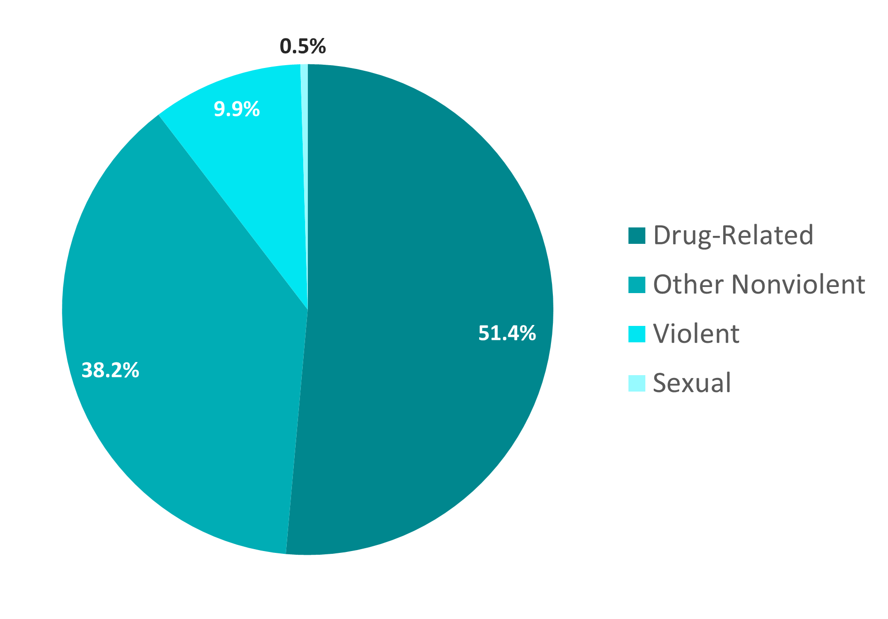
Crime Categories
White Sentencing Population
Half of offenses by white offenders are drug-related

Slide 10
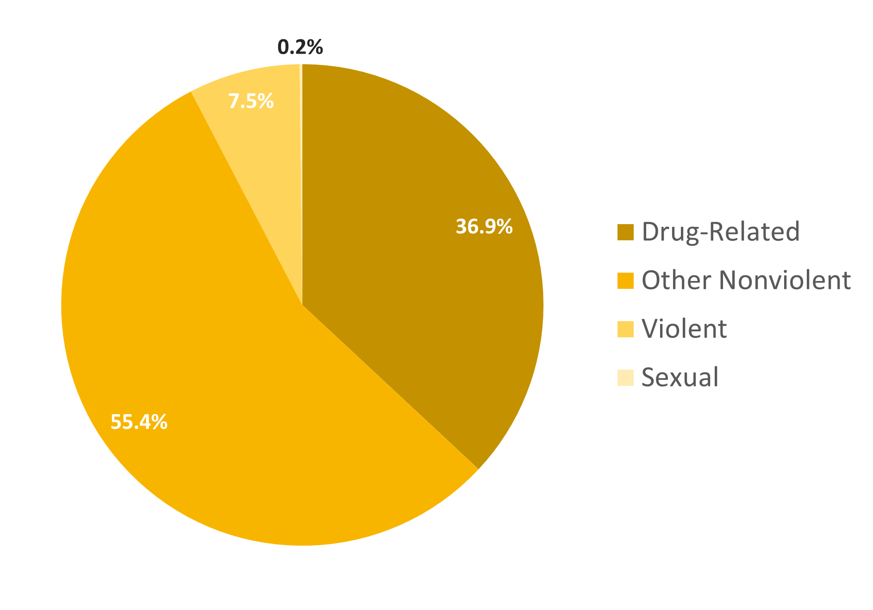
Crime Categories
Black Sentencing Population
Over half of offenses by black offenders are not violent or drug related

Slide 11
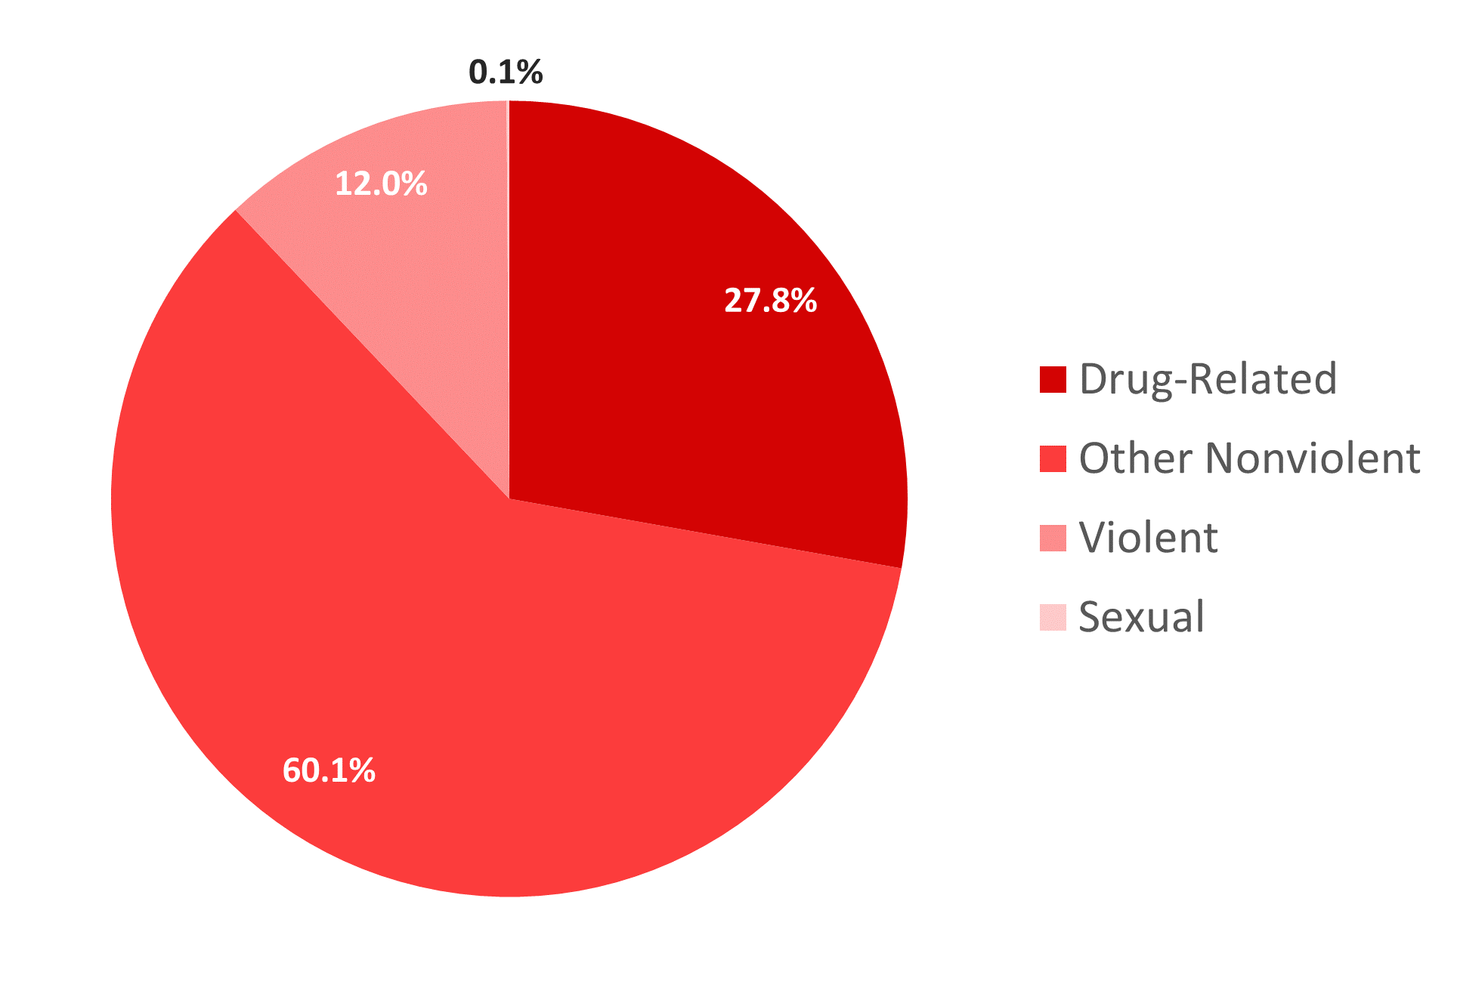
Crime Categories
Hispanic Sentencing Population
Nearly 2/3 of offenses by Hispanic offenders are not violent or drug related

Slide 12
Are people of color receiving longer sentences on average?

Slide 13
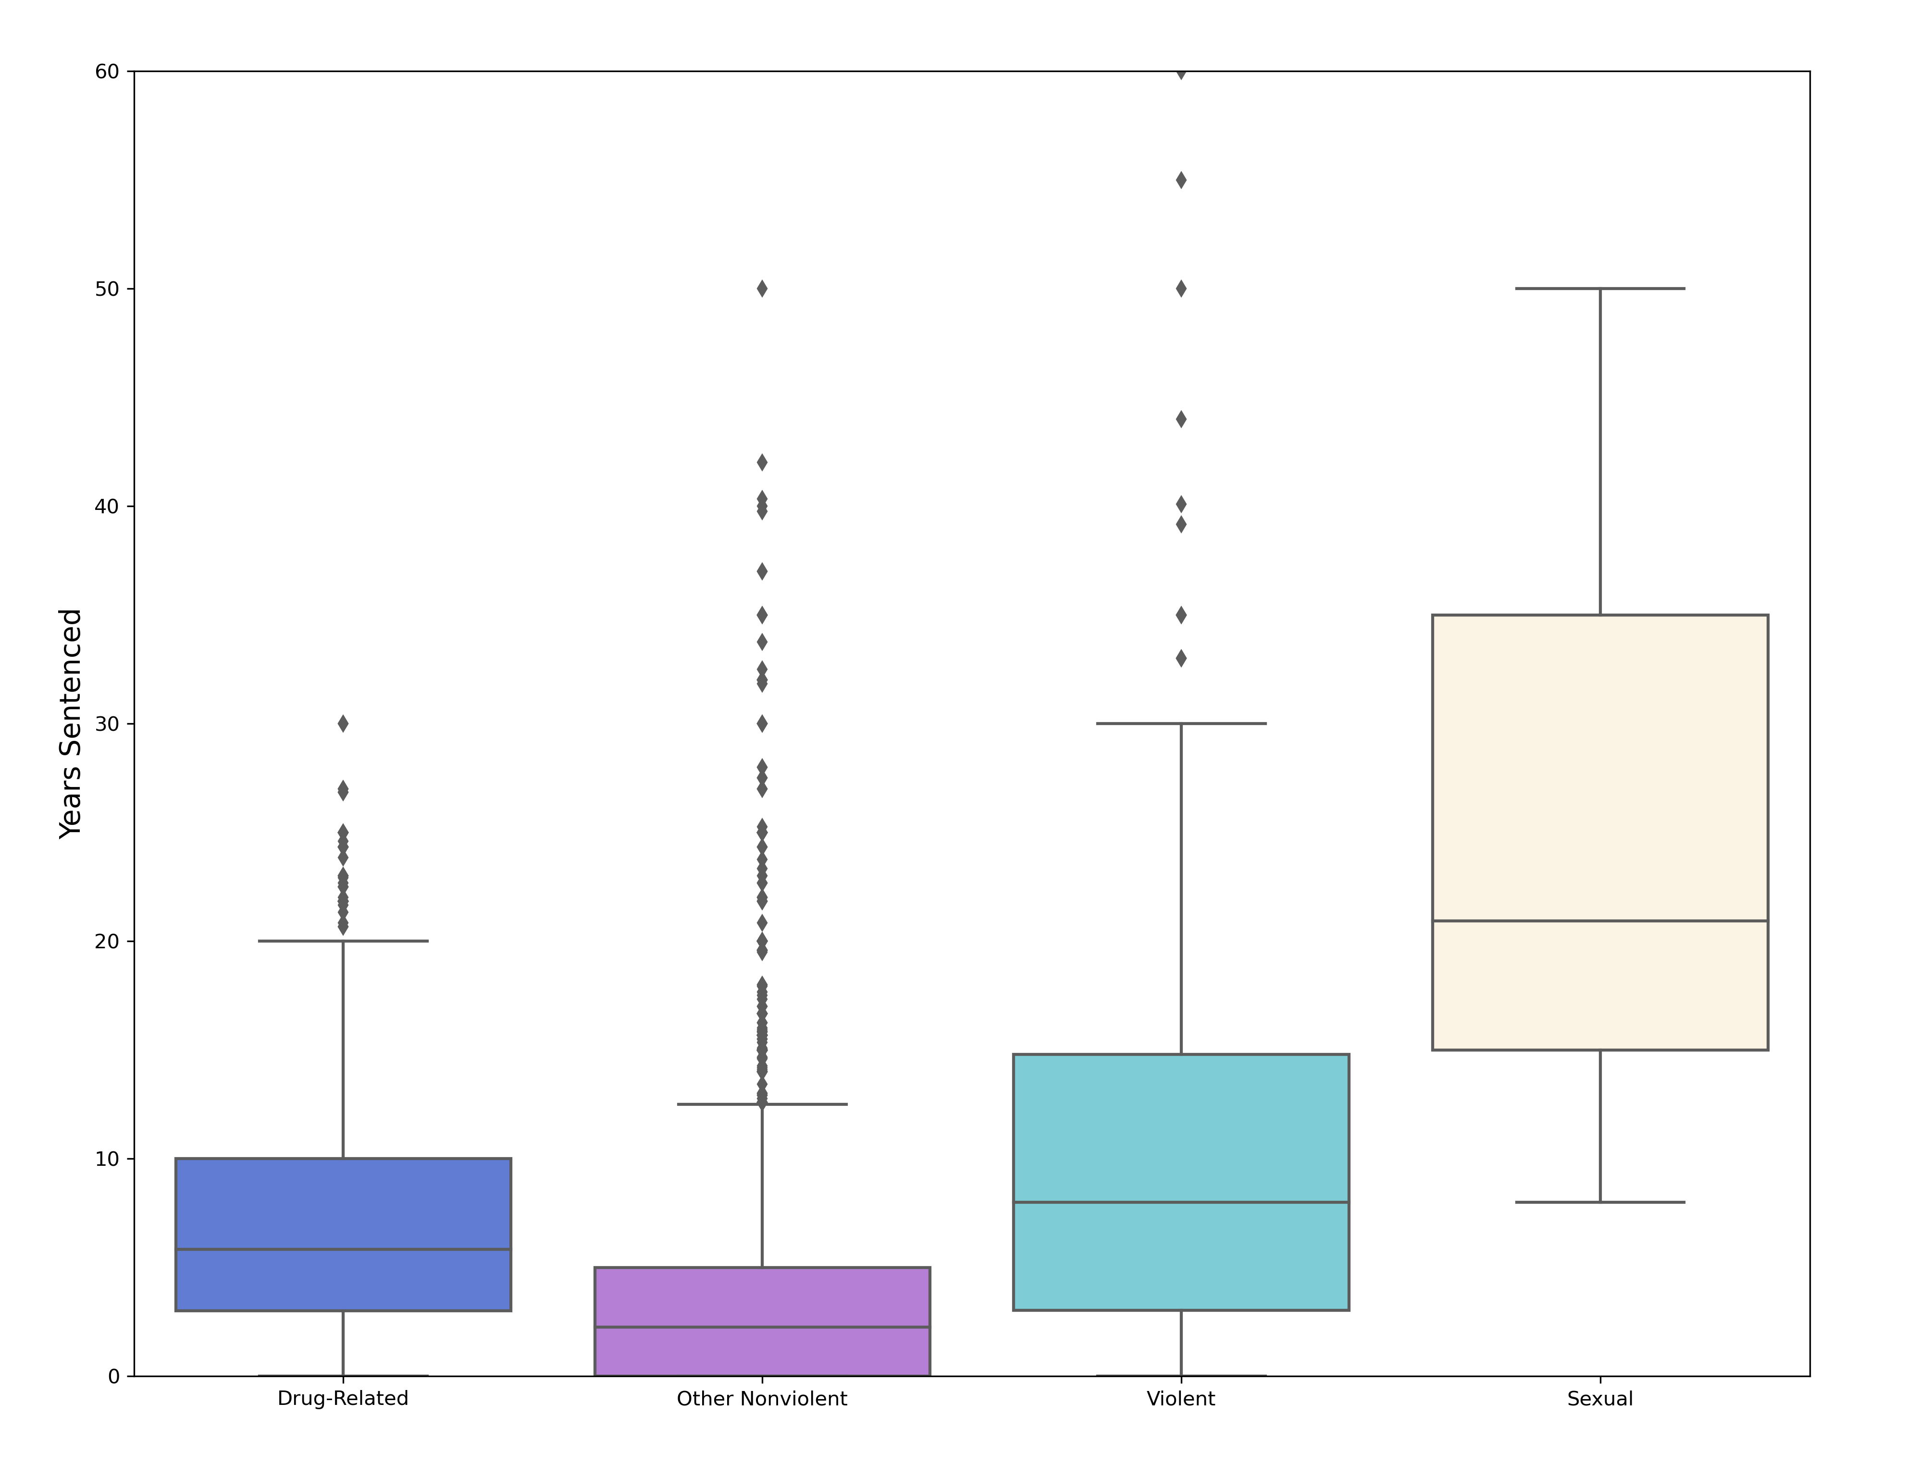
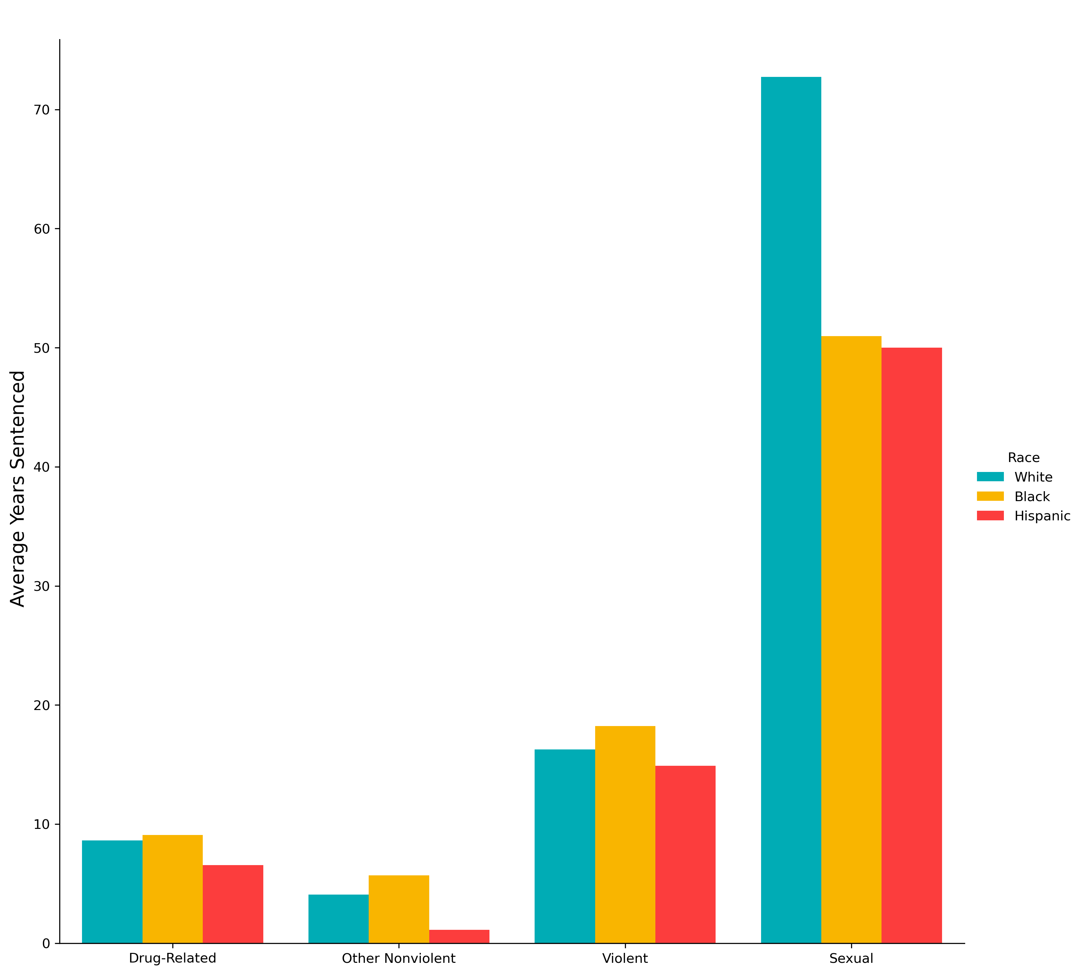
Sentence Length by Crime Category
Sentence Distribution
Racial Breakdown

Slide 14
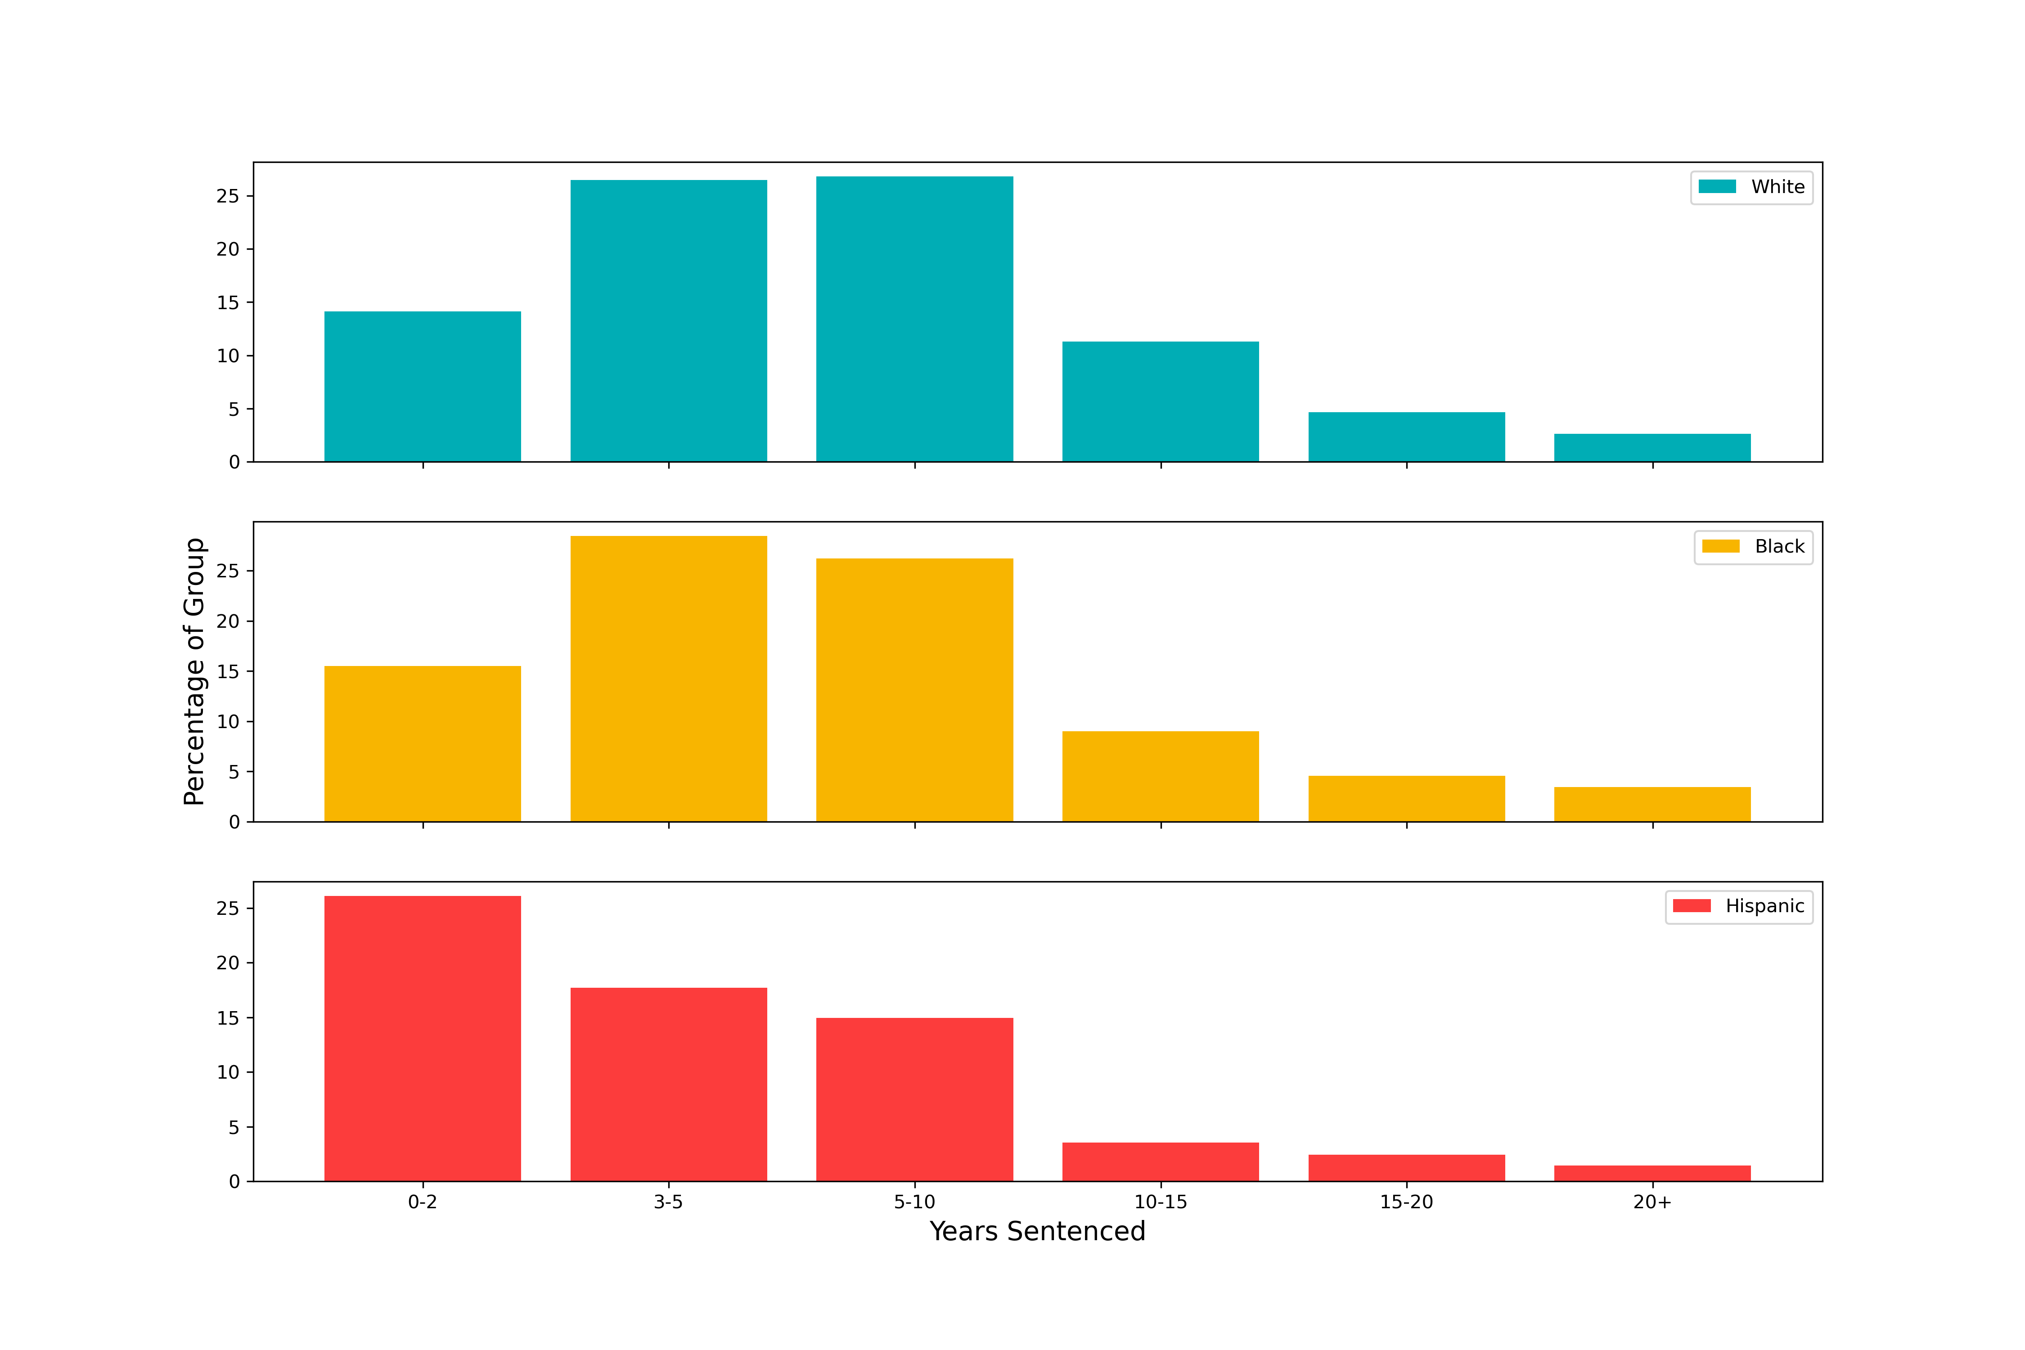
Distribution of Sentence Length by Race

Slide 15
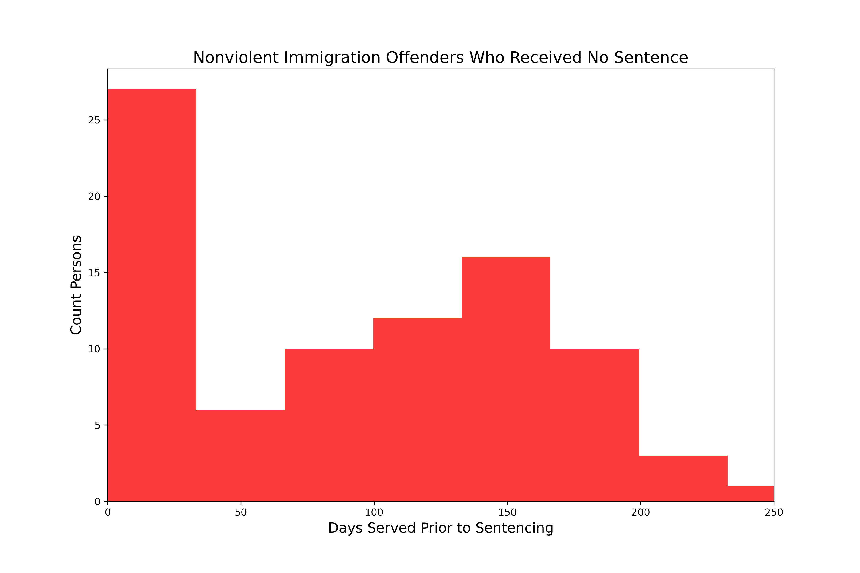
Closer Look: Immigration Offenses
97%
not legal residents
71% of nonviolent offenses by Hispanic offenders are immigration related offenses, which carry no mandatory minimum sentence.
Of those, exactly half received credit for time served and therefore receive no additional sentence.
The average time served prior to sentencing for this group is 70 days.
Additionally, 97% of them are not legal residents of the U.S., meaning they may have been deported rather than sentenced to additional time.

Slide 16
Are there disparities in the application of sentence enhancements and sentence mitigation measures?

Slide 17

Sentence Enhancements & Mitigation
Sentence enhancements available:
Criminal history points
“Career Offender” status
“Armed Career Offender” status
Sentence mitigations available:
Safety valve

Slide 18
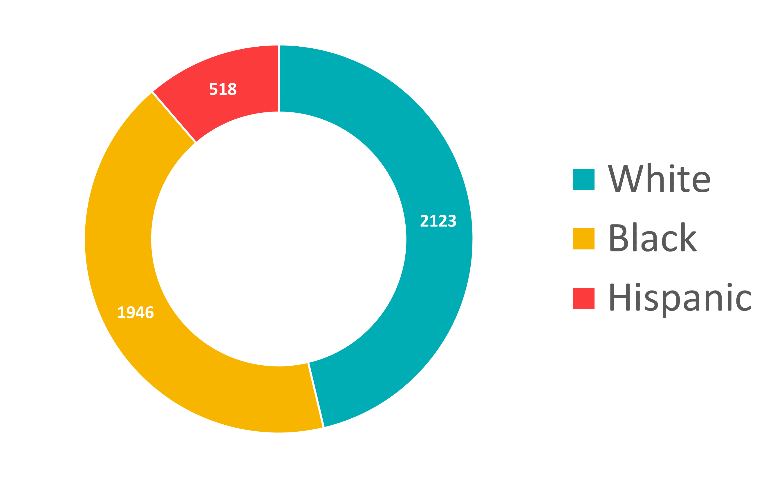
Sentence Enhancements
Criminal History Points Applied
Distribution roughly matches demographics of general sentencing population
Applied in
64%
of cases
Increases sentence by average of
2.6
years

Slide 19
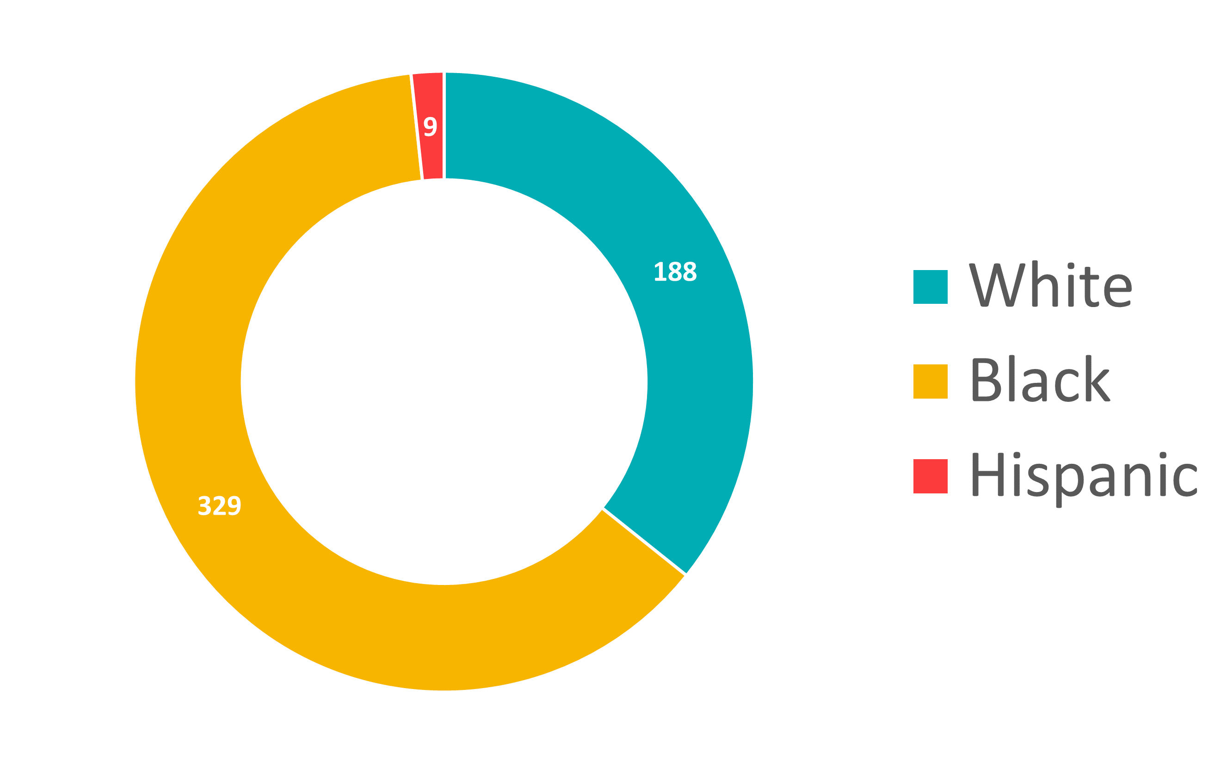
Sentence Enhancements
Career Offender Status Applied
Distribution skews heavily towards black offenders
Applied in
7%
of cases
Increases sentence by average of
12.7
years

Slide 20
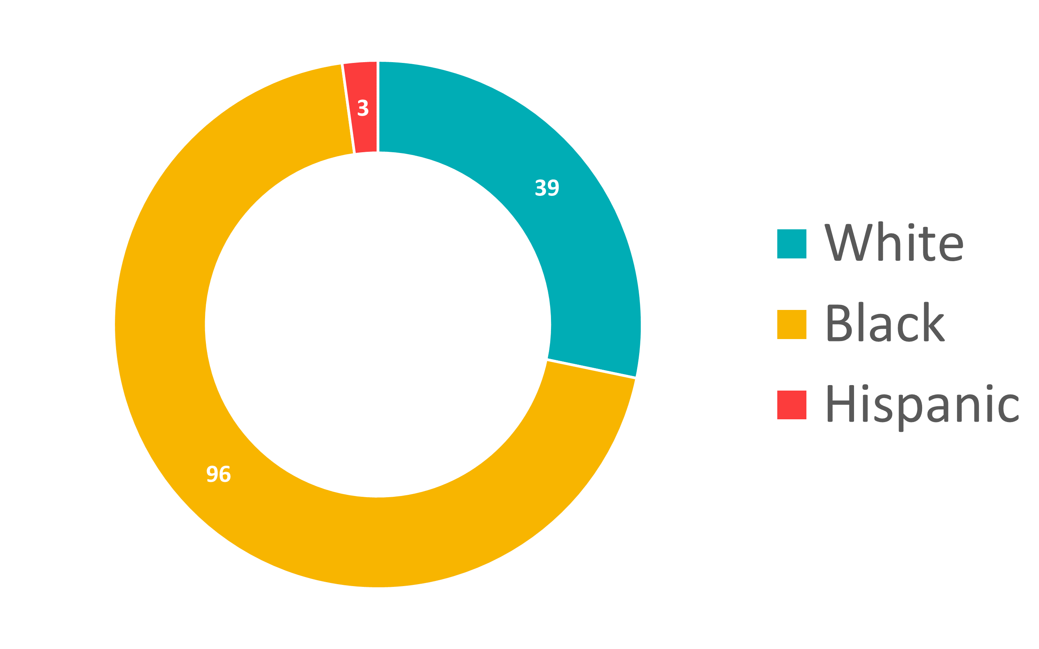
Sentence Enhancements
Armed Career Offender Status Applied
Distribution skews even further toward black offenders
Applied in
2%
of cases
Increases sentence by average of
25.3
years

Slide 21
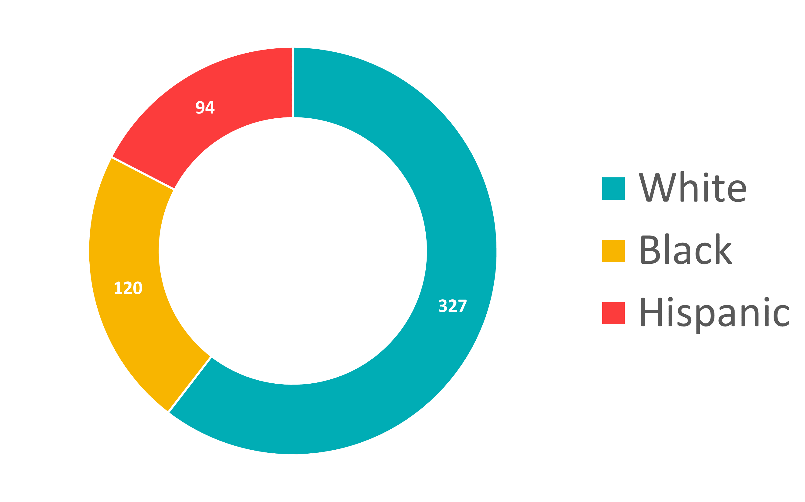
Sentence Mitigation
Safety Valve Measure Applied
Disproportionately applied to white and Hispanic offenders
Note: Safety valve offenders have an average of 2025x the drugs of non-safety valve offenders
Applied in
19%
of drug cases
Reduces sentence by average of
7.2
years

Slide 22
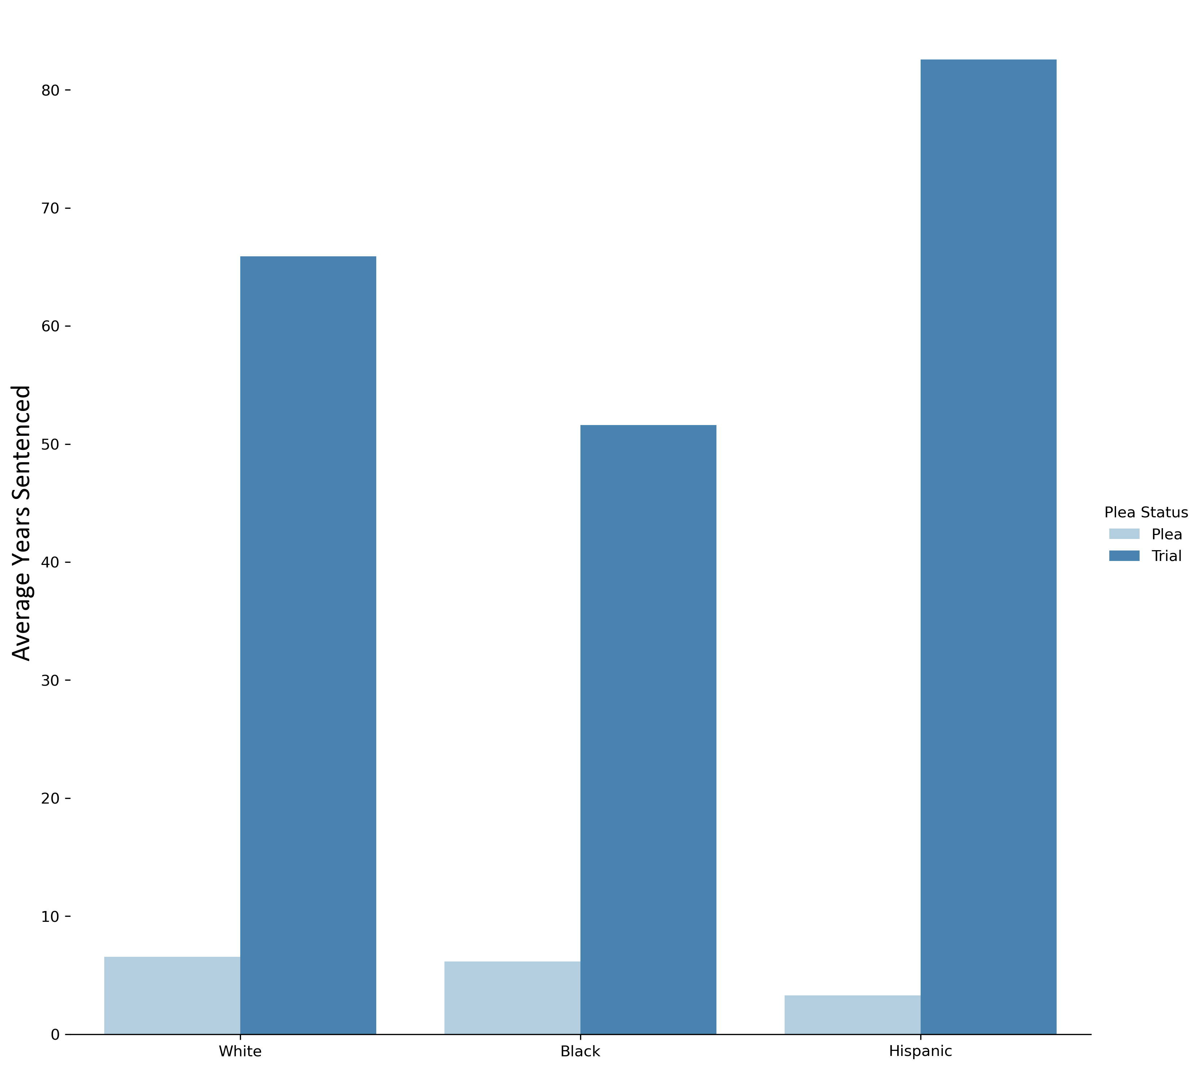
Final Note: Pleas v. Trials
Average sentence for a plea:
5.9
years
Average sentence for a trial:
58.3
years
Difference between average sentence length for plea v. trial:
Black: 45.4 years
White: 59.3 years
Hispanic 81.5 years
Median sentences are dramatically lower, but going to trial still increases the median sentence by 6.6 years

Slide 23
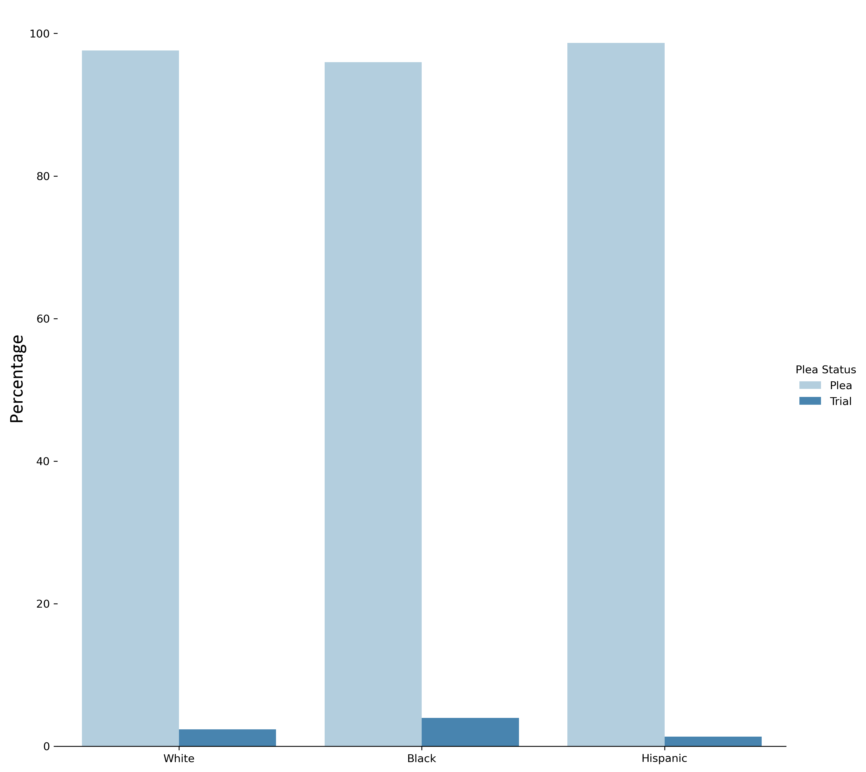
Final Note: Pleas v. Trials
97%
of all defendants plead out
3.9% of black defendants pursue trial
2.4% of white defendants pursue trial
1.3% of Hispanic defendants pursue trial

Slide 24
Questions?

