Slide 1
T1
T2
T3
T4
T5
T6
T7
T8
T9
T10
T11
T12
T1
T2
T3
T4
T5
T6
T7
T8
T9
T10
T11
T12
8 tokens kept — same set for ALL heads
Head 1
Head 2
Head 3
Head 4
Head 1
Head 2
Head 3
Head 4
total budget = 8 tokens
per-head budget = 8 / 1 (shared)
each head keeps its own top-2 tokens
total budget = 8 tokens
per-head budget = 8 / 4 = 2 each

Slide 2
The
Cat
Sat
On
The
Mat
Near
The
TV
Head 1
Sub, Verbs
Head 2
Article, det
Head 3
Location
Head 4
Preposition

Slide 3
Patch attn.forward
All 16 layers
Set output_attenttions=True
Register eviction hook
modle.model.rehoster_forward_hook
Set up
Per sample
Reset scores() for heavy hitters
model.generate() with prompts and article
Prefill with full sequence
prompt to fill KV cache
Eviction hook select:
heavy hitters with accumulated scores
recent window
Prefill
Patched forward
New token comes-> update accumulated score
Len >budget?
Decode step
Mean across 8 heads
Per head top K
Aggregate and write back

Slide 4
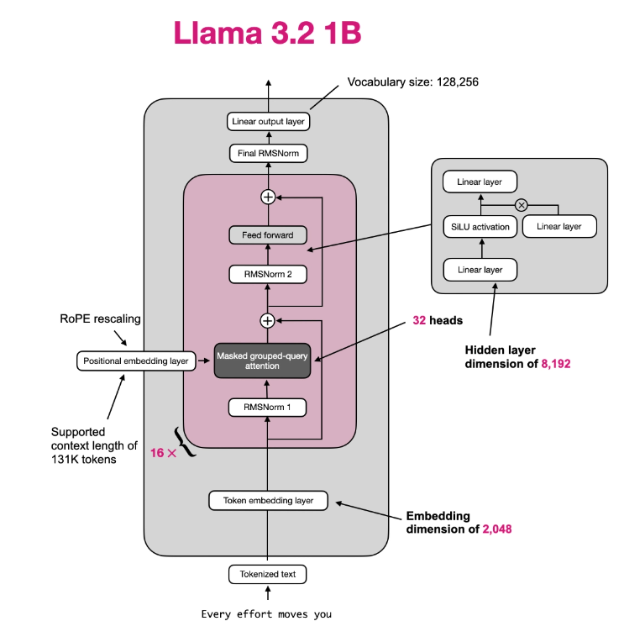
Update past_key_values
Force output_attentions
Acc_scores accumulation

