Slide 1
Yelp Review Predictions Based on Textual Features
Jon Kaykin & Jin Jeon

Slide 2
Summary
We analyzed Yelp’s review dataset in order to predict whether a review is good (4 or 5 stars) or bad (1 or 2 stars) solely based on textual features (exclude subjective biases).
We came up with five textual features to build a classifier to predict whether a rating is positive or negative.
With the combination of the five features into account, we used logistic regression to get 79% accuracy.

Slide 3

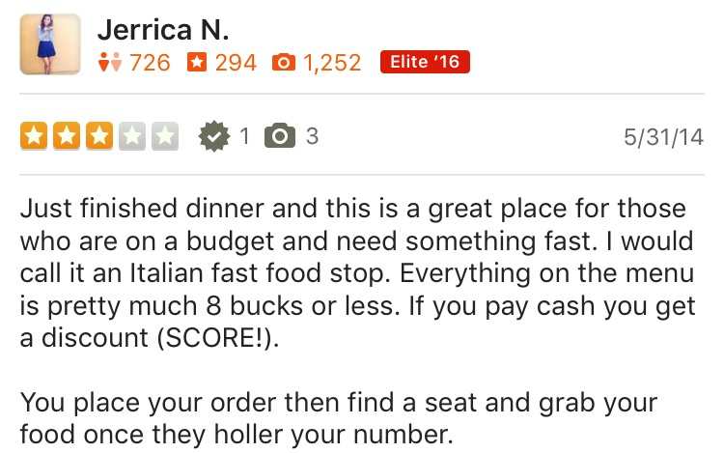
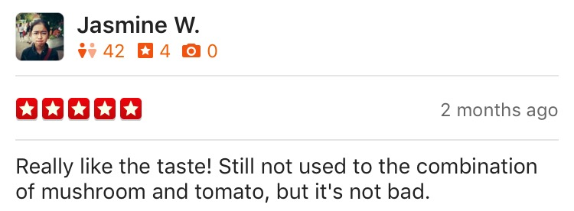
Intro (motivation)
Yelp review ratings for Gypsy’s in Berkeley (@ Asian Ghetto)

Slide 4
Intro (motivation cont.)
Yelp reviews now influence over where to visit or what to eat.
Yelp’s star ratings are useful for quick overview, but often misleading.
Star ratings are easily subject to bias
→ Classifier that only looks at textual features of reviews without taking random user preference and behavior into account.

Slide 5
Intro (hypothesis)
Improvements from Last Time
Positive reviews (star rating > 3) will have longer word length, fewer stopwords, and more positive words than negative reviews (star rating < 3).
Build a classifier that predicts whether a review is positive or negative with more than 75% accuracy.
Added negative word lists as one of the textual features; total five features
Combined five features and used logistic regression to raise classifier accuracy (was 67.3% last time; see results later)

Slide 6
Methods (part 1)
Randomly sampled 50,000 reviews from the Yelp dataset
Removed 3 star reviews
Cleaned up data (lowercased, removed characters)
Featurized dataset:
Average Word Length
Review Length
Stopword Count
Positive Word Count
Negative Word Count

Slide 7
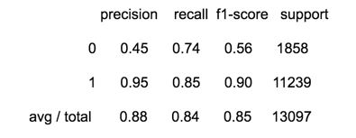
Results (part 1)
Created a model with the featurized training data
Ran prediction on test set
84% recall!
This was great! But then we saw the precision score…
Of all the reviews that the model predicted to be negative, it was only correct on 45% of them

Slide 8
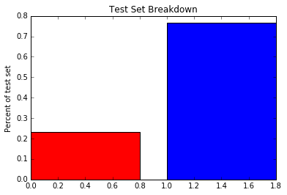
Discovery
There was a large bias towards positive reviews (both in test set and Yelp dataset)
The mean for our dataset was 0.768
Conclusion
If we guessed yes on all the reviews, we would have 76.8% accuracy

Slide 9
Back to the drawing board
Sampled evenly from 50,000 samples
Created new dataset with 20,292 reviews:
10,146 pos/neg reviews
Created a training set and test set from this new data
Trained a new multiple logistic regression model
Used the new model for prediction on the test set

Slide 10
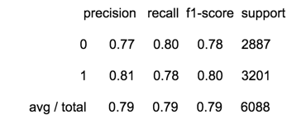
Results (part 2)
Much better results
While our recall rate fell from 84% to 79%, our precision on 0 went from 45% to 77%
79% recall is higher than our predicted 75%!

Slide 11
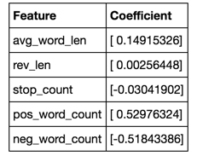
Conclusion
Average word length and positive word count had the highest influence on positive review prediction
Negative word count had the highest influence on negative review prediction
Our hypothesis was correct and we achieved 4% higher than the 75% we expected

Slide 12
Thank You

