Slide 1

5. Decision Tree (Rule Induction)

Slide 2
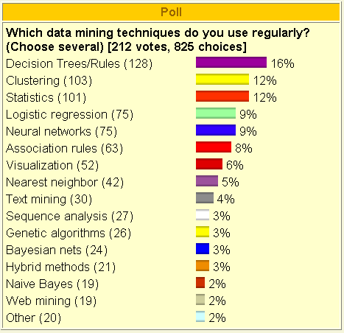
Poll: Which data mining technique..?

Slide 3
Case 1 on Predicting ‘To Tenure’ or ‘Not To Tenure’
Faculty in school should be evaluated for tenure sometime in his position.
In this case, evaluation is made with 2 variable rank and years of work in current position. (Input variables, X variables, prediction variables)
Prediction is tenure or not tenure. (Output variables, Y variables, predicted variable, target variable)

Slide 4
Processes of prediction modeling in general
Data collection
Modeling
Testing of model
Prediction with tested model (use)

Slide 5

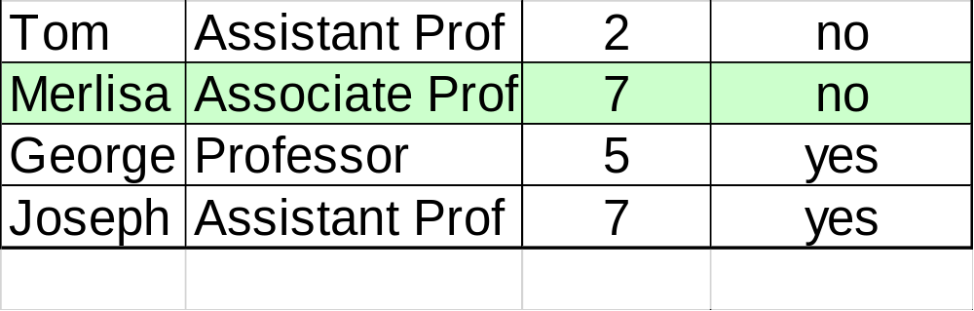
Step 1: Data collection
Original data has 10 records.
10 faculty members in the past whose tenure was already known.

Slide 6
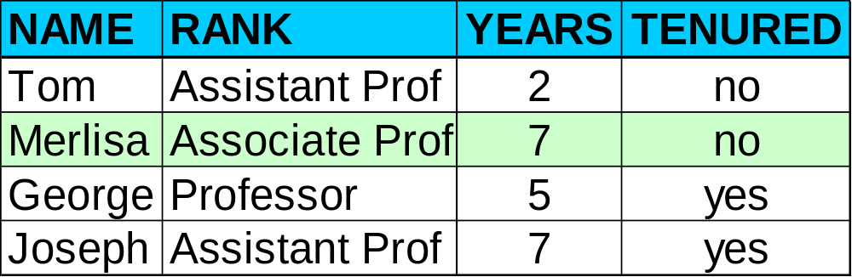
Data Sets
(Divide it into 2 groups: training data set, testing data set)
[Training data set of 6] –it is used to build models
[Test data set of 4]- it is used to test the model

Slide 7


Step 2: Model Construction with 6 records (Modeling with training data set)
Classification
Algorithms
Training
Data
Classifier
(Model)
IF rank = ‘professor’
OR years > 6
THEN tenured = ‘yes’

Slide 8


Step 3: Test the model with 4 records
Prediction accuracy of the model
=Performance of the model
= ¾ = 0.75=75%
Testing
Data
0
X
0
0

Slide 9


Step 4: Use the Model for Prediction
Question for prediction:
Is Jeff going to be tenured or not?
(Predicting whether Jeff will be tenured or not)
Classifier
(Prediction Model)
IF rank = ‘professor’
OR years > 6
THEN tenured = ‘yes’
Apply
Unseen Data
(Jeff, Professor, 4)
Tenured?

Slide 10
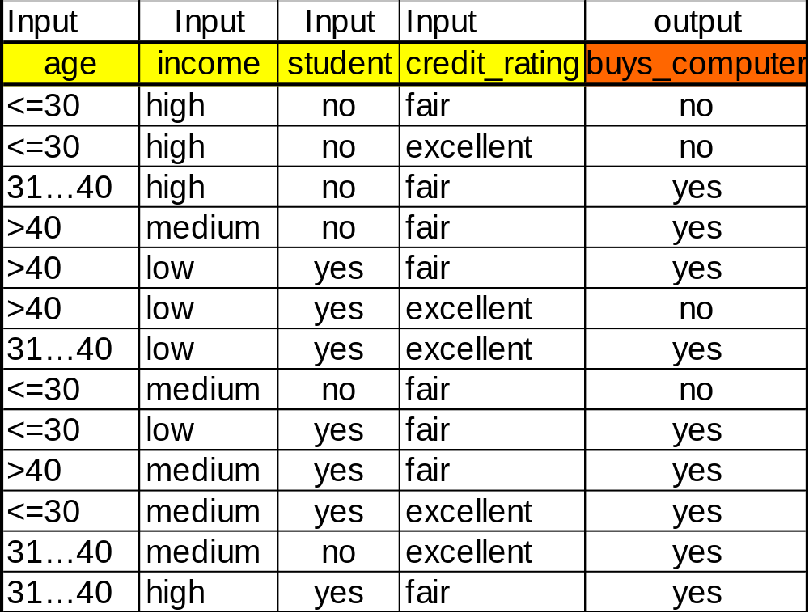
Case 2 on “Who buys notebook computer?” Training Dataset is given below:
Input variable 1
Input variable 2
Input variable 3
Input variable 4
Output variable
. 4 input variables,
(age, income, student, credit rating)
. 1 output variable
(buy or not buy notebook computer)

Slide 11
A case on Tree Output:
A Decision Tree for ‘Buy’ or ‘Not Buy’
age?
<=30
overcast
>40
30..40
student?
yes
credit rating?
no
yes
excellent
fair
no
yes
yes
no

Slide 12
Extracting Classification Rules from Tree
Represent the knowledge in the form of IF-THEN rules
One rule is created for each path from the root to a leaf
Each attribute-value pair along a path forms a conjunction
The leaf node holds the class prediction
Rules are easier for humans to understand
Example
  IF age = “<=30” AND student = “no” THEN buys_computer = “no”
  IF age = “<=30” AND student = “yes” THEN buys_computer = “yes”
  IF age = “31…40” THEN buys_computer = “yes”
  IF age = “>40” AND credit_rating = “excellent” THEN buys_computer = “yes”
  IF age = “>40” AND credit_rating = “fair” THEN buys_computer = “no”

Slide 13
Advantages of using decision tree
Shows us most important variable on top of the tree
Shows important, relevant variables only
Easy to understand
Tree can be converted into rules

Slide 14
Case 3 on ‘Car Buyers’ – Who buys Lexton, a SUV?
4 input variables
Output variable
Job
(14,5,9)
no | Job | M/F | Area | Age | Y/N
1 | NJ | M | N | 35 | N
2 | NJ | F | N | 51 | N
3 | OW | F | N | 31 | Y
4 | EM | M | N | 38 | Y
5 | EM | F | S | 33 | Y
6 | EM | M | S | 54 | Y
7 | OW | F | S | 49 | Y
8 | NJ | F | N | 32 | N
9 | NJ | M | N | 32 | Y
10 | EM | M | S | 35 | Y
11 | NJ | F | S | 54 | Y
12 | OW | M | N | 50 | Y
13 | OW | F | S | 36 | Y
14 | EM | M | N | 49 | N
Emplyee
(5,2,3)
Owner
(4,0,4)
No Job
(5,3,2)
Age
Y
Res. Area
Below 43
(3,0,3)
Above 43
(2,2,0)
South
(2,0,2)
North
(3,3,0)
Y
N
Y
N
* (a,b,c) means
a: total # of records, b: ‘N’ counts, c: ‘Y’ counts

Slide 15
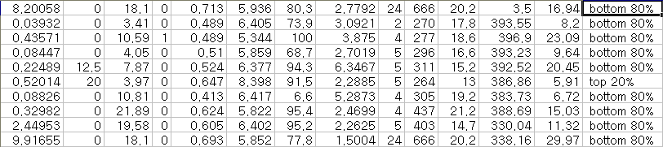
Case 4 on Decision Tree
Prediction whether a house is classified as top 20%(expensive) or bottom 80%(usual) in its price.
This data set is on deciding house price group of two in Boston area.
It has 350 cases and input 13 variables.
[Sample data set]

Slide 16
Selecting Variables
Input variables(13 input variables)
  crime rate
  proportion large lots: residential space
  proportion industrial: ratio of commercial area
  CHAS: dummy variable
  nitric oxides ppm: polution rate in ppm
  av rooms per dwelling: # of room for dwelling
  proportion pre-1940
  distance to employment centers: distance to the center of city
  accessibility to radial highways: accessibility to high way
  property tax rate per $10\,000
  pupil-teacher ratio: teachers’ rate
  B: racial statistics
  percentage low income earners: ratio of low income people
Decision variable (2 types)
  Top 20%, Bottom 80%

Slide 17
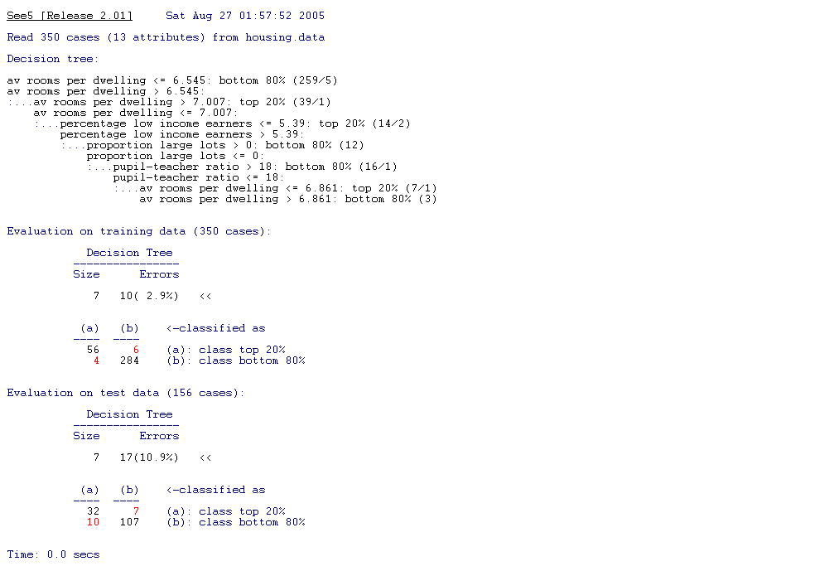
Output from analysis
Decision Tree
Evaluation with Training data
Evaluation with Test data

Slide 18
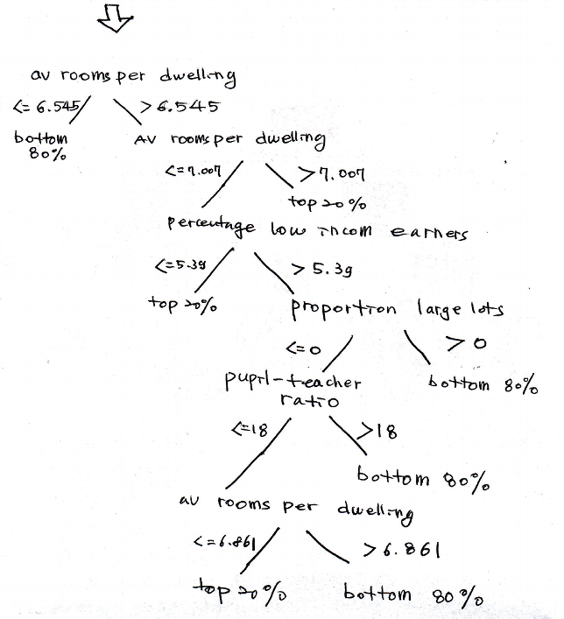
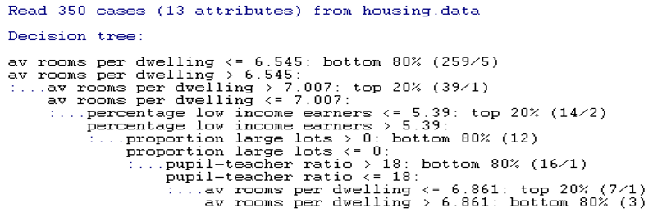
Decision tree from Analysis

Slide 19
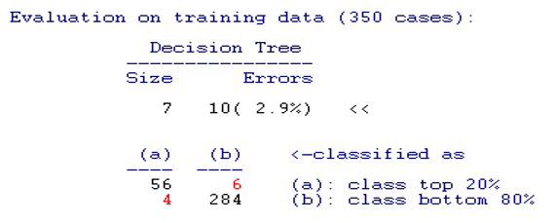
Fitting of the model (R-square)
How the model is explaining the training data set.
R-square of the model
= (56 + 284 )/ (56 + 6 + 4 + 284) = 97.1%

Slide 20
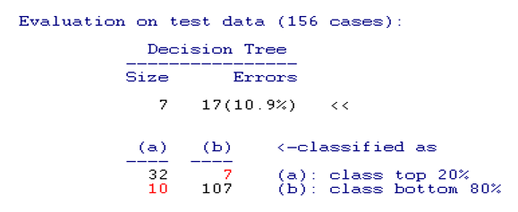
Prediction performance with test data set
Prediction performance of the model
= (32 + 107) / (32 + 7 + 10 + 107)
= 139/156 = 89.1%
In binary prediction (for an example 1, 0 or true or false, male or female),
if prediction performance is greater than 90%, the model is great
If it is greater than 80%, the model is good.
If it is greater than 70%, the model is usable.
If it is less than 70%, the model is un-usable.

