Slide 1

Autism Spectrum Disorder
single cell transcriptome profiles
Department of Bioinformatics & Life Science
Songsil University
박정운 (Jeong-Woon, Park)

Slide 2
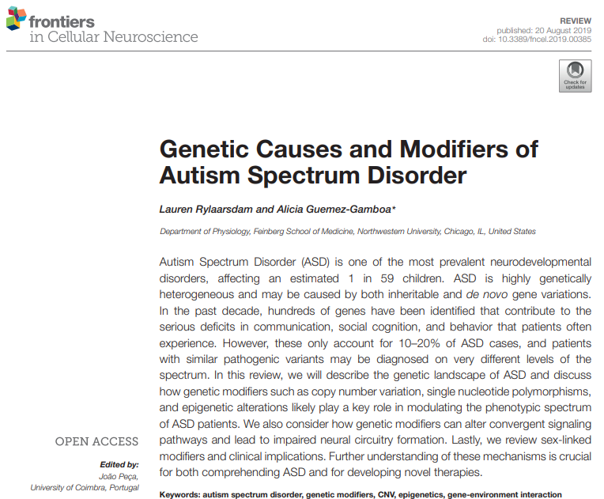
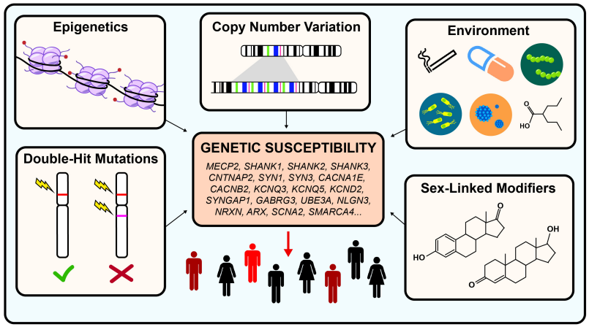

Background : Autism Spectrum Disorders (ASD)
Because ASD is highly genetically heterogenous, It is important to analyze single cell transcriptome profiling in ASD.

Slide 3
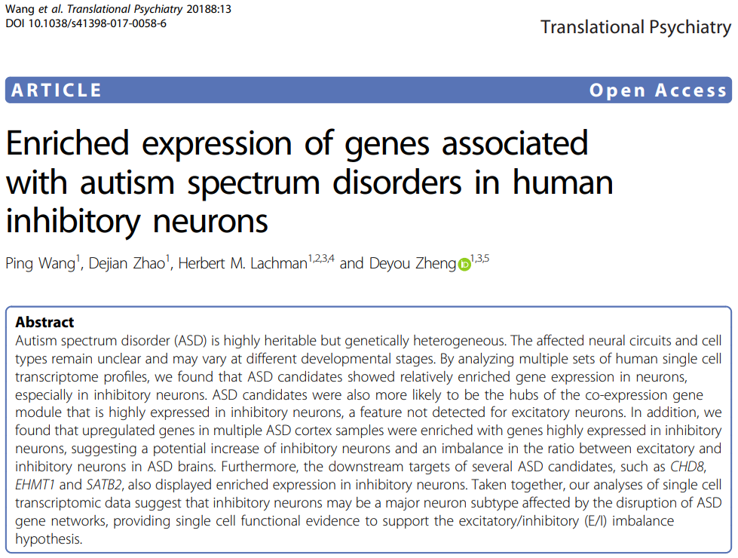
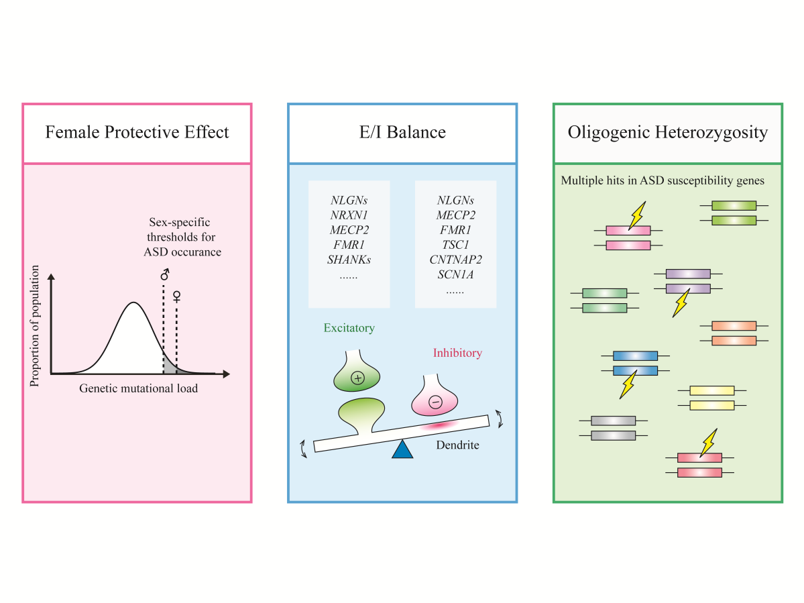
Jiani Yin et al, “Autism genetics - an overview”, PRENATAL DIAGNOSIS, 2016
In pervious studies, many researcher proposed theories for the etiology of ASD.
This study provides single cell functional evidence to support the E/I imbalance hypothesis.

Slide 4
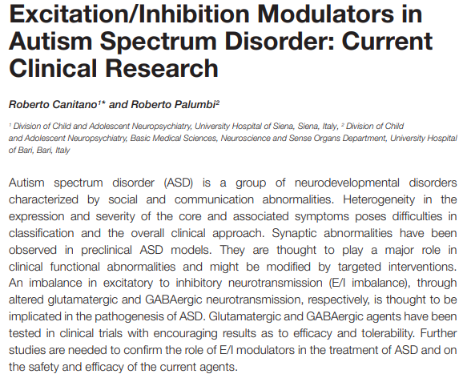
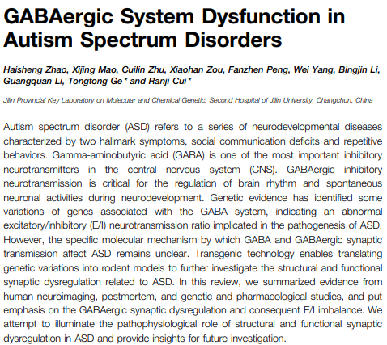
Aim : Is it true that E/I imbalance make the pathogenesis of ASD?

Slide 5
Design : Analyzing single cell transcriptome profiles in autism spectrum disorder
Normal group
Brain Cortex
(Fluidigm C1)
Merge each raw count matrices using Python
Get raw count matrix per each samples from GEO database
Based on full-length
Make Seurat object for each groups
Downstream analysis
ASD group
Identify cell markers for each groups
Integration data
Assign cluster name from marker genes. (THE HUMAN PROTEIN ATLAS, Reference paper and so on …)
Prefrontal cortex
(10X genomics)
Make the raw count matrix using Cell ranger
Get Fastq data from SRA database
Based on UMI

Slide 6
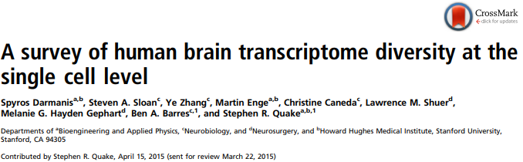

Dataset sources
Spyros Darmanis et al, “A survey of human brain transcriptome diversity at single cell level”, PNAS, 2015
Dmitry Velmeshev et al, “Single-cell genomics identifies cell type-specific molecular changes in autism”, Science, 2019

Slide 7
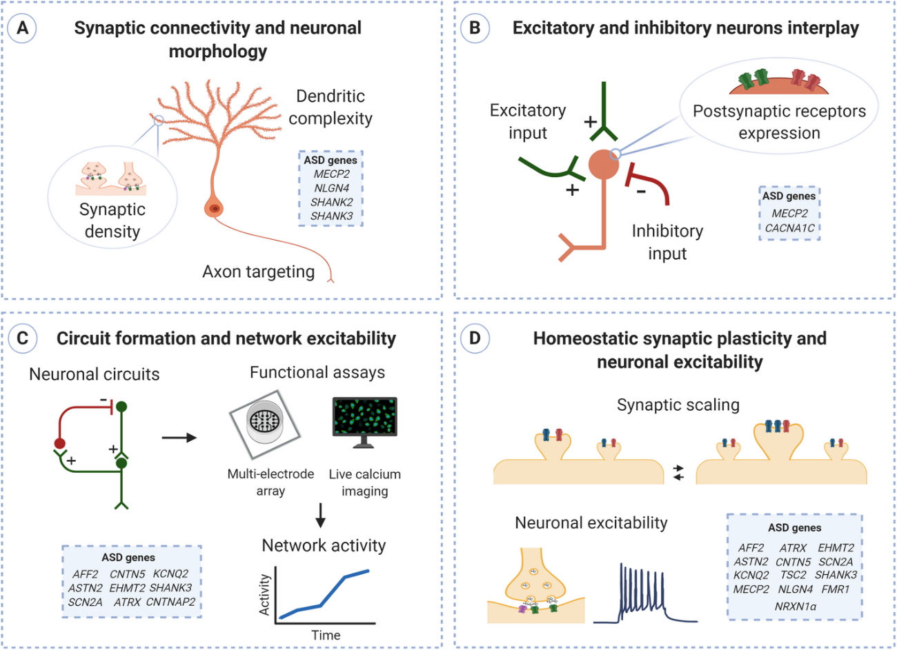
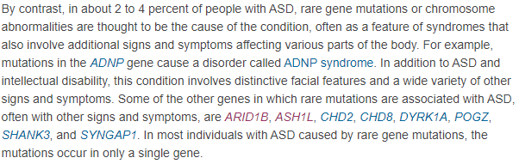
ASD gene sources
Lorenza Culotta et al, “Exploring the mechanisms underlying excitation / inhibition imbalance in human iPSC-derived models of ASD”, Molecular Autism, 2020
https://medlineplus.gov/genetics/condition/autism-spectrum-disorder/#causes

Slide 8
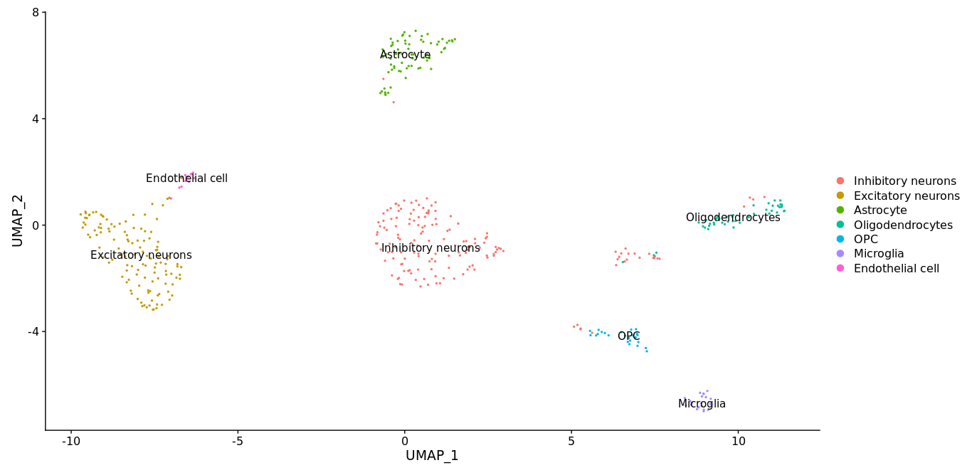
Result 1A. Visualization for normal cortex data (Fluidigm C1 platform)

Slide 9
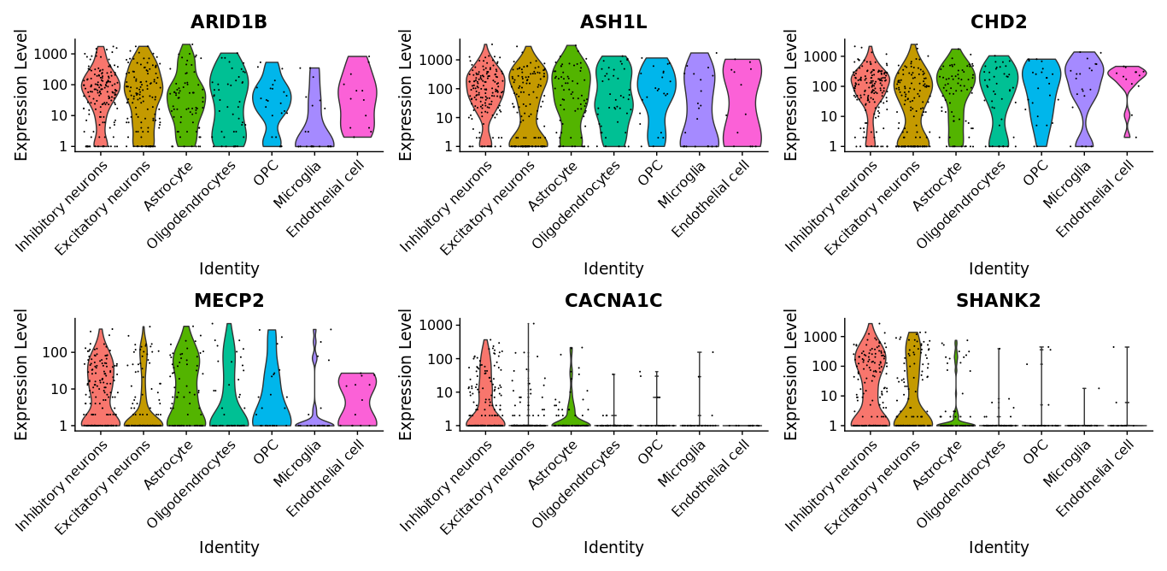
Result 1B. Find markers for every cluster compared to all remaining cells
ARID1B, ASH1L, CHD2, MECP2, CACNA1C and SHANK2 are associated with ASD.

Slide 10
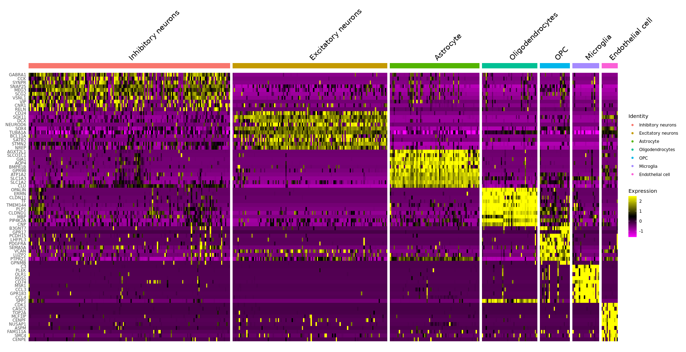
Result 1C. Draw top marker expression heatmap in normal cortex

Slide 11
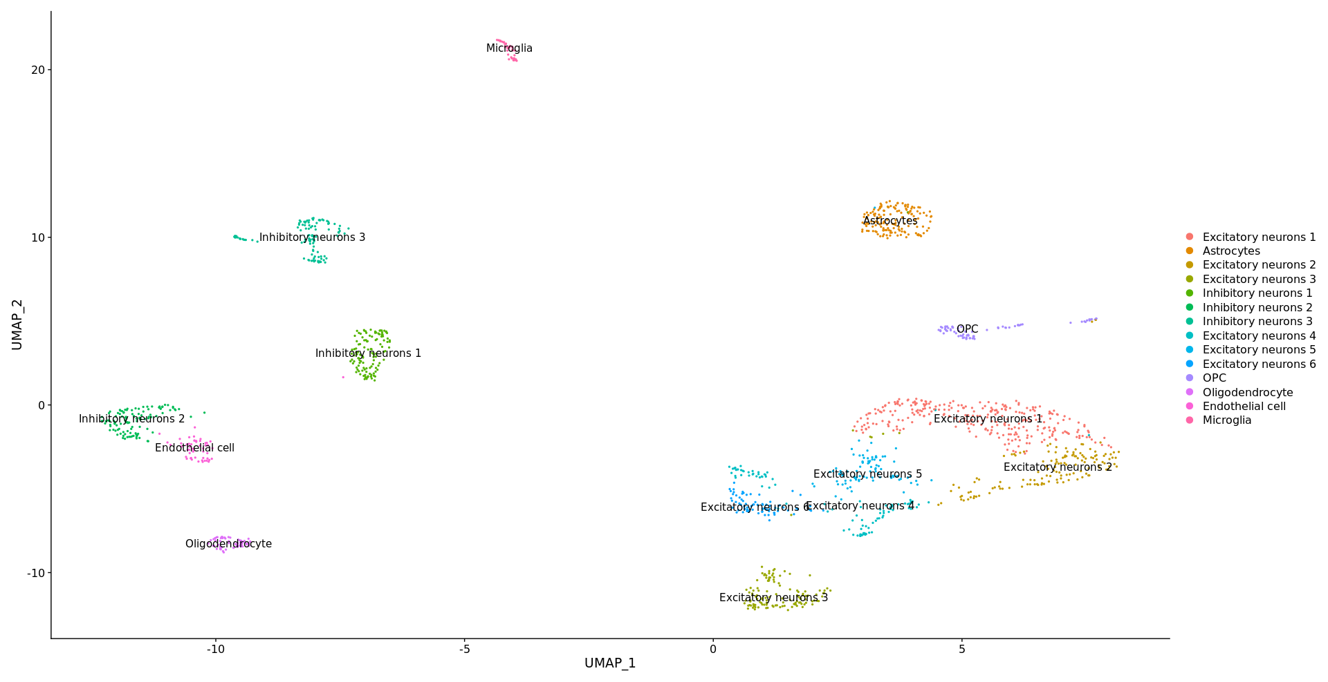
Result 2A. Visualization for ASD Prefrontal cortex (10x genomics platform)

Slide 12
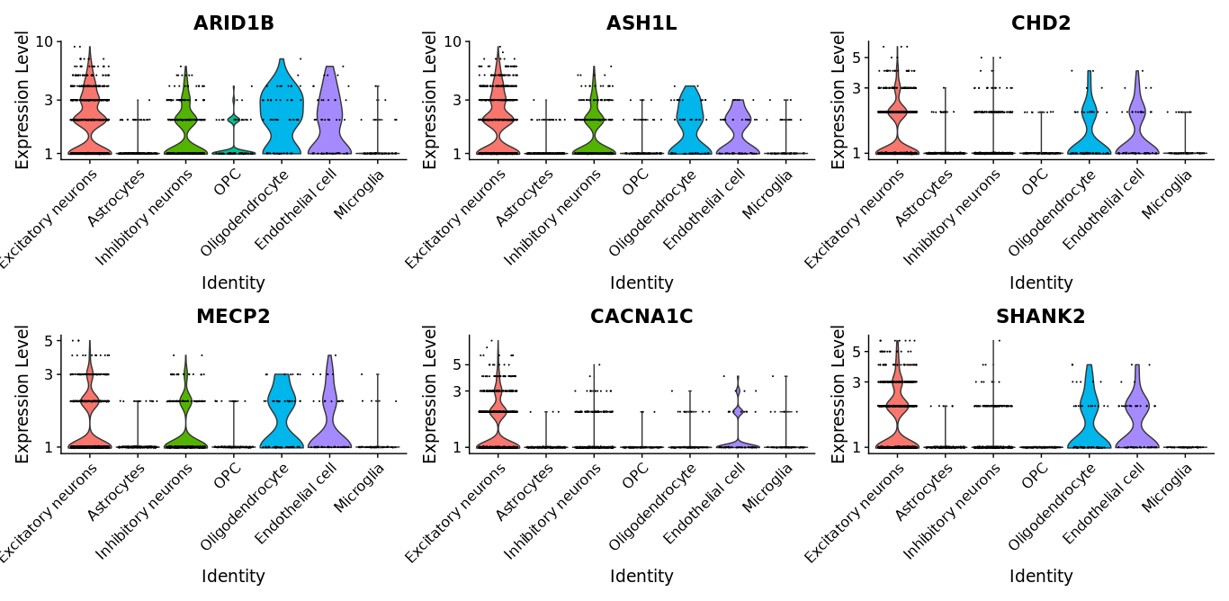
Result 2B. Find markers for each cluster compared to all remaining cells
ARID1B, ASH1L, CHD2, MECP2, CACNA1C and SHANK2 are associated with ASD.

Slide 13
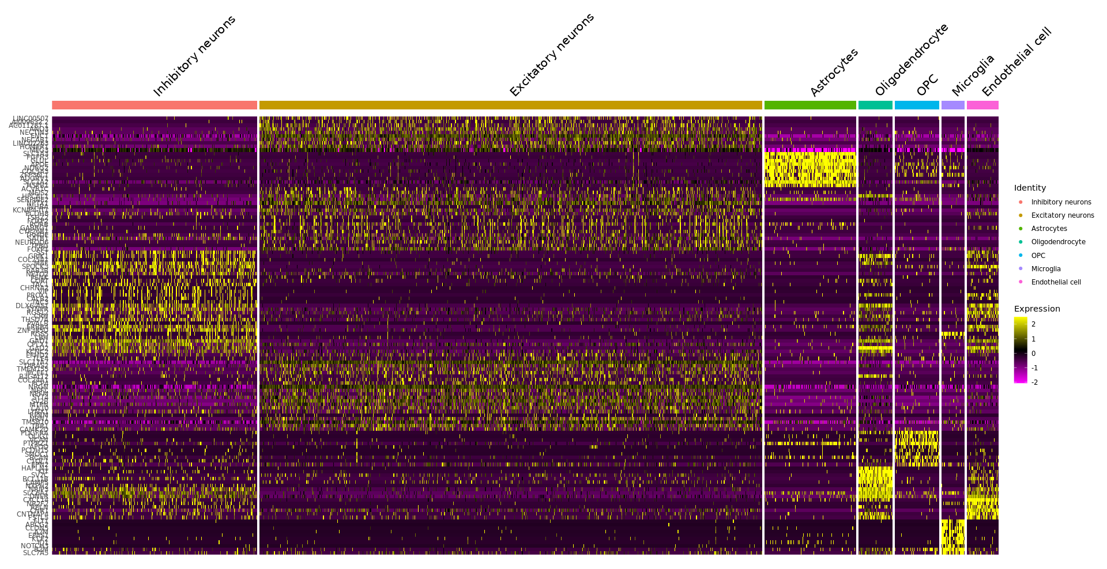
Result 2C. Draw top marker expression heatmap in ASD Prefrontal cortex

Slide 14
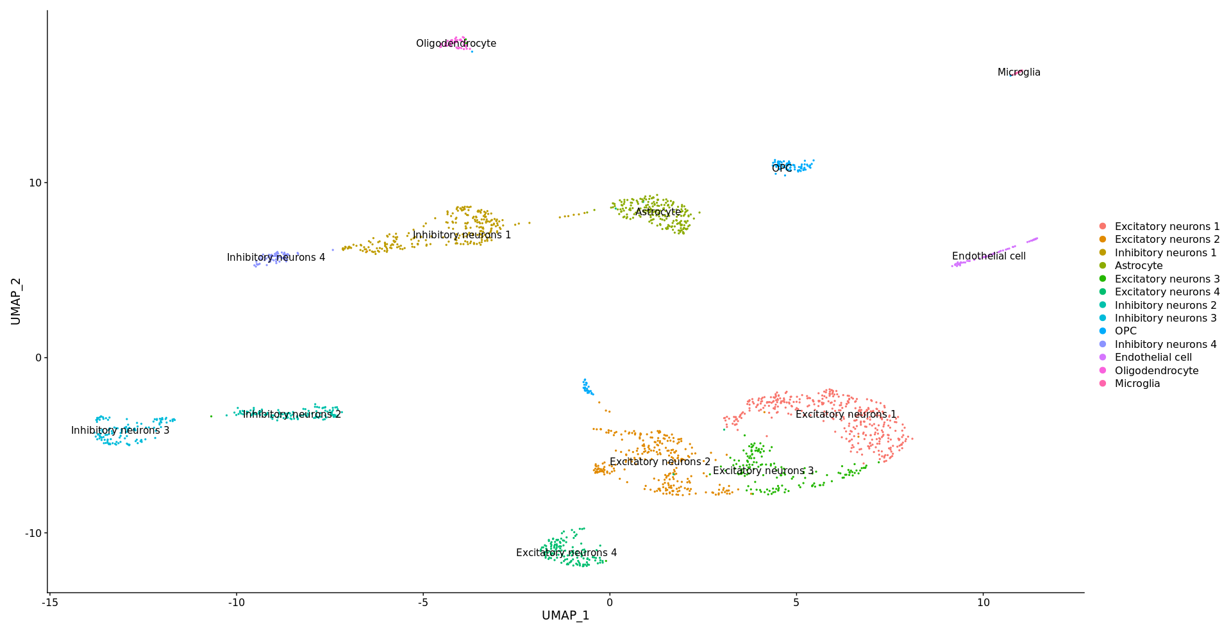
Result 3A. Visualization for integrated data (Control + ASD)

Slide 15
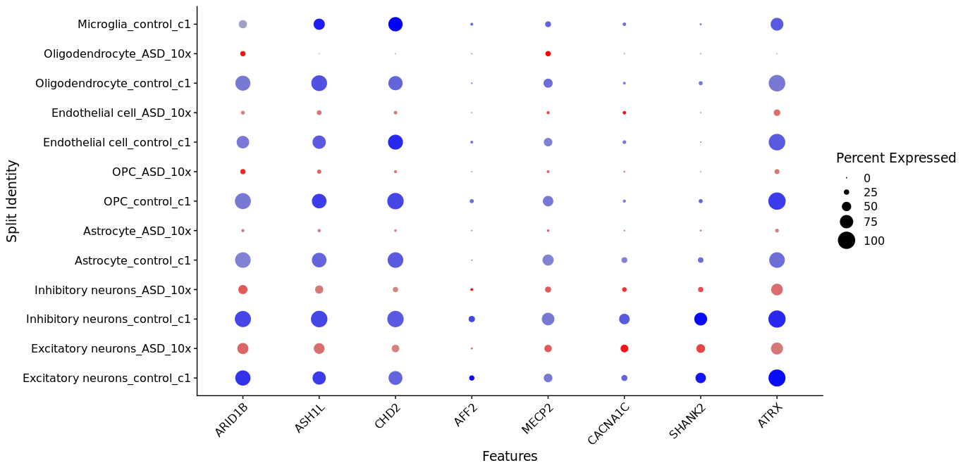
Result 3B. View conserved cell type markers across conditions
ARID1B, ASH1L, CHD2, MECP2, CACNA1C , SHANK2, AFF2 and ATRX are associated with ASD.

Slide 16
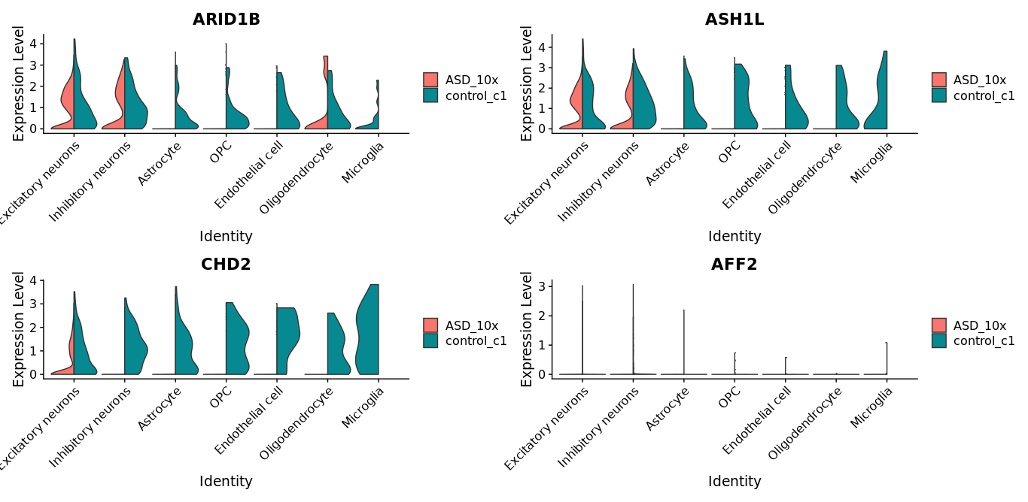
Result 3C. Identify differential expressed genes across conditions
ARID1B, ASH1L, CHD2, MECP2, CACNA1C , SHANK2, AFF2 and ATRX are associated with ASD.

Slide 17
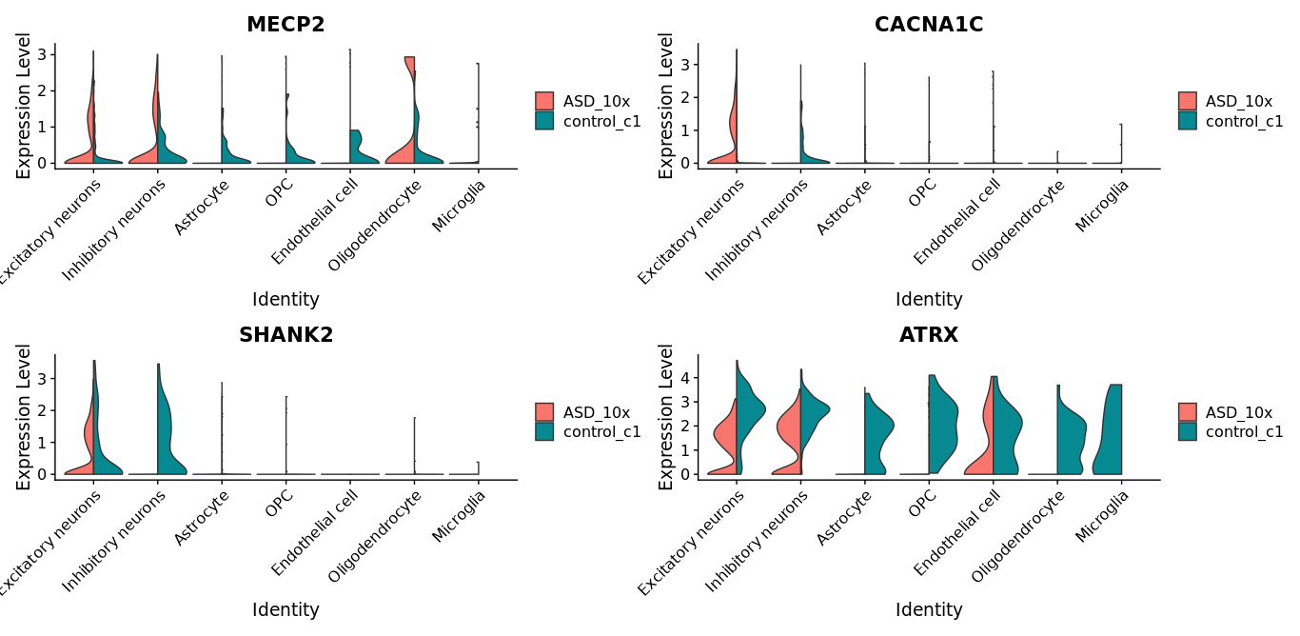
Result 3C. Identify differential expressed genes across conditions
ARID1B, ASH1L, CHD2, MECP2, CACNA1C , SHANK2, AFF2 and ATRX are associated with ASD.

Slide 18
Discussion
It is believed that abnormal excitatory / inhibitory neurotransmission ratio implicated in the pathogenesis of ASD.
To validate it, we try to analyze single cell transcriptome profiles in normal and ASD.
According to Result 1 and 2, generally, it was confirmed that there was a difference in the ratio of excitatory neurons and inhibitory neurons in ASD candidate genes.
In integration data, Result 3 shows that the ASD candidate genes are differentially expressed.
Our dataset is not the same platform, Therefore there may be some errors if we interpret the results.
Despite this limitation, this study provides single cell functional evidence to support the E/I imbalance hypothesis.

Slide 19
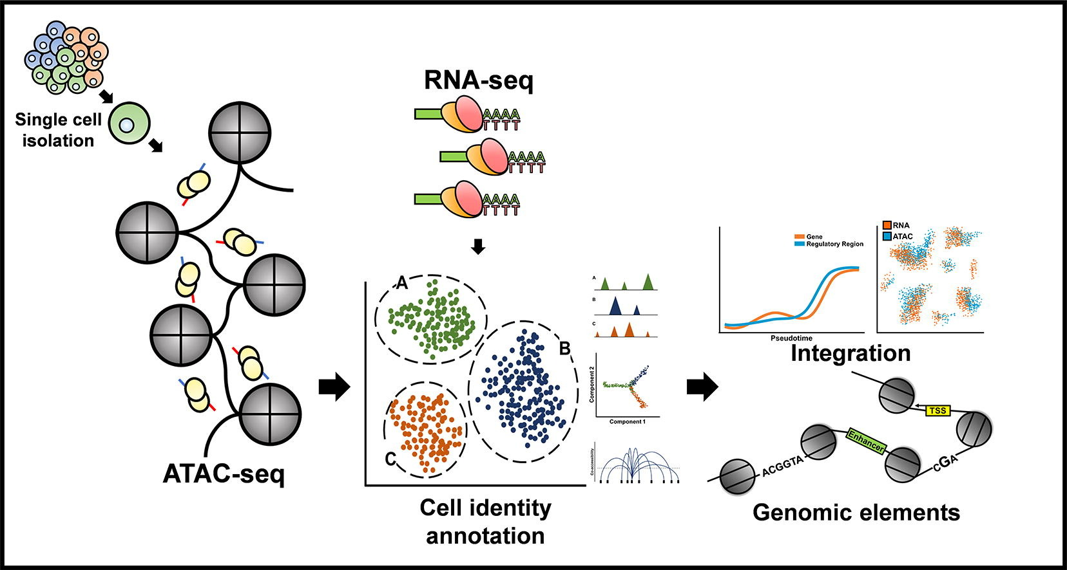
Further study

Slide 20


Supplementary information
https://github.com/jeong2624/Single_cell_Genomics_Class

Slide 21
Q & A

