Slide 1
회귀분석: 통계적 유의성 (p-value) 11월 2일 (월요일) ~ 11월 4일 (수요일)
1. 선형 회귀: 통계적 유의성 검정
1.1. 회귀분석 설명력
1.2. 유의성 검정: pvalue
2. 파이썬 실습: 회귀분석 유의성 적용
2.1. 전 지구 증발량 통계적 유의성 검증 실습
2.2 mapping 실습

Slide 2
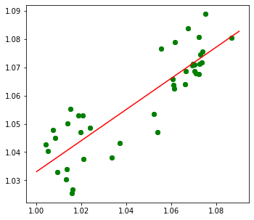






Least-square method (최소제곱법)
$$\hat{y_{i}}=α+βx_{i}$$
$$y_{i}=\left(α+βx_{i}\right)+ε_{i}$$
$$\hat{y_{i}}=\left(α+βx_{i}\right)$$
$$ε_{i}$$
$$y_{i}$$
$$y_{i}=\hat{y_{i}}+ε_{i}$$

Slide 3
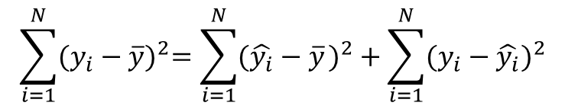
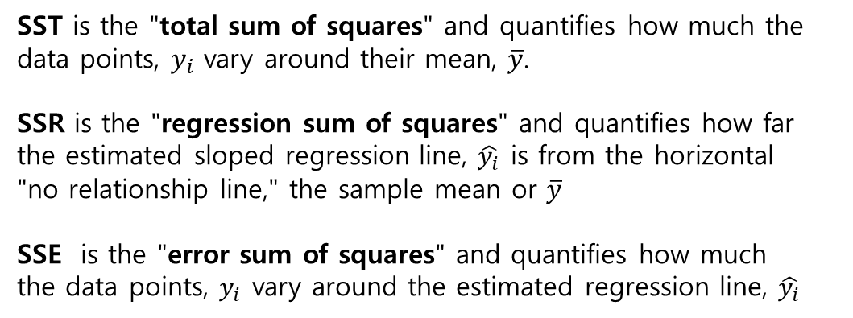



SST, SSR, SSE
$$\sum_{i=1}^{N}{{(y_{i}−\overline{y})}^{2}=\sum_{i=1}^{N}{{({\hat{y_{i}}−\overline{y}}_{ })}^{2}}+\sum_{i=1}^{N}{{(y_{i}−\hat{y_{i}})}^{2}}}$$
$$y_{i}$$
$$\hat{y_{i}}$$
SST = SSR + SSE
$$\overline{y}$$
SST is the "total sum of squares" and quantifies how much the data points, $y_{i}$ vary around their mean, $\overline{y}$.
SSR is the "regression sum of squares" and quantifies how far the estimated sloped regression line, $\hat{y_{i}}$ is from the horizontal "no relationship line," the sample mean or $\overline{y}$
SSE is the "error sum of squares" and quantifies how much the data points, $y_{i}$ vary around the estimated regression line, $\hat{y_{i}}$

Slide 4

SST, SSR, SSE
$$\sum_{i=1}^{N}{{(y_{i}−\overline{y})}^{2}=\sum_{i=1}^{N}{{({\hat{y_{i}}−\overline{y}}_{ })}^{2}}+\sum_{i=1}^{N}{{(y_{i}−\hat{y_{i}})}^{2}}}$$
$$y_{i}$$
$$ε_{i}$$
$$\hat{y_{i}}$$
SST = SSR + SSE
$$\overline{y}$$
SST is the "total sum of squares" and quantifies how much the data points, $y_{i}$ vary around their mean, $\overline{y}$.
SSR is the "regression sum of squares" and quantifies how far the estimated sloped regression line, $\hat{y_{i}}$ is from the horizontal "no relationship line," the sample mean or $\overline{y}$
SSE is the "error sum of squares" and quantifies how much the data points, $y_{i}$ vary around the estimated regression line, $\hat{y_{i}}$

Slide 5
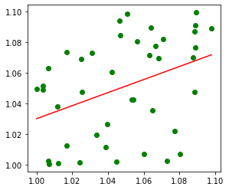
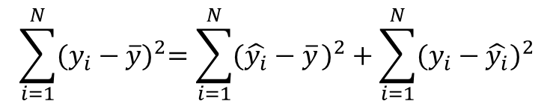
$$\sum_{i=1}^{N}{{(y_{i}−\overline{y})}^{2}=\sum_{i=1}^{N}{{({\hat{y_{i}}−\overline{y}}_{ })}^{2}}+\sum_{i=1}^{N}{{(y_{i}−\hat{y_{i}})}^{2}}}$$
SST = SSR + SSE
SSR > SSE
(회귀식의 설명력이 높은 편)
SSR < SSE
(회귀식의 설명력이 낮음)

Slide 6
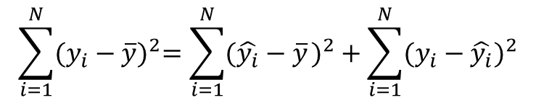


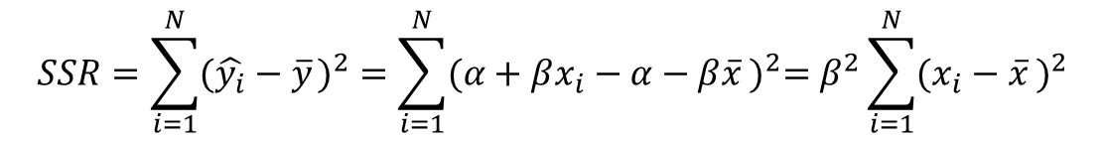
SST, SSR, SSE and${\text{r}}^{2}$
$$\sum_{i=1}^{N}{{(y_{i}−\overline{y})}^{2}=\sum_{i=1}^{N}{{({\hat{y_{i}}−\overline{y}}_{ })}^{2}}+\sum_{i=1}^{N}{{(y_{i}−\hat{y_{i}})}^{2}}}$$
$$\hat{y_{i}}$$
SST = SSR + SSE
$$\overline{y}$$
$$SSR=\sum_{i=1}^{N}{{({\hat{y_{i}}−\overline{y}}_{ })}^{2}}=\sum_{i=1}^{N}{{({α+βx_{i}−α−β\overline{x}}_{ })}^{2}=β^{2}\sum_{i=1}^{N}{{({x_{i}−\overline{x}}_{ })}^{2}}}$$

Slide 7

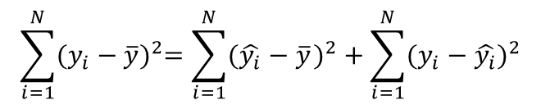

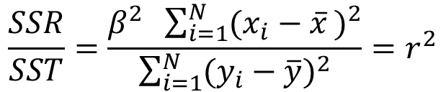
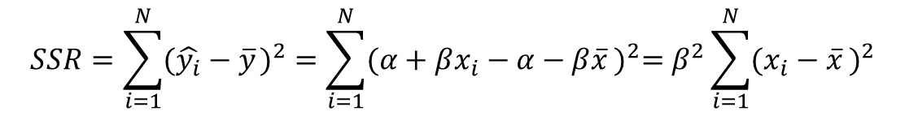
SST, SSR, SSE and${\text{r}}^{2}$
$$\sum_{i=1}^{N}{{(y_{i}−\overline{y})}^{2}=\sum_{i=1}^{N}{{({\hat{y_{i}}−\overline{y}}_{ })}^{2}}+\sum_{i=1}^{N}{{(y_{i}−\hat{y_{i}})}^{2}}}$$
$$\hat{y_{i}}$$
SST = SSR + SSE
$$\overline{y}$$
$$SSR=\sum_{i=1}^{N}{{({\hat{y_{i}}−\overline{y}}_{ })}^{2}}=\sum_{i=1}^{N}{{({α+βx_{i}−α−β\overline{x}}_{ })}^{2}=β^{2}\sum_{i=1}^{N}{{({x_{i}−\overline{x}}_{ })}^{2}}}$$
$$\frac{SSR}{SST}=\frac{β^{2} \sum_{i=1}^{N}{{({x_{i}−\overline{x}}_{ })}^{2}}}{\sum_{i=1}^{N}{{(y_{i}−\overline{y})}^{2}}}=r^{2}$$

Slide 8

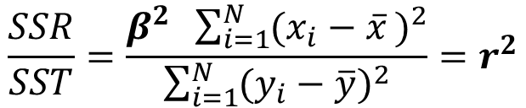

SST, SSR, SSE and${\text{r}}^{2}$
$$\sum_{i=1}^{N}{{(y_{i}−\overline{y})}^{2}=\sum_{i=1}^{N}{{({\hat{y_{i}}−\overline{y}}_{ })}^{2}}+\sum_{i=1}^{N}{{(y_{i}−\hat{y_{i}})}^{2}}}$$
$$\hat{y_{i}}$$
SST = SSR + SSE
$$\overline{y}$$
$$SSR=\sum_{i=1}^{N}{{({\hat{y_{i}}−\overline{y}}_{ })}^{2}}=\sum_{i=1}^{N}{{({α+βx_{i}−α−β\overline{x}}_{ })}^{2}=β^{2}\sum_{i=1}^{N}{{({x_{i}−\overline{x}}_{ })}^{2}}}$$
$$\frac{SSR}{SST}=\frac{β^{2} \sum_{i=1}^{N}{{({x_{i}−\overline{x}}_{ })}^{2}}}{\sum_{i=1}^{N}{{(y_{i}−\overline{y})}^{2}}}=r^{2}$$
→ 상관관계 $r$ 이 클수록 회귀식의 설명력이 높고, $β$ 값이 통계적으로 유의

Slide 9
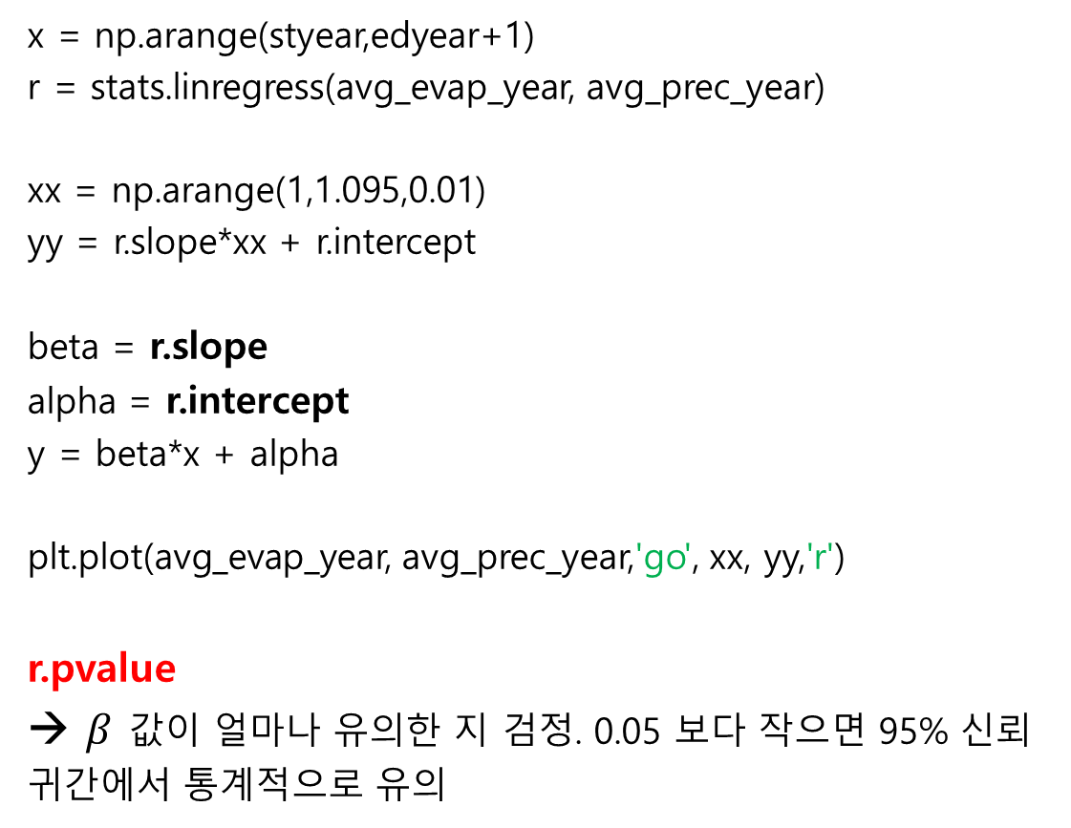
회귀분석 통계적 유의성: pvalue
x = np.arange(styear,edyear+1)
r = stats.linregress(avg_evap_year, avg_prec_year)
xx = np.arange(1,1.095,0.01)
yy = r.slope*xx + r.intercept
beta = r.slope
alpha = r.intercept
y = beta*x + alpha
plt.plot(avg_evap_year, avg_prec_year,'go', xx, yy,'r')
r.pvalue
→ $β$ 값이 얼마나 유의한 지 검정. 0.05 보다 작으면 95% 신뢰귀간에서 통계적으로 유의

Slide 10
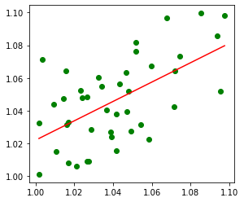
1.0~1.1 사이의 값을 랜덤으로 41개씩 두 번 추출해서 각각 rlist1 과 rlist2 에 저장해서, 둘 사이의 상관 관계를 보면 100~1000번에 한번 정도는 우연히 위와 같은 유의미한 관계가 나올 수 있음.
k = 0
Idx = 0
while idx < 1:
rlist1 = []
rlist2 = []
for i in range(0, 42):
n1 = random.uniform(1.0, 1.1)
rlist1.append(n1)
for i in range(0,42):
n2 = random.uniform(1.0, 1.1)
rlist2.append(n2)
r = stats.linregress(rlist1, rlist2)
if r.pvalue < 0.01:
idx = 1
k += 1
x = np.sort(rlist1)
y = r.slope*x + r.intercept
plt.plot( rlist1, rlist2, 'go', x, y, ‘r' )
rlist2
rlist1

