Slide 1

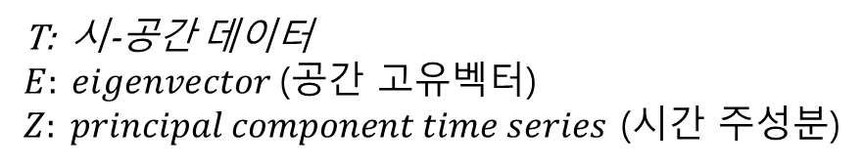
주성분 분석 실습 11월 17일 (수요일 실습)
주성분 분석: 파이썬 스크립트 설명
$$T=\vec{E} \vec{Z}$$
T: 시-공간 데이터
$E: eigenvector$(공간 고유벡터)
$Z: principal component time series$ (시간 주성분)

Slide 2
→ 3차원 시-공간 데이터를 2차원으로 변환
data = nc.Dataset("T2m_ERA5_1979_2018_lowR.nc", 'r' )
lon = data.variables['lon'][:]
lat = data.variables['lat'][:]
time = data.variables['time'][:]
T2 = data.variables['t2m'][:,:,:]
T2_mean = np.mean(T2, 0)
T2a = np.array(T2 - T2_mean)
T2a_1d = np.reshape( T2a, (len(time), len(lon)*len(lat)) )
cov_T2a_1d = np.matmul( T2a_1d.T, T2a_1d )
eigen_val, eigen_vec = np.linalg.eig(cov_T2a_1d)
→ 시간에 대한 평균
→ 시간에 대한 평균 제거 (아노말리)
→ 공분산 행렬

Slide 3
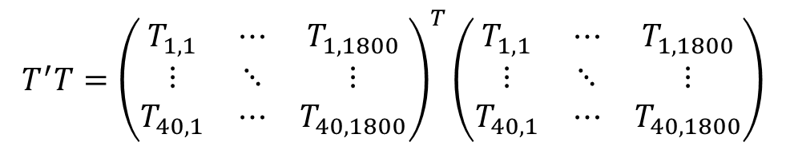
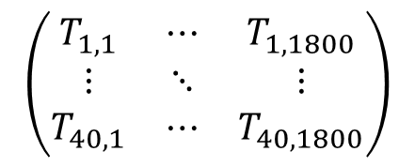
공분산 행렬 (covariance matrix)
T2_mean = np.mean(T2, 0)
T2a = np.array(T2 - T2_mean)
T2a_1d = np.reshape( T2a, (len(time), len(lon)*len(lat)) )
cov_T2a_1d = np.matmul( T2a_1d.T, T2a_1d )
공간
$$\left(\begin{matrix}T_{1,1} & ⋯ & T_{1, 1800} \\ ⋮ & ⋱ & ⋮ \\ T_{40,1} & ⋯ & T_{40, 1800}\end{matrix}\right)$$
$$T^{′}T={\left(\begin{matrix}T_{1,1} & ⋯ & T_{1, 1800} \\ ⋮ & ⋱ & ⋮ \\ T_{40,1} & ⋯ & T_{40, 1800}\end{matrix}\right)}^{T}\left(\begin{matrix}T_{1,1} & ⋯ & T_{1, 1800} \\ ⋮ & ⋱ & ⋮ \\ T_{40,1} & ⋯ & T_{40, 1800}\end{matrix}\right)$$
시간
np.matmul( T2a_1d.T, T2a_1d )

Slide 4
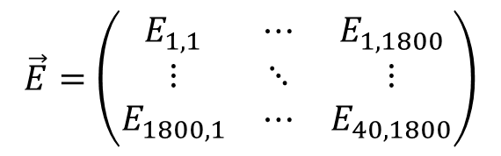
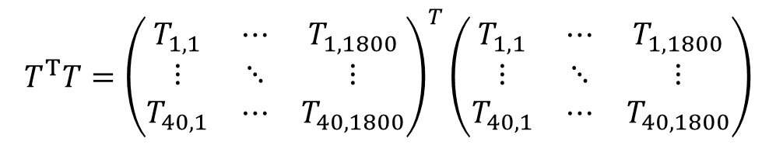

T2_mean = np.mean(T2, 0)
T2a = np.array(T2 - T2_mean)
T2a_1d = np.reshape( T2a, (len(time), len(lon)*len(lat)) )
cov_T2a_1d = np.matmul( T2a_1d.T, T2a_1d )
$$T^{T}T={\left(\begin{matrix}T_{1,1} & ⋯ & T_{1, 1800} \\ ⋮ & ⋱ & ⋮ \\ T_{40,1} & ⋯ & T_{40, 1800}\end{matrix}\right)}^{T}\left(\begin{matrix}T_{1,1} & ⋯ & T_{1, 1800} \\ ⋮ & ⋱ & ⋮ \\ T_{40,1} & ⋯ & T_{40, 1800}\end{matrix}\right)$$
eigen_val, eigen_vec = np.linalg.eig(cov_T2a_1d)
$$\left(T^{T}T\right)\vec{E}=λ\vec{E}$$
$$\vec{E}=\left(\begin{matrix}E_{1,1} & ⋯ & E_{1, 1800} \\ ⋮ & ⋱ & ⋮ \\ E_{1800,1} & ⋯ & E_{40, 1800}\end{matrix}\right)$$
eigen_vec:

Slide 5
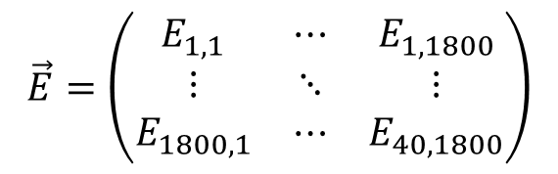
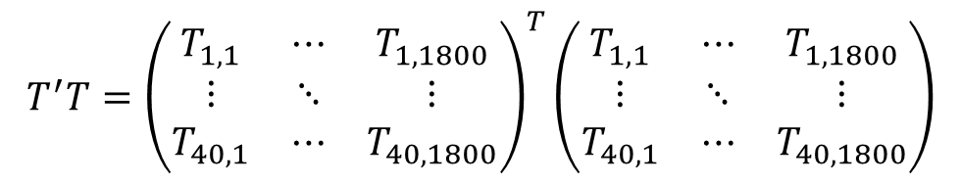
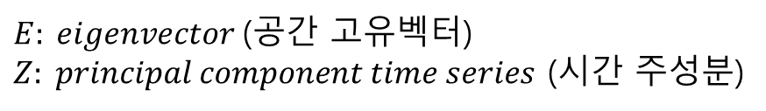


T2_mean = np.mean(T2, 0)
T2a = np.array(T2 - T2_mean)
T2a_1d = np.reshape( T2a, (len(time), len(lon)*len(lat)) )
cov_T2a_1d = np.matmul( T2a_1d.T, T2a_1d )
$$T^{′}T={\left(\begin{matrix}T_{1,1} & ⋯ & T_{1, 1800} \\ ⋮ & ⋱ & ⋮ \\ T_{40,1} & ⋯ & T_{40, 1800}\end{matrix}\right)}^{T}\left(\begin{matrix}T_{1,1} & ⋯ & T_{1, 1800} \\ ⋮ & ⋱ & ⋮ \\ T_{40,1} & ⋯ & T_{40, 1800}\end{matrix}\right)$$
eigen_val, eigen_vec = np.linalg.eig(cov_T2a_1d)
$$\left(T^{T}T\right)\vec{E}=λ\vec{E}$$
$$\vec{E}=\left(\begin{matrix}E_{1,1} & ⋯ & E_{1, 1800} \\ ⋮ & ⋱ & ⋮ \\ E_{1800,1} & ⋯ & E_{40, 1800}\end{matrix}\right)$$
eigen_vec:
$$T^{T}=\vec{E} \vec{Z}$$
$E: eigenvector$(공간 고유벡터)
$Z: principal component time series$ (시간 주성분)

Slide 6



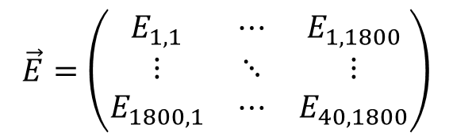

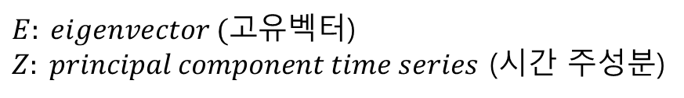

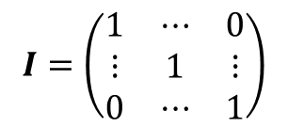
eigen_val, eigen_vec = np.linalg.eig(cov_T2a_1d)
$$\left(T^{T}T\right)\vec{E}=λ\vec{E}$$
$$\vec{E}=\left(\begin{matrix}E_{1,1} & ⋯ & E_{1, 1800} \\ ⋮ & ⋱ & ⋮ \\ E_{1800,1} & ⋯ & E_{40, 1800}\end{matrix}\right)$$
eigen_vec:
$$T^{T}=\vec{E} \vec{Z}$$
$E: eigenvector (고$유벡터)
$Z: principal component time series$ (시간 주성분)
$$T={(\vec{E} \vec{Z})}^{T}={\vec{Z}}^{T}{\vec{E}}^{T}$$
$$T\vec{E}={\vec{Z}}^{T}\left({\vec{E}}^{T}\vec{E}\right)={\vec{Z}}^{T}$$
$${\vec{E}}^{T}\vec{E}=I$$
$$I=\left(\begin{matrix}1 & ⋯ & 0 \\ ⋮ & 1 & ⋮ \\ 0 & ⋯ & 1\end{matrix}\right)$$

Slide 7

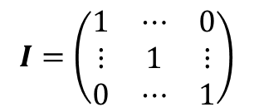
eigen_val, eigen_vec = np.linalg.eig(cov_T2a_1d)
$$\left(T^{T}T\right)\vec{E}=λ\vec{E}$$
$$\vec{E}=\left(\begin{matrix}E_{1,1} & ⋯ & E_{1, 1800} \\ ⋮ & ⋱ & ⋮ \\ E_{1800,1} & ⋯ & E_{40, 1800}\end{matrix}\right)$$
eigen_vec:
$$T^{T}=\vec{E} \vec{Z}$$
$E: eigenvector (고$유벡터)
$Z: principal component time series$ (시간 주성분)
$$T={(\vec{E} \vec{Z})}^{T}={\vec{Z}}^{T}{\vec{E}}^{T}$$
$$I=\left(\begin{matrix}1 & ⋯ & 0 \\ ⋮ & 1 & ⋮ \\ 0 & ⋯ & 1\end{matrix}\right)$$
$$T\vec{E}={\vec{Z}}^{T}\left({\vec{E}}^{T}\vec{E}\right)={\vec{Z}}^{T}$$
$${\vec{E}}^{T}\vec{E}=I$$
시간 주성분
$${\vec{Z}}^{T}=T \vec{E}$$

Slide 8
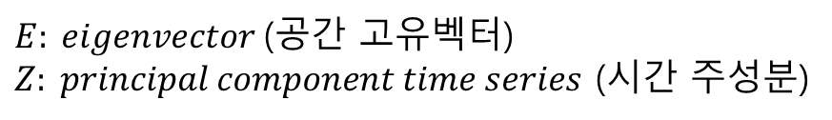




$$T^{T}=\vec{E} \vec{Z}$$
$E: eigenvector$(공간 고유벡터)
$Z: principal component time series$ (시간 주성분)
$$T={(\vec{E} \vec{Z})}^{T}={\vec{Z}}^{T}{\vec{E}}^{T}$$
$$T\vec{E}={\vec{Z}}^{T}\left({\vec{E}}^{T}\vec{E}\right)={\vec{Z}}^{T}$$
# PCs = np.dot( T2a_1d, eigen_vec )
PCs = np.matmul( T2a_1d, eigen_vec )
시간 주성분
$${\vec{Z}}^{T}=T \vec{E}$$

Slide 9
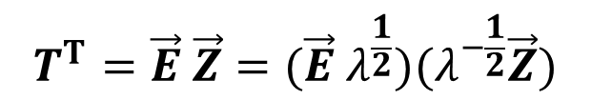



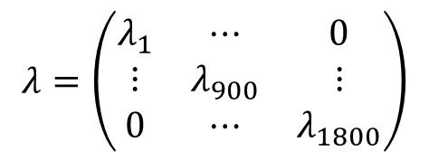
Eigenvalue 를 이용한 표준화 (normalize)
$$T^{T}=\vec{E} \vec{Z}$$
$$λ=\left(\begin{matrix}λ_{1} & ⋯ & 0 \\ ⋮ & λ_{900} & ⋮ \\ 0 & ⋯ & λ_{1800}\end{matrix}\right)$$
$$T^{T}=\vec{E} \vec{Z}=(\vec{E} λ^{\frac{1}{2}})(λ^{−\frac{1}{2}}\vec{Z})$$
###### Normalize eigenvector
n_EOF = -EOF * np.sqrt( eigen_val[MODE-1] )
###### Normalize PC Time-series
n_PC = -PC / np.sqrt( eigen_val[MODE-1] )
$$(\vec{E} λ^{\frac{1}{2}})$$
$$(λ^{−\frac{1}{2}}\vec{Z})$$

Slide 10
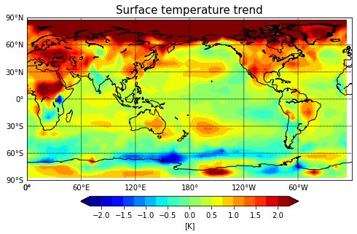
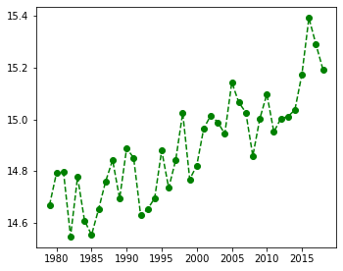
지구 온난화 패턴: 회귀분석 and 주성분분석

Slide 11
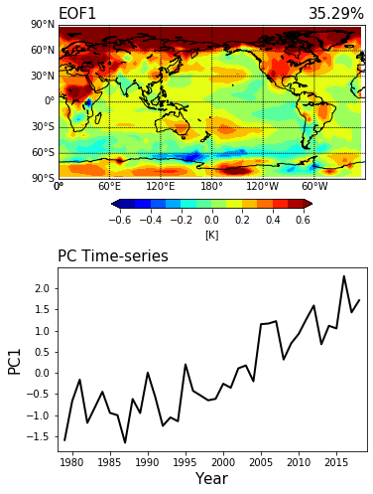
지구 온난화 패턴: 회귀분석 and 주성분분석

