Slide 1
재해석 자료: 증발량과 강우량 전지구 평균값 계산 10월 19일 (월요일) ~ 10월 21일 (수요일)
1. 재해석 자료 생산
1.1. 기상-기후 빅데이터
1.2. 재해석 자료
1.3 연간 총 증발량 (m/day → m/year)
2. 파이썬 프로그래밍 실습
2.1. 증발량 및 강우량 연 증발량 계산
2.2 증발량 및 강우량 공간 평균 (area average)
2.3. 증발량과 강우량 상관성 보여주기

Slide 2
증발량 meter/day 를 meter/year 로 변환
evap_year = np.zeros( [ (edyear-styear+1), len(lat), len(lon)] )
nday_list1 = np.array( [31,28,31,30,31,30,31,31,30,31,30,31] )
nday_list2 = np.array( [31,29,31,30,31,30,31,31,30,31,30,31] )
for i in range( styear, edyear+1 ):
if i%4 != 0:
nday = nday_list1[:]
else:
nday = nday_list2[:]

Slide 3
evap_year = np.zeros( [ (edyear-styear+1), len(lat), len(lon)] )
nday_list1 = np.array( [31,28,31,30,31,30,31,31,30,31,30,31] )
nday_list2 = np.array( [31,29,31,30,31,30,31,31,30,31,30,31] )
for i in range( styear, edyear+1 ):
if i%4 != 0:
nday = nday_list1[:]
else:
nday = nday_list2[:]
for j in range(1,13):
year = str(i)
month = str(j).zfill(2)
filename = EVAPdir+'EVAP.'+year+month+'.nc'
data = nc.Dataset(filename)
evap_month = data.variables['e'][:,:]
evap_year[ i-styear, :, : ] += evap_month[0,:,:]*nday[j-1]

Slide 4
evap_year = np.zeros( [ (edyear-styear+1), len(lat), len(lon)] )
nday_list1 = np.array( [31,28,31,30,31,30,31,31,30,31,30,31] )
nday_list2 = np.array( [31,29,31,30,31,30,31,31,30,31,30,31] )
for i in range( styear, edyear+1 ):
if i%4 != 0:
nday = nday_list1[:]
else:
nday = nday_list2[:]
for j in range(1,13):
year = str(i)
month = str(j).zfill(2)
filename = EVAPdir+'EVAP.'+year+month+'.nc'
data = nc.Dataset(filename)
evap_month = data.variables['e'][:,:]
evap_year[ i-styear, :, : ] += evap_month[0,:,:]*nday[j-1]
숙제 3) 리스트 (list)를 이용해서 코딩을 다시 해보세요~!

Slide 5
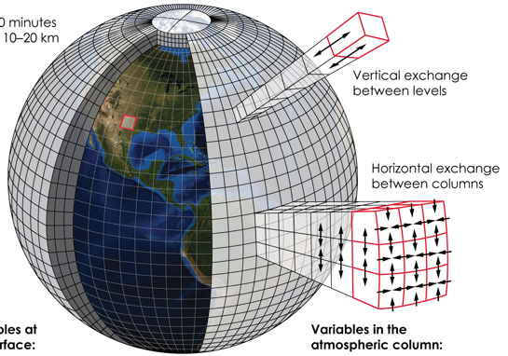
weighted average: 각 격자의 면적이 달라서

Slide 6
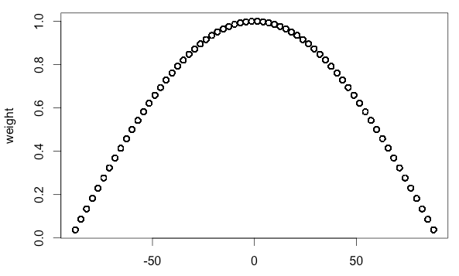
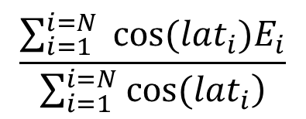
weighted average: 각 격자의 면적이 달라서
위도 (latitude)
$$\frac{\sum_{i=1}^{i=N}{ cos⁡({lat}_{i})E_{i}}}{\sum_{i=1}^{i=N}{\left. cos⁡({lat}_{i}\right)}}$$

Slide 7
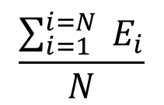
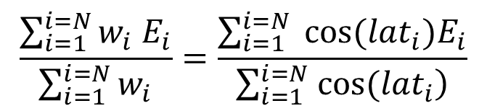
simple average vs. weighted average
simple average
weighted average
$$\frac{\sum_{i=1}^{i=N}{{ E}_{i}}}{N}$$
$$\frac{\sum_{i=1}^{i=N}{w_{i} E_{i}}}{\sum_{i=1}^{i=N}{w_{i}}}=\frac{\sum_{i=1}^{i=N}{ cos⁡({lat}_{i})E_{i}}}{\sum_{i=1}^{i=N}{\left. cos⁡({lat}_{i}\right)}}$$

Slide 8
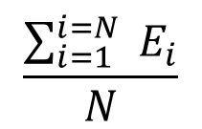
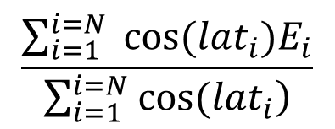
simple average vs. weighted average
$$\frac{\sum_{i=1}^{i=N}{{ E}_{i}}}{N}$$
$$\frac{\sum_{i=1}^{i=N}{ cos⁡({lat}_{i})E_{i}}}{\sum_{i=1}^{i=N}{\left. cos⁡({lat}_{i}\right)}}$$
simple average
weighted average
37
latitudes
37
latitudes
Evaporation
X
Cosine weighting
72
longitudes
72
longitudes

Slide 9
simple average vs. weighted average
$$\frac{\sum_{i=1}^{i=N}{{ E}_{i}}}{N}$$
$$\frac{\sum_{i=1}^{i=N}{ cos⁡({lat}_{i})E_{i}}}{\sum_{i=1}^{i=N}{\left. cos⁡({lat}_{i}\right)}}$$
simple average
weighted average
Cos(90)
Cos(90)
Cos(90)
37
latitudes
37
latitudes
Evaporation
X
Cos(0)
Cos(0)
Cos(0)
Cos(-90)
Cos(-90)
Cos(-90)
72
longitudes
72
longitudes

Slide 10
Cos(90)
Cos(90)
Cos(90)
37
latitudes
37
latitudes
Evaporation
X
Cos(0)
Cos(0)
Cos(0)
Cos(-90)
Cos(-90)
Cos(-90)
72
longitudes
72
longitudes
for t in range( 0, len(evap_year) ):
wgt_evap_year0[t, :, :] = evap_year[t, :, :]*cosarray

Slide 11
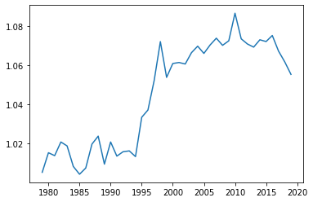
Globally-averaged annual evaporation from 1979 to 2019
연 증발량
(meter)
모든 격자 값들의 평균 (지역 평균)
연도 (year)

