Slide 1
회귀분석 소개 및 적용 10월 26일 (월요일) ~ 10월 28일 (수요일)
1. 선형 회귀분석법
1.1. 최소제곱법 소개
1.2. 회귀분석 식 유도
2. 파이썬에서 회귀분석
2.1. scipy.stats 응용
2.2 증발량 및 강우량 상관관계 분석 (실습)

Slide 2
단순 회귀 분석법
( simple linear regression )
회귀분석법은 연속형 변수들에 대해 두 변수 사이의 “최적 선형모형”을 구하는 방법 중의 하나이다.
하나의 종속변수와 하나의 독립변수 사이의 관계를 분석할 경우를 단순회귀분석( simple regression analysis )
$$Y=\left(α+βX\right)$$

Slide 3
단순 회귀 분석법
( simple linear regression )
하나의 종속변수를 하나의 독립변수로 설명할 경우를 단순회귀분석( simple regression analysis )
$$Y=\left(α+βX\right)$$
하나의 종속변수를 여러 독립변수로 규명하고자 할 경우를 다중회귀분석( multiple regression analysis) 이라고 한다.
$$Y=\left(α+β_{1}X_{1}+β_{2}X_{2}+…+β_{n}X_{n}\right)$$

Slide 4
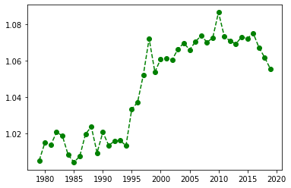
Least-square method (최소제곱법)
Globally-averaged annual evaporation
최근 40년 동안 전 지구 평균 증발량이 얼마나 증가했는지 객관적으로 정량화 할 수 있는 방법은?
→ 최소제곱법을 이용한 단순 회귀분석법
Let’s mentally draw a straight line through the middle of the data.
In statistics, this line that we're drawing is called a regression line.

Slide 5
Least-square method (최소제곱법)
Globally-averaged annual evaporation
최근 40년 동안 전 지구 평균 증발량이 얼마나 증가했는지 객관적으로 정량화 할 수 있는 방법은?
→ 최소제곱법을 이용한 단순 회귀분석법
Let’s mentally draw a straight line through the middle of the data.
In statistics, this line that we're drawing is called a regression line.

Slide 6
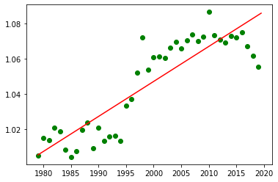

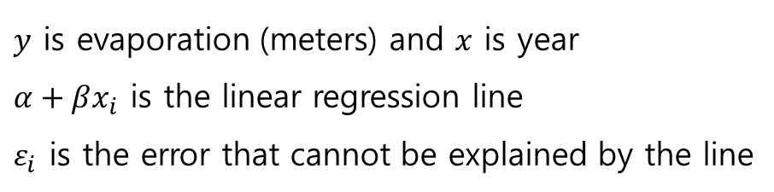
Least-square method (최소제곱법)
The regression line goes through the middle of the data.
Let’s formulate the regression line something like below:
$$y_{i}=\left(α+βx_{i}\right)+ε_{i}$$
( at each data point i )
$y$ is evaporation (meters) and $x$ is year
$α+βx_{i}$ is the linear regression line
$ε_{i}$ is the error that cannot be explained by the line

Slide 7




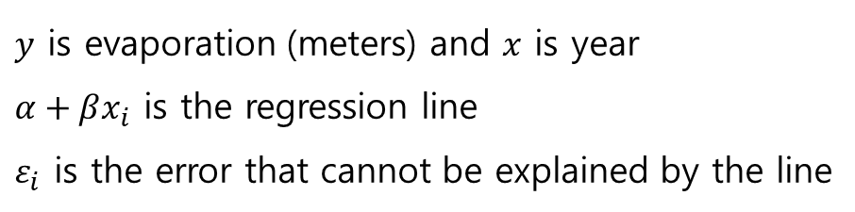
Least-square method (최소제곱법)
$$y_{i}$$
$$y_{i}=\left(α+βx_{i}\right)+ε_{i}$$
( at each data point i )
$$ε_{i}$$
$y$ is evaporation (meters) and $x$ is year
$α+βx_{i}$ is the regression line
$ε_{i}$ is the error that cannot be explained by the line
$$α+βx_{i}$$

Slide 8
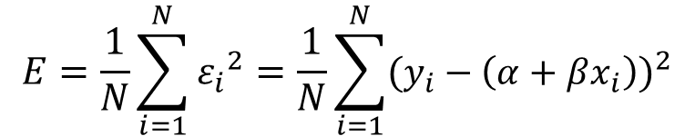


Least-square method (최소제곱법)
$$y_{i}$$
$$y_{i}=\left(α+βx_{i}\right)+ε_{i}$$
( at each data point i )
$$ε_{i}$$
Mean square error (잔차 제곱 평균)
$$E=\frac{1}{N}\sum_{i=1}^{N}{{ε_{i}}^{2}=\frac{1}{N}\sum_{i=1}^{N}{{(y_{i}−\left(α+βx_{i}\right))}^{2}}}$$
$$α+βx_{i}$$

Slide 9
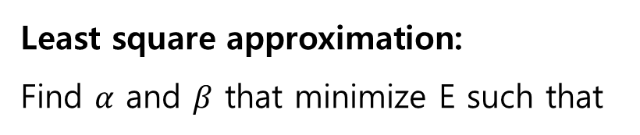

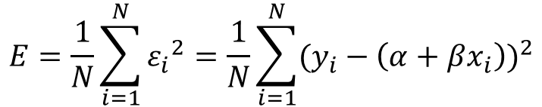
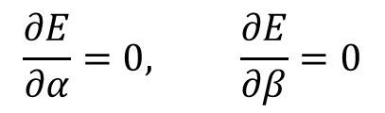
Least-square method (최소제곱법)
$$y_{i}=\left(α+βx_{i}\right)+ε_{i}$$
( at each data point i )
$$y_{i}$$
$$ε_{i}$$
Mean square error
$$E=\frac{1}{N}\sum_{i=1}^{N}{{ε_{i}}^{2}=\frac{1}{N}\sum_{i=1}^{N}{{(y_{i}−\left(α+βx_{i}\right))}^{2}}}$$
Least square approximation:
Find $α$ and $β$ that minimize E such that
$$\frac{∂E}{∂α}=0, \frac{∂E}{∂β}=0$$

Slide 10
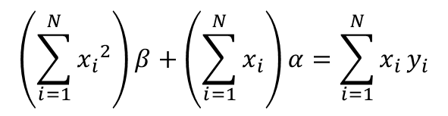
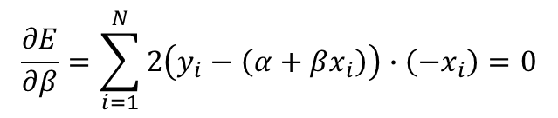
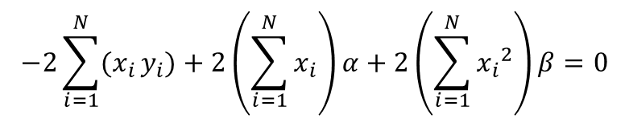
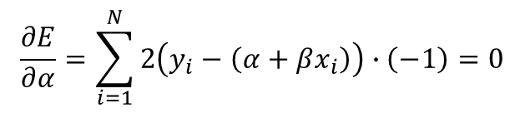
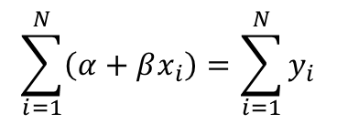
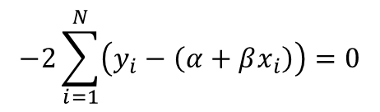
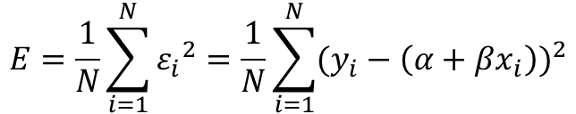
$$E=\frac{1}{N}\sum_{i=1}^{N}{{ε_{i}}^{2}=\frac{1}{N}\sum_{i=1}^{N}{{(y_{i}−\left(α+βx_{i}\right))}^{2}}}$$
$$\frac{∂E}{∂α}=\sum_{i=1}^{N}{2\left(y_{i}−\left(α+βx_{i}\right)\right)∙\left(−1\right)}=0$$
$$−2\sum_{i=1}^{N}{\left(y_{i}−\left(α+βx_{i}\right)\right)=0}$$
$$\sum_{i=1}^{N}{\left(α+βx_{i}\right)=\sum_{i=1}^{N}{y_{i}}}$$
$$\frac{∂E}{∂β}=\sum_{i=1}^{N}{2\left(y_{i}−\left(α+βx_{i}\right)\right)}∙\left(−x_{i}\right)=0$$
$$−2\sum_{i=1}^{N}{(x_{i}}y_{i})+2\left(\sum_{i=1}^{N}{x_{i}}\right)α+2\left(\sum_{i=1}^{N}{{x_{i}}^{2}}\right)β=0$$
$$\left(\sum_{i=1}^{N}{{x_{i}}^{2}}\right)β+\left(\sum_{i=1}^{N}{x_{i}}\right)α=\sum_{i=1}^{N}{x_{i}}y_{i}$$

Slide 11
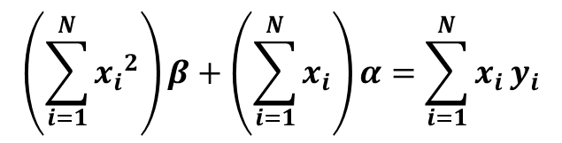
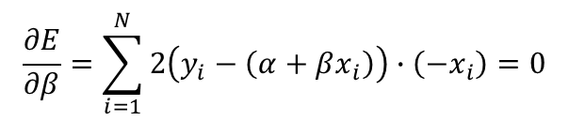
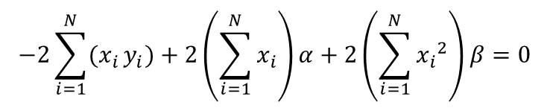
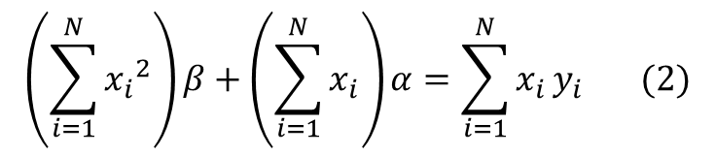
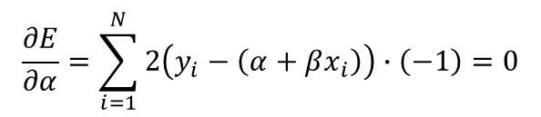
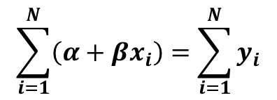
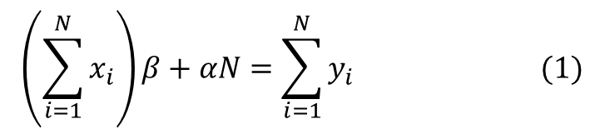
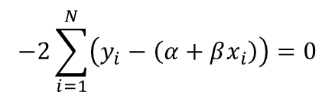
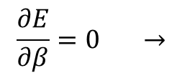
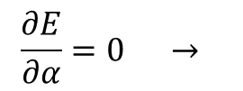
$$E=\frac{1}{N}\sum_{i=1}^{N}{{ε_{i}}^{2}=\frac{1}{N}\sum_{i=1}^{N}{{(y_{i}−\left(α+βx_{i}\right))}^{2}}}$$
$$\frac{∂E}{∂α}=\sum_{i=1}^{N}{2\left(y_{i}−\left(α+βx_{i}\right)\right)∙\left(−1\right)}=0$$
$$−2\sum_{i=1}^{N}{\left(y_{i}−\left(α+βx_{i}\right)\right)=0}$$
$$\sum_{i=1}^{N}{\left(α+βx_{i}\right)=\sum_{i=1}^{N}{y_{i}}}$$
$$\frac{∂E}{∂β}=\sum_{i=1}^{N}{2\left(y_{i}−\left(α+βx_{i}\right)\right)}∙\left(−x_{i}\right)=0$$
$$−2\sum_{i=1}^{N}{(x_{i}}y_{i})+2\left(\sum_{i=1}^{N}{x_{i}}\right)α+2\left(\sum_{i=1}^{N}{{x_{i}}^{2}}\right)β=0$$
$$\left(\sum_{i=1}^{N}{{x_{i}}^{2}}\right)β+\left(\sum_{i=1}^{N}{x_{i}}\right)α=\sum_{i=1}^{N}{x_{i}}y_{i}$$
Therefore, minimizing the mean square error leads to the following equations:
$$\left(\sum_{i=1}^{N}{x_{i}}\right)β+αN=\sum_{i=1}^{N}{y_{i} } (1)$$
$$\frac{∂E}{∂α}=0 →$$
$$\left(\sum_{i=1}^{N}{{x_{i}}^{2}}\right)β+\left(\sum_{i=1}^{N}{x_{i}}\right)α=\sum_{i=1}^{N}{x_{i}}y_{i} (2)$$
$$\frac{∂E}{∂β}=0 →$$

Slide 12
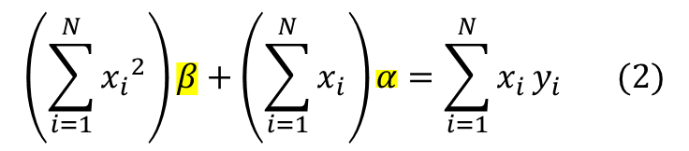
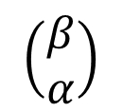
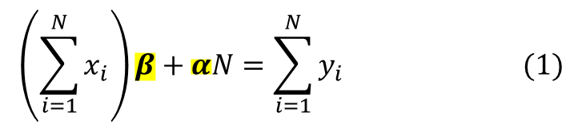
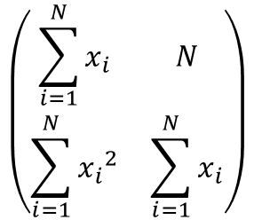
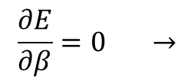
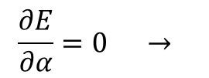
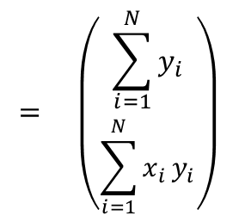

$$\left(\sum_{i=1}^{N}{x_{i}}\right)β+αN=\sum_{i=1}^{N}{y_{i} } (1)$$
$$\frac{∂E}{∂α}=0 →$$
$$\left(\sum_{i=1}^{N}{{x_{i}}^{2}}\right)β+\left(\sum_{i=1}^{N}{x_{i}}\right)α=\sum_{i=1}^{N}{x_{i}}y_{i} (2)$$
$$\frac{∂E}{∂β}=0 →$$
Equations (1) and (2) can be written as a matrix:
$$\left(\begin{matrix}\sum_{i=1}^{N}{x_{i}} & N \\ \sum_{i=1}^{N}{{x_{i}}^{2}} & \sum_{i=1}^{N}{x_{i}}\end{matrix}\right)$$
$$= \left(\begin{matrix}\sum_{i=1}^{N}{y_{i}} \\ \sum_{i=1}^{N}{x_{i}}y_{i}\end{matrix}\right)$$
$$\left(\begin{matrix}β \\ α\end{matrix}\right)$$
$$y_{i}=\left(α+βx_{i}\right)+ε_{i}$$

Slide 13

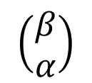
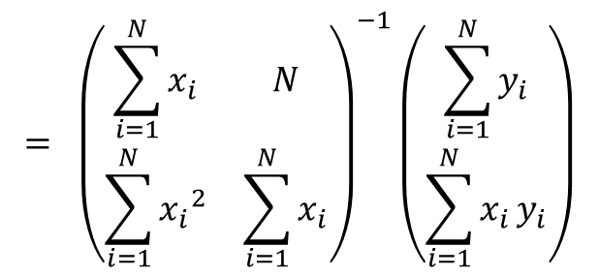
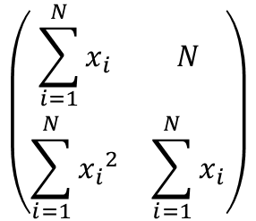
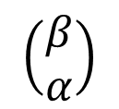
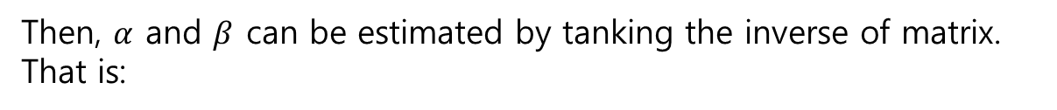
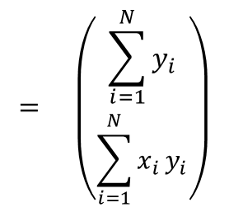
Equations (1) and (2) can be written as a matrix:
$$\left(\begin{matrix}\sum_{i=1}^{N}{x_{i}} & N \\ \sum_{i=1}^{N}{{x_{i}}^{2}} & \sum_{i=1}^{N}{x_{i}}\end{matrix}\right)$$
$$= \left(\begin{matrix}\sum_{i=1}^{N}{y_{i}} \\ \sum_{i=1}^{N}{x_{i}}y_{i}\end{matrix}\right)$$
$$\left(\begin{matrix}β \\ α\end{matrix}\right)$$
Then, $α$ and $β$ can be estimated by tanking the inverse of matrix. That is:
$$= {\left(\begin{matrix}\sum_{i=1}^{N}{x_{i}} & N \\ \sum_{i=1}^{N}{{x_{i}}^{2}} & \sum_{i=1}^{N}{x_{i}}\end{matrix}\right)}^{−1}\left(\begin{matrix}\sum_{i=1}^{N}{y_{i}} \\ \sum_{i=1}^{N}{x_{i}}y_{i}\end{matrix}\right)$$
$$\left(\begin{matrix}β \\ α\end{matrix}\right)$$
$$y_{i}=\left(α+βx_{i}\right)+ε_{i}$$

Slide 14
파이썬을 이용한 회귀분석법 실습
R 에서는 어떻게 했는지 간단히 복습:
lm is used to fit linear model and can be used to carry out regression analysis
lm( y ~ x )
→ Predict the Y variable from X using the linear model (simple linear regression)

Slide 15
파이썬을 이용한 회귀분석법 실습
R 에서는 어떻게 했는지 간단히 복습:
lm is used to fit linear model and can be used to carry out regression analysis
lm( y ~ x )
→ Predict the Y variable from X using the linear model (simple linear regression)
파이썬 에서는 ?
stats.linregress 함수로 회귀분석을 쉽게 할 수 있음.
import scipy.stats as stats
stats.linregress(x, y)

Slide 16
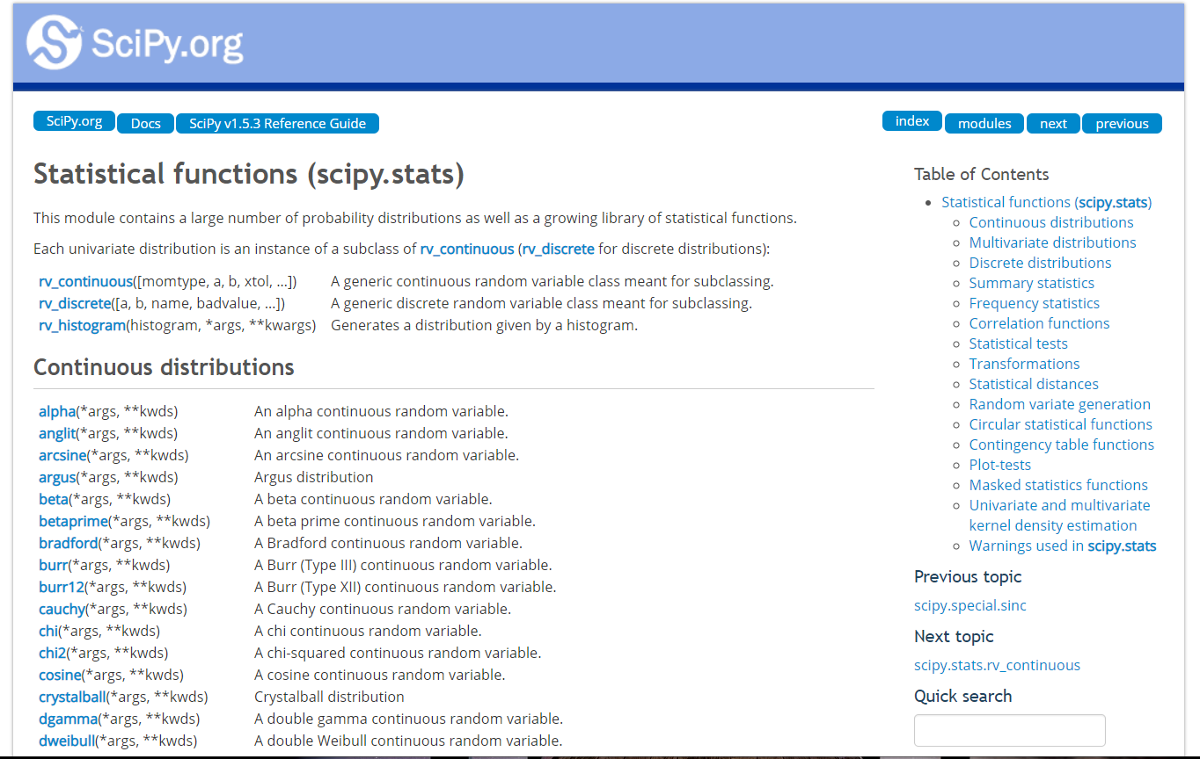
Statistical functions (scipy.stats)
https://docs.scipy.org/doc/scipy/reference/stats.html

Slide 17

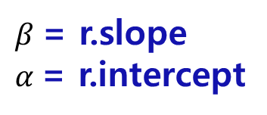
파이썬을 이용한 회귀분석법 실습
파이썬 에서는 ?
stats.linregress 함수로 회귀분석을 쉽게 할 수 있음.
import scipy.stats as stats
r = stats.linregress(x, y)
$β$= r.slope
$α$= r.intercept
$$y_{i}=\left(α+βx_{i}\right)+ε_{i}$$

Slide 18

파이썬을 이용한 회귀분석법 실습
import scipy.stats as stats
x = np.arange(styear,edyear+1)
r = stats.linregress(x, avg_evap_year)
beta = r.slope
alpha = r.intercept
y = beta*x + alpha
plt.plot(x, avg_evap_year, 'go', x, y, 'r')

