Slide 1

Web-Server Programming
XML
2016.03.11 (Fri)

Slide 2
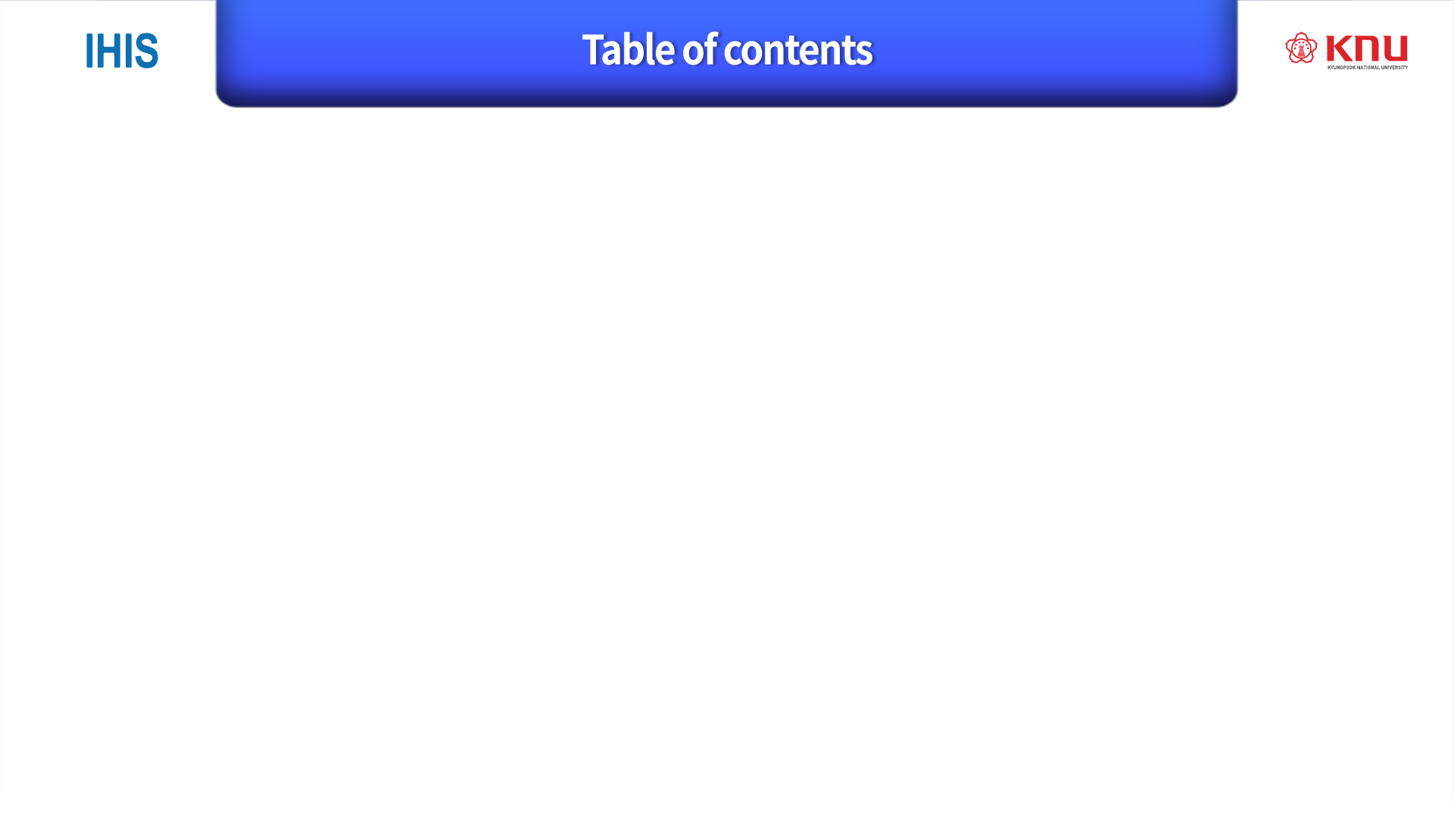
Feature of XML ( 3 to 10)
Syntax of XML(11 to 18)
Namespace of XML(19 to 22)
DOM
SAX
Simple-xml

Slide 3
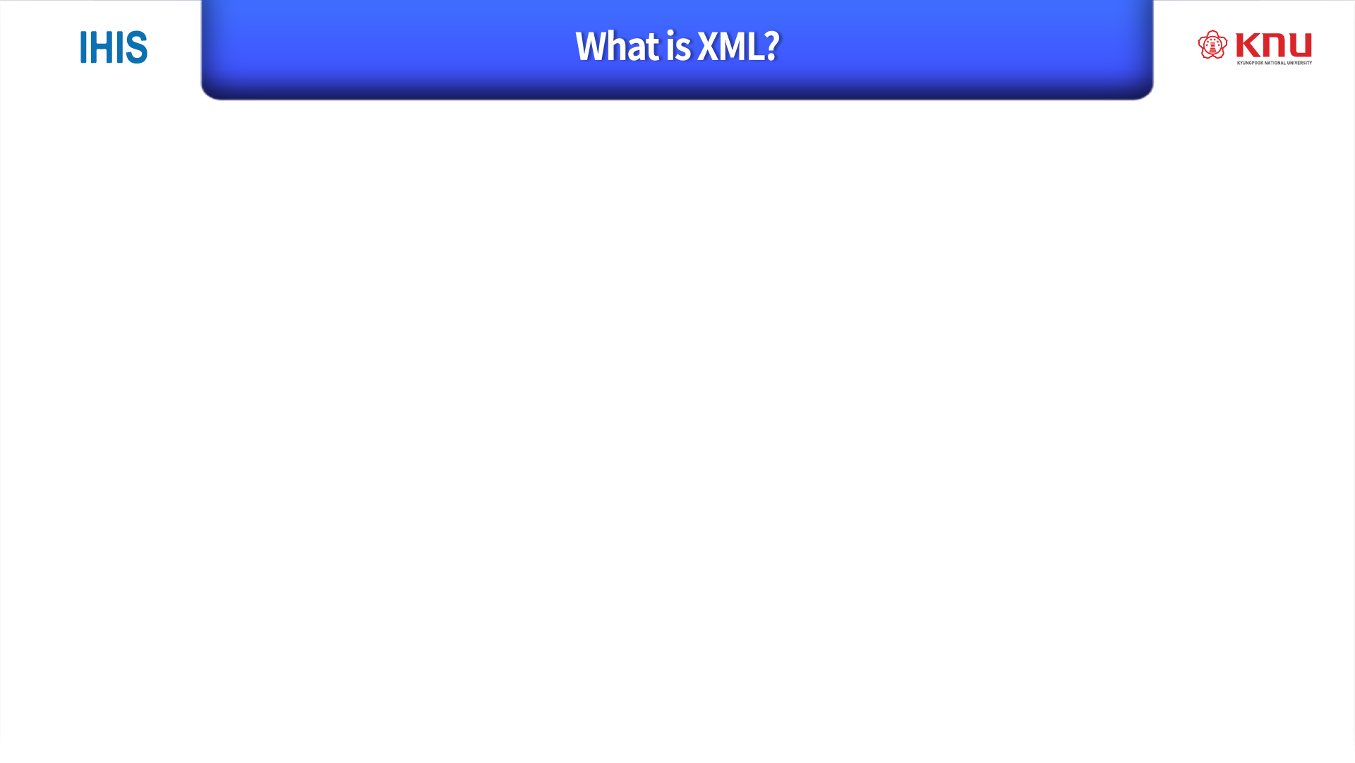
Why Study XML?
XML stands for Extensible Markup Language
XML is a markup language much like HTML
XML was designed to store and transport data
XML was designed to be self-descriptive 태그를 준다.
XML is a W3C(The World Wide Web Consortium) Recommendation
XML plays an important role in many IT systems.
For this reason, it is important for all software developers to have a good understanding of XML.
Before you continue, you should also have a basic understanding of:
HTML, JavaScript

Slide 4
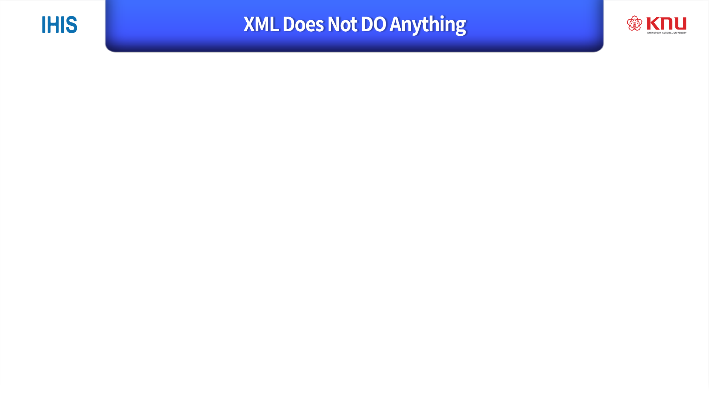
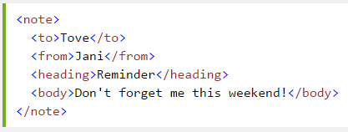
Maybe it is a little hard to understand, but XML does not DO anything.
This note is a note to Tove, from Jani, stored as XML:
XML is just information wrapped in tags.

Slide 5
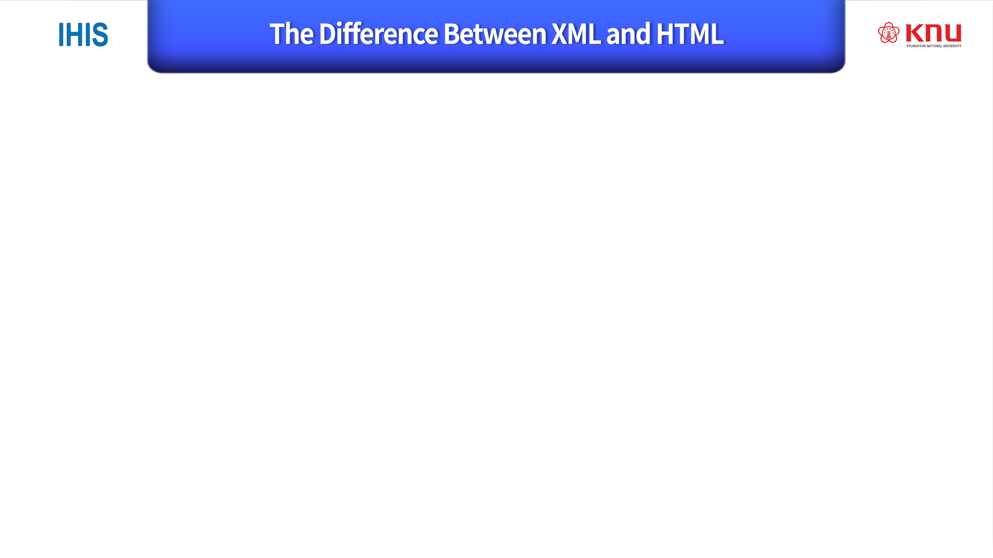
XML and HTML were designed with different goals:
XML was designed to carry data - with focus on what data is
HTML was designed to display data - with focus on how data looks
XML tags are not predefined like HTML tags are : Information model 에서 스키마의 규격을 정하는 것은 다르다. 거의 predefined 수준으로 활용된다.
XML Does Not Use Predefined Tags
The XML language has no predefined tags.
The tags in the example above (like <to> and <from>) are not defined in any XML standard. These tags are "invented" by the author of the XML document.
HTML works with predefined tags like <p>, <h1>, <table>, etc.
With XML, the author must define both the tags and the document structure.

Slide 6
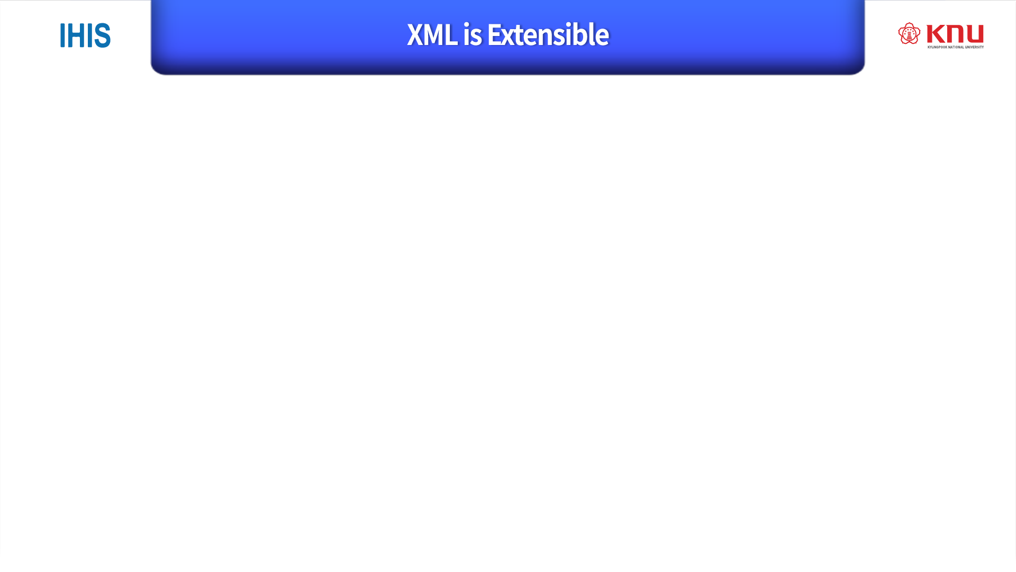
Most XML applications will work as expected even if new data is added (or removed).
Imagine an application designed to display the original version of note.xml (<to> <from> <heading> <data>).
Then imagine a newer version of note.xml with added <date> and <hour> elements, and a removed <heading>.

Slide 7
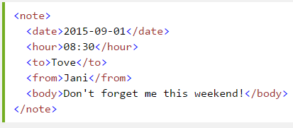
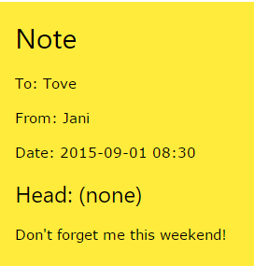
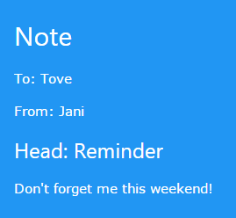
The way XML is constructed, older version of the application can still work:
확장성.
Old version
New version

Slide 8
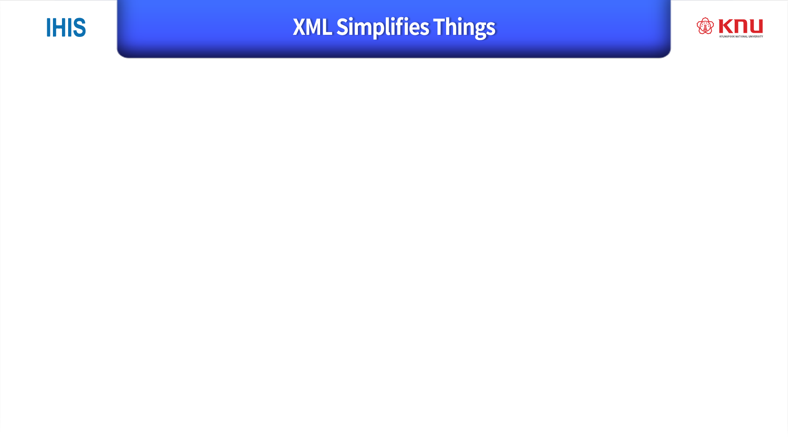
It simplifies data sharing
It simplifies data transport
It simplifies platform changes
It simplifies data availability
데이터를 잘 활용한다.

Slide 9
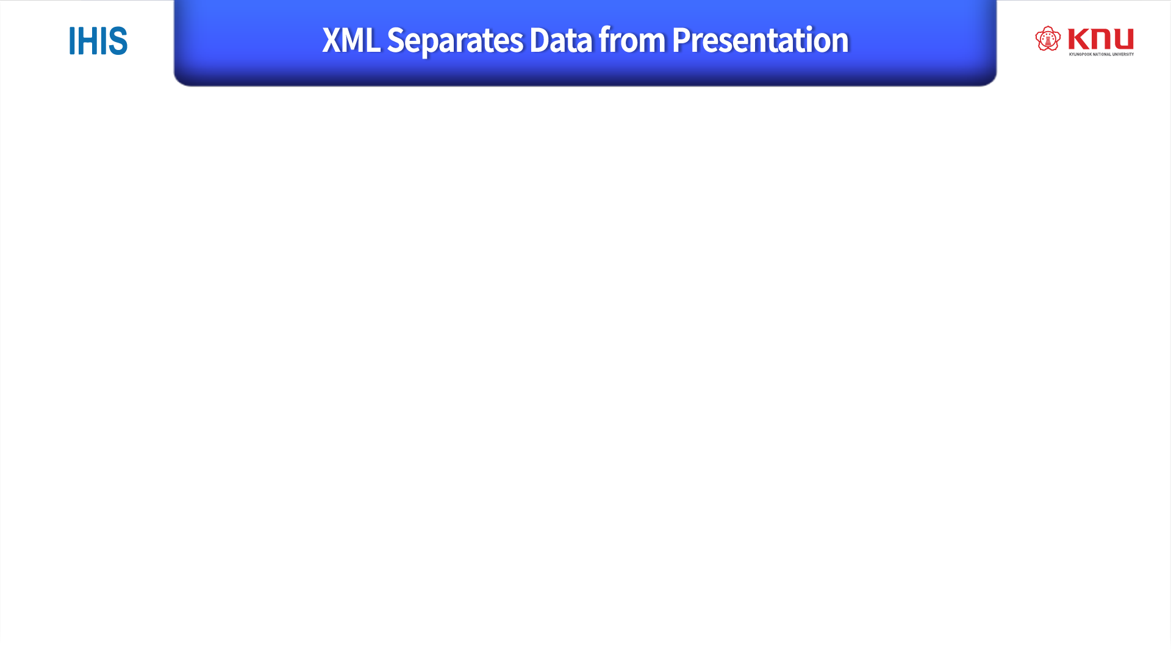
XML does not carry any information about how to be displayed.
The same XML data can be used in many different presentation scenarios.
Because of this, with XML, there is a full separation between data and presentation.
데이터를 보여주는식은 XML은 가지고 있지않다.
3. Full separation data

Slide 10
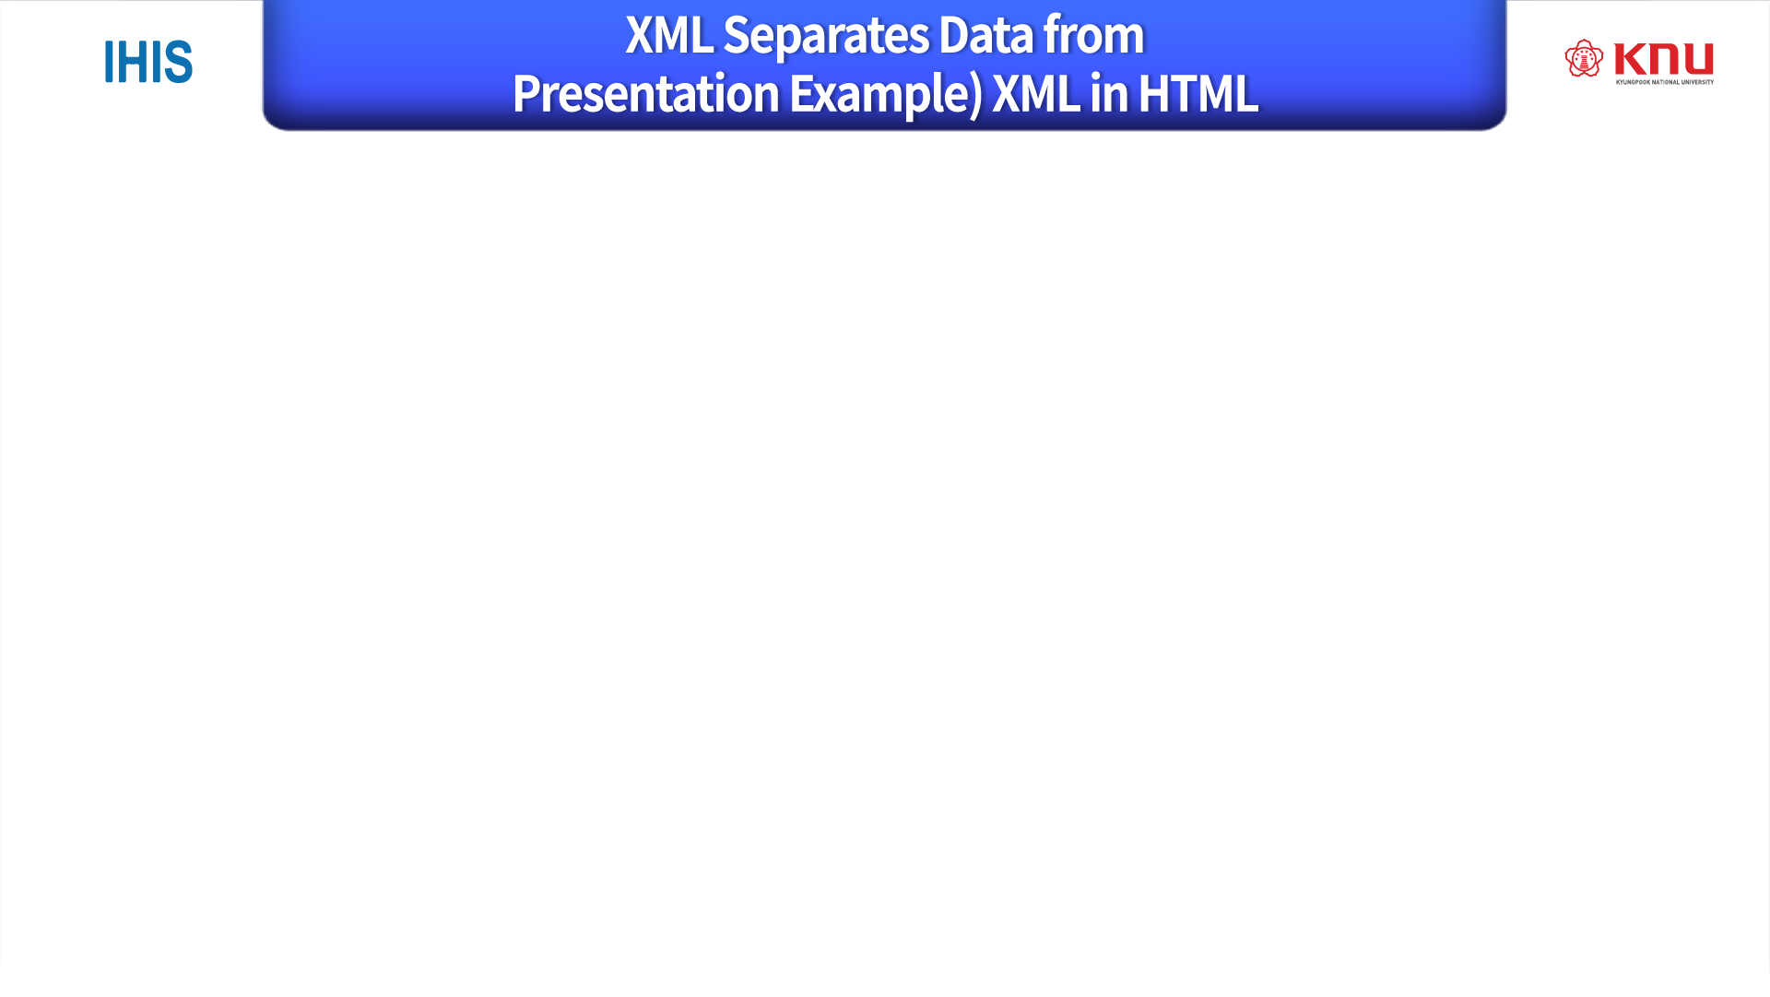
XML Separates Data from HTML
When displaying data in HTML, you should not have to edit the HTML file when the data changes.
With XML, the data can be stored in separate XML files.
With a few lines of JavaScript code, you can read an XML file and update the data content of any HTML page.

Slide 11
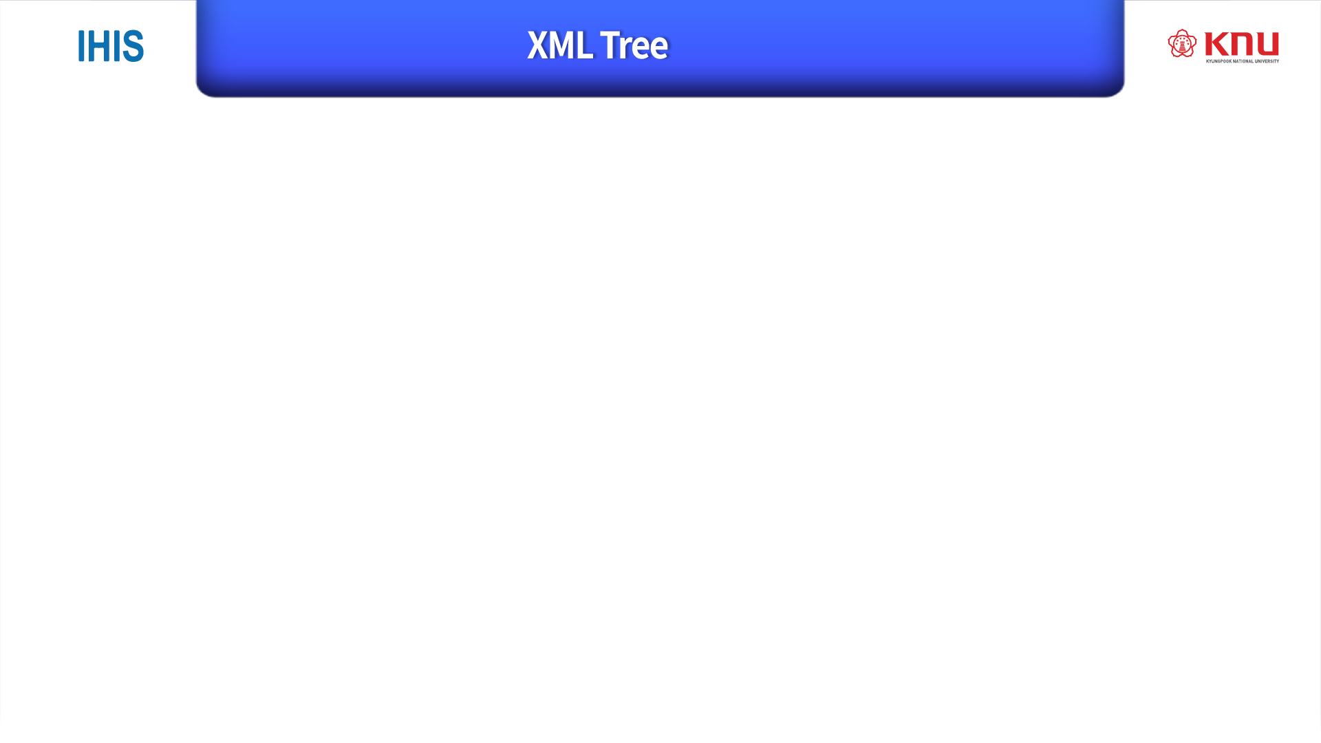
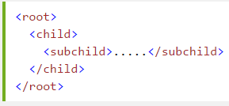
XML documents form a tree structure that starts at "the root" and branches to "the leaves".
XML Tree Structure
XML documents are formed as element trees.
An XML tree starts at a root element and branches from the root to child elements.
All elements can have sub elements (child elements):

Slide 12
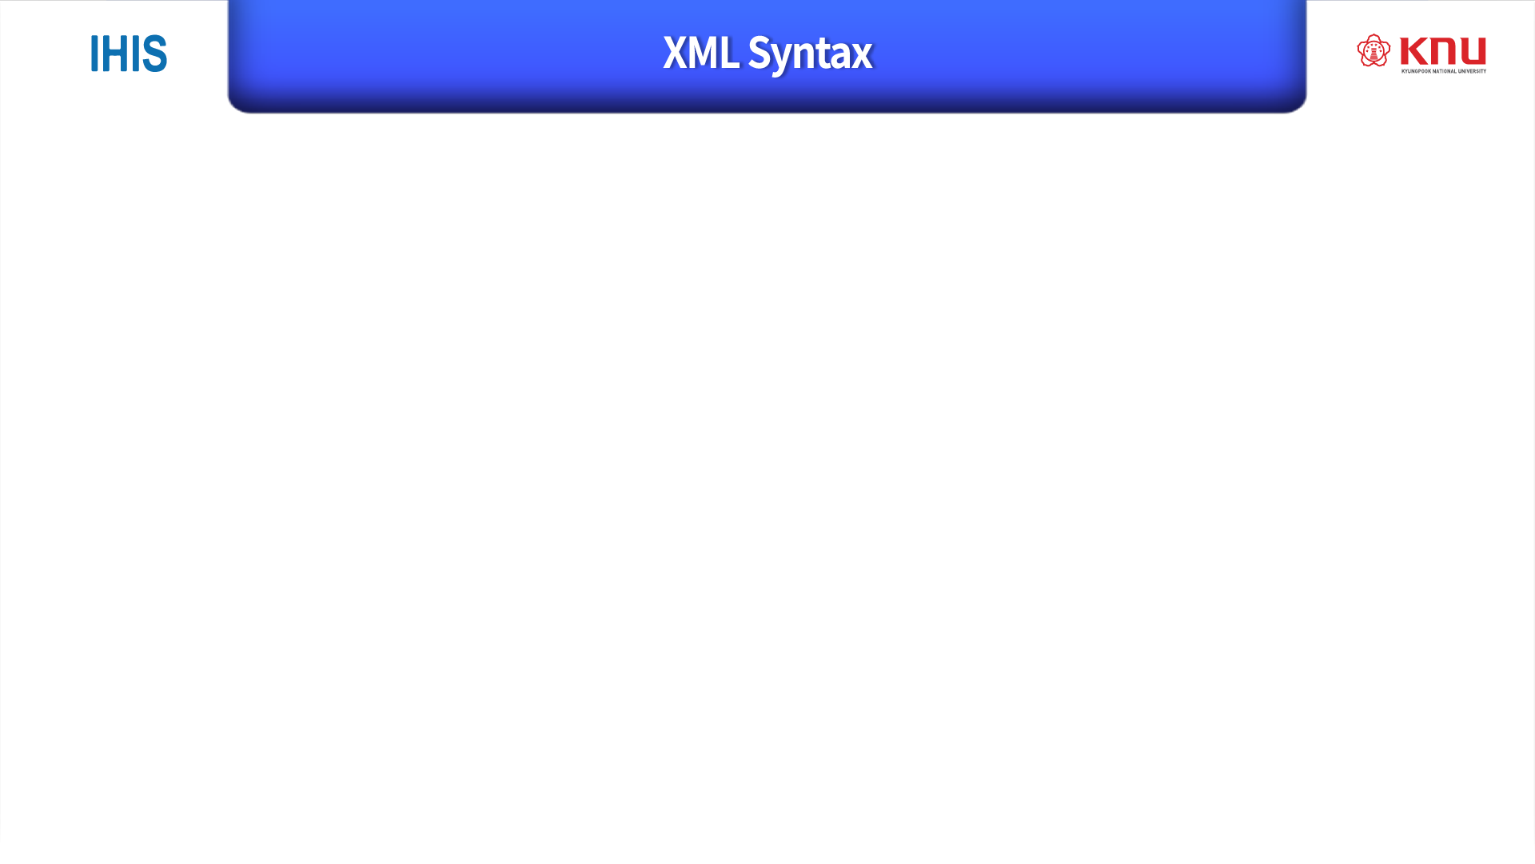
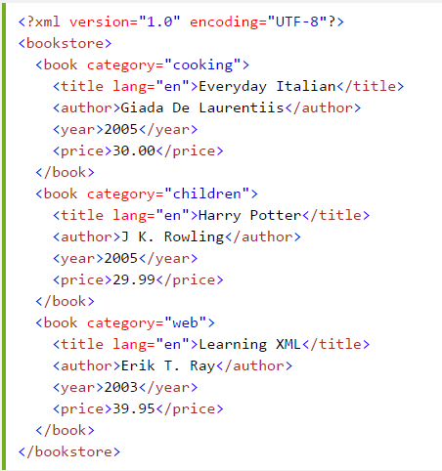


The XML Prolog:
All XML Elements Must Have a Closing:
XML Elements Must be Properly Nested:
XML Attribute Values Must be Quoted

Slide 13

XML Tags are Case Sensitive
XML tags are case sensitive. The tag <Letter> is different from the tag <letter>.
Opening and closing tags must be written with the same case:

Slide 14

If you place a character like "<" inside an XML element, it will generate an error because the parser interprets it as the start of a new element.
To avoid this error, replace the "<" character with an entity reference:
&lt; | < | less than
&gt; | > | greater than
&amp; | & | ampersand
&apos; | ' | apostrophe
&quot; | " | quotation mark

Slide 15

Comments in XML: <!-- This is a comment -->
White-space is Preserved in XML
-XML does not truncate multiple white-spaces (HTML truncates multiple white-spaces to one single white-space):

Slide 16
XML Stores New Line as LF
Windows applications store a new line as: carriage return and line feed (CR+LF).
Unix and Mac OSX uses LF.
Old Mac systems uses CR.
XML stores a new line as LF.

Slide 17

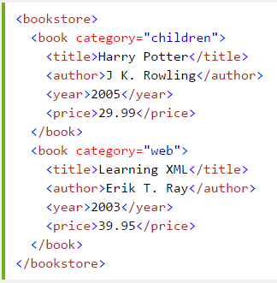
An element can contain: Text, attributes, other elements, or a mix of the above
In the example above:
<title>, <author>, <year>, and <price> have text content because they contain text (like 29.99).
<bookstore> and <book> have element contents, because they contain elements.
<book> has an attribute (category="children").

Slide 18
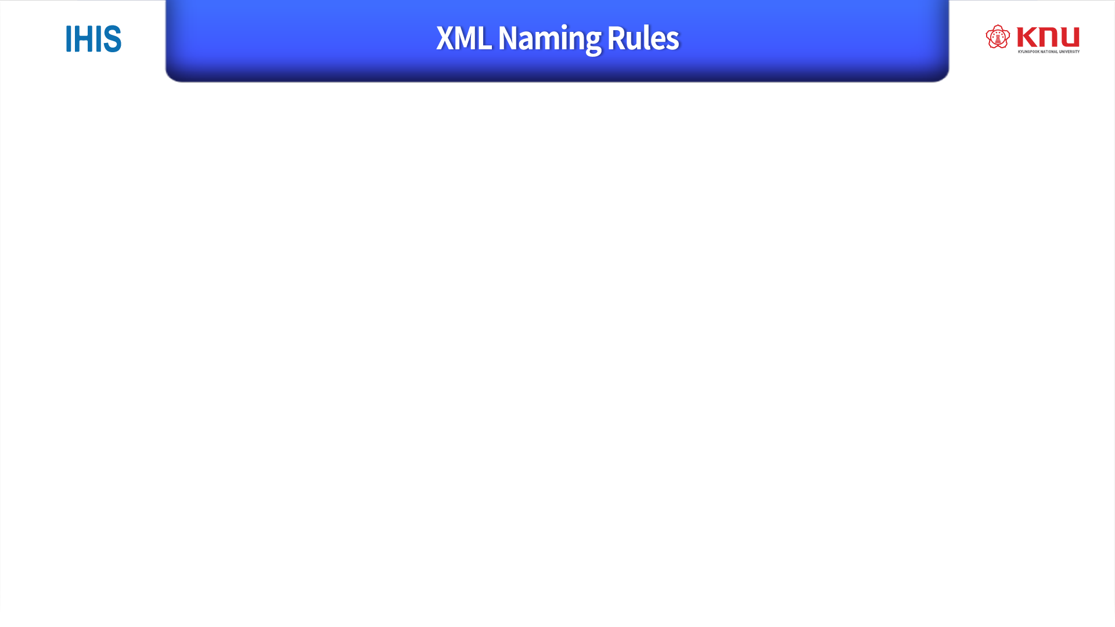
Information model 에서 각 부분을 나누고, 거기에 맞는 XML의 structure을 만들어 넣음.
XML elements must follow these naming rules:
Element names are case-sensitive
Element names must start with a letter or underscore
Element names cannot start with the letters xml (or XML, or Xml, etc)
Element names can contain letters, digits, hyphens, underscores, and periods
Element names cannot contain spaces
Best Naming Practices
Create descriptive names, like this: <person>, <firstname>, <lastname>.
Create short and simple names, like this: <book_title> not like this: <the_title_of_the_book>.
Avoid "-". If you name something "first-name", some software may think you want to subtract "name" from "first".
Avoid ".". If you name something "first.name", some software may think that "name" is a property of the object "first".
Avoid ":". Colons are reserved for namespaces (more later).
Non-English letters like éòá are perfectly legal in XML, but watch out for problems if your software doesn't support them.

Slide 19
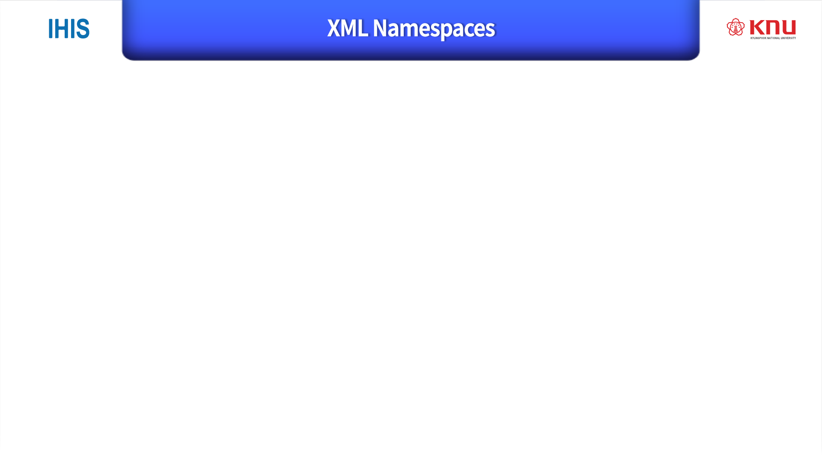
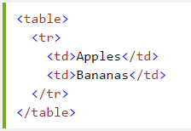
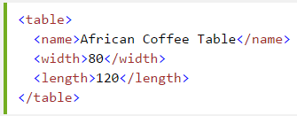
In XML, element names are defined by the developer. This often results in a conflict when trying to mix XML documents from different XML applications.
If these XML fragments were added together, there would be a name conflict. Both contain a <table> element, but the elements have different content and meaning.
A user or an XML application will not know how to handle these differences.
조각이 합쳐지면 이름 충돌이 생길 수 있다.

Slide 20
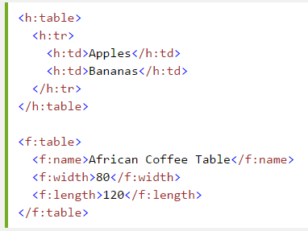
Solving the Name Conflict Using a Prefix
혼돈을 막기 위해서
이름을 준다.

Slide 21
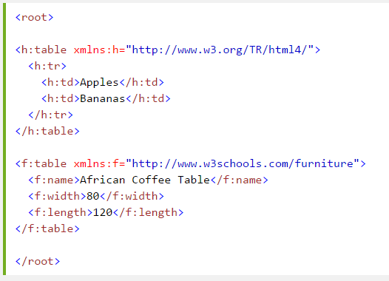
When using prefixes in XML, a namespace for the prefix must be defined.
The namespace can be defined by an xmlns attribute in the start tag of an element.
The namespace declaration has the following syntax. xmlns:prefix="URI".
*Note: The purpose of using an URI is to give the namespace a unique name.

Slide 22

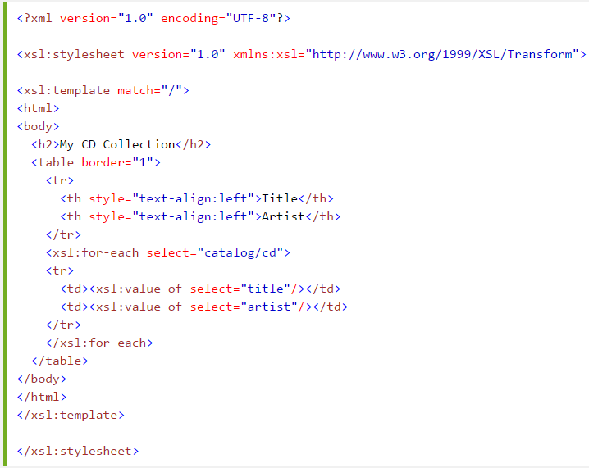
XSLT is a language that can be used to transform XML documents into other formats.
The XML document below, is a document used to transform XML into HTML.
The namespace "http://www.w3.org/1999/XSL/Transform" identifies XSLT elements inside an HTML document:

Slide 23
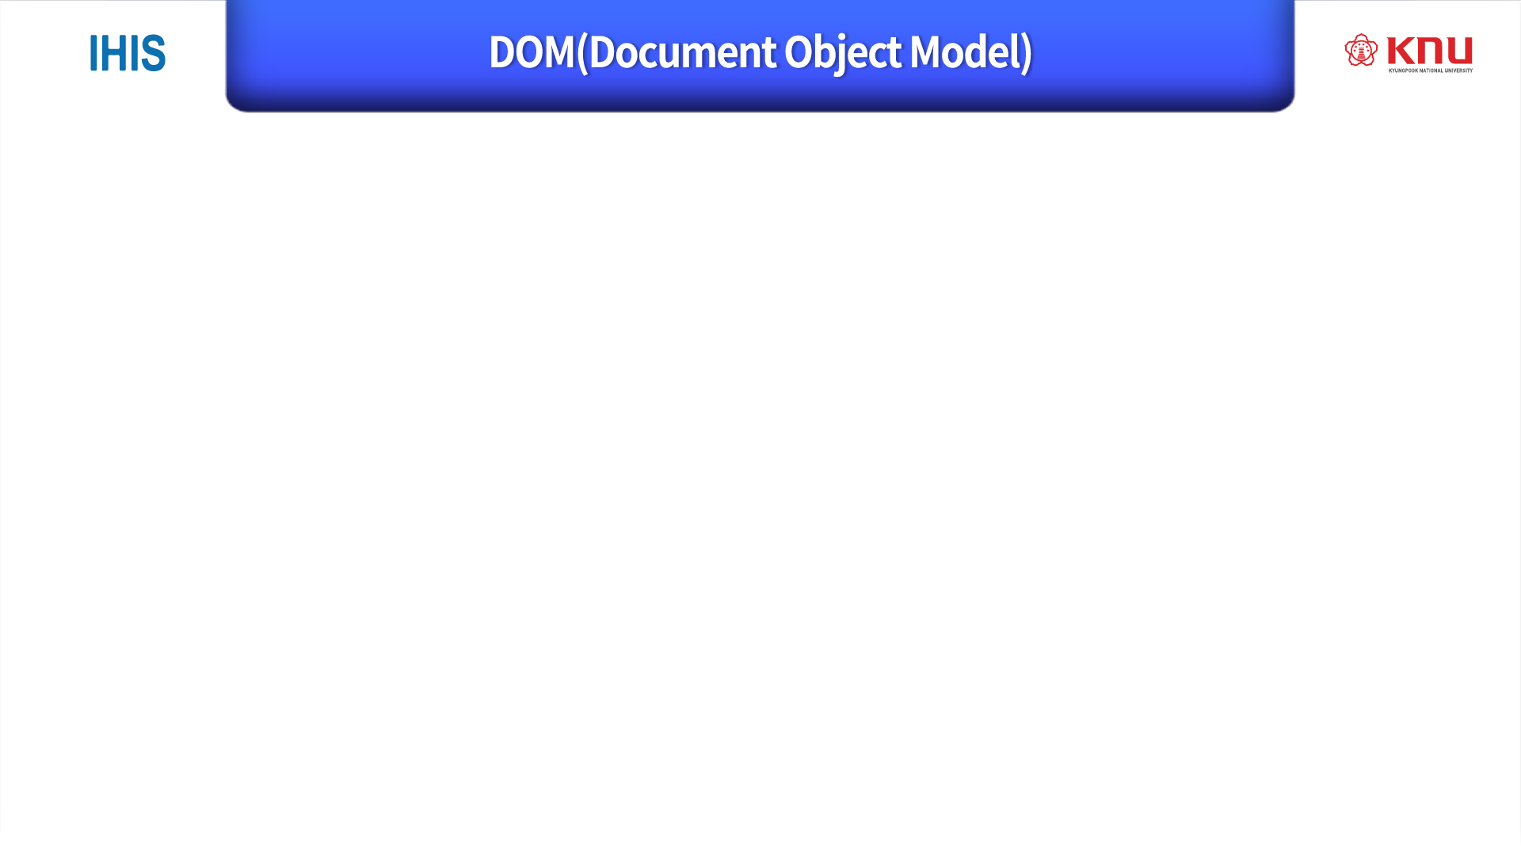
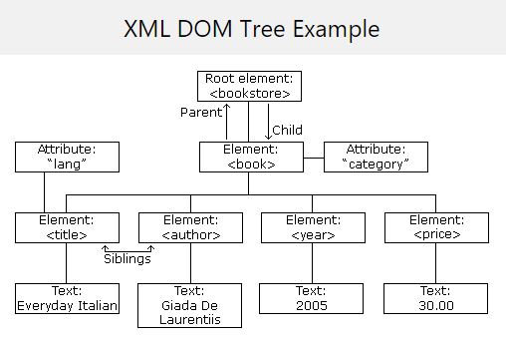
The DOM defines a standard for accessing and manipulating documents.
The XML DOM presents an XML document as a tree-structure.
The HTML DOM presents an HTML document as a tree-structure.
Understanding the DOM is a must for anyone working with HTML or XML.
XML doc.를 tree structure로 만드는 과정이 DOM 임.
Parent, child, sibling 같은 관계를 만들어냄.

Slide 24

The DOM defines a standard for accessing documents like XML and HTML:
"The W3C Document Object Model (DOM) is a platform and language-neutral interface that allows programs and scripts to dynamically access and update the content, structure, and style of a document.“
The DOM is separated into 3 different parts / levels:
Core DOM - standard model for any structured document
XML DOM - standard model for XML documents
HTML DOM - standard model for HTML documents
The DOM defines the objects and properties of all document elements, and the methods (interface) to access them.

Slide 25
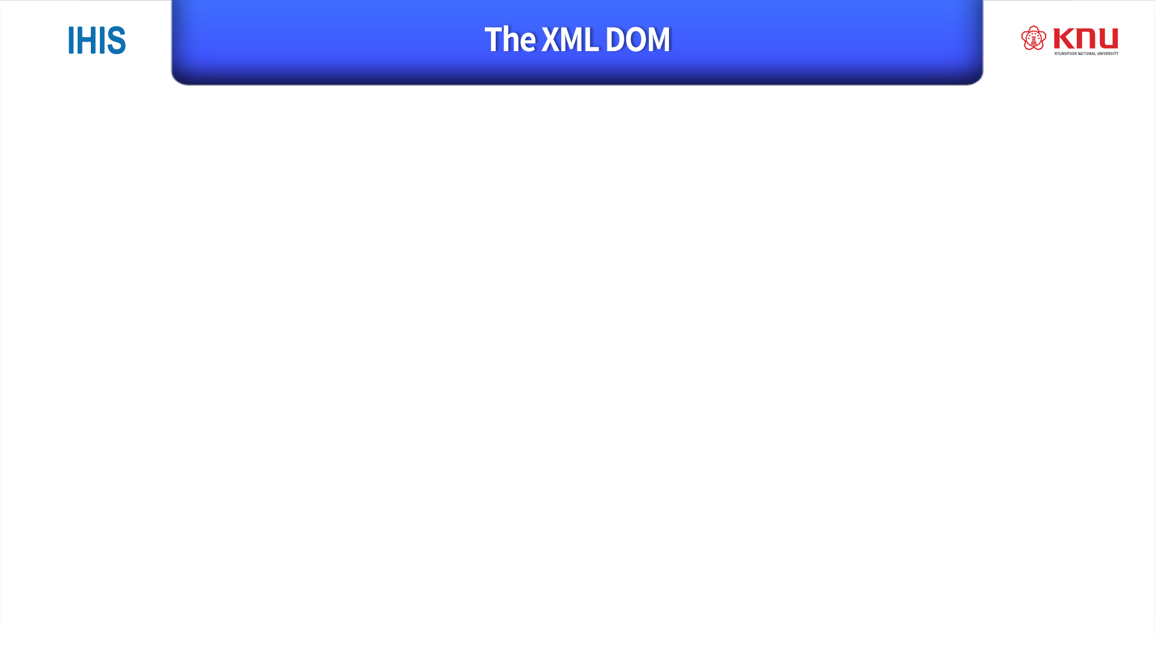
The XML DOM defines a standard way for accessing and manipulating XML documents.
All XML elements can be accessed through the XML DOM.
The XML DOM defines the objects, properties and methods of all XML elements.
The XML DOM is:
A standard object model for XML
A standard programming interface for XML
Platform- and language-independent
A W3C standard
In other words: The XML DOM is a standard for how to get, change, add, or delete XML elements.

Slide 26

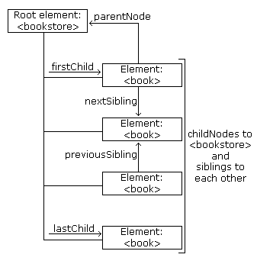
The XML DOM Node Tree
The XML DOM views an XML document as a tree-structure. The tree structure is called a node-tree.

Slide 27
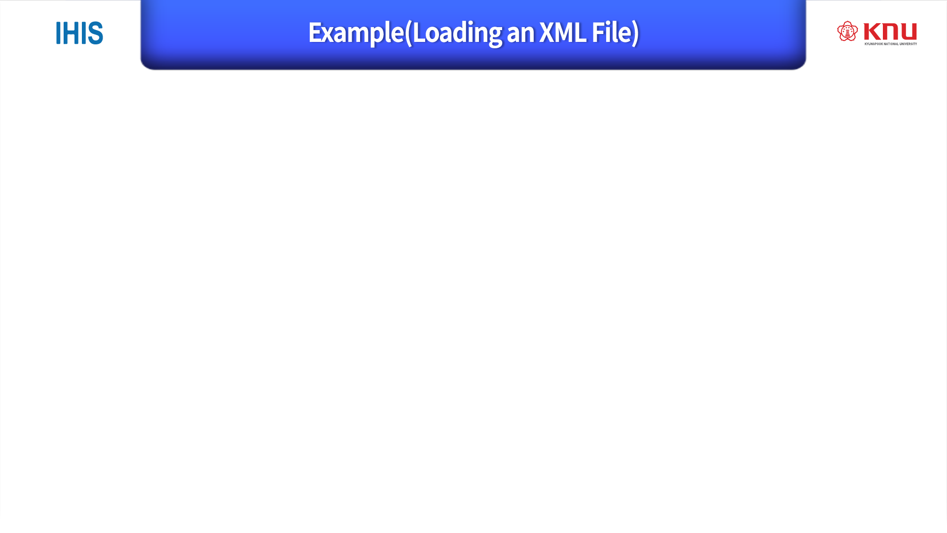
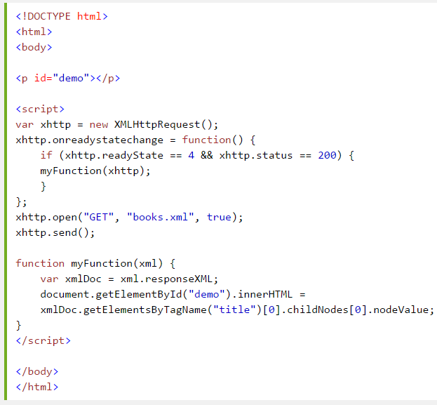
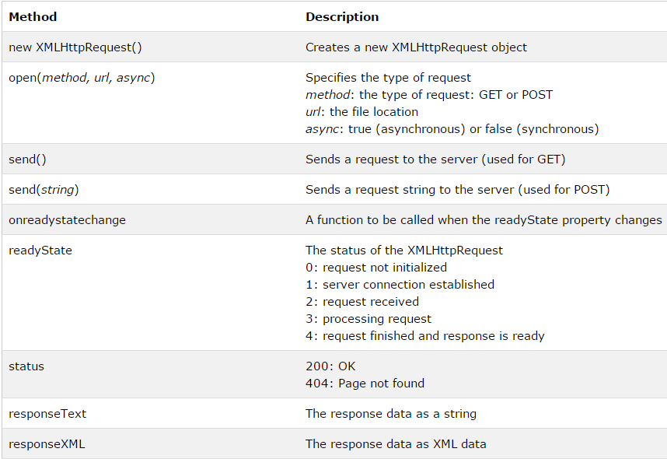
(Callback method)

Slide 28
The XML file used in the examples is books.xml.
This example reads "books.xml" into xmlDoc and retrieves the text value of the first <title> element in books.xml:
xmlDoc - the XML DOM object created by the parser.
getElementsByTagName("title")[0] - get the first <title> element
childNodes[0] - the first child of the <title> element (the text node)
nodeValue - the value of the node (the text itself)

Slide 29
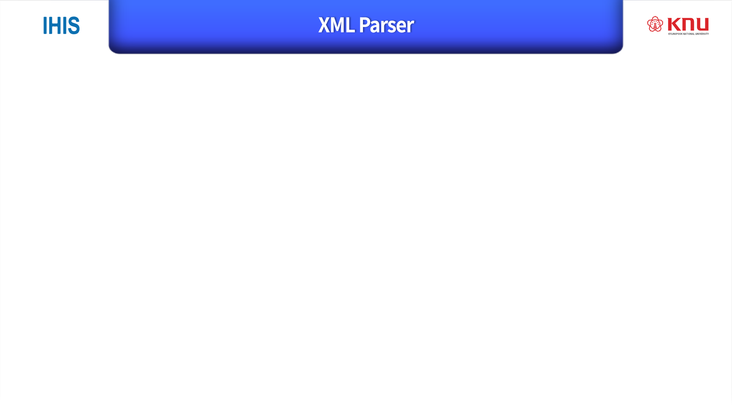
All modern browsers have a built-in XML parser.
The XML Document Object Model (the XML DOM) contains a lot of methods to access and edit XML.
However, before an XML document can be accessed, it must be loaded into an XML DOM object.
An XML parser can read plain text and convert it into an XML DOM object.

Slide 30
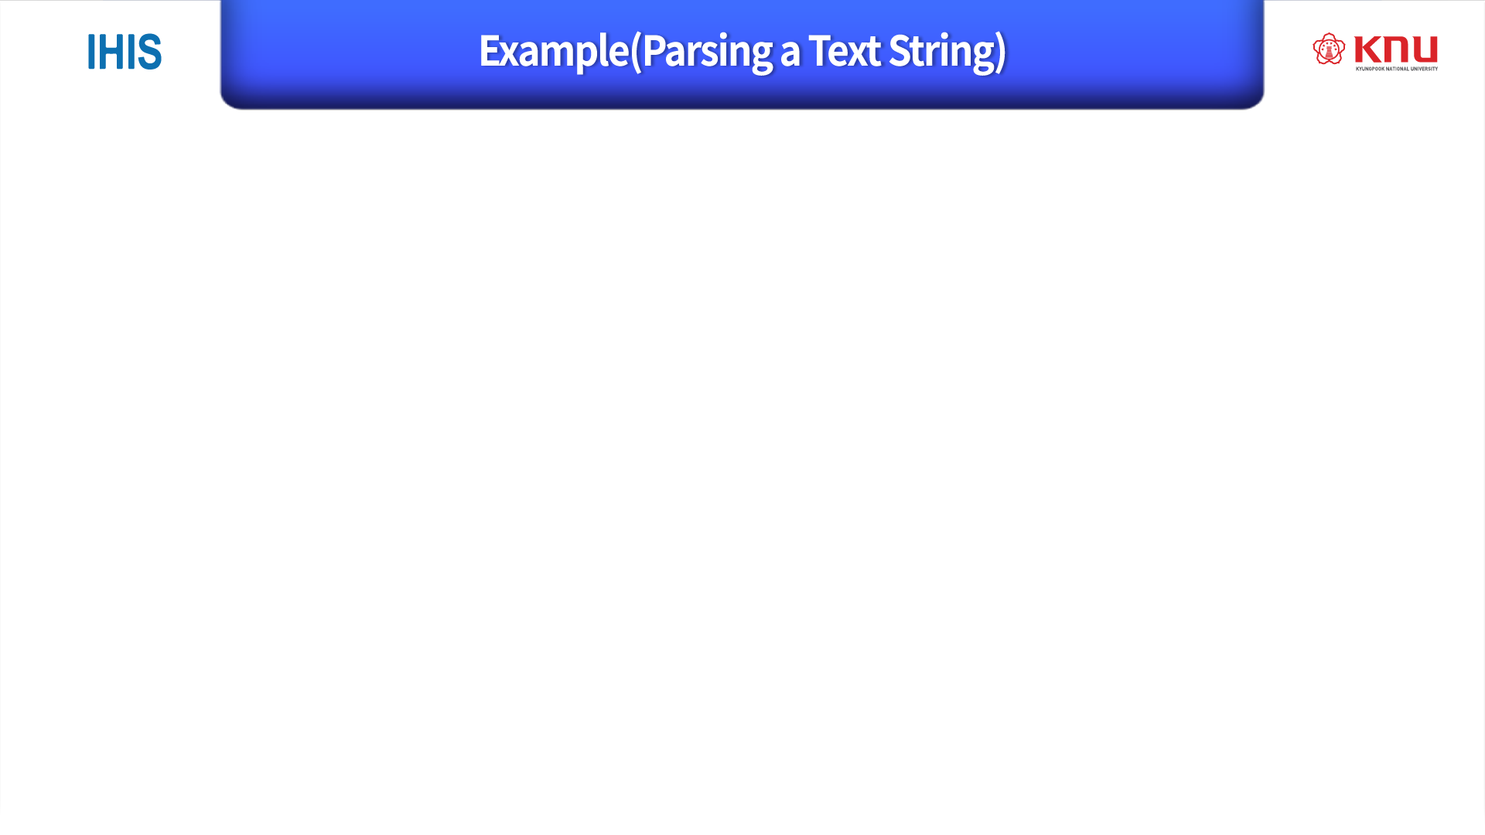
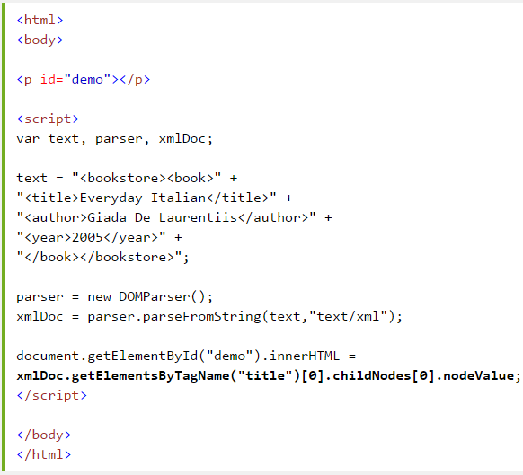

Slide 31
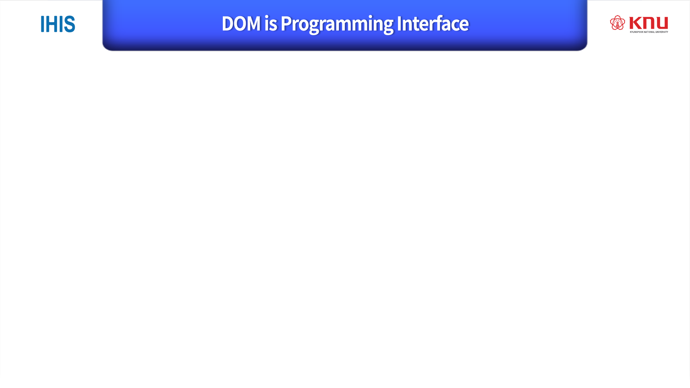
The DOM models XML as a set of node objects. The nodes can be accessed with JavaScript or other programming languages.
The programming interface to the DOM is defined by a set standard properties and methods.
Properties are often referred to as something that is
(i.e. nodename is "book"). 노드이름
Methods are often referred to as something that is done
(i.e. delete "book"). 함수

