Slide 1

2016.03.18

Slide 2
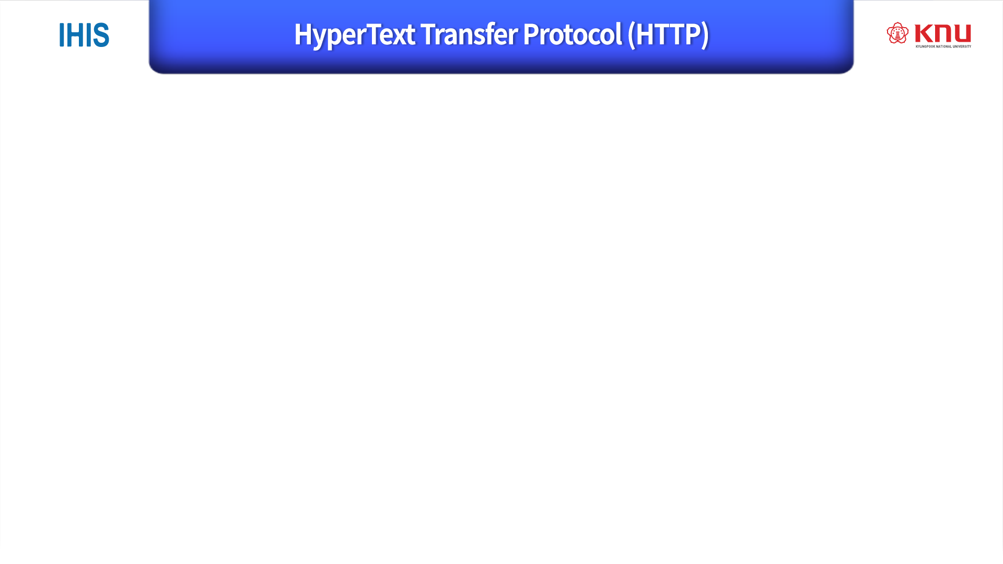
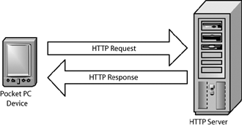
Designed to enable communications between clients and (Web) Servers.
Works as a request-response protocol for WWW(World Wide Web).
HTTP is Connectionless Service
telnet, FTP etc. connection service.
uses the Method to communicate
GET, POST, HEAD etc.
Web Browser may be the client.
Hypertext Transfer Protocol (HTTP/1.1):
Message Syntax and Routing
Abstract The Hypertext Transfer Protocol (HTTP) is a stateless
application- level protocol for distributed, collaborative, hypertext information
systems. This document provides an overview of HTTP architecture
and its associated terminology, defines the "http" and "https" Uniform Resource
Identifier (URI) schemes, defines the HTTP/1.1 message syntax and parsing
requirements, and describes related security concerns
for implementations.
표준 material >
W3c와 IEFT가 같이 만듬.
https://www.w3.org/Protocols/

Slide 3
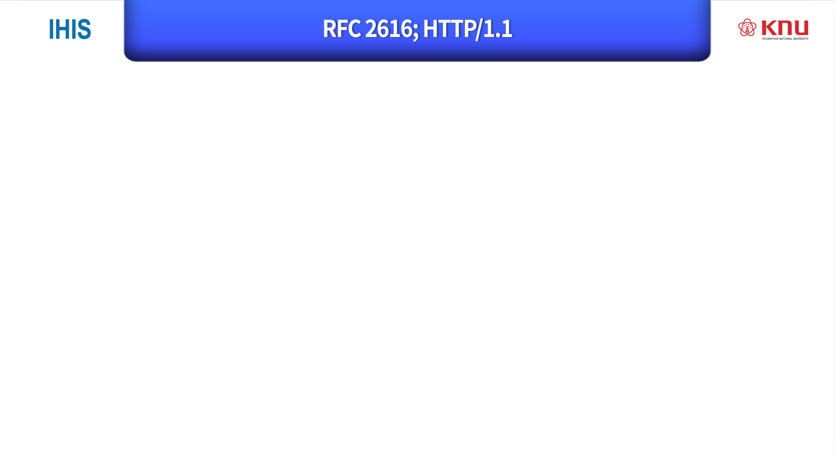
work as Request-Reply.
Very simple protocol
[operation]
HTTP Client requests to server.
The request includes method, URL, HTTP version etc.
HTTP Server replies to client.
- The reply includes statues code, contents etc.

Slide 4
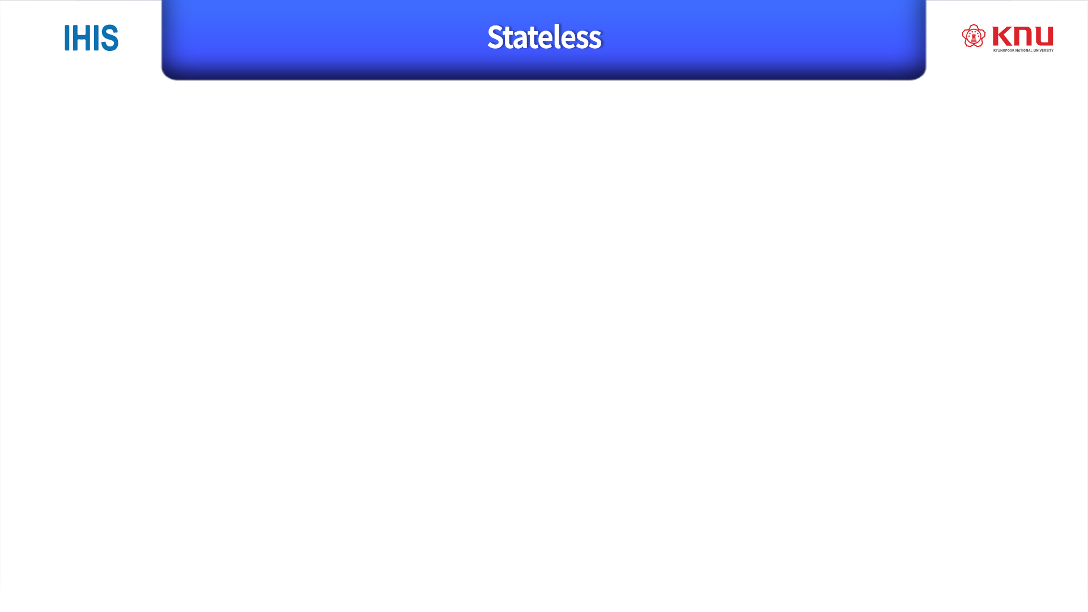
다른쪽 상관x 자기것만 keeping
HTTP does not keep track of things that other session-based protocols do such as connection time, idle time and so on.
If reply contents have high-quality image or data file, it does not perform well.
HTTP
Client
HTTP
Server
TCP Connection
Request
Reply
TCP Disconnection

Slide 5
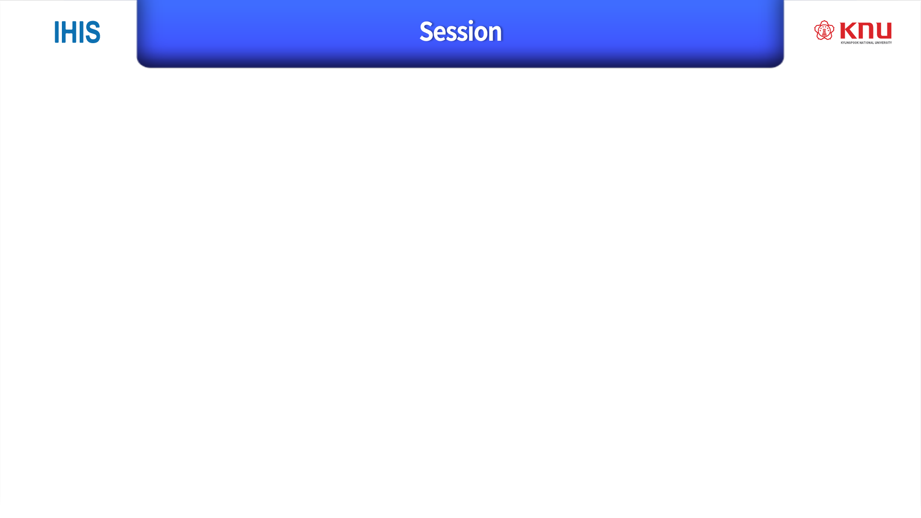
a sequence of network request-response transactions.
An HTTP client initiates a request by establishing a TCP connection to a particular port on a server (typically port 80, occasionally port 8080).
An HTTP server listening on that port waits for a client's request message.
Upon receiving the request, the server sends back a status line, such as "HTTP/1.1 200 OK", and a message of its own.
The body of this message is typically the requested resource, although an error message or other information may also be returned.

Slide 6
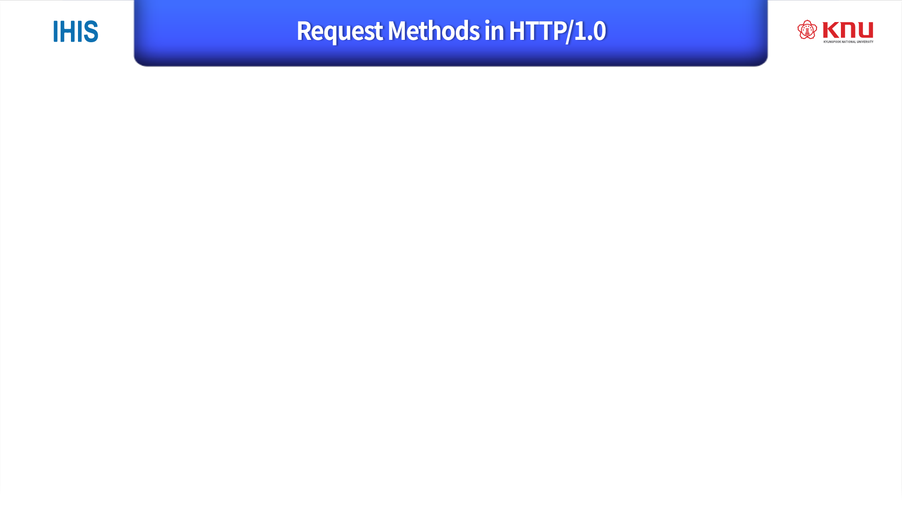
메소드 라능~
GET
requests a representation of the specified resource.
only retrieve(검색하다) data and should have no other effect.
HEAD
asks for a response identical to that of a GET request, but without the response body
is useful for retrieving meta-information written in response headers, without having to transport the entire content.
POST
requests that the server accept the entity enclosed in the request as a new subordinate of the web resource identified by the URI. -> 내가 만들고 싶은 부분을 해달라! -> CREATE

Slide 7
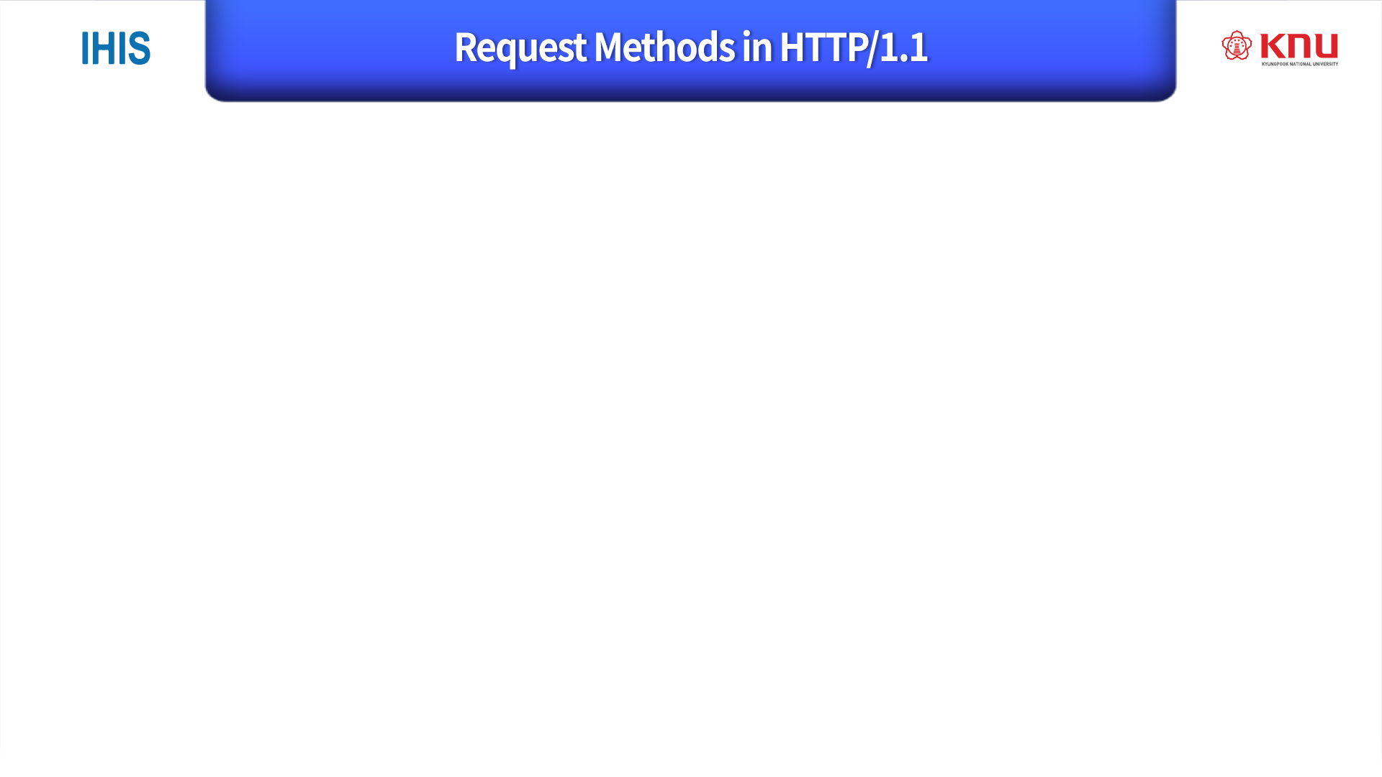
PUT
The enclosed entity be stored under the supplied URI.
If the URI refers to an already existing resource, it is modified
If the URI does not point to an existing resource, then the server can create the resource with that URI. -> store/modify or create and push
DELETE
Deletes the specified resource.
TRACE, OPTIONS, CONNECT, PATCH.

Slide 8
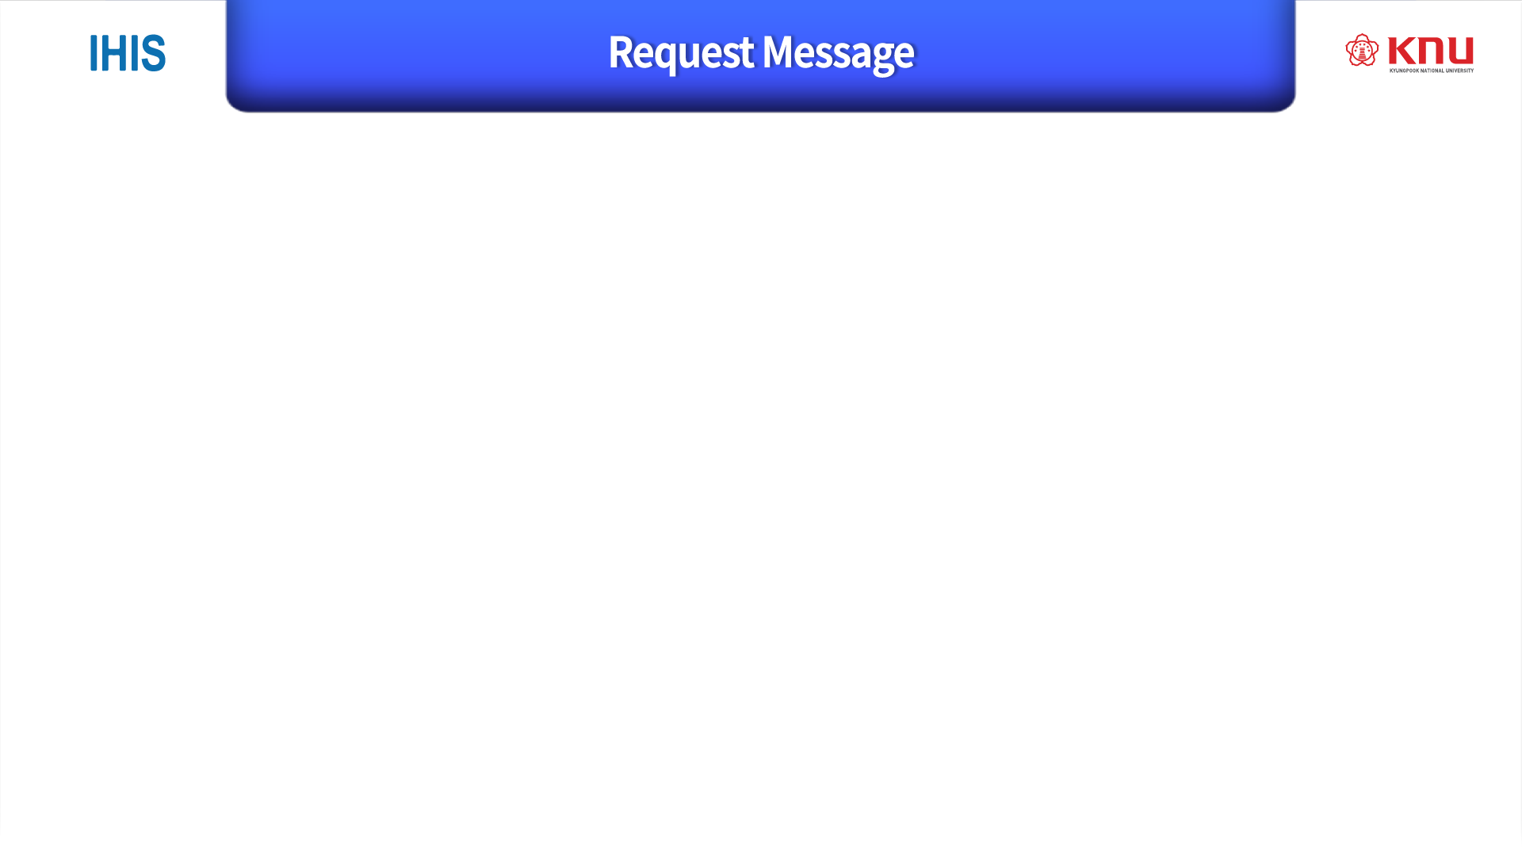

Request Line
Request Line
[Method] [URL] [HTTP version]
Header
blank line
Body

Slide 9

Status Line
Status Line
[HTTP version] [Status Code] [Status Name]
[Status Code]
200 OK
202 Accepted
400 Bad Request
401 Unauthorized
403 Forbidden
404 Not Found
500 Internal Server Error
501 Not Implemented
Header
blank line
Body
Status code : https://en.wikipedia.org/wiki/List_of_HTTP_status_codes

Slide 10

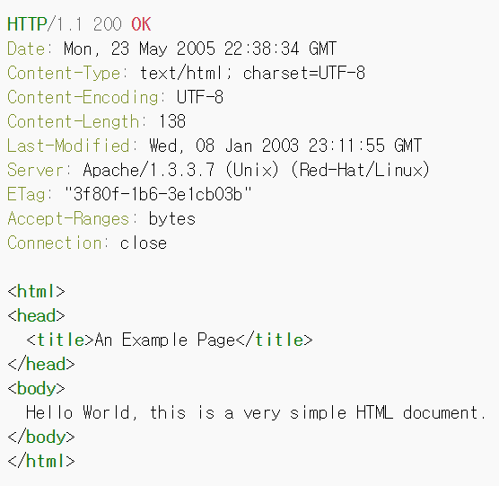
Sample conversation running on www.example.com, port 80.
Client Request
Server Response

Slide 11


