Slide 1
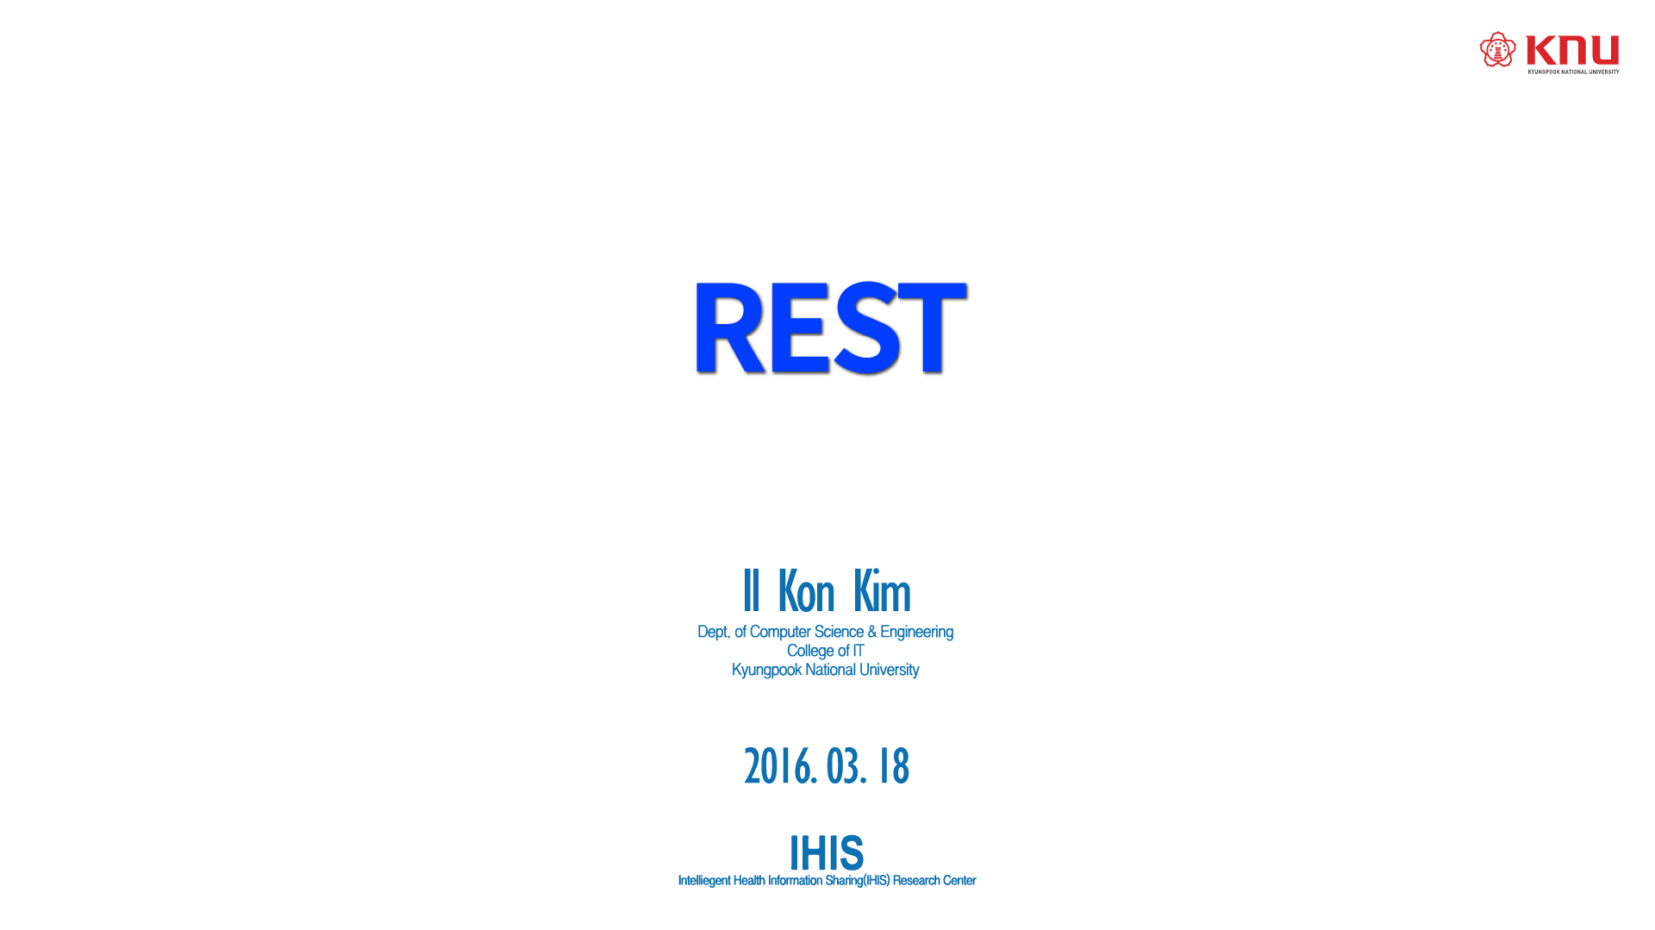
2016.03.18

Slide 2
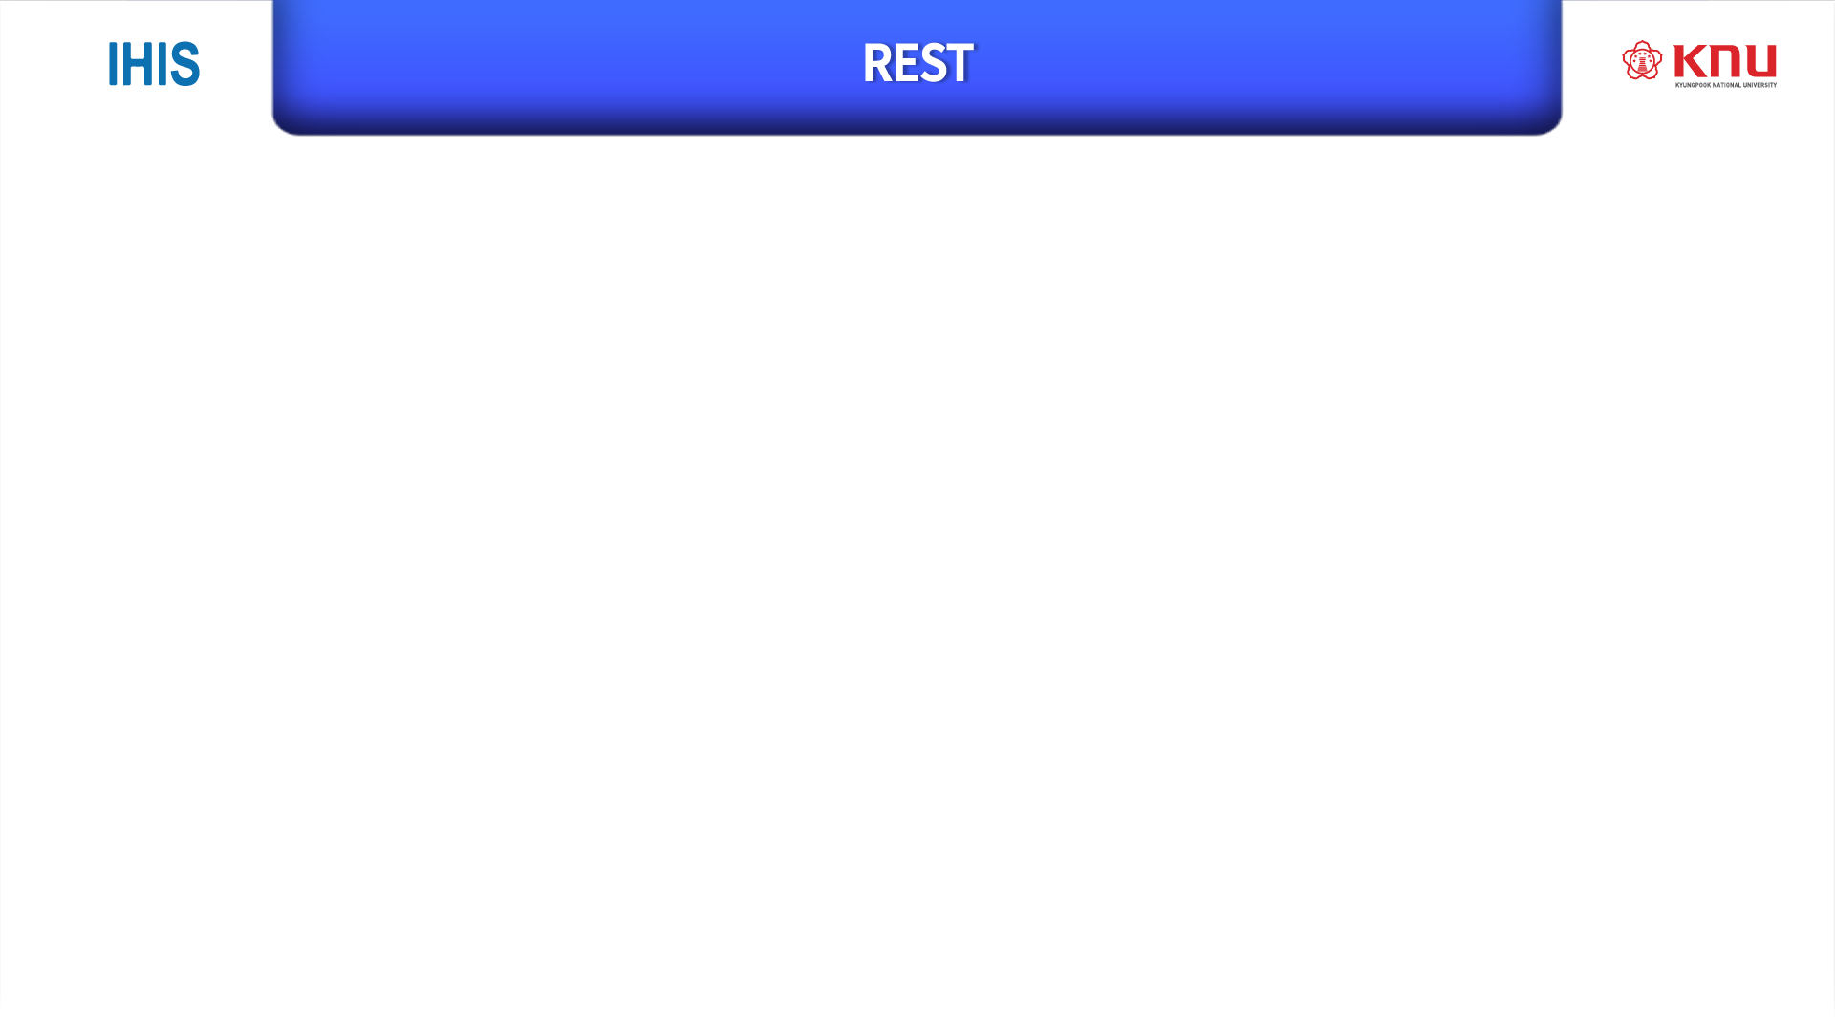
REpresentational State Transfer
The software architectural style of the WWW
De facto standard for OpenAPI
Resource Oriented Architecture(ROA)

Slide 3
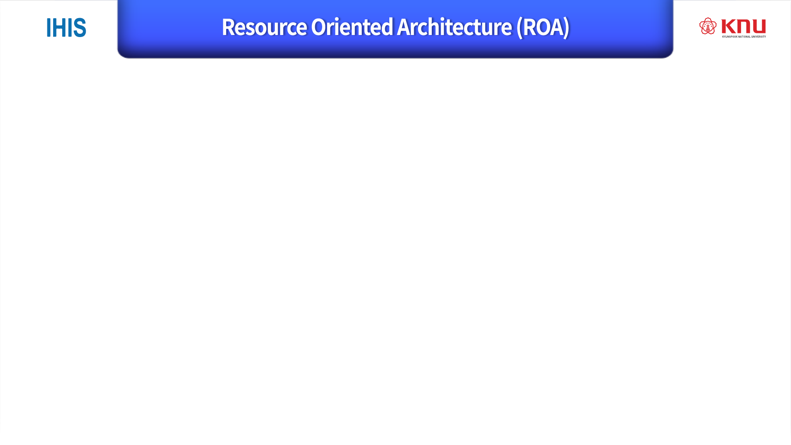
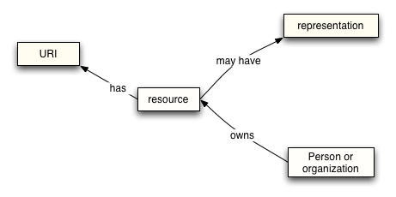
Focus on ‘Things(resources)’ rather than ‘Actions(Services)’
Use HTTP as service
Use ‘noun’ in URI rather than ‘verb’
Separate from their representations

Slide 4
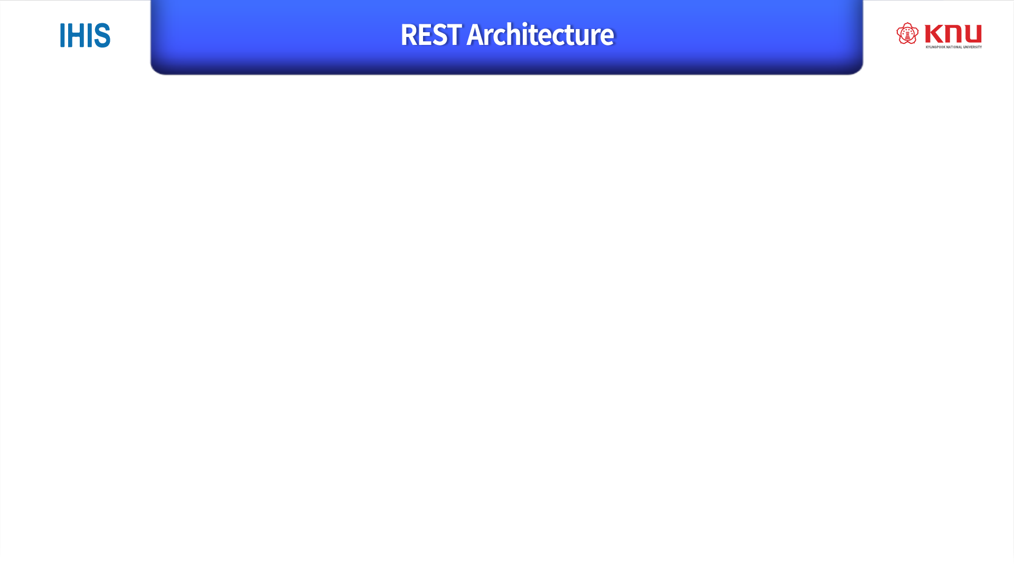
Resources
Use URI with noun
i.e. http://knu.ac.kr/student/2011105013
Services
Representations
Use HTTP method
i.e. GET, POST
i.e. JSON, XML

Slide 5
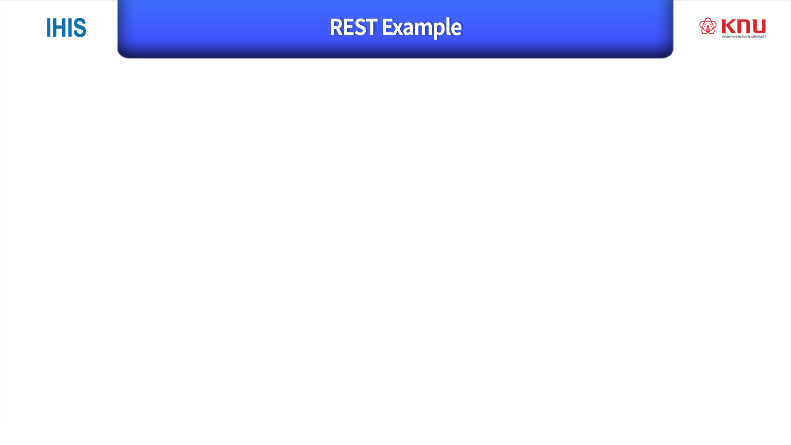
Services
HTTP Post,
Resources
http://knu.ac.kr/student/2011105013
Representations
{
“name”:”Anderson”,
“address”:”joya-dong”,
“grade”:”senior”,`
}

Slide 6
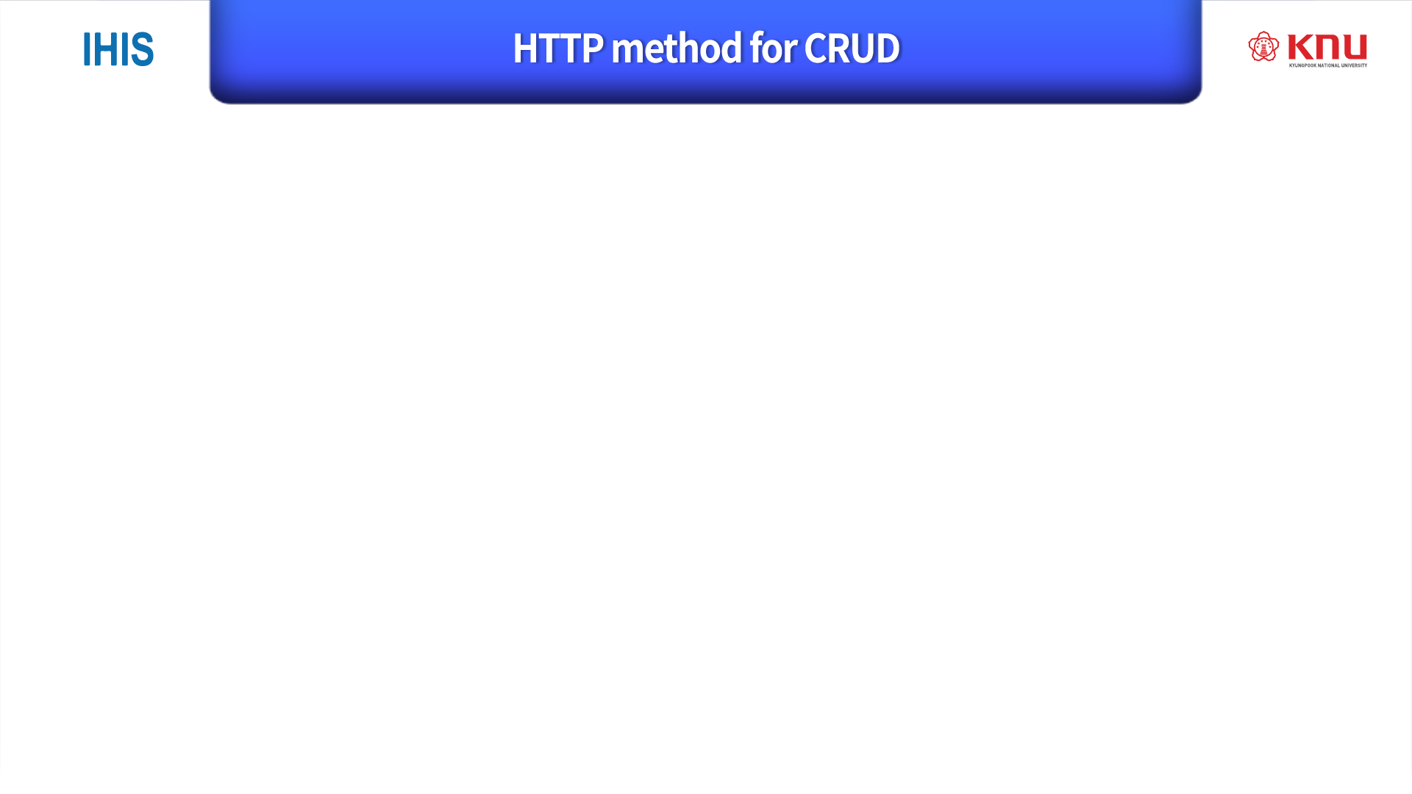
CRUD : Create, Read, Update, Delete
Method | CRUD | Idempotent
POST | Create | NO
GET | Select | YES
PUT | Update | YES
DELETE | Delete | YES
※ Idempotent : can be applied multiple times without changing the result beyond the initial application.

Slide 7

Client-server
Stateless
Cacheable
Layered system
Code on demand (Optional)
Uniform interface

Slide 8
Client-server
Server is concerned with data storage
→ Client’s portability is improved
Client is concerned with user interface and user state
→ Server can be simpler and more scalable
Server and client can be developed independently

Slide 9
Stateless
Server do not keep a client state
Client take responsibility to store it’s context and pass the context to server
→ It simplifies application design, makes RESTful web service work seamlessly with HTTP
→ Server needs extra information about client and then should interpret to get client’s state

Slide 10
Cacheable
REST uses HTTP, clients can cache responses.
Responses must define themselves as cacheable or not.
→ can partially or completely eliminates some client-server interactions
→ can improve scalability and performance

Slide 11
Layerd system
Clients just send message to server
and they don’t know who receive their message.
Because…
Server can consist of multiple layers
→ can improve system scalability
by enabling load balancing and providing shared caches.

Slide 12
Uniform interface : 형태가 REST 디자인에 맞게끔 잘 정의되어있다.
Fundamental to the design of REST
It simplifies and decouples the architecture
Four constraints are in the Uniform interface
1- Identification of resources
2- Manipulation of resources through these representations
3- Self-descriptive messages : 메시지를 보면 분명히 뭐할건지 안다
4- Hypermedia as the engine of application state (HATEOAS)

Slide 13
Uniform interface
Identification of resources
Individual resources are identified in requests, for example using URIs in web-based REST systems
e.g. http://computer.knu.ac.kr/student/2011105028/grade
But the resources themselves are separate from the representations.
For example, the server may send data from its database as HTML, JSON or XML, none of which are the server’s internal representation

Slide 14
Uniform interface
Manipulation of resources through these representations
When a client holds a representation of a resource,
It has enough information to modify or delete the resource
Kind of encapsulation…..?

Slide 15
Uniform interface
Self-descriptive message
Each message includes enough information to describe how to process the message
e.g. “students”:
[
{”name”:”Rhino”, ”major”:”Computer Science”},
{”name”:"Anderson”, “major”:”Health”},
{”name”:”Peter”, “lastName”:”Statistics”}
]

Slide 16
Uniform interface
Hypermedia as the engine of application state (HATEOAS)
It means that hypertext should be used to find your way through the API
A HATEOAS-driven site provides information to navigate the site’s REST interfaces dynamically by including hypermedia links with the responses.
Examples are in the next slides

Slide 17
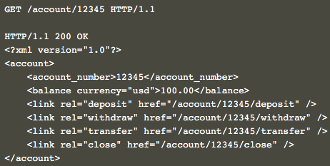
Uniform interface (HATEOAS)
We can see 100 dollors in the balance
And we can also see the 4 options :
deposit
withdraw
transfer
close
”link” tags allow us to find out the URLs that are needed for the specified options

Slide 18
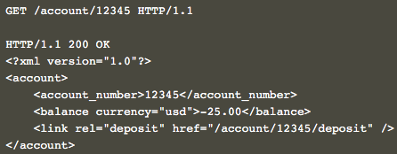
Uniform interface (HATEOAS)
But when we have 25 dollars in the red,
We have only one options :
close
The hypertext is actually telling us what is allowed and what not
And it is HATEOAS

Slide 19
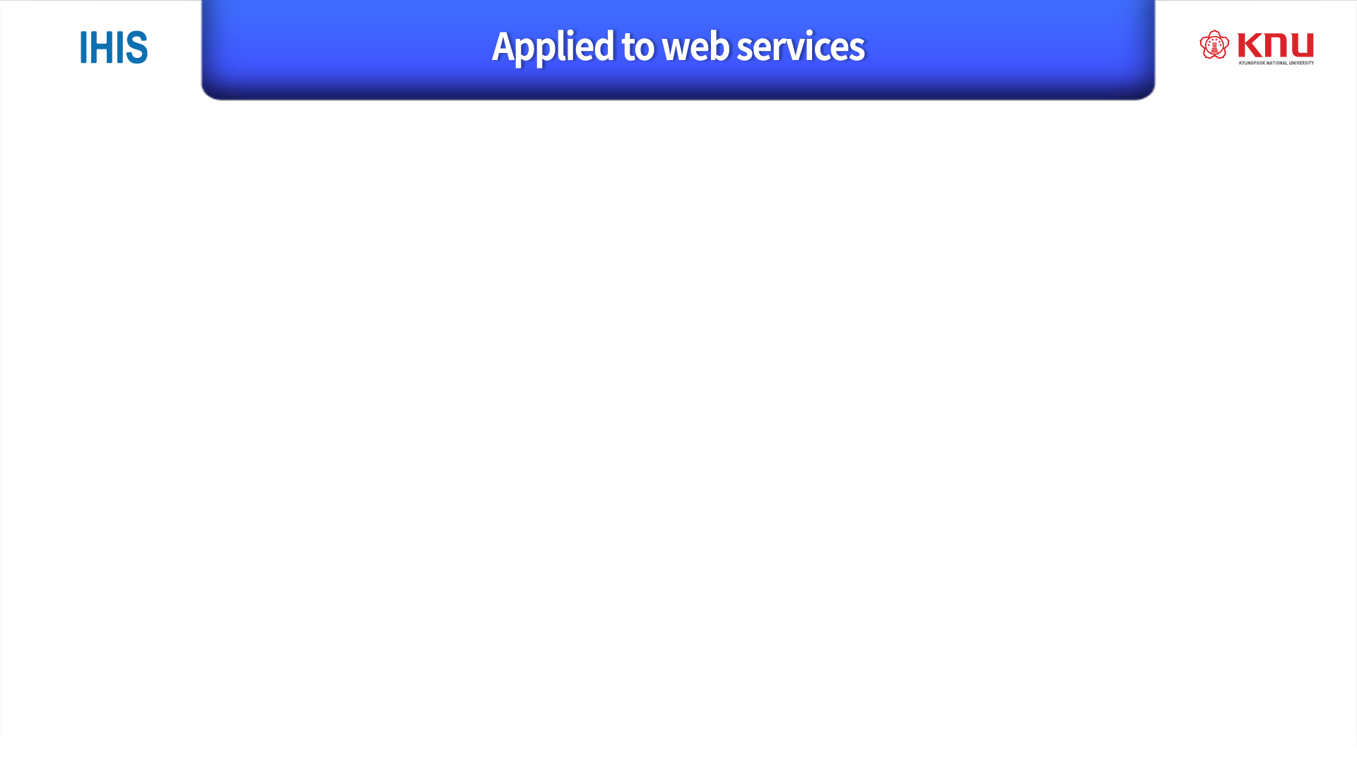
HTTP-based RESTful APIs are defined with the 5 aspects :
Base URI, like http://giant.knu.ac.kr/resources/
An Internet media type, often JSON but others can be used
Standard HTTP methods (POST, GET, PUT, DELETE)
Hypertext links to reference state
Hypertext links to reference-related resources

Slide 20
HTTP-based RESTful API Example :
Resources | GET | PUT | POST | DELTE
Collection URI, such as http://api.example.com/resources | List the URIs and perhaps other details of the collection’s members | Replace the entire collection with another collection | Create a new entry in the collection. | Delete the entire collection
Elementry URI, such as http://api.example.com/resources/item17 | Retrieve a representation of the addressed member of the collection | Replace the addressed member of the collection, if it does not exist, create it | Not generally used. | Delete the addressed member of the collection

Slide 21

http://bcho.tistory.com/953
http://bcho.tistory.com/954
Https://en.wikipedia.org/wiki/Representational_state_transfer
http://www.w3.org/TR/ws-arch/#concepts
https://ko.wikipedia.org/wiki/REST
https://slipp.net/wiki/pages/viewpage.action?pageId=12878219
http://www.tutorialspoint.com/restful/restful_statelessness.htm
http://restcookbook.com/Basics/hateoas/
https://spring.io/understanding/HATEOAS

Slide 22


